Slide 1
Allocating time to Instructors
Presented by
Gayatri Kakumanu

Slide 2
Outline:
Problem
Bipartite Graph
Graph Colouring
Solving Complication
References

Slide 3
Problem:
In an university there are m number of professors and n number of subjects. The university administration is facing problem to allocate these m number of professors to the minimum number of periods for teaching there subjects.

Slide 4
Bipartite Graph:
This Bipartite graph is a graph whose vertices can be divided into two disjoint sets u and v such that every edge connects a vertex in u to one in v, that is u and v are independent sets.
A complete bipartite graph with m-5, n-3

Slide 5
Properties:
All acyclic graphs are bipartite(tree).
A graph is bipartite if and only if it does not contain an odd cycle.
Every subgraph H of a bipartite graph G is, itself, bipartite.
A graph is bipartite if and only if it is 2-colorable, (i.e. its chromatic number is less than or equal to 2).

Slide 6
Graph Colouring:
Graphs are used to depict “What is in conflict with what”, and colours are used to denote the state of vertex.
So more precisely, colouring theory of “partitioning the sets having internal unrecognisable conflicts”

Slide 7
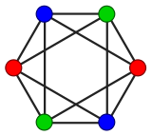
Terminology:
Vertex Colouring:
It is a way of colouring the vertices of a graph such that no two adjacent vertices share the same colour.

Slide 8
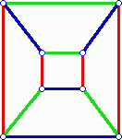
Edge Colouring:
An edge colouring assigns a colour to each edge so that no two adjacent edges share same colour

Slide 9
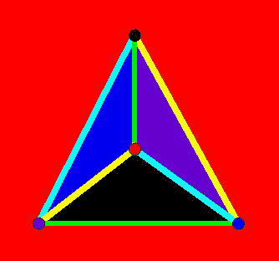
Face Colouring:
A face colouring of a planar graph assigns a colour to each face or region so that no two faces that share a boundary have the same colour

Slide 10
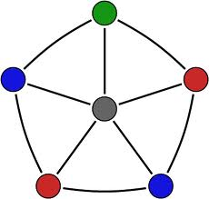
Chromatic Number:
The chromatic number of a graph is the minimum number of colors in a proper coloring of that graph. If chromatic number is r then the graph is r-chromatic.
Chromatic number: 4

Slide 11
Solving Complication:
Let us consider that there are m1,m2,……mk number of professors and n1,n2,…..nm number of subjects as vertices of a bipartite graph and they are connected with pi periods as edges.

Slide 12
If we consider teaching requirement p=[pij] matrix taking m1,m2,m3,m4 professors and n1 to n5 5 subjects to be taught
Pij=
0 1 1 0
0 1 0 1 0
0 1 1 1 1
0 0 0 1 1

Slide 13
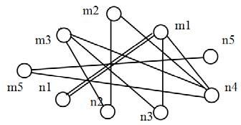
Bipartite graph for the given matrix or timings

Slide 14
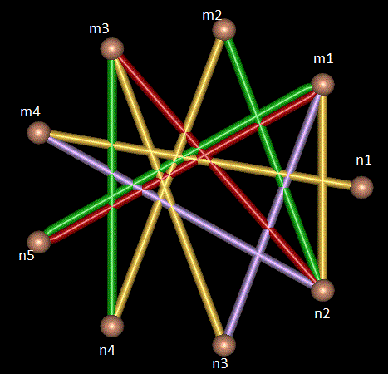
Now edge colouring is done so that no two adjacent edges have same colour

Slide 15
Then the timetable without any conflicts based on vertex minimum colouring will become
 | Period 1 | Period 2 | Period 3 | Period 4
Professor 1 | N1 | N1 | N3 | N4
Professor 2 | N4 | 0 | 0 | N2
Professor 3 | N2 | N4 | 0 | N3
Professor 4 | 0 | 0 | N4 | N5

Slide 16
References
Wikipedia
https://en.wikipedia.org/wiki/Bipartite_graph
https://en.wikipedia.org/wiki/Graph_coloring
Academia
https://www.academia.edu/2479839/Applications_of_Graph_Coloring_in_Modern_Computer_Science

