Slide 1
Assigning tropical fish into tanks
Presented by,
Manisha Reddy Podduturi

Slide 2
Plan for the talk:
Tropical fish Problem
Real-World problem
Graph Construction
Special property
Problem solution

Slide 3
Tropical Fish Problem
A tropical fish hobbyist had six different types of fish: Alphas, Betas, Cartas, Deltas, Epsalas and Fetas which shall be designated by A, B, C, D, E and F respectively.
Real-World Problem:
Because of Predator-prey relationships, water conditions and size only few fishes can be kept in the same tank.
What is the least number of tanks needed to place all the fish?

Slide 4
Consider the following table shows which fish cannot be together:
Type | A | B | C | D | E | F
Cannot be with | B, C | A, C, D | A, B, D, E | C, E, F | C, D, F | D, E

Slide 5
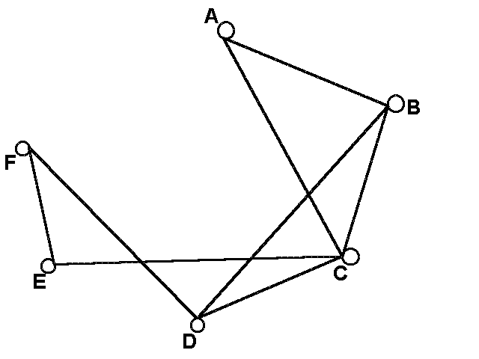
Graph Construction:

Slide 6
Can you figure out what each vertex and each edge represent? Here, each vertex represents one of the type of fish and each edge connects vertices that are not compatible.

Slide 7
Interval Graph: The problem turns out to be interval graph problem. A B C D E F The interval graph shows the intersecting interval on a real line. It has one vertex for each interval in the family and an edge between every pair of vertices corresponding to intervals that intersect.

Slide 8
Special Property: Umbrella-Free Ordering For every interval graph there will be an umbrella free ordering. It states that, arranging the vertices in an order such that if there is an edge between two vertices then any edge that lies between the two vertices must be adjacent to the right vertex in the ordering. G has umbrella-free ordering if their exists an ordering of vertices of G v1, v2, …. vn such that a<b<c and a~c ⇒ b~c.

Slide 9
Umbrella-Free Ordering:

Slide 10
Problem Solution: Graph Coloring: It’s the simplest form, it is a way of coloring the vertices of a graph such that no two adjacent vertices share the same colour. After coloring the graph using UFO: 1 Red Blue Green Red Blue Green

Slide 11
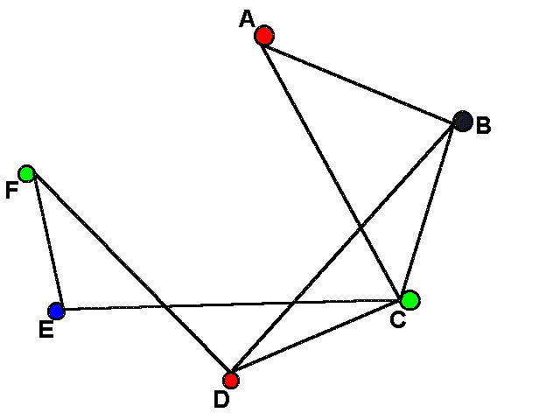
Problem Solution: What does each colour on the graph represent? How Chromatic number help to solve the problem?

Slide 12
Several different combinations of fish are possible depending on how the graph is coloured. Fish with vertices of the same colour go in to the same tank. The fewest number of tanks the tropical fish owner will need is three.
Tank 1 | Tank 2 | Tank 3
Alphas and Deltas | Fetas and Cartas | Betas and Epsalas

