Slide 1
CLIQUE RELAXATION MODELS IN SOCIAL NETWORK ANALYSIS Jeffrey Pattillo, Nataly Youssef, and Sergiy Butenko
Suchitra Ganga Bhavani Anusha Inti
810846173

Slide 2
INTRODUCTION
Social networks represent certain types of social interaction, such as acquaintance, friendship, or collaboration between people or groups of people that are referred to as actors.
In social networks, vertices usually stand for actors and edges.
Example:
Connections between terrorists associated with the September 11, 2001 attack on the World Trade Center.
The links were identified by Krebs after the terrorist attack, network is reconstructed based on the information that was publicly available before September 11

Slide 3
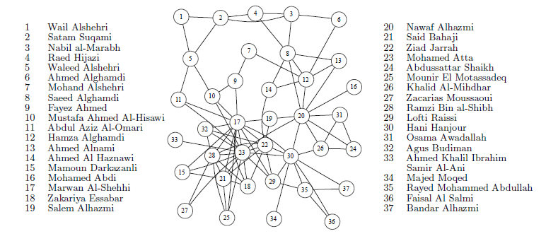
The network representation of data describing connection between terrorists associated with September 11 attacks

Slide 4
Social network analysis is the notion of a cohesive subgroup, which is a “tightly knit” subgroup of actors in a social network.
Clique embodies a “perfect” cohesive group, in which every two entities are connected to each other.
One may not need to require every possible link to exist between elements of a cohesive subgroup;
the social network of interest may be built based on empirical data, which are prone to errors, so, even if a completely connected cohesive subgroup is sought for, it may be impossible to detect due to erroneous data.

Slide 5
To overcome this impracticality of the clique model, other graph-theoretic formalizations of the cohesive subgroup concept have been proposed.
Clique generalizations, each of which relaxes one of the elementary clique properties, such as familiarity, reachability, or robustness.
Hence, we use the term “clique relaxations” in reference to such models.
The aim is to find the clique relaxation structures of largest possible size in the given network.

Slide 6
DEFINITIONS AND PROPERTIES OF CLIQUE RELAXATION MODELS
consider a simple undirected graph G = (V;E)
Where V = {1,…,n} and E ⊆V ×V, respectively, denote the sets of vertices and edges in G, with |V| = n and |E|= m.
G is said to be complete if for every u,v ∈ V such that u ̸= v, (u;v) ∈ E
Given a subset of vertices S ⊆V, G[S] = (S;E ∩(S×S)) denotes the subgraph induced by S,
Obtained by deleting all vertices in V \ S and their corresponding incident edges from G.

Slide 7
A clique is called maximal if it is not contained in a larger clique
and it is called maximum if there is no larger clique in G.
The size of the maximum clique in G is referred to as the clique number and is denoted by w(G).
Two paths are called independent if they only intersect at their ends
The length of the shortest path between two vertices u,v ∈ V in G is represented by dG (u,v), referred to as the distance between u and v

Slide 8
PROPERTIES OF CLIQUE
Reachability
Familiarity
Density
Robustness

Slide 9
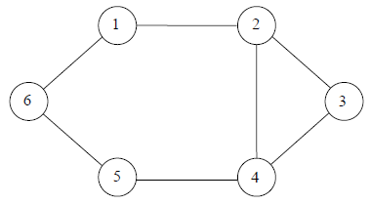
A graph illustrating the difference between 2-cliques and 2-clubs

Slide 10
K-CLIQUE
Pairwise distances between members of the clique is equal to one.
One, k-cliques ensure that any two vertices within the subgraph are at most distance k from each other in the original graph.
Definition:
A k-clique S is a subset of V such that, for all vertices u;v ∈ S,dG(u;v) ≤ k. The size of the largest k-clique is called the k-clique number and is denoted by w˜k(G).

Slide 11
K-CLUB
k-clubs require the diameter of the induced subgraph to be at most k
Definition :
A k-club S is a subset of V such that the induced subgraph G[C] has a diameter of at most k. The size of the largest k-club is called the k-club number and is denoted by wk(G).

Slide 12
Maximum k-clique
The maximum k-clique problem consists of finding the k-clique in the graph with largest cardinality wk(G).
Maximum k-clique problem in graph G can be equivalently formulated as the maximum clique problem in graph Gk representing the k-th power of graph G.
Gk has the same set of vertices as G, with edges connecting all pairs of vertices that are distance at most k from each other in G.

Slide 13
Algorithms for detection of clique relaxation structures
Maximum k-clique problem is NP-hard for any positive integer k.
Attacking problem is by reducing the maximum clique problem k-th power of the graph Gk
Gk has higher edge density than G
Maximum k-clique problem is more challenging than the maximum clique problem.

Slide 14
Greedy heuristics have been developed based on either a sequential addition of vertices until the clique is built or a removal of vertices from a larger graph.
They use local information, such as vertex degree, to order the vertices in the greedy scheme.

Slide 15
Conclusion
The concept of a clique has been widely used in a variety of applied Systems.
We believe that clique relaxation models provide an excellent opportunity for even more important developments.

Slide 16
THANK YOU

