Slide 1
Chinese Postman Problem
Presented By
V.Siva Varun

Slide 2
Contents
1.Real World Problem
2. Special Properties
3.Interpreting graph solution to Real world problem
4.Solution to the Problem
5.Real World Applications
6.References

Slide 3
Real World Problem
There is a Postman who delivers mail to a certain neighborhood of street. The postman is unwilling to walk far so he wants to find the shortest route possible. The postman should start and end at same spot and walk down each street at least once.

Slide 4
Behind the Problem
It was first proposed by a Chinese mathematician Mei-Ku Kaun.
It was proposed in year 1962.

Slide 5
Special Properties
A traversable graph is one that can be drawn without taking a pen from the paper and without retracing the same edge. In such a case the graph is said to have an Eulerian trail.

Slide 6
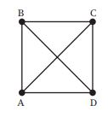
Special Properties(Contd)
Vertex | Order
A | 3
B | 3
C | 3
D | 3
It is Impossible to draw the above graph without either taking the pen of the paper or re-tracing an edge. This is because all the vertices have odd degree.

Slide 7
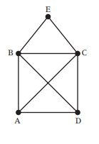
Special Properties(Contd)
Vertex | Order
A | 3
B | 4
C | 4
D | 3
E | 2
It is possible to draw the above graph without taking the pen of the paper and without retracing the same edge but we can achieve this by starting at either A or D and in each case the path will end at the other vertex of D or A.
If a graph has exactly 2 odd vertices then it is said to be Semi-Eulerian Graph.

Slide 8
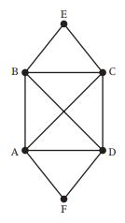
Special Properties (Contd)
Vertex | Order
A | 4
B | 4
C | 4
D | 4
E | 2
F | 2
Here we can draw the above graph without retracing the edge or taking the pen of the paper regardless the starting position and we will always return to the start vertex. This is because all the vertices have even degree.
If a graph has all even vertices then it is said to be Eulerian-Trail.

Slide 9
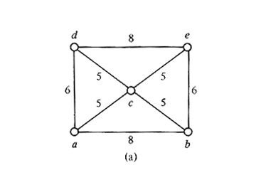
Interpreting graph solution to Real world problem
Vertex | Order
A | 3
B | 3
C | 4
D | 3
E | 3

Slide 10
Problem Solution
Algorithm:
Step 1: List all odd vertices.
Step 2: List all possible pairings of odd vertices.
Step 3: For each pairing find the edges that connect the vertices with the minimum weight.
Step 4: Find the pairings such that the sum of the weights is minimized.
Step 5: On the original graph add the edges that have been found in Step 4.
Step 6: The length of an optimal Chinese postman route is the sum of all the edges added to the total found in Step 4.
Step 7: A route corresponding to this minimum weight can then be easily found.

Slide 11
Solution(Contd)
Step1: List All Vertices that have odd degree.
Vertex | Order
A | 3
B | 3
D | 3
E | 3

Slide 12
Solution (Contd)
Step2: List all possible Pairing of odd vertices.
Serial Number | Possible Pairing
1 | AB and DE
2 | AD and BE
3 | ACE and BCD

Slide 13
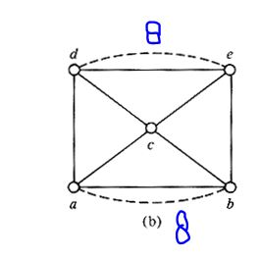
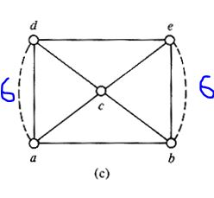
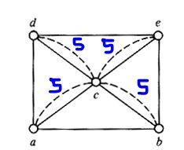
Solution (Contd)
Step3: For each pairing find the edges that connect the vertices with the minimum weight.
1
2 3

Slide 14
Solution(Contd)
Step4: Find the pairings such that the sum of the weights is minimized.
8+8 = 16
6+6 = 12
5+5+5+5 = 20

Slide 15
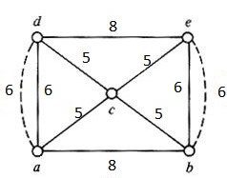
Solution(Contd)
Step 5: On the original graph add the edges that have been found in Step 4.

Slide 16
Solution (Contd)
Step 6: The length of an optimal Chinese postman route is the sum of all the edges added to the total found in Step 4.
Length of an optimal Chinese Postman route= 48
Sum of new edges = 12
Therefore, 48+12 = 60

Slide 17
Solution(Contd)
Step 7: A route corresponding to this minimum weight can then be easily found.
a -> b -> e -> d -> a -> c -> e -> b -> c -> d -> a
8+6+8+6+5+5+6+5+5+6=60

Slide 18
Real World Applications
1.Site Seeing
2.Deliveries
3.Shopping

Slide 19
Thank You!!!!

Slide 20
References
http://web.mit.edu/urban_or_book/www/book/chapter6/6.4.4.html
http://www.suffolkmaths.co.uk/pages/Maths%20Projects/Projects/Topology%20and%20Graph%20Theory/Chinese%20Postman%20Problem.pdf
http://www.utdallas.edu/~dxd056000/cs6363/Chinese.htm

