Slide 1
NURSE SCHEDULING, USING GRAPH COLOURING
BY
Abilash Choudary Sukhavasi

Slide 2
Agenda
Real World Scenario
Objective of the Study
Proposed Solution
Planar Graph
Graph Coloring
Chromatic Number
Applying Graph theory for R-W Problem
Construction of Graph for R-W Problem
Conclusion

Slide 3
Real World Scenario
A hospital consists of a number of operation wards Pediatric ward is one of them.
The Pediatric ward provides 24 x 7 Services.
Scheduling nurses to staff shift is usually made by a head nurse.
The allocation of nursing staff is a critical task in hospital management:
The allocation of the right number and skill mix of staff to each shift becomes crucial.
Nurse schedule policies can have a direct impact on nurse satisfaction and hence on turnover.
Schedule requiring nurses to work difficult and tiring combinations of shifts can again impact on the quality and safety of patient care.
Hospital management is therefore further concerned with providing rosters that minimize nurse dissatisfaction

Slide 4
Objective of the Study
To apply graph coloring technique to generate efficient and reliable nurses’ schedule.
Criteria which needs to be satisfied in this study are:
To produce the right combination of nurses for each shift
To remove various conflicts which normally create problems in the nurses schedule

Slide 5
Proposed Solution
To provide effective method for solving Nurse Scheduling Problem (NSP) by satisfying the nurses, patients and hospital requirements.
A Conflict graph is constructed and the vertices of the graph represented the different types of nurses.
The vertices are then colored using Greedy algorithm approach and this removes the various conflicts.
The result is then used to create the nurses schedule.

Slide 6
Planar Graph
A planar graph will be a graph that can be drawn in the plane so that no two edges intersect with each other.
All simple planar graphs can be 6-colored
Planar Graph
Not a Planar Graph
Planar Graph

Slide 7
Graph Coloring
Graph coloring is a special case of graph labeling; it is an assignment of labels traditionally called "colors" to elements of a graph.
In general, graphs are used to depict “What is in conflict with what”, and colours are used to denote the state of vertex.
Graph coloring is classified into 3 ways:
1) Vertex Colouring
2) Edge Colouring
3) Face Colouring

Slide 8
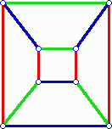
Vertex Coloring
It is a way of colouring the vertices of a graph such that no two adjacent vertices share the same colour.
Edge Coloring
An edge colouring assigns a colour to each edge so that no two adjacent edges share same colour.

Slide 9
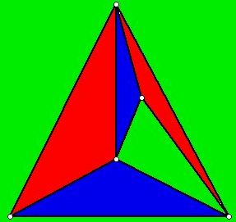
Face Coloring
A face colouring of a planar graph assigns a colour to each face or region so that no two faces that share a boundary have the same colour

Slide 10
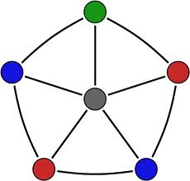
Chromatic Number
The chromatic number of a graph is the minimum number of colors in a proper coloring of that graph. If chromatic number is r then the graph is r-chromatic.
Basic Facts of Chromatic Number
r=4
If graph G has n vertices, then X(G)<=n
X(G)=1 <==> G has no edges
X(C2n)=2 and where as X(C2n+1)=3
X(Kn)=n
If H is a subgraph of G then X(G)>=X(H)

Slide 11
Applying Graph Theory For R-W Problem
To solve this nurse schedule problem, considered there were fifteen nurses.
The types of nurses in the ward are Staff Nurse (SN), Principal Enrolled Nurse (PEN), Rotation Nurse (RN), Enrolled Nurse (EN), Senior Ward Assistant (SWA) and Health Extension Workers (HEW).
They were named as SN1, SN2, SN3,SN4, PEN, RN1, RN2,EN1, EN2, SWA, HEW1, HEW2, HEW3, HEW4, HEW5.
Also, considered the below constraints:
Nurses with different skills levels can be in same shift. But only the junior or senior nurses can’t be in same shift.

Slide 12
Applying Graph Theory For R-W Problem (cont..)
There are some nurses, who don’t like to work together. So they must be put in to different groups.
Sometimes hospital management also wants to put some nurses in to different shifts to create high quality roster.
Initially by Considering the different skills levels the nurses were put into groups.
A | SN1,SN3,SN4
B | SN4,EN1,EN2
C | RN1,RN2
D | EN2,HEW3
E | HEW2,HEW3,HEW4
F | RN1,EN1
G | EN1,EN2
Table 1: Group of conflicting nurses

Slide 13
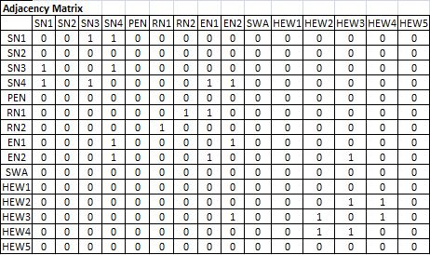
Construction of Graph For R-W Problem
Adjacency Matrix based on Table 1 details:

Slide 14
Construction of Graph For R-W Problem (Cont…)
SN3
SN2
SN4
PEN
HEW5
SN1
RN1
HEW4
RN2
HEW3
EN1
HEW2
EN2
HEW1
SWA
Conflicting Graph of nurse

Slide 15
Construction of Graph For R-W Problem (Cont…)
SN3
SN2
SN4
PEN
HEW5
SN1
RN1
HEW4
RN2
HEW3
EN1
HEW2
EN2
HEW1
Colored Conflict Graph of nurses using GREEDY Algorithm
SWA

Slide 16
Conclusion
GROUPS | NURSES
G1 | SN1,EN1,RN1,HEW3
G2 | SN3,EN2,RN2,HEW2
G3 | SN4,HEW4
G4 | SN2,PEN,SWA,HEW1,HEW5
Nurses group after applying graph coloring
Nurses in same group can work in one shift with out any conflicts.
Nurses like SN3 and EN1 can’t work is same shift as they belong to different groups G1 and G2.
Willingly, different color is assigned for SN2,PEN,SWA,HEW1,HEW5.
Nurses who belong to G4 can work along with any other group members, as they don’t have any conflicts to work in any circumstances.

Slide 17
References
https://courses.engr.illinois.edu/cs173/sp2011/lectures/planargraphs.pdf
http://docplayer.net/11553209-A-nurse-scheduling-using-graph-colouring-anane-gideon-bed-hons-mathematics-a-thesis-submitted-to-the-department-of-industrial-mathematics.html
http://math.cmu.edu/~bkell/21110-2010s/conflict-graphs.html
https://www.google.com/search?q=vertex+coloring+graphs&espv=2&biw=1280&bih=699&source=lnms&tbm=isch&sa=X&ved=0ahUKEwj0yMbd2qjMAhWIJiYKHR1OCTkQ_AUICCgD#imgrc=TdFI1qSeQMXgXM%3A

Slide 18
Thank You ☺
Queries?

