Slide 1
On the Ability of Graph Coloring Heuristics to Find Substructures in Social Networks David Chalupa
By,
Tejaswini Nallagatla

Slide 2
Introduction
Social network is a graph representing relationships between people.
Social substructure is a clique Km with m vertices of social network.
Thus, in a social substructure, everybody knows everybody.
At this point, we need to decide if there is a clique of a particular size in a graph, is an NP-complete problem.
A heuristic algorithm is first used to search for social substructures called the uninformed approach
The uninformed approach is apparently reducible to a computationally hard problem.
Therefore it is transformed to the graph coloring problem.

Slide 3
A local search algorithm is used for the greedy approach of graph coloring which begins with random coloring and improves with sequence of elementary moves.
Tabu search algorithm is used in our approach. On our graph based approach we use only binary information, represented with edges.

Slide 4
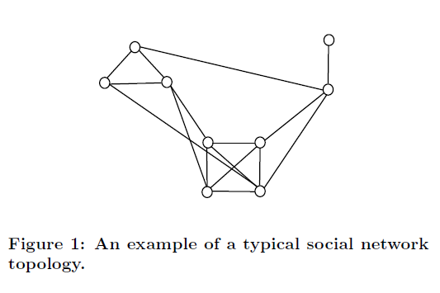
Topology of Social Networks
Based on the topology of social networks we assume that people who know each other have an edge between them.

Slide 5
The uninformed approach to substructure discovery
Let G = [V,E] be an undirected graph and let c be a number of colors.
The objective of the graph coloring problem is to find a partitioning of the vertex set V into partitions V1, V2,.., Vc such that the partitions cover the whole vertex set and the number of adjacent vertices in the same partitions is minimal.
That means to find internally independent partitions, where no couple of vertices is connected with an edge.

Slide 6
Basic steps of the method
Instead of searching for cliques, it "breaks" the complementary graph into independent sets.
We choose a group of candidates and extract information about contacts of each candidate. We construct topology of the network as a graph G.
We create a complementary graph G’ because we do not want to minimize but maximize dependence in the resulting partitions.
Considering c colors, where c is a parameter. By repeated resetting of this parameter, we minimize its value. Thus, we minimize the number of substructures.
Each subset contains vertices of the same color. We assign people to each of the vertices.

Slide 7
Graph coloring heuristic
Tabu search algorithm is selected for the graph coloring problem ,due to its balanced simplicity and performance.
Working
First, an entirely random coloring is generated then, an iterative procedure is performed.
In each iteration, we have an actual coloring S, on which a mutation is going to be performed.
A neighborhood N(S) is defined as a set of all colorings obtained from S by recoloring every conflicting vertex with every other possible color.

Slide 8
one with the highest fitness is chosen as a new actual coloring S*.
This process is iteratively repeated until a maximal number of iterations is reached or an optimal coloring is found.
If a tabu move leads to a coloring that has a higher fitness than any coloring found so far, tabu search also accepts it.
While performing the moves we may get trapped, Suppose that vertex v had a color c1 and the search algorithm recolored it with c2. Thus, the move is defined by the couple [v,c2]. However, the inverse move [v, c1] would lead the search back to the previous state. Thus, the tabu search forbids this move for a number of iterationsdefined by tabu tenture.

Slide 9
Results on artificial instances
Using our model, we generated 3 artificial social networks with 100, 500 and
2000 vertices and tried solving with tenure ranging from 0 to 20.
An example of a result on the network with 100 vertices and 20 substructures, grouped to circles, is depicted in the figure below.

Slide 10
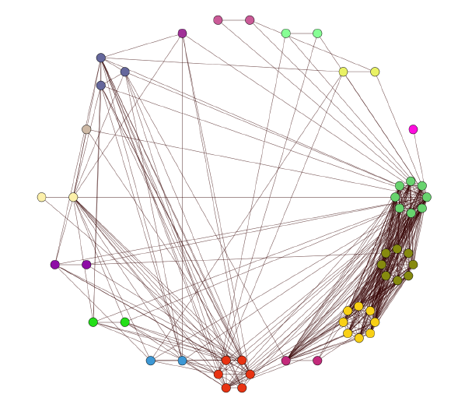
Result obtained on a sample of real data obtained from social network Facebook.

Slide 11
Conclusion
To find information in graphs generated by a modern real world application
Regarding graphs with more than 2000 vertices, there still is a space for further improvement.
Methodology produces results of high relevance for real data.

