Slide 1
BIPARTITE GRAPHS AND ITS APPLICATIONS
PRESENTED BY
SARIKA PAMMI

Slide 2
OUTLINE :
INTRODUCTION
BIPARTITE GRAPH
PROBLEMS IN BIPARTITE GRAPH
PROBLEM DEFINITION
EXAMPLE TO SOLVE
APPLICATIONS

Slide 3
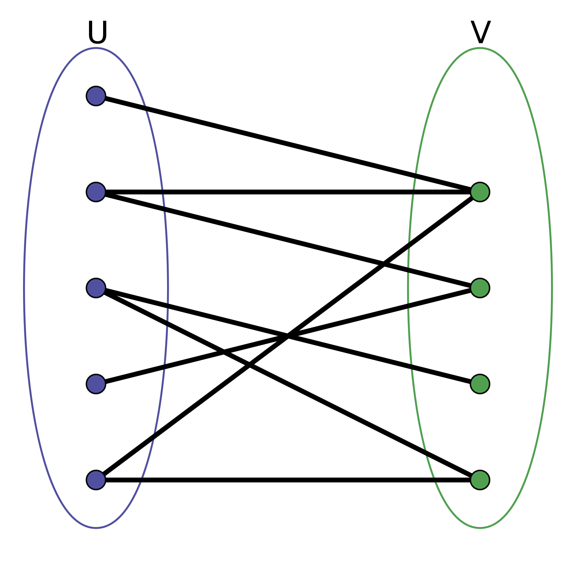
INTRODUCTION :
BIPARTITE GRAPH :
A graph G = (U,V,E) whose vertices can be divided in to two disjoint sets U and V such that every edge connects a vertex in U to one in V.

Slide 4
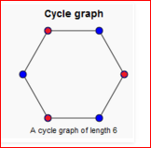
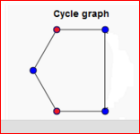
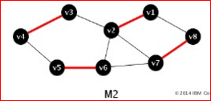
PROBLEMS IN BIPARTITE MATCHING:
Testing Bipartiteness:
Matching:
A matching M of a graph G=(V,E) is a set of edges of G
such that no two edges in M share a common vertex.
Maximum matching problem:
A matching is said to be maximum if any edge is added to it such that every edge has one end point in X and other end point in Y.

Slide 5
PROBLEM DEFINITION :
To find maximum flow in a flow network from a single source s to a single sink t.
Example :
Finding the maximum number of trucks we can send out a location according to road map with different road capacities.

Slide 6
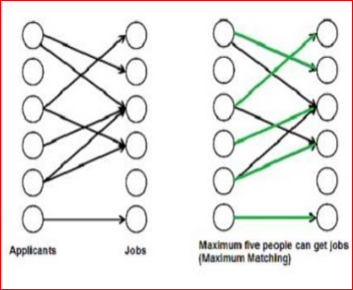
BIPARTITE MAXIMUM MATCHING :
INPUT :
U and V are the vertex sets with E no. of edges.
Matching :
M c E is said to be a matching if atmost one edge from M is incident on any vertex in U or V.
Output :
Matching of Maximum size.

Slide 7
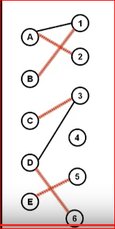
EXAMPLE :

Slide 8
GRAPHS USED :
Flow nework (G):
Simple Directed graph
1 source s 1 sink t
Non negative capacity edge
Residual graph (Gf):
only edges from G can still have flow
Added edges : reverse edges to decrease flow
Augmenting paths (p):
path from s to t in GF
Residual capacity = smallest capacity of edges of p

Slide 9
BIPARTITE GRAPH TO FLOW GRAPH :

Slide 10
FLOW GRAPH TO RESIDUAL NETWORKS :

Slide 11
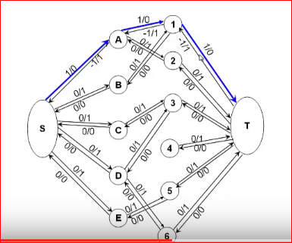
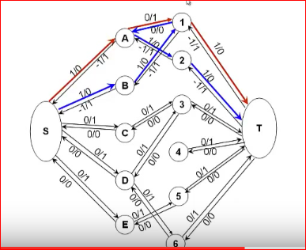
S – A – 1 – T S – B – 1 – A – 2 – T

Slide 12
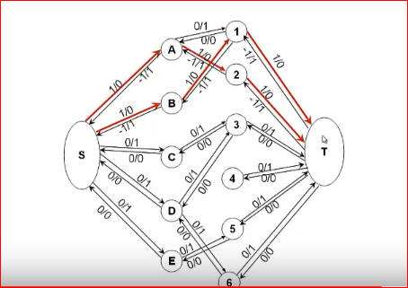
.
.

Slide 13
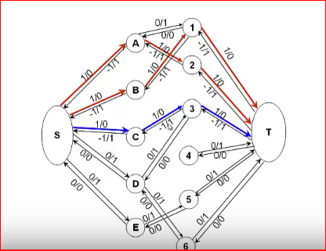
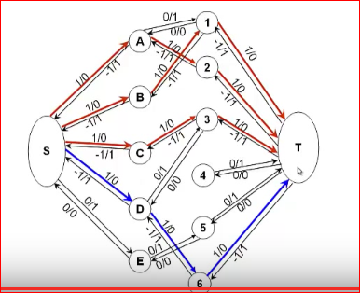
S – C – 3 – T S – D – 6 – T
.

Slide 14
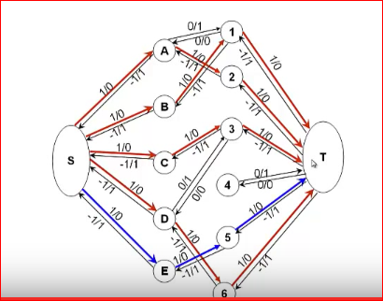
S – D – 6 – T S – E – 5 – T
.

Slide 15
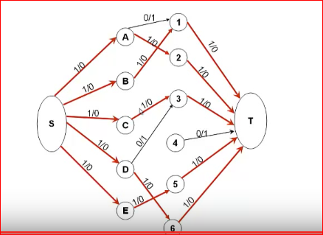
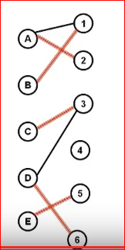
RESULTANT MAXIMUM MATCHING GRAPH :
.

Slide 16
APPLICATIONS :
Scheduling problems such as assigning M jobs to a machine with N time slots with constraints such as certain jobs can be performed only during some particular time slots. What may be the maximum number of jobs that can be performed in a day.
In real world : scheduling the Advertisements.
Scheduling the trains on the tracks.

Slide 17
.
CONCLUSION

Slide 18
.
ANY QUERRIES ???

