Slide 1
Timetable Problem solving using Graph Coloring
By,
Venkateswara reddy. Tallapu reddy

Slide 2
Outline
What is Timetable problem..?
Problem Statement.
How to construct a graph for this Real-World problem..?
What is Graph Coloring..?
How graph coloring can solve this RW problem..?
Is it NP-hard or not..?
References.

Slide 3
What is Timetable Problem..?
Timetable problem can be seen as a form of scheduling where the task is to allocate activities to available slots within resources respecting some constraints.
There has been a lot of algorithms developed for this particular problem using different techniques like Graph Coloring, Tabu Search, Genetic Algorithm, Optimization problem and so on..
This is a problem with so many variations due to various constraints that can be tied to it.

Slide 4
Problem Statement.
Design a simple class schedule with no conflict between a set of teachers and a set of courses with the following set of constraints:
1. No same courses can be taken by any teacher or batch for a given time slot.
2. Minimize the number of time slots required and prove that it is optimum.

Slide 5
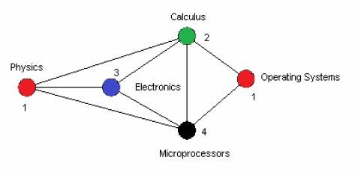
How to construct a Graph for this RW Problem..?
For example, let us consider 5 courses needed to be scheduled without any conflicts. Then how we can represent them in a graph is as shown below
Graph representation
Vertices: represents courses
Edges: represents a pair of courses that conflict, and a
Color: represents the period in which that particular course is to be scheduled.

Slide 6
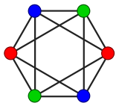
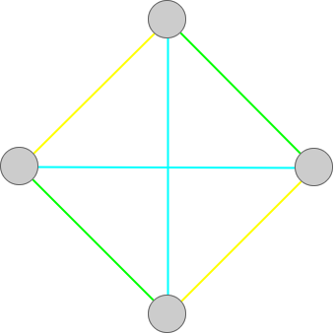
What is Graph Coloring..?
Vertex coloring : It is a way of coloring the vertices of a graph such that no two adjacent vertices share the same color.
Edge coloring :
An edge-coloring of G is a mapping f : E(G)→S. The element of S are colors; the edges of one color form a color class. If |S| = k, then f is a k-edge coloring.
Chromatic Number: χ = least number of colors needed to color a graph.

Slide 7
How graph coloring can solve this RW problem..?
Let us consider an example, In a college there are m professors x₁, x₂, …, x_{m} and n subjects y₁, y₂, …, y_{n} to be taught.
Given that professor x_{i} is required to teach subject y_{j} for p_{ij} periods.
Construct a bipartite multigraph G with vertices x₁, x₂, …, x_{m}, and y₁, y₂, …, y_{n} such that vertices x_{i} and y_{j} are connected by p_{ij} edges.
Initially consider a single period. The timetable for this single period corresponds to a matching in the graph and, conversely, each matching corresponds to a possible assignment of professors to subjects taught during this period.
Thus, the solution to the timetabling problem consists of partitioning the edges of G into the minimum number of matching's. Equivalently, we must properly color the edges of G with the minimum number of colors.

Slide 8
Contd….
We shall show yet another way of solving the problem using the vertex coloring algorithm.
Recall that the line graph L(G) of G has as vertices the edges of G and two vertices in L(G) are connected by an edge if and only if the corresponding edges in G have a vertex in common.
The line graph L(G) is a simple graph and a proper vertex coloring of L(G) yields a proper edge coloring of G using the same number of colors.
Thus, to solve the timetabling problem, it needs to find a minimum proper vertex coloring of L(G).We demonstrate the solution with a small example.

Slide 9
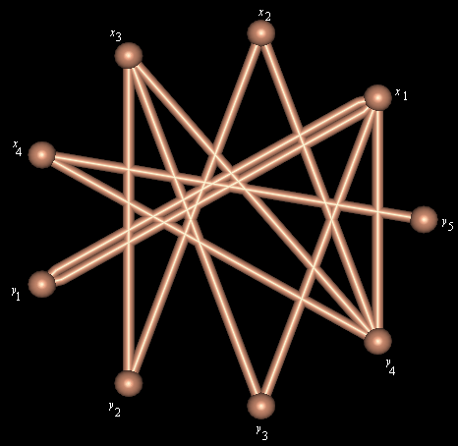
Suppose there are four professors x₁, x₂, x₃, x₄ and five subjects y₁, y₂, y₃, y₄, y₅ to be taught.
The teaching requirement matrix p = [ p_{ij} ] is as shown:
p | y₁ | y₂ | y₃ | y₄ | y₅
x₁ | 2 | 0 | 1 | 1 | 0
x₂ | 0 | 1 | 0 | 1 | 0
x₃ | 0 | 1 | 1 | 1 | 0
x₄ | 0 | 0 | 0 | 1 | 1
The bipartite multi graph G

Slide 10
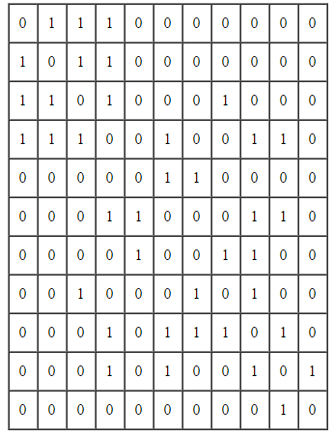
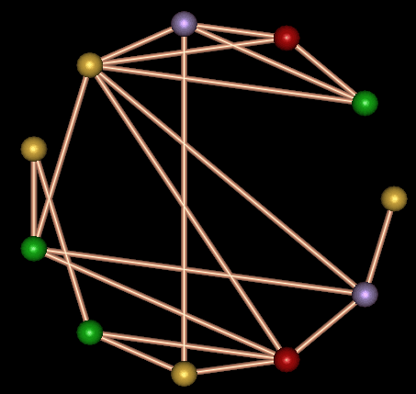
Vertex Coloring:
(1, green), (2, red), (3, blue), (4, yellow), (5, yellow), (6, green), (7, green), (8, yellow), (9, red), (10, blue), (11, yellow).
This, in turn, yields a minimum proper vertex 4-coloring of the bipartite multigraph G:
3
2
4
1
5
11
6
10
7
8
9

Slide 11
Edge Coloring:
({x₁, y₁}, green), ({x₁, y₁}, red), ({x₁, y₃}, blue), ({x₁, y₄}, yellow),
({x₂, y₂}, yellow), ({x₂, y₄}, green),
({x₃, y₂}, green), ({x₃, y₃}, yellow), ({x₃, y₄}, red),
({x₄, y₄}, blue), ({x₄, y₅}, yellow).
Then, from the edge coloring of G, we obtain a solution of the given timetabling problem as shown below:
- | 1 | 2 | 3 | 4
x₁ | y₁ | y₁ | y₃ | y₄
x₂ | y₄ | - | - | y₂
x₃ | y₂ | y₄ | - | y₃
x₄ | - | - | y₄ | y₅
Consider green, red, blue, yellow as periods 1, 2, 3, 4 respectively.

Slide 12
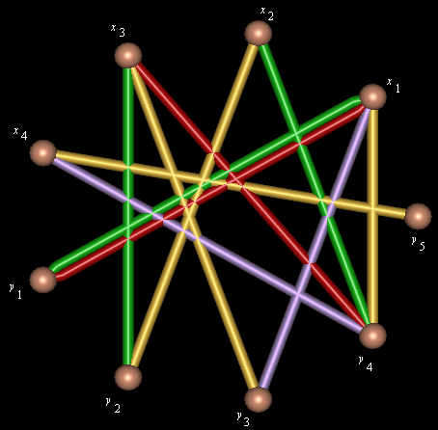
Contd..

Slide 13
Is it NP-hard or not..?
Timetable problem solving has many variations due to various constraints that can be tied to it.
That is why it is so hard and is considered as NP(Non-Polynomial) complete.
i.e. it does not have any polynomial time bound. However, approximate algorithm or heuristic approach can be taken to attain solution in a feasible time bound

Slide 14
References.
http://www.iro.umontreal.ca/~hahn/IFT3545/GTWA.pdf
http://www.hoonzis.com/applications-of-graph-theory/
http://www.cs.xu.edu/csci390/12s/IJEST10-02-09-124.pdf

