Slide 1
Flow Scheduling for Interactive Video Streaming
MD Iftakharul Islam (Tamim)
Department of Computer Science
Kent State University
Kent, OH, USA.

Slide 2
Outline
Problem scope
Maximum-weight Independent Set
Graph construction (interval graph)
Flow Scheduling

Slide 3
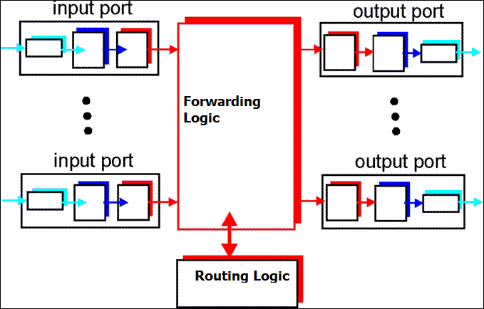
Logical Architecture of a Router

Slide 4
Competing Flows
IP routers provide differentiated services
Different types of traffics are allocated with different resources, so web traffic and video streaming don’t compete with each other.
Video streaming flows compete among themselves for the allocated resources.
Video streaming sources
Outgoing channels
Router
s1
s2
s3
s4
s5

Slide 5
Video Streaming
A source sends a video in a regular interval (Usually several times in a second)
Though the duration of each video is same, their size varies
Achieving constant quality results in Variable Bit Rate (VBR).
High motion scene needs more bits than little motion
High frequency scene needs more bit
Video size (B)
Time

Slide 6
Packets in Time Unit
Routers treat the video packets in an unit of time.
Different routers have different processing power. So, size in bit is not universal across routers, but time does.
Video size (B)
Time
10
5
5
12
15
time

Slide 7
Competing Flows
How to schedule the flows to a channel (port) such that the channel utilization is maximized?
Flow 1
10
5
5
12
15
Flow 2
5
5
12
15
Flow 3
10
5
5
12
15
time
Router’s Output Buffer

Slide 8
A possible solution
Does it maximize the channel utilization? - NO
Flow 1
10
5
5
12
15
Flow 2
5
5
12
15
Flow 3
10
5
5
12
15
time
Router’s Output Buffer

Slide 9
Candidate Solutions
Greedy Strategy? Earliest Deadline First?
Suboptimal result (Will pick B over J)
0-1 Knapsack problem?
NP-complete. Dynamic programming based pseudo polynomial time algorithm exists.
Maximum-weight independent set of a graph
Flow 1
A
B
C
D
E
Flow 2
F
G
H
I
Flow 3
J
K
L
M
N
time
Router’s Output Buffer

Slide 10
Graph Construction
Nodes | Weight
C | 5
D | 15
E | 10
H | 8
I | 7
K | 5
L | 7
M | 8
N | 8
Flow 1
C
D
E
Flow 2
H
I
Flow 3
K
L
M
L
N
time
C
D
E
H
I
K
L
M
N

Slide 11
Maximum-weight Independent Set (MWIS)
Nodes | Weight
C | 5
D | 15
E | 10
H | 8
I | 7
K | 5
L | 7
M | 8
N | 8
MWIS is an independent set whose weights sum is maximum.
NP-hard on general graph but O(n+m) for interval graph
C
D
E
H
I
K
L
M
N

Slide 12
Maximum-weight Independent Set
Nodes | Weight
C | 5
D | 15
E | 10
H | 8
I | 7
K | 5
L | 7
M | 8
N | 8
Find the umbrella-free ordering. O(n+m)
Find the independent sets from the umbrella-free ordering.
Find the maximum-weight independent set from the IS.
Maximum Independent Set {C, L, M, N} = 28
Maximum-weighted Independent Set: {K, D, E} = 30
C
D
E
H
I
K
L
M
N

Slide 13
Flow Scheduling
C
D
E
H
I
K
L
M
N
Flow 1
C
D
E
Flow 2
H
I
Flow 3
K
L
M
L
N
time

Slide 14
References
Xiaojun Cao, Yichuan Wang, Alex Zelikovsky “Scheduling Bursts using Interval Graphs in Optical Burst witching Networks”, IEEE GLOBECOM 2009.

Slide 15
Thank you!

