Slide 1
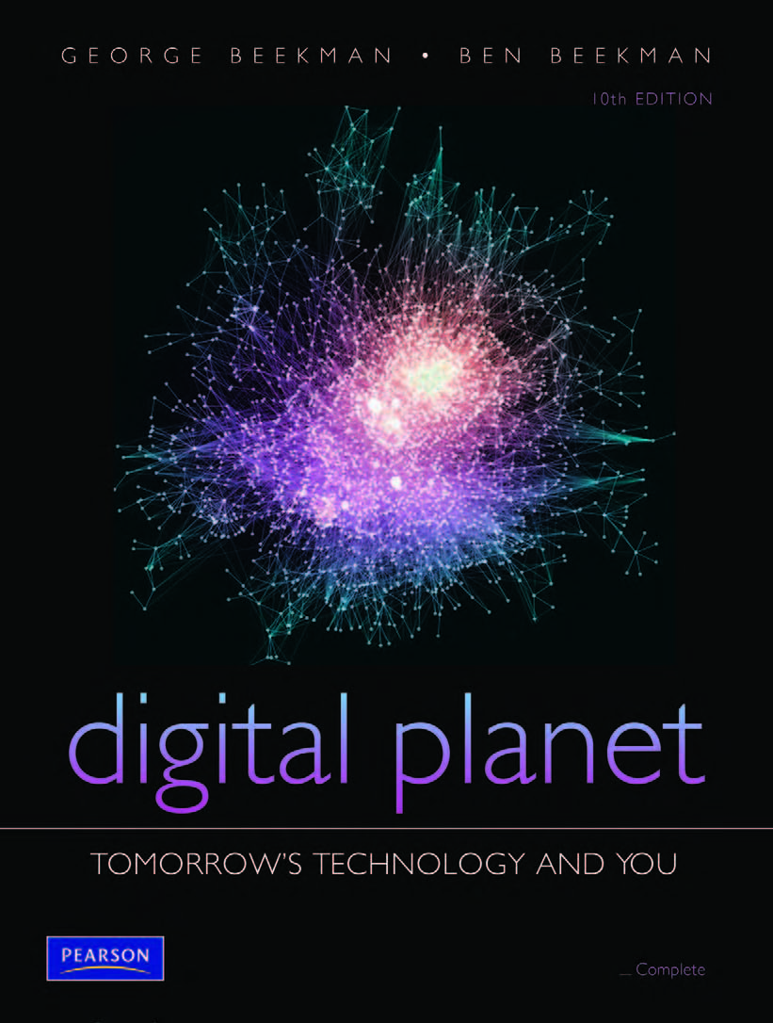
Digital Planet:
Tomorrow’s Technology and You
George Beekman • Ben Beekman
Tenth Edition
Copyright © 2012 Pearson Education, Inc. publishing as Prentice Hall
Notes:
1

Slide 2
Digital Planet: Tomorrow’s Technology and You
Chapter 3
Hardware Basics
Peripherals
Copyright © 2012 Pearson Education, Inc. publishing as Prentice Hall
Notes:
2

Slide 3
Chapter 3 Objectives
List several examples of input devices and explain how they can make it easier to get different types of information into the computer
List several examples of output devices and explain how they make computers more useful
Explain why a typical computer has different types of storage devices
Diagram how the components of a computer system fit together

Slide 4
Input: From Person to Processor
Nuts and bolts of information processing hidden from computer user.
User sees only input and output or I/O.
Early computer users had to flip switches or plug wires into switchboards.
Today, users have choice of hundreds of input devices that make it easy to enter data and commands.

Slide 5
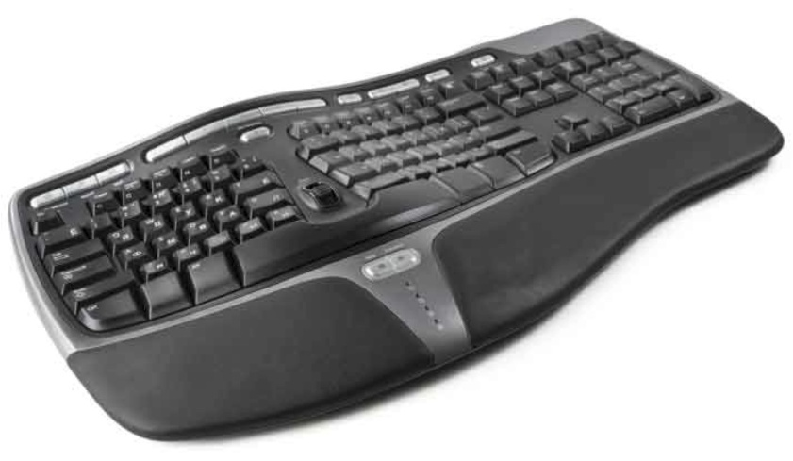
The Keyboard
Keyboard: Most familiar input device
QWERTY keyboard dates back to manual typewriters
Typical keyboard sends signals to computer through cable—usually USB
Keyboards may be wireless
Ergonomic keyboards: Keys are at angles; easy on arms and hands

Slide 6
Pointing Devices
Mouse: Designed to move pointer around screen
Wireless mice: Use Bluetooth or other wireless frequencies
Touchpad: A flat panel, sensitive to light pressure
Trackpoint and trackball: Used to control pointer
Game controllers, graphics tablets, touch screens: Used for inputting

Slide 7
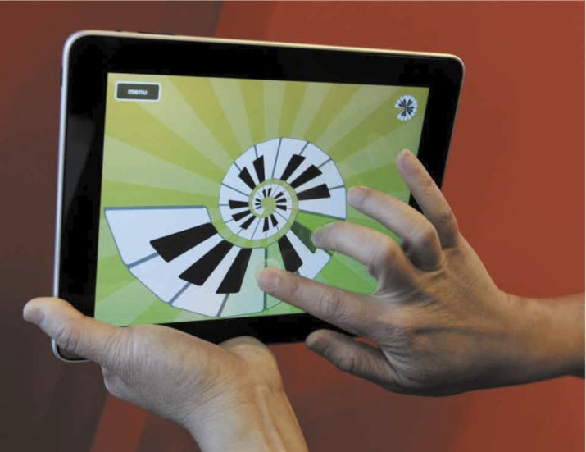
Multi-Touch Input Devices
Use multi-finger or multi-hand gestures to accomplish complex tasks quickly
Touch-sensitive screen, touch tablet, or trackpad can recognize position, pressure, and movement of more than one finger or hand at a time
Best known example is Apple’s iPhone
iPad recognizes one- and two- fingered movements

Slide 8
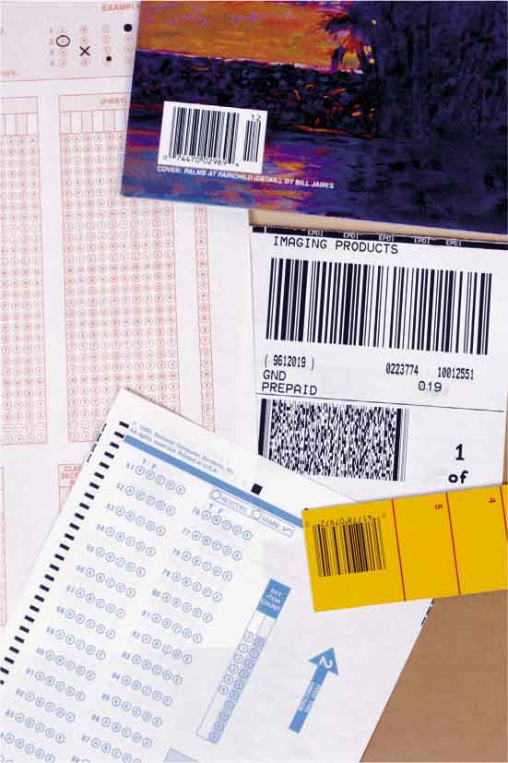
Reading Tools
Devices allow computers to read marks that represent codes:
Optical mark readers
Magnetic ink character readers
Bar code readers
Radio frequency identification (RFID) readers
Scanners and pen scanners
Handwriting recognition devices
Notes:
Magnetic ink character readers – for checks
RFID readers – uses radio waves to communicate with RFID tags
RFID tags - as small as grain of rice --- as large as card deck
Optical character recognition – OCR – printed characters only

Slide 9
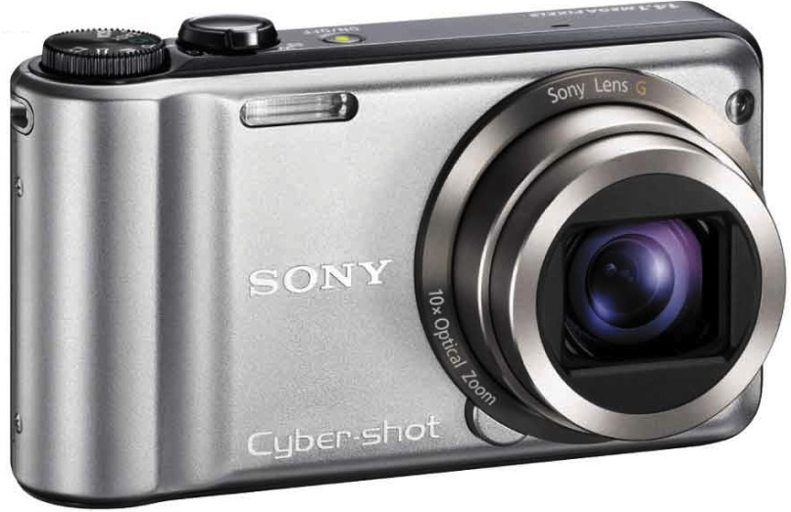
Digitizing Devices and Sensors
Devices for capturing and digitizing information—converting it into digital form:
Scanners
Flatbed scanner
Film scanners
Drum scanners
Digital cameras and digital video cameras
Notes:
Film Scanners -

Slide 10
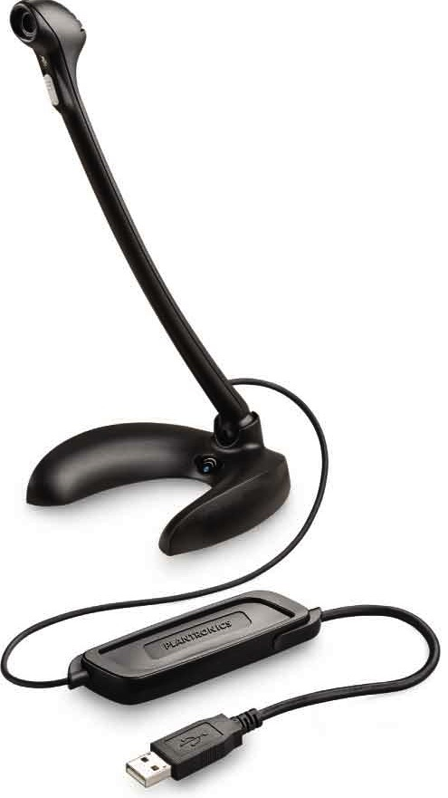
Digitizing Devices and Sensors (cont.)
Voice Input
PCs contain circuitry to convert audio signals from microphones or other sound sources into digital signals.
Speech recognition software can convert voice data into words that can be edited and printed.

Slide 11
Output: From Pulses to People
Output devices convert computer’s internal bit patterns into a form humans can understand.
Output produced through two main devices:
Display screens for immediate visual output
Printers for permanent paper output

Slide 12
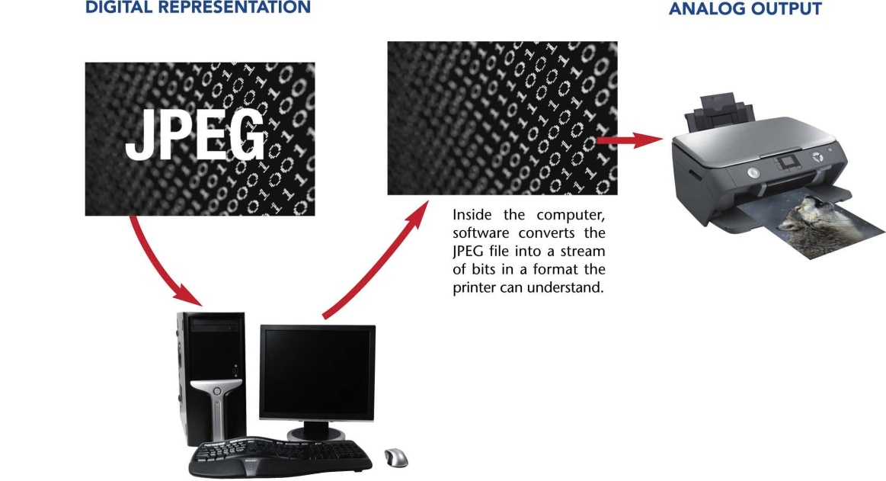
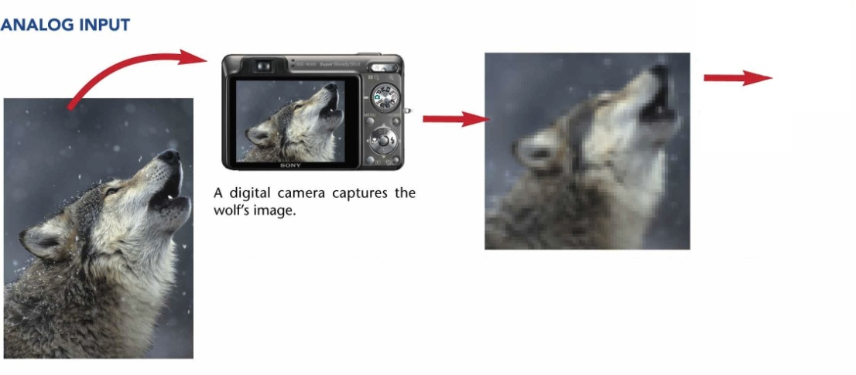
Digitizing the Real World
Digitizing involves using an input device to take millions of tiny samples.
A representation of the original image can be reconstructed by assembling all samples in sequence.

Slide 13
Screen Output
Display: Also called a monitor
Display size measured length of diagonal line across screen
Images composed of tiny dots called pixels.
Resolution: Measured in dots per inch (dpi)
Aspect ratio: Relationship between width and height
Monitors use liquid crystal digital (LCD) technology.

Slide 14
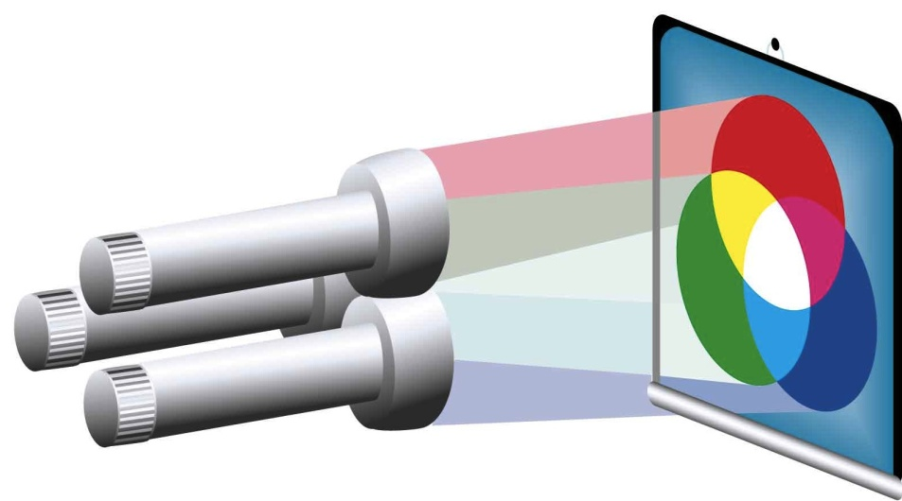
Color Display
Image is made up of rows of colored pixels
Pixels are extremely small and can’t be distinguished
Monitor’s image is refreshed many times per second
Each pixel is made up of mixture of red, green, blue
By varying the brightness of the three colors, a monitor can display millions of unique colors

Slide 15
Paper Output
Printers come in two basic groups:
Impact printers: Form images by physically striking paper, ribbon, and print hammer together
Nonimpact printers: Replaced impact printers
Laser printers: High-quality pages, quickly
Inkjet printers: Spray ink directly onto paper
Photo printers: Specialized inkjets print photos

Slide 16
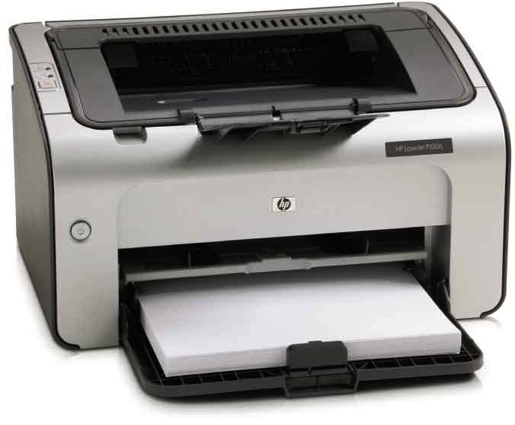
Paper Output (cont.)
Multifunction Printers
All-in-one devices: Take advantage of fact that different tools can use similar technology
Devices can serve as a printer, scanner, color photocopy machine, and fax machine.

Slide 17
Color Printing
Most printers, like monitors, form images from tiny dots.
Most printers mix various amounts of cyan, magenta, yellow, and black pigments to create a color.
Matching on-screen color with printed color is difficult.
Monitors can display more colors than printers.

Slide 18
Fax Machines and Fax Modems
Facsimile (fax) machine: Scans page, converts it to series of electronic pulses, and sends signals over phone lines to another fax machine
Fax modem: Translates document into signals that can be sent over phone wires
Receiving fax machine uses signals to construct and print facsimile of original pages

Slide 19
Output You Can Hear
Most PCs have internal speakers
Play system sounds and spoken recordings
Sound output jacks for headphones, powered speakers, and other audio output devices
High-fidelity music playback
Headsets are particularly useful for telephone and teleconferencing applications

Slide 20
Controlling Other Machines
Many machines and systems accept orders from computers:
Robot arms
Telephone switchboards
Transportation devices
Automated factory equipment
Spacecraft

Slide 21
Storage Devices: Input Meets Output
Some peripherals perform both input and output functions:
Storage devices: Include tape and disk drives
Referred to as secondary storage
Record information so it can be read later

Slide 22
Magnetic Tape
Tape drives: Common storage devices on most mainframe computers
Can store massive amounts of information on magnetic tape in a small space at a relatively low cost
Tape is sequential-access medium, so retrieving information is time consuming
Primarily used to back up data
Notes:
No longer tape cartridges – but boxes.
Access is still sequential access
Used primarily for backing up data and other non-sensitive operations.

Slide 23
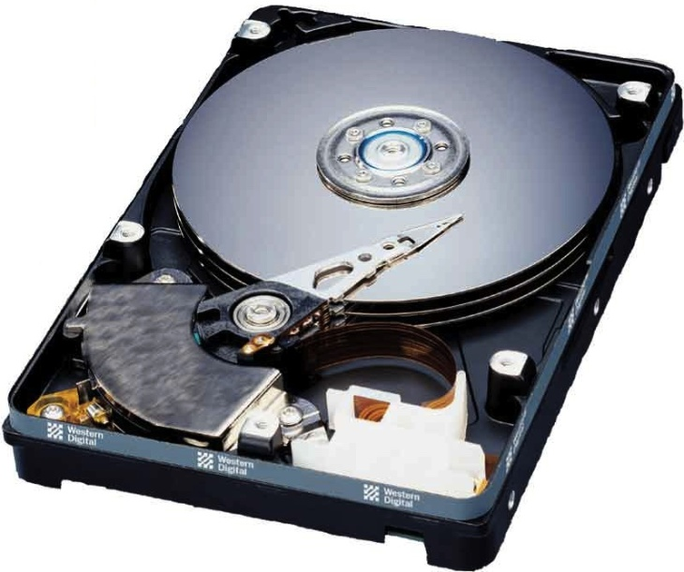
Magnetic Disks
Magnetically coated surface stores encoded information
Provide random access capability
Retrieve information rapidly
PCs include hard disks as main storage device
Older diskettes (floppy disks) and Zip disks have all but disappeared
Notes:
Spins very rapidly and continuously inside computer chassis or separate box
Holds hundreds of gigabytes of storage
Can hold several books including images, entire music collections, several movie-length clips, and years of photographssssssssssssssssssss

Slide 24
Optical Discs
Optical disc drives: Use laser beams to read and write data
Transparent plastic disc surface protects from physical damage – while letting laser light through
Access speeds are slower than for magnetic disks
Often used to make backup copies
Upper surface is more sensitive to scratching – which leads to deterioration & information loss

Slide 25
Optical Discs (cont.)
CD-ROM (compact disc—read-only memory) discs – oldest & also identical to those used to store music
CD-RW drive: Read data from CD-ROMs; record data onto CD-R and CD-RW discs
CD-R (compact disc-recordable)—write-once, read-many
CD-RW (compact disc rewritable) erasable
Rewritable DVD drives: Commonplace in PCs today
Can read and write to CD and DVD media
Gradually being replaced by Blu-ray drives
Notes:
DVDs – 4.7-17 GB of information. Single disc can hold 4.7 Gb

Slide 26
Disc Capacity
CD-ROM (read-only CD) | CD-RW | DVD-ROM (read-only DVD) | DVD/RW | BD/ROM (read-only Blu-ray) | BD/RW
 |  | 4.7 GB (single-layer disc) | 4.7 GB (single-layer disc) | 27 GB (single-layer disc) | 27 GB (single-layer disc)
700 MB | 700 MB | 9.4 GB (dual-layer disc) | 9.4 GB (dual-layer disc) | 50 GB (dual-layer disc) | 50 GB (dual-layer disc)

Slide 27
Internal and External Drives
Hard disk drives and optical disk drives can be external or internal.
Internal drives: Reside inside casing of computer
External drives: Can be connected through USB or FireWire ports
Relatively easy to transport between locations
Can be shared between computers

Slide 28
Disk Storage
Magnetic disks
CD-ROM
Coated with a magnetic oxide similar to material used to coat cassette tapes and videotapes
Hard disks consists of several platters, each accessed by a read/write head on a movable armature.
CD-ROM drive contains a small laser that shines on the disc surface, “reading” reflections.
Information is represented optically on bottom surface of CD.
CD-ROMs are read only.
Notes:
Magnetic disks – Each divided into sectors and concentric tracks
Accessed by a read/write head on a moveable arm-armature
Head glides above disk on a thin cushion of air
CD-ROM – burns pits on bottom surface in reflective metal film

Slide 29
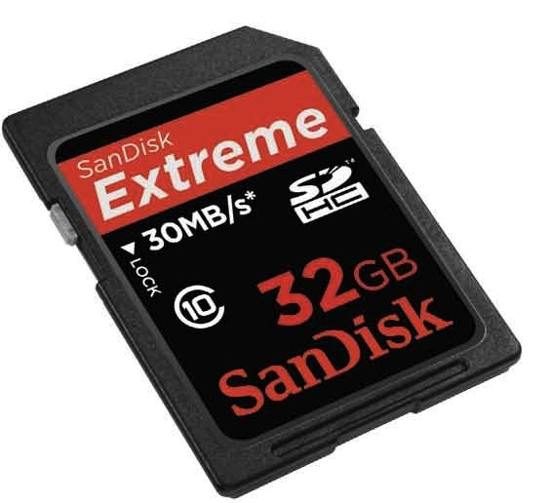
Flash Memory Storage Devices
Flash memory: Type of erasable memory
Flash memory cards: Used to store images in digital cameras
USB flash drives: Store and transport data
Still more expensive than spinning drives
Notes:
Flash memory is too expensive to replace disk drives now, but price is dropping
Used now to store digital images (camera), sound (digital recorders), and computer data files
Almost certain to become the new standard for storage.

Slide 30
Ergonomics and Health
Choose equipment that’s ergonomically designed.
Create a healthful workspace.
Build flexibility into work environment.
Protect your ears.
Rest your eyes.
Let technology work for you.
Stretch.
Listen to your body.
Don’t leave healthy habits at home.
Seek help when you need it.
Notes:
Heavy computer users – repetitive-stress injuries, carpal tunnel syndrom

Slide 31
The Computer System: The Sum of Its Parts
Four basic design classes for personal computers:
Tower systems: Tall narrow boxes that generally have more expansion slots and bays
Flat desktop systems: Designed to sit under the monitor like a platform
All-in-one systems: Combine the monitor and system unit into a single housing
Laptop computers: Include all essential components in one compact box

Slide 32
Ports and Slots Revisited
Legacy ports are too slow for today’s needs:
Serial ports send and receive data one bit at a time
Parallel ports send and receive bits in groups
USB (universal serial bus) transmits data faster:
USB 1.0 data transmitted at approximately 11 Mbps
USB 2.0 has transfer rates of up to 480 Mbps
USB 3.0 has data transfer rate of more than 3 Gbps

Slide 33
Ports and Slots Revisited (cont.)
FireWire: A high-speed connection standard developed by Apple
Can move data between devices at:
400 Mbps (original version)
800 Mbps (newer FireWire 800)
FireWire allows multiple devices to be connected to the same port.
Also can supply power to peripherals so they don’t need an external power supply

Slide 34
Wireless Peripherals, Network Peripherals, and the Cloud
Wireless technology
Wireless keyboards, mice, cameras, printers
Computer networks
Peripherals communicate with multiple PCs
Internet “cloud”
Common for computers to use peripherals—especially storage devices—located somewhere in the cloud

Slide 35
Chapter 3 Summary
Peripherals allow computer to communicate with outside world and store information for later use.
Some peripherals are strictly input devices.
Others are output devices
Storage devices can accept and send information.
Keyboard and mouse are most common peripherals.
Growing number of devices can support multi-touch technology.

Slide 36
Summary (cont.)
Bar code readers, optical mark readers, and magnetic ink readers recognize and translate specially printed patterns and characters.
Scanners and digital cameras convert photographs, drawings, and other analog images to digital files.
Sound digitizers convert information from microphone and other external audio devices.
Sensors detect motion, temperature, pressure, and other characteristics.

Slide 37
Summary (cont.)
Output devices accept strings of bits from the computer and transform them into a form useful outside the computer.
Video monitors used to display information
Variety of printers produce paper output.
Sound output is delivered through speakers and headphones.
Output devices allow computers to control other machines.

Slide 38
Summary (cont.)
Storage devices designed to send and receive large quantities of data
Large capacity magnetic disks are most common form of storage because of high-speed random access capability.
Optical discs are most common removable storage media
Solid-state flash memory is replacing disks and tapes for many applications.

Slide 39
All rights reserved. No part of this publication may be reproduced, stored in a retrieval system, or transmitted, in any form or by any means, electronic, mechanical, photocopying, recording, or otherwise, without the prior written permission of the publisher. Printed in the United States of America.
Notes:
39

