Slide 1
Running Hadoop

Slide 2
Hadoop Platforms
Platforms: Unix and on Windows.
Linux: the only supported production platform.
Other variants of Unix, like Mac OS X: run Hadoop for development.
Windows + Cygwin: development platform (openssh)
Java 6
Java 1.6.x (aka 6.0.x aka 6) is recommended for running Hadoop.
http://www.wikihow.com/Install-Oracle-Java-on-Ubuntu-Linux

Slide 3
Hadoop Installation
1. Download a stable version of Hadoop:
http://hadoop.apache.org/core/releases.html
2.Untar the hadoop file:
tar xvfz hadoop-0.20.2.tar.gz
3.JAVA_HOME at hadoop/conf/hadoop-env.sh:
Mac OS: /System/Library/Frameworks/JavaVM.framework/Versions/1.6.0/Home (/Library/Java/Home)
Linux: which java
4.Environment Variables:
export PATH=$PATH:$HADOOP_HOME/bin

Slide 4
Hadoop Platforms
Or you can do
gedit ~/.bashrc
.bashrc is the file that is executed when you open a terminal window
And paste the stuff below
# JAVA HOME directory setup export JAVA_HOME="/usr/local/java/jdk1.7.0_45" PATH="$PATH:$JAVA_HOME/bin" export HADOOP_HOME="/hadoop-1.2.1" PATH=$PATH:$HADOOP_HOME/bin export PATH
Then restart the terminal

Slide 5
Hadoop Modes
Standalone (or local) mode
There are no daemons running and everything runs in a single JVM. Standalone mode is suitable for running MapReduce programs during development, since it is easy to test and debug them.
Pseudo-distributed mode
The Hadoop daemons run on the local machine, thus simulating a cluster on a small scale.
Fully distributed mode
The Hadoop daemons run on a cluster of machines.

Slide 6
Pseudo Distributed Mode
http://hadoop.apache.org/docs/r0.23.10/hadoop-project-
dist/hadoop-common/SingleNodeSetup.html
Create an RSA key to be used by hadoop when ssh’ing to Localhost:
ssh-keygen -t rsa -P ""
cat ~/.ssh/id_rsa.pub >> ~/.ssh/authorized_keys
ssh localhost
Configuration Files
Core-site.xml
Mapredu-site.xml
Hdfs-site.xml
Masters/Slaves: localhost

Slide 7
Configuration Files
conf/hdfs-site.xml:
<configuration>
<property>
<name>dfs.replication</name>
<value>1</value>
</property>
</configuration>
conf/mapred-site.xml:
<configuration>
<property>
<name>mapred.job.tracker</name>
<value>localhost:9001</value>
</property>
</configuration>
conf/core-site.xml:
<configuration>
<property>
<name>fs.defaultFS</name> <value>hdfs://localhost:9000</value> </property>
</configuration>

Slide 8
Start Hadoop
Hadoop namenode –format
bin/star-all.sh (start-dfs.sh/start-mapred.sh)
bin/stop-all.sh
Web-based UI
http://localhost:50070 (Namenode report)
http://localhost:50030 (Jobtracker)

Slide 9
Basic File Command in HDFS
hadoop fs –cmd <args>
hadoop dfs
URI: //authority/path
authority: hdfs://localhost:9000
Adding files
hadoop fs –mkdir
hadoop fs -put
Retrieving files
hadoop fs -get
Deleting files
hadoop fs –rm
hadoop fs –help ls

Slide 10
Run WordCount
Create an input directory in HDFS
Run wordcount example
hadoop jar hadoop-examples-0.20.203.0.jar wordcount /user/jin/input /user/jin/ouput
Check output directory
hadoop fs lsr /user/jin/ouput
http://localhost:50070

Slide 11
Setup Eclipse Plugin
1.You can download the Hadoop plugin for Eclipse from http://www.cs.kent.edu/~xchang/files/hadoop-eclipse-plugin-0.20.203.0.jar
2.And then drag and drop it into plugins folder of your eclipse
3. Then Start your eclipse you should be able to see the elephant icon on the right upper corner which is Map/Reduce Perspective, activate it.

Slide 12
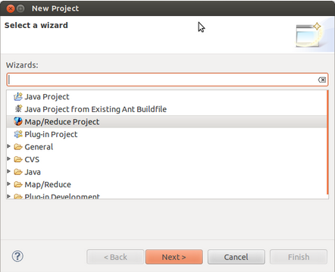
Setup Eclipse Plugin
Now you should be able to create a Map/Reduce Project

Slide 13
Setup Eclipse Plugin
And configure your DFS in the tab lies in lower section
Click the New Hadoop Location button on the right

Slide 14
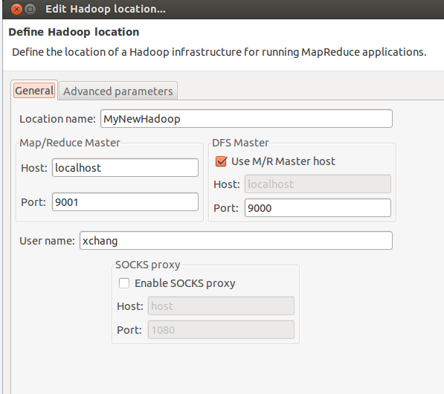
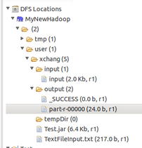
Setup Eclipse Plugin
Name your location and fill out the rest of text boxes like below in the case of local single node
After successes connection you should be able to see the figure on the right

Slide 15
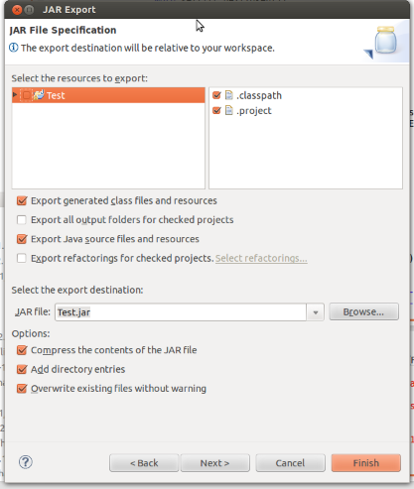
Export Your Own Jar
After you have done project
Right Click -> Export -> Jar
And then configure the JAR Export panel like below

Slide 16
Or You Can Test On Eclipse
But the path format will be different from the parameter you use on command line.
So you need put the URL like this
Path input=new Path("hdfs://localhost:9000/user/xchang/input");
Path output=new Path("hdfs://localhost:9000/user/xchang/output");
But a WRONG FS error will happen when you try to operate on the DFS in this way.
FileSystem fs = FileSystem.get(conf);
fs.delete(new Path("hdfs://localhost:9000/user/xchang/output"), true);

Slide 17
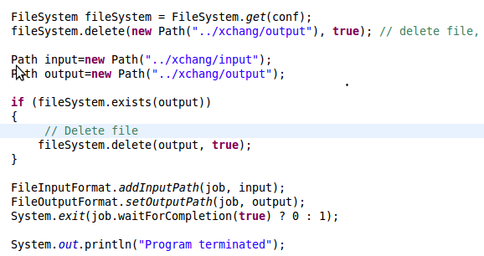
Or You Can Test On Eclipse
To set the path on DFS
1.Load your configure files to Configuration instance
2. Then you can specify the relative path on the DFS

Slide 18
References
http://hadoop.apache.org/common/docs/r0.20.2/quickstart.html
http://oreilly.com/other-programming/excerpts/hadoop-tdg/installing-apache-hadoop.html
http://www.michael-noll.com/tutorials/running-hadoop-on-ubuntu-linux-single-node-cluster/
http://snap.stanford.edu/class/cs246-2011/hw_files/hadoop_install.pdf

Slide 19
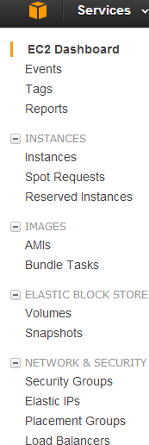
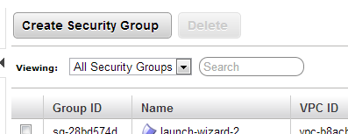
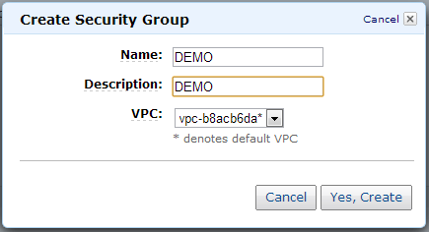
Run on EC2
Security Group Port number

Slide 20
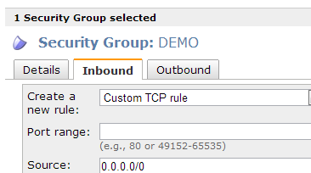
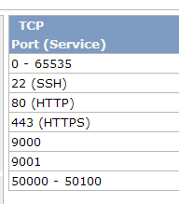
Run on EC2
Security Group Port number

Slide 21
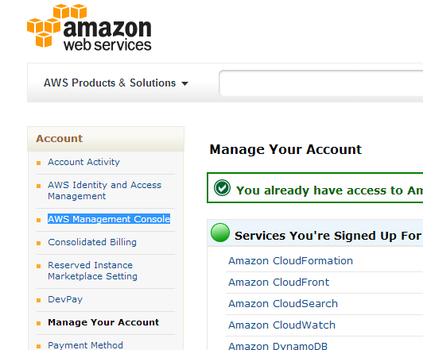
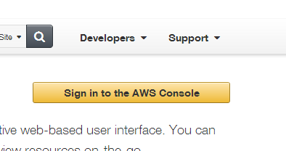
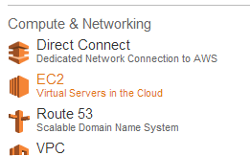
Run on EC2
Find EC2

Slide 22
Run on EC2
Choose AMI

Slide 23
Run on EC2
Create instance

Slide 24
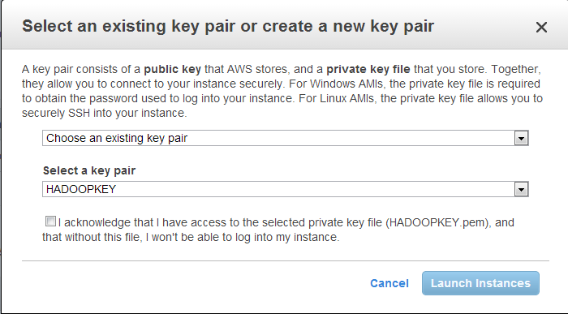
Run on EC2

Slide 25
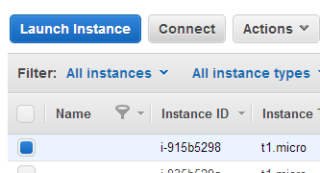
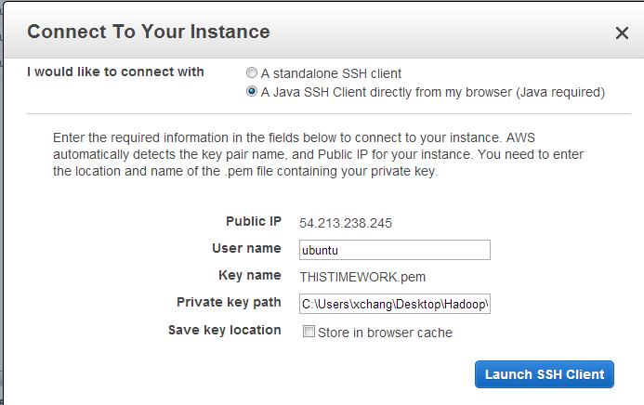
Run on EC2
Upload the private key

Slide 26
Setup Master and Slave
sudo wget www.cs.kent.edu/~xchang/.bashrc
sudo mv .bashrc.1 .bashrc
exit
sudo wget http://mirrors.sonic.net/apache/hadoop/common/hadoop-1.2.1/hadoop-1.2.1-bin.tar.gz
tar xzf hadoop-1.2.1-bin.tar.gz hadoop-1.2.1
cd /
sudo mkdir -p /usr/local/java
cd /usr/local/java
sudo wget www.cs.kent.edu/~xchang/jdk-7u45-linux-x64.gz
sudo tar xvzf jdk-7u45-linux-x64.gz
cd $HADOOP_HOME/conf
Change conf/masters and conf/slaves on both
cd $HADOOP_HOME/conf
nano masters
nano slaves

Slide 27
Run on EC2
/home/ubuntu/hadoop-1.0.3/conf/core-site.xml
<configuration>
<property>
<name>fs.default.name</name>
<value>hdfs://ec2-107-20-118-109.compute-1.amazonaws.com:9000</value>
</property>
</configuration>
/home/ubuntu/hadoop-1.0.3/conf/hdfs-site.xml
<configuration>
<property>
<name>dfs.replication</name>
<value>1</value>
</property>
</configuration>
/home/ubuntu/hadoop-1.0.3/conf/mapred-site.xml
<configuration>
<property>
<name>mapred.job.tracker</name>
<value>ec2-107-22-78-136.compute-1.amazonaws.com:54311</value>
</property>
</configuration>

Slide 28
Run on EC2
Spread the configuration
cd /home/ubuntu/.ssh
chmod 400 id_rsa
cd $HADOOP_HOME/conf
scp * ubuntu@ec2-54-213-238-245.us-west-2.compute.amazonaws.com:/home/ubuntu/hadoop-1.2.1/conf
hadoop namenode -format
start-dfs.sh

Slide 29
Run on EC2
Check status
Jps on Masters and slave
http://54.213.238.245:50070/dfshealth.jsp
When things are correct you can see
If not go and check logs under hadoop folder
If no logs at all check Master and Slave connections

Slide 30
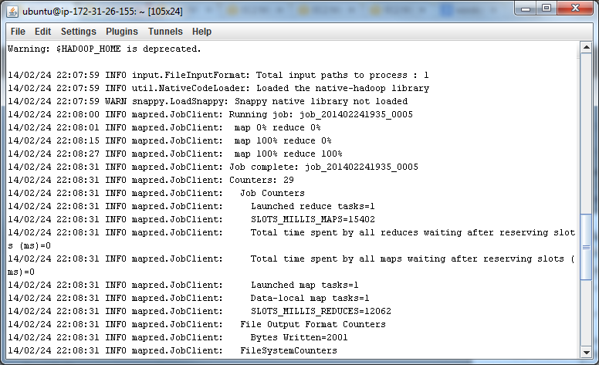
Run on EC2
Run The Jar
hadoop fs –mkdir input
hadoop fs –mkdir output
hadoop fs –put /folderOnServer/yourfileName /input/inputFileName
hadoop jar wordcount.jar WordCount /input/output

