Slide 1
Running Hadoop

Slide 2
Hadoop Platforms
Platforms: Unix and on Windows.
  Linux: the only supported production platform.
  Other variants of Unix, like Mac OS X: run Hadoop for development.
  Windows + Cygwin: development platform (openssh)
Java 6
  Java 1.6.x (aka 6.0.x aka 6) is recommended for running Hadoop.

Slide 3
Hadoop Installation
Download a stable version of Hadoop:
  http://hadoop.apache.org/core/releases.html
Untar the hadoop file:
  tar xvfz hadoop-0.20.2.tar.gz
JAVA_HOME at hadoop/conf/hadoop-env.sh:
  Mac OS: /System/Library/Frameworks/JavaVM.framework/Versions/1.6.0/Home (/Library/Java/Home)
  Linux: which java
Environment Variables:
  export PATH=$PATH:$HADOOP_HOME/bin

Slide 4
Hadoop Modes
Standalone (or local) mode
  There are no daemons running and everything runs in a single JVM. Standalone mode is suitable for running MapReduce programs during development, since it is easy to test and debug them.
Pseudo-distributed mode
  The Hadoop daemons run on the local machine, thus simulating a cluster on a small scale.
Fully distributed mode
  The Hadoop daemons run on a cluster of machines.

Slide 5
Pseudo Distributed Mode
Create an RSA key to be used by hadoop when ssh’ing to Localhost:
  ssh-keygen -t rsa -P ""
  cat ~/.ssh/id_rsa.pub >> ~/.ssh/authorized_keys
  ssh localhost
Configuration Files
  Core-site.xml
  Mapredu-site.xml
  Hdfs-site.xml
  Masters/Slaves: localhost

Slide 6
<?xml version="1.0"?>
<!-- core-site.xml -->
<configuration>
<property>
<name>fs.default.name</name>
<value>hdfs://localhost/</value>
</property>
</configuration>
<?xml version="1.0"?>
<!-- hdfs-site.xml -->
<configuration>
<property>
<name>dfs.replication</name>
<value>1</value>
</property>
</configuration>
<?xml version="1.0"?>
<!-- mapred-site.xml -->
<configuration>
<property>
<name>mapred.job.tracker</name>
<value>localhost:8021</value>
</property>
</configuration>

Slide 7
Start Hadoop
hadoop namenode –format
bin/star-all.sh (start-dfs.sh/start-mapred.sh)
jps
bin/stop-all.sh
Web-based UI
  http://localhost:50070 (Namenode report)
  http://localhost:50030 (Jobtracker)

Slide 8
Basic File Command in HDFS
hadoop fs –cmd <args>
  hadoop dfs
URI: //authority/path
  authority: hdfs://localhost:9000
Adding files
  hadoop fs –mkdir
  hadoop fs -put
Retrieving files
  hadoop fs -get
Deleting files
  hadoop fs –rm
hadoop fs –help ls

Slide 9
Run WordCount
Create an input directory in HDFS
Run wordcount example
  hadoop jar hadoop-examples-0.20.203.0.jar wordcount /user/jin/input /user/jin/ouput
Check output directory
  hadoop fs lsr /user/jin/ouput
  http://localhost:50070

Slide 10
References
http://hadoop.apache.org/common/docs/r0.20.2/quickstart.html
http://oreilly.com/other-programming/excerpts/hadoop-tdg/installing-apache-hadoop.html
http://www.michael-noll.com/tutorials/running-hadoop-on-ubuntu-linux-single-node-cluster/
http://snap.stanford.edu/class/cs246-2011/hw_files/hadoop_install.pdf

Slide 11
Hadoop and HFDS
Programming

Slide 12
import java.io.IOException;
import org.apache.hadoop.conf.Configuration;
import org.apache.hadoop.fs.FSDataInputStream;
import org.apache.hadoop.fs.FSDataOutputStream;
import org.apache.hadoop.fs.FileStatus;
import org.apache.hadoop.fs.FileSystem;
import org.apache.hadoop.fs.Path;
public class PutMerge {
public static void main(String[] args) throws IOException {
if(args.length != 2) {
System.out.println("Usage PutMerge <dir> <outfile>");
System.exit(1);
}
Configuration conf = new Configuration();
FileSystem hdfs = FileSystem.get(conf);
FileSystem local = FileSystem.getLocal(conf);
int filesProcessed = 0;
Path inputDir = new Path(args[0]);
Path hdfsFile = new Path(args[1]);
try {
FileStatus[] inputFiles = local.listStatus(inputDir);
FSDataOutputStream out = hdfs.create(hdfsFile);
for(int i = 0; i < inputFiles.length; i++) {
if(!inputFiles[i].isDir()) {
System.out.println("\tnow processing <" + inputFiles[i].getPath().getName() + ">");
FSDataInputStream in = local.open(inputFiles[i].getPath());
byte buffer[] = new byte[256];
int bytesRead = 0;
while ((bytesRead = in.read(buffer)) > 0) {
out.write(buffer, 0, bytesRead);
}
filesProcessed++;
in.close();
}
}
out.close();
System.out.println("\nSuccessfully merged " + filesProcessed + " local files and written to <" + hdfsFile.getName() + "> in HDFS.");
} catch (IOException ioe) {
ioe.printStackTrace();
}
}
}

Slide 13
import java.io.IOException;
import org.apache.hadoop.fs.Path;
import org.apache.hadoop.io.IntWritable;
import org.apache.hadoop.io.Text;
import org.apache.hadoop.mapred.FileInputFormat;
import org.apache.hadoop.mapred.FileOutputFormat;
import org.apache.hadoop.mapred.JobClient;
import org.apache.hadoop.mapred.JobConf;
public class MaxTemperature {
public static void main(String[] args) throws IOException {
if (args.length != 2) {
System.err.println("Usage: MaxTemperature <input path> <output path>"); System.exit(-1); }
JobConf conf = new JobConf(MaxTemperature.class);
conf.setJobName("Max temperature");
FileInputFormat.addInputPath(conf, new Path(args[0])); FileOutputFormat.setOutputPath(conf, new Path(args[1]));
conf.setMapperClass(MaxTemperatureMapper.class);
conf.setReducerClass(MaxTemperatureReducer.class);
conf.setOutputKeyClass(Text.class);
conf.setOutputValueClass(IntWritable.class);
JobClient.runJob(conf);
}
}

Slide 14
JobClient.runJob(conf)
The client, which submits the MapReduce job.
The jobtracker, which coordinates the job run. The jobtracker is a Java application whose main class is JobTracker.
The tasktrackers, which run the tasks that the job has been split into. Tasktrackers are Java applications whose main class is TaskTracker.
The distributed filesystem, which is used for sharing job files between the other entities.

Slide 15
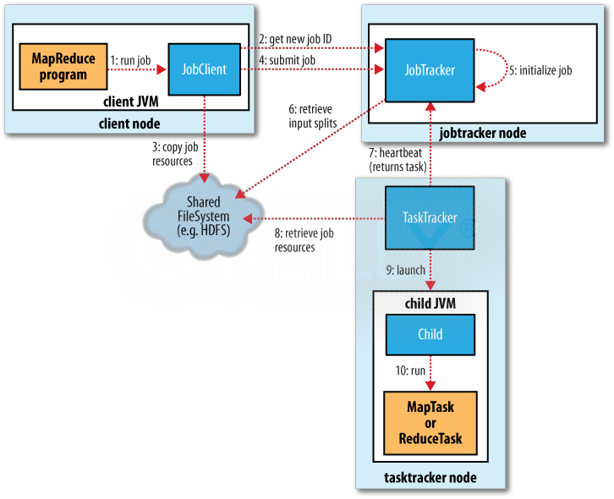

Slide 16
Job Launch: Client
Client program creates a JobConf
  Identify classes implementing Mapper and Reducer interfaces
    setMapperClass(), setReducerClass()
  Specify inputs, outputs
    setInputPath(), setOutputPath()
  Optionally, other options too:
    setNumReduceTasks(), setOutputFormat()…

Slide 17
Job Launch: JobClient
Pass JobConf to
  JobClient.runJob() // blocks
  JobClient.submitJob() // does not block
JobClient:
  Determines proper division of input into InputSplits
  Sends job data to master JobTracker server

Slide 18
Job Launch: JobTracker
JobTracker:
  Inserts jar and JobConf (serialized to XML) in shared location
  Posts a JobInProgress to its run queue

Slide 19
Job Launch: TaskTracker
TaskTrackers running on slave nodes periodically query JobTracker for work
Retrieve job-specific jar and config
Launch task in separate instance of Java
  main() is provided by Hadoop

Slide 20
Job Launch: Task
TaskTracker.Child.main():
  Sets up the child TaskInProgress attempt
  Reads XML configuration
  Connects back to necessary MapReduce components via RPC
  Uses TaskRunner to launch user process

Slide 21
Job Launch: TaskRunner
TaskRunner, MapTaskRunner, MapRunner work in a daisy-chain to launch Mapper
  Task knows ahead of time which InputSplits it should be mapping
  Calls Mapper once for each record retrieved from the InputSplit
Running the Reducer is much the same

Slide 22
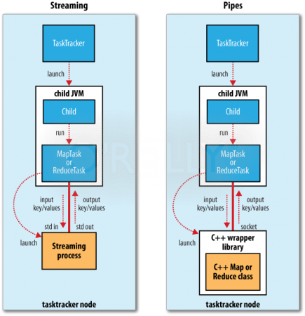

Slide 23
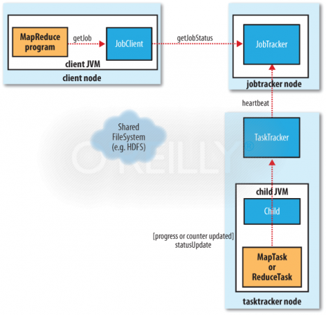

Slide 24
public class MaxTemperature {
public static void main(String[] args) throws IOException {
if (args.length != 2) {
System.err.println("Usage: MaxTemperature <input path> <output path>"); System.exit(-1); }
JobConf conf = new JobConf(MaxTemperature.class);
conf.setJobName("Max temperature");
FileInputFormat.addInputPath(conf, new Path(args[0])); FileOutputFormat.setOutputPath(conf, new Path(args[1]));
conf.setMapperClass(MaxTemperatureMapper.class);
conf.setReducerClass(MaxTemperatureReducer.class);
conf.setOutputKeyClass(Text.class);
conf.setOutputValueClass(IntWritable.class);
JobClient.runJob(conf);
} }

Slide 25
public static void main(String[] args) throws Exception {
Configuration conf = new Configuration();
String[] otherArgs = new GenericOptionsParser(conf, args).getRemainingArgs();
if (otherArgs.length != 2) {
System.err.println("Usage: wordcount <in> <out>");
System.exit(2);
}
Job job = new Job(conf, "word count");
job.setJarByClass(WordCount.class);
job.setMapperClass(TokenizerMapper.class);
job.setCombinerClass(IntSumReducer.class);
job.setReducerClass(IntSumReducer.class);
job.setOutputKeyClass(Text.class);
job.setOutputValueClass(IntWritable.class);
FileInputFormat.addInputPath(job, new Path(otherArgs[0]));
FileOutputFormat.setOutputPath(job, new Path(otherArgs[1]));
System.exit(job.waitForCompletion(true) ? 0 : 1);
}

Slide 26
Creating the Mapper
Your instance of Mapper should extend MapReduceBase
One instance of your Mapper is initialized by the MapTaskRunner for a TaskInProgress
  Exists in separate process from all other instances of Mapper – no data sharing!

Slide 27
Mapper
void map (
WritableComparable key,
Writable value,
OutputCollector output,
Reporter reporter
)
void map (
WritableComparable key,
Writable value,
Context context,
)

Slide 28
public static class TokenizerMapper
extends Mapper<Object, Text, Text, IntWritable>{
private final static IntWritable one = new IntWritable(1);
private Text word = new Text();
public void map(Object key, Text value, Context context
) throws IOException, InterruptedException {
StringTokenizer itr = new StringTokenizer(value.toString());
while (itr.hasMoreTokens()) {
word.set(itr.nextToken());
context.write(word, one);
}
}
}

Slide 29
What is Writable?
Hadoop defines its own “box” classes for strings (Text), integers (IntWritable), etc.
All values are instances of Writable
All keys are instances of WritableComparable

Slide 30
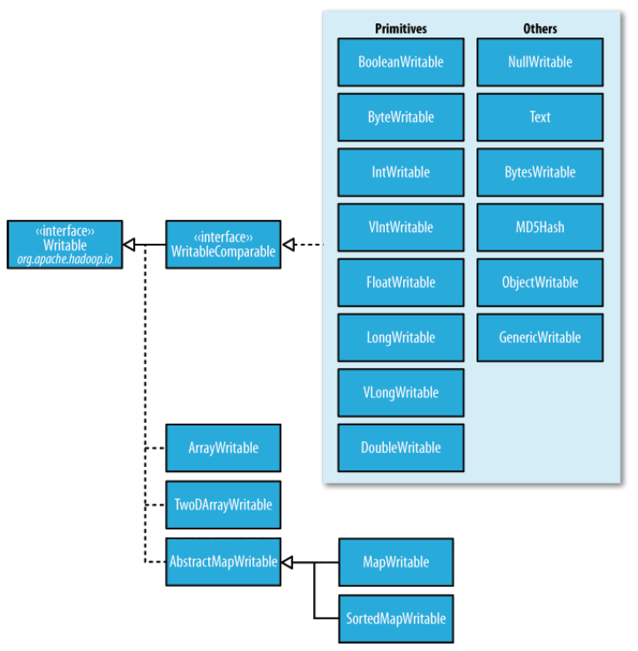

Slide 31
public class MyWritableComparable implements WritableComparable {
// Some data
private int counter;
private long timestamp;
public void write(DataOutput out) throws IOException {
out.writeInt(counter);
out.writeLong(timestamp);
}
public void readFields(DataInput in) throws IOException {
counter = in.readInt();
timestamp = in.readLong();
}
public int compareTo(MyWritableComparable w) {
int thisValue = this.value;
int thatValue = ((IntWritable)o).value;
return (thisValue < thatValue ? -1 : (thisValue==thatValue ? 0 : 1));
}
}
Notes:
http://hadoop.apache.org/common/docs/current/api/org/apache/hadoop/io/WritableComparable.html

Slide 32
Getting Data To The Mapper

Slide 33
public static void main(String[] args) throws Exception {
Configuration conf = new Configuration();
String[] otherArgs = new GenericOptionsParser(conf, args).getRemainingArgs();
if (otherArgs.length != 2) {
System.err.println("Usage: wordcount <in> <out>");
System.exit(2);
}
Job job = new Job(conf, "word count");
job.setJarByClass(WordCount.class);
job.setMapperClass(TokenizerMapper.class);
job.setCombinerClass(IntSumReducer.class);
job.setReducerClass(IntSumReducer.class);
job.setOutputKeyClass(Text.class);
job.setOutputValueClass(IntWritable.class);
FileInputFormat.addInputPath(job, new Path(otherArgs[0]));
FileOutputFormat.setOutputPath(job, new Path(otherArgs[1]));
System.exit(job.waitForCompletion(true) ? 0 : 1);
}

Slide 34
Reading Data
Data sets are specified by InputFormats
  Defines input data (e.g., a directory)
  Identifies partitions of the data that form an InputSplit
  Factory for RecordReader objects to extract (k, v) records from the input source

Slide 35
FileInputFormat and Friends
TextInputFormat
  Treats each ‘\n’-terminated line of a file as a value
KeyValueTextInputFormat
  Maps ‘\n’- terminated text lines of “k SEP v”
SequenceFileInputFormat
  Binary file of (k, v) pairs (passing data between the output of one MapReduce job to the input of some other MapReduce job)
SequenceFileAsTextInputFormat
  Same, but maps (k.toString(), v.toString())

Slide 36
Filtering File Inputs
FileInputFormat will read all files out of a specified directory and send them to the mapper
Delegates filtering this file list to a method subclasses may override
  e.g., Create your own “xyzFileInputFormat” to read *.xyz from directory list

Slide 37
Record Readers
Each InputFormat provides its own RecordReader implementation
  Provides (unused?) capability multiplexing
LineRecordReader
  Reads a line from a text file
KeyValueRecordReader
  Used by KeyValueTextInputFormat

Slide 38
Input Split Size
FileInputFormat will divide large files into chunks
  Exact size controlled by mapred.min.split.size
RecordReaders receive file, offset, and length of chunk
Custom InputFormat implementations may override split size
  e.g., “NeverChunkFile”

Slide 39
public class ObjectPositionInputFormat extends
FileInputFormat<Text, Point3D> {
public RecordReader<Text, Point3D> getRecordReader(
InputSplit input, JobConf job, Reporter reporter)
throws IOException {
reporter.setStatus(input.toString());
return new ObjPosRecordReader(job, (FileSplit)input);
}
InputSplit[] getSplits(JobConf job, int numSplits) throuw IOException;
}

Slide 40
class ObjPosRecordReader implements RecordReader<Text, Point3D> {
public ObjPosRecordReader(JobConf job, FileSplit split) throws IOException {}
public boolean next(Text key, Point3D value) throws IOException {
// get the next line}
public Text createKey() {
}
public Point3D createValue() {
}
public long getPos() throws IOException {
}
public void close() throws IOException {
}
public float getProgress() throws IOException {}
}

Slide 41
Sending Data To Reducers
Map function receives OutputCollector object
  OutputCollector.collect() takes (k, v) elements
Any (WritableComparable, Writable) can be used

Slide 42
WritableComparator
Compares WritableComparable data
  Will call WritableComparable.compare()
  Can provide fast path for serialized data
JobConf.setOutputValueGroupingComparator()

Slide 43
Sending Data To The Client
Reporter object sent to Mapper allows simple asynchronous feedback
  incrCounter(Enum key, long amount)
  setStatus(String msg)
Allows self-identification of input
  InputSplit getInputSplit()

Slide 44
Partition And Shuffle

Slide 45
Partitioner
int getPartition(key, val, numPartitions)
  Outputs the partition number for a given key
  One partition == values sent to one Reduce task
HashPartitioner used by default
  Uses key.hashCode() to return partition num
JobConf sets Partitioner implementation

Slide 46
public class MyPartitioner implements Partitioner<IntWritable,Text> {
@Override
public int getPartition(IntWritable key, Text value, int numPartitions) {
/* Pretty ugly hard coded partitioning function. Don't do that in practice, it is just for the sake of understanding. */
int nbOccurences = key.get();
if( nbOccurences < 3 )
return 0;
else
return 1;
}
@Override
public void configure(JobConf arg0) {
}
}
conf.setPartitionerClass(MyPartitioner.class);

Slide 47
Reduction
reduce( WritableComparable key,
  Iterator values,
  OutputCollector output,
  Reporter reporter)
Keys & values sent to one partition all go to the same reduce task
Calls are sorted by key – “earlier” keys are reduced and output before “later” keys

Slide 48
public static class IntSumReducer
extends Reducer<Text,IntWritable,Text,IntWritable> {
private IntWritable result = new IntWritable();
public void reduce(Text key, Iterable<IntWritable> values,
Context context
) throws IOException, InterruptedException {
int sum = 0;
for (IntWritable val : values) {
sum += val.get();
}
result.set(sum);
context.write(key, result);
}
}

Slide 49
Finally: Writing The Output

Slide 50
OutputFormat
Analogous to InputFormat
TextOutputFormat
  Writes “key val\n” strings to output file
SequenceFileOutputFormat
  Uses a binary format to pack (k, v) pairs
NullOutputFormat
  Discards output

Slide 51
public static void main(String[] args) throws Exception {
Configuration conf = new Configuration();
String[] otherArgs = new GenericOptionsParser(conf, args).getRemainingArgs();
if (otherArgs.length != 2) {
System.err.println("Usage: wordcount <in> <out>");
System.exit(2);
}
Job job = new Job(conf, "word count");
job.setJarByClass(WordCount.class);
job.setMapperClass(TokenizerMapper.class);
job.setCombinerClass(IntSumReducer.class);
job.setReducerClass(IntSumReducer.class);
job.setOutputKeyClass(Text.class);
job.setOutputValueClass(IntWritable.class);
FileInputFormat.addInputPath(job, new Path(otherArgs[0]));
FileOutputFormat.setOutputPath(job, new Path(otherArgs[1]));
System.exit(job.waitForCompletion(true) ? 0 : 1);
}

