Slide 1
Introduction to Advanced Computing Platforms for Data Analysis
Ruoming Jin

Slide 2
Welcome!
Instructor: Ruoming Jin
Office: 264 MCS Building
Email: jin AT cs.kent.edu
Office hour: Tuesdays and Thursdays (4:30PM to 5:30PM) or by appointment
TA: Lin Liu
Email: lliu AT cs.kent.edu
Homepage: http://www.cs.kent.edu/~jin/Cloud12Spring/Cloud.html

Slide 3
Topics
Scope: Big Data + Cloud Computing
Topics:
Basic Hadoop/Map-Reduce Programming (3 weeks)
Advanced Data Processing on Hadoop (5 weeks)
NoSQL (2 weeks)
Cloud Computing Research (Student Presentation, 4 weeks)

Slide 4
Topic 1: Basic Hadoop Programming
Basic Usage of Hadoop+HDFS
Install Hadoop+HDFS on your local computers
Components of Hadoop and HDFS
Programming on Hadoop
Running Hadoop on Amazon EC2
Hadoop Programming Platform (Eclipse or Netbean) and Pipes (C++) + Streamming (Python) [Tutorial]

Slide 5
Topic 2: Data Processing on Hadoop
Basic Data Processing: Sort and Join
Information Retrieval using Hadoop
Data Mining using Hadoop (Kmeans+Histograms)
Graph Processing on Hadoop
Machine Learning on Hadoop (EM)
Hive and Pig will also be covered

Slide 6
Topic 3: No SQL
HBase/BigTable
Amazon S3/SimpleDB
Graph Database (http://en.wikipedia.org/wiki/Graph_database)
Native Graph Database (Neo4j)
Pregel/Giraph (Distributed Graph Processing Engine)

Slide 7
Topic 4: Cloud Computing Research
Database on Cloud
Data Processing on Cloud
Cloud Storage
Service-Oriented Architecture in Cloud Computing
Maintenance and Management of Cloud
Computing Cloud Computing Architecture

Slide 8
Textbooks
No Official Textbooks
References:
Hadoop: The Definitive Guide, Tom White, O’Reilly
Hadoop In Action, Chuck Lam, Manning
Data-Intensive Text Processing with MapReduce, Jimmy Lin and Chris Dyer (www.umiacs.umd.edu/~jimmylin/MapReduce-book-final.pdf)
Many Online Tutorials and Papers

Slide 9
Cloud Resources
Hadoop on your local machine
Hadoop in a virtual machine on your local machine (Pseudo-Distributed on Ubuntu)
Hadoop in MacLab (364?)
Hadoop in the clouds with Amazon EC2

Slide 10
Course Prerequisite
Prerequisite:
Java Programming / C++
Data Structures and Algorithm
Computer Architecture
Database and Data Mining (preferred)

Slide 11
This course is not for you…
If you do not have a strong Java programming background
This course is not about only programming (on Hadoop).
Focus on “thinking at scale” and algorithm design
Focus on how to manage and process Big Data!
No previous experience necessary in
MapReduce
Parallel and distributed programming

Slide 12
Grade Scheme
M.S. and Undergraduates
Ph.D. Students
Homework | 55%
Project Class Participation | 35% 10%
Homework | 50%
Project Paper Presentation | 35% 15%

Slide 13
Presentation
Paper presentation
One per Ph.D. student
Research paper(s)
List of recommendations (will be available by the end of February)
Three parts (<=30 minutes)
Review of research ideas in the paper
Debate (Pros/Cons)
Questions and comments from audience
For M.S. and Undergraduate students who would like to present
Additional 5 bonus points maximally
If we many multiple volunteers, the criterion will be based on the homework grades and class participation
Each presentation will be graded by other students

Slide 14
Project
Project (due April 24th)
One project: Group size <= 4 students
Checkpoints
Proposal: title and goal (due March 1st)
Outline of approach (due March 15th)
Implementation and Demo (April 24th and 26th)
Final Project Report (due April 29th)
Each group will have a short presentation and demo (15-20 minutes)
Each group will provide a five-page document on the project; the responsibility and work of each student shall be described precisely

Slide 15
What is Cloud Computing?

Slide 16
And Where it all starts?
MapReduce/GFS/BigTable 2004-2005
AWS 2006
Notes:
Amazon 2006?

Slide 17
Cloud Computing
IT resources provided as a service
Compute, storage, databases, queues
Clouds leverage economies of scale of commodity hardware
Cheap storage, high bandwidth networks & multicore processors
Geographically distributed data centers
Offerings from Microsoft, Amazon, Google, …

Slide 18
wikipedia:Cloud Computing

Slide 19
Benefits
Cost & management
Economies of scale, “out-sourced” resource management
Reduced Time to deployment
Ease of assembly, works “out of the box”
Scaling
On demand provisioning, co-locate data and compute
Reliability
Massive, redundant, shared resources
Sustainability
Hardware not owned

Slide 20
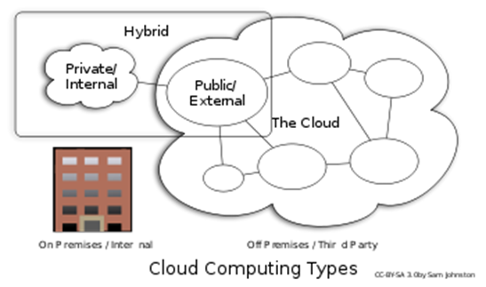
Types of Cloud Computing
Public Cloud: Computing infrastructure is hosted at the vendor’s premises.
Private Cloud: Computing architecture is dedicated to the customer and is not shared with other organisations.
Hybrid Cloud: Organisations host some critical, secure applications in private clouds. The not so critical applications are hosted in the public cloud
Cloud bursting: the organisation uses its own infrastructure for normal usage, but cloud is used for peak loads.
Community Cloud

Slide 21
Classification of Cloud Computing based on Service Provided
Infrastructure as a service (IaaS)
Offering hardware related services using the principles of cloud computing. These could include storage services (database or disk storage) or virtual servers.
Amazon EC2, Amazon S3, Rackspace Cloud Servers and Flexiscale.
Platform as a Service (PaaS)
Offering a development platform on the cloud.
Google’s Application Engine, Microsofts Azure, Salesforce.com’s force.com .
Software as a service (SaaS)
Including a complete software offering on the cloud. Users can access a software application hosted by the cloud vendor on pay-per-use basis. This is a well-established sector.
Salesforce.coms’ offering in the online Customer Relationship Management (CRM) space, Googles gmail and Microsofts hotmail, Google docs.

Slide 22
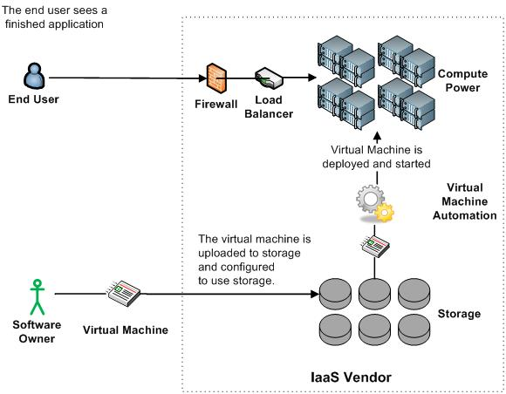
Infrastructure as a Service (IaaS)

Slide 23
More Refined Categorization
Storage-as-a-service
Database-as-a-service
Information-as-a-service
Process-as-a-service
Application-as-a-service
Platform-as-a-service
Integration-as-a-service
Security-as-a-service
Management/
Governance-as-a-service
Testing-as-a-service
Infrastructure-as-a-service
InfoWorld Cloud Computing Deep Dive

Slide 24
Key Ingredients in Cloud Computing
Service-Oriented Architecture (SOA)
Utility Computing (on demand)
Virtualization (P2P Network)
SAAS (Software As A Service)
PAAS (Platform AS A Service)
IAAS (Infrastructure AS A Servie)
Web Services in Cloud

Slide 25
Utility Computing
What?
Computing resources as a metered service (“pay as you go”)
Ability to dynamically provision virtual machines
Why?
Cost: capital vs. operating expenses
Scalability: “infinite” capacity
Elasticity: scale up or down on demand
Does it make sense?
Benefits to cloud users
Business case for cloud providers

Slide 26
Enabling Technology: Virtualization
App
App
App
App
App
App
OS
OS
OS
Operating System
Hypervisor
Hardware
Hardware
Traditional Stack
Virtualized Stack

Slide 27
Everything as a Service
Utility computing = Infrastructure as a Service (IaaS)
Why buy machines when you can rent cycles?
Examples: Amazon’s EC2, Rackspace
Platform as a Service (PaaS)
Give me nice API and take care of the maintenance, upgrades, …
Example: Google App Engine
Software as a Service (SaaS)
Just run it for me!
Example: Gmail, Salesforce

Slide 28
Cloud versus cloud
Amazon Elastic Compute Cloud
Google App Engine
Microsoft Azure
GoGrid
AppNexus

Slide 29
The Obligatory Timeline Slide (Mike Culver @ AWS)
COBOL, Edsel
Amazon.com
ARPANET
Internet
Darkness
Web Awareness
Web as a Platform
Web Services, Resources Eliminated
1959
1969
1982
1996
1997
2001
2004
2006
Dot-Com Bubble
Web 2.0
Web Scale
Computing

Slide 30
AWS
Elastic Compute Cloud – EC2 (IaaS)
Simple Storage Service – S3 (IaaS)
Elastic Block Storage – EBS (IaaS)
SimpleDB (SDB) (PaaS)
Simple Queue Service – SQS (PaaS)
CloudFront (S3 based Content Delivery Network – PaaS)
Consistent AWS Web Services API

Slide 31
What does Azure platform offer to developers?
Your Applications
…
Service Bus
Workflow
Database
Analytics
Identity
Contacts
Access Control
…
Reporting
…
Devices
…
Compute
Storage
Manage
…

Slide 32
Google’s AppEngine vs Amazon’s EC2
Python BigTable Other API’s
VMs Flat File Storage
AppEngine:
Higher-level functionality (e.g., automatic scaling)
More restrictive (e.g., respond to URL only)
Proprietary lock-in
EC2/S3:
Lower-level functionality
More flexible
Coarser billing model

