Slide 1
Data Mining and Machine Learning with EM

Slide 2
Data Mining and Machine Learning are Ubiquitous!
Netflix
Amazon
Wal-Mart
Algorithmic Trading/High Frequency Trading
Banks (Segmint)
Google/Yahoo/Microsoft/IBM
CRM/Consumer Behavior Profiling
Consumer Review
Mobile Ads
Social Network (Facebook/Twitter/Google+)
Voting Behaviors
…

Slide 3
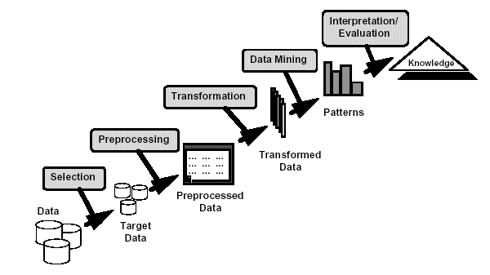
Data Mining
Non-trivial extraction of implicit, previously unknown and potentially useful information from data
Exploration & analysis, by automatic or semi-automatic means, of large quantities of data in order to discover meaningful patterns

Slide 4
Data Mining Tasks
Prediction Methods
Use some variables to predict unknown or future values of other variables.
Description Methods
Find human-interpretable patterns that describe the data.
From [Fayyad, et.al.] Advances in Knowledge Discovery and Data Mining, 1996

Slide 5
Data Mining Tasks...
Classification [Predictive]
Clustering [Descriptive]
Association Rule Discovery [Descriptive]
Sequential Pattern Discovery [Descriptive]
Regression [Predictive]
Deviation Detection [Predictive]

Slide 6
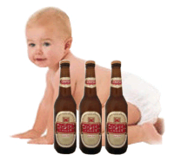

Slide 7
Association Rule Discovery: Definition
Given a set of records each of which contain some number of items from a given collection;
Produce dependency rules which will predict occurrence of an item based on occurrences of other items.
Rules Discovered:
{Milk} --> {Coke}
{Diaper, Milk} --> {Beer}

Slide 8
Association Rule Discovery: Application 1
Marketing and Sales Promotion:
Let the rule discovered be
{Bagels, … } --> {Potato Chips}
Potato Chips as consequent => Can be used to determine what should be done to boost its sales.
Bagels in the antecedent => Can be used to see which products would be affected if the store discontinues selling bagels.
Bagels in antecedent and Potato chips in consequent => Can be used to see what products should be sold with Bagels to promote sale of Potato chips!

Slide 9
Definition: Frequent Itemset
Itemset
A collection of one or more items
Example: {Milk, Bread, Diaper}
k-itemset
An itemset that contains k items
Support count (σ)
Frequency of occurrence of an itemset
E.g. σ({Milk, Bread,Diaper}) = 2
Support
Fraction of transactions that contain an itemset
E.g. s({Milk, Bread, Diaper}) = 2/5
Frequent Itemset
An itemset whose support is greater than or equal to a minsup threshold

Slide 10
Frequent Itemsets Mining
TID | Transactions
100 | { A, B, E }
200 | { B, D }
300 | { A, B, E }
400 | { A, C }
500 | { B, C }
600 | { A, C }
700 | { A, B }
800 | { A, B, C, E }
900 | { A, B, C }
1000 | { A, C, E }
Minimum support level 50%
{A},{B},{C},{A,B}, {A,C}

Slide 11
Frequent Itemset Generation
Given d items, there are 2^{d} possible candidate itemsets

Slide 12
Frequent Itemset Generation
Brute-force approach:
Each itemset in the lattice is a candidate frequent itemset
Count the support of each candidate by scanning the database
Match each transaction against every candidate
Complexity ~ O(NMw) => Expensive since M = 2^{d} !!!

Slide 13
Reducing Number of Candidates
Apriori principle:
If an itemset is frequent, then all of its subsets must also be frequent
Apriori principle holds due to the following property of the support measure:
Support of an itemset never exceeds the support of its subsets
This is known as the anti-monotone property of support

Slide 14
Illustrating Apriori Principle
Found to be Infrequent
Pruned supersets

Slide 15
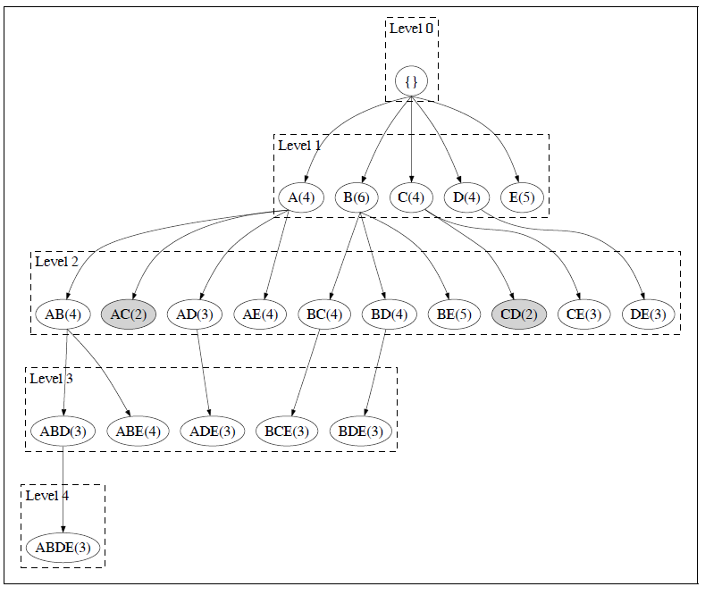

Slide 16
Apriori
R. Agrawal and R. Srikant. Fast algorithms for mining association rules. VLDB, 487-499, 1994

Slide 17
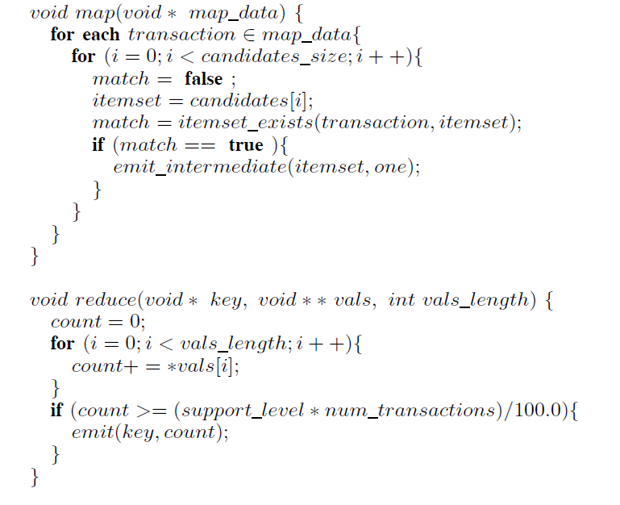

Slide 18
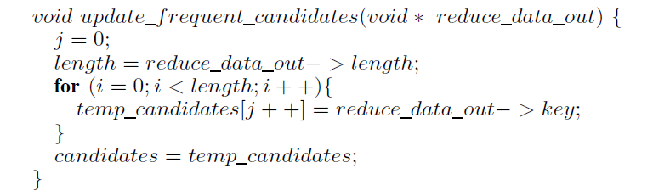

Slide 19
What is Cluster Analysis?
Finding groups of objects such that the objects in a group will be similar (or related) to one another and different from (or unrelated to) the objects in other groups
Inter-cluster distances are maximized
Intra-cluster distances are minimized

Slide 20
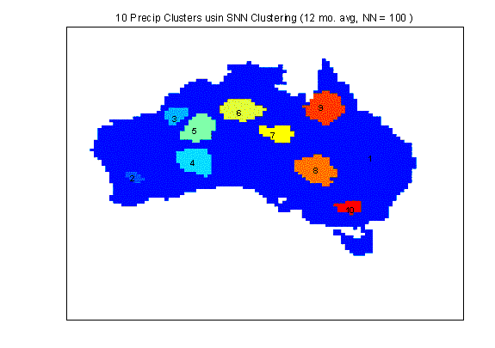
Applications of Cluster Analysis
Understanding
Group related documents for browsing, group genes and proteins that have similar functionality, or group stocks with similar price fluctuations
Summarization
Reduce the size of large data sets
Clustering precipitation in Australia

Slide 21
Notion of a Cluster can be Ambiguous
How many clusters?
Six Clusters
Two Clusters
Four Clusters

Slide 22
Types of Clusterings
A clustering is a set of clusters
Important distinction between hierarchical and partitional sets of clusters
Partitional Clustering
A division data objects into non-overlapping subsets (clusters) such that each data object is in exactly one subset
Hierarchical clustering
A set of nested clusters organized as a hierarchical tree

Slide 23
Partitional Clustering
Original Points
A Partitional Clustering

Slide 24
Hierarchical Clustering
Traditional Hierarchical Clustering
Traditional Dendrogram
Non-traditional Hierarchical Clustering
Non-traditional Dendrogram

Slide 25
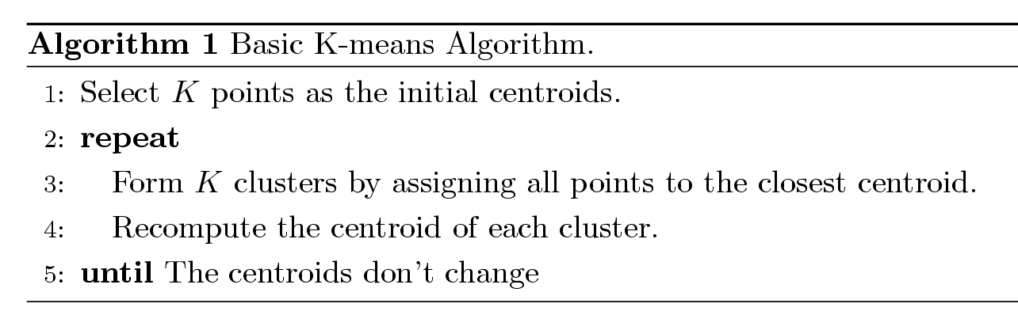
K-means Clustering
Partitional clustering approach
Each cluster is associated with a centroid (center point)
Each point is assigned to the cluster with the closest centroid
Number of clusters, K, must be specified
The basic algorithm is very simple

Slide 26
K-means Clustering – Details
Initial centroids are often chosen randomly.
Clusters produced vary from one run to another.
The centroid is (typically) the mean of the points in the cluster.
‘Closeness’ is measured by Euclidean distance, cosine similarity, correlation, etc.

Slide 27
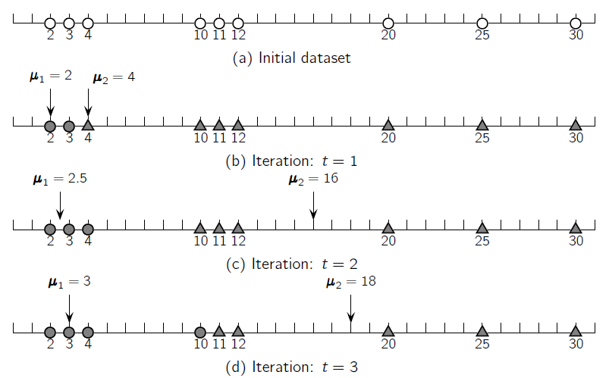

Slide 29
K-means Clustering – Details
K-means will converge for common similarity measures mentioned above.
Most of the convergence happens in the first few iterations.
Often the stopping condition is changed to ‘Until relatively few points change clusters’
Complexity is O( n * K * I * d )
n = number of points, K = number of clusters, I = number of iterations, d = number of attributes

Slide 31
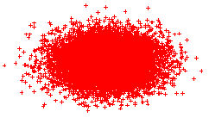
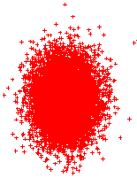

K-Means Clustering

Slide 32
How to MapReduce K-Means?
Given K, assign the first K random points to be the initial cluster centers
Assign subsequent points to the closest cluster using the supplied distance measure
Compute the centroid of each cluster and iterate the previous step until the cluster centers converge within delta
Run a final pass over the points to cluster them for output

Slide 33
K-Means Map/Reduce Design
Driver
Runs multiple iteration jobs using mapper+combiner+reducer
Runs final clustering job using only mapper
Mapper
Configure: Single file containing encoded Clusters
Input: File split containing encoded Vectors
Output: Vectors keyed by nearest cluster
Combiner
Input: Vectors keyed by nearest cluster
Output: Cluster centroid vectors keyed by “cluster”
Reducer (singleton)
Input: Cluster centroid vectors
Output: Single file containing Vectors keyed by cluster

Slide 34
Mapper - mapper has k centers in memory.
Input Key-value pair (each input data point x).
Find the index of the closest of the k centers (call it iClosest).
Emit: (key,value) = (iClosest, x)
Reducer(s) – Input (key,value)
Key = index of center
Value = iterator over input data points closest to ith center
At each key value, run through the iterator and average all the
Corresponding input data points.
Emit: (index of center, new center)

Slide 35
Improved Version: Calculate partial sums in mappers
Mapper - mapper has k centers in memory. Running through one
input data point at a time (call it x). Find the index of the closest of the
k centers (call it iClosest). Accumulate sum of inputs segregated into
K groups depending on which center is closest.
Emit: ( , partial sum)
Or
Emit(index, partial sum)
Reducer – accumulate partial sums and
Emit with index or without

Slide 36
Issues and Limitations for K-means
How to choose initial centers?
How to choose K?
How to handle Outliers?
Clusters different in
Shape
Density
Size

Slide 37
Two different K-means Clusterings
Original Points
Optimal Clustering
Sub-optimal Clustering

Slide 38
Importance of Choosing Initial Centroids

Slide 39
Importance of Choosing Initial Centroids

Slide 40
Importance of Choosing Initial Centroids …

Slide 41
Importance of Choosing Initial Centroids …

Slide 42
Solutions to Initial Centroids Problem
Multiple runs
Helps, but probability is not on your side
Sample and use hierarchical clustering to determine initial centroids
Select more than k initial centroids and then select among these initial centroids
Select most widely separated
Postprocessing
Bisecting K-means
Not as susceptible to initialization issues

Slide 43
EM-Algorithm

Slide 44
What is MLE?
Given
A sample X={X₁, …, X_{n}}
A vector of parameters θ
We define
Likelihood of the data: P(X | θ)
Log-likelihood of the data: L(θ)=log P(X|θ)
Given X, find

Slide 45
MLE (cont)
Often we assume that X_{i}s are independently identically distributed (i.i.d.)
Depending on the form of p(x|θ), solving optimization problem can be easy or hard.

Slide 46
An easy case
Assuming
A coin has a probability p of being heads, 1-p of being tails.
Observation: We toss a coin N times, and the result is a set of Hs and Ts, and there are m Hs.
What is the value of p based on MLE, given the observation?

Slide 47
An easy case (cont)
p= m/N

Slide 48
EM: basic concepts

Slide 49
Basic setting in EM
X is a set of data points: observed data
Θ is a parameter vector.
EM is a method to find θ_{ML} where
Calculating P(X | θ) directly is hard.
Calculating P(X,Y|θ) is much simpler, where Y is “hidden” data (or “missing” data).

Slide 50
The basic EM strategy
Z = (X, Y)
Z: complete data (“augmented data”)
X: observed data (“incomplete” data)
Y: hidden data (“missing” data)

Slide 51
The log-likelihood function
L is a function of θ, while holding X constant:

Slide 52
The iterative approach for MLE
In many cases, we cannot find the solution directly.
An alternative is to find a sequence:
s.t.

Slide 53
Jensen’s inequality

Slide 54
Jensen’s inequality
log is a concave function

Slide 55
Maximizing the lower bound
The Q function

Slide 56
The Q-function
Define the Q-function (a function of θ):
Y is a random vector.
X=(x₁, x₂, …, x_{n}) is a constant (vector).
Θ^{t} is the current parameter estimate and is a constant (vector).
Θ is the normal variable (vector) that we wish to adjust.
The Q-function is the expected value of the complete data log-likelihood P(X,Y|θ) with respect to Y given X and θ^{t}.

Slide 57
The inner loop of the EM algorithm
E-step: calculate
M-step: find

Slide 58
L(θ) is non-decreasing at each iteration
The EM algorithm will produce a sequence
It can be proved that

Slide 59
The inner loop of the Generalized EM algorithm (GEM)
E-step: calculate
M-step: find

Slide 60
Recap of the EM algorithm

Slide 61
Idea #1: find θ that maximizes the likelihood of training data

Slide 62
Idea #2: find the θ^{t} sequence
No analytical solution ➔ iterative approach, find
s.t.

Slide 63
Idea #3: find θ^{t+1} that maximizes a tight lower bound of
a tight lower bound

Slide 64
Idea #4: find θ^{t+1} that maximizes the Q function
Lower bound of
The Q function

Slide 65
The EM algorithm
Start with initial estimate, θ⁰
Repeat until convergence
E-step: calculate
M-step: find

Slide 66
Important classes of EM problem
Products of multinomial (PM) models
Exponential families
Gaussian mixture
…

Slide 67
Probabilistic Latent Semantic Analysis (PLSA)
PLSA is a generative model for generating the co-occurrence of documents d∈D={d₁,…,d_{D}} and terms w∈W={w₁,…,w_{W}}, which associates latent variable z∈Z={z₁,…,z_{Z}}.
The generative processing is:
P(w|z)
P(z|d)
w₁
z₁
d₁
P(d)
w₂
z₂
d₂
…
…
w_{W}
z_{Z}
d_{D}

Slide 68
Model
The generative process can be expressed by:
Two independence assumptions:
Each pair (d,w) are assumed to be generated independently, corresponding to ‘bag-of-words’
Conditioned on z, words w are generated independently of the specific document d.

Slide 69
Model
Following the likelihood principle, we detemines P(z), P(d|z), and P(w|z) by maximization of the log-likelihood function
co-occurrence times of d and w.
P(d), P(z|d), and P(w|d)
Unobserved data
Observed data

Slide 70
Maximum-likelihood
Definition
We have a density function P(x|Θ) that is govened by the set of parameters Θ, e.g., P might be a set of Gaussians and Θ could be the means and covariances
We also have a data set X={x₁,…,x_{N}}, supposedly drawn from this distribution P, and assume these data vectors are i.i.d. with P.
Then the likehihood function is:
The likelihood is thought of as a function of the parameters Θwhere the data X is fixed. Our goal is to find the Θthat maximizes L. That is

Slide 71
Jensen’s inequality

Slide 72
Estimation-using EM
difficult!!!
Idea: start with a guess Θ^{t}, compute an easily computed lower-bound B(Θ; Θ^{t}) to the function log P(Θ|U) and maximize the bound instead
By Jensen’s inequality:

Slide 73
(1)Solve P(w|z)
We introduce Lagrange multiplier λwith the constraint that ∑_{w}P(w|z)=1, and solve the following equation:

Slide 74
(2)Solve P(d|z)
We introduce Lagrange multiplier λwith the constraint that ∑_{d}P(d|z)=1, and get the following result:

Slide 75
(3)Solve P(z)
We introduce Lagrange multiplier λwith the constraint that ∑_{z}P(z)=1, and solve the following equation:

Slide 76
(1)Solve P(z|d,w)
We introduce Lagrange multiplier λwith the constraint that ∑_{z}P(z|d,w)=1, and solve the following equation:

Slide 77
(4)Solve P(z|d,w) -2

Slide 78
The final update Equations
E-step:
M-step:

Slide 79
Coding Design
Variables:
double[][] p_dz_n // p(d|z), |D|*|Z|
double[][] p_wz_n // p(w|z), |W|*|Z|
double[] p_z_n // p(z), |Z|
Running Processing:
Read dataset from file
ArrayList<DocWordPair> doc; // all the docs
DocWordPair – (word_id, word_frequency_in_doc)
Parameter Initialization
Assign each elements of p_dz_n, p_wz_n and p_z_n with a random double value, satisfying ∑_{d} p_dz_n=1, ∑_{d} p_wz_n =1, and ∑_{d} p_z_n =1
Estimation (Iterative processing)
Update p_dz_n, p_wz_n and p_z_n
Calculate Log-likelihood function to see where ( |Log-likelihood – old_Log-likelihood| < threshold)
Output p_dz_n, p_wz_n and p_z_n

Slide 80
Coding Design
Update p_dz_n
For each doc d{
For each word w included in d {
denominator = 0;
nominator = new double[Z];
For each topic z {
nominator[z] = p_dz_n[d][z]* p_wz_n[w][z]* p_z_n[z]
denominator +=nominator[z];
} // end for each topic z
For each topic z {
P_z_condition_d_w = nominator[j]/denominator;
nominator_p_dz_n[d][z] += tf_{wd}*P_z_condition_d_w;
denominator_p_dz_n[z] += tf_{wd}*P_z_condition_d_w;
} // end for each topic z
}// end for each word w included in d
}// end for each doc d
For each doc d {
For each topic z {
p_dz_n_new[d][z] = nominator_p_dz_n[d][z]/ denominator_p_dz_n[z];
} // end for each topic z
}// end for each doc d

Slide 81
Coding Design
Update p_wz_n
For each doc d{
For each word w included in d {
denominator = 0;
nominator = new double[Z];
For each topic z {
nominator[z] = p_dz_n[d][z]* p_wz_n[w][z]* p_z_n[z]
denominator +=nominator[z];
} // end for each topic z
For each topic z {
P_z_condition_d_w = nominator[j]/denominator;
nominator_p_wz_n[w][z] += tf_{wd}*P_z_condition_d_w;
denominator_p_wz_n[z] += tf_{wd}*P_z_condition_d_w;
} // end for each topic z
}// end for each word w included in d
}// end for each doc d
For each w {
For each topic z {
p_wz_n_new[w][z] = nominator_p_wz_n[w][z]/ denominator_p_wz_n[z];
} // end for each topic z
}// end for each doc d

Slide 82
Coding Design
Update p_z_n
For each doc d{
For each word w included in d {
denominator = 0;
nominator = new double[Z];
For each topic z {
nominator[z] = p_dz_n[d][z]* p_wz_n[w][z]* p_z_n[z]
denominator +=nominator[z];
} // end for each topic z
For each topic z {
P_z_condition_d_w = nominator[j]/denominator;
nominator_p_z_n[z] += tf_{wd}*P_z_condition_d_w;
} // end for each topic z
denominator_p_z_n[z] += tf_{wd};
}// end for each word w included in d
}// end for each doc d
For each topic z{
p_dz_n_new[d][j] = nominator_p_z_n[z]/ denominator_p_z_n;
} // end for each topic z

Slide 83

Apache Mahout
Industrial Strength Machine Learning
May 2008

Slide 84


Current Situation
Large volumes of data are now available
Platforms now exist to run computations over large datasets (Hadoop, HBase)
Sophisticated analytics are needed to turn data into information people can use
Active research community and proprietary implementations of “machine learning” algorithms
The world needs scalable implementations of ML under open license - ASF

Slide 85

History of Mahout
Summer 2007
Developers needed scalable ML
Mailing list formed
Community formed
Apache contributors
Academia & industry
Lots of initial interest
Project formed under Apache Lucene
January 25, 2008

Slide 86

Current Code Base
Matrix & Vector library
Memory resident sparse & dense implementations
Clustering
Canopy
K-Means
Mean Shift
Collaborative Filtering
Taste
Utilities
Distance Measures
Parameters

Slide 87

Under Development
Naïve Bayes
Perceptron
PLSI/EM
Genetic Programming
Dirichlet Process Clustering
Clustering Examples
Hama (Incubator) for very large arrays

Slide 88
Appendix
From Mahout Hands on, by Ted Dunning and Robin Anil, OSCON 2011, Portland

Slide 89
Step 1 – Convert dataset into a Hadoop Sequence File
http://www.daviddlewis.com/resources/testcollections/reuters21578/reuters21578.tar.gz
Download (8.2 MB) and extract the SGML files.
$ mkdir -p mahout-work/reuters-sgm
$ cd mahout-work/reuters-sgm && tar xzf ../reuters21578.tar.gz && cd .. && cd ..
Extract content from SGML to text file
$ bin/mahout org.apache.lucene.benchmark.utils.ExtractReuters mahout-work/reuters-sgm mahout-work/reuters-out

Slide 90
Step 1 – Convert dataset into a Hadoop Sequence File
Use seqdirectory tool to convert text file into a Hadoop Sequence File
$ bin/mahout seqdirectory \
-i mahout-work/reuters-out \
-o mahout-work/reuters-out-seqdir \
-c UTF-8 -chunk 5

Slide 91
Hadoop Sequence File
Sequence of Records, where each record is a <Key, Value> pair
<Key1, Value1>
<Key2, Value2>
…
…
…
<Keyn, Valuen>
Key and Value needs to be of class org.apache.hadoop.io.Text
Key = Record name or File name or unique identifier
Value = Content as UTF-8 encoded string
TIP: Dump data from your database directly into Hadoop Sequence Files (see next slide)

Slide 92
Writing to Sequence Files
Configuration conf = new Configuration();
FileSystem fs = FileSystem.get(conf);
Path path = new Path("testdata/part-00000");
SequenceFile.Writer writer = new SequenceFile.Writer(
fs, conf, path, Text.class, Text.class);
for (int i = 0; i < MAX_DOCS; i++)
writer.append(new Text(documents(i).Id()),
new Text(documents(i).Content()));
}
writer.close();

Slide 93
Generate Vectors from Sequence Files
Steps
Compute Dictionary
Assign integers for words
Compute feature weights
Create vector for each document using word-integer mapping and feature-weight Or
Simply run $ bin/mahout seq2sparse

Slide 94
Generate Vectors from Sequence Files
$ bin/mahout seq2sparse \ -i mahout-work/reuters-out-seqdir/ \ -o mahout-work/reuters-out-seqdir-sparse-kmeans
Important options
Ngrams
Lucene Analyzer for tokenizing
Feature Pruning
Min support
Max Document Frequency
Min LLR (for ngrams)
Weighting Method
TF v/s TFIDF
lp-Norm
Log normalize length

Slide 95
Start K-Means clustering
$ bin/mahout kmeans \ -i mahout-work/reuters-out-seqdir-sparse-kmeans/tfidf-vectors/ \ -c mahout-work/reuters-kmeans-clusters \ -o mahout-work/reuters-kmeans \ -dm org.apache.mahout.distance.CosineDistanceMeasure –cd 0.1 \ -x 10 -k 20 –ow
Things to watch out for
Number of iterations
Convergence delta
Distance Measure
Creating assignments

Slide 96
Inspect clusters
$ bin/mahout clusterdump \ -s mahout-work/reuters-kmeans/clusters-9 \ -d mahout-work/reuters-out-seqdir-sparse-kmeans/dictionary.file-0 \ -dt sequencefile -b 100 -n 20
Typical output
:VL-21438{n=518 c=[0.56:0.019, 00:0.154, 00.03:0.018, 00.18:0.018, …
Top Terms:
iran => 3.1861672217321213
strike => 2.567886952727918
iranian => 2.133417966282966
union => 2.116033937940266
said => 2.101773806290277
workers => 2.066259451354332
gulf => 1.9501374918521601
had => 1.6077752463145605
he => 1.5355078004962228

