Slide 1
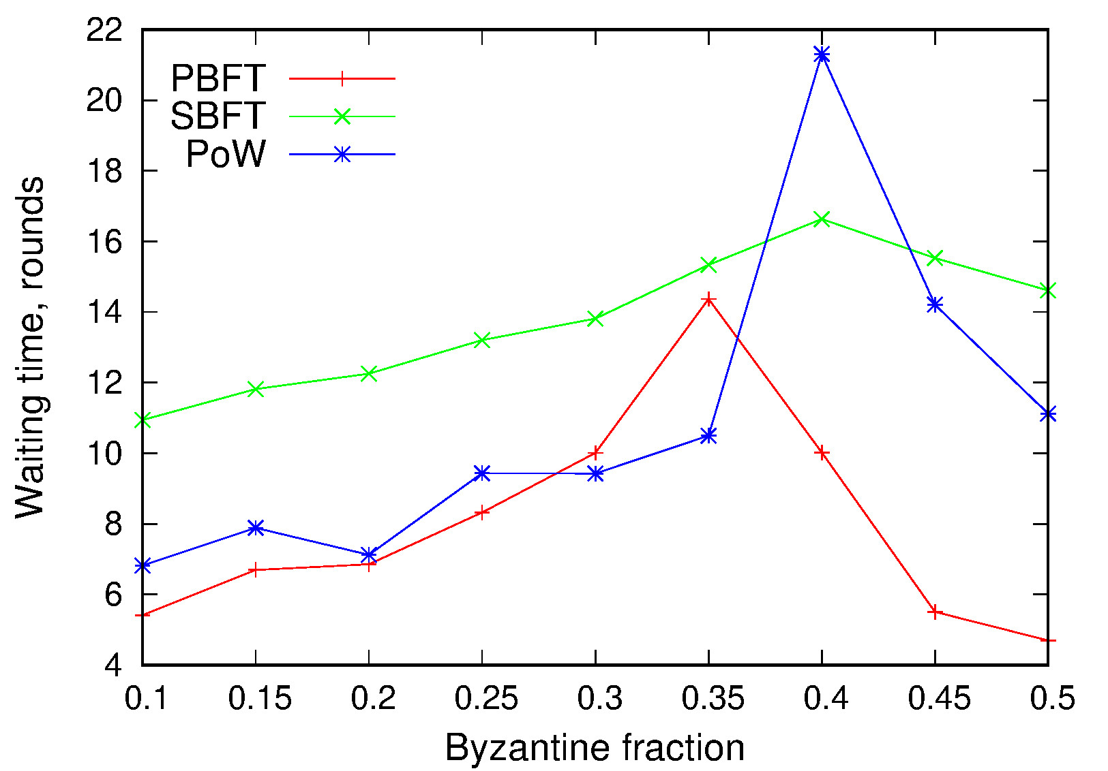
Blockguard: Adaptive Blockchain Security
Shishir Rai
Kendric Hood
Mikhail Nesterenko
Gokarna Sharma
picture, coming
Pisa, Italy
October 2019

Slide 2
Adaptive Security
blockchain – distributed ledger of linked transactions maintained by a peer-to-peer network
able to securely record transactions without central authority
can withstand a fraction of Byzantine peers
security is ensured by majority of honest peers
poor performance
low throughput (transactions per unit time)
high waiting time (time to transaction confirmation)
adaptive security
assign each transaction a security level
dynamically allocate peers proportional to security level
concurrently process transactions
we present Blockguard two adaptive security algorithms
we describe and evaluate their performance

Slide 3
Notation
peers are
honest – conform to algorithm
Byzantine – capable of arbitrary actions
consensus – set of processes cooperating to approve transaction despite actions of Byzantine peers
classic – peers exchange messages to achieve consensus
PBFT – practical byzantine fault tolerant algorithm – asynchronous
SBFT - synchronous byzantine-tolerant
Proof-of-Work (PoW)– Nakamoto-style with peers mining transactions, the longest chain of mined transactions is accepted
both have some fixed tolerance to Byzantine peers
sharding group – a set of processes that maintain single blockchain
committee - each committee runs a consensus algorithm

Slide 4
Adaptive Security Algorithms
Composite
multiple groups
combined dynamically based on transaction security requirements form committees.
asynchronous
Dynamic
single group
individual peers are selected from this group dynamically based on transaction security requirements form committees.
synchronous

Slide 5
Performance Evaluation Setup
abstract simulation
represented as a sequence of rounds
receive messages
preform local computation
send messages
channels are FIFO
messages have random delay between 1 and max delay
Byzantine peer model in evaluation
goal is to commit fraudulent transaction to the blockchain
committees are either reliable or defeated
reliable committees
number of Byzantine peers is under consensus tolerance threshold
always commits non-fraudulent transactions
consensus can be slowed by Byzantine peers
defeated
number of Byzantine peers are above consensus tolerance threshold
Always commits fraudulent transactions
consensus can be slowed by non-Byzantine peers

Slide 6
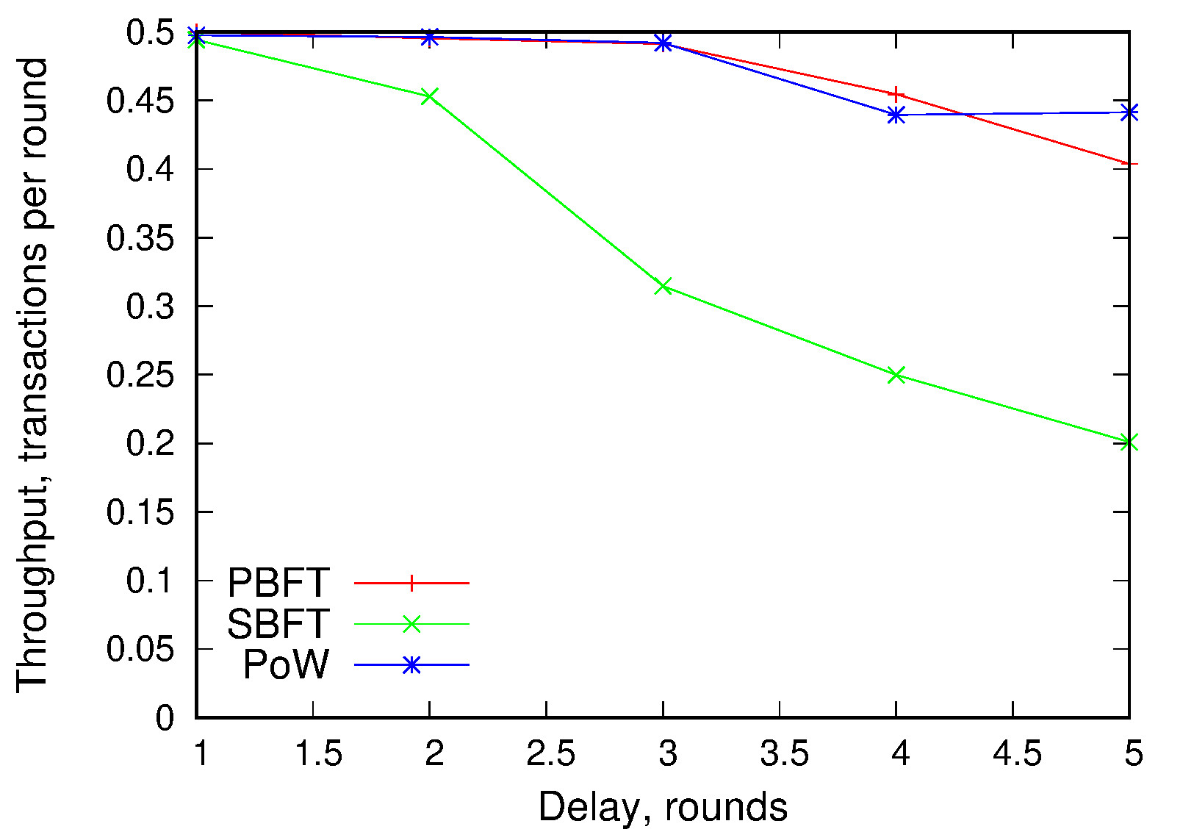
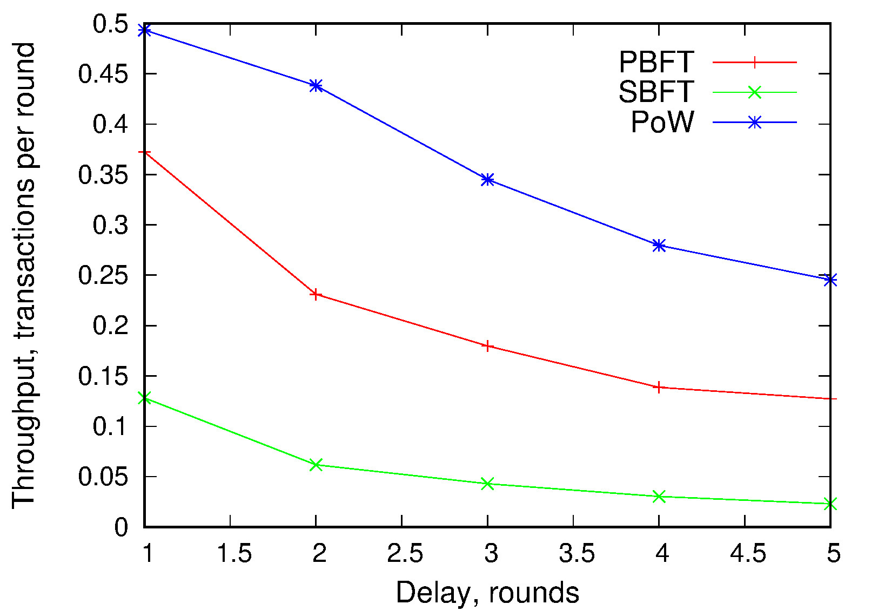
Performance Results: Throughput varying delay
Composite Blockguard
Dynamic Blockguard
increase in delay negatively affects throughput for both composite and dynamic
SBFT is affected the most because it is synchronous
Composite is asynchronous and so both PBFT and PoW have similar reactions to delay
Dynamic is synchronous and must wait for the slowest committee, sense PoW committees are faster than PBFT committees PoW performs better

Slide 7
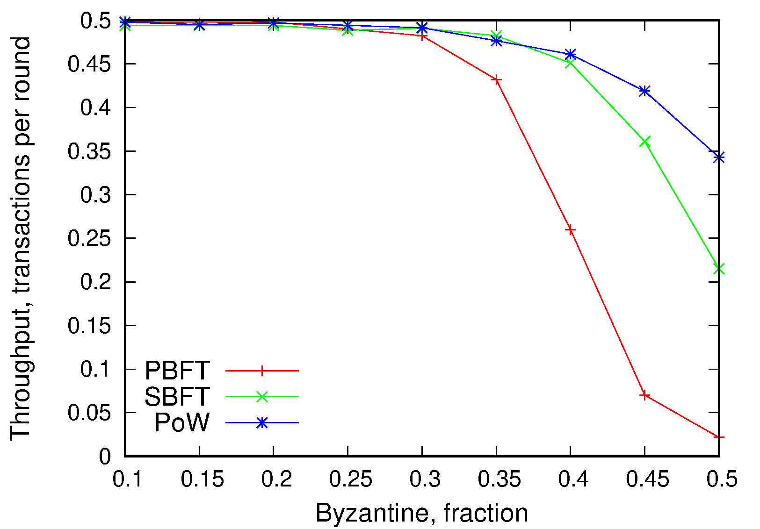
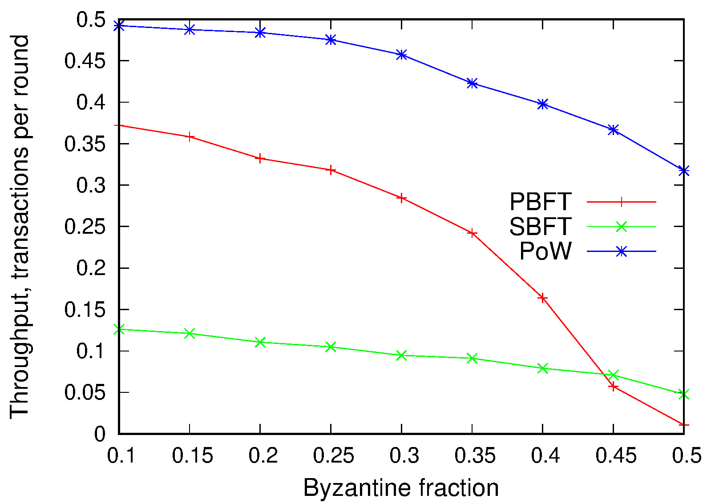
Performance Results: Throughput varying Byzantine ratio
Composite Blockguard
Dynamic Blockguard
increase in Byzantine peers affects throughput negatively, more Byzantine peers means more view changes which slow down consusnes
PBFT suffers the most because it has the lowest tolerance to Byzantine peers
SBFT outperforms PBFT because it has a higher tolerance to Byzantine peers
PoW has the best performance because is a asynchronous and has a high tolerance to Byzantine peers

Slide 8
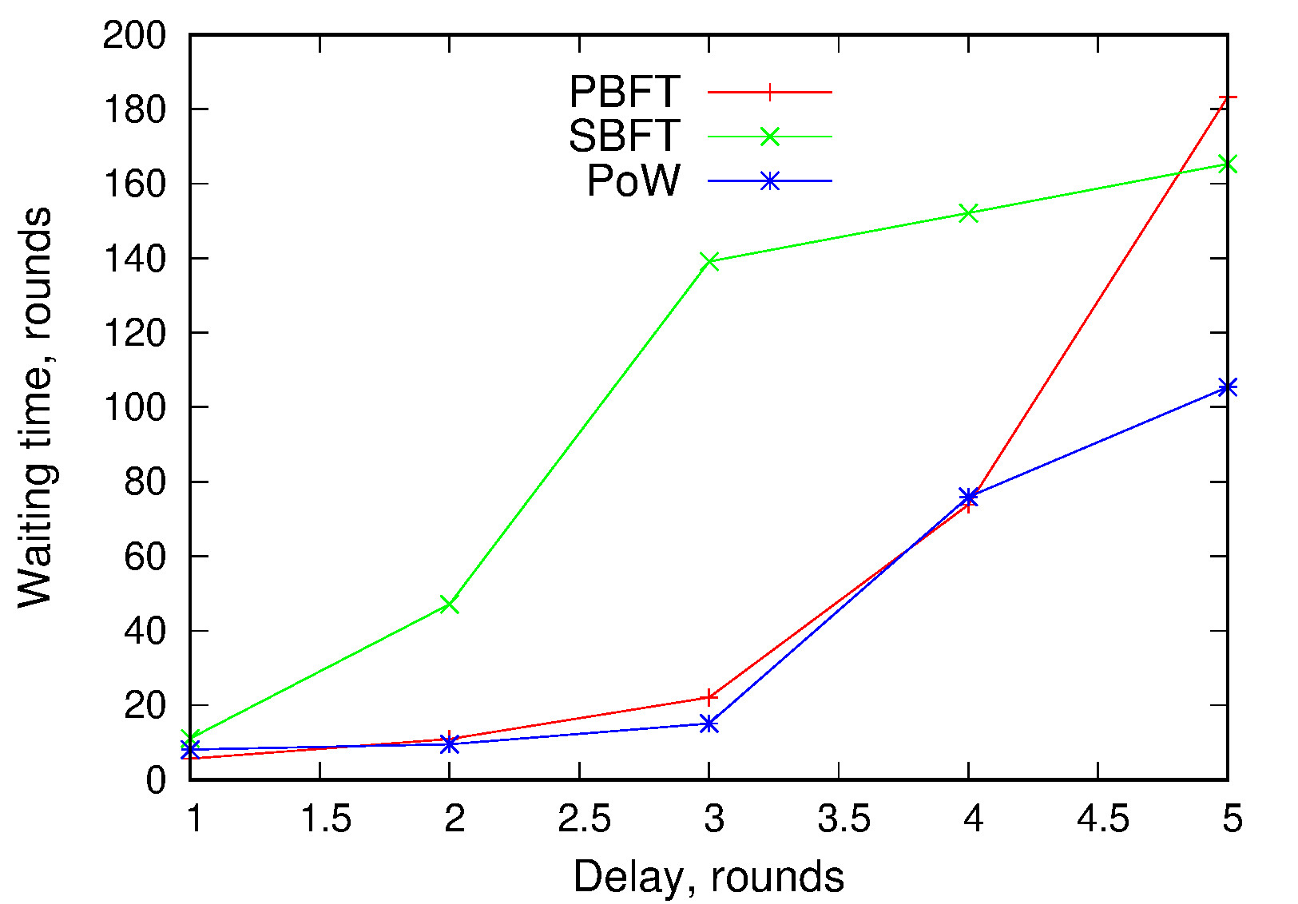
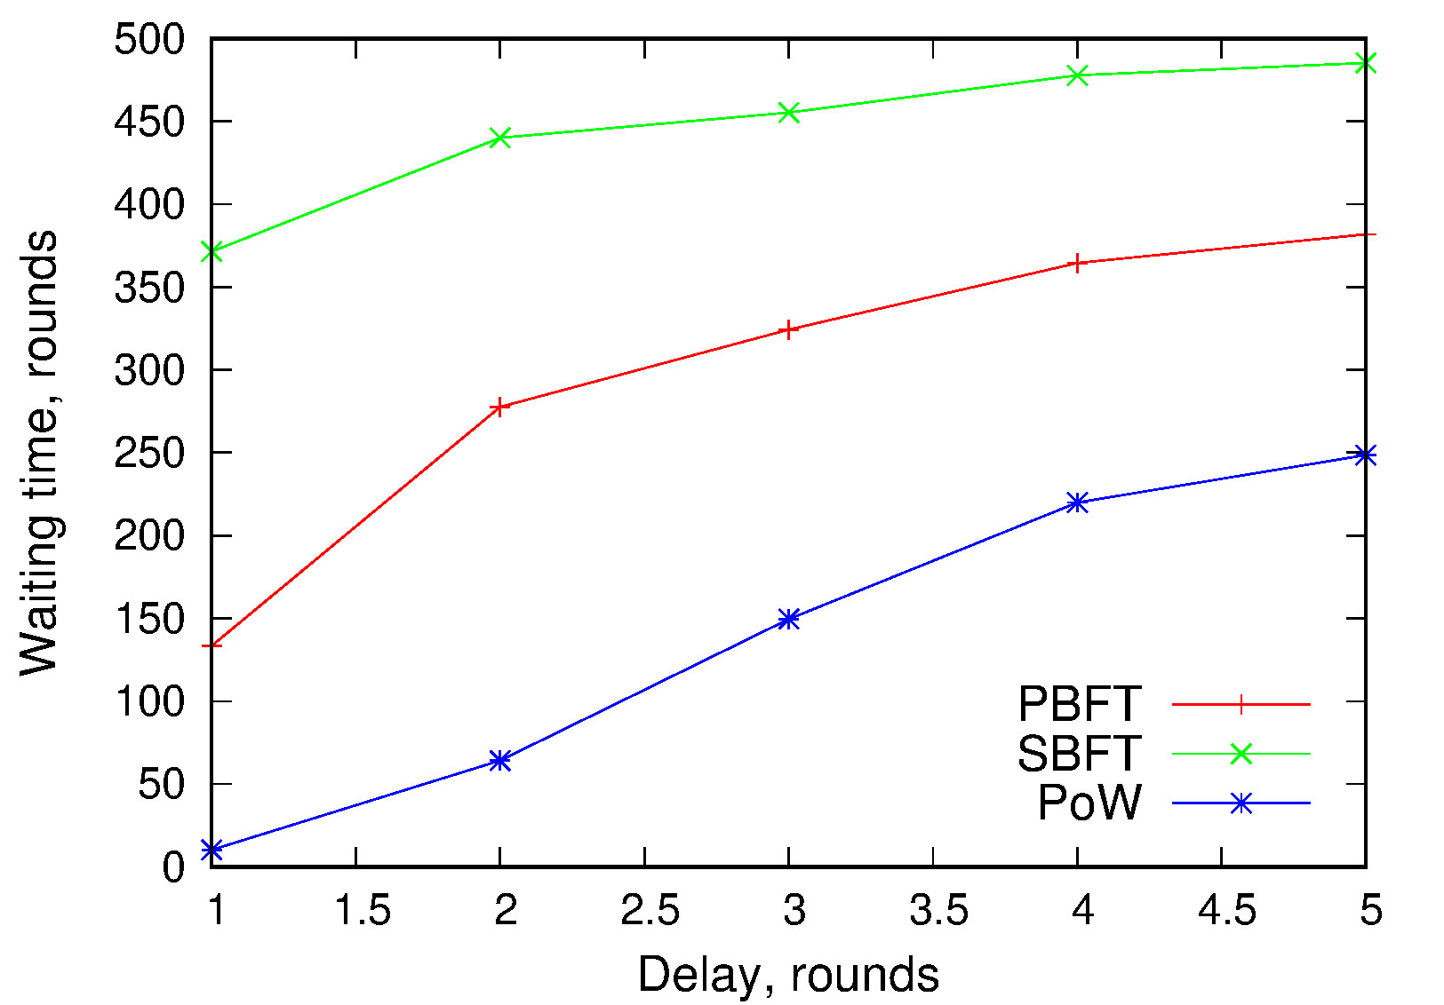
Performance Results: Waiting time varying delay
Composite Blockguard
Dynamic Blockguard
waiting time increases with delay
SBFT suffers the most because it is synchronous
PBFT requires multiple broadcast
PoW performs best because it only needs to broadcast once

Slide 9
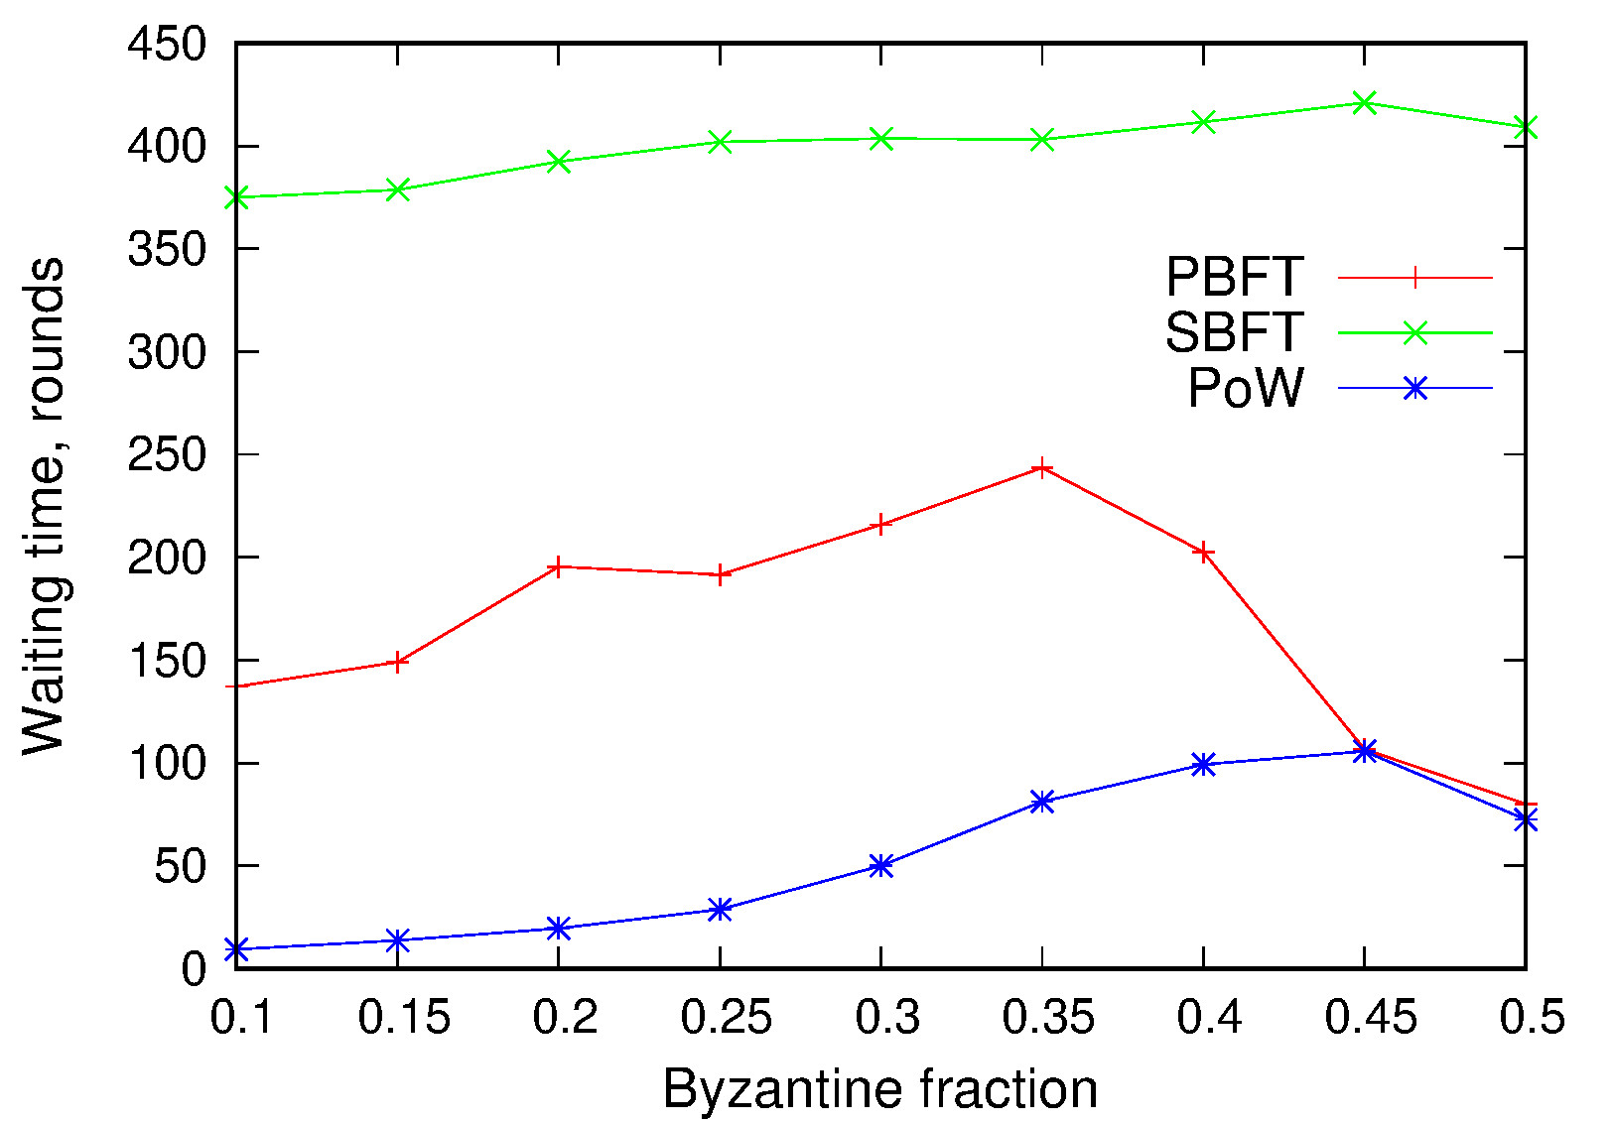
Performance Results: Waiting time varying Byzantine ratio
Composite Blockguard
Dynamic Blockguard
as Byzantine ratio approaches the threshold for the committee’s consensus algorithm more view changes happen, increasing waiting time.
once over this threshold the number of view changes decreases. Causing the waiting time to decrease, but more fraudulent transactions to be committed.
PoW can be slowed down by a single Byzantine peer multiple times while PBFT and SBFT can not, thus PoW is most affected by an increase.

Slide 10
Result Analysis
PoW
can be very reactive to Byzantine peer
can make up for this because it is the fastest algorithm
PBFT
can be fast with low numbers of Byzantine peer
SBFT
worst performance due to synchrony
least reactive to Byzantine peer
Composite
has the best performance due to it’s asynchrony
is less tolerable to Byzantine peers
Dynamic
has best tolerance to Byzantine peers
suffers from poor performance due to synchrony
both can easily be adapted to any consensus algorithm
both provide adaptive security
Composite and Dynamic have a trade off between performance and security.

Slide 11
Conclusion
Blockguard demonstrates that adaptive security is viable as a technique for achieving tradeoff between security and performance
is applicable to major consensus algorithms
should be implemented in practical systems
Thank you!
Questions?

