Slide 1
Corona Robust Low Atomicity Peer-To-Peer Systems
Rizal Mohd Nor
Mikhail Nesterenko
Christian Scheideler

Slide 2
Overlay Networks and Stabilization
self-stabilization guarantees that
starting from arbitrary initial state, system will converge to legal state in finite time

Slide 3
Overlay Networks and Stabilization
self-stabilization guarantees that
starting from arbitrary initial state, system will converge to legal state in finite time
stabilization is good for overlay networks:
overlay network is effective way to distribute information at scale
many users constantly leave and join
faults and inconsistencies are the norm
esoteric faulty states may be reached
large scale precludes centralized fault tolerance and initialization

Slide 4
Outline
overlay networks and programming model
necessary conditions
corona
bottom level
skip-list

Slide 5
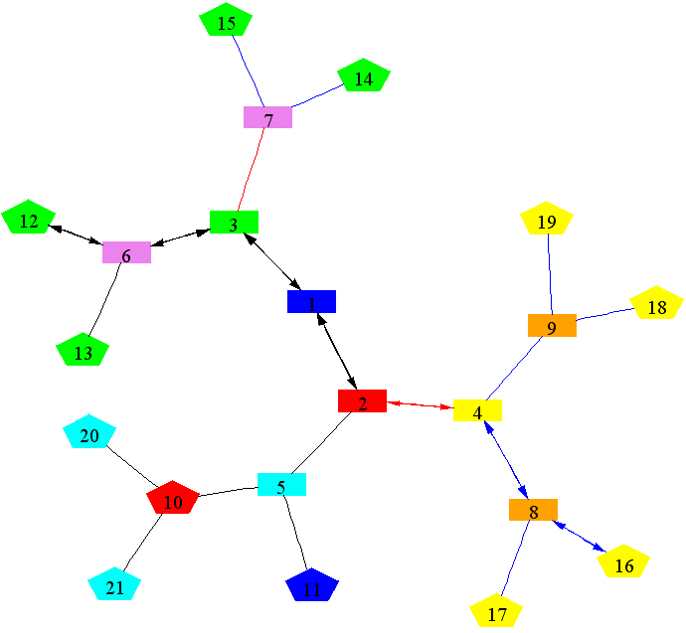
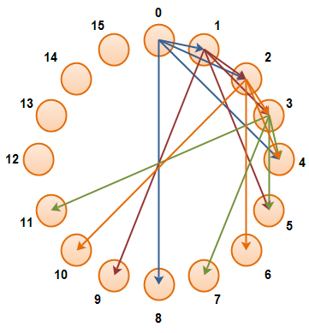
Overlay Network Terminology
in overlay network, any pair of peers can establish a link
topology
unstructured: low mainte-nance, high search cost
structured : predictable performance, fast search, higher maintenance
our focus: structured overlay networks

Slide 6
Related Work
Self-stabilizing overlay networks:
Sorted lists and rings [Cramer & Fuhrmann 2005] [Shaker & Reeves 2005] [Onus & Richa & S 2007] …
Skip lists [Clouser & Nesterenko & S 2008]
Delaunay graph [Jacob & Ritscher & S & Schmid 2009]
Skip graph [Jacob & Richa & S & Schmid & Täubig 2009]
Chord [Kniesburges & Koustopoulos & S 2011]
De Bruijn graph [Richa & S & Stevens 2011]
Universal [Berns & Ghosh & Pemmaraju 2011]
…
Only simple communication models: shared memory or synchronous message passing

Slide 7
Our Approach
Self-stabilizing skip list (and skip graph) for asynchronous message passing model
Basic assumptions:
actions: triggered by messages (or predicate „true“) , only compare-store-send
atomic action execution
weak fairness: action enabled in all but finitely many states will be executed infinitely often
fair message receipt: every message eventually received (i.e., triggers an action) no FIFO needed!

Slide 8
Outline
overlay networks and programming model
necessary conditions
corona
bottom level
skip-list

Slide 9
Necessary Conditions
Graph model:
nodes with unique, ordered identifiers (ids)
directed links
application level: knowledge (msgs, connections)
network level: reliable channels of unbounded capacity
a
b
c
d
e

Slide 10
Necessary Conditions
graph has to be initially weakly connected
ids of non-existing nodes are not present in the system.
A disconnected graph, will always remain
disconnected
a
b
c
d
e
a non-existing identifier, or an unresponsive one, may result in a graph to be disconnected
forever
a
b
c
d
e

Slide 11
Outline
overlay networks and programming model
necessary conditions
corona
bottom level
skip-list

Slide 12
Skip-List
skip-list: enables searches & updates in logarithmic work
0th is a sorted list of nodes (peers)
only a fraction of the nodes is promoted to each subsequent level
1-2 skip-list:
at each level i>0, any two nodes a and b are neighbors at level i if the distance between a and b at level i-1 is no less than 2 and no more than 3 hops
3
2
1
0
a
b
c
d
e
f
g
h
i
k

Slide 13
Execution Model
notation
left node – lower id
right node – higher id
process UP state – promoted to upper levels
process DOWN state – not promoted to upper levels
channel links act as storage
a
b
c
d
e

Slide 14
L-corona (bottom level)
invariant: at the bottom level, each node stores IDs of closest left and right neighbors seen so far (in l and r)
actions
receive ID from right:
update r, forward remaining ID to r
receive ID from left:
update l, forward remaining ID to l
true: send own ID to r & l
a
b
c
d
e

Slide 15
L-corona
actions
receive ID from right:
update r, forward remaining ID to r
receive ID from left:
update l, forward remaining ID to l
true: send own ID to r & l
Node a sends its id
a
a
b
c
d
e

Slide 16
L-corona
actions
receive ID from right:
update r, forward remaining ID to r
receive ID from left:
update l, forward remaining ID to l
true: send own ID to r & l
Node e receives a's id, forwards to c
a
b
c
d
a
e

Slide 17
L-corona
actions
receive ID from right:
update r, forward remaining ID to r
receive ID from left:
update l, forward remaining ID to l
true: send own ID to r & l
Node c receives a's id, forwards to b
a
a
b
c
d
e

Slide 18
L-corona
actions
receive ID from right:
update r, forward remaining ID to r
receive ID from left:
update l, forward remaining ID to l
true: send own ID to r & l
Node b receives a's id, set its new left neighbor
a
b
c
d
e

Slide 19
L-corona
actions
receive ID from right:
update r, forward remaining ID to r
receive ID from left:
update l, forward remaining ID to l
true: send own ID to r & l
Node b sends its id to
node a
b
a
b
c
d
e

Slide 20
L-corona
actions
receive ID from right:
update r, forward remaining ID to r
receive ID from left:
update l, forward remaining ID to l
true: send own ID to r & l
Node a receives b's id, set its new right neighbor
a
b
c
d
e

Slide 21
L-corona
Processes execute actions one by one
1.
c
a
b
c
d
e

Slide 22
L-corona
Processes execute actions one by one
1.
c
a
b
c
d
e
2.
d
a
b
c
d
e
e

Slide 23
L-corona
Processes execute actions one by one
1.
c
a
b
c
d
e
2.
d
a
b
c
d
e
3.
d
a
b
c
d
e

Slide 24
L-corona
Processes execute actions one by one
1.
c
a
b
c
d
e
2.
d
a
b
c
d
e
3.
d
a
b
c
d
e
4.
a
b
c
d
e

Slide 25
L-corona
Processes execute actions one by one
1.
c
5.
a
b
c
d
e
a
b
c
d
e
e
2.
d
a
b
c
d
e
3.
d
a
b
c
d
e
4.
a
b
c
d
e

Slide 26
L-corona
Processes execute actions one by one
1.
c
5.
a
b
c
d
e
a
b
c
d
e
e
d
2.
6.
e
a
b
c
d
e
a
b
c
d
e
3.
d
a
b
c
d
e
4.
d
a
b
c
d
e

Slide 27
L-corona
Processes execute actions one by one
1.
c
5.
a
b
c
d
e
a
b
c
d
e
e
d
2.
6.
e
a
b
c
d
e
a
b
c
d
e
3.
d
7.
e
a
b
c
d
e
a
b
c
d
e
4.
d
a
b
c
d
e

Slide 28
S-corona
constructs the 1-2 skip list at each level.
lower levels have to stabilize before level can stabilize.
actions for process p
receive state from right:
if (right & p state = UP) then p state := DOWN
receive state from left:
if (left & right & p state = DOWN) then p state := UP
true: send state to right & left nodes
State is always UP if right neighbor is undefined
level i+1
level i
Starting from an arbitrary
state where level i is linearized from L-corona

Slide 29
S-corona
actions for process p
receive state from right:
if (right & p state = UP) then p state := DOWN
receive state from left:
if (left & right and p state = DOWN) then p state := UP
true: send state to right & left nodes
Left and right neighbor state is DOWN
Level i+1
Level i
a
b
c
d
e
f
g
h
i
k
Change state
to
UP
Level i+1
Level i
a
b
c
d
e
f
g
h
i
k

Slide 30
S-corona
Level i+1
Level i
a
b
c
d
e
f
g
h
i
k
Level i+1
Level i
a
b
c
d
e
f
g
h
i
k
Level i+1
Level i
a
b
c
d
e
f
g
h
i
k

Slide 31
Correctness Proof Outline
level by level stabilization proof
assume bottom level is connected.
stabilization of L-corona
closure – link connecting consequent nodes is never removed
convergence – path connecting consequent nodes is always shortened
stabilization of S-corona (by level)
assume lower level(s) are stable,
closure – a node UP/DOWN state only changes a finite number of times
convergence – eventually satisfy the predicate rules of a skip-list

Slide 32
Skip-graph
a single node can disconnect a skip list.
solution: concurrently construct a skip-list of out the remaining nodes that are not upgraded to the next levels.
3
k
k
2
d
k
e
k
1
b
d
g
k
b
e
h
k
0
a
b
c
d
e
f
g
h
i
k
a
b
c
d
e
f
g
h
i
k
Skip-graph with 2 layers

Slide 33
Conclusion
Corona: first self-stabilizing overlay network under asynchronous message passing
Open problems:
What if ids of non-existing nodes are present in system
Churn
Byzantine behavior
Fault containment
Any questions?

Slide 34
Topology Updates (Joins)
Joins require L-corona to linearize its lower level, then S-corona will make sure correct 1-2 skip list structure
Consider a node c' joining at node c
Level i+1
Level i
Node c' sends its ID to c
a
b
c
d
c'
Node c & d updates right and left neighbor following L-corona alg.
Level i+1
Level i
a
b
c
d
c'

Slide 35
Topology Updates (Joins)
Lower level stabilizes, S-corona can correctly stabilize
Level i+1
Level i
a
b
c
c'
d
Level i+1
Level i
a
b
c
c'
d
Only node c will be enabled to change state to UP by following the S-corona alg.

Slide 36
Topology Updates (departures)
Similar to joins, L-corona must stabilize before S-corona can correctly stabilize.
Level i+1
Level i
a
b
c
c'
d
Departing node c’
Level i+1
Level i
d
a
b
c
From the algorithm node c receives node d UP status
Level i+1
Level i
d
a
b
c
node c is and node d is UP, node c changes
its state to DOWN

Slide 37
Minimal Detectors
recall:
it is necessary for the channel connectivity graphs to be initially connected
non-existing identifiers to be not present in the system.
thus, node crashes have to be removed from the system
proposed solution:
redesign detectors used by Chandra & Toueg to detect failed nodes.
remove crashed ids
challenge
identifying the weakest kind of detectors to be sufficient for self-stabilization
identify absolute minimality of these detectors.

Slide 38
Byzantine fault containment
Byzantine node is a faulty node that behaves arbitrarily
can corrupt its own local state
send arbitrary messages to neighboring nodes
may also send messages aimed to disrupt the peer-to-peer system
many security attacks are modeled as Byzantine faults
propose Byzantine fault containment
extend Corona to identify subset of Byzantine nodes
isolate Byzantine nodes from affecting other nodes

Slide 39
Fault Containment
Corona is a self-stabilizing algorithm designed to
converge to a desired stable state
starting from an arbitrary initial state arising from a large number of faults.
However, large number of faults in a peer-to-peer system are rarely
mostly, faults are limited to a specific region
motivation:
contain the effects of limited transient fault
limited to a local set of nodes
does not perturb the operations of the larger set in the network.
propose fault containment
extend Corona's algorithm to recover very fast from a bounded number of faults.

Slide 40
Resistance to Churn
Churn
participating nodes join and leave the system continuously.
may cause a partition in the topology
may render the topology to be inefficient.
propose
improve Corona to maintain correct topology despite churn.
methods
redesign Corona to allow non-interfering concurrent topology updates
extend self-stabilizing dining philosophers
allow only one neighbor to modify its state and links at a time.
redesign Corona to allow non-interfering concurrent topology updates

