Slide 1
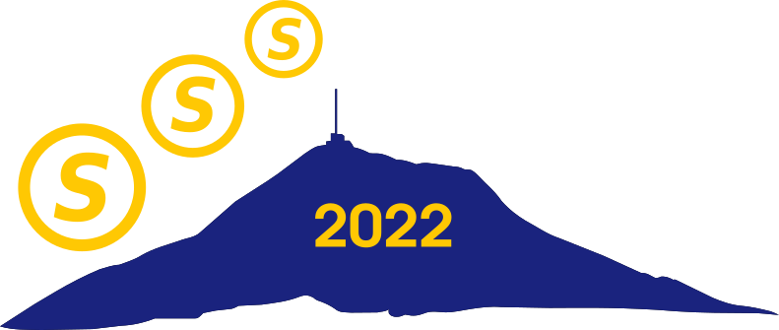
Blockchain in Dynamic Networks
. . .
Rachel Bricker
Mikhail Nesterenko
Gokarna Sharma
a
g
. . .
b
Clermont-Ferrand, France
November 15-17, 2022

Slide 2
Blockchain and Dynamic Networks
blockchain - distributed ledger of linked
transactions/blocks
consensus on block addition is
achieved through competition
between peers generating blocks: the
longest branch wins
able to securely and robustly record transactions
without central authority
security is provided by majority of honest peers
applications - cryptocurrency, massive storage, internet-of-things communication, electronic voting, etc.
dynamic network - network whose topology changes over time
most general: edges appear/disappear at
any state of computation
edges are directed
a
g
. . .
b
longest branch/chain
. . .
time t
time t + 1

Slide 3
Blockchain in Dynamic Networks Motivation, Model, Our Contribution
traditionally, blockchain is considered always connected or delays are insignificant
may not be the case if large network, long delay, or narrow bandwidth
what is the behavior of competitive consensus in communication-limited networks?
our contribution
define the Blockchain Decision Problem for dynamic networks
prove lack of general solution
develop algorithms KPT (known propagation time) and KSM (known pool membership) to solve the problem
implement KPT and KSM, simulate and analyze performance

Slide 4
Terms
branch
. . .
source pool
a
g
. . .
b
appears infinitely often
appears finitely often
journey - sequence of miners and communication links:
m₁ → · · · → m_{i} → m_{i + 1} → · · · → m_{x}
branch - maximal sequence of blocks starting from genesis,
could be finite or infinite
mining pool - every pair of miners have infinitely many journeys
source pool - finitely many incoming edges from outsiders
block is
accepted - the ancestor of all but finitely many blocks
rejected - the ancestor of finitely many blocks
mining pool
potential communication link

Slide 5
Terms
branch
. . .
source pool
a
g
. . .
b
appears infinitely often
appears finitely often
journey - sequence of miners and communication links:
m₁ → · · · → m_{i} → m_{i + 1} → · · · → m_{x}
branch - maximal sequence of blocks starting from genesis,
could be finite or infinite
mining pool - every pair of miners have infinitely many journeys
source pool - finitely many incoming edges from outsiders
block is
accepted - the ancestor of all but finitely many blocks
rejected - the ancestor of finitely many blocks
mining pool
potential communication link

Slide 6
Outline
impossibility
Theorem 1: one infinite branch belongs one source pool
Theorem 2: no general solution to Blockchain Decision Problem
algorithms
KPT: Known Propagation Time
KSM: Known Source Pool Membership
algorithms performance evaluation
. . .
a
g
. . .
b

Slide 7
Necessity of Global and Local Decision
computation is
globally decisive - each block either accepted or rejected
locally decisive - globally decisive and each miner receives every accepted block
globally decisive ⇒ exactly one infinite branch
Theorem 1. If a computation is globally and locally decisive, then it has exactly one infinite branch and one source pool. Moreover, this infinite branch belongs to this source pool.
two infinite branches case:
P₂ → P₁ disappears
network topology
. . .
P₁
disappears
in r₁
g
b
. . .
P₂
t
r₁
neither rejected nor accepted!

Slide 8
Necessity of Global and Local Decision
computation is
globally decisive - each block either accepted or rejected
locally decisive - globally decisive and each miner receives every accepted block
globally decisive ⇒ exactly one infinite branch
Theorem 1. If a computation is globally and locally decisive, then it has exactly one infinite branch and one source pool. Moreover, this infinite branch belongs to this source pool.
no infinite branch case:
network topology
P₂ → P₁ disappears
P₁
disappears
in r₁
g
b
P₂
r₁
t
rejected and accepted!

Slide 9
Outline
impossibility
Theorem 1: one infinite branch belongs one source pool
Theorem 2: no general solution to Blockchain Decision Problem
algorithms
KPT: Known Propagation Time
KSM: Known Source Pool Membership
algorithms performance evaluation
. . .
a
g
. . .
b

Slide 10
Blockchain Decision Problem and Impossibility
Definition 1 (The Blockchain Decision Problem BDP).
Decision: each miner eventually confirms every accepted block;
Confirmation Validity: each miner confirms only accepted blocks.
Theorem 2. There does not exist a solution to the Blockchain Decision Problem even for globally and locally decisive computations.
network topology
P₁
g
P₂
t

Slide 11
Blockchain Decision Problem and Impossibility
Definition 1 (The Blockchain Decision Problem BDP).
Decision: each miner eventually confirms every accepted block;
Confirmation Validity: each miner confirms only accepted blocks.
Theorem 2. There does not exist a solution to the Blockchain Decision Problem even for globally and locally decisive computations.
network topology
P₁
P₂ → P₁ disappears
source pool
g
b
P₂
t
r₁

Slide 12
Blockchain Decision Problem and Impossibility
Definition 1 (The Blockchain Decision Problem BDP).
Decision: each miner eventually confirms every accepted block;
Confirmation Validity: each miner confirms only accepted blocks.
Theorem 2. There does not exist a solution to the Blockchain Decision Problem even for globally and locally decisive computations.
network topology
P₁
P₂ → P₁ disappears
g
b
. . .
P₂
t
r₁

Slide 13
Blockchain Decision Problem and Impossibility
Definition 1 (The Blockchain Decision Problem BDP).
Decision: each miner eventually confirms every accepted block;
Confirmation Validity: each miner confirms only accepted blocks.
Theorem 2. There does not exist a solution to the Blockchain Decision Problem even for globally and locally decisive computations.
network topology
P₁
P₂ → P₁ disappears
P₂ confirms b
g
b
. . .
P₂
t
r₁
r₂

Slide 14
Blockchain Decision Problem and Impossibility
Definition 1 (The Blockchain Decision Problem BDP).
Decision: each miner eventually confirms every accepted block;
Confirmation Validity: each miner confirms only accepted blocks.
Theorem 2. There does not exist a solution to the Blockchain Decision Problem even for globally and locally decisive computations.
P₃
network topology
P₂ → P₁ disappears
P₂ confirms b
P₃ → P₁ appears
has no incoming edges!
P₁
. . .
g
b
P₂
t
r₁
r₂

Slide 15
Outline
impossibility
Theorem 1: one infinite branch belongs one source pool
Theorem 2: no general solution to Blockchain Decision Problem
algorithms
KPT: Known Propagation Time
KSM: Known Source Pool Membership
algorithms performance evaluation
. . .
a
g
. . .
b

Slide 16
KPT (Known Propagation Time)
Theorem 3. Known Source Pool Propagation Time Algorithm KPT solves the Blockchain Decision Problem with initially closed source pool.
cousin - consider block b; blocks which are neither descendants or
ancestors of b are cousin blocks: block a
algorithm:
if mined then
Ｌ link to local blockchain tree T
if available link to miner then
Ｌ send local blockchain tree T
if received message Tq from q then
Ｌ merge T and Tq
if exists unlabeled block b s.t. its branch’s length has been shorter than the depth of a particular cousin block for 2·PT rounds then
Ｌ reject block b
if exists unlabeled block b’ s.t. all its cousins are rejected then
Ｌ accept block b’
cousin of block b
a
b
// orange is
// bookkeeping

Slide 17
KPT (Known Propagation Time)
a
BR₁
length of b’s branch is less than the depth of a for 2·PT rounds!
b
BR₂
round: r₁
.
.
.
a
BR₁
b
BR₂
round: r₁ + 2·PT
intuition for 2·PT :
takes at most PT rounds for a message from miner m to reach all miners → takes at most another PT rounds for message to come back to m

Slide 18
Outline
impossibility
Theorem 1: one infinite branch belongs one source pool
Theorem 2: no general solution to Blockchain Decision Problem
algorithms
KPT: Known Propagation Time
KSM: Known Source Pool Membership
algorithms performance evaluation
. . .
a
g
. . .
b

Slide 19
KSM (Known Source Pool Membership)
Theorem 4. Known Source Pool Membership Algorithm KSM solves the Blockchain Decision Problem with initially closed source pool.
algorithm:
if mined then
Ｌ link to local blockchain tree T
if available link to miner then
Ｌ send local blockchain tree T
if received message Tq from q then
Ｌ merge T and Tq
if exists unlabeled block b s.t. its branch’s length is shorter than the
depth of any source pool member’s position then
Ｌ reject block b
if exists unlabeled block b’ s.t. all its cousins are rejected then
Ｌ accept block b’
// blue is same
// as KPT!

Slide 20
KSM (Known Source Pool Membership)
round r₁
BR₁
BR₂
positions of source pool miners
BR₃

Slide 21
KSM (Known Source Pool Membership)
round r₂
position of NO source pool miner &
shorter than know positions
X
X
BR₁
BR₂
positions of source pool miners
BR₃

Slide 22
KSM (Known Source Pool Membership)
round r₃
X
X
BR₁
position of NO source pool miner & shorter than know positions
X
X
X
X
X
BR₂
BR₃
position of all source pool
miners

Slide 23
Outline
impossibility
Theorem 1: one infinite branch belongs one source pool
Theorem 2: no general solution to Blockchain Decision Problem
algorithms
KPT: Known Propagation Time
KSM: Known Source Pool Membership
algorithms performance evaluation
. . .
a
g
. . .
b

Slide 24
Performance Evaluation Setup
generated dynamic topologies as follows
maximum number of neighbors mx ≤ |N| – 1 is fixed
each round, for every miner, number of actual neighbors, x, was selected uniformly at random from 0 to mx
x number of unique neighbor identifiers were then selected randomly
3
4
numberOfNeighbors = 4
uniqueIDsOfNeighbors = {2, 3, 5, 7}
2
0
1
5
8
6
7

Slide 25
Performance Evaluation Setup
simulated using QUANTAS abstract simulator
chance of mining: 2.5%
acceptance rate - ratio of accepted vs. generated blocks
confirmation time (for particular block) - number of rounds from the round when the block was generated till the round when the last miner outputs the confirmation decision (experiments only record accepted blocks)
all data points are an average of 10 experiments

Slide 26
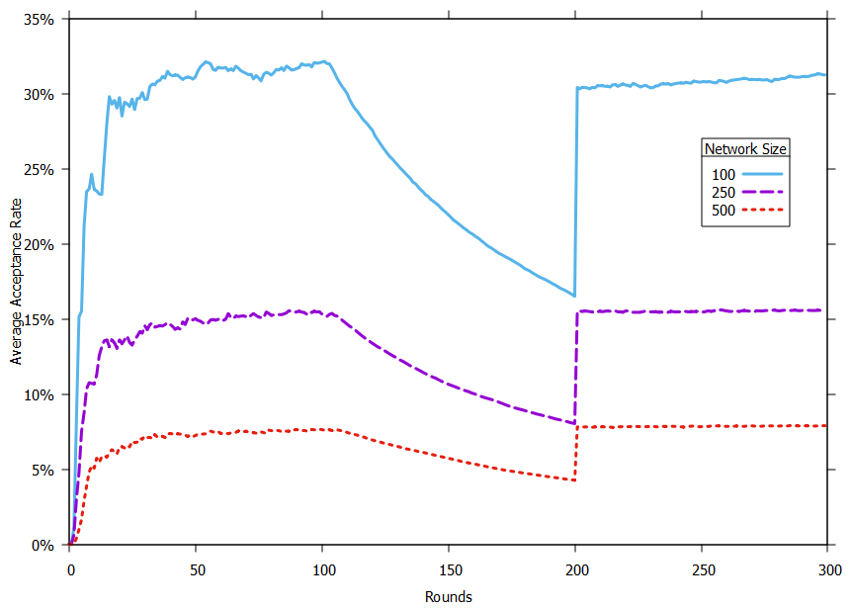
Changing Pool Membership
block is accepted if everyone is mining on top of it
complete network from rounds 0 to 99, ⌊25⌋% of miners were selected to be the source pool from 100 to 199, and complete network thereafter
dip caused by the source pool miners not receiving the blocks!

Slide 27
Changing Pool Membership
one mining pool containing entire network
network split into two mining pools
one mining pool containing entire network
⌊25⌋%
complete
network
complete
network
rounds:
rounds:
rounds:
0-99
100-199
200-299

Slide 28
Changing Pool Membership
block is accepted if everyone is mining on top of it
complete network from rounds 0 to 99, ⌊25⌋% of miners were selected to be the source pool from 100 to 199, and complete network thereafter
dip caused by the source pool miners not receiving the blocks!

Slide 29
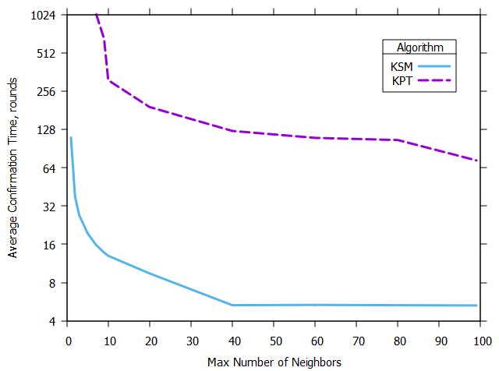
Confirmation Time for Varying Neighborhood Size
observing how the neighborhood size affects the time it takes KPT and KSM to confirm the blocks
network size: 100; source pool was fixed at 75 miners
computation lengths: 12·PT
blocks propagate faster the more you relax the restriction on the number of actual neighbors a miner can have, causing a drop in confirmation time

Slide 30
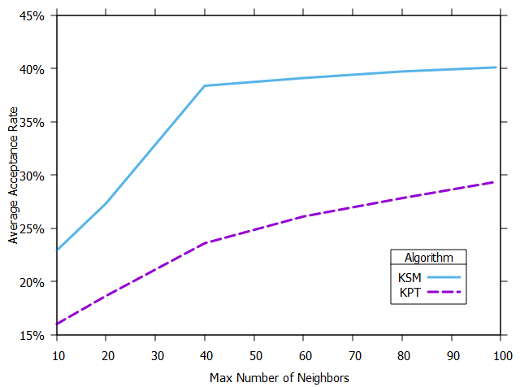
Acceptance Rate for Varying Neighborhood Size
observing how the neighborhood size affects the number of blocks our algorithms accept
network size: 100; source pool was fixed at 75 miners
computation lengths: 12·PT
blocks propagate faster the more you relax the restriction on the number of actual neighbors a miner can have, causing an increase in the number of blocks accepted

Slide 31
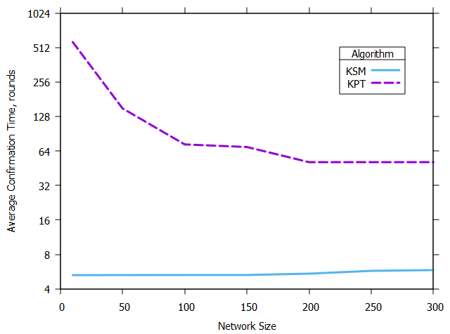
Confirmation Time as Network Scales Up
observing the performance of the two algorithms as the network scale changes
source pool size is fixed at ⌊75⌋% of the network size
computation lengths: 12·PT
KPT: more potential journeys as network size increases → KPT accepts blocks faster
KSM: more source pool members have to collaborate as network size increases → KSM accepts blocks slightly slower
Notes:
Question: do KPT and KSM converge at a specific value? If so, what values?

Slide 32
Conclusion
we explored competitive consensus in communication-limited (dynamic) networks
we established general possibility boundaries
presented and evaluated algorithms that solve consensus in known propagation delay or root membership
are these conditions necessary? future research!
Thank you!
. . .
a
g
Questions?
. . .
b

Slide 33
Future Enhancements
Notes:
Known upper bound when the source pool is closed
Miner sends only its longest branch, not entire tree
Communication over link is delayed (i.e., arbitrarily long), not instantaneous
Relaxing the assumptions for our algorithms

