Slide 1
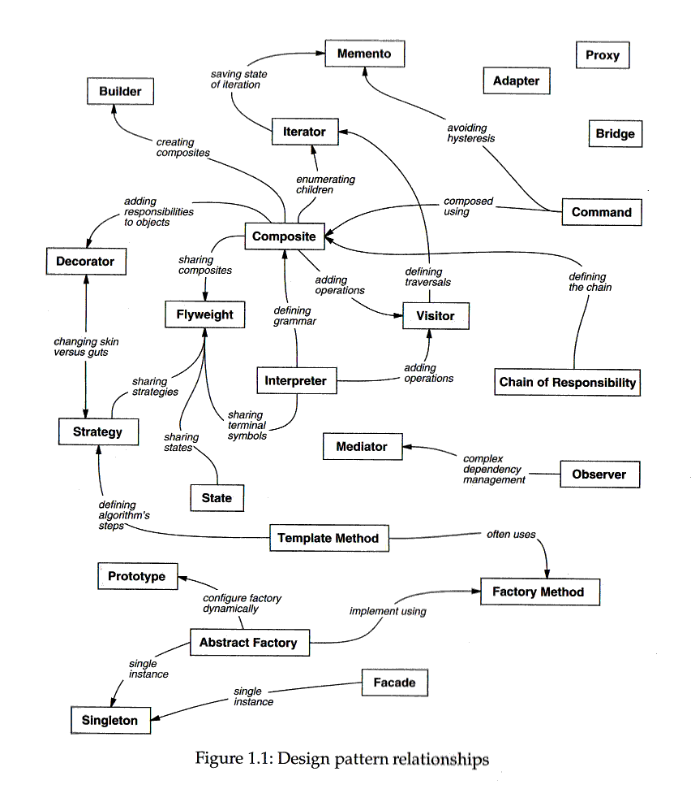
Design Pattern Relationships
did not study
non-canonical
look up prototypes
Registry
look up subjects

