Slide 1
Chapter 3 – Agile Software Development
Lecture 1

Slide 2
Rapid software development
Rapid development and delivery is now often the most important requirement for software systems
Businesses operate in a fast –changing requirement and
it is practically impossible to produce a set of stable software requirements
Software has to evolve quickly to reflect changing business needs.
Rapid software development
Specification, design, and implementation are inter-leaved
System is developed as a series of versions with stakeholders involved in version evaluation
User interfaces are often developed using an IDE and graphical toolset.

Slide 3
Agile methods
Dissatisfaction with the overheads involved in software design methods of the 1980s and 1990s led to the creation of agile methods. These methods:
Focus on the code rather than the design
Are based on an iterative approach to software development
Are intended to deliver working software quickly and evolve this quickly to meet changing requirements.
The aim (goal) of agile methods is to:
reduce overheads in the software process (e.g. by limiting documentation) and
be able to respond quickly to changing requirements without excessive rework.

Slide 4
Agile manifesto
We are uncovering better ways of developing software by doing it and helping others do it. Through this work we have come to value:
Individuals and interactions over processes and tools
Working software over comprehensive documentation
Customer collaboration over contract negotiation
Responding to change over following a plan
That is, while there is value in the items on the right, we value the items on the left more.

Slide 5
The principles of agile methods
Principle | Description
Customer involvement | Customers should be closely involved throughout the development process. Their role is provide and prioritize new system requirements and to evaluate the iterations of the system.
Incremental delivery | The software is developed in increments with the customer specifying the requirements to be included in each increment.
People not process | The skills of the development team should be recognized and exploited. Team members should be left to develop their own ways of working without prescriptive processes.
Embrace change | Expect the system requirements to change and so design the system to accommodate these changes.
Maintain simplicity | Focus on simplicity in both the software being developed and in the development process. Wherever possible, actively work to eliminate complexity from the system (refactoring).

Slide 6
Agile method applicability
Product development where a software company is developing a small or medium-sized product for sale.
Custom system development within an organization,
where there is a clear commitment from the customer to become involved in the development process and
where there are not a lot of external rules and regulations that affect the software.
Because of their focus on small, tightly-integrated teams, there are problems in adapting agile methods to large systems.

Slide 7
Problems with agile methods
It can be difficult to keep the interest of customers who are involved in the process.
Team members may be unsuited to the intense involvement that characterizes agile methods.
Prioritizing changes can be difficult where there are multiple stakeholders.
Maintaining simplicity requires extra work.
Contracts may be a problem as with other approaches to iterative development.

Slide 8
Plan-driven and agile development
Plan-driven development
Not necessarily waterfall model – plan-driven incremental development is possible
Iteration occurs within activities.
Agile development
Specification, design, implementation, and testing are inter-leaved and
the outputs from the development process are decided through a process of negotiation during the software development process.

Slide 9
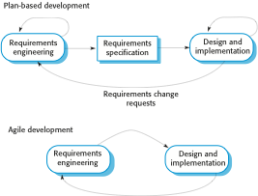
Plan-driven and agile specification

Slide 10
Example of Agile process: Extreme programming (XP)
Perhaps the best-known and most widely used agile method.
Extreme Programming (XP) takes an ‘extreme’ approach to iterative development.
New versions may be built several times per day;
Increments are delivered to customers every 2 weeks;
All tests must be run for every build and the build is only accepted if all tests run successfully.

Slide 11
XP and agile principles
Customer involvement means full-time customer engagement with the team.
Incremental development is supported through small, frequent system releases (i.e. every 2 weeks).
People not process through
pair programming,
collective ownership, and
a process that avoids long working hours (no large amount of overtime).
Change supported through regular system releases.
Maintaining simplicity through constant code refactoring (Improving code quality).

Slide 12
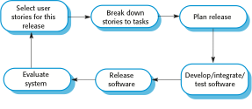
The XP Release Cycle

Slide 13
Extreme Programming Practices (a)
Principle or practice | Description
Incremental planning | Requirements are recorded on story cards and the stories to be included in a release are determined by the time available and their relative priority. The developers break these stories into development ‘Tasks’. See Figures 3.5 and 3.6.
Small releases | The minimal useful set of functionality that provides business value is developed first. Releases of the system are frequent and incrementally add functionality to the first release.
Simple design | Enough design is carried out to meet the current requirements and no more.
Test-first development | An automated unit test framework is used to write tests for a new piece of functionality before that functionality itself is implemented.
Refactoring | All developers are expected to refactor the code continuously as soon as possible code improvements are found. This keeps the code simple and maintainable.

Slide 14
Extreme programming Practices (b)
Pair programming | Developers work in pairs, checking each other’s work and providing the support to always do a good job.
Collective ownership | The pairs of developers work on all areas of the system, so that no islands of develop expertise and all the developers take responsibility for all of the code. Anyone can change anything.
Continuous integration | As soon as the work on a task is complete, it is integrated into the whole system. After any such integration, all the unit tests in the system must pass.
Sustainable pace | Large amounts of overtime are not considered acceptable as the net effect is often to reduce code quality and medium term productivity
On-site customer | A representative of the end-user of the system (the customer) should be available full-time for the use of the XP team. In an extreme programming process, the customer is a member of the development team and is responsible for bringing system requirements to the team for implementation.

Slide 15
Requirements Scenarios
In XP, a customer or user is part of the XP team and is responsible for making decisions on requirements.
User requirements are expressed as scenarios or user stories.
These are written on cards and the development team break them down into implementation tasks. These tasks are the basis of schedule and cost estimates.
The customer chooses the stories for inclusion in the next release based on their priorities and the schedule estimates.

Slide 16
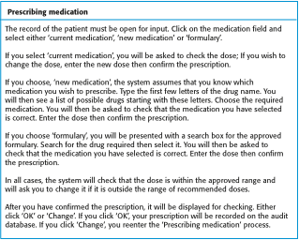
A ‘prescribing medication’ story

Slide 17
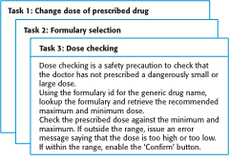
Examples of task cards for prescribing medication

Slide 18
Refactoring
Programming team look for possible software improvements and make these improvements even where there is no immediate need for them.
This improves the understandability of the software and so reduces the need for documentation.
Changes are easier to make because the code is well-structured and clear.
However, some changes requires architecture refactoring and this is much more expensive.

Slide 19
Examples of refactoring
remove duplicate code.
renaming attributes and methods to make them easier to understand.
The replacement of long parameter list with a struct or a class types to ease calling.

Slide 20
Testing in XP
Testing is central to XP and XP has developed an approach where the program is tested after every change has been made.
XP testing features:
Test-first development.
Incremental test development from scenarios.
User involvement in test development and validation.
Automated test harnesses are used to run all component tests each time that a new release is built.

Slide 21
Test-first development
Writing tests before code clarifies the requirements to be implemented.
Tests are written as programs rather than data so that they can be executed automatically. The test includes a check that it has executed correctly.
Usually relies on a testing framework such as Junit (for java programs).
All previous and new tests are run automatically when new functionality is added, thus checking that the new functionality has not introduced errors.

Slide 22
Customer involvement
The role of the customer in the testing process is to help develop acceptance tests for the stories that are to be implemented in the next release of the system.
The customer who is part of the team writes tests as development proceeds.
All new code is therefore validated to ensure that it is what the customer needs.
However, people adopting the customer role have limited time available and so cannot work full-time with the development team.
They may feel that providing the requirements was enough of a contribution and so may be reluctant (unwilling, hesitant) to get involved in the testing process.

Slide 23
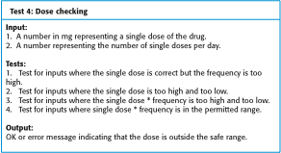
Test case description for dose checking

Slide 24
Advantages of pair programming
It supports the idea of collective ownership and responsibility for the system.
Individuals are not held responsible for problems with the code. Instead, the team has collective responsibility for resolving these problems.
It acts as an informal review process because each line of code is looked at by at least two people.
It helps support refactoring, which is a process of software improvement.
Where pair programming and collective ownership are used, others benefit immediately from the refactoring so they are likely to support the process.

