Slide 1
CS 43118 & CS 53118
ST: Graph and Social Network Analysis
Chapter 3: Types of Networks and its Applications
Niranjan Rai
Department of Computer Science
Kent State University

Slide 2
Types of Networks
Road Networks
Biological Networks
Bibliography Networks
Social Networks
Geo-social Networks

Slide 3
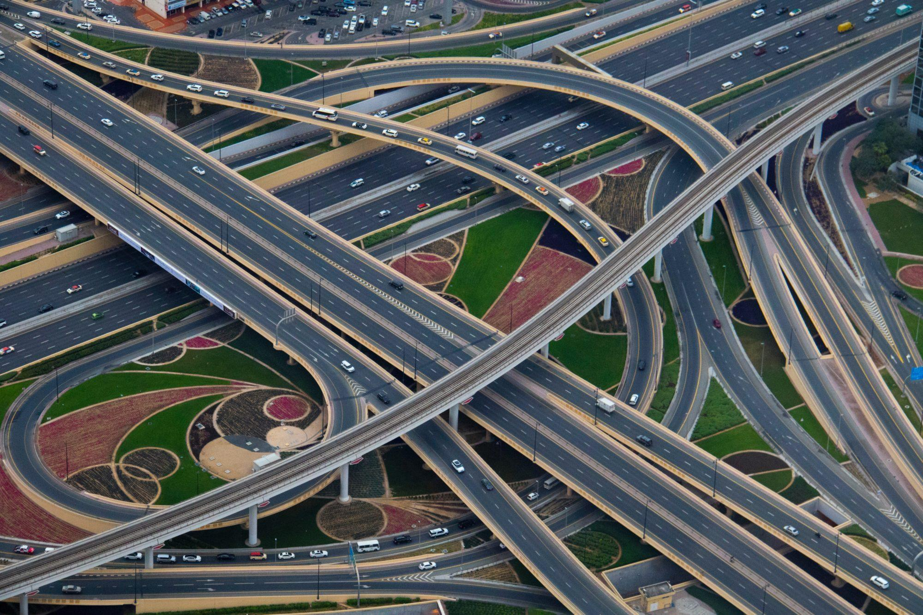
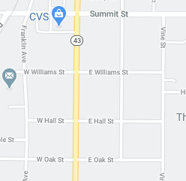
Road Networks
A graph, G = (V, E), where an intersection or POI are the vertices whereas the road connecting them are the edges
Connection of roads (Streets, Highway, Freeway)
Applications:
Location Services / GPS
GIS (Geographic Information System)

Slide 4
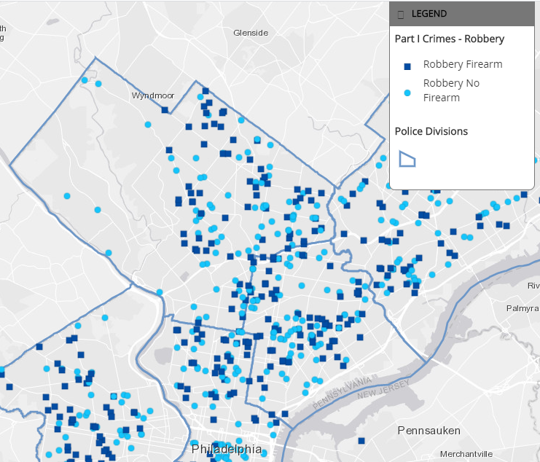
GIS
Framework for gathering, managing, and analyzing data.
Especially using the geography and spatial information.
Road Network plays a vital role in GIS.
Example: Understanding the drug use in different neighborhood, crime rates in different geographical locations, etc.
Fig: Crime rates data in Philadelphia ^{[1]}

Slide 5
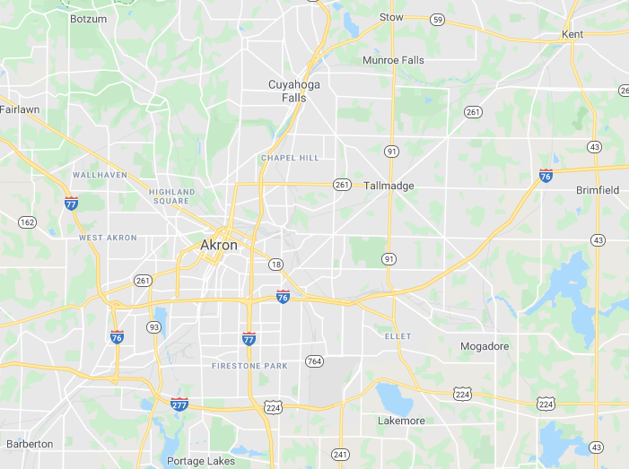
Location Services
Road Network is very important in location services such as google maps
It helps visualize the geography and roads
Allows to generate the shortest path as well as other available path from source to destination
Allows users to see where they are located
Fig: Google Maps^{[2]}

Slide 6
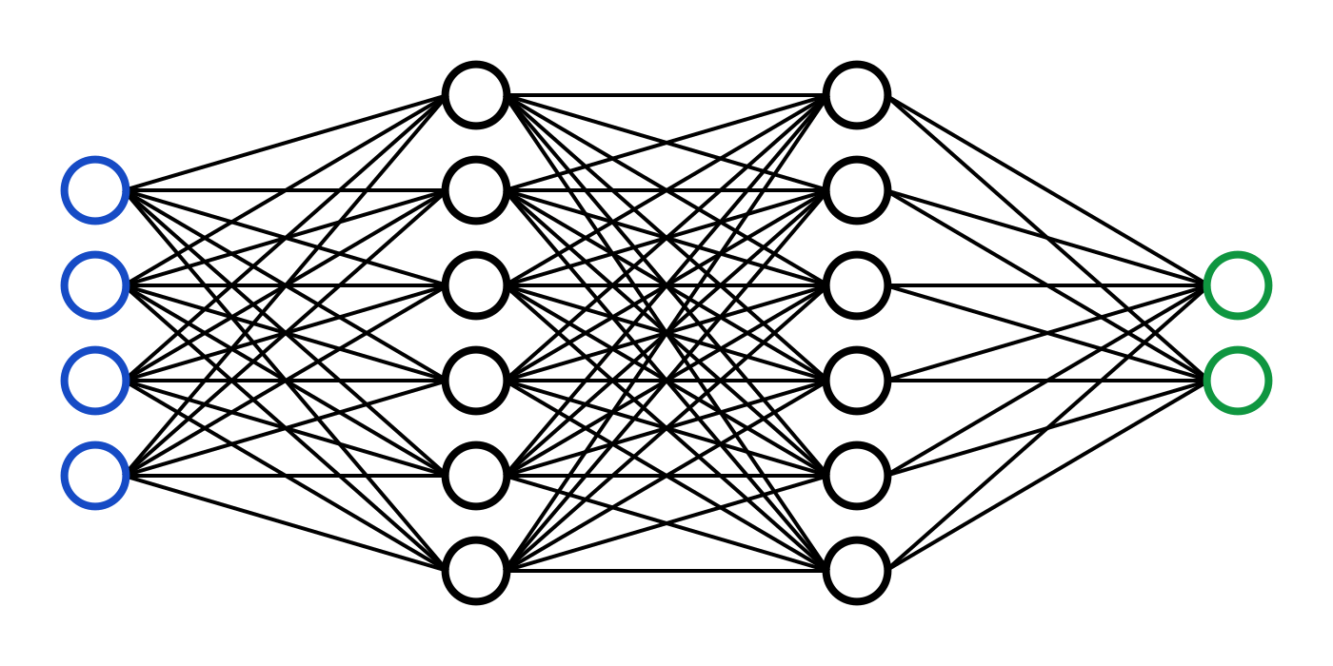
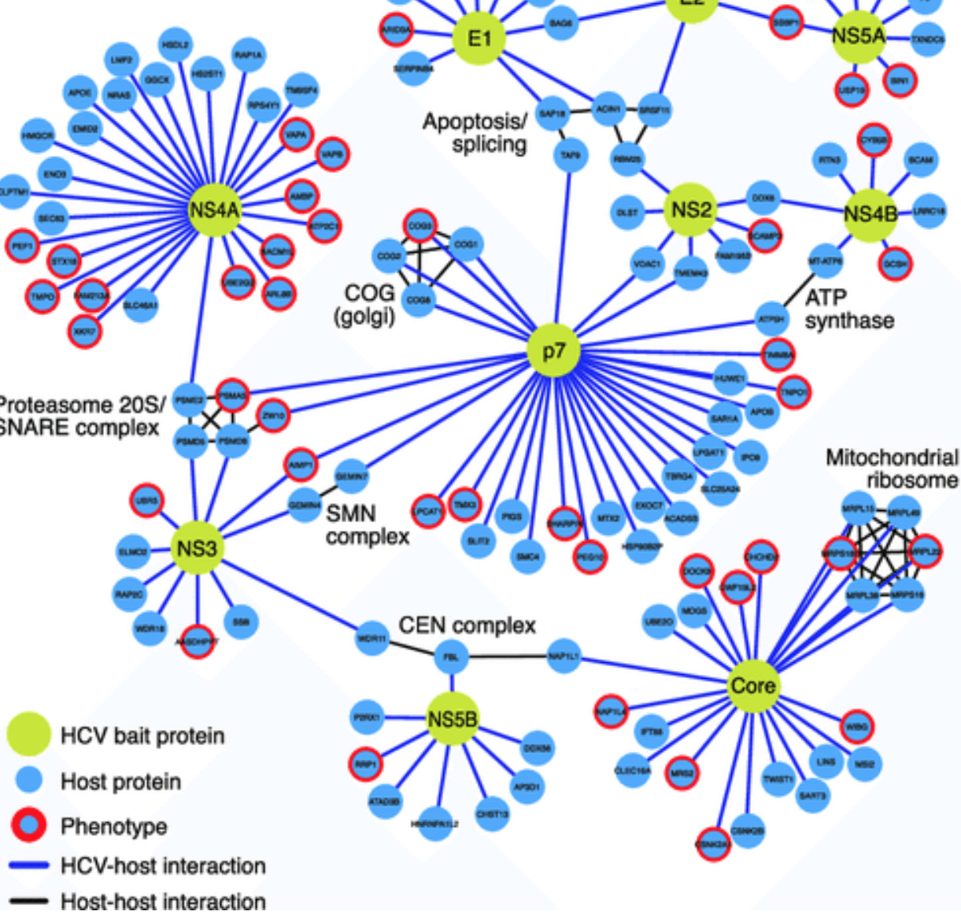
Biological Networks
Any network that applies to biological systems
Provides a mathematical representation of connections found in ecological, evolutionary, and physiological studies
Wide range of applications, such as:
Network medicine
Protein-Protein interaction (PPI) networks
Gene regulatory networks (DNA-protein interaction networks)
Fig: Neural Network
Fig: PPI Network

Slide 7
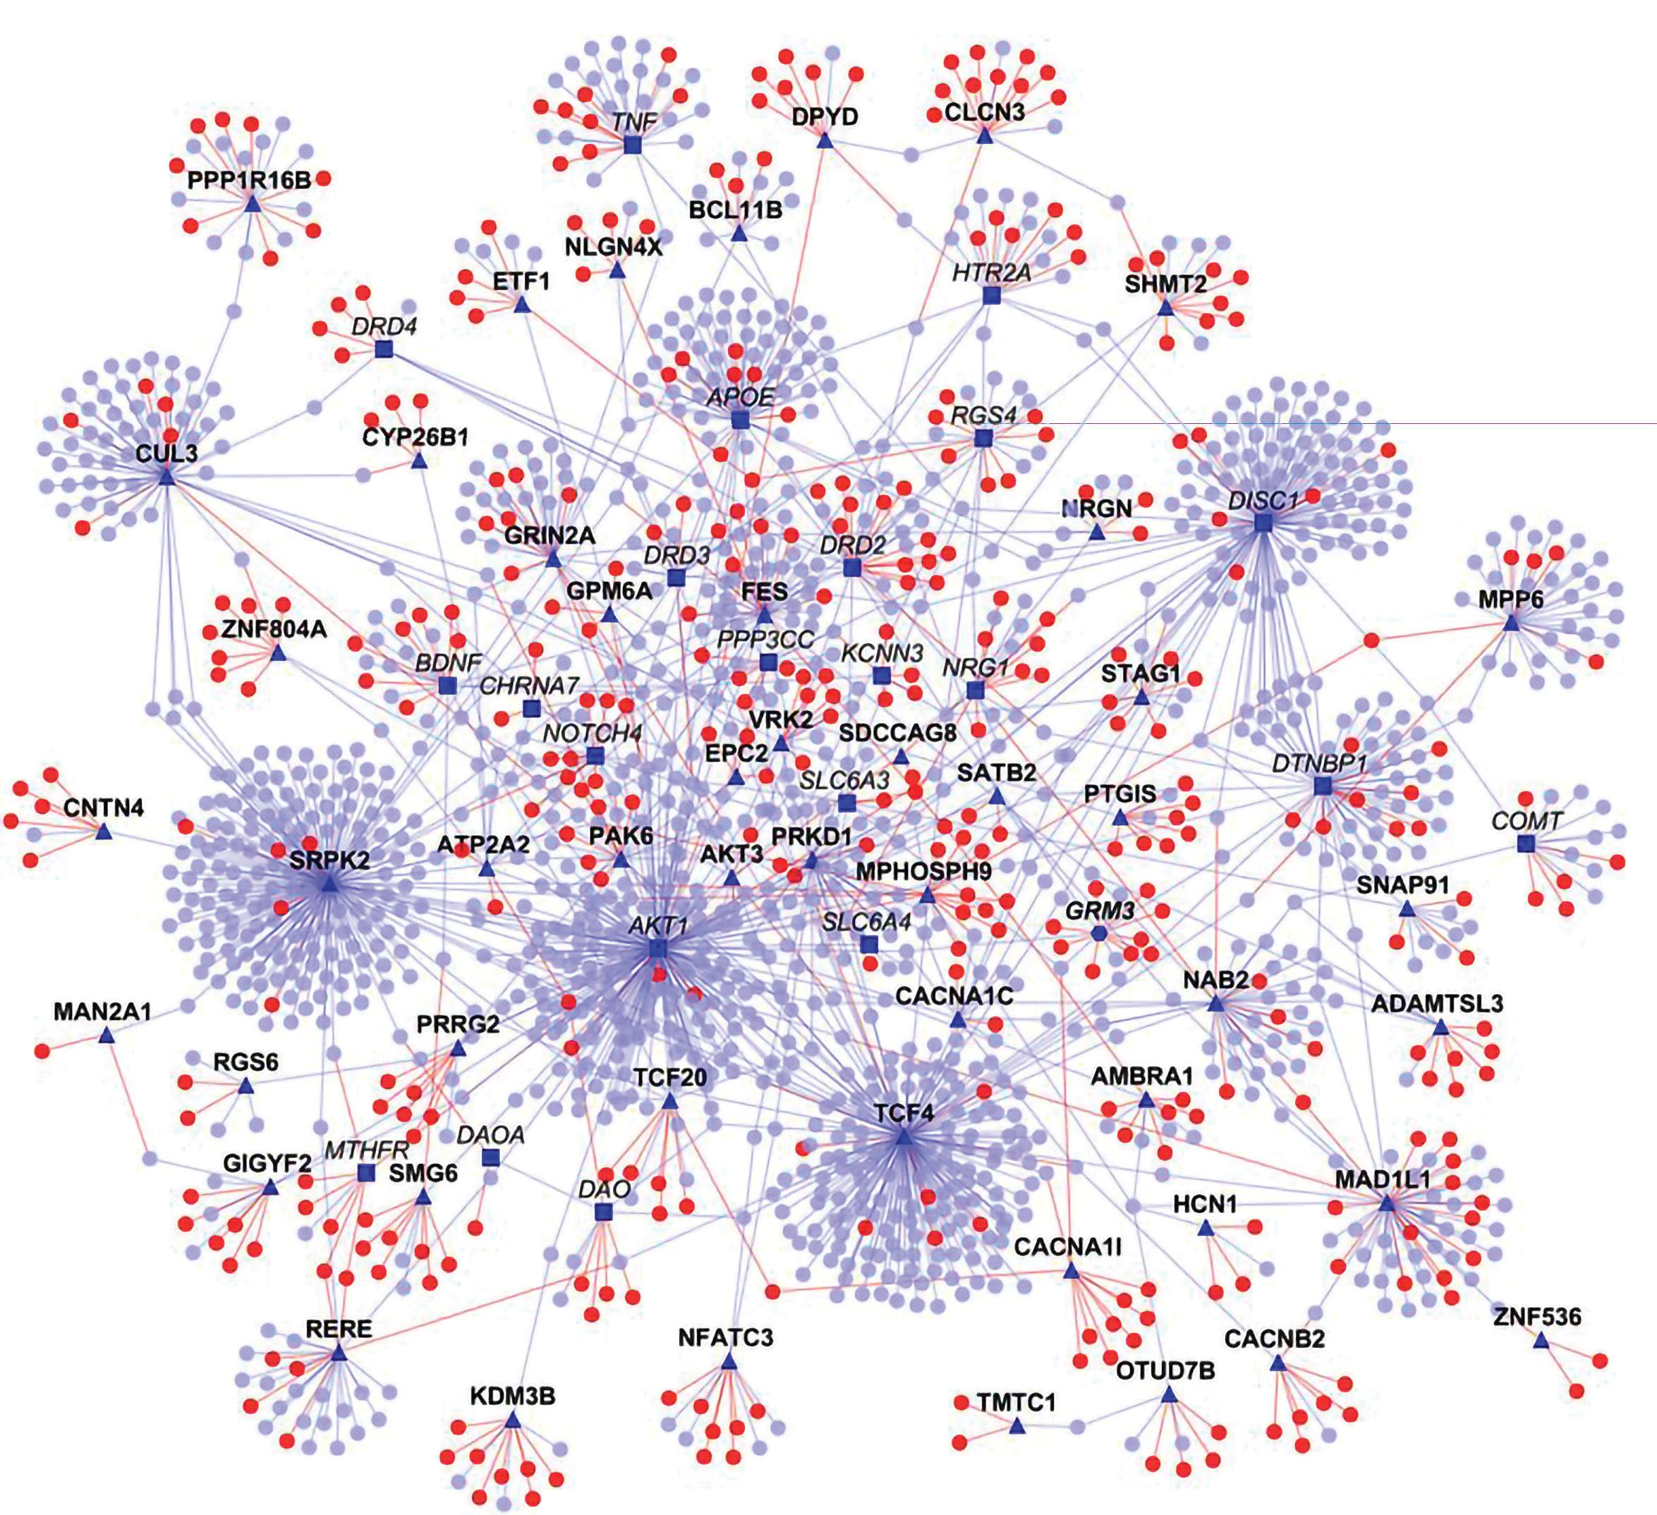
Protein-Protein Interaction (PPI) Network
Proteins as nodes and their interaction as edges
Usually the edges are undirected and weighted to incorporate reliability information associated to the corresponding interaction
Most intensely analyzed networks in biology
Fig: PPI Network
Notes:
https://www.sciencedirect.com/topics/biochemistry-genetics-and-molecular-biology/protein-protein-interaction-networks
https://www.ncbi.nlm.nih.gov/pmc/articles/PMC4017556/

Slide 8
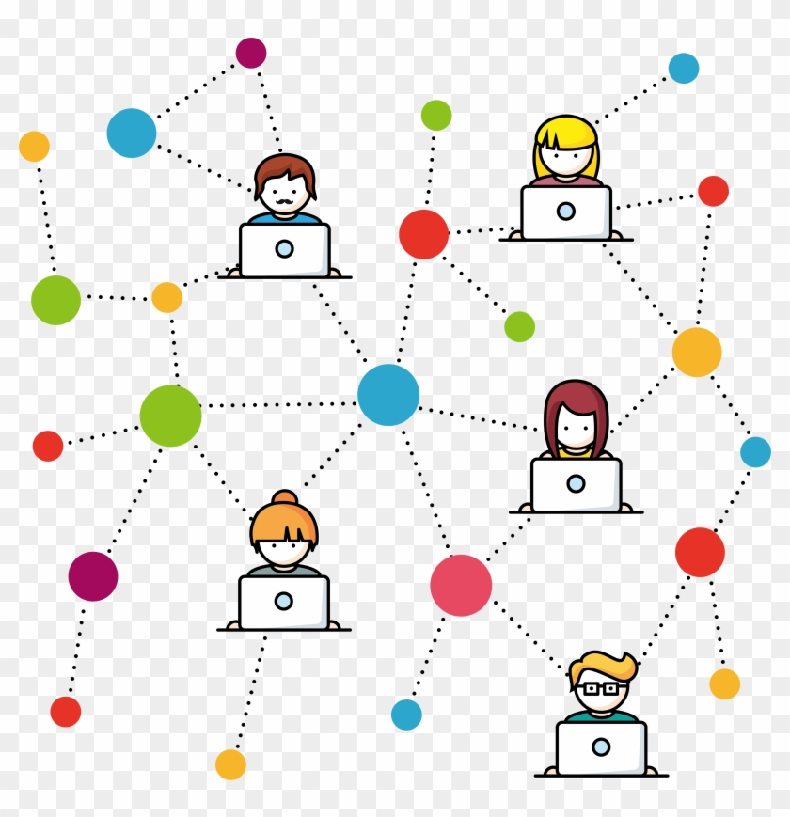
Social Networks
Network of social actors (such as individual or organizations)
Individual/Organization are the nodes and connection/friendship/followers are the edges
Used to analyze and investigate the structure as well as different patterns in social settings
Common social networks:
Facebook
Twitter
Instagram

Slide 9
Bibliography Networks
Network of citations of paper, co-author relationships, and author nodes
Research papers or links are the nodes and the papers or links that cites or are cited in those papers are the edges
Helps understand and analyse the links between papers and also the influence of a paper

Slide 10
Geo-Social Networks
Social network with spatial feature
Each node may have multiple check-in locations
Helps analyse the behavior and trends among a community of people for a specific geographical location

Slide 11
References
[1] Crime rate data for Philadelphia. http://modelpd.maps.arcgis.com/apps/MapJournal/index.html?appid=3fa8f73b99e047d093447cbf9f7af1e3&webmap=f56a5720743c4297949371f9534bbdd4
[2]. Google Maps.

