Slide 1
CS 43118 & CS 53118
ST: Graph and Social Network Analysis
Chapter 4: Introduction to Social Network Analysis
Niranjan Rai
Department of Computer Science
Kent State University

Slide 2
What is Network?
Actors / nodes / vertices / points
Ties / edges / arcs / lines / links

Slide 3
Dyads, Triads and Relations
actor
dyad
triad
Friendship /kinship/ follower
Relation: collection of specific ties

Slide 4
What is Social Network?
Actors / nodes / vertices / points
Individuals / Celebrities
Ties / edges / arcs / lines / links
Friendship / Followers
Colleagues / Acquaintance
Collaboration

Slide 5
What is Social Network Analysis?
Process of investigating social structures through the use of networks and graph theory^{[1]}
Hallmarks for social network analysis:
Understand relationships between actors as well as attributes of actors
A molecular rather than atomistic view
Structure affects substantive outcomes

Slide 6
Why Study Social Networks?
Wide range of applications:
Security applications
Textual analysis applications
Internet applications
Business applications

Slide 7
Key Concepts and Measures in Network Analysis
Distributions
Bridge
Density
Distance
Centrality
Segmentation
Clustering
Clustering coefficient
Cohesion
Size
Connections
Homophily
Multiplexity
Mutuality/Reciprocity
Network Closure
Propinquity

Slide 8
Size
The number of members in a given network
How many people in a network?
Figure (a) has size 3 and (b) has size 7
(a)
(b)

Slide 9
Connections
Homophily
Multiplexity
Mutuality/Reciprocity
Network Closure
Propinquity

Slide 10
Homophily / Assortativity
Measure of how actors form ties/edges with other similar actors versus dissimilar others
Similarity can be defined by gender, race, age, occupation, status, educational achievement or any salient characteristics
For example, in the table below, male had 32 male friends and only 12 female friends whereas female had 15 male friends and 45 female friends on average
 | Male | Female
Male | 32 | 12
Female | 15 | 45

Slide 11
Multiplexity
Number of content-forms contained in a tie
For example, two people who are friends and also work together have multiplexity of 2
friends
colleagues

Slide 12
Mutuality / Reciprocity
Extent to which two actors reciprocate each others friendship or other interaction
For example: Friends in Facebook are mutual (100% reciprocity) , followers may or may not be reciprocal in Twitter / Instagram
follows
follows
Mutual
Non-mutual

Slide 13
Network Closure / Triadic Closure
Network Closure: measure of the completeness of relational triads
Tendency that A-C are friends, if A-B and B-C are friends
Helps understand and predict the growth of networks
Transitivity: An individual’s assumption of network closure
friend
friend

Slide 14
Distributions
Bridge
Density
Distance
Centrality

Slide 15
Bridge
An individual whose weak ties fill a structural hole
Provides the only link between two individuals or clusters
Bridge
Notes:
Granovetter, M. (1973). "The strength of weak ties". American Journal of Sociology. 78 (6): 1360–1380. doi:10.1086/225469.

Slide 16
Distance
Minimum number of edges required to connect two particular actors / nodes
What is the distance between A and B?
B
A

Slide 17
Density
The proportion of direct ties in network to total number possible
i.e. density = no. of edges, |E| / total possible edges, |V| * (|V|-1)/2
In fig, density = 13 / 21

Slide 18
Centrality^{[2]}
Measure of interaction between individuals
Identifies the most important (influential) vertices / individuals within the network
Types:
Degree centrality
Closeness centrality
Betweenness centrality

Slide 19
Degree Centrality
Who knows the most actors / nodes?
Who has the highest degree?
Helps interpret risk of catching whatever is flowing through the network (e.g. virus, messages, etc.)

Slide 20
Closeness Centrality
Who has the shortest distance to other actors?
How fast can this person reach everyone in the network?

Slide 21
Betweenness Centrality
The number of times a node lies on the shortest path between other nodes
Who controls knowledge flows?

Slide 22
Segmentations
Clustering
Clustering coefficient
Cohesion

Slide 23
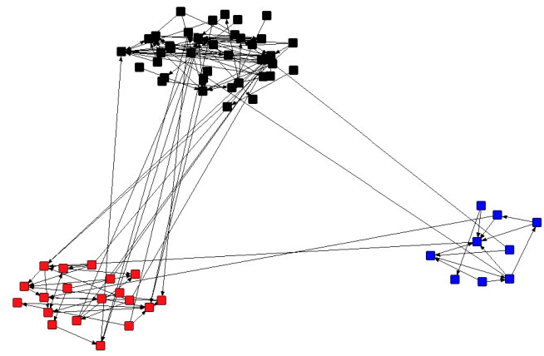
Cluster
A cluster is a group of similar things or people positioned closely together
Similarly, a cluster in a social network is a collection of actors with dense friendship patterns internally and sparse externally

Slide 24
Clustering Coefficient
Measure of degree to which nodes tend to cluster together
Higher clustering coefficient indicates a greater ‘cliquishness’ (togetherness) or more clusters
Types:
Local clustering coefficient
Global clustering coefficient

Slide 25
Local Clustering Coefficient
Quantifies how close its neighbors are to being complete graph
Proportion of links between the vertices within its neighborhood divided by total links possible between them

Slide 26
Global Clustering Coefficient
Based on a triplets of nodes
Triplet is three nodes connected by two (open triplet) or three (closed triplet) undirected ties
Number of closed triplets over total number of triplets (open and closed) in the network
GCC = number of closed triplets / number of all triplets
Open triplet
Closed triplet

Slide 27
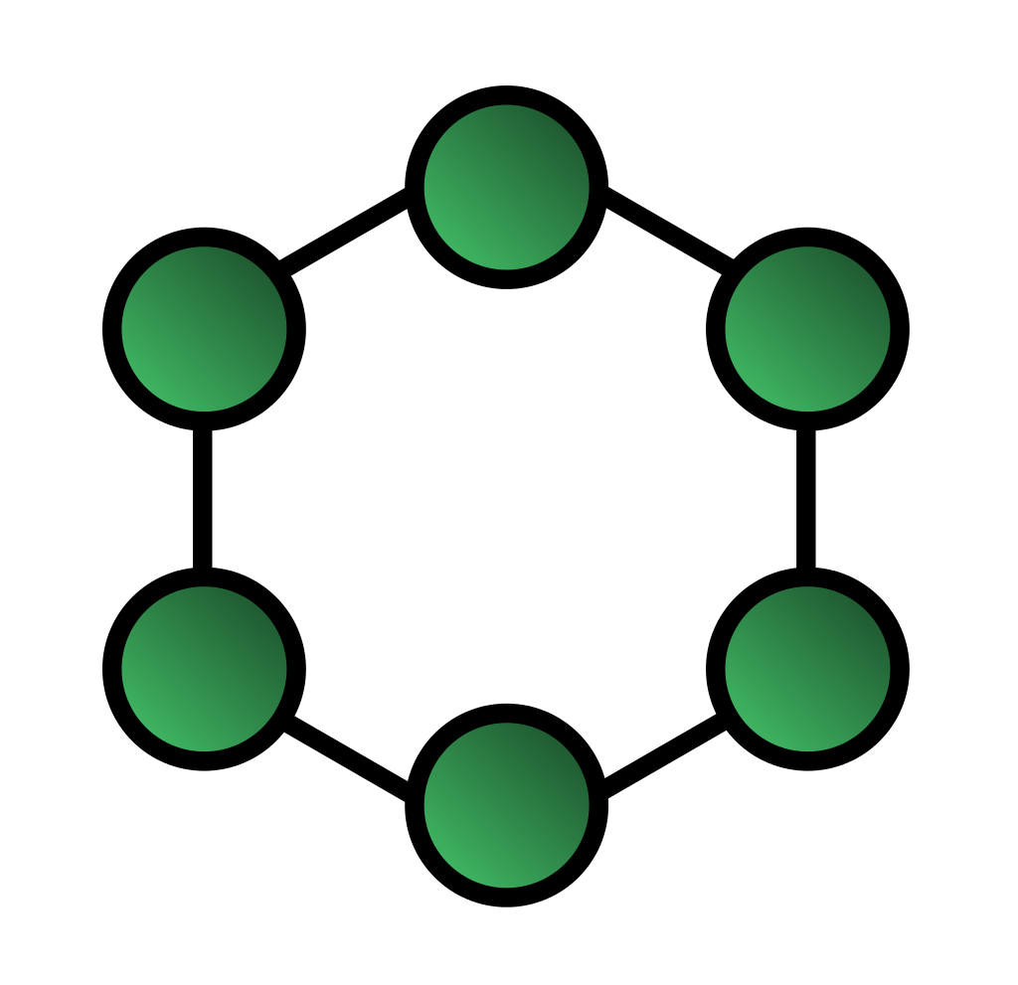
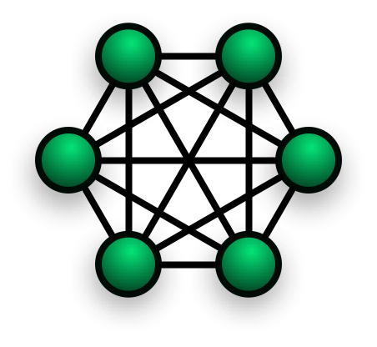
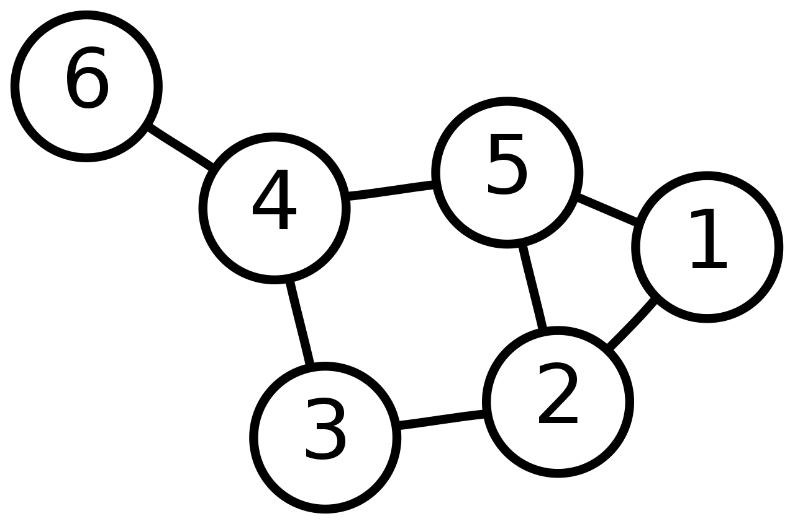
Cohesion
The degree to which actors are connected directly to each other by cohesive bonds.
Structural cohesion = minimum number of members who, if removed from group, would disconnect the group

Slide 28
References
Wikipedia contributors. (2020, August 30). Social network analysis. In Wikipedia, The Free Encyclopedia. Retrieved 02:38, September 1, 2020, from https://en.wikipedia.org/w/index.php?title=Social_network_analysis&oldid=975713301
Wikipedia contributors. (2020, September 1). Centrality. In Wikipedia, The Free Encyclopedia. Retrieved 02:37, September 1, 2020, from https://en.wikipedia.org/w/index.php?title=Centrality&oldid=976497756

