Slide 1
CS 43118 & CS 53118
ST: Graph and Social Network Analysis
Chapter 6: Properties of Social Network
Niranjan Rai
Department of Computer Science
Kent State University

Slide 2
In this chapter, we will
Learn about different level of social network analysis
Learn about some important structures in social networks

Slide 3
Properties of Social Network Analysis
Level of analysis
Micro-level
Meso-level
Macro-level
Structures in Social Networks
Cliques
N-Cliques
N-clans
K-plexes
K-Cores
K-Truss

Slide 4
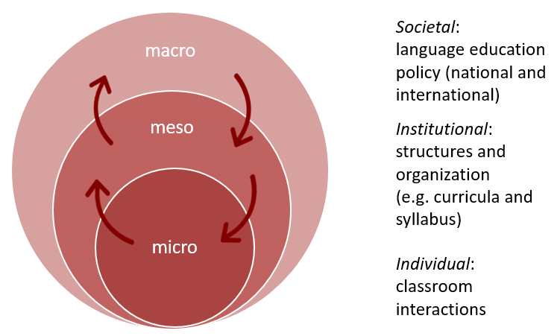
Different level of analysis
Source: https://www.researchgate.net/figure/The-multilayered-context-of-this-study-macro-meso-and-micro-levels_fig7_331396051
Notes:
https://www.researchgate.net/publication/331396051_Teachers'_Beliefs_and_Strategies_when_Teaching_Reading_in_Multilingual_Settings_Case_Studies_in_German_Swedish_and_Chilean_Grade_4_Classrooms

Slide 5
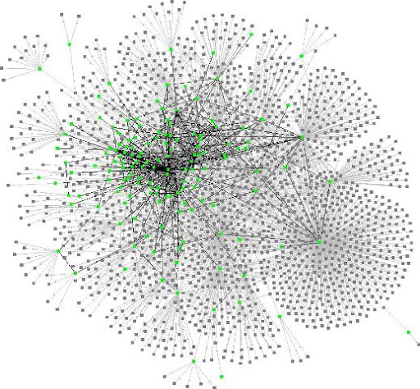
Why different level of analysis?
Global network analysis, all interpersonal relationships in the world is not feasible and likely to contain so much information as to be uninformative

Slide 6
Why different level of analysis?
Practical limitations of computing power, ethics and participant recruitment and payment also limit scope of social network analysis

Slide 7
Why different level of analysis?
Quality of information may be more important than its scale for understanding network properties

Slide 8
Micro-level analysis
Usually with individuals or may be with a small group.
It can also be in different levels
Actor level
Dyadic level
Triadic Level
Subset level

Slide 9
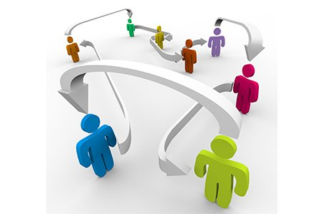
Actor Level
The smallest unit of analysis i.e., an “actor” or “ego”
Focuses on network characteristics such as size, relationship strength, density, centrality, prestige , and bridges etc.

Slide 10
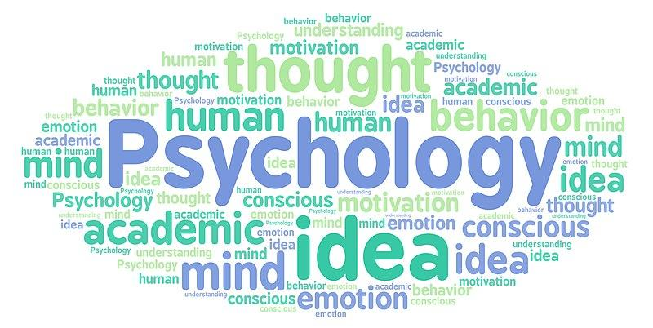
Actor Level
Such analyses, are most commonly used in the fields of psychology or social psychology, ethnographic kinship analysis or other genealogical studies of relationships between individuals

Slide 11
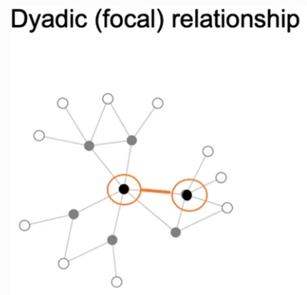
Dyadic Level
A dyad is a social relationship between two individuals.
Network research on dyads may concentrate on structure of the relationship (e.g. multiplexity, strength), social equality, and tendencies toward reciprocity/mutuality.

Slide 12
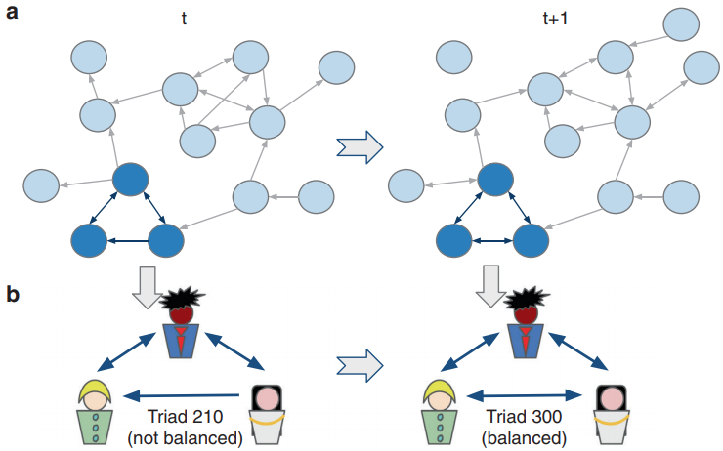
Triadic Level
Three individuals, one more individual added to a dyad
Research at this level may concentrate on factors such as balance and transitivity, as well as social equality and tendencies toward reciprocity/mutuality
triad
Notes:
https://www.nature.com/articles/s41467-019-10548-8

Slide 13
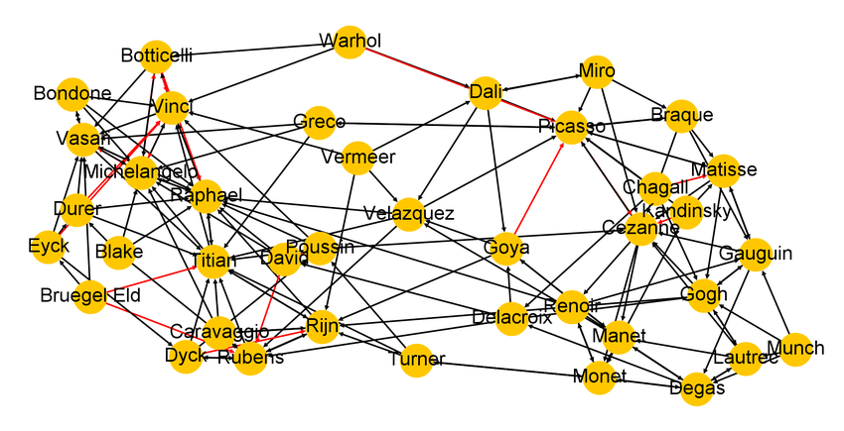
Triadic Level
Triads are key to social dynamics
The discord in a rivalrous love triangle is an example of an unbalanced triad
The dynamics of social friendships in society has been modeled by balancing triads
Notes:
https://www.nature.com/articles/s41467-019-10548-8

Slide 14
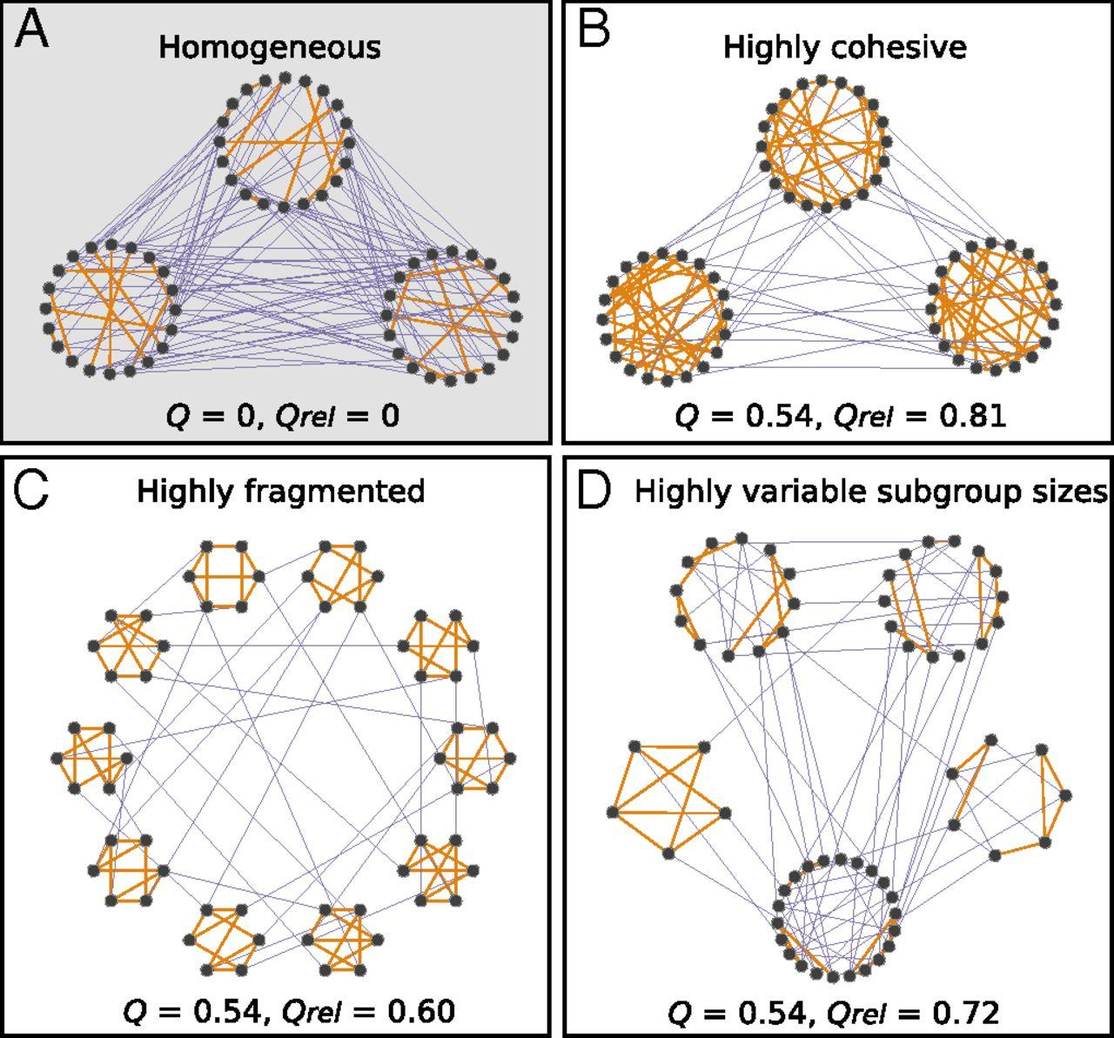
Subset Level
Also called subgroup analysis
Subset levels of network research problems begin at the micro-level, but may cross over into the meso-level of analysis
Notes:
https://www.pnas.org/content/114/16/4165/tab-figures-data

Slide 15
Subset Level
Examine and evaluate the social environment in a workplace such as connectedness, reciprocity, transitivity, or hierarchy, etc.
Subset level research may focus on distance and reachability, cliques, cohesive subgroups, or other group actions or behavior
Notes:
https://www.pnas.org/content/114/16/4165/tab-figures-data

Slide 16
Meso Level
In general, meso-level theories begin with a population size that falls between the micro- and macro-levels.
However, meso-level may also refer to analyses that are specifically designed to reveal connections between micro- and macro-levels
Meso-level networks are low density and may exhibit causal processes distinct from interpersonal micro-level networks

Slide 17
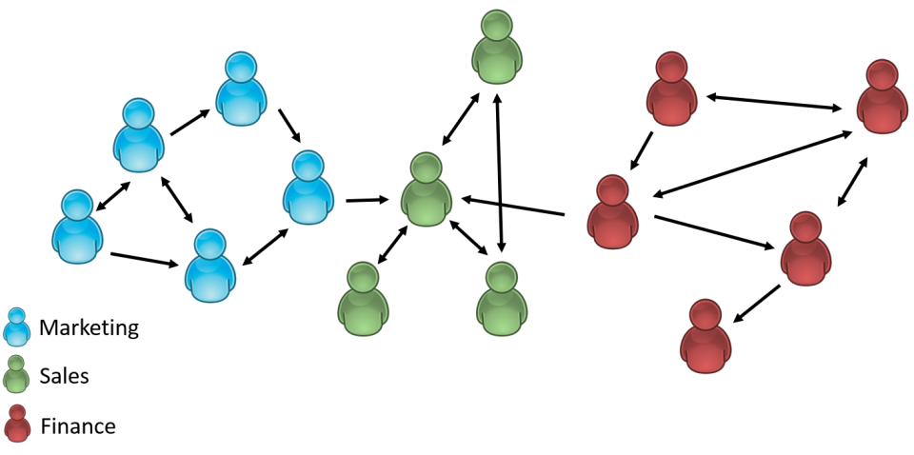
Organizations
Formal organizations are social groups that distribute tasks for a collective goal.
Network research on organizations may focus on either intra-organizational or inter-organizational ties in terms of formal or informal relationships.

Slide 18
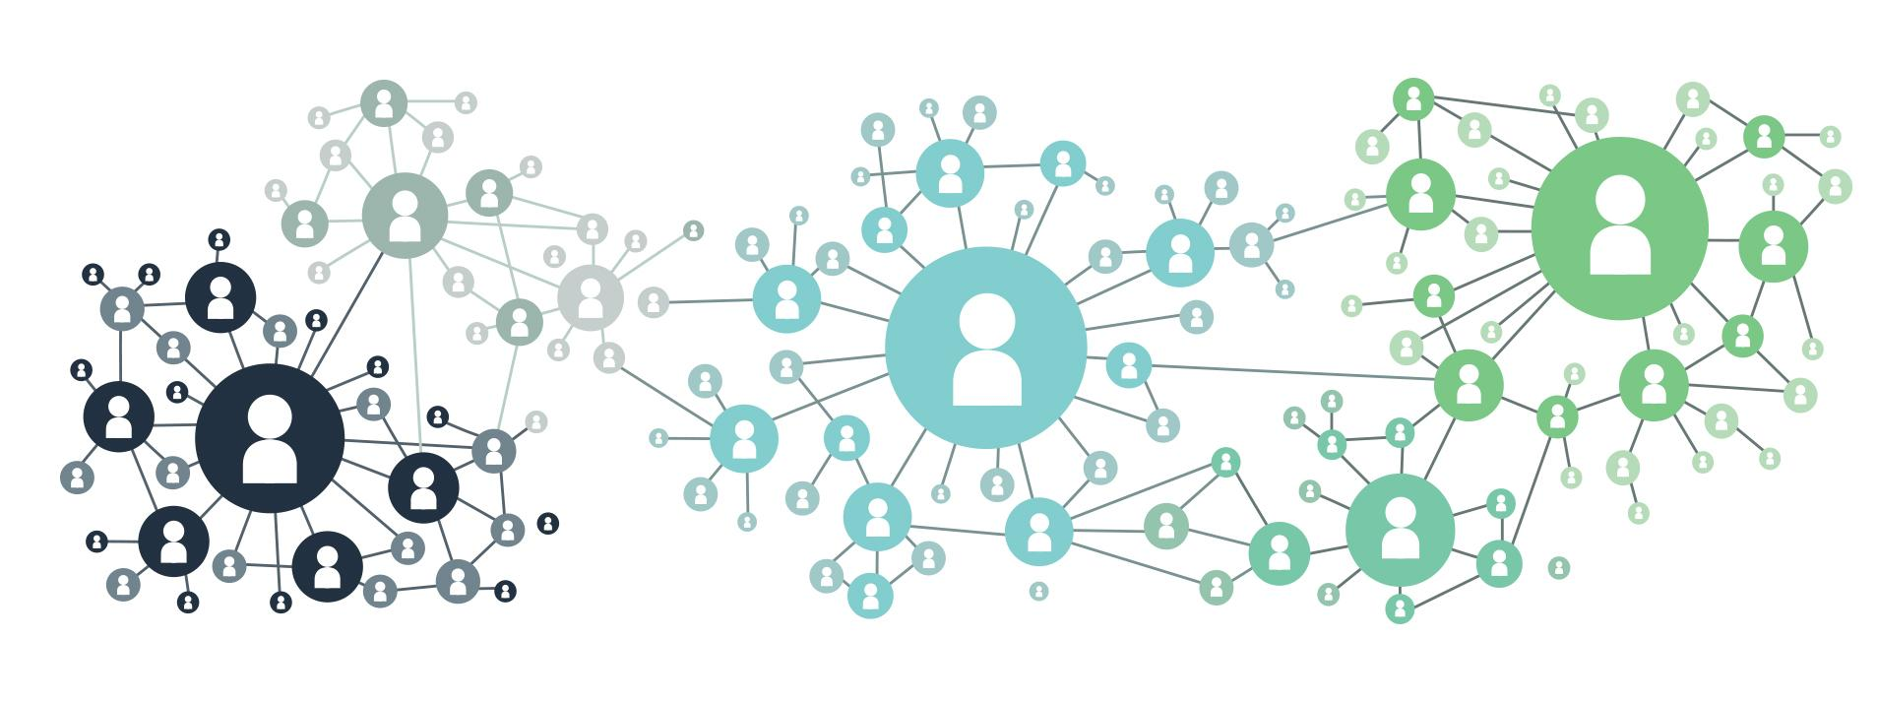
Organizations
Intra-organizational networks themselves often contain multiple levels of analysis, especially in larger organizations with multiple branches, franchises or semi-autonomous departments

Slide 19
Organizations
In these cases, research is often conducted at a work group level and organization level, focusing on the interplay between the two structures
Experiments with networked groups online have documented ways to optimize group-level coordination through diverse interventions, including the addition of autonomous agents to the groups

Slide 20
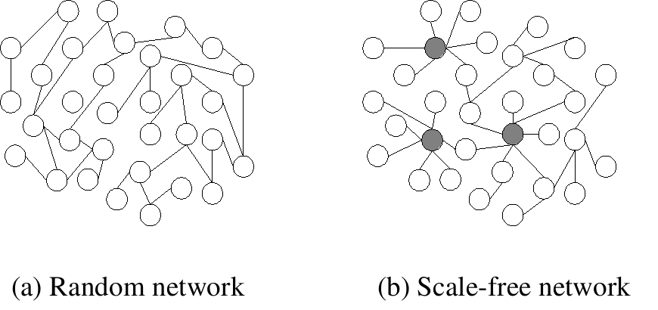
Scale-free Networks
A scale-free network is a network whose degree distribution follows a power law
The highest-degree nodes are often called "hubs", and may serve specific purposes in their networks
hubs

Slide 21
Scale-free Networks
Characteristic in a scale-free network is the
relative commonness of vertices with a degree that greatly exceeds the average
clustering coefficient distribution, which decreases as the node degree increases and also follows a power law

Slide 22
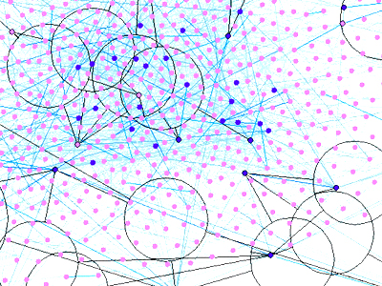
Macro Level
Rather than tracing interpersonal interactions, macro-level analyses generally trace the outcomes of interactions, such as economic or other resource transfer interactions over a large population

Slide 23
Large-Scale Networks
Large-scale network is a term somewhat synonymous with "macro-level" as used, primarily, in social and behavioral sciences, in economics
This level of analysis is to understand relationship between large communities or organizations

Slide 24
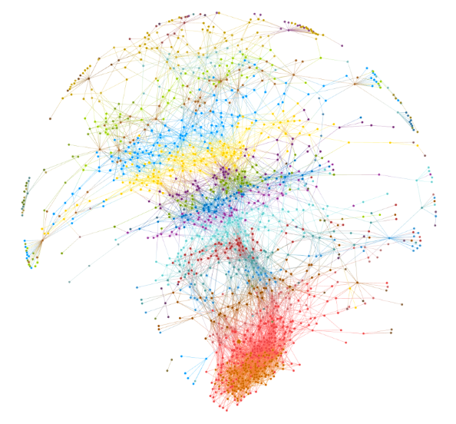
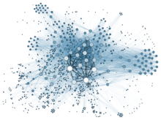
Complex Networks
Most larger social networks display features of social complexity, which involves substantial non-trivial features of network topology, with patterns of complex connections between elements

Slide 25
Complex Networks
Such complex network features include a heavy tail in the degree distribution, a high clustering coefficient, assortativity or dis-assortativity among vertices, community structure , and hierarchical structure

Slide 26
Structures in Social Networks
Cliques
N-Cliques
N-Clans
K-Plexes
K-Cores
K-Truss
Notes:
https://faculty.ucr.edu/~hanneman/nettext/C11_Cliques.html#subgraph

Slide 27
Cliques
Generally, a clique is a subset of a network in which the actors are more closely and intensely tied to one another than they are to other members of the network
In terms of friendship ties, for example, it is not unusual for people in human groups to form "cliques" on the basis of age, gender, race, ethnicity, religion/ideology, and many other things
Notes:
Effective Community Search over Large Spatial Graphs
http://www.vldb.org/pvldb/vol10/p709-fang.pdf

Slide 28
Cliques
“a clique is a subset of vertices of an undirected graph such that every two distinct vertices in the clique are adjacent; that is, its induced subgraph is complete” - Wikipedia
The "cliques" composed of two actors is a dyad. But dyads can be "extended" to become more and more inclusive -- forming strong or closely connected regions in graphs

Slide 29
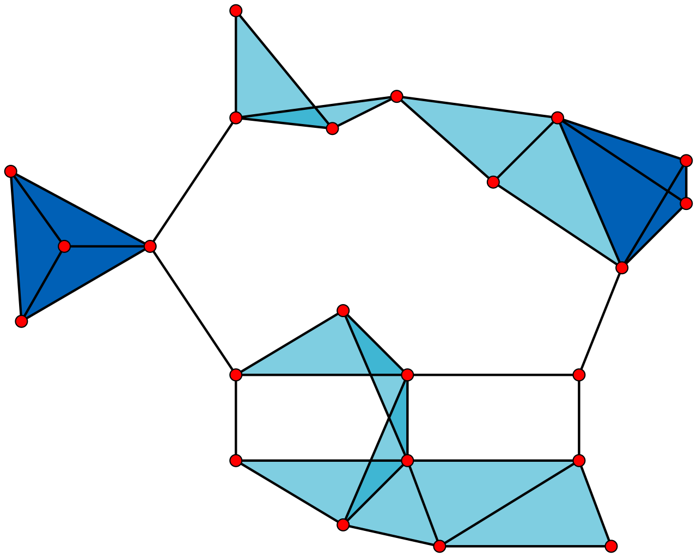
Cliques
A graph with
23 × 1-vertex cliques (the vertices or actors),
42 × 2-vertex cliques (the edges or dyads),
19 × 3-vertex cliques (light and dark blue triangles or triads), and
2 × 4-vertex cliques (dark blue areas).
Notes:
Effective Community Search over Large Spatial Graphs
http://www.vldb.org/pvldb/vol10/p709-fang.pdf

Slide 30
Cliques
A maximal clique is a clique that cannot be extended by including one more adjacent vertex, that is, a clique which does not exist exclusively within the vertex set of a larger clique
The 11 light blue triangles form maximal cliques

Slide 31
Cliques
A maximum clique of a graph, G, is a clique, such that there is no clique with more vertices
The two dark blue 4-cliques are both maximum and maximal, and the clique number of the graph is 4
Notes:
Clique (graph theory) https://en.wikipedia.org/wiki/Clique_(graph_theory)

Slide 32
Cliques
Insisting that every member of a clique be connected to every other member is a very strong definition of what we mean by a group
There are a number of ways in which this restriction could we relaxed
Two major approaches are
the N-clique/N-clan approach
the K-plex approach
Notes:
Clique (graph theory) https://en.wikipedia.org/wiki/Clique_(graph_theory)

Slide 33
N-Cliques
One alternative is to define an actor as a member of a clique if they are connected to every other member of the group at a distance greater than one.
Usually, the path distance of 2 is used (2-clique)"a friend of a friend"

Slide 34
N-Cliques
This approach to defining sub-structures is called N-clique, where N stands for the length of the path allowed to make a connection to all other members
Formal definition: “An n-clique of an undirected graph is a maximal subgraph in which every pair of vertices is connected by a path of length n or less”

Slide 35
Disadvantages of N-clique
The N-clique approach
tends to find long and stringy groupings rather than the tight and discrete ones of the maximal approach
In some cases, N-cliques is probably undesirable for many purposes
it is possible for members of N-cliques to be connected by actors who are not, themselves, members of the clique
For most sociological applications, this is quite troublesome
To overcome this problem
we can restrict the total span or path distance between any two members of an N-clique
The additional restriction has the effect of forcing all ties among members of an n-clique to occur by way of other members of the n-clique. This is the n-clan approach

Slide 36
N-Clans
Definition
An n-clique in which distance between nodes in the subgraph is no greater than n
Members of set within n links of each other without using outsider
N-clique approach allows an actor to be a member of a clique even if they do not have ties to all other clique members;
Whereas N-clans need do have ties to some member
Example: Red nodes (BDF) can be a 2-clique
But, (BDF) is not a 2-clan
ABC is a 2-clan
A
B
F
C
E
D

Slide 37
N-Clans
A relatively minor modification on the n-clique, requires all the ties among actors occur through other members of the group
An alternative way of relaxing the strict assumptions of the clique definition in N-clans -- the K-plex approach

Slide 38
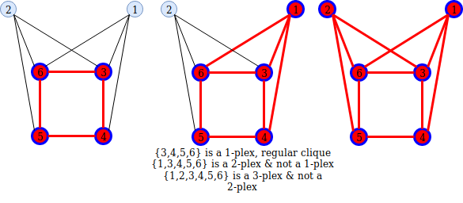
K-plexes
A node is a member of a clique of size n if it has direct ties to n-k members of that clique
Notes:
K-plex : https://www.youtube.com/watch?v=V2CgqTLWxvY

Slide 39
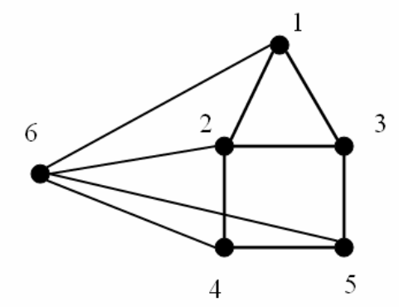
K-plexes
Another relaxation of a clique
Figure below is 3-plex, because N = 6, k = 3, and to be 3-plex each vertex should have (N-k) = 3 direct ties

Slide 40
K-plexes
The k-plex seems common with N-clique, but k-plex often gives quite a different picture of the sub-structures of a graph
Rather than the large and "stringy" groupings produced by n-clique, k-plex finds relatively large numbers of smaller groupings
This tends to focus attention on overlaps and co-presence (centralization) more than solidarity and reach

Slide 41
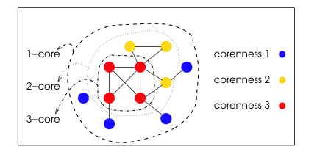
K-Core / K-degenerate graph
A k-core is a maximal group of actors, all of whom are connected to some number (k) of other members of the group.
More relaxed than k-plex
Allows actors to join the group if they are connected to k members, regardless of how many other members they may not be connected to.

Slide 42
K-Core / K-degenerate graph
By varying the value of k, different pictures can emerge
K-cores can be (and usually are) more inclusive than k-plexes
And, as k becomes smaller, group sizes will increase

Slide 43
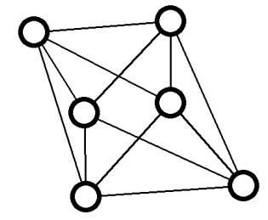
K-Truss
Given an integer k ≥ 2, the k-truss of G is the inclusion maximal edge-induced subgraph H of G such that each edge e of H belongs to at least k − 2 triangles of H.
An example of 4-truss
Notes:
Truly Scalable K-Truss and Max-Truss Algorithms for Community Detection in Graphs
https://ieeexplore.ieee.org/stamp/stamp.jsp?tp=&arnumber=9146824
Xin Huang, Laks V.S. Lakshmanan. “Attribute-Driven Community Search”, VLDB 2017. http://www.vldb.org/pvldb/vol10/p949-huang.pdf

Slide 44
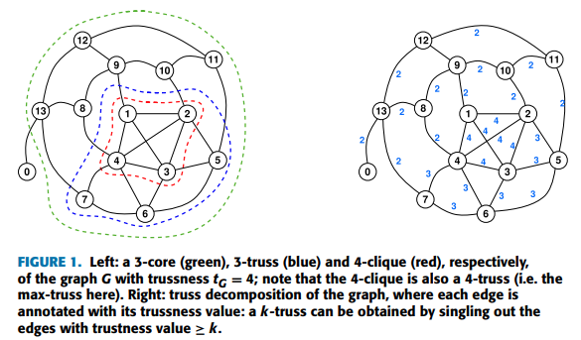
K-Truss
Notes:
Truly Scalable K-Truss and Max-Truss Algorithms for Community Detection in Graphs
https://ieeexplore.ieee.org/stamp/stamp.jsp?tp=&arnumber=9146824

Slide 45
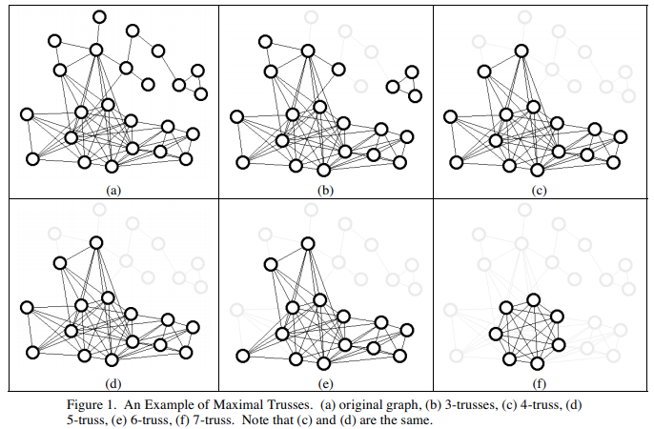
K-Truss
Notes:
Trusses: Cohesive Subgraphs for Social Network Analysis
http://sariyuce.com/sem/NSATR08.pdf

Slide 46
A Maximal K-Truss
A maximal k-truss is a k-truss that is not a proper subgraph of another k-truss.
Notes:
Trusses: Cohesive Subgraphs for Social Network Analysis
http://sariyuce.com/sem/NSATR08.pdf

Slide 47
References
Trusses: Cohesive Subgraphs for Social Network Analysis http://sariyuce.com/sem/NSATR08.pdf
Truly Scalable K-Truss and Max-Truss Algorithms for Community Detection in Graphs
https://ieeexplore.ieee.org/stamp/stamp.jsp?tp=&arnumber=9146824
Xin Huang, Laks V.S. Lakshmanan. “Attribute-Driven Community Search”, VLDB 2017. http://www.vldb.org/pvldb/vol10/p949-huang.pdf
Clique (graph theory) https://en.wikipedia.org/wiki/Clique_(graph_theory)
Effective Community Search over Large Spatial Graphs
http://www.vldb.org/pvldb/vol10/p709-fang.pdf
https://www.researchgate.net/publication/331396051_Teachers'_Beliefs_and_Strategies_when_Teaching_Reading_in_Multilingual_Settings_Case_Studies_in_German_Swedish_and_Chilean_Grade_4_Classrooms
https://www.nature.com/articles/s41467-019-10548-8
https://faculty.ucr.edu/~hanneman/nettext/C11_Cliques.html#subgraph
K-plex : https://www.youtube.com/watch?v=V2CgqTLWxvY

