Slide 1
CS 43118 & CS 53118
ST: Graph and Social Network Analysis
Chapter 7: Algorithms in Social Network
Niranjan Rai
Department of Computer Science
Kent State University
Notes:
https://ieeexplore.ieee.org/stamp/stamp.jsp?tp=&arnumber=6005872

Slide 2
In this chapter, we will
Learn about different algorithms
Community Detection in Social Networks
Community Search in Social Networks
Influence Maximization in Social Networks

Slide 3
Communities
Real-life graphs are not random
E.g., in a social network people pick their friends based on their common interests and activities
We expect that the nodes in a graph will be organized in communities
Group of vertices which probably share common properties and/or play similar roles within the graph
How do we find them?
Nodes in communities will be densely connected to each other, and sparsely connected with other communities

Slide 4
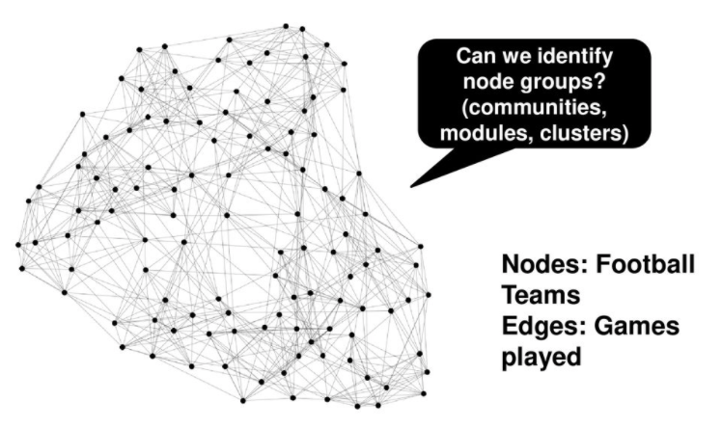
NCAA Football Network

Slide 5
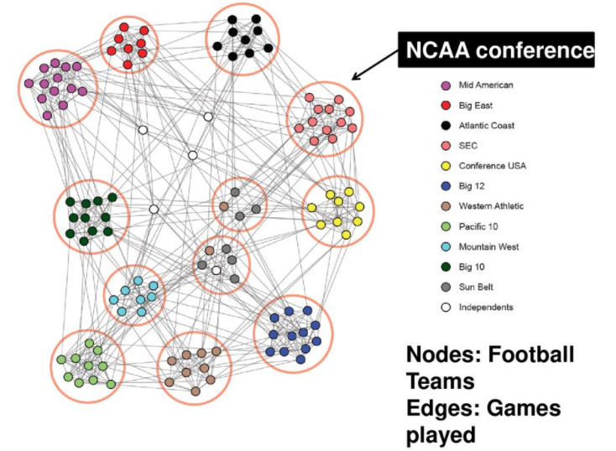

Slide 6
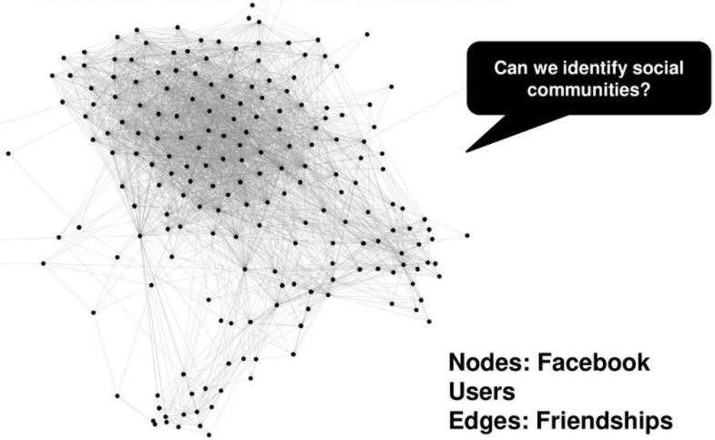
Stanford Facebook Network

Slide 7
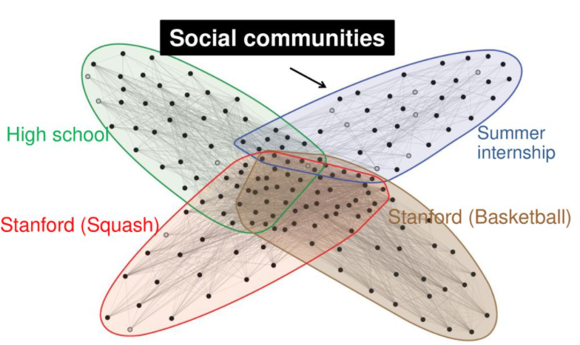
Stanford Facebook Network
Notes:
https://slideplayer.com/slide/14253033/

Slide 8
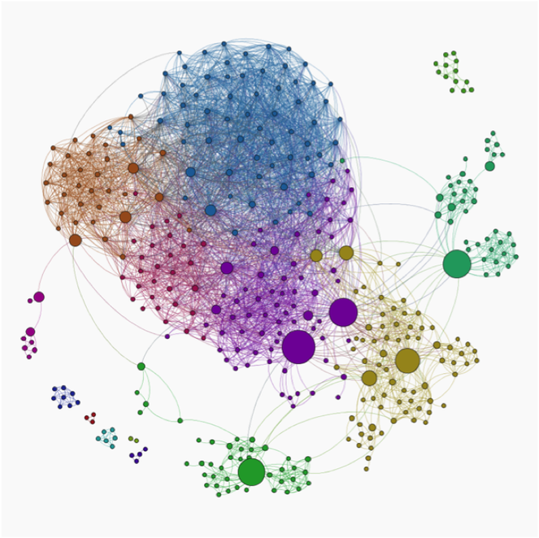
Community
Community in Social Network is a structure in where vertices are densely connected internally

Slide 9
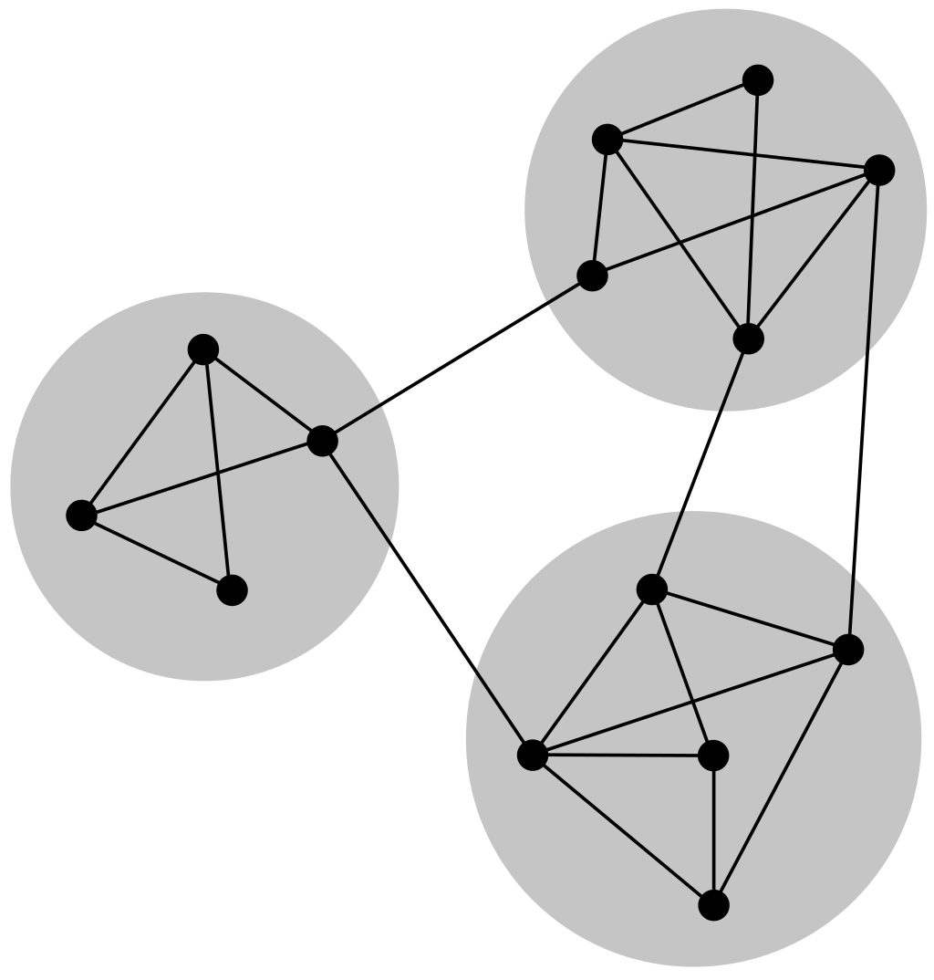
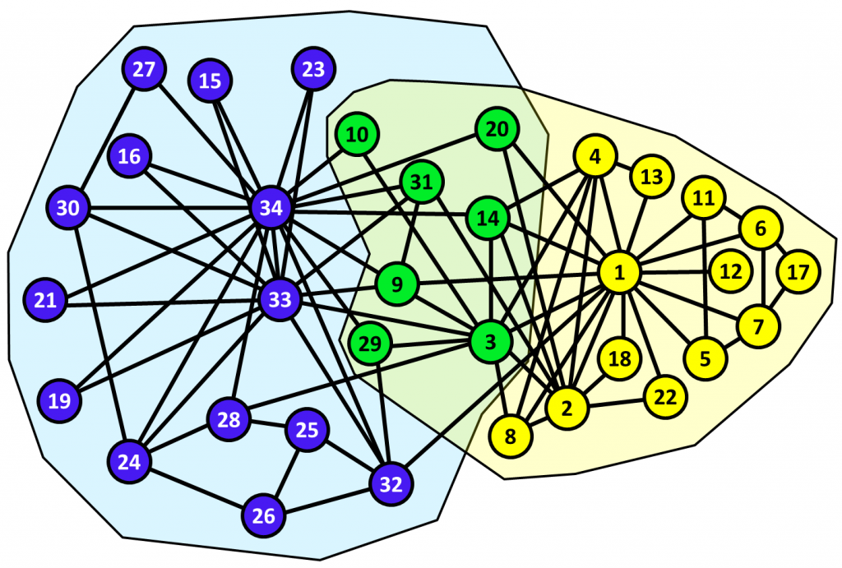
Community types
Overlapping communities vs non-overlapping communities

Slide 10
Non-Overlapping Community
Each node is put into one and only one community

Slide 11
Overlapping Community
Vertices are in more than one community

Slide 12
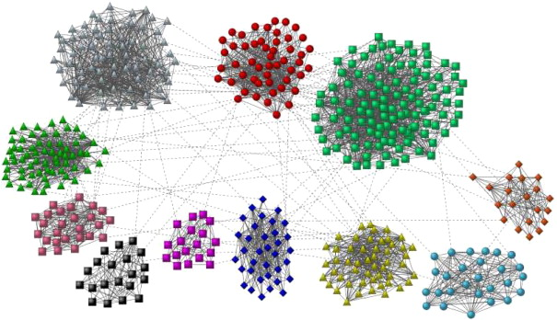
Community Detection
The problem of efficiently finding the communities in a given network is called Community Detection

Slide 13
Why Detect Communities?
Finding an underlying community structure in a network, if it exists, is important for a number of reasons:
Communities allow us to create a large scale map of a network which makes its study easier
Individual communities also shed light on the function of the system represented by the network since communities often correspond to functional units of the system
They often have very different properties than the average properties of the networks

Slide 14
Algorithms for community detection
Minimum-cut method
Hierarchical clustering
Girvan–Newman algorithm
Modularity maximization
Statistical inference
Clique-based methods

Slide 15
Minimum-cut method
One of the oldest algorithms for dividing networks
Cuts the network into a predetermined number of parts
Usually of same size
Tries to minimize the number of edges between groups

Slide 16
Minimum-cut method
Works well in many of the applications for which it was originally intended
But is less than ideal for finding community structure in general networks
Since it will find communities regardless of whether they are implicit in the structure

Slide 17
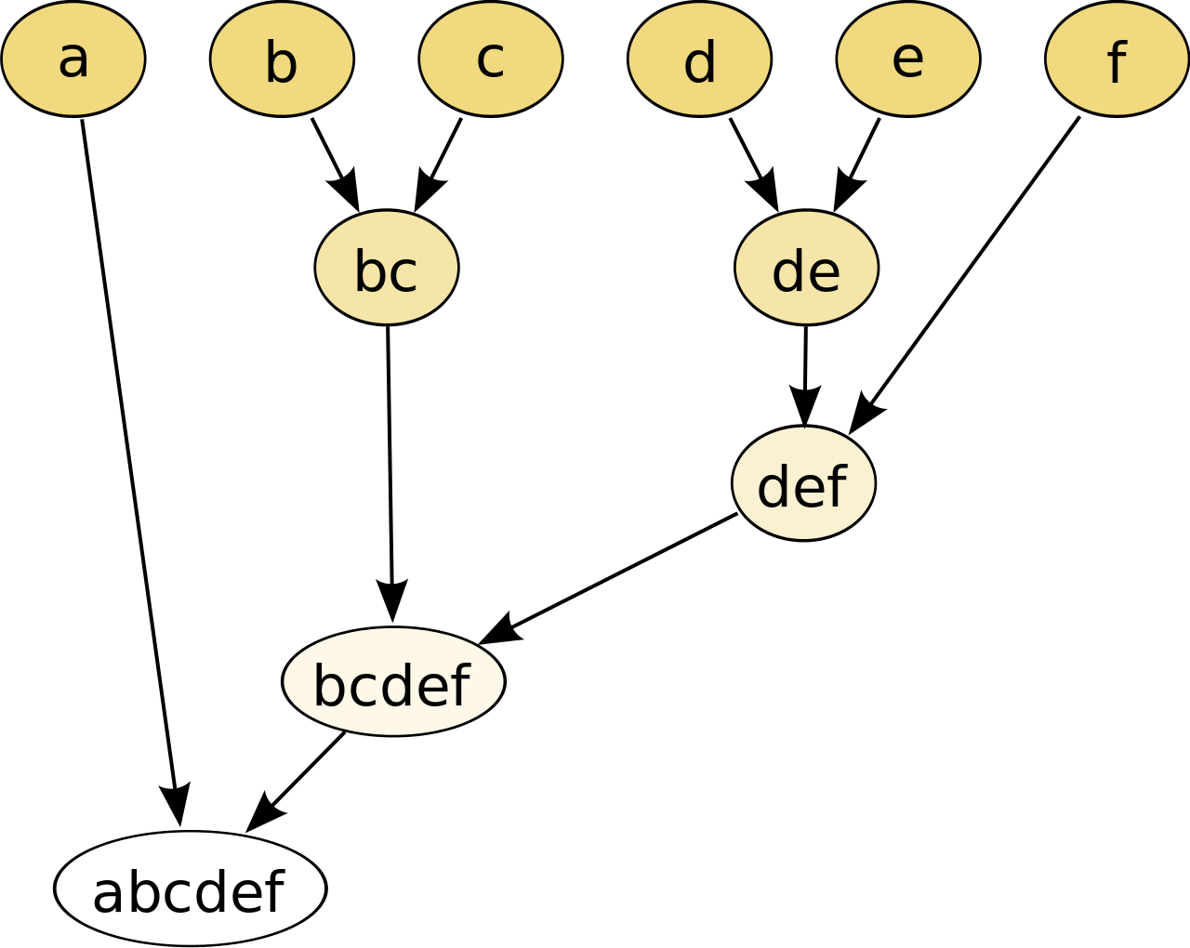
Hierarchical Clustering
Uses a similarity measure quantifying some (usually topological) type of similarity between node pairs
Commonly used measures: cosine similarity, Jaccard index/similarity, and Hamming distance
Then one groups similar nodes into communities according to this measure
Notes:
https://www.displayr.com/what-is-hierarchical-clustering/#:~:text=Hierarchical%20clustering%2C%20also%20known%20as,broadly%20similar%20to%20each%20other.

Slide 18
Hierarchical Clustering
There are several common schemes for performing the grouping
Two simplest hierarchical clustering methods are:
single-linkage clustering: two groups are considered separate communities if and only if all pairs of nodes in different groups have similarity lower than a given threshold
complete linkage clustering: all nodes within every group have similarity greater than a threshold

Slide 19
Girvan-Newman Algorithm
Detects communities by progressively removing edges from the original network
The algorithm's steps for community detection are summarized below
Calculate betweenness of all existing edges in the network
Remove edge(s) with the highest betweenness
Calculate betweenness of all edges affected by the removal
Repeat steps 2 and 3 until no edges remain

Slide 20
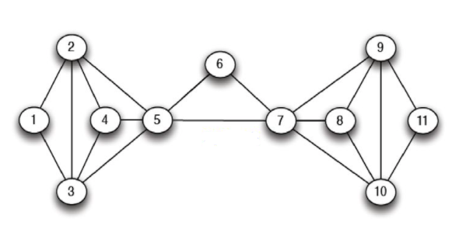
Girvan-Newman Algorithm

Slide 21
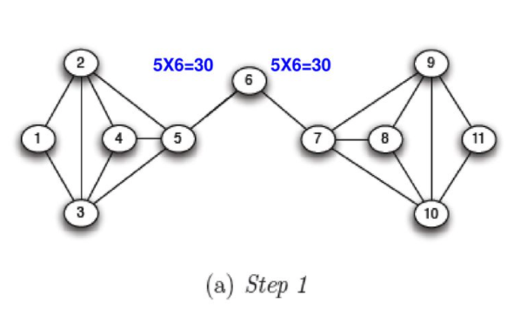
Girvan-Newman Algorithm

Slide 22
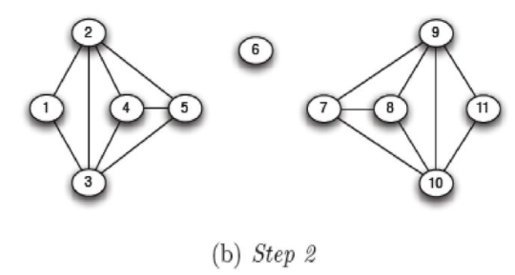
Girvan-Newman Algorithm

Slide 23
Girvan-Newman Algorithm
The Girvan–Newman algorithm returns results of reasonable quality and is popular because it has been implemented in a number of standard software packages
But it also runs slowly, taking time O(m²n) on a network of n vertices and m edges, making it impractical for networks of more than a few thousand nodes

Slide 24
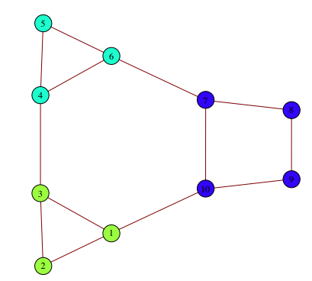
Modularity Maximization
One of the most widely used methods for community detection
Modularity is a benefit function that measures the quality of a particular division of a network into communities

Slide 25
Modularity Maximization
Detects communities by searching over possible divisions of a network for one or more that have particularly high modularity
Some practical algorithms are based on approximate optimization methods such as greedy algorithms, simulated annealing, or spectral optimization, with different approaches offering different balances between speed and accuracy
A popular modularity maximization approach is the Louvain method

Slide 26
Louvain Method
Greedy algorithm - O(n log²n) time
Widely utilized because of:
Rapid convergence property
High modularity
Hierarchical partitioning

Slide 27
Modularity Function, M
A_{ij} represents the edge weight between nodes i and j
k_{i} and k_{j} are the sum of the weights of the edges attached to nodes i and j, respectively
m is the sum of all of the edge weights in the graph
c_{i} and c_{j} are the communities of nodes
δ is Kronecker delta function δ(x,y) = 1 if x = y, 0 otherwise
Notes:
https://en.wikipedia.org/wiki/Louvain_method

Slide 28
Louvain Method
Divided into two phases:
Modularity Optimization
Community Aggregation

Slide 29
Modularity Optimization Phase
First, each node in the network is assigned to its own community
Then for each node i, the change in modularity is calculated for removing i from its own community and moving it into the community of each neighbor j of i
This value is easily calculated by two steps:
remove i from its original community
insert i to the community of j. The two equations are quite similar, and the equation for step (2) is:
Notes:
https://en.wikipedia.org/wiki/Louvain_method

Slide 30
Modularity Optimization Phase
Then, once this value is calculated for all communities i is connected to, i is placed into the community that resulted in the greatest modularity increase.
If no increase is possible, i remains in its original community. This process is applied repeatedly and sequentially to all nodes until no modularity increase can occur.
Once this local maximum of modularity is hit, the first phase has ended
Notes:
https://en.wikipedia.org/wiki/Louvain_method

Slide 31
Community Aggregation Phase
Groups all of the nodes and builds a new network where nodes are the communities from the previous phase
Any links between nodes of the same community are now represented by self-loops on the new community node
Links from multiple nodes in the same community to a node in a different community are represented by weighted edges between communities
Once the new network is created, modularity optimization phase can be re-applied to the new network and so on until maximum modularity is achieved
Notes:
https://en.wikipedia.org/wiki/Louvain_method

Slide 32
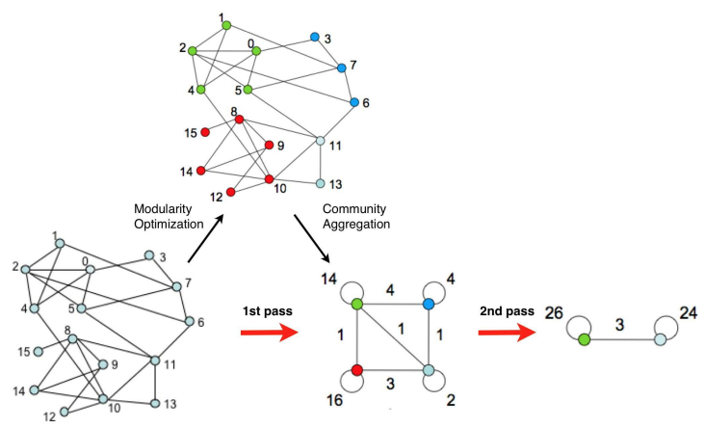
Example^{[3]}

Slide 33
Statistical Inference
Attempts to fit a generative model to the network data, which encodes the community structure
Advantage of this approach:
More principled nature
Has capacity to inherently address issues of statistical significance
Notes:
https://implementationscience.biomedcentral.com/articles/10.1186/1748-5908-8-116

Slide 34
Statistical Inference
SVINET in [5] is an algorithm based on Statistical Inference
It is based on a Bayesian model for graphs with overlapping communities
In this model, each node is assigned a vector of community memberships 𝜃 of length K, where K is the number of communities in the graph (which is assumed to be known)

Slide 35
Statistical Inference
First, a set of pairs of nodes is subsampled from the graph
Next, this subsample is analyzed and the community structure of the graph is updated accordingly
This subsampling procedure is repeated for a given number of iterations
Hence, SVINET analyzes a subgraph of the graph at each iteration

Slide 36
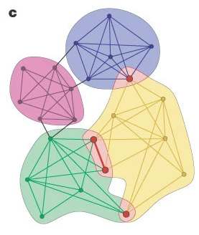
Clique-based Method
Cliques are complete subgraphs
As nodes cannot be more tightly connected than this
A node can be a member of more than one clique, a node can be a member of more than one community in these methods giving an "overlapping community structure"

Slide 37
Clique-based Method
One approach is to find the "maximal cliques", that is find the cliques which are not the subgraph of any other clique
The classic algorithm to find these is the Bron–Kerbosch algorithm
The overlap of these can be used to define communities in several ways
The simplest is to consider only maximal cliques bigger than a minimum size (number of nodes)
One common algorithm is Clique Percolation Method^{[4]}

Slide 38
Clique Percolation Method
Normally use cliques as a core or a seed to find larger communities
Input
A parameter k, and a network
Procedure
Find out all cliques of size k in a given network
Construct a clique graph: two cliques are adjacent if they share k-1 nodes
The nodes depicted in the labels of each connected components in the clique graph form a community
Notes:
https://www.nature.com/articles/nature03607

Slide 39
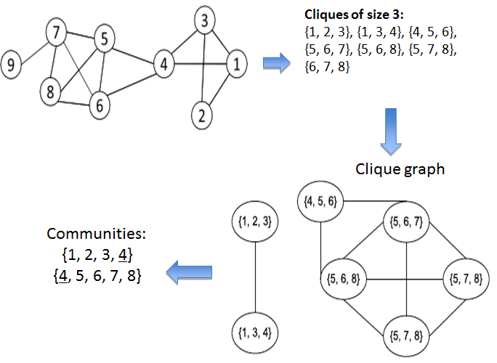
Clique Percolation Method^{[4]}
{6,7,8}
Notes:
https://www.nature.com/articles/nature03607

Slide 40
Community Search
Aims to find the most likely community that contains the query node q
Has attracted great attention from both academic and industry areas
Some applications of community search are:
Event organization
Friend recommendation
Advertisement in e-commerce
Notes:
https://arxiv.org/pdf/1904.12539.pdf

Slide 41
Community Search
How to effectively and efficiently find communities from large graphs is an important research topic in the era of big data
Some of the factors that the community retrieval solutions should satisfy are:
High Efficiency
High Scalability
High personalization
High quality
Support for dynamic graphs
Notes:
https://arxiv.org/pdf/1904.12539.pdf

Slide 42
Community Search
High efficiency. For many real applications (e.g., event organization), the communities often need to be retrieved in real-time, based on query requests
Thus, the community retrieval solutions should be able to respond in real-time
High scalability. Nowadays, many real networks contain millions or billions of vertices. As a result, the solutions should be scalable to real big graphs
Notes:
https://arxiv.org/pdf/1904.12539.pdf

Slide 43
Community Search
High personalization. In practice, for large networks, people usually are interested in communities of some specific users, rather than all the users. Thus, the solutions should allow users to specify query vertices. Moreover, some personalized requirements on structures (and attributes) could be imposed
High quality. The vertices in the communities retrieved should be cohesively linked. Moreover, the communities should be easy for interpretation
Support for dynamic graphs. Since real networks often involve as the time goes on, the solutions should be able to adapt for the dynamic changes easily
Notes:
https://arxiv.org/pdf/1904.12539.pdf

Slide 44
Community Search
Generally, the goal of CS is to search high-quality communities in an online manner, based on a query request
Specifically, given a vertex q of a graph G, it aims to find a community, or a dense subgraph, which contains q and satisfies the properties:
connectivity, i.e., vertices in the community are connected;
cohesiveness, i.e., vertices in the community are intensively linked to each other w.r.t. a particular goodness metric1
Notes:
https://arxiv.org/pdf/1904.12539.pdf

Slide 45
Cohesiveness Metrics
Some commonly used cohesiveness metrics are:
k-core
k-truss
k-clique
k-ECC (k-Edge Connected Component)
Notes:
https://arxiv.org/pdf/1904.12539.pdf

Slide 46
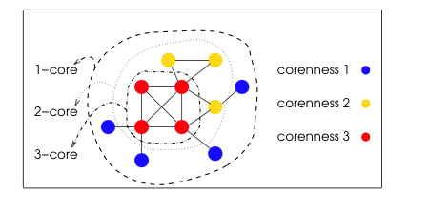
k-core
A k-core is a maximal group of actors, all of whom are connected to some number (k) of other members of the group
Notes:
https://arxiv.org/pdf/1904.12539.pdf

Slide 47
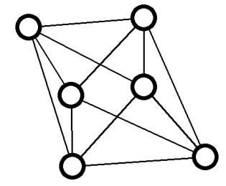
k-truss
Given an integer k ≥ 2, the k-truss of G is the inclusion maximal edge-induced subgraph H of G such that each edge e of H belongs to at least k − 2 triangles of H
An example of 4-truss
Notes:
https://arxiv.org/pdf/1904.12539.pdf

Slide 48
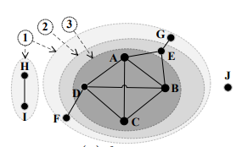
k-clique
A k-clique is a complete graph with k vertices where there is an edge between every pair of vertices
Example: {A, B, C, D} is a 4-clique, {A, B, E} is a 3-clique, any edge is a 2-clique
Notes:
https://arxiv.org/pdf/1904.12539.pdf

Slide 49
k-ECC (k-edge connected component)
A connected graph is k-edge-connected if it remains connected whenever fewer than k edges are removed
Example: The subgraph of {A, B, C, D} is the 3-ECC, because for any pair of vertices in it, to disconnect them, we need to remove at least 3 edges
The 2-ECC has vertices {A, B, C, D, E}
Notes:
https://arxiv.org/pdf/1904.12539.pdf

Slide 50
Cohesiveness and Computational Efficiency

Slide 51
K-Core-Based Community Search
Uses k-core as structure cohesiveness metric
In [1] Sozio et. al. defines the community search problem as:
Given an undirected simple graph G(V, E), a set of query vertices Q ⊆ V, and a goodness function f, return a subgraph H(V_{H}, E_{H}) of G such that
V_{H} contains Q;
H is connected;
f(H) is maximized among all feasible choices for H
f(H) is a general goodness function for measuring cohesiveness of the community H
Higher f(H) means densely connected

Slide 52
K-Core-Based Community Search
Many possible choices for f
One outstanding method is based on the minimum degree i.e. f(H) = min_{∀v∊H}deg_{H}(v)
The minimum degree is a good metric for the community because:
it is the most fundamental characteristics of a graph
it is often used to measure the cohesiveness of user groups in social network
it is better than other metrics, for community search

Slide 53
K-Core-Based Community Search
To solve the problem of community search mentioned earlier, there are two online algorithms which are based on global and local search and one index-based algorithm

Slide 54
A global search algorithm
Sozio et al. [1] proposed a greedy algorithm, Global
Follows the peeling framework of computing the densest subgraphs and removes vertices iteratively
Specifically, let G₀=G and G_{t} be the graph in t-th iteration (1 ≤ t < n) step, it removes the vertex which has the minimum degree in G_{t−1} and obtain an updated graph G_{t}
The above operation iterates and stops at the T-th step, if either
at least one of the query vertices Q has minimum degree in the graph G_{T −1}, or
the query vertices Q are no longer connected

Slide 55
A local search algorithm
In [7], Cui et al. proposed a local CS method named “Local”
It works in a local expansion manner and finds a community that may have smaller size than that of Global
Specifically, it assumes that there is only one query vertex q (i.e., Q={q})
Local consists of three steps:
First, it expands the search space from q
Second, it generates a candidate vertex set C in the search space
Third, it finds the community from C

Slide 56
An index-based algorithm
In [8], Barbieri et al. proposed an index structure, called ShellStruct, which organizes all the connected k-cores in an offline manner
Based on ShellStruct, k-core community search problem can be answered in optimal time cost, i.e., O(|H_{V}|), where H_{V} is the set of vertices in the returned community and it is the same with that of Global

Slide 57
An index-based algorithm
The index is built based on the key observation that cores are nested
That is, for any integer 0 < k ≤ k_{max} , the k-core is contained by the (k–1)-core, where k_{max} is the maximum core number
ShellStruct is a tree-like structure with k_{max} levels
The root of the tree corresponds to the 1-core, and the k-th level keeps track of the information about the k-th core

Slide 58
An index-based algorithm
In k-th level, each tree node, p_{k}, corresponds to a connected component C_{k} of the k-core, and it keeps:
the set of “children” nodes, each of which corresponds to a connected component that is in the (k+1)-core and contained by C_{k};
the set of vertices in C_{k} but not in (k+1)-core

Slide 59
K-Truss-Based Community Search
Uses k-truss as structure cohesiveness metrics
Some CS that are based on k-truss includes triangle connected truss community [9,10], closest truss community [11], attribute-driven truss community [12], and weighted truss community [13], etc.

Slide 60
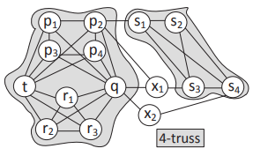
K-Truss-Based Community Search
In [9] Huang et al. proposes a triangle connected k-truss community model
Finds all communities containing a query vertex
Problem:
k-truss may be disconnected with several components in a graph
For example, in the Figure, there exist two shaded components to form the 4-truss of G, which are disconnected
Disconnected graphs are insufficient to define a cohesive and meaningful community
Example of 4-truss with 2 disconnected components

Slide 61
K-Truss-Based Community Search
To address the dis-connectivity problem, k-truss triangle connectivity is imposed on top of the k-truss in [9]
Given two triangles ∆ ₁ and ∆₂ in G, ∆₁ and ∆₂ are said to be adjacent if they share a common edge
Then, for two edges e₁, e₂ ∈ E, e₁ and e₂ are triangle connected if they either belong to the same triangle, or are reachable from each other through a series of adjacent triangles

Slide 62
K-Truss-Based Community Search
Based on the k-truss and triangle connectivity, the problem of triangle-connected truss community (TTC) search is formulated as follows
(TTC search) Given an undirected simple graph G(V, E), a query vertex q ∈ V, and an integer k ≥ 2, return all subgraphs H ⊆ G satisfies the following three properties:
Structure Cohesiveness. H contains the query vertex q such that ∀e ∈ E(H), sup(e, H) ≥ (k − 2);
Triangle Connectivity. ∀e₁, e₂ ∈ E(H), e₁ and e₂ are triangle connected;
Maximal Subgraph. H is the maximal subgraph of G satisfying Properties 1 and 2

Slide 63
K-Truss-Based Community Search
To tackle the problem of TTC search, in [9] Huang et al. proposes an online search algorithm

Slide 64
Online Search Algorithm
The algorithm firstly applies the truss decomposition on graph G to compute the trussness of all edges in G
By the community definition, it starts from the query vertex q and checks an incident edge of (q, v) ∈ E with trussness τ ((q, v)) ≥ k to search triangle-connected truss communities
It explores all edges that are triangle-connected to (q, v) and having trussness no less than k in a BFS manner
This process iterates until all incident edges of q have been processed
Finally, a set of k-truss communities containing q are returned

Slide 65
K-Clique-Based Community Search
Uses k-clique or its variants to capture the structure cohesiveness
In [6], Cui et al. showed that there are two shortcomings for k-clique community model:
there are overwhelming number of k-cliques communities in real life graphs; and
the k-clique constraint and the definition of adjacent (i.e., sharing k-1 common vertices) are not flexible in practice

Slide 66
K-Clique-Based Community Search
To address these two shortcomings, they proposed an online community search (OCS) problem
Instead of enumerating all communities, they focused on the search of the communities containing a given query vertex q
They relaxed the k clique adjacent from k−1 common vertices to α vertices, namely α-adjacency

Slide 67
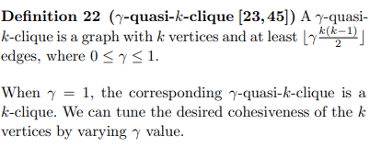
K-Clique-Based Community Search
They also relaxed k-clique model to γ-quasi-k-clique model
By doing this, the k-clique components in the k-clique communities are relaxed to the γ-quasi-k-clique components

Slide 68
K-Clique-Based Community Search
A naive algorithm for exact solution is to enumerate all γ quasi-k-cliques containing the query vertex q, and then compute the γ-quasi-k-clique components based on the α-adjacency
To avoid enumerating cliques belonging to none of the valid communities, a new computing framework is proposed to check the adjacency when a clique is discovered
By carefully maintaining the visit status of each clique, authors further optimize the searching cost
Authors also proposed an approximate solution

Slide 69
K-Clique-Based Community Search
To reduce the search space, the approximate algorithm only enumerates an unvisited clique which contains at least one new vertex not contained by any existing community
A heuristic is proposed to choose a vertex sequence such that the resulting clique sequence is short, leading to a good approximation solution

Slide 70
K-ECC-Based Community Search
Uses k-ECC as the community structure cohesiveness
Given a graph G and a set Q of vertices, the goals is to find a subgraph H of G, which contains Q and has the maximum edge-connectivity, also called the Steiner Maximum-Connected Subgraph (SMCS)

Slide 71
K-ECC-Based Community Search
In [14], Chang et al. computed the maximum SMCS for a set of query vertices Q, which is defined as follows:
Problem Definition. Given an undirected simple graph G(V, E), and a set of query vertices Q ⊆ V , return a subgraph H(V_{H}, E_{H}) of G, such that
V_{H} contains Q;
Connectivity, λ(H), is maximized;
There exists no other subgraph H₀ satisfying the above properties, such that H ⊂ H’

Slide 72
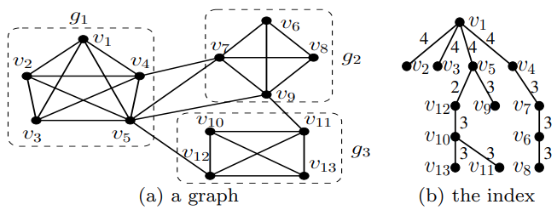
K-ECC-Based Community Search
For example, in the graph below. Let Q = {v₁, v₄} then the query will return the subgraph g₁, and its connectivity is λ(g₁) = 4

Slide 73
K-ECC-Based Community Search
To improve the query efficiency, Chang et al. [14] proposed a novel compact index structure, which allows the query can be answered in optimal time cost, i.e., the time cost is linear to the size of H
The index is built based on a key observation that for any pair of vertices u and v in H, their connectivity λ(u, v) is at least λ(H)

Slide 74
K-ECC-Based Community Search
To preserve all the connectivity information of G, Chang et al. developed the concept of connectivity graph G_{c} for the graph G, which has the same sets of vertices and edges with G, and for each edge (u, v) ∈ G_{c}, it is associated with a connectivity value denoting the edge connectivity between vertices u and v in G
Then, the maximum spanning tree (MST) of G_{c} is the index structure built for G
For example, figure b presents the index structure for the graph in Fig. (a). The index can be built by first constructing the connectivity graph G_{c} and then computing the MST from G_{c}

Slide 75
K-ECC-Based Community Search
Based on the index MST, Chang et al. proposed an efficient query algorithm to solve k-ECC based community search
Specifically, it first computes λ(H) by using the MST, and then finds the maximum SMCS by collecting the subtree of MST, whose edges have connectivity values being at least λ(H)
By using the technique of lowest common ancestor (LCA), the query can achieve a time cost of O(|HV|), which is optimal since outputting the vertex set of H takes O(V_{H}) time

Slide 76
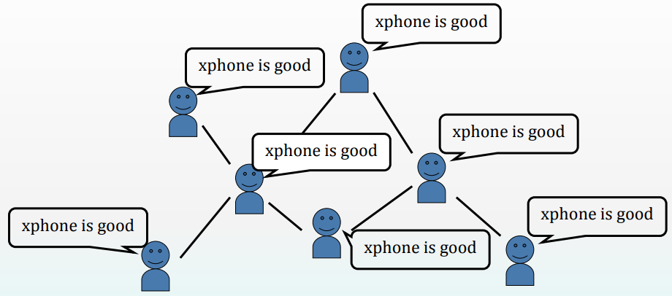
Influence Maximization
Social network plays a fundamental role as a medium for the spread of INFLUENCE among its members
opinions, ideas, information, innovation…
Word of Mouth (WOM) effect

Slide 77
Problem Setting
Given
a limited budget B for initial advertising (e.g. give away free samples of product)
estimates for influence between individuals
Goal
trigger a large cascade of influence (e.g. further adoptions of a product)
Question
Which set of individuals should B target at?
Application besides product marketing
spread an innovation
detect stories in blogs

Slide 78
Influence Models
Linear Threshold Model
Independent Cascade Model

Slide 79
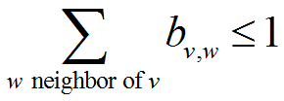
Linear Threshold Model
A node v has random threshold θ_{v} ~ U[0,1]
A node v is influenced by each neighbor w according to a weight b_{vw} such that
A node v becomes active when at least (weighted) θ_{v} fraction of its neighbors are active

Slide 80
Linear Threshold Model
A node v has random threshold θ_{v} ~ U[0,1]
A node v is influenced by each neighbor w according to a weight b_{vw} such that
A node v becomes active when at least (weighted) θ_{v} fraction of its neighbors are active

Slide 81
Example
Inactive Node
0.6
Active Node
0.3
0.2
0.2
Threshold
X
Active neighbors
0.1
0.4
U
0.5
0.3
Stop!
0.2
w
0.5
v

Slide 82
Independent Cascade Model
When node v becomes active, it has a single chance of activating each currently inactive neighbor w
The activation attempt succeeds with probability p_{vw}

Slide 83
Example
0.6
Inactive Node
0.3
0.2
0.2
Active Node
X
U
Newly active
node
0.1
0.4
Successful
attempt
0.5
0.3
0.2
Unsuccessful
attempt
w
0.5
v
Stop!

Slide 84
References
M. Sozio and A. Gionis. The community-search problem and how to plan a successful cocktail party. In SIGKDD, pages 939–948, 2010.
https://slideplayer.com/slide/14253033/
V. D. Blondel, J.-L. Guillaume, R. Lambiotte and E. Lefebvre, "Fast unfolding of communities in large networks," J. Stat. Mech. (2008) P10008, p. 12, 2008.
Uncovering the overlapping community structure of complex networks in nature and society.
Gopalan PK, Blei DM. Efficient discovery of overlapping communities in massive networks. Proc Natl Acad Sci 2013, 110:14534–14539
W. Cui, Y. Xiao, H. Wang, Y. Lu, and W. Wang. Online search of overlapping communities. In SIGMOD, pages 277–288, 2013.
W. Cui, Y. Xiao, H. Wang, and W. Wang. Local search of communities in large graphs. In SIGMOD, pages 991– 1002, 2014.
N. Barbieri, F. Bonchi, E. Galimberti, and F. Gullo. Efficient and effective community search. DMKD, 29(5):1406–1433, 2015.

Slide 85
References
X. Huang, H. Cheng, L. Qin, W. Tian, and J. X. Yu. Querying k-truss community in large and dynamic graphs. In SIGMOD, pages 1311–1322, 2014.
E. Akbas and P. Zhao. Truss-based community search: A truss-equivalence based indexing approach. PVLDB, 10(11):1298–1309, Aug. 2017.
X. Huang, L. V. Lakshmanan, J. X. Yu, and H. Cheng. Approximate closest community search in networks. PVLDB, 9(4):276–287, 2015.
X. Huang and L. V. S. Lakshmanan. Attribute-driven community search. PVLDB, 10(9):949–960, May 2017.
Z. Zheng, F. Ye, R.-H. Li, G. Ling, and T. Jin. Finding weighted k-truss communities in large networks. Information Science, 417(C):344–360, Nov. 2017.
L. Chang, X. Lin, L. Qin, J. X. Yu, and W. Zhang. Index-based optimal algorithms for computing steiner components with maximum connectivity. In SIGMOD, pages 459–474, 2015.

