Slide 1
CS 43118 & CS 53118
ST: Graph and Social Network Analysis
Chapter 8: Data Mining in Social Network
Niranjan Rai
Department of Computer Science
Kent State University

Slide 2
In this chapter, we will
Learn about different algorithms
Graph Clustering in Social Networks
Graph pattern matching / Graph Isomorphism in Social Networks

Slide 3
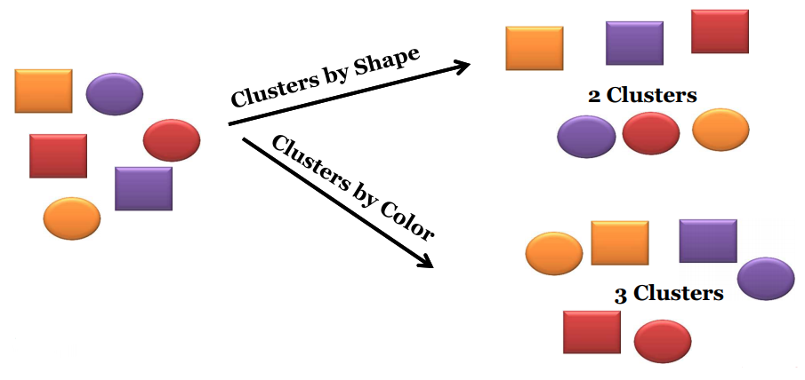
What is Cluster Analysis?
The process of dividing a set of input data into possibly overlapping, subsets, where elements in each subset are considered related by some similarity measure

Slide 4
What is Graph Clustering?
Types
Between-graph
Clustering a set of graphs
Within-graph
Clustering the nodes/edges of a single graph

Slide 5
Between-graph Clustering
Between-graph clustering methods divide a set of graphs into different clusters
E.g., A set of graphs representing chemical compounds can be grouped into clusters based on their structural similarity

Slide 6
Within-graph Clustering
Within-graph clustering methods divides the nodes of a graph into clusters
E.g., In a social networking graph, these clusters could represent people with same/similar hobbies

Slide 7
Algorithms for Within-graph Clustering
k-Spanning Tree
Shared Nearest Neighbor
Betweenness Centrality Based
Highly Connected Components
Maximal Clique Enumeration
Kernel k-means

Slide 8
k-Spanning Tree algorithm
STEPS:
Obtains the Minimum Spanning Tree (MST) of input graph G
Removes k-1 edges from the MST
Results in k clusters

Slide 9
What is a Spanning Tree?
A connected subgraph with no cycles that includes all vertices in the graph
Note: Weight can represent either distance or similarity between two vertices or similarity of the two vertices

Slide 10
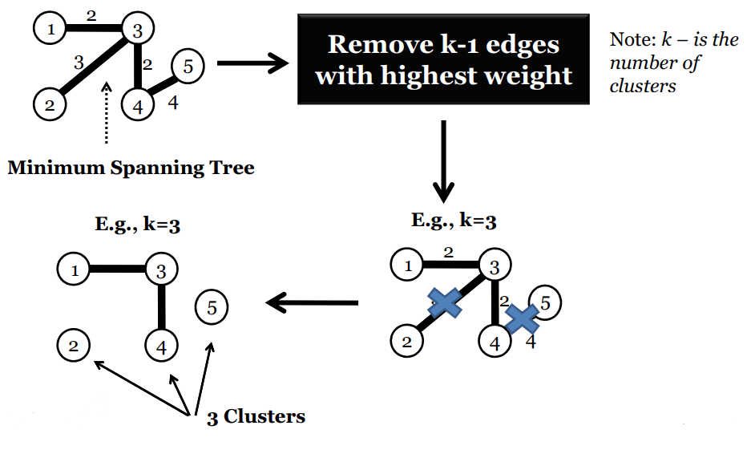
k-Spanning Tree

Slide 11
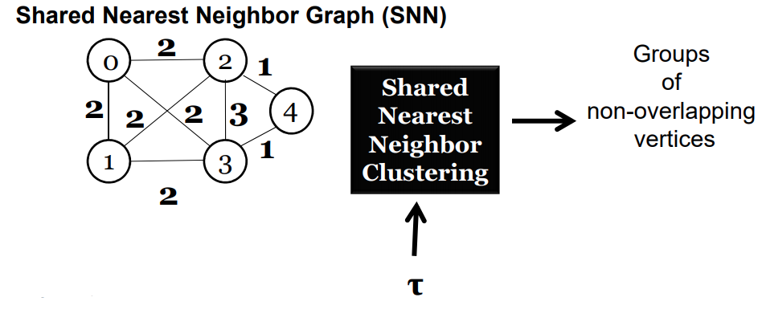
Shared Nearest Neighbor Clustering
STEPS:
Obtains the Shared Nearest Neighbor Graph (SNN) of input graph G
Removes edges from the SNN with weight less than τ

Slide 12
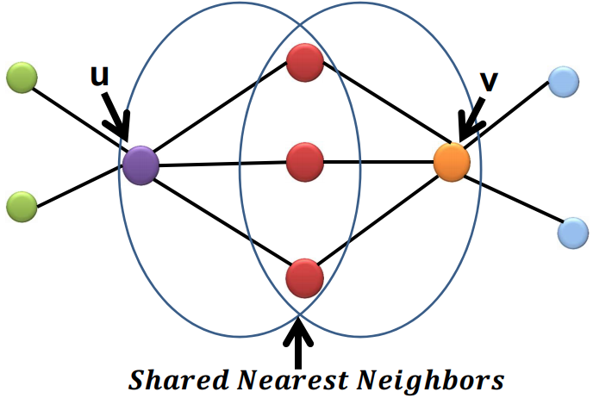
What is Shared Nearest Neighbor?
Shared Nearest Neighbor is a proximity measure and denotes the number of neighbor nodes common between any given pair of nodes

Slide 13
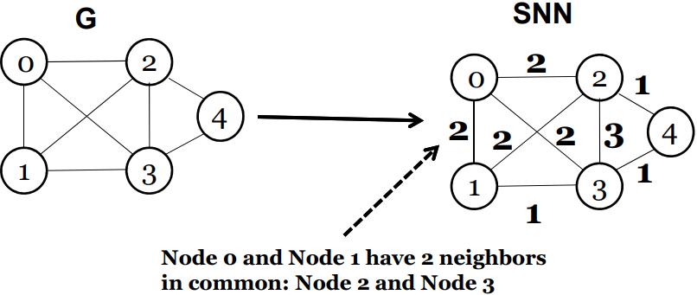
Shared Nearest Neighbor (SNN) Graph
Given input graph G, weight each edge (u,v) with the number of shared nearest neighbors between u and v

Slide 14
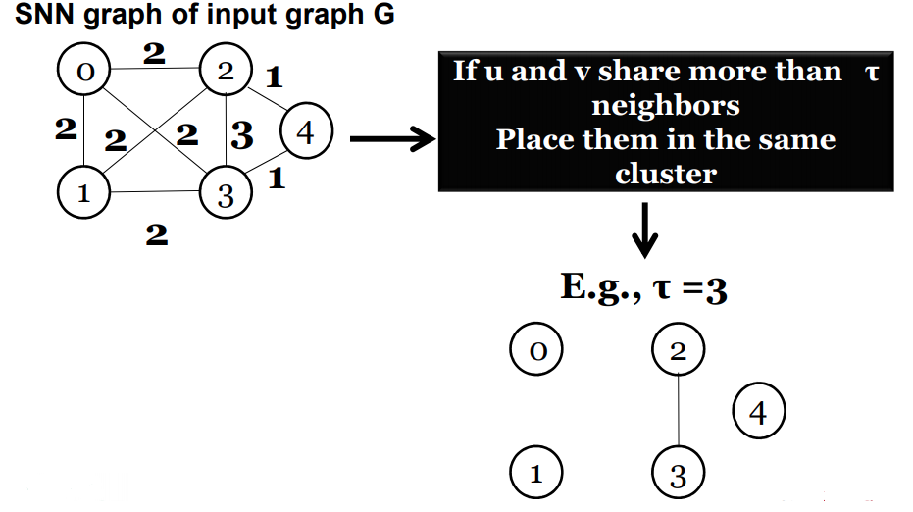
Shared Nearest Neighbor Clustering
Jarvis-Patrick Algorithm

Slide 15
Betweenness Centrality Based
Vertex Betweenness Clustering
Edge Betweenness Clustering

Slide 16
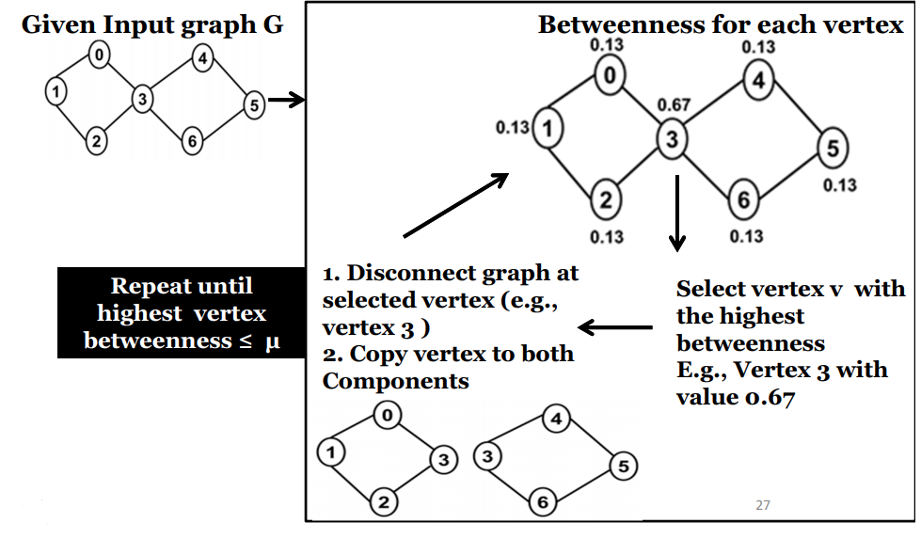
Vertex Betweenness Clustering

Slide 17
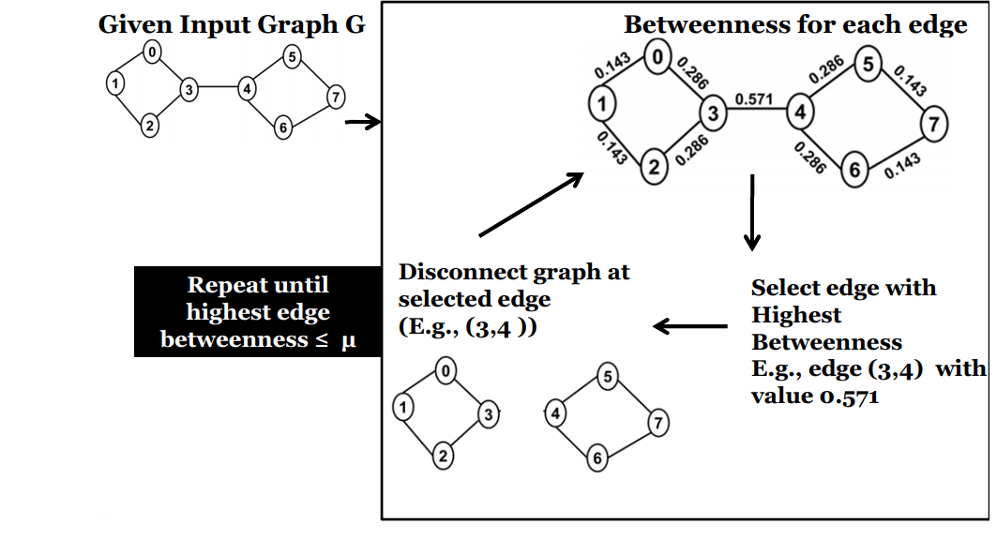
Edge-Betweenness Clustering
Girvan and Newman Algorithm

Slide 18
Highly Connected Components
Requires the following definitions
Cut
Minimum Edge Cut (MinCut)
Edge Connectivity (EC)

Slide 19
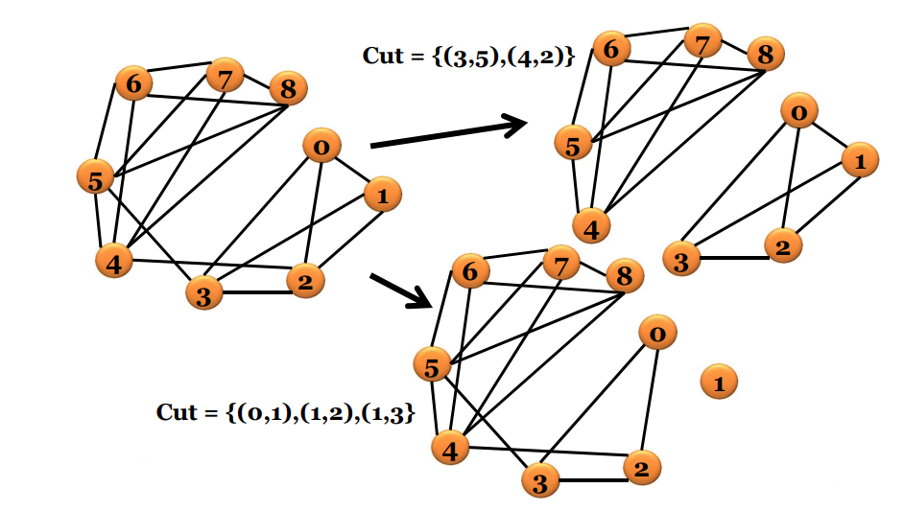
Cut
The set of edges whose removal disconnects a graph

Slide 20
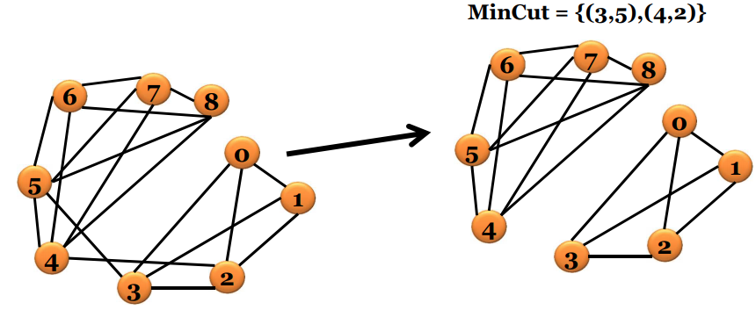
Minimum Cut
The minimum set of edges whose removal disconnects a graph

Slide 21
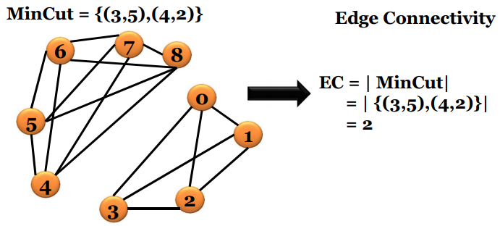
Edge Connectivity (EC)
Minimum number of edges that will disconnect a graph

Slide 22
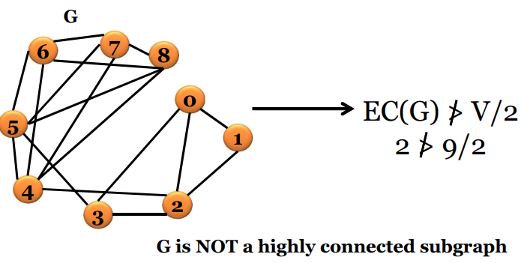
Highly Connected Subgraph (HCS)
A graph G =(V,E) is highly connected if EC(G) > V/2

Slide 23
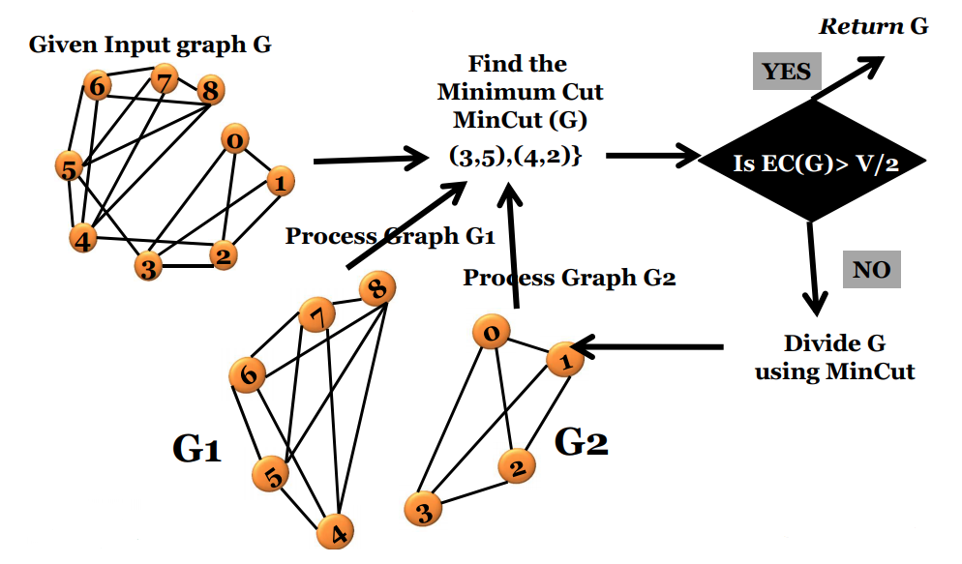
HCS Clustering

Slide 24
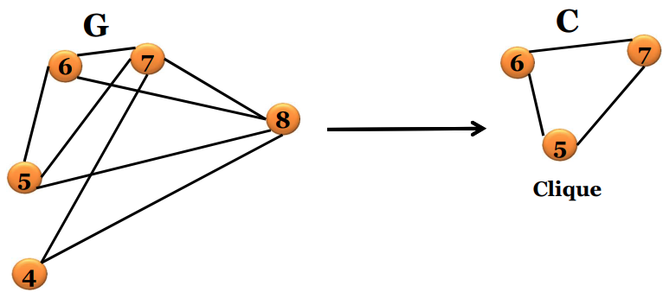
Maximal Clique Enumeration
Clique: A subgraph C of graph G with edges between all pairs of nodes

Slide 25
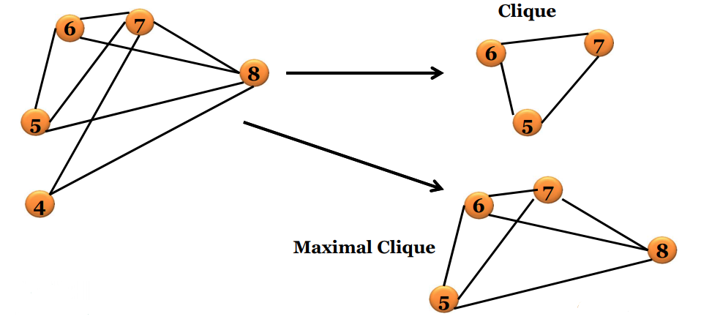
Maximal Clique Enumeration
Maximal Clique: A maximal clique is a clique that is not part of a larger clique

Slide 26
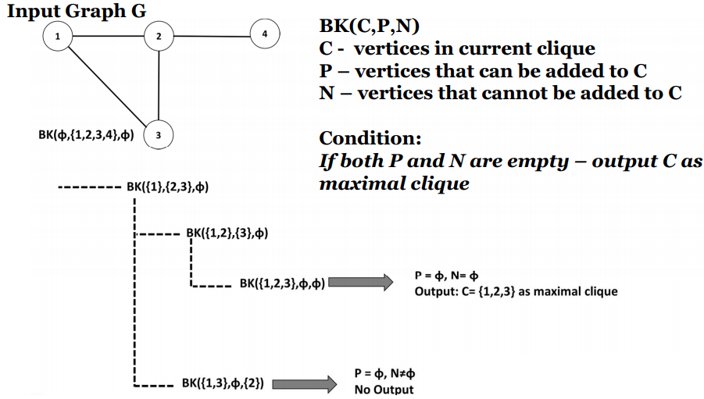
Maximal Clique Enumeration
Bron and Kerbosch Algorithm

Slide 27
Kernel k-means algorithm
k-means is a clustering algorithm applied to vector data points
Algorithm:
Select k data points from input as centroids
Assign other data points to the nearest centroid
Recompute centroid for each cluster
Repeat Steps 1 and 2 until centroids don’t change

Slide 28
Kernel k-means algorithm
Basic algorithm is the same as k-means on Vector data
We utilize the “kernel trick” (recall Kernel Chapter)
“kernel trick” recap
We know that we can use within-graph kernel functions to calculate the inner product of a pair of vertices in a user defined feature space.
We replace the standard distance/proximity measures used in k-means with this within-graph kernel function

Slide 29
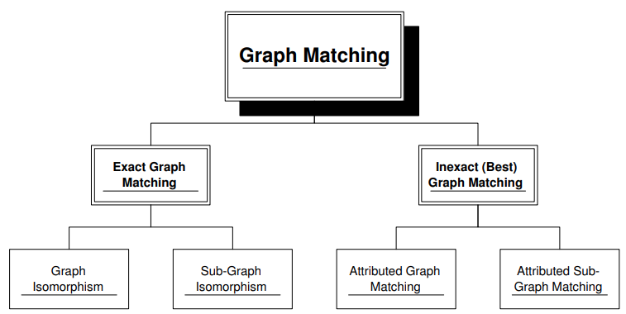
Graph Matching in Social Networks
The process of evaluating the similarity of two graphs
Two categories of tasks
exact matching
inexact matching (error-tolerant graph matching)

Slide 30
Algorithms for Exact Graph Matching
Ullmann’s algorithm
Grahraman’s algorithm
VF and VF2 algorithm

Slide 31
Ullmann’s Algorithms
Popular algorithm for exact graph matching
Take use of algebraic formulations for graph isomorphism and subgraph isomorphism

Slide 32
Ullmann’s Algorithms
Given a graph G and a graph H, find if G is subgraph isomorphic to H
So, the algorithm search for a permutation matrix M* of size |$V_{G}|$x |$V_{H}$| that satisfies the subgraph isomorphism criterion
Enumerate over candidate permutation matrices of the same size, denoting a candidate by M’, from a set of candidates that satisfies:
(The set of all M*-s) $⊆$(The set of all M’-s)
During the enumeration, check the isomorphism criterion over each candidate.
If a candidate satisfies the criterion, returns ‘yes’ otherwise returns ‘no’

Slide 33
Ullmann’s algorithm
Construction of another matrix M⁽⁰⁾ with the same size of the M’-s:
Generation of all M’-s by setting to 0 all but one 1 in each row of M⁽⁰⁾
A subgraph isomorphism has been found if M implies: .

Slide 34
The Ullman Algorithm
Example
Root - M⁽⁰⁾
Inner Nodes – M-s
Leaves – M’-s

Slide 35
Inexact Graph Matching
In some real situations the variability of the patterns, the noise in the acquisition process or other causes, produce deformations in the observed graphs
So, two graphs may have a structure that is almost the same, but with some extra or missing nodes and edges.
In this case, the constraints imposed by the exact graph matching are too strong to find out a mapping between the two graphs.
The most adopted solution is to make the matching process tolerant in respect to deformations

Slide 36
Inexact Graph Matching
A well known method to define the matching cost is the graph edit distance
Assigns a cost to each operation needed to transform the first graph in the second one
Then sums all these costs to obtain the overall transformation cost
Graph edit distance finds applications in handwriting recognition, fingerprint recognition and cheminformatics

Slide 37
Graph Edit Distance ^{[4]}
A flexible graph dissimilarity measure
measures the deformation between two graphs by considering the cost assigned to the sequence of elementary graph edit operations needed to transform the first graph in the second one
an elementary graph operation e is the simplest alteration which may be performed on a graph, such as add or remove a node
A transformation is composed of a set of edit operations sequentially applied to a graph, namely an edit path

Slide 38
Elementary Graph Edit Operations
An elementary graph edit operation (or edit operation) is one of the following operation applied on a graph:
Node/Edge removal
Node/Edge insertion
Node/Edge substitution if the graph is a labeled one. Such an operation modifies the label of a node or an edge and thus transforms the node or edge labeling functions

Slide 39
Edit Path
An edit path of a graph G is a sequence of elementary operations applied on G, where node removal and edge insertion have to satisfy the following constraints:
A node removal implies a first removal of all its incident edges,
An edge insertion can be applied only between two existing or already inserted nodes

Slide 40
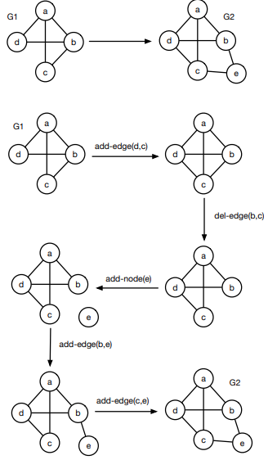
Graph Edit Distance ^{[4]}
Among all the possible transformations P(G₁, G₂) that involve two graphs G₁ and G₂, find the cheapest one whose cost is the graph edit distance d(G₁, G₂) between G₁ and G₂
An edit path from G₁ to G₂ with minimal cost is called an optimal path
It is the closest graph match

Slide 41
References
https://www.csc2.ncsu.edu/faculty/nfsamato/practical-graph-mining-with-R/slides/pdf/Graph_Cluster_Analysis.pdf
https://www.slideserve.com/reese/exact-graph-matching-powerpoint-ppt-presentation
An Algorithm for Subgraph Isomorphism https://dl.acm.org/doi/pdf/10.1145/321921.321925
https://hal.archives-ouvertes.fr/tel-01315389/document

