Slide 1
ImageJ Tutorial

Slide 2
Outline
Introduction to ImageJ
Install ImageJ
How To Use ImageJ and Examples
Hello ImageJ——The first plugin
Programming Tricks
Test data

Slide 3
Introduction to ImageJ
What is ImageJ?
ImageJ is a public domain, Java-based image processing program developed at the National Institutes of Health.
ImageJ was designed with an open architecture that provides extensibility via Java plugins and recordable macros.

Slide 4
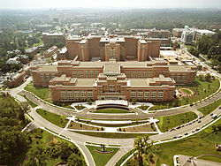
Introduction to ImageJ
Who is using ImageJ?
The first ImageJ was released in 1997 for medical image processing use in NIH (National Institutes of Health).
Image from http://en.wikipedia.org/wiki/National_Institutes_of_Health

Slide 5
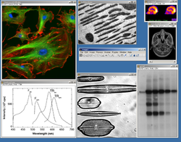
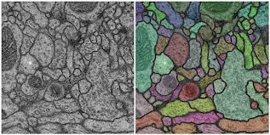
Introduction to ImageJ
Who is using ImageJ?
Now it is widely used by physicist, biologist, medical scientist, neurologist etc.
Image from http://wiki.imagej.net/
http://en.wikipedia.org/wiki/ImageJ

Slide 6
Introduction to ImageJ
Why do they use ImageJ?
There are so many reasons:
It is free
It runs everywhere
User Community
Macros
Plugins
Toolkit
Speed
Data Types
File Formats
Image display
Selections
Image Enhancement
referent http://rsbweb.nih.gov/ij/features.html
Geometric Operations
Analysis
Editing
Color Processing
Stacks

Slide 7
Introduction to ImageJ
What does ImageJ do?
IT IS UP TO YOU

Slide 8
Install ImageJ
Fiji can be Downloaded from:
http://fiji.sc/Downloads
If you don’t have Java environment you’ll need to download it from
http://www.oracle.com/technetwork/java/javase/downloads/jdk7-downloads-1880260.html
To setup Java environment please follow Section 1 of this tutorial
http://javapapo.blogspot.com/2013/03/setup-your-java-development-environment.html

Slide 9
Install ImageJ
If you don’t have Java developing tool Eclipse on your computer you can download it from
http://www.eclipse.org/downloads/
If you are not familiar with Java, you may look at http://www.tutorialspoint.com/java/

Slide 10
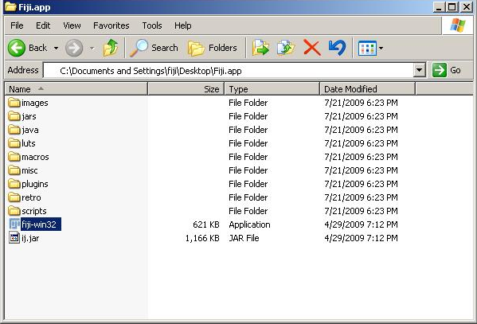
Install ImageJ
To install ImageJ or Fiji, just simply extract the package, and congrats you are done

Slide 11
How to use ImageJ
For detailed tutorial please visit
http://rsbweb.nih.gov/ij/docs/guide/user-guide.pdf
Or the webpage version
http://rsb.info.nih.gov/ij/docs/guide/146.html
Writing ImageJ PlugIns – A Tutorial
http://rsbweb.nih.gov/ij/docs/pdfs/tutorial10.pdf

Slide 12
How to use ImageJ
To open sample data to play with
File->Open Samples
To open a single image
File->Open or just press key o
To open a set of images in a folder
File->Import->Image Sequence

Slide 13
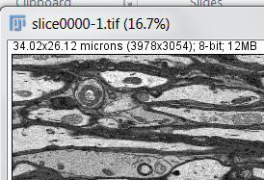
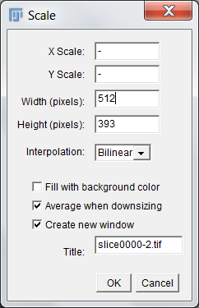
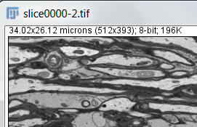
How to use ImageJ
When Image is too big to process
Image -> Scale -> adjust the size

Slide 14
How to use ImageJ
Some Definitions -- Stack vs Visual Stack
ImageJ can display multiple spatially or temporally related images in a single window. These image sets are called stacks.
The images that make up a stack are called slices.
Virtual stacks are disk resident (as opposed to RAM resident) and are the only way to load image sequences that do not ﬁt in RAM. Read only.

Slide 15
How to use ImageJ
Example: Look the stack from the other side
Image->Stack->Reslice->Choose a direction

Slide 16
How to use ImageJ
Mysteries in Tool kits
Left click – choose a toolkit.
Right click – check toolkit options.
Double click – check toolkit settings.
Show different toolkit set.

Slide 17
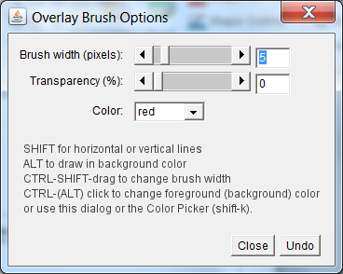
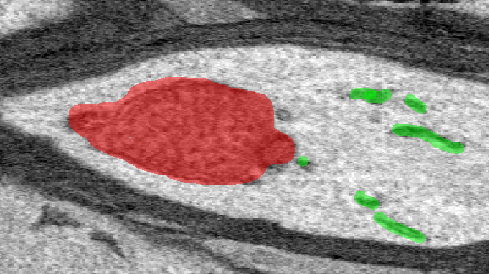
How to use ImageJ
Example: Color inner structures
-> Overlay Brush -> Double Click -> Change settings

Slide 18
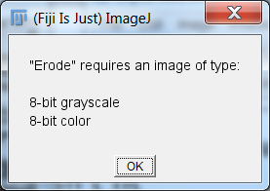
How to use ImageJ
Sometimes Message shows up when Image Type doesn’t fit
In case above, Image->Type->Choose the type you want
In this case, Image->Process -> Binary -> Make Binary

Slide 19
How to use ImageJ
Preprocesses, Blurs and Denoise
Process -> Filters -> Choose a Filter
Process -> Noise -> Despeckle

Slide 20
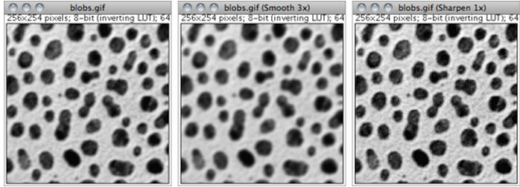
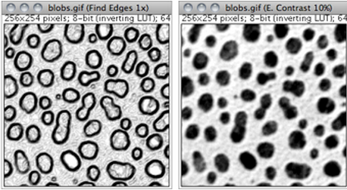
How to use ImageJ

Slide 21
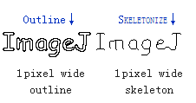
How to use ImageJ
Binary process, some useful tools

Slide 22
Hello ImageJ——The first plugin
Assume you already have Java environment and have eclipse installed n your computer

Slide 23
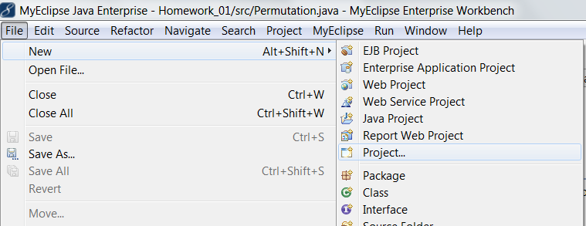
Hello ImageJ——The first plugin
Step 1, create a plain java project

Slide 24
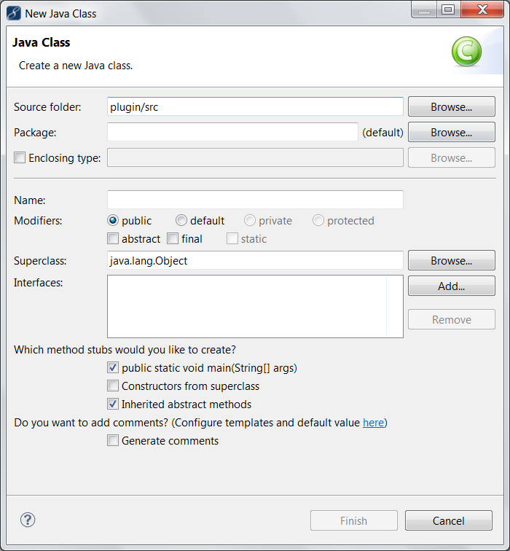
Hello ImageJ——The first plugin
Step 2, create a new class better with main method

Slide 25
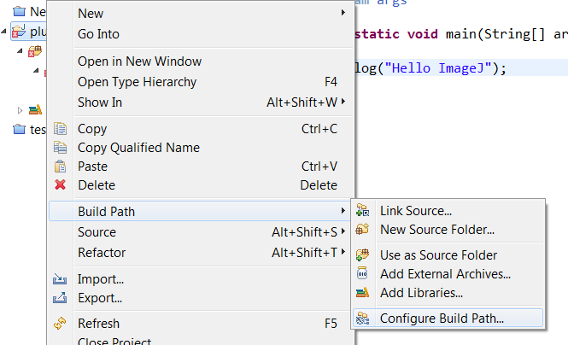
Hello ImageJ——The first plugin
Step 3, add Fiji jar
Right click on the project,

Slide 26
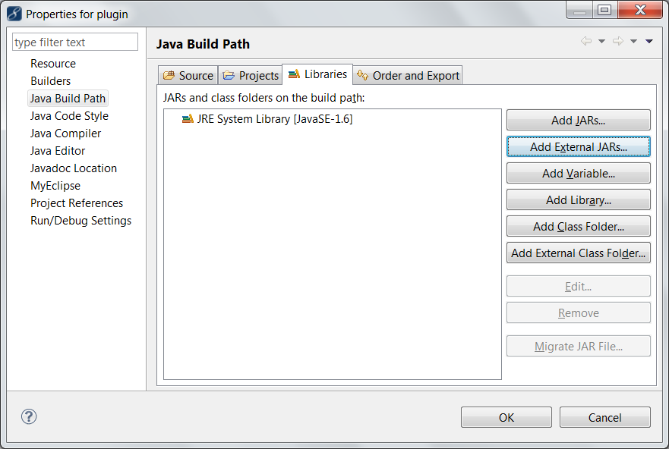
Hello ImageJ——The first plugin
Step 3, add Fiji jar

Slide 27
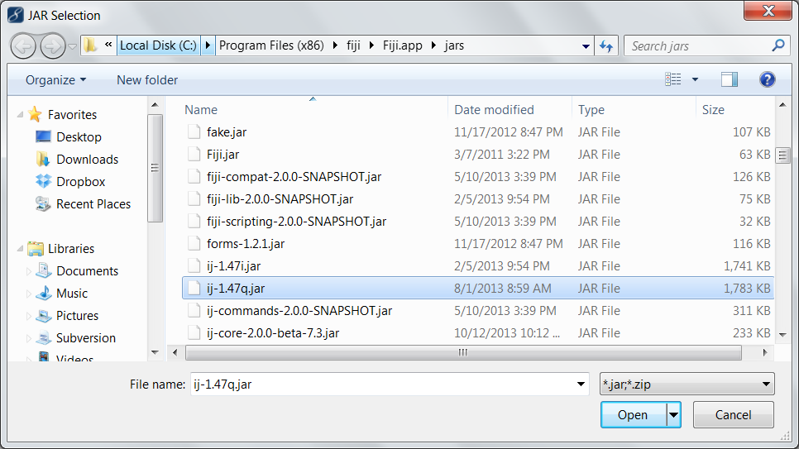
Hello ImageJ——The first plugin
Step 3, add Fiji jar
Under the path of your ImageJ, inside ../jars/ folder select the jar with version number

Slide 28
Hello ImageJ——The first plugin
Step 3, add Fiji jar
If previous steps succeed, this will show up, then import without thinking.

Slide 29
Hello ImageJ——The first plugin
Step 4, test your Hello ImageJ
Run the code in previous slide, nothing impressive happened except the regular console output.
You need add two more lines to your main method in order to make ImageJ run
String [] ij_args =
{ "-Dplugins.dir=/Users/erwin/Desktop/fiji_git/fiji/plugins",
"-Dmacros.dir=/Users/erwin/Desktop/fiji_git/fiji/macros" };
ij.ImageJ.main(ij_args);

Slide 30
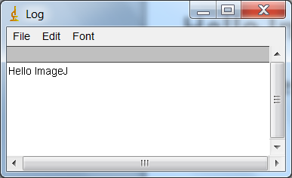
Hello ImageJ——The first plugin
Step 4, test your Hello ImageJ
These two will pop up when successes

Slide 31
Hello ImageJ——The first plugin
Step 5, pack up the jar
First you need to create your plugins.config
The content of it should be like:
Under Menu
Plugin Name
Location of Entrance

Slide 32
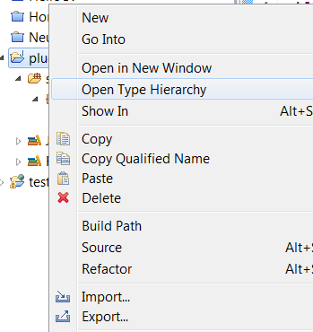
Hello ImageJ——The first plugin
Step 5, pack up the jar
Second right click your project, and click Export

Slide 33
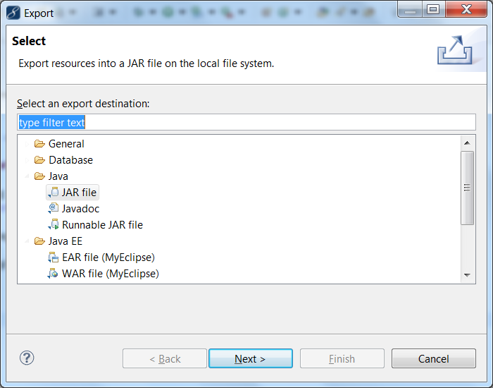
Hello ImageJ——The first plugin
Step 5, pack up the jar
Select Jar file， then Next>

Slide 34
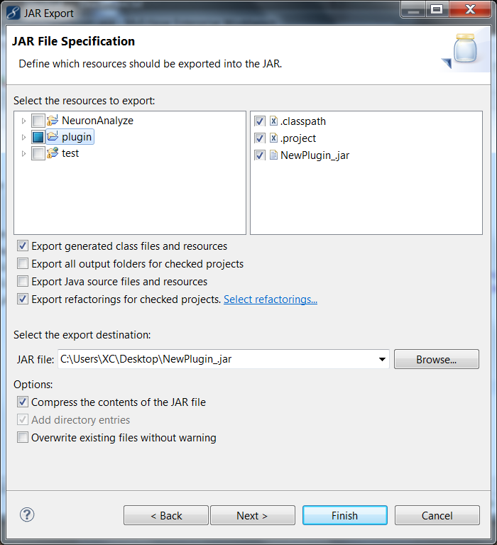
Hello ImageJ——The first plugin
Step 5, pack up the jar
Browse your export destination, and name the package.
The package name must contains a underscore “_”, Then Finish

Slide 35
Hello ImageJ——The first plugin
Step 6 install the new plugin
Plugins -> Install -> Select your plugin
OR
Drag and drop your plugin to the ImageJ UI
When the plugin is successfully installed.
It will be shown in the plugin list

Slide 36
Programming Tricks
With our first plugin installed, when we execute the plugin nothing happened. Why?
We need our class implements PlugInFilter
And override the run method

Slide 37
Programming Tricks
After each alteration, we need to repeat the steps of making jar and install the plugin.
Or we can test it directly like this.

Slide 38
Programming Tricks
PlugInFilter class is an interface has to be implemented by plugins, that require an image as input
PlugIn Class is an interface has to be implemented by plugins, that do not require an image as
input

Slide 39
Programming Tricks
And now we’ll start to have problem like this.
This is because after we implemented PlugInFilter class, a int setup(java.lang.String arg, ImagePlus imp) method is also overridden. It is for input image type check.

Slide 40
Programming Tricks
You do not have to care for the argument imp – this is handled by ImageJ and the currently active image is passed. The setup method returns a flag word that represents the filter’s capabilities (i.e. which types of images it can handle). The following capability flags are defined in PlugInFilter:
static int DOES_16
The plugin filter handles 16 bit grayscale images.
static int DOES_32
The plugin filter handles 32 bit floating point grayscale images.
static int DOES_8C
The plugin filter handles 8 bit color images.
static int DOES_8G
The plugin filter handles 8 bit grayscale images.
static int DOES_ALL
The plugin filter handles all types of images.
static int DOES_RGB
The plugin filter handles RGB images.
static int DOES_STACKS
The plugin filter supports stacks, ImageJ will call it for each slice in a stack.
static int DONE
If the setup method returns DONE the run method will not be called.
static int NO_CHANGES
The plugin filter does not change the pixel data.
static int NO_IMAGE_REQUIRED
The plugin filter does not require an image to be open.

Slide 41
Programming Tricks
static int NO_UNDO
The plugin filter does not require undo.
static int ROI_REQUIRED
The plugin filter requires a region of interest (ROI).
Static int STACK_REQUIRED
The plugin filter requires a stack.
static int SUPPORTS_MASKING
Plugin filters always work on the bounding rectangle of the ROI. If this flag is set
and there is a non-rectangular ROI, ImageJ will restore the pixels that are inside
the bounding rectangle but outside the ROI.

Slide 42
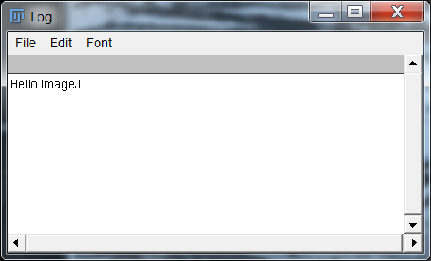
Programming Tricks
Here is a example of setup method
Then export and install the plugin again.
And here you go

Slide 43
Programming Tricks
Do more testing
No active image when we test the plugin in eclipse, so we need to load the image into memory by code.
Those part has been added to the new plugin and you can download the template project from:
http://www.cs.kent.edu/~xchang/plugin.zip

Slide 44
Programming Tricks
Get pixels, and better getPixels
Two ways to get and set color from image
Way 1:
int color = Imp.getStack().getProcessor(i+1).getPixel(x,y);
Way 2 :
byte[] pixels = (byte[]) imp.getStack().getPixels(i+1);
byte color = pixels (y*width+x);

Slide 45
Programming Tricks
RGB vs Greyscale
We get greyscale color in byte type, and get RGB color in int type.
How to get color value:
int red = (int)(pixels[i] & 0xff0000)>>16;
int green = (int)(pixels[i] & 0x00ff00)>>8;
int blue = (int)(pixels[i] & 0x0000ff);
How to put it back:
pixels[i] = ((red & 0xff) << 16) + ((green & 0xff) << 8) + (blue & 0xff);

Slide 46
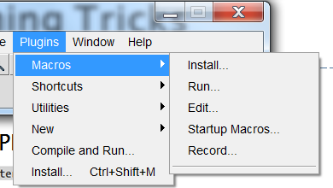
Programming Tricks
Call existing functions
Google ImageJ API and find out
Or
Call macro in plugin

Slide 47
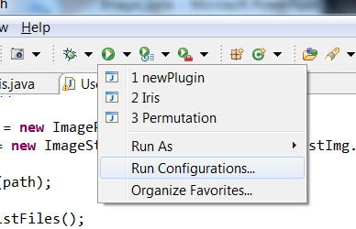
Programming Tricks
When you don’t have enough memory
Open run configurations

Slide 48
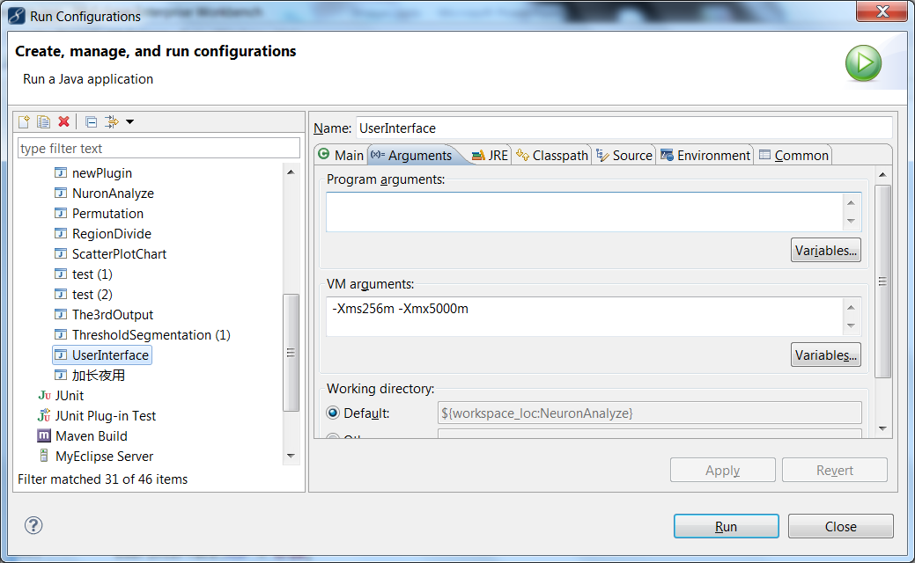
Programming Tricks
Go to Arguments tab, and put the VM memory usage arguments –Xms256m –Xmx5000m

Slide 49
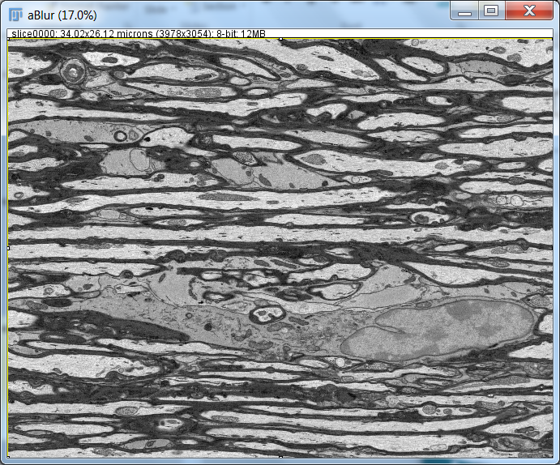
Test Data
This data can be get from www.cs.kent.edu/~xchang/all-bak.zip

Slide 50
Download and Tutorial Links
Fiji can be Downloaded from:
http://fiji.sc/Downloads
If you don’t have Java environment you’ll need to download it from
http://www.oracle.com/technetwork/java/javase/downloads/jdk7-downloads-1880260.html
To setup Java environment please follow Section 1 of this tutorial
http://javapapo.blogspot.com/2013/03/setup-your-java-development-environment.html
If you don’t have Java developing tool Eclipse on your computer you can download it from
http://www.eclipse.org/downloads/
If you are not familiar with Java, you may look at http://www.tutorialspoint.com/java/
For detailed tutorial please visit
http://rsbweb.nih.gov/ij/docs/guide/user-guide.pdf
Or the webpage version
http://rsb.info.nih.gov/ij/docs/guide/146.html
Writing ImageJ PlugIns – A Tutorial
http://rsbweb.nih.gov/ij/docs/pdfs/tutorial10.pdf
Project Template
http://www.cs.kent.edu/~xchang/plugin.zip
This data can be get from
www.cs.kent.edu/~xchang/all-bak.zip

