Slide 1
Managing Uncertainty in Social Networks
Written by: Eytan Adar and Christopher Re
Presented by: Amir
Adar, E., & Re, C. (2007). Managing uncertainty in social networks. IEEE Data Eng. Bull., 30(2), 15-22.

Slide 2
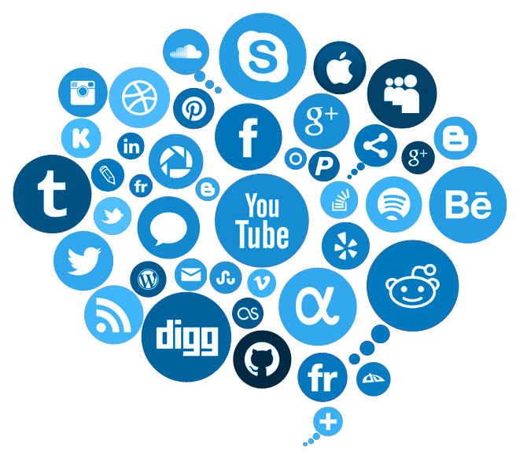
Social network analysis
Social Network Analysis (SNA):
It is a process to analyze social network related data (e.g., network structure, use of network, etc.).
Traditionally, the SNA is done by graph theory.

Slide 3
SNA

Slide 4
Challenges in SNA
Multiple sources may provide different results.
Sometime you forget to update your information in all places. Maybe, you are not focusing on all Social Networking Sites (SNS) at the same time.
How to combine these data?
Combine data from different SNS, blogs, etc.
How much certainty each data has, and their combinations?
Network is growing, but, we still need faster way to find the data.

Slide 5
Abstract
Collecting Social Network (SN) related data may be imprecise as the network grows (e.g., shift in scale).
Traditional techniques (e.g., graph theory) works fine with small database, however the degree of imprecision increases as the database become large.
Probabilistic database management addresses existing challenges.

Slide 6
Background and solution
In last 50 years, SNA has grown a lot. Therefore, analyzing large-scale social network received public attention.
SNA helps to understand marketing, health, communication, and trend of commercial applications.
Large-scale comes with imprecision, we need ways to analyze the data with confidence.

Slide 7
Background and solution
Traditionally managing and analyzing large-scale data has been the domain of data management research and technologies, which have almost always assumed that the data is precise.
Probabilistic databases (PDBs) can be a solution to model, manage and mine emerging SNA

Slide 8
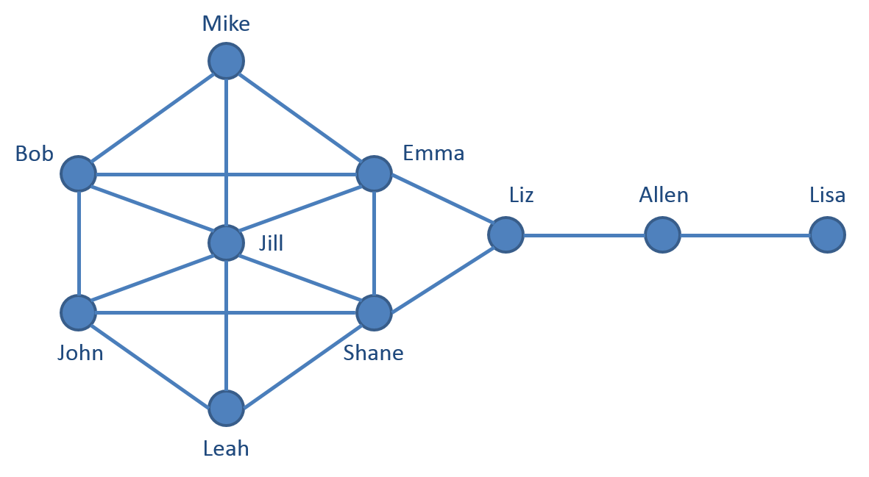
Graph techniques
Nodes are called actor--people
Edges are relationship between nodes

Slide 9
Issues with collecting Social Network data
Survey
Observation\Missed observation
Reporting\misreporting
Imitate involvement of researcher (frequently, and over extended periods)
Internet\spammers
Noise data: tremendous level of uncertainty in the data.

Slide 10
Challenges
How to find an accurate (up the level of certainty) data?
How to find data fast?
How to maintain large scale database?

Slide 11
Probabilistic relational databases
All these challenges can be addressed with the help of Probabilistic relational databases.
As Adar and Re (2007) wrote, “Probabilistic relational databases—the potential answer to these issues…” (p. 2).
In following slides I will try to explain how they used Probabilistic relational databases to address mentioned challenges.
Adar, E., & Re, C. (2007). Managing uncertainty in social networks. IEEE Data Eng. Bull., 30(2), 15-22.

Slide 12
PD and RD
For example, Tuples (i.e., rows of data) can be stored, searched, and aggregated in different ways.
StudentID | Name
001 | John
002 | Paul
003 | Smith
Student Table
CourseID | CourseName
001 | Intro to CS
002 | Intro to Math
003 | Intro o Physics
Course Table

Slide 13
StudentID | Name
001 | John
002 | Paul
003 | Smith
Student Table
EnrollmentID | StudentID | CourseID
001 | 001 | 001
002 | 001 | 002
003 | 002 | 001
Enrollment Table
CourseID | CourseName
001 | Intro to CS
002 | Intro to Math
003 | Intro o Physics
Course Table

Slide 14
StudentID | Name
001 | John
002 | Paul
003 | Smith
Student Table
EnrollmentID | StudentID | CourseID | Probability
001 | 001 | 001 | 0.9
002 | 001 | 002 | 0.1
003 | 002 | 001 | 1.0
Enrollment Table
CourseID | CourseName
001 | Intro to CS
002 | Intro to Math
003 | Intro o Physics
Course Table
Notes:
Adding and dropping classes

Slide 15
Another example of imprecise data
You have seen Paul in Apartment A 9 times and in Apartment B 1 time. Which apartment does he live in?

Slide 16
Diffusion model
“The diffusion model is a model of the cognitive processes involved in simple two-choice decisions. It separates the quality of evidence entering the decision from decision criteria and from other, nondecision, processes such as stimulus encoding and response execution. The model should be applied only to relatively fast two-choice decisions (mean RTs less than about 1000 to 1500 ms) and only to decisions that are a single-stage decision process (as opposed to the multiple-stage processes that might be involved in, for example, reasoning tasks).”
Ratcliff, R., & McKoon, G. (2008). The diffusion decision model: theory and data for two-choice decision tasks. Neural computation, 20(4), 873-922.
https://www.ncbi.nlm.nih.gov/pmc/articles/PMC2474742/

Slide 17
Model and system

Slide 18
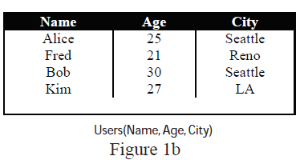
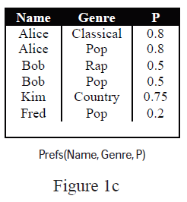
Data
From Fig 1: There are two types of data
(1) standard actor/node information (e.g.., name, age, residing city, etc.) – see figure 1b
(2) preference data (e.g., music preference) in terms of genre. – see figure 1c
This model is assigning a probability to tuple (p. 2)

Slide 19
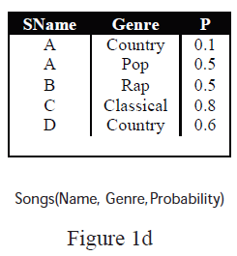
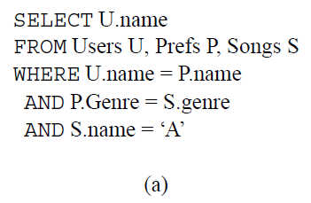
Continue…
Relation between genre and songs (see Fig 1d)
“What is the probability that a user would like A?”

Slide 20
SELECT U.name
FROM Users U, Prefs P, Songs S
WHERE U.name = P.name AND P.genre = S.genre AND S.name =‘A’
User Kim would have probability of 0.75*0.1 = 0.075

Slide 21
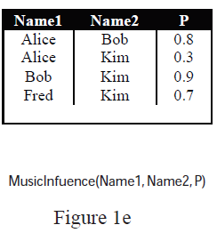
“What is the probability that Kim will be affected by these recommendations?”
SELECT U.Name
FROM Users U , Prefs P, Song S, MusicInfluence M, Recommends R
WHERE U.name = P.name AND P.Genre = S.genre AND M.name2 = U.name
AND M.name1 = R.from
AND R.To = U.name AND R.song = S.sname AND S.sname = ’D’
0.6*0.75*(1 – (1-0.8)*(1-0.9)) = 0.441

Slide 22
Application area
Data analysis (SNA)
“in our scenario we may be interested in distributing free concert tickets for a new artist to a small subset of users. Since there is a cost to providing these tickets, we would like to find a small group of consumers who have a large amount of influence, i.e. a set of trend-setters or influencers.”
How would you identify influencers?
Sol: Nodes with a high degree-centrality measure (e.g. the number of outgoing edges is high).
Keep in mind that different social network may provide different values---uncertain data???
Sol: Send the tickets to high value users, e.g. those with a high probability of having more than k edges

Slide 23
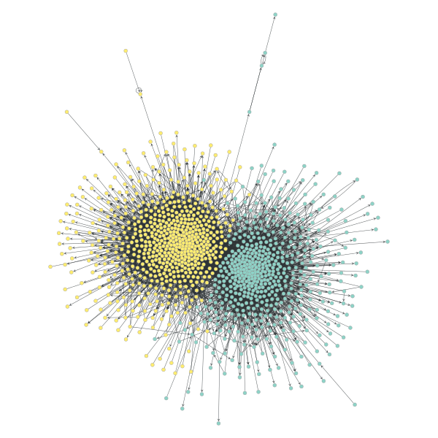
Scalability:
Find similar nodes? Record number of outgoing nodes and incoming nodes. List them, sort them.
Sometimes, query may take long time to execute and degrade the performance of the system.
Run: SQL safe plans.
Safe plans tell us when a probabilistic query can be computed by simply multiplying (and
summing) probabilities.
Also, materialize a probabilistic view.
This will help us to scale

Slide 24
Materialized view
“A materialized view is simply the result of a query that has been precomputed and stored. n traditional databases, materialized views are used widely to speed up query processing” (Dalvi, Re & Suciu, 2011, p. 473).
Dalvi, N., Re, C., & Suciu, D. (2011). Queries and materialized views on probabilistic databases. Journal of Computer and System Sciences, 77(3), 473-490.

Slide 25
It is sort of copy of a table(s)
Changes will reflect in the materialized view
This is run periodically
If can also create index in materialized view to improve performance
Delete will reflect immediately
Joining takes time, however, once created and stored, the view would be faster

Slide 26
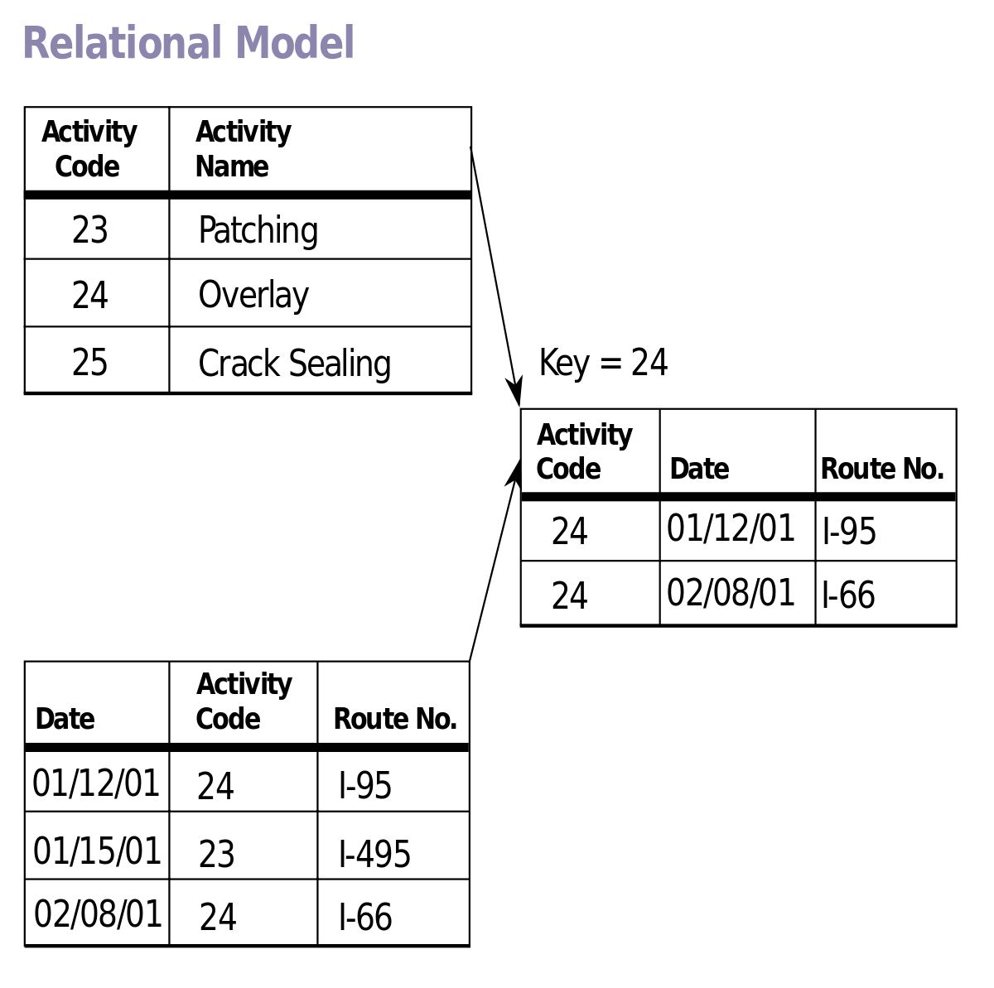
Maintainability
Adding new tuple adds new probability value.
It also changes the relationship
It is important for administrator to know
how and why the probability value is computed.

Slide 27
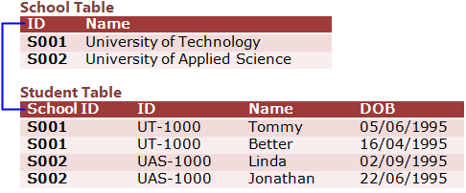
Integration
Relational database allows to integrate databases (e.g., tables) using reconciliation method.

Slide 28
Missing data
Object | Instance | Probability
A | A1 | 0.7
 | A2 | ???0.3
B | B1 | 0.6
 | B2 | 0.2
 | B3 | ?? 0.2
C | C1 | 0.7
 | C2 | ?? 0.3

Slide 29
Conclusion
Probabilistic databases are useful paradigm
Helpful for data collection and analysis.
It helps in many database related issues, e.g., integration, calculation, handling missing data, etc.
Still there is lot to explore.

