Slide 1
Clustering Uncertain Taxi data
By: Jianfeng Zhu Salwa Aljehani
Kent State University

Slide 2
Outline
Introduction
Problem definition and solution
Experiment
Conclusion

Slide 3
Introduction
Considering a database of location data reported from moving Taxi in a GPS system.
Data Clustering: used to discover any cluster patterns in a dataset
dataset may partitioned into several groups:
  such that the data within the same cluster are closer to each other or more similar (based on some distance functions) than the data from any other clusters.
Uncertainty on location:
  In case of moving objects such as taxies, The actual locations may have changed when their reported locations data is received.
Extending traditional clustering methods to handle the uncertain data.

Slide 4
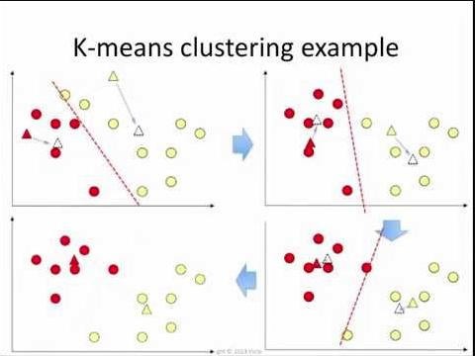
Problem definition and Solution
Clustering on taxi data, which is on weekend of summer holiday (Sunday, Feb 3rd, 2008), in Beijing City, China.
To Find What is the hotspots for visitors.
Many methods for clustering data, such as K-means clustering.
K-means clustering considers each cluster to have a centroid (it is the mean of the data in the cluster).
Notes:
K-means clustering assigns each vehicle to one of the K clusters such that its location is closer in Euclidean distance to that cluster's representative than any others' representatives.
Then the representative of each cluster is updated to the mean of the locations of the vehicles in the cluster. And each vehicle is re-assigned to the K clusters with the new representatives.
This process repeats until some objectives is met, e.g. no changes of any vehicles' clusters between two successive processes.

Slide 5
Problem definition and Solution
In the case of uncertainty, the data in the database is not very accurate.
The Taxi data will have an "uncertainty" region around the taxi where its actual location lies within this region.
The uncertainty region could be a circle region:
  using the reported location of the taxi as its center
  and has a radius of the taxi's maximum speed.
Notes:
Assume one time stamp for the radius.

Slide 6
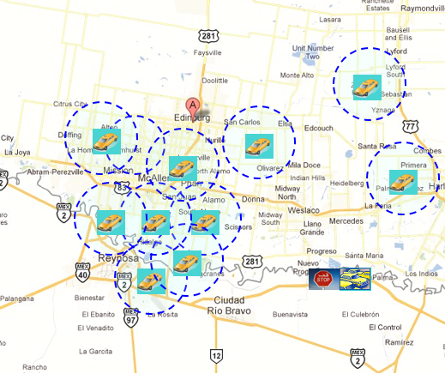

Slide 7
Problem definition and Solution
for the probability of the vehicle's actual location being in a particular point of the region:
The uncertainty region could be associated with an arbitrary probability density function (pdf).
Using uniform distribution Probability Function.
  Based on the total number of the samples inside the region.
If part of the region is sea or building ,
  that part may be associated with a total of 0.1 probability and
  A probability 0.9 is for the taxi to be in any points of the remaining part of the region.

Slide 8

Problem definition and Solution
UK-means clustering is used with uncertain data .
UK-means clustering is based on traditional K-means clustering algorithm
its distance function is the "expected distance”
  from the data's uncertainty region (the Taxi region ) to the centroid of the cluster that should assigned to.
For centroid c of the cluster, an uncertainty region R with a pdf f, and a Euclidean distance function D(p,c) , the expected distance is:

Slide 9
Experiment :
The dataset contains the GPS trajectories of 10,357 taxis during 3 days
in Beijing. The total number of points in this dataset is about 15 million, and the total distance of the trajectories reaches to 9 million kilometers.

Slide 10
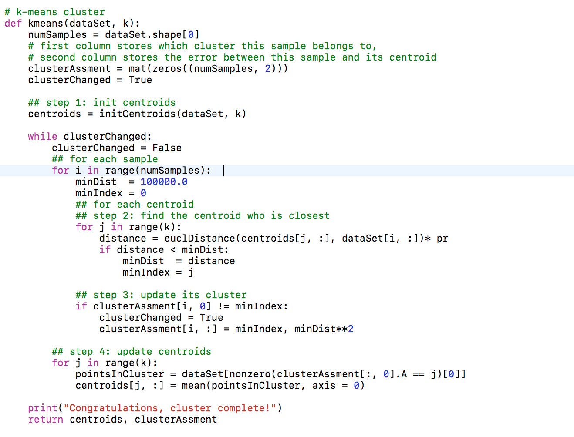
UK-Mean:

Slide 11
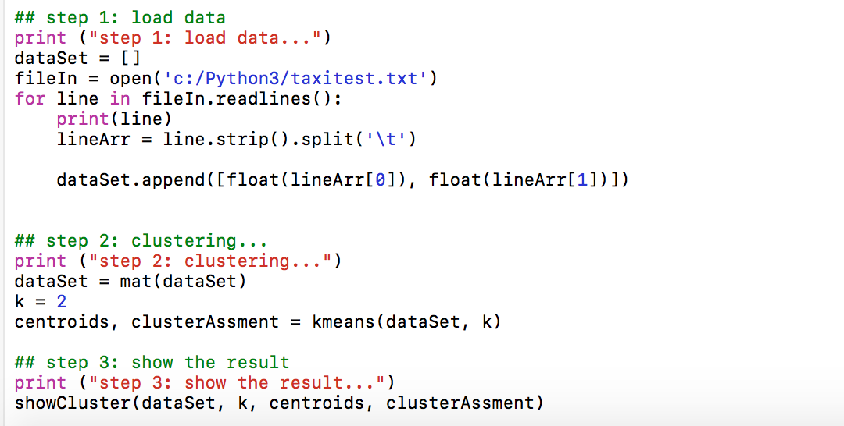

Slide 12
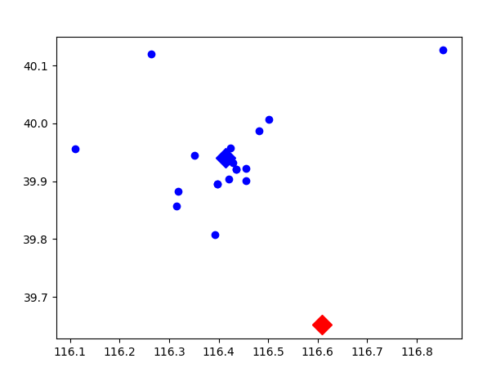
Clustering with K-mean:

Slide 13
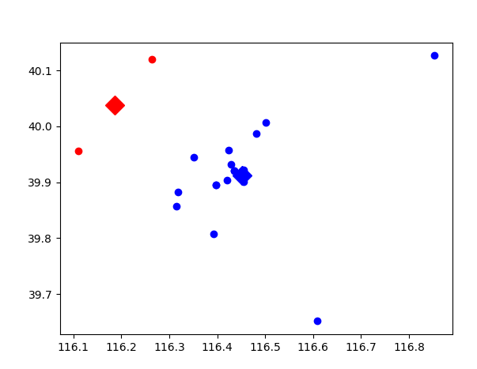
Clustering with UK-mean:

Slide 14
Pruning Method:
Considering the moving of the object :
Basic idea
  Compute the lower/upper bounds of the Taxi speed, spd(s1, s2), from object point T in the uncertain region.
  Use lower/upper bounds of speed to filter out false sample points.

Slide 15
Conclusion and Future Work:
In this project we studied the problem of clustering moving objects with the uncertainty regions defined .
applying the UK-means algorithm to cluster uncertain objects using expected distances.
To reduce the cost of expected distance computations, effective pruning techniques are necessary.
This work can applied to other clustering methods such as nearest neighbor
Also we can apply for another pdf to computer the probability of the uncertain points, such as Gaussian distribution.

Slide 16
Reference:
Ngai, Wang Kay, et al. "Efficient clustering of uncertain data." Data Mining, 2006. ICDM'06. Sixth International Conference on. IEEE, 2006.
Yang, Z., & Tang, H. (2010). A Model of Clustering Uncertain Data, 969–972.
Patil, A. B. (2014). A Review of Clustering Algorithms for Clustering Uncertain Data, (November), 3643–3646.
https://mubaris.com/2017-10-01/kmeans-clustering-in-python
Dataset: https://www.microsoft.com/en-us/research/publication/t-drive-trajectory-data-sample/

Slide 17
Thank You

