Slide 1
Distributed Probabilistic Range-Aggregate Query on Uncertain Data
Presenters: Niranjan Rai and Weilong Ren

Slide 2
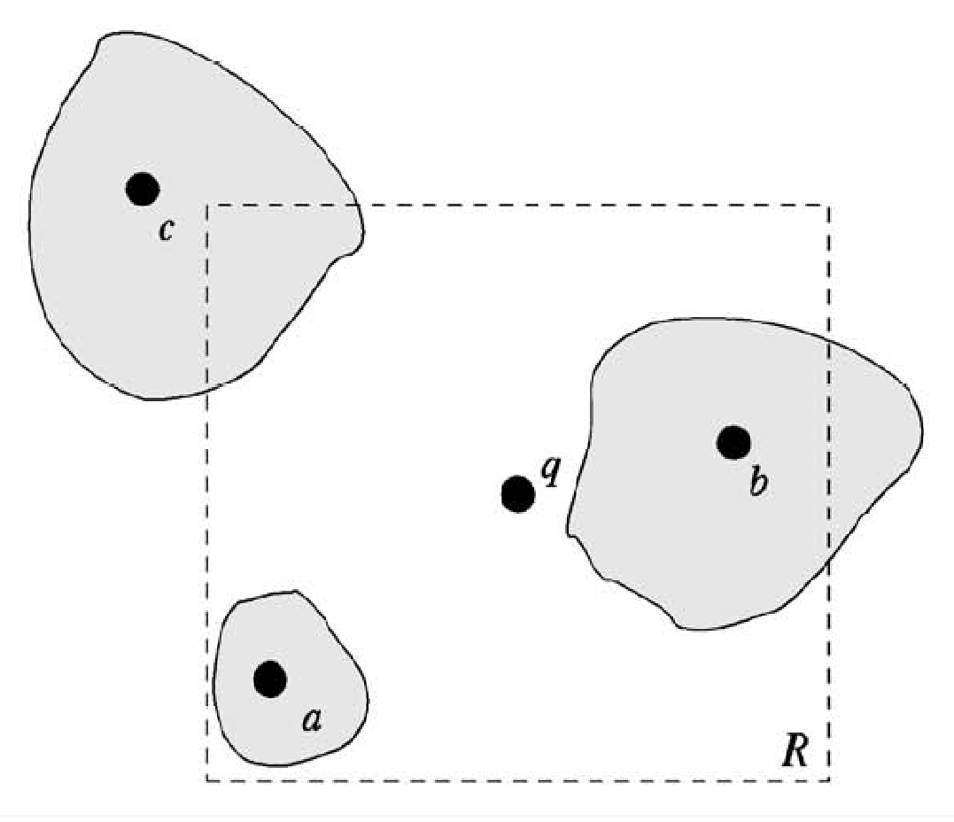
What is Probabilistic Range Query?
A probabilistic range query (PRQ) retrieves a set of data objects o_{i} which are in the query region, QR(q) , with probability p_{i} greater than or equal to a threshold p (≥ 0)
query region

Slide 3
What is Aggregate Query?
An Aggregate query is a query which will return the aggregate results such as COUNT, SUM, MIN/MAX, AVG,MEDIAN, QUARTILE values of the selected points or objects

Slide 4
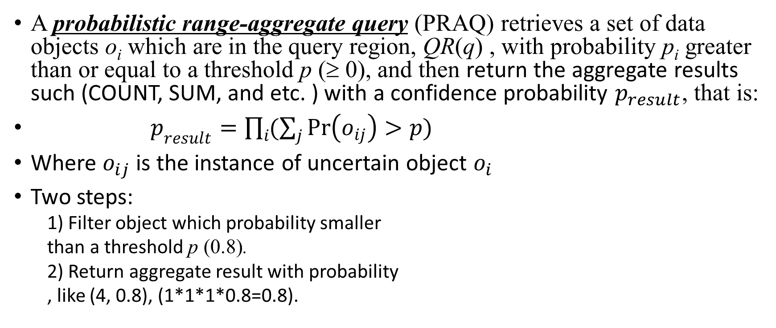
So for probabilistic range-aggregate query
Query Region
1
1
1
0.5
0.8
0.3

Slide 5
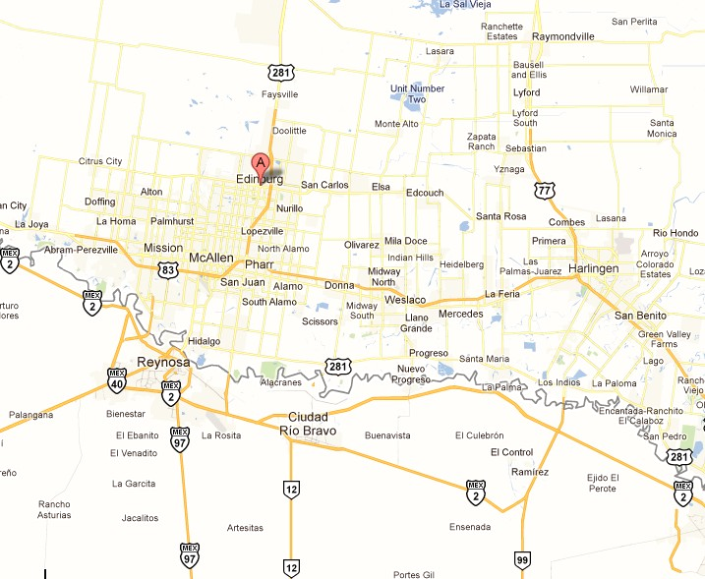
Motivation of our project

Slide 6
The Intuitive solution
For every uncertain object with multiple possible instances, we compute the distance between object and the query point, and then prune these objects whose probabilities are smaller than the threshold p. Next, we return the aggregate result with a probability.
This method is not efficient, and time consuming.

Slide 7
Solution in our project
1. Pruning method
R*-tree
2. Distributed System
Map-Reduce

Slide 8
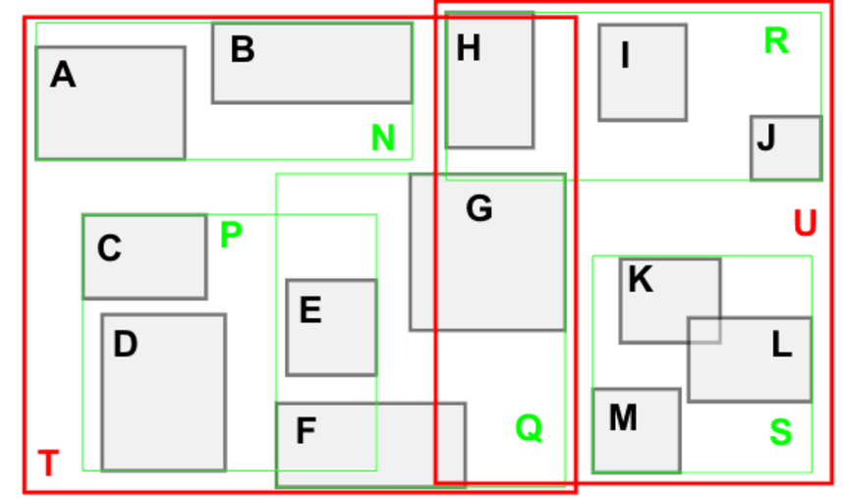
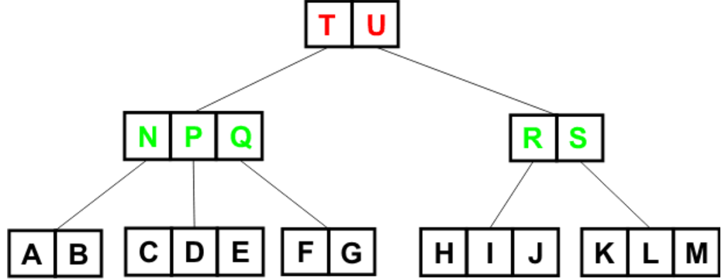
R-Tree
Minimum Bounding Rectangle (MBR)
Use a smallest rectangle (or hyperrectangle in the multidimensional space) to bound objects/nodes
A number of spatial objects (e.g., points, lines, rectangles, polygons, or irregular shapes)
A. Guttman. R-trees: a dynamic index structure for spatial searching. In SIGMOD, 1984.
Notes:
A. Guttman. R-trees: a dynamic index structure for spatial searching. In SIGMOD, 1984.
http://cglab.ca/~cdillaba/comp5409_project/R_Trees.html
https://en.wikipedia.org/wiki/B%2B_tree

Slide 9
R*-tree
R-tree aims to minimize the areas of the index nodes (e.g., while splitting nodes)
R*-tree further optimized the R-tree index
Essentially: coverage and overlap

Slide 10
Map-Reduce
<Range, Threshold> R*-tree
Partition 1
Partition 2
Partition N
reducer
Uncertain Database
mapper

Slide 11
Experimental Data set
To obtain a database with probabilistic objects, we manually generated 1M objects, each of which has 1 to 10 instances with relative probabilities. So the overall data size is between 1M to 10M.
Especially, for each object, the probability sum of all instances is equal to 1.

Slide 12
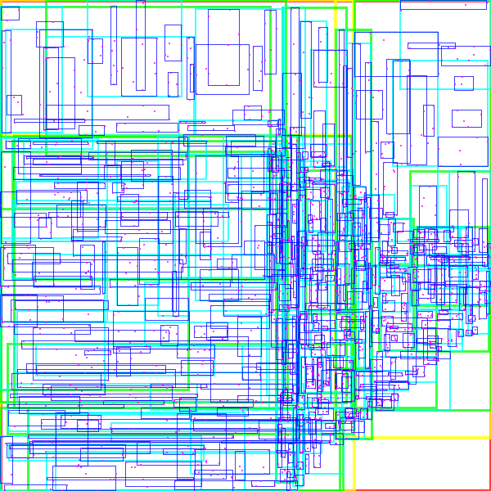
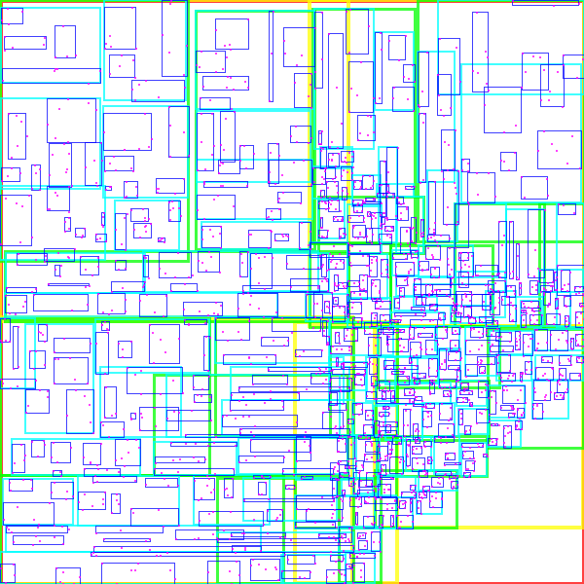
Experimental Result
Fig. (a) R-Tree
Fig. (b) R*-Tree

Slide 13
Questions?

