Slide 1
Time Series Data and Moving Object Trajectory
Made by: Yu Cao, Fengqi Xing, XiangXu Lin, Zhiqing Gu

Slide 2
Overview
Time Series data is a series of data points indexed(or listed/graphed) in time order.
General graph predict the future trending.
Moving object Trajectory
Edit Distance on Real sequence (EDR)
Problem
EDR for project

Slide 3
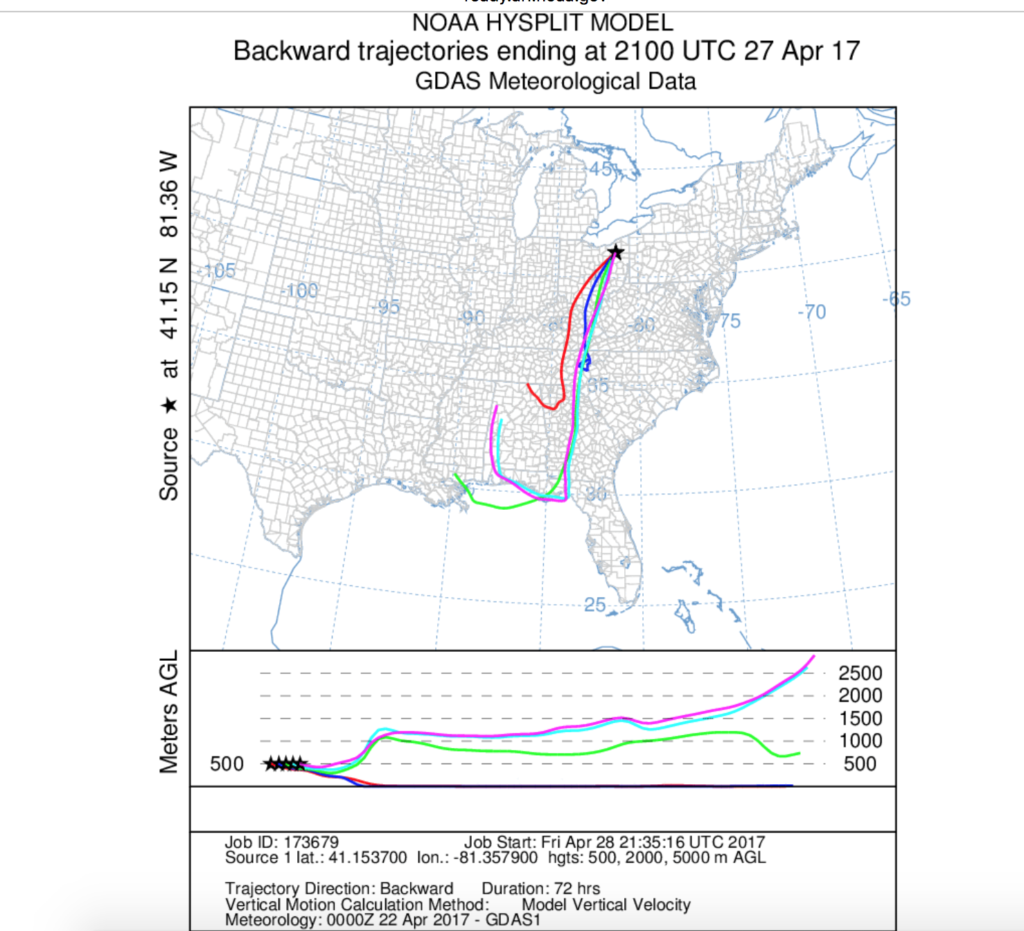
Moving object Trajectory
Financial data analysis
Weather forecasting.
Cars moving .

Slide 4
Moving object Trajectory
Problem: The existing distance functions are usually sensitive to noise, shifts and scaling of data that commonly occur due to sensor failures, errors in detection techniques, disturbance signals, and different sampling rates. Cleaning data to eliminate these is not always possible.
Analysis: Edit Distance on Real sequence (EDR) , Dynamic Time Warp-ing (DTW), Edit distance with Real Penalty (ERP) , Longest Common Subsequences (LCSS)

Slide 5
Edit Distance on Real sequence (EDR)
Find how dissimilar with two string (words) are to one another by counting the minimum number of operations required to transform one string into the other.
Euclidean distance

Slide 6
Evaluation of EDR
EDR performs as well as DTW, ERP and LCSS.
Conclude: the results of above two tests prove that EDR per- forms as well as DTW, ERP, and LCSS when trajectories contain little or no noise, and it is more robust than DTW and ERP, and on average 50% more accurate than LCSS in noisy conditions. In terms of efficiency, the computation cost of DTW, ERP, LCSS, and EDR is the same, which are quadratic using dynamic programming.

Slide 7
Improving of EDR
EDR is not a perfect function for trajectory
3 ways to improve the efficiency:
Mean value Q-grams
Near triangle inequality
Trajectory histogram

Slide 8
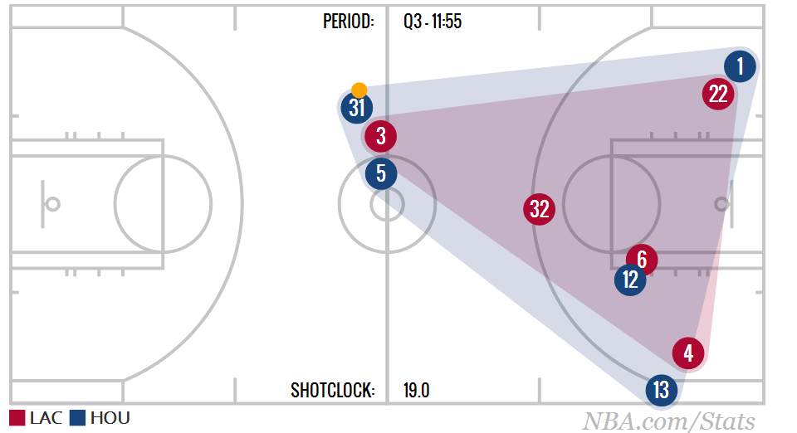
Moving Object Trajectories
NBA players moving trajectories.

Slide 9
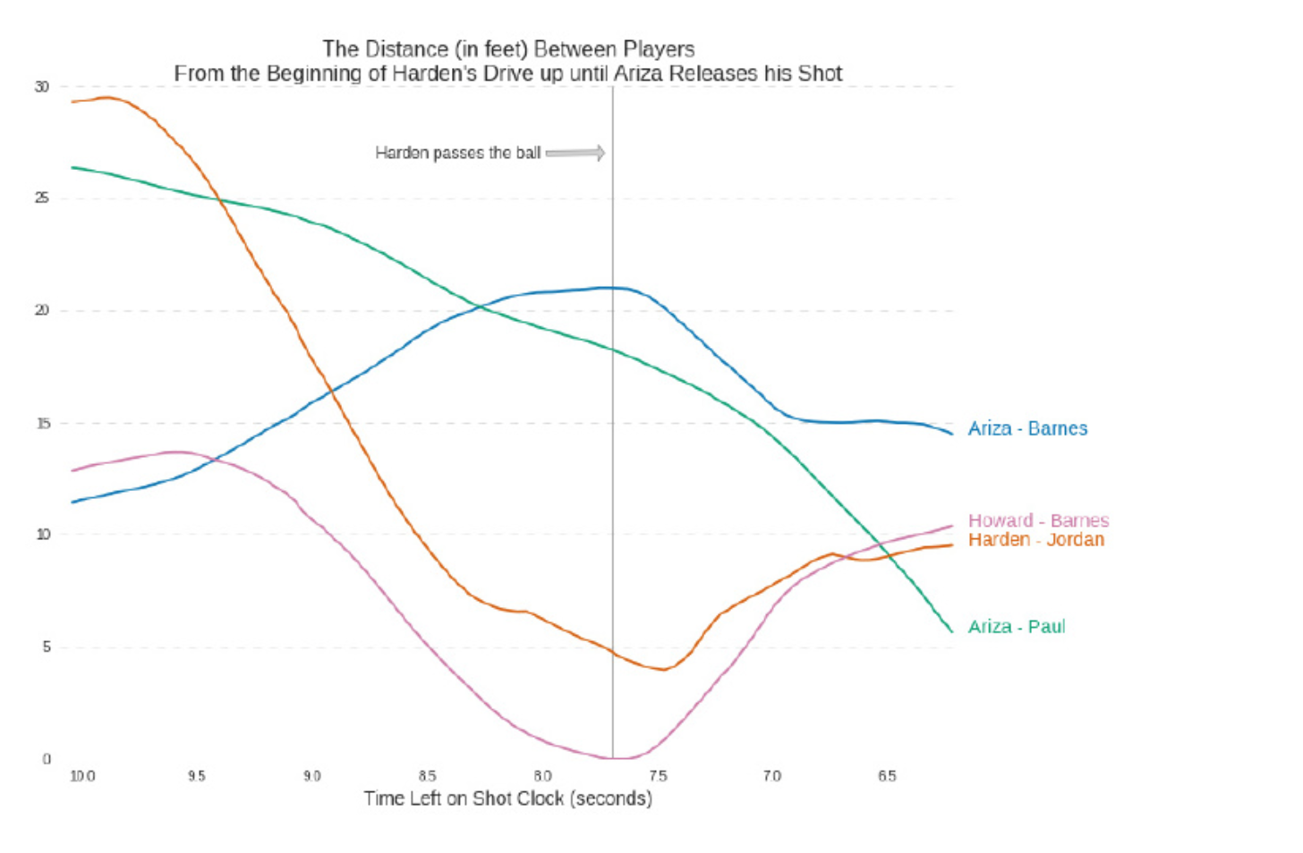
Moving Object Trajectories
Find all similar trajectories in database.

Slide 10
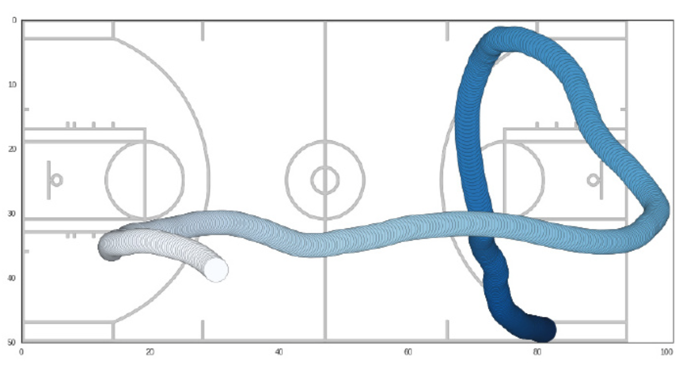
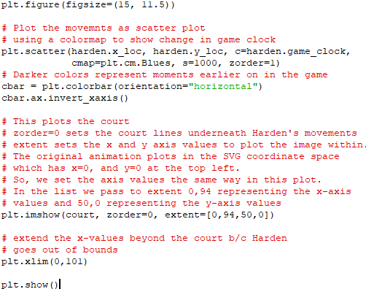
Draw the Movement

Slide 11
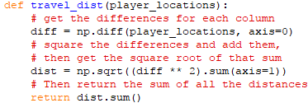
Calculating Euclidean Distance
Calculating Euclidean distance between consecutive points of an array with Numpy

Slide 12
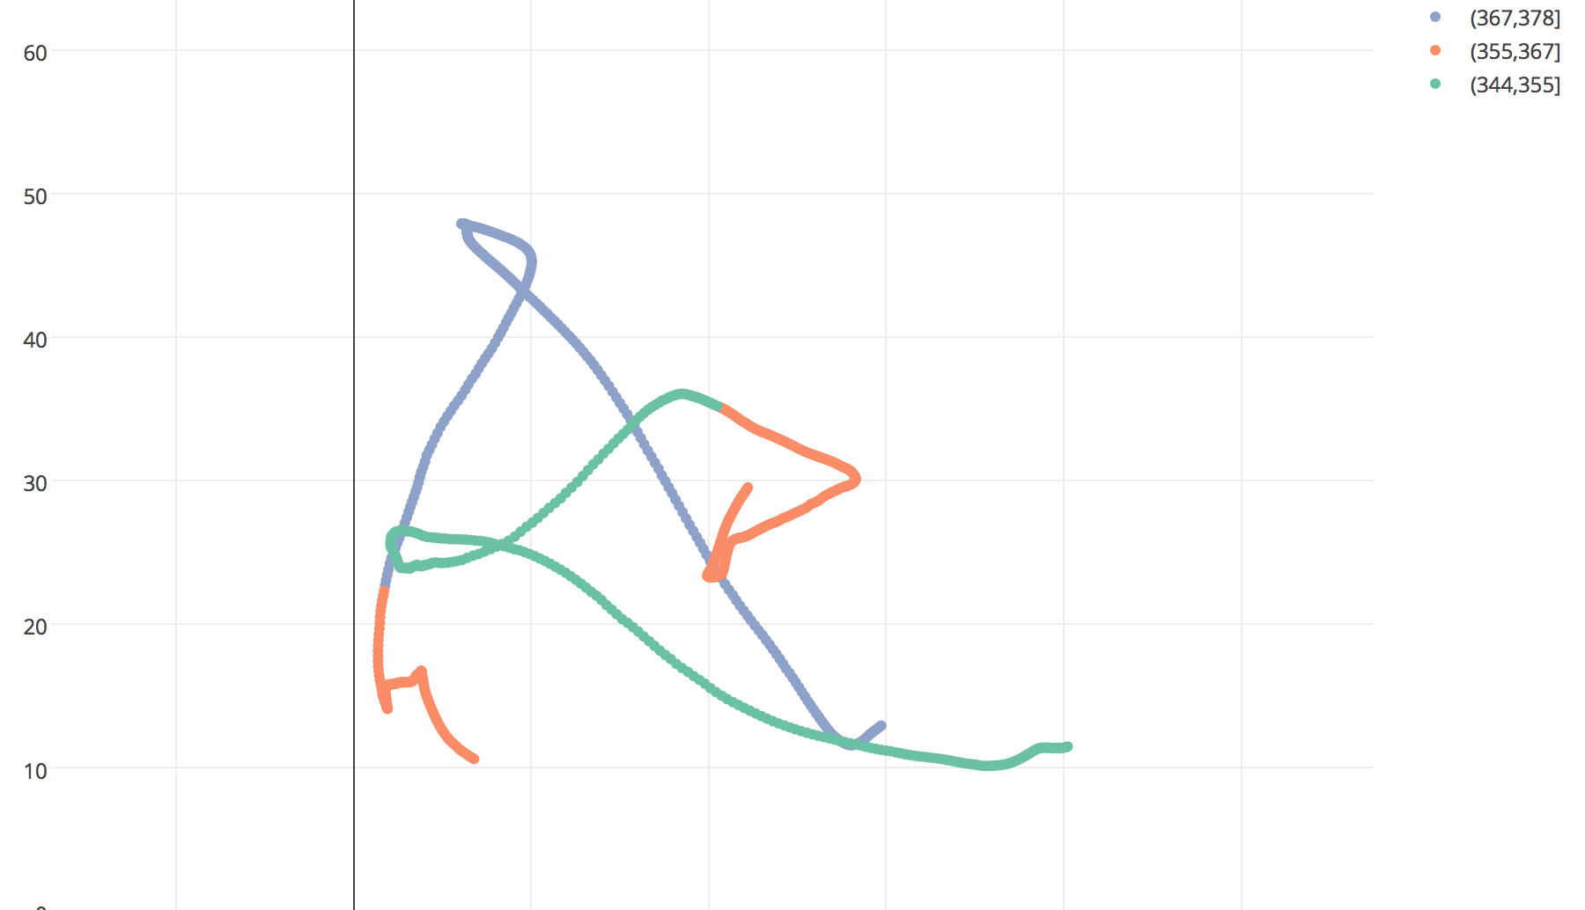
Expect Output
https://plot.ly/~cricel.design/1.embed

Slide 13
Thank you!

