Slide 1
Queries Over Graph Data: Presidential Election
KYLE BROWN, CHUKWUDI OGUEJIOFOR, ANDREW RADOSEVIC, TAPTI SAHA

Slide 2
Motivation: Presidential Election
The 2016 United States Presidential Election was one of the most heated campaigns in the history of our country.
All projections pointed towards Hillary Clinton claiming victory over Donald Trump.
Take a look into finding sentiment based on language used in responses to questions.
Why was the polling off?
Big Data was a very new concept during the 2012 election, but it was used to predict the outcome.
How can big data be used to help win an election?

Slide 3
Proposed Solution
We performed a survey with more than 100 people of different age, religion etc to gather a wide variety of data and opinion.
We determined the confidence using an open source online tool.
We needed to program the data.

Slide 4
Software Used
Graph Viz
  Produces graph visualizations quickly for large amounts of data
Neo4j Community Edition
  Native property graph database
  Database is visible to a browser
Sentiment Classifier Tool
  Online tool for classifying the responses to our questionnaire
  Based on Naïve Bayes classification
Python
  GraphViz and Neo4j are supported in python 2.7 and python 3

Slide 5
Importing Libraries
We used three libraries:
  Graph Viz
  Neo4j
  Panda
Library Attributes:
  R style data frame works well with Pandas as it supports column header.
  Handles different data types in one package.
  Rendering graphs in graphviz is easy.
  Command line tool so it can generate any number of data.
  Neo4j Database is interactive and supports queries.

Slide 6
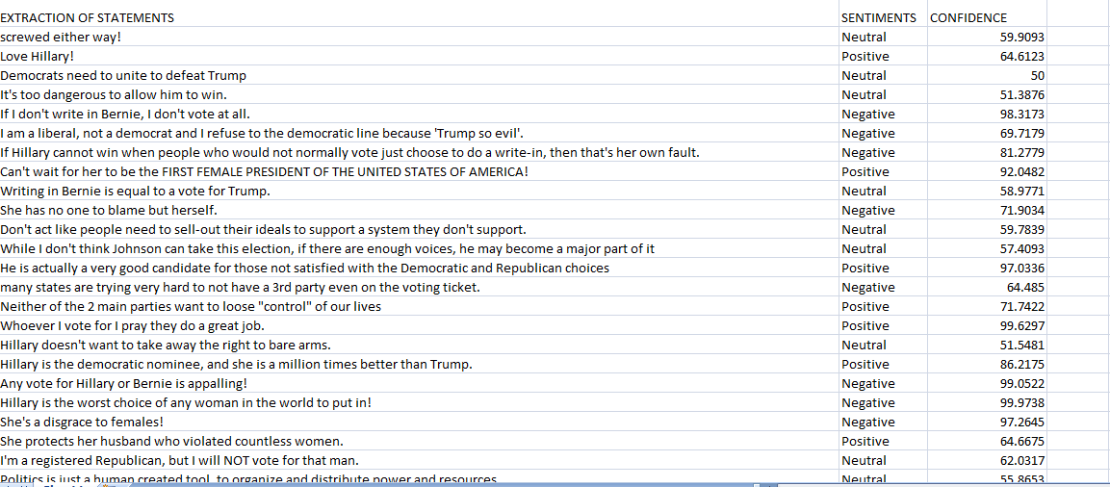
Loading Data
We used Excel to store our Database Data

Slide 7
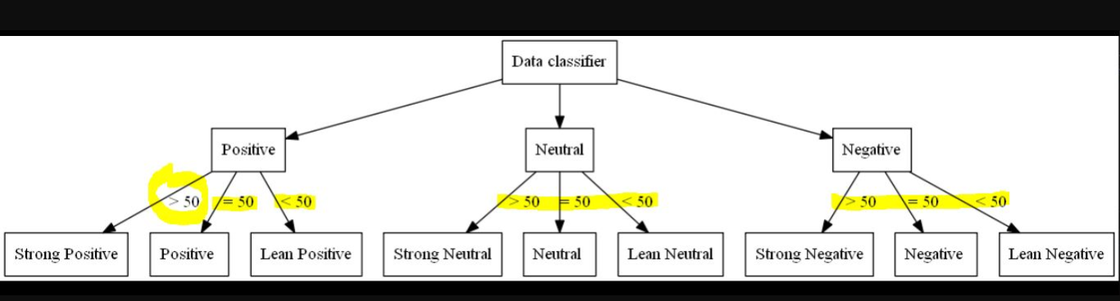
Sentiment Type
We have divided our sentiments(data classifier) into 3 different types:
Positive
Negative
Neutral
These three types are
further divided into two
categories:
Lean
Strong

Slide 8
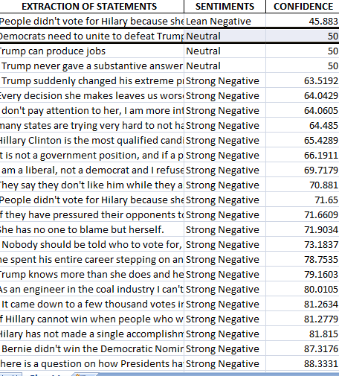
Sorting
The program will sort the data according to the sentiment and the confidence value
After sorting the data, it will save into a new file with the updated classifications.

Slide 9
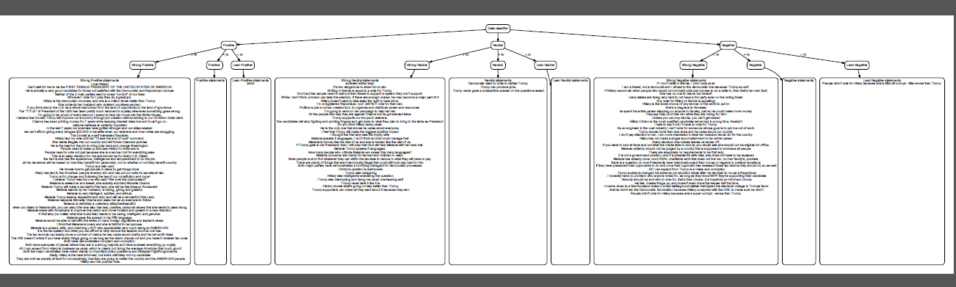
Creating the Graph with GraphViz
The program will create the text for the graph
Nodes will all align at the top
A graph will be created based on the nodes
Build time: 15s

Slide 10
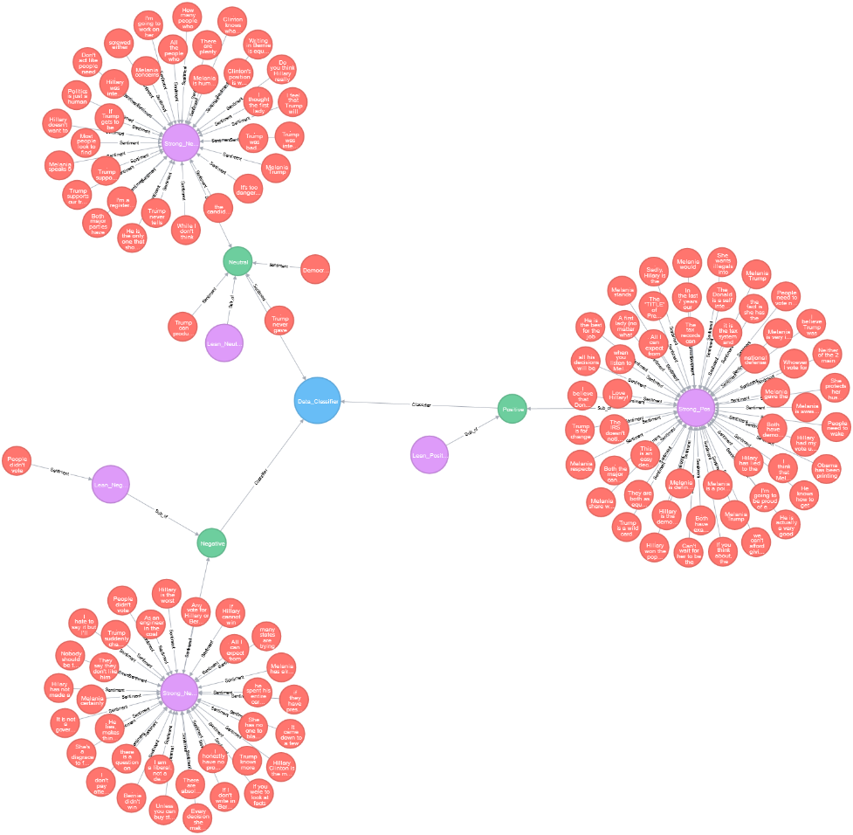
Creating the Graph with Neo4j
Each statement is binned into a list for its sentiment.
Then all lists are iterated over and the statements are assigned to a node and related to their sentiment node
Current Timing:
  Time Elapsed: 128.229000092s
  Time to Clear DB: 1.07999992371s
  Time to Init: 1.03800010681s
  Time Loading Nodes:126.111000061s
  Total Node Count: 122

Slide 11
Future Works
Use a larger dataset
  More surveys or mining data from social media such as Twitter
Use Neo4j for statement similarity and machine learning
  Split statements into individual words and create more relationships
Expand to more than 3 dimensions (text, confidence, sentiment)
  Possibly adding the target candidate as a dimension
More visualizations
More complex queries in Neo4j

Slide 12
Conclusion
This hyped up election in history is also the most modern which allows for the largest data pool.
Hilary was not a heavy favorite but was noticeably favored to win.
Instead of polling on simple Y/N basis, it could be beneficial to look into people’s sentiment.
Trump was able to swing previously identified democratic voters in order to obtain victory.

Slide 13
Questions?

