Slide 1
CS 49995 & CS 63016
ST: Big Data Analytics
Chapter 5: Queries Over Big Data (1)
Xiang Lian
Department of Computer Science
Kent State University
Email: xlian@kent.edu
Homepage: http://www.cs.kent.edu/~xlian/
Notes:
The slides of this Big Data course used some public slides/materials on the Web. I would like to acknowledge these resources, and please let me know if I failed to cite them.

Slide 2
Objectives
In this chapter, you will:
  Learn different query types over large-scale data
  Understand how to design the pruning strategies
  Get familiar with query processing algorithms via indexes over large-scale databases

Slide 3
Outline
Introduction
Query Types
  Problem Definitions
  Pruning Strategies
  Indexing Mechanisms
  Query Answering Algorithms

Slide 4
Introduction
In real-world applications, we need to manage and analyze different data types
  Spatial data
  Temporal data
  Time-series data
  Tree data
  Graph data
  Stream data
  Documents
  Relational tables
  …

Slide 5
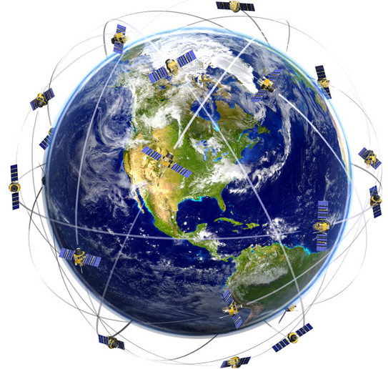
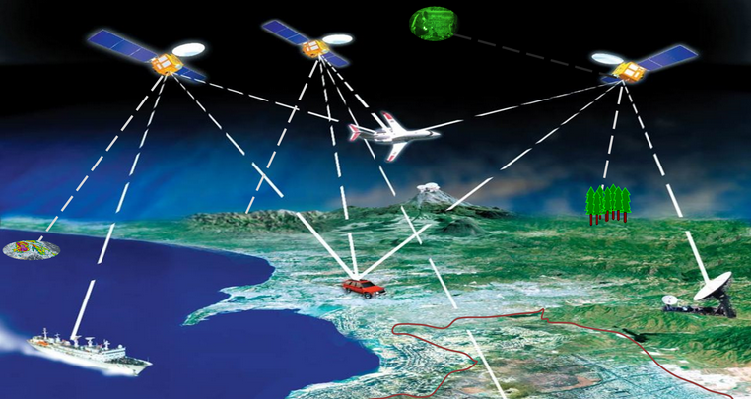
Spatial Databases
GPS data
(latitude, longitude, elevation)
Notes:
http://www.broderie-creationviv.com/wp-content/uploads/2017/01/GPS-LOGIC.png
https://www.figonet.com/wp-content/uploads/2013/12/science-of-gps.jpg

Slide 6
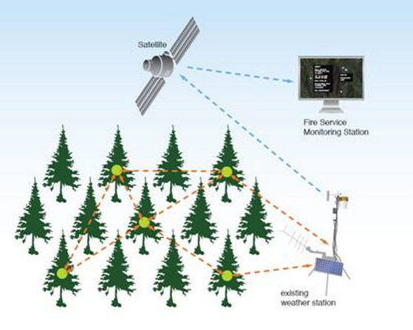
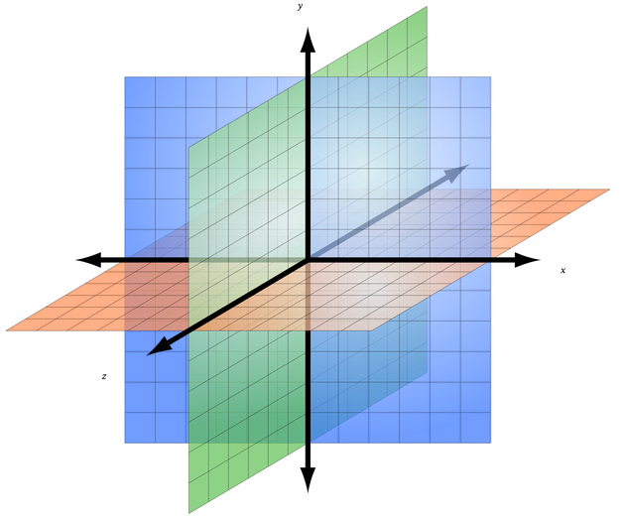
Spatial Databases (cont'd)
Sensor data
(temperature, humidity, density of oxygen, …)
density of oxygen
temperature
humidity
Notes:
http://www.altenergymag.com/articles/08.12.01/links/contents_clip_image006.jpg
https://upload.wikimedia.org/wikipedia/commons/thumb/2/2c/3D_coordinate_system.svg/2000px-3D_coordinate_system.svg.png

Slide 7


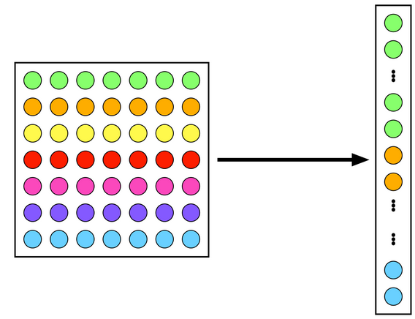
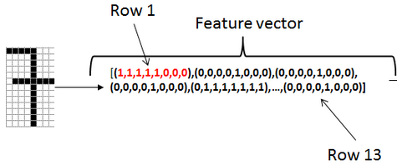
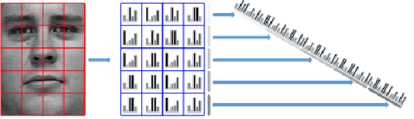
Spatial Databases (cont'd)
Image database
  Feature vectors
    Color histogram
    Texture
    Interest points
giraffe
Notes:
http://www.computersdontsee.net/images/NLmeans/patch-lexico.png
https://i.stack.imgur.com/jCQ31.png
https://cdn.vectorstock.com/i/composite/49,59/my-best-feature-vector-8034959.jpg
https://assets.pando.com/uploads/2013/10/big-data-darpa.jpg
https://www.researchgate.net/profile/Karolina_Nurzynska/publication/278816831/figure/fig3/AS:294398391799810@1447201454580/Fig-6-Creation-of-the-concatenated-feature-vector-with-the-LBP-texture-operator.png

Slide 8

Temporal Databases
Moving object database
  Mobile computing

Slide 9
Temporal Databases (cont'd)
Bank account over time
account
balance
deposit $100
withdraw $50
$150
$100
$50
Jan.
Feb.
Mar.
time

Slide 10
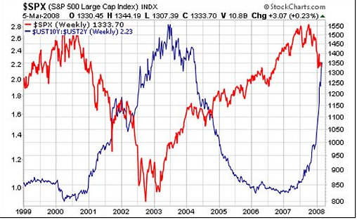
Time-Series Databases
Stock data: {(x₁, t₁); (x₂, t₂); …}
Notes:
http://www.investmentpostcards.com/wp-content/uploads/2008/03/6-maart-2.jpg

Slide 11
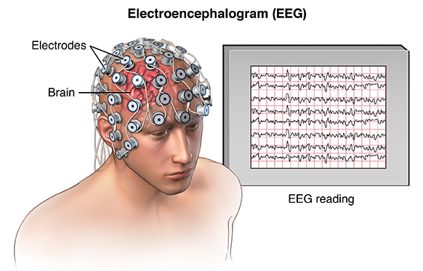
Time-Series Databases (cont'd)
EEG: {(x₁, t₁); (x₂, t₂); …}
Notes:
http://www.medicalestudy.com/wp-content/uploads/2016/10/EEG.jpg

Slide 12
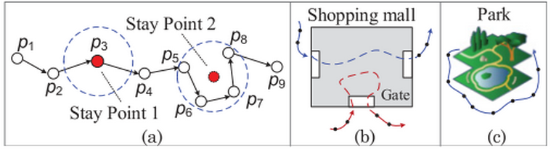
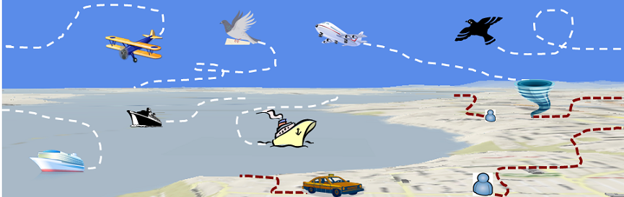
Time-Series Databases (cont'd)
Trajectory data: {(x₁, y₁, t₁); (x₂, y₂, t₂); …}
Notes:
https://adriancolyer.files.wordpress.com/2016/03/trajectory-mining-fig-3.png?w=600
https://www.microsoft.com/en-us/research/wp-content/uploads/2016/03/trajectorycomputing-head.png

Slide 13
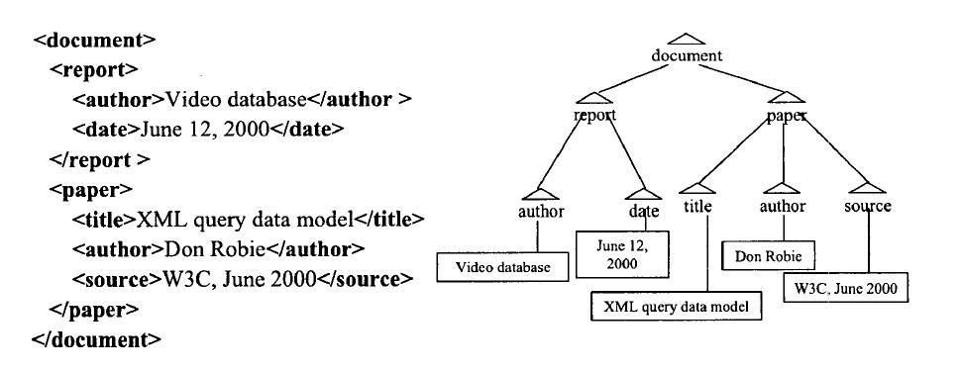
Tree Data
XML documents
  Semi-structured data

Slide 14
Graph Databases
Many application data can be represented by graphs
  Chemical database
  Biological database
  Computer networks
  Sensor networks
  Social networks
  Workflow database
  RDF graph database

Slide 15
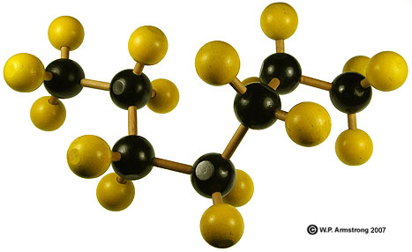
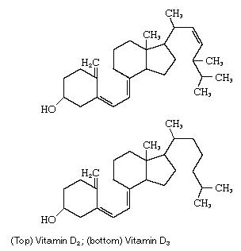
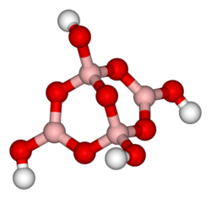
Chemical Compounds
Notes:
http://waynesword.palomar.edu/chemid1.htm
http://creationwiki.org/Chemical_compound
http://media-2.web.britannica.com/eb-media/20/13820-004-47BA0779.jpg

Slide 16
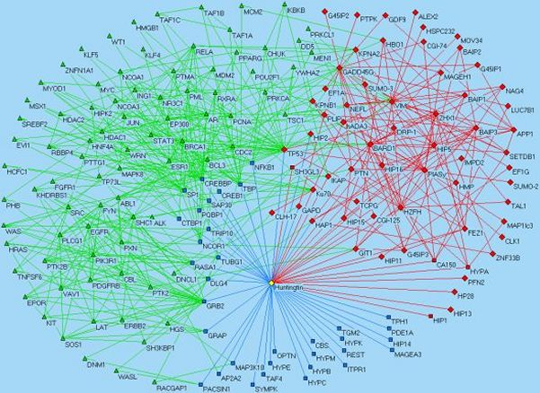
Biological Databases – Protein-to-Protein Interaction Networks

Slide 17
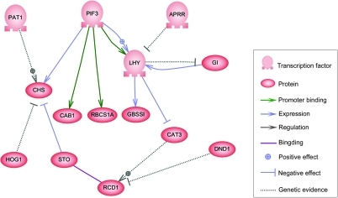
Biological Databases – Gene Regulatory Networks (GRNs)

Slide 18
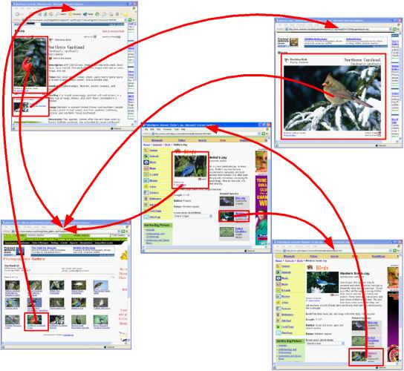
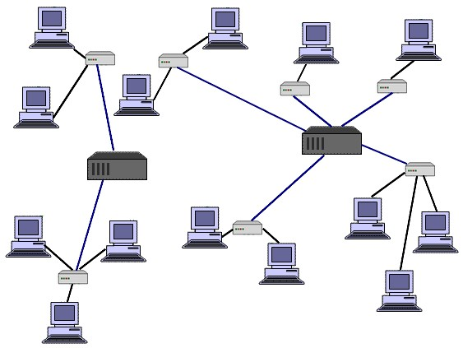
Computer Networks
Internet
Web Pages

Slide 19
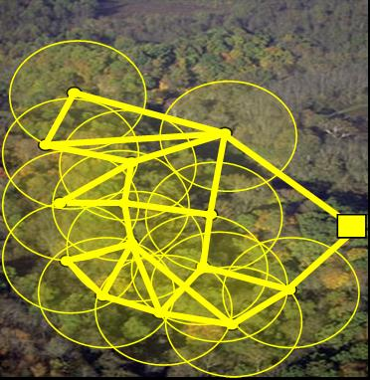

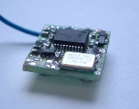
Sensor Networks
sink
sensors

Slide 20



Social Networks

Slide 21
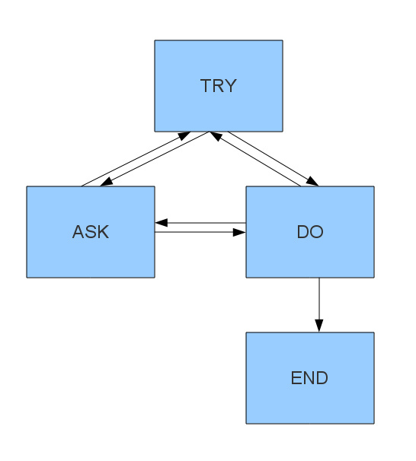
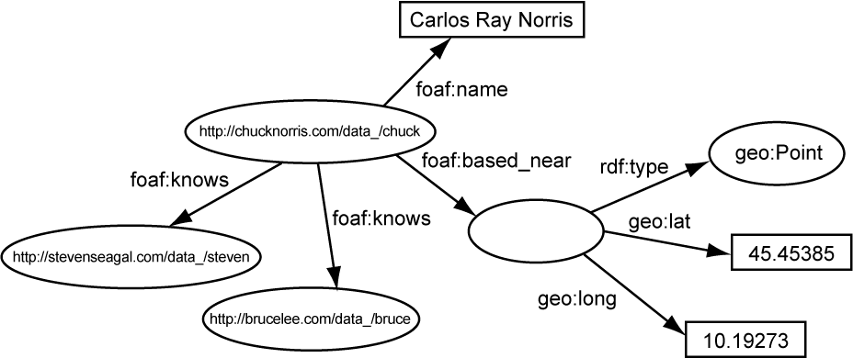
Semantic Web and Workflows
Semi-structured data
RDF Graph
Workflow
Notes:
http://milicicvuk.com/blog/wp-content/uploads/2011/08/rdf_graph_example.png

Slide 22
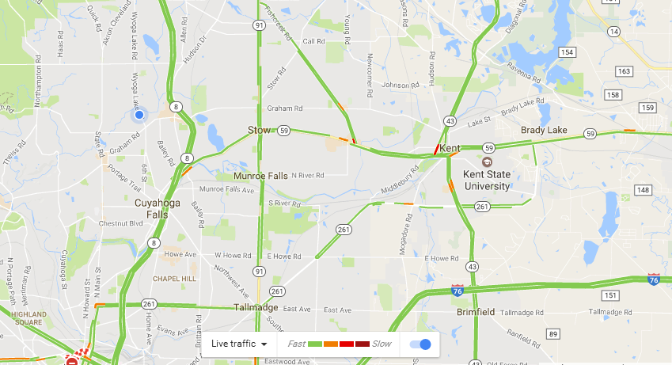
Road Networks
Road Networks (from Google Map)

Slide 23

Stream Data
Data Streams
  Data continuously arrive at the system
    Packet data from computer networks
    Sensory data from sensor networks
    Trajectory data from mobile devices
    Stock data
    Video data
Notes:
https://thumbs.dreamstime.com/x/data-stream-22469049.jpg

Slide 24
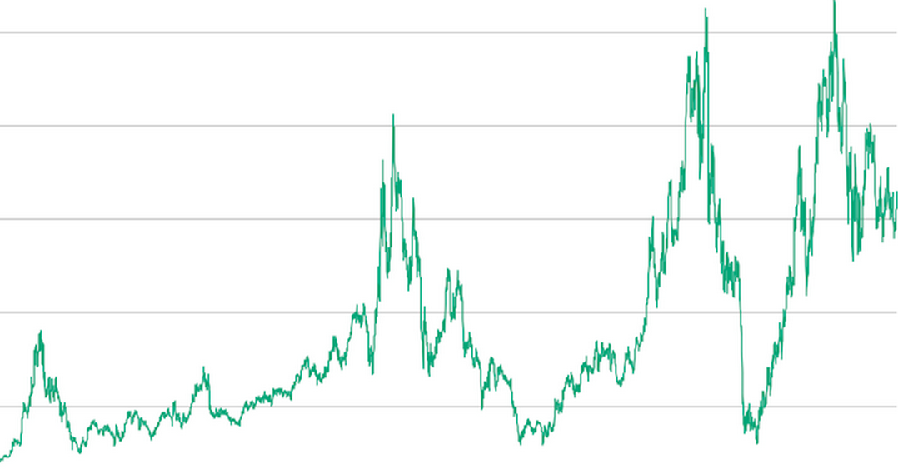
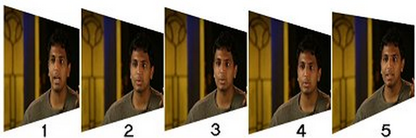
Stream Data (cont'd)
Data Streams
  T = {s₁, s₂, …, s_{t}, …}
stock
video
Notes:
http://nickyguides.digital-digest.com/pictures/key_exap.jpg
http://cfa.wpengine.netdna-cdn.com/investor/files/2012/12/BID-stock-prices.png

Slide 25
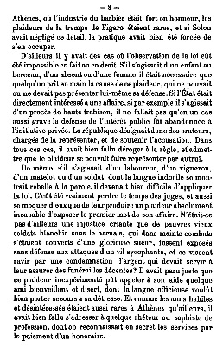

Documents
Text data
  Unstructured data
  Strings

Slide 26
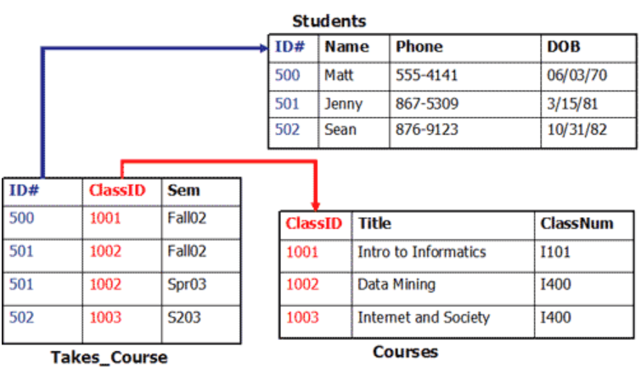
Relational Tables
Structured data
Notes:
http://www.informatics.indiana.edu/mhottell/i101/labs/summer05/images/table2.gif

Slide 27
Queries Over Big Data
Range Query
Nearest Neighbor (NN) Query
k-Nearest Neighbor (kNN) Query
Group Nearest Neighbor (GNN) Query
Reverse Nearest Neighbor (RNN) Query
Top-k Query
Skyline Query
Top-k Dominating Query
Reverse Skyline Query
Inverse Ranking Query
Aggregate Queries
Keyword Search Query
Graph Queries

Slide 28
Range Queries
One of the most widely used spatial queries
  A range query retrieves all objects o_{i} falling into the query range Q
q
a query range Q₁
a query range Q₂
data objects o_{i}

Slide 29
A Straightforward Method
For each object o
  Check if o is in the query range Q
Disadvantages
  Not efficient for large-scale spatial data sets

Slide 30
Recall: R-Tree Data Structure
Minimum Bounding Rectangle (MBR)
  Use a smallest rectangle (or hyperrectangle in the multidimensional space) to bound objects/nodes
X₂
x_{2max}
MBR
(x_{1min}, x_{1max}; x_{2min}, x_{2max})
x_{2min}
X₁
x_{1min}
x_{1max}

Slide 31
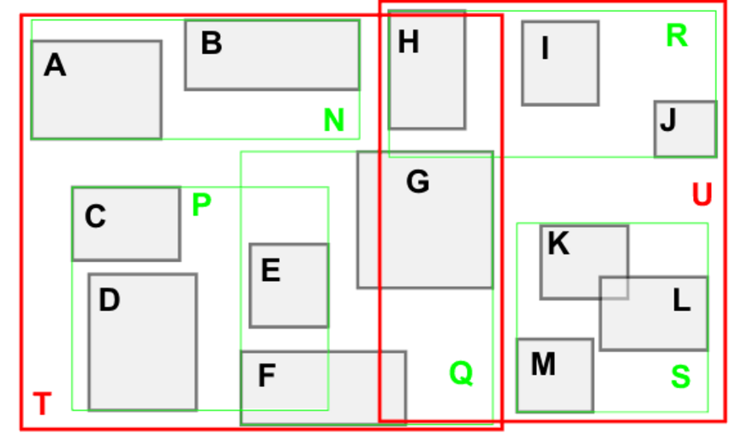
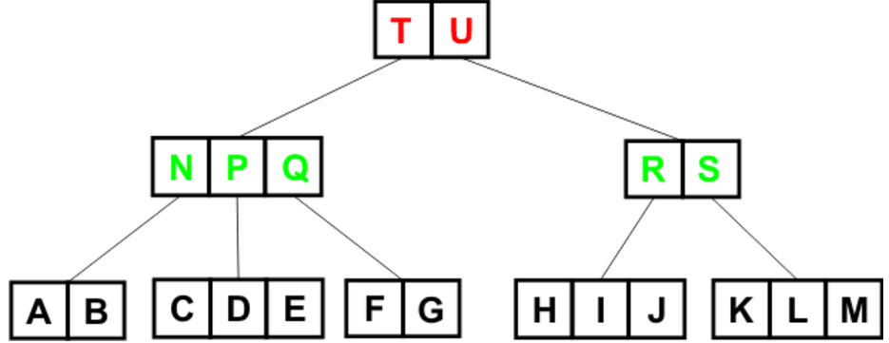
Recall: R-Tree Data Structure (cont'd)
R-tree is a height-balanced multi-way external memory tree over n multidimensional data objects (height: log_{F}(n))
  Non-leaf node (or intermediate node): contains a number of entries (MBRs) that minimally bound their child nodes, as well as pointers pointing to child nodes
  Leaf node: contains spatial objects
node fanout: F ∈ [m, M],
where m ≤ M/2

Slide 32
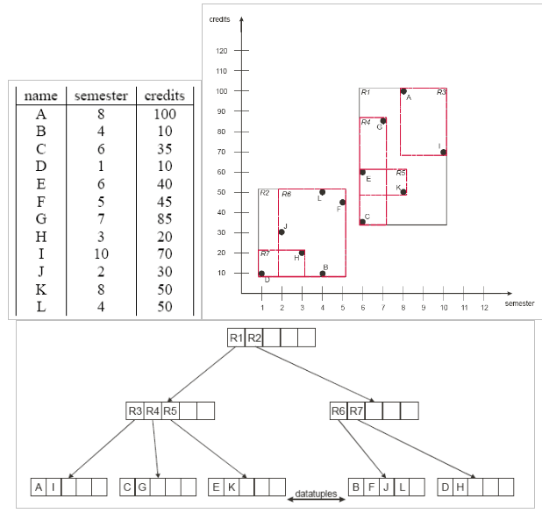
Recall: Example of R-Tree in 2D Space
Notes:
http://sysnet.ucsd.edu/~cfleizac/cse262/R-Trees.ppt

Slide 33
Pruning Heuristics
Pruning Strategy with the index (e.g., R-tree family)
  Basic idea if the query range Q is not intersection with an MBR E, then all objects in E can be safely pruned
q
a query range Q₁
a query range Q₂
an MBR node E in a R-tree

Slide 34
Pruning Heuristics (cont'd)
Pruning conditions
q
a query range Q₁
a query range Q₂
an MBR node E in a R-tree

Slide 35
Pruning Heuristics (cont'd)
Input: an MBR node E = (x_{1min}, x_{1max}; x_{2min}, x_{2max}; …; x_{dmin}, x_{dmax}) and a rectangular query range Q₁ = (q_{1min}, q_{1max}; q_{2min}, q_{2max}; …; q_{dmin}, q_{dmax})
// basic idea: if MBR E and query range Q₁ overlap on all dimensions
// (i.e., [x_{imin}, x_{imax}] and [q_{imin}, q_{imax}] on all dimensions i), two nodes overlap;
// otherwise, two nodes are disjoint
bool overlap = true;
for each dimension i
{
if ([x_{imin}, x_{imax}] and [q_{imin}, q_{imax}] do not overlap with each other)
{
overlap = false;
break;
}
}
return overlap;

Slide 36
Pruning Heuristics (cont'd)
Pruning condition for circular query range Q₂
  if mindist(q, E) > r, then all objects in E can be safely pruned
mindist (q, E)
radius r
q
a query range Q₂
an MBR node E in a R-tree

Slide 37
Range Query Processing
Traverse the R-tree index, I, starting from the root
If we encounter a leaf node E
  For each object o in E, check if o is in the query range Q
  If yes, add o to an answer set S_{cand}
If we encounter a non-leaf node E
  For each entry E_{i}, check if E_{i} is intersecting with Q
  If yes, continue to check E_{i}'s children

Slide 38
Range Query Processing Algorithm
Queue H=empty;
Insert root(index I) into H;
while (H is not empty)
{
Pop out a node E from H;
If (E is a leaf node)
{
for each object o in E
if o is in Q
add o to candidate set S_{cand}
}
else // non-leaf nodes
{
for each entry, E_{i}, in E
if E_{i} intersects with Q
insert E_{i} into H;
}
}

Slide 39
Nearest Neighbor (NN) Query
Given a query point q and a spatial database D, a nearest neighbor (NN) query retrieves an object o_{i} in D that is the closed to q
  For other objects o', dist(q, o_{i}) ≤ dist(q, o')
q
data objects o_{i}

Slide 40
NN Pruning Heuristics
Basic idea
  Given a object candidate o, an MBR node E, and a query point q
    If dist(q, o) ≤ mindist(q, E), then all objects in E can be safely pruned
MBR E
o
dist(q, o)
mindist(q, E)
q

Slide 41
NN Pruning Heuristics (cont'd)
Two MBR nodes E₁ and E₂?
  If maxdist(q, E₁) ≤ mindist(q, E₂), then all objects in node E₂ can be safely pruned
MBR E₂
MBR E₁
maxdist(q, E₁)
mindist(q, E₂)
q

Slide 42
NN Pruning Heuristics (cont'd)
Can we prune more objects?
  If minmaxdist(q, E₁) ≤ mindist(q, E₂), then all objects in node E₂ can be safely pruned
MBR E₂
MBR E₁
maxdist(q, E₁)
minmaxdist(q, E₁)
mindist(q, E₂)
q

Slide 43
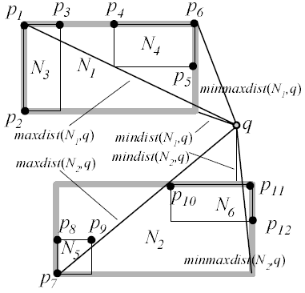
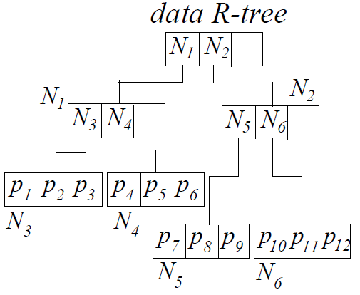
NN Query Processing Over R-Tree

Slide 44
Depth-First (DF) Traversal
N. Roussopoulos, S. Kelly, and F. Vincent. Nearest Neighbor Queries. In SIGMOD, 1995.

Slide 45
Best-First (BF) Traversal
Use a minimum heap H to traverse the R-tree
A. Henrich. A Distance Scan Algorithm for Spatial Access Structures. In ACM GIS, 1994.

Slide 46
Best-First (BF) Traversal (cont'd)
H={<N₁, mindist(N₁, q)>, <N₂, mindist(N₂, q)>}
H={<N₂, mindist(N₂, q)>, <N₄, mindist(N₄, q)>, <N₃, mindist(N₃,q)>}
H={<N₆, mindist(N₆,q)>, <N₄, mindist(N₄,q)>, <N₅, mindist(N₅,q)>, <N₃, mindist(N₃,q)>}
H={<N₄, mindist(N₄,q)>, <N₅, mindist(N₅,q)>, <N₃, mindist(N₃,q)>}

Slide 47
Best-First Algorithm
best_dist_so_far = +∞; S_{cand}=Φ;
Initialize a minimum heap H = Φ;
Insert <root(I), mindist(q, root(I))> into heap H
while (H is not empty)
{
(E, d_{min}) = pop-out (H)
if (d_{min}> best_dist_so_far), then terminate;
if E is a leaf node
for each object o in E
compute dist(q, o)
if (dist(q, o) < best_dist_so_far)
S_{cand} = {o}; best_dist_so_far = dist(q, o);
else // non-leaf node
for each entry E_{i} in E
compute mindist(q, E_{i})
if (mindist(q, E_{i}) < best_dist_so_far) // pruning
insert (E_{i}, mindist(q, E_{i})) into heap H
update best_dist_so_far with minmaxdist(q, E_{i})
}

Slide 48
Nearest Neighbor Interpretation
perpendicular bisector
o_{i}
o_{j}
q

Slide 49
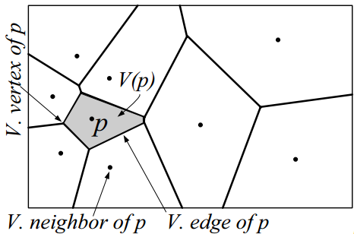
VoR-Tree
Voronoi Diagram
q
M. Sharifzadeh and C. Shahabi. VoR-Tree: R-trees with Voronoi Diagrams for Efficient Processing of Spatial Nearest Neighbor Queries. In VLDB, 2010.
Notes:
http://infolab.usc.edu/papers/VorTree.pdf

Slide 50
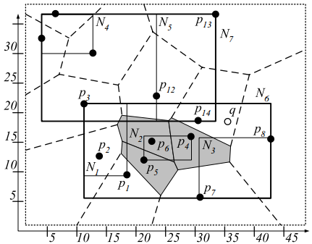
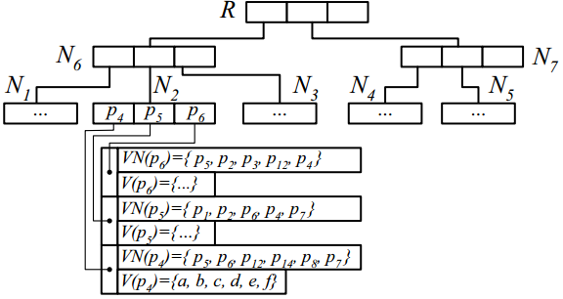
VoR-Tree Structure
Leaf nodes: data objects with their Voronoi Diagrams

Slide 51
k-Nearest Neighbor (kNN) Query
Given a spatial database D and a query point q, a k-nearest neighbor (k-NN) query retrieves k objects in a set S such that
  For any objects o'∈D–S and o∈S, it holds that: dist(q, o) ≤ dist(q, o')
q
k=2
data objects o_{i}

Slide 52
kNN Pruning Heuristics
Assume that we have obtained k candidates p₁, p₂, …, p_{k} in a candidate set S_{cand}
Let best_so_far be the maximum distance from q to k candidates
  best_so_far = max_{i=1,..., k} dist(q, p_{i})
For any object o, if it holds that dist(q, o) ≥ best_so_far, then object o can be safely pruned (Why?);
Otherwise, we need to update the candidate set S_{cand} (adding o and removing the one with the maximum distance), and set a new best_so_far value

Slide 53
Example of kNN Pruning
Candidate set S_{cand}={o₁, o₂}
S_{cand}={o₂, o₃}
o₁
o₂
k=2
q
o₃

Slide 54
Group Nearest Neighbor (GNN) Query
Group Nearest Neighbor (GNN) Search [ICDE04]
  Given a database D and a set, Q, of query objects q₁, q₂, …, and q_{n}, a GNN query retrieves an object o ∈ D that has the smallest summed distance to Q, i.e. Σ_{i=1~n} dist(q_{i}, o)
find a data object o that minimizes
Σ_{i=1~3} dist(q_{i}, o)
D. Papadias, Q. Shen, Y. Tao, and K. Mouratidis. Group Nearest Neighbor Queries. In ICDE, 2004.
Notes:
D. Papadias, Q. Shen, Y. Tao, and K. Mouratidis, “Group Nearest Neighbor Queries,” Proc. 20th Int’l Conf. Data Eng. (ICDE), 2004.

Slide 55
An Example of GNN Query
In a city, there are many restaurants
Three people want to have lunch together at a restaurant
Problem:
  To find a restaurant in the city that minimizes its total distances to these 3 people

Slide 56
Other GNN Applications
Image Retrieval
  Find an image in the database that is similar to a group of user-specified query images
Geographic information system
Mobile computing applications

Slide 57
Basic Pruning Idea for GNN Query
Maintain an upper bound threshold of the smallest summed distance, Σ_{i=1~n} dist(q_{i}, o), for pruning other objects/MBRs
  Upper bound in the example = ?
If the upper bound is smaller than Σ_{i=1~n} mindist(q_{i}, E), then all objects in E can be safely pruned
p₁
p₂
3
10
q₂
4
9
MBR E
q₁

Slide 58
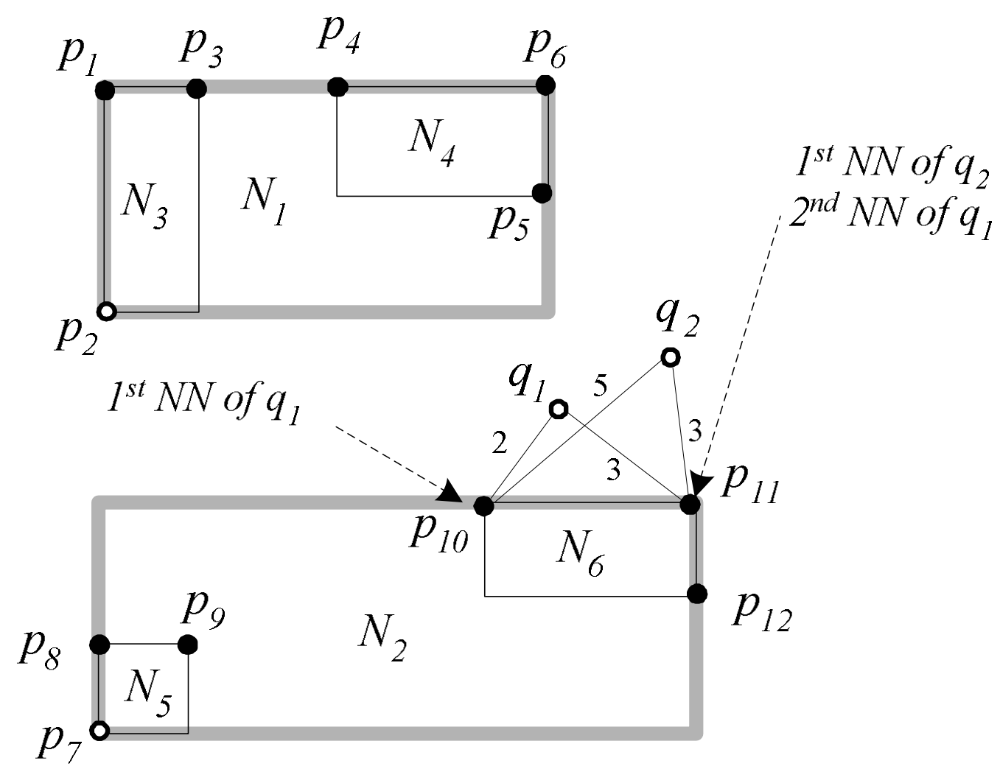
Multiple Query Method (MQM)
Incremental NN search for each query point
best_dist: |p₁₀q₁|+|p₁₀q₂|=7
best_dist: |p₁₁q₁|+|p₁₁q₂|=6
>
threshold T: |p₁₀q₁|+|p₁₁q₂| = 5
threshold T: |p₁₁q₁|+|p₁₁q₂| = 6
D. Papadias, Q. Shen, Y. Tao, and K. Mouratidis. Group Nearest Neighbor Queries. In ICDE, 2004.
Notes:
D. Papadias, Q. Shen, Y. Tao, and K. Mouratidis. Group Nearest Neighbor Queries. In ICDE, 2004.

Slide 59
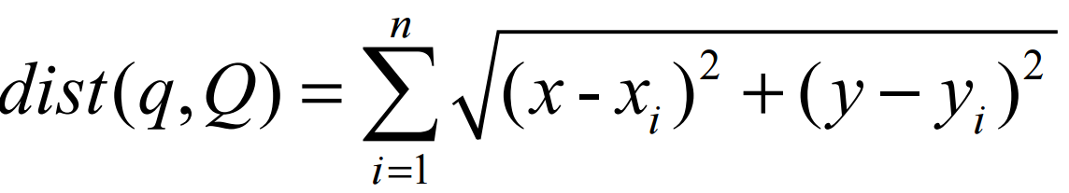
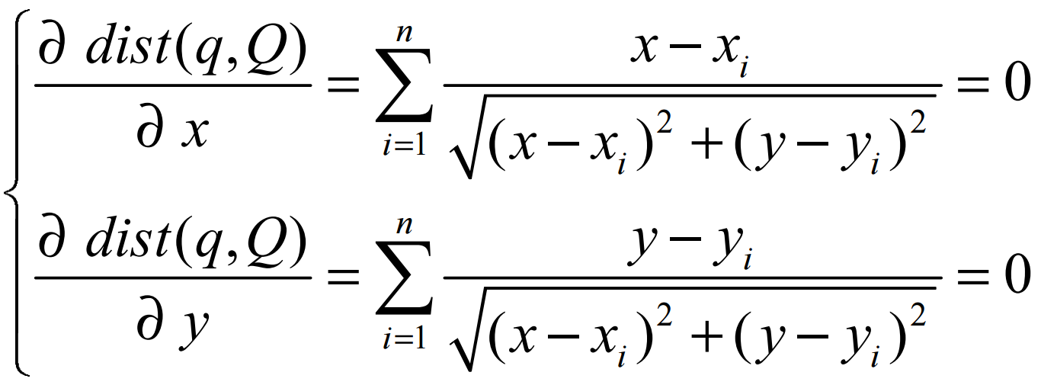

Single Point Method (SPM)
MQM has the problem of multiple NN queries accessing the same objects
Instead, SPM computes with a centroid q of the query set Q
  A centroid q(x, y) minimizing
where ŋ is a step size.

Slide 60

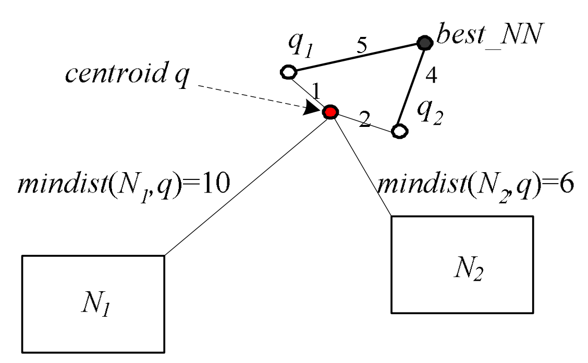
Pruning Conditions for SPM
An MBR node N can be pruned, if it holds that:
  where best_dist is the distance of the best GNN found so far

Slide 61
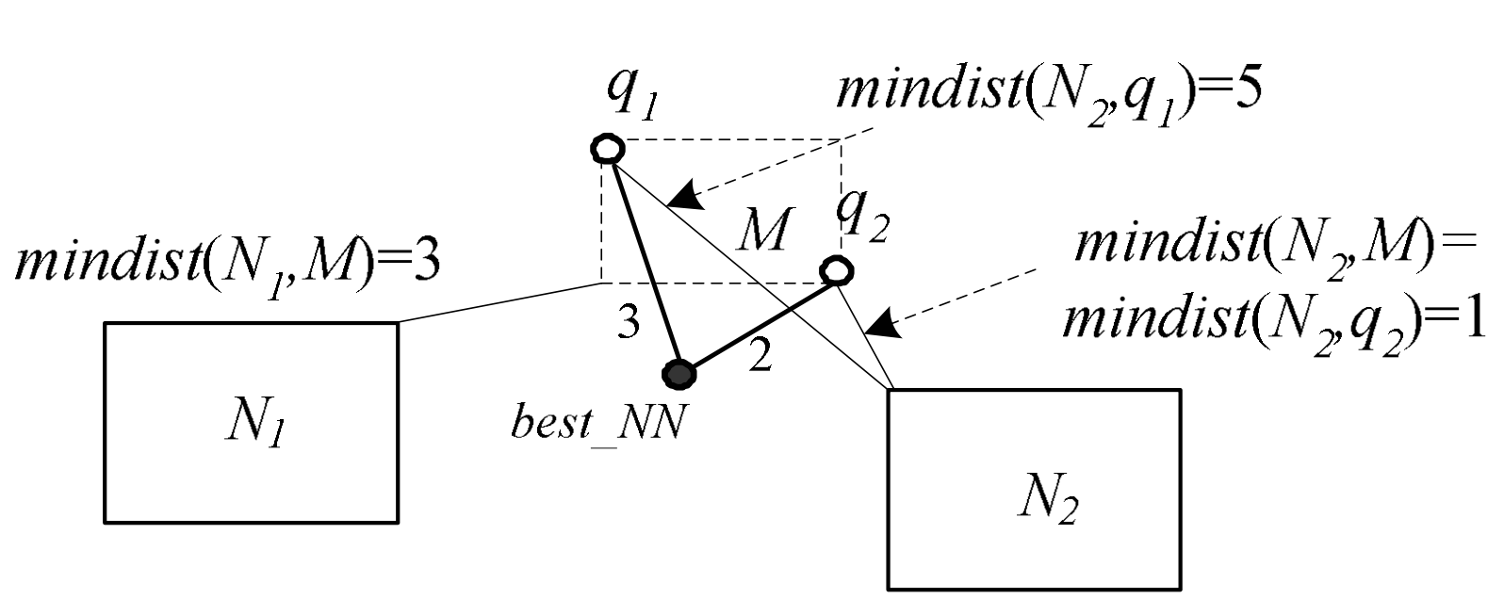
Minimum Bounding Method (MBM)
MBM uses the minimum bounding rectangle M of Q (instead of the centroid q) to prune the search space

Slide 62
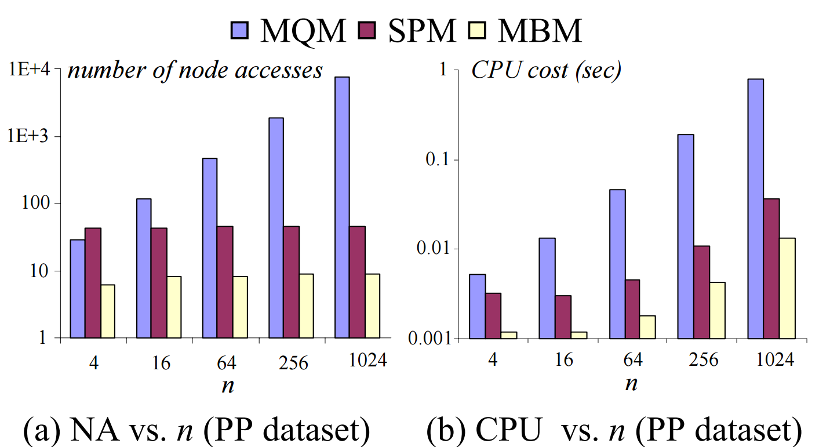
Experimental Results for GNN
Comparisons of three approaches
  PP data sets: 24,493 populated places in North America
D. Papadias, Q. Shen, Y. Tao, and K. Mouratidis. Group Nearest Neighbor Queries. In ICDE, 2004.

Slide 63
Reverse Nearest Neighbor Query (RNN)
Rescue tasks in oceans
  In the case of emergency, a ship will ask its nearest ship for help
  A rescue ship needs to monitor those ships that have itself as their nearest neighbors
  In other words, the rescue ship needs to obtain its reverse nearest neighbors (RNNs)

Slide 64
Other Applications
Mixed-Reality Games

Slide 65
RNN Problem Definition
Reverse Nearest Neighbor Query (RNN)
  Given a database D and a query object q, a RNN query retrieves those data objects o ∈ D that have q as their nearest neighbors
q
o₅
o₄
o₁
o₂
o₃
F. Korn and S. Muthukrishnan. Influence Sets Based on Reverse Nearest Neighbor Queries. In SIGMOD, 2000.

Slide 66
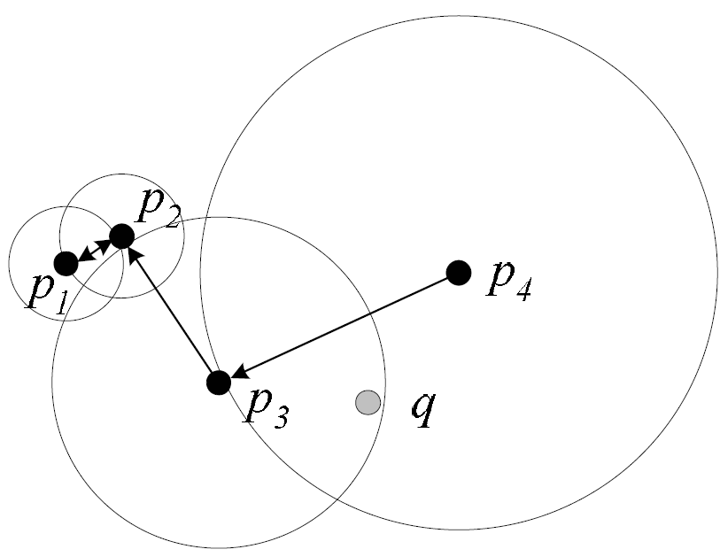
KM Method
Pre-compute the nearest neighbor, NN(p), of each object p in the database D
q
vicinity circle
F. Korn and S. Muthukrishnan. Influence Sets Based on Reverse Nearest Neighbor Queries. In SIGMOD, 2000.

Slide 67
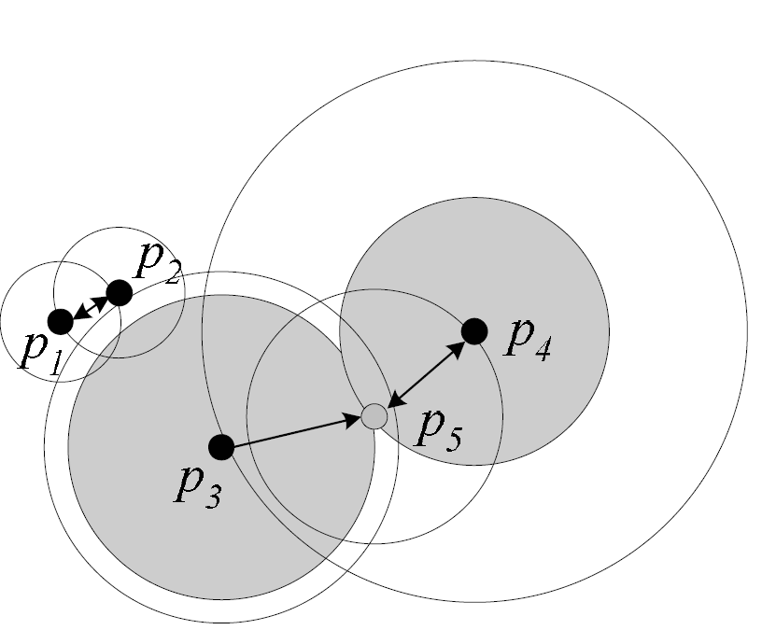
KM Method (cont'd)
Index all vicinity circles (p, dist(p, NN(p))) of objects p by an R-tree index, called RNN-tree
Dynamic update of the RNN-tree index
q
insertion of object p₅
RNN-tree index is designed specific for RNN queries, but not optimized for NN queries!

Slide 68
YL Method
Combine RNN-tree and R-tree in the RdNN-tree
  Each leaf node of the RdNN-tree contains vicinity circles of data points
  Each intermediate node contains:
    The MBR of the underlying points (not their vicinity circles)
    The maximum distance from every point in the sub-tree to its nearest neighbor
C. Yang and K. Lin. An Index Structure for Efficient Reverse Nearest Neighbor Queries. In ICDE, 2001.

Slide 69
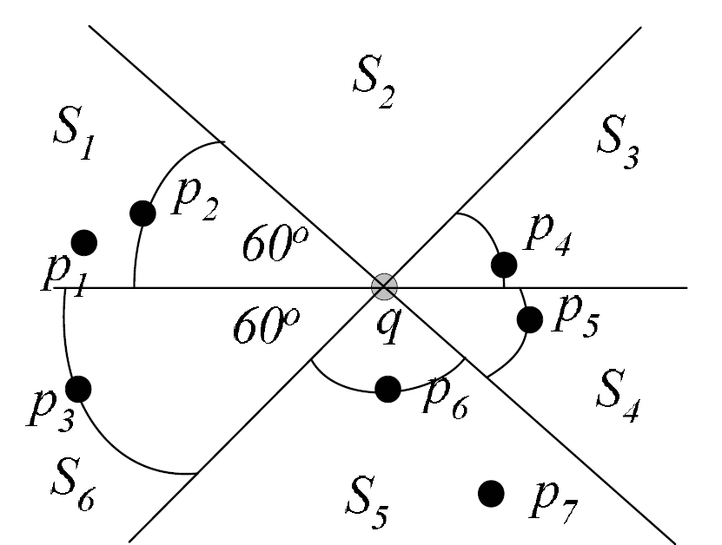
SAA Method
SAA only applies to RNN in the 2D space
I. Stanoi, D. Agrawal, and A. Abbadi. Reverse Nearest Neighbor Queries for Dynamic Databases. In SIGMOD Workshop on Research Issues in Data Mining and Knowledge Discovery, 2000.

Slide 70
TPL Pruning Idea
TPL Approach
q
RNN candidate
o₅
o₄
o₁
o₂
o₃
pruning region
Y. Tao, D. Papadias, and X. Lian. Reverse kNN Search in Arbitrary Dimensionality. In VLDB, 2004.
70

Slide 71
TPL Pruning Idea (cont'd)
TPL Approach [VLDB'04]
RNN candidate
q
RNN candidate
o₅
o₄
o₁
o₂
MBR E
o₃
pruning region
71

Slide 72
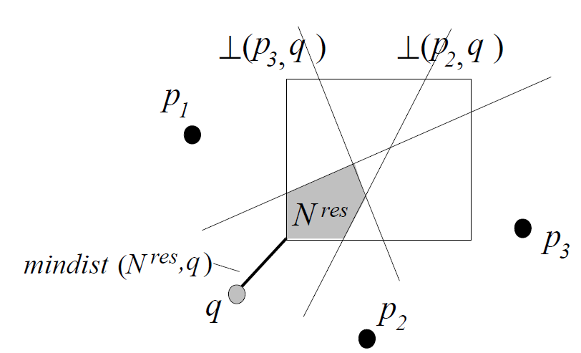
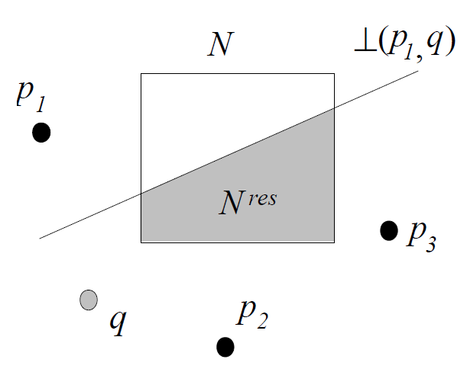
Pruning with MBRs
q
q

Slide 73
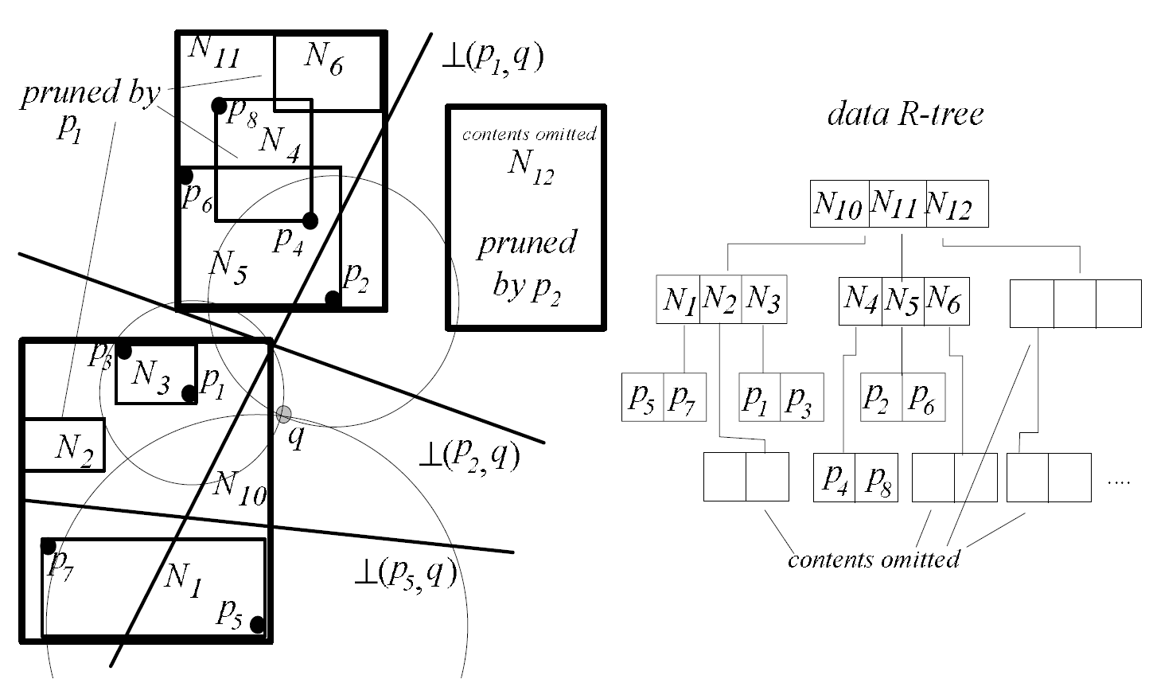
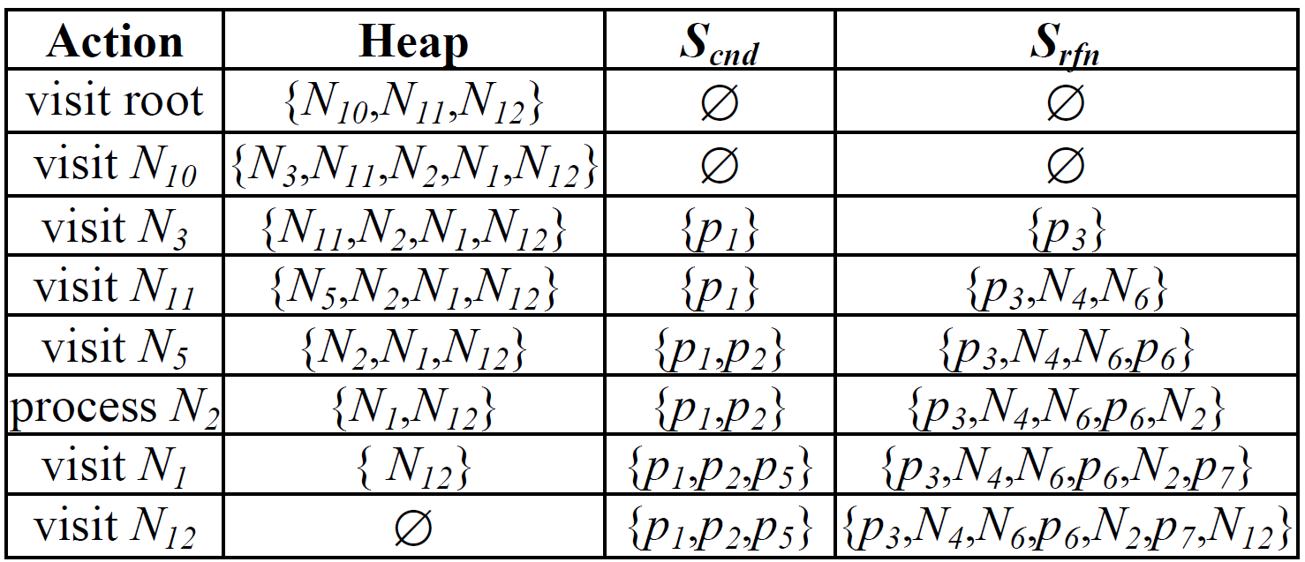
Example of TPL Query Processing
q

Slide 74
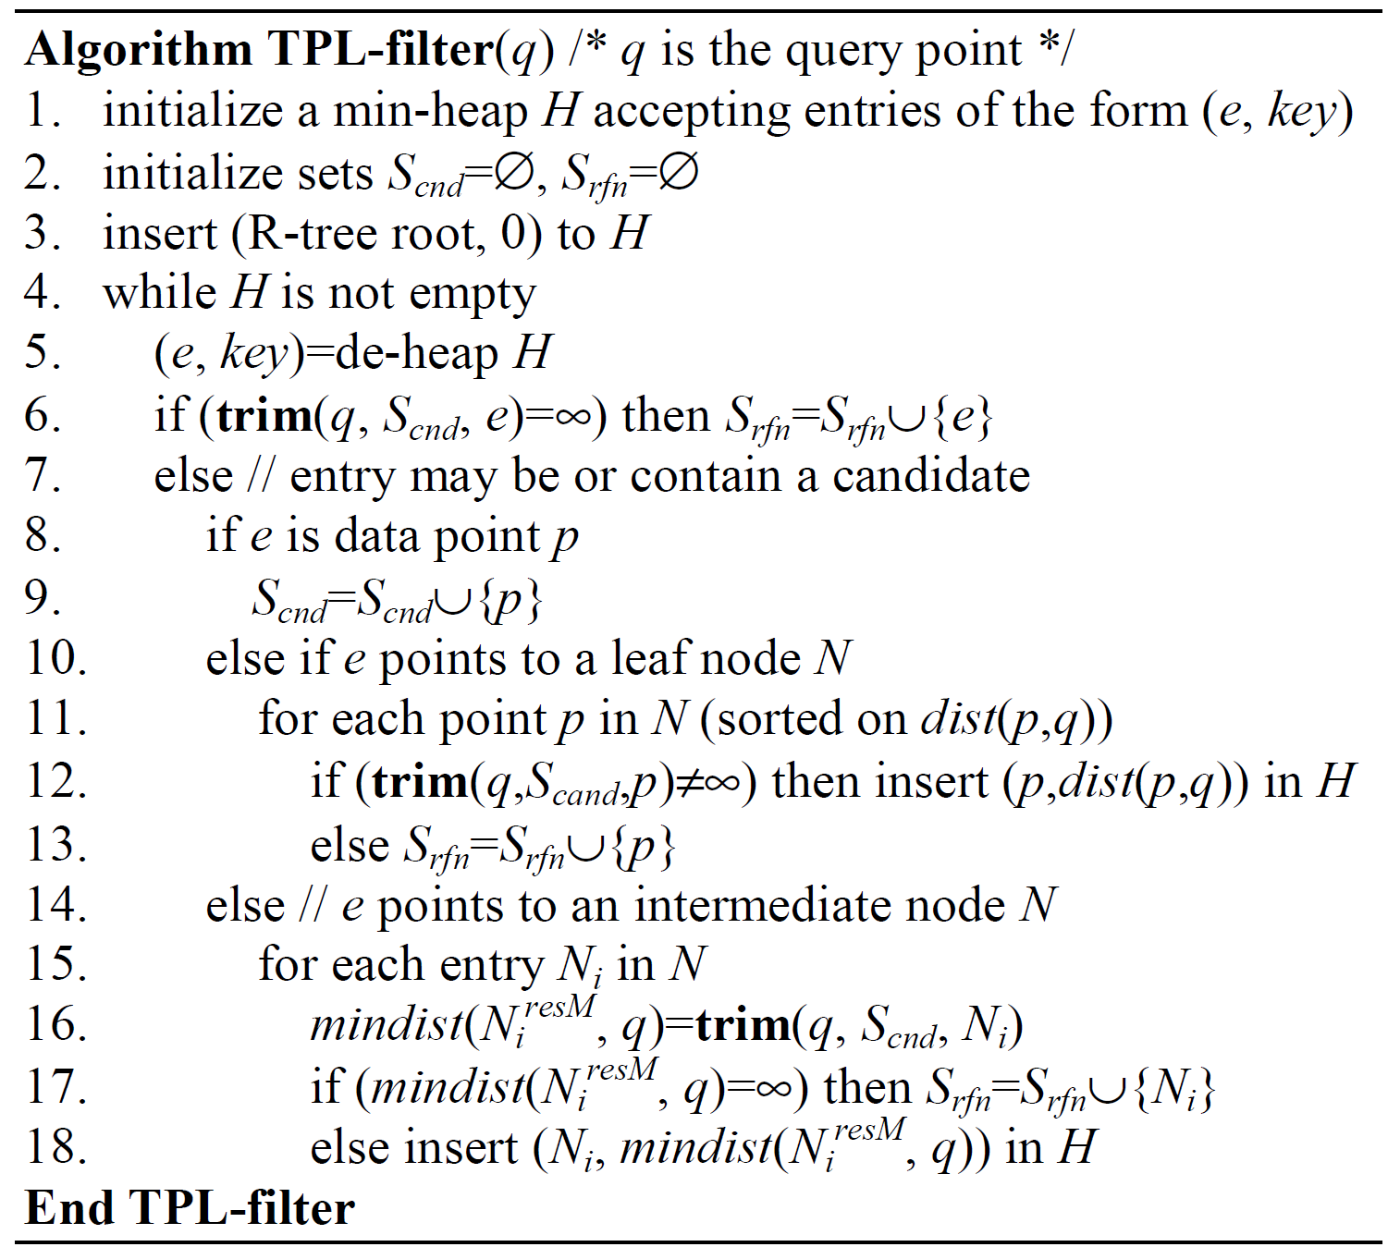
TPL Query Processing Algorithm
Maintain a minimum heap H

Slide 75

The Performance of TPL
Real spatial data sets
  SFT [CIKM 2003]: an approximate approach to retrieve KNNs
Notes:
Singh, A., Ferhatosmanoglu, H., Tosun, A. High Dimensional Reverse Nearest Neighbor Queries. CIKM, 2003.

Slide 76
Motivation of Top-k Queries
Applications
  Multimedia search by contents (multi-features/examples)
  Middleware
  Search engines
  Data mining
New requirements
  Multi-criteria ranking
  Rank aggregation from external sources
  Joining ranked infinite streams
Most applications are interested in the top-k results
Notes:
https://www.coursehero.com/file/18972603/442-s09-Topkppt/

Slide 77





Example 1: Ranking in Multimedia Retrieval
Query
Color Histogram
Edge Histogram
Texture
Video
Database
Color Histogram
Edge Histogram
Texture
Notes:
https://www.coursehero.com/file/18972603/442-s09-Topkppt/

Slide 78
Example 2: SQL Over Relational Database
SELECT h.id , s.name
FROM houses h , schools s
WHERE h.location = s.location
ORDER BY h.price+10 x s.tuition
STOP AFTER 10
RANK( ) OVER in SQL 99
Notes:
https://www.coursehero.com/file/18972603/442-s09-Topkppt/

Slide 79
Example 2 (Cont’d)
ID | Location | Price
1 2 3 4 5 6 | Lafayette W.Lafayette Indianapolis Kokomo Lafayette Kokomo …… | 90,000 110,000 111,000 118,000 125,000 154,000
ID | Location | Tuition
1 2 3 4 5 6 7 8 | Indianapolis W.Lafayette Lafayette Lafayette Indianapolis Indianapolis Kokomo Kokomo | 3000 3500 6000 6200 7000 7900 8200 8200
1 | 3 | 150000
1 | 4 | 152000
2 | 2 | 145000
3 | 1 | 141000
Houses
Schools
Notes:
https://www.coursehero.com/file/18972603/442-s09-Topkppt/

Slide 80
Example 3: Coal Mine Surveillance
In a coal mine surveillance application, a number of sensors are deployed to detect density of gas, temperature, and so on
Assume we have a preference function f(O) = O.temp + O.den

Slide 81

Top-k Queries
Given a spatial database D, a ranking function (or preference function) f(o), and an integer parameter k, a top-k query retrieves k objects, o, from the database D such that they have the highest ranking score f(o) among all objects in D

Slide 82
Ranking Functions
Various ranking functions
  f(o) = o.x + o.y
  f(o) = w₁ ⋅ o.x + w₂ ⋅ o.y
  …

Slide 83

Pre-Computation Techniques
Onion
  Convex hull of objects in the data space
Y.-C. Chang, L. D. Bergman, V. Castelli, C.-S. Li, M.-L. Lo, and J. R. Smith. The Onion technique: indexing for linear optimization queries. In SIGMOD, 2000.

Slide 84

Onion for Top-k Queries
Top-k answers must be in the first k layers of the convex hulls
Y.-C. Chang, L. D. Bergman, V. Castelli, C.-S. Li, M.-L. Lo, and J. R. Smith. The Onion technique: indexing for linear optimization queries. In SIGMOD, 2000.

Slide 85
A View-Based Approach
PREFER
  Pre-define some preference functions f_{v}(.)
  Create a materialized view of objects in non-descending order w.r.t. each preference function f_{v}(.)
  Given a query ranking function f(.),
    We select one of the pre-computed views, with respect to a preference function f_{v}(·) that is the most similar to f(·)
    Sequentially scan only a portion of this materialized view (w.r.t. f_{v}(·)), stopping at the watermark point
V. Hristidis, N. Koudas, and Y. Papakonstantinou. PREFER: A system for the efficient execution of multi-parametric ranked queries. In SIGMOD, 2001.

Slide 86
Example of PREFER
f(o)
f₁(o)
f₂(o)

Slide 87
Pruning with MBRs?
Obtain lower/upper bounds of ranking scores
  k = 2
E
f(E_{top-right})
f(E_{bottom-left})

Slide 88
Pruning Conditions for Top-k Queries
Given k candidate objects
  Let threshold T be the smallest lower bound of ranking scores for all k candidates
  If an MBR E has the score upper bound, UB_f(E), smaller than or equal to T, then all objects in E can be safely pruned
E
T
UB_f(E)

Slide 89


Skyline
Skyline operator
Skyline of Hotels
Skyline of Manhattan
S. Börzsönyi, D. Kossmann, and K. Stocker. The Skyline Operator. In ICDE, 2001.

Slide 90
Dominance
Object o dominates object p, iff
  o[i] ≤ p[i], for all dimension i
  o[j] < p[j], for at least one dimension j
distance to beach
p"
p
dominating
region of o
p'
o
O
price
hotels

Slide 91
Skyline Query
Given a spatial database D, a skyline query retrieves those objects in D that are not dominated by other objects
distance to beach
o₆
skyline objects
o₃
o₇
o₅
o₄
o₁
o₂
o₈
O
price

Slide 92
A Naïve Way to Compute Skylines
For each object p
  If p is not dominated by all other points in D, then p is a skyline point
Time complexity: O(|D|²)

Slide 93
Block Nested Loop (BNL)
Basic idea: BNL scans the data file and keeps a list of candidate skylines
Initially, the first object is inserted into the list
Then, for each subsequent object p,
  (i) If p is dominated by any point in the list, it is discarded (as it is not part of the skyline)
  (ii) If p dominates any point in the list, it is inserted into the list, and all points in the list dominated by p are dropped.
  (iii) If p is neither dominated, nor dominates, any point in the list, it is inserted into the list as it may be part of the skyline
S. Börzsönyi, D. Kossmann, and K. Stocker. The Skyline Operator. In ICDE, 2001.
Notes:
http://www.cs.ust.hk/~dimitris/PAPERS/SIGMOD03-Skyline.pdf

Slide 94

Divide-and-Conquer (D&C)
D&C
  Divides the data set into partitions, each fitting in memory
  Compute partial skylines for each partition
  Merge partial skylines into a final skyline set
S. Börzsönyi, D. Kossmann, and K. Stocker. The Skyline Operator. In ICDE, 2001.
Notes:
http://www.cs.ust.hk/~dimitris/PAPERS/SIGMOD03-Skyline.pdf

Slide 95
Other Skyline Approaches
K. Tan, P. Eng, and B. Ooi Efficient Progressive Skyline Computation. In VLDB, 2001.
  Bitmap
  Index
D. Kossmann, F. Ramsak, and S. Rost. Shooting Stars in the Sky: an Online Algorithm for Skyline Queries. In VLDB, 2002.
  Nearest Neighbor

Slide 96


Nearest Neighbor Method
NN of origin O is always a skyline point
D. Kossmann, F. Ramsak, and S. Rost. Shooting Stars in the Sky: an Online Algorithm for Skyline Queries. In VLDB, 2002.
Notes:
http://www.cs.ust.hk/~dimitris/PAPERS/SIGMOD03-Skyline.pdf

Slide 97




Nearest Neighbor Method for the 3D Space

Slide 98


Branch and Bound Skyline (BBS)
BBS uses R-tree to retrieve the skyline objects
D. Papadias, Y. Tao, G. Fu, and B. Seeger. An Optimal and Progressive Algorithm for Skyline Queries. In SIGMOD, 2003.

Slide 99

BBS Algorithm
y
e
o
e
O
x
BBS is proved to be I/O optimal!

Slide 100

Example of BBS Algorithm

Slide 101
Motivation Example of Spatial Skylines
candidate locations
to open a shop
Assume we have a number of candidate locations to open a shop in a city
The shop is targeting at customers in some residential areas
The problem is to find out appropriate locations such that there are no better locations in terms of travelling distances to customers
targeting customers

Slide 102
Spatial Skyline or Multi-Source Skyline Query
Attributes of objects are not static, but dynamically computed w.r.t. a number of query points
Given a set, Q, of n query points q_{i}, each object o_{j} has the dynamic attribute dist_{N}(o_{j}, q_{i}) on the i-th dimension
A multi-source skyline query retrieves those objects that are not dynamically dominated by other objects
p₂
p₁
7
3
q₂
6
M. Sharifzadeh and C. Shahabi. The Spatial Skyline Queries. In VLDB, 2006.
4
q₁
network distance
K. Deng, X. Zhou, and H. T. Shen. Multi-source skyline query processing in road networks. In ICDE, 2007.

Slide 103
The Metric Skyline Query
Metric Skyline
  Given a database D with m data objects in a metric space, and a set of query objects Q = {q₁, q₂, …, q_{n}},
    A metric skyline query retrieves all the objects o_{i} such that their dynamic attribute vectors <dist(o_{i}, q₁), dist(o_{i}, q₂), …, dist(o_{i}, q_{n})> are not dominated by those of other objects, where dist(., .) is a metric distance function
q₃
q₂
q₁
o_{i}
L. Chen and X. Lian. Dynamic skyline queries in metric spaces. In EDBT, 2008.

Slide 104
Properties of Metric Distance Functions
For any 3 objects x, y, z in a metric space,
  1. dist(x, y) ≥ 0,
  2. dist(x, y) = 0 ↔ x = y,
  3. dist(x, y) = dist(y, x)
  4. (Triangle inequality)
  |dist(x, y) - dist(y, z)| ≤ dist(x, z) ≤ dist(x, y) + dist(y, z)
pivot
query
object
y
x
z

Slide 105
Triangle-Based Pruning
Denote LB_{ij} = |dist(q_{j}, p) – dist(p, o_{i})| and UB_{ij} = dist(q_{j}, p) + dist(p, o_{i}), where p is a pivot
Given a database D, and a set of query points Q ={q₁, q₂, …, q_{n}}, a data object o_{i} can be safely pruned if there exists an object o_{k} such that UB_{kj} ≤ LB_{ij} for all 1 ≤ j ≤ n
p
q₂
q₁
o_{k}
o_{i}

Slide 106
Conceptual Vector Space (CVS)
By the triangle inequality, we can convert each data object o_{i} into a hyperrectangle in an attribute (vector) space, namely conceptual vector space (CVS), where each dimension corresponds to [LB_{ij}, UB_{ij}]
Intuitively, we want to conduct a skyline computation in CVS

Slide 107
Indexing
We assume data are indexed by M-tree

Slide 108
Pruning Intermediate Nodes
Let e_{i} be an intermediate node of M-tree with pivot e_{i}.piv and radius e_{i}.r
By the triangle inequality, we have:
  For any object o_{x} ∈ e_{i}
  dist(q_{j}, o_{x}) ∈
  A node e_{i} can be safely pruned if lower bound of dist(q_{j}, o_{x}) is greater than UB_{kj} for all 1 ≤ j ≤ n, for some candidate o_{k}

Slide 109
Metric Skyline Query Processing
We index data objects in the metric space with an M-tree
We traverse the M-tree in a best-first manner such that skyline is implicitly computed in CVS
  Maintain a minimum heap with entries in the form (e, key), where e is a point/node, and key is a summation of minimum distances from e to q_{j}, for 1 ≤ j ≤ n

Slide 110
Top-k vs. Skyline Queries
Advantages/disadvantages of top-k query
  The output size can be controlled
  Ranking functions need to be specified by users
  The result is dependent on the scales at different dimensions
Advantages/disadvantages of skyline query
  The output size cannot be controlled
  No ranking functions need to be specified by users
  The result is independent of the scales at different dimensions

Slide 111
Top-k Dominating Query
Skyline in high dimensional spaces
  Almost all objects are skylines
  Meaningless!
Solution: Rank objects by scores!
  How to define the score function f(o)?
  f(o) is the number of objects dominated by object o
  The output size can be controlled
  No ranking functions need to be specified by users
  The result is independent of the scales at different dimensions
M. L. Yiu and N. Mamoulis. Efficient Processing of Top-k Dominating Queries on Multi-Dimensional Data. In VLDB, 2007.

Slide 112

Top-k Dominating Query
Given a spatial database D and an integer parameter k, a top-k dominating query returns k objects o in D with the highest score f(o)
  f(o) is the number of dominated objects by o
f(p₄) = ?
f(p₅) = ?
k=2

Slide 113

aR-Tree Index
Aggregate R-tree (aR-tree)
I. Lazaridis and S. Mehrotra. Progressive Approximate Aggregate Queries with a Multi-Resolution Tree Structure. In SIGMOD, 2001.
Notes:
I. Lazaridis and S. Mehrotra. Progressive Approximate Aggregate Queries with a Multi-Resolution Tree Structure. In SIGMOD, 2001.
D. Papadias, P. Kalnis, J. Zhang, and Y. Tao. Efficient OLAP Operations in Spatial Data Warehouses. In SSTD, 2001.
M. L. Yiu and N. Mamoulis. Efficient Processing of Top-k Dominating Queries on Multi-Dimensional Data. In VLDB, 2007.

Slide 114

Pruning for Top-k Dominating Queries
Score bounding functions via aR-tree
  LB_f(e₁) ≤ f(e₁) ≤UB_f(e₁)
LB_f(e₁)
UB_f(e₁)

Slide 115
Basic Pruning Idea
Given two nodes e₁ and e₂
  If |e₁| ≥ k and UB_f(e₂) < LB_f(e₁), then node e₂ can be safely pruned

Slide 116
Reading Materials
(Range Query) N. Beckmann, H.P. Kriegel, R. Schneider, and B. Seeger. The R*-tree: An Efficient and Robust Access Method for Points and Rectangles. In SIGMOD, 1990.
(Nearest Neighbor Query; Depth-First) N. Roussopoulos, S. Kelly, and F. Vincent. Nearest Neighbor Queries. In SIGMOD, 1995.
(Nearest Neighbor Query; Best-First) A. Henrich. A Distance Scan Algorithm for Spatial Access Structures. In ACM GIS, 1994.
(k-Nearest Neighbor Query; VoR-Tree) M. Sharifzadeh and C. Shahabi. VoR-Tree: R-trees with Voronoi Diagrams for Efficient Processing of Spatial Nearest Neighbor Queries. In VLDB, 2010.
(Group Nearest Neighbor Query) D. Papadias, Q. Shen, Y. Tao, and K. Mouratidis. Group Nearest Neighbor Queries. In ICDE, 2004.
(Reverse Nearest Neighbor Query; KM) F. Korn and S. Muthukrishnan. Influence Sets Based on Reverse Nearest Neighbor Queries. In SIGMOD, 2000.

Slide 117
Reading Materials (cont'd)
(Reverse Nearest Neighbor Query; YL) C. Yang and K. Lin. An Index Structure for Efficient Reverse Nearest Neighbor Queries. In ICDE, 2001.
(Reverse Nearest Neighbor Query; SAA) I. Stanoi, D. Agrawal, and A. Abbadi. Reverse Nearest Neighbor Queries for Dynamic Databases. In SIGMOD Workshop on Research Issues in Data Mining and Knowledge Discovery, 2000.
(Reverse Nearest Neighbor Query; TPL) Y. Tao, D. Papadias, and X. Lian. Reverse kNN Search in Arbitrary Dimensionality. In VLDB, 2004.
(Top-k Query; Onion) Y.-C. Chang, L. D. Bergman, V. Castelli, C.-S. Li, M.-L. Lo, and J. R. Smith. The Onion technique: indexing for linear optimization queries. In SIGMOD, 2000.
(Top-k Query; PREFER) V. Hristidis, N. Koudas, and Y. Papakonstantinou. PREFER: A system for the efficient execution of multi-parametric ranked queries. In SIGMOD, 2001.
(Skyline Query; BNL & D&C) S. Börzsönyi, D. Kossmann, and K. Stocker. The Skyline Operator. In ICDE, 2001.

Slide 118
Reading Materials (cont'd)
(Skyline Query; Bitmap & Index) K. Tan, P. Eng, and B. Ooi Efficient Progressive Skyline Computation. In VLDB, 2001.
(Skyline Query; NN) D. Kossmann, F. Ramsak, and S. Rost. Shooting Stars in the Sky: an Online Algorithm for Skyline Queries. In VLDB, 2002.
(Skyline Query; BBS) D. Papadias, Y. Tao, G. Fu, and B. Seeger. An Optimal and Progressive Algorithm for Skyline Queries. In SIGMOD, 2003.
(Spatial Skyline) M. Sharifzadeh and C. Shahabi. The Spatial Skyline Queries. In VLDB, 2006.
(Multi-Source Skyline) K. Deng, X. Zhou, and H. T. Shen. Multi-source skyline query processing in road networks. In ICDE, 2007.
(Metric Skyline) L. Chen and X. Lian. Dynamic skyline queries in metric spaces. In EDBT, 2008.
(Top-k Dominating Query) M. L. Yiu and N. Mamoulis. Efficient Processing of Top-k Dominating Queries on Multi-Dimensional Data. In VLDB, 2007.
(aR-Tree) I. Lazaridis and S. Mehrotra. Progressive Approximate Aggregate Queries with a Multi-Resolution Tree Structure. In SIGMOD, 2001.

