Slide 1
CS 49901 & CS 44901 Capstone Project & Software Development Project
Project Descriptions (1)
Xiang Lian
Department of Computer Science
Kent State University
Email: xlian@kent.edu
Homepage: http://www.cs.kent.edu/~xlian/
Notes:
The slides of this course used some public slides/materials on the Web. I would like to acknowledge these resources, and please let me know if I failed to cite them.

Slide 2
More Clarifications about the Project
Initially, a project coordinator will be elected to coordinate all members and discuss the project topics and roles of each member
During the phase of project development, all group members (not just project coordinator) will report the project progress in turn in each iteration (week)
Each week, in the lecture period, you need to prepare about 10-minute slides to report the project progress
Unfortunately, there are no other suitable classrooms for the lab session

Slide 3
List of Potential Projects
1. Location-based Web system and iOS implementation
2. iCampus
3. Street View Based GPS Assistance
4. Path Navigation over Road Networks
5. Spatial Question/Answer System
6. Keyword Search and Visualization of Knowledge Graphs
7. Crawling and Querying Social Networks
8. Guide of the Course Selection
9. Parsing and Visualizing the Bibliography
10. Visualizing and Querying New York Taxi Data
http://www.cs.kent.edu/~xlian/2018Spring_CS49901_CS44901/project_list.pdf

Slide 4
Background
Crowdsourcing
Spatial Crowdsourcing

Slide 5
What is Crowdsourcing?
Jeff Howe, Wired Magazine, 2006
"distributed labor networks are using the Internet to exploit the spare processing power of millions of human brains" – best example, Wikipedia…
Any end achieved by harnessing the wisdom and labor of crowds
Distributing the burden of a large endeavor
Howe, Jeff. “The Rise of Crowdsourcing”,
Wired Magazine, Issue 14.06, June 2006
Notes:
thescholarship.ecu.edu/bitstream/handle/10342/1858/Crowdsourcing.ppt
Crowdsourcing is a term that was coined by Jeff Howe in a 2006 article for Wired magazine. The basic premise is that a task normally performed by a regular paid employee would get “outsourced” to a large group of people by harnessing the internet to bring them together. The advantages Howe touted were cheap, even free labor for some of the companies using the method, and innovative solutions that were otherwise not happening via traditional research and development. The use of the term has grown and morphed since that original article to mean simply any end that is achieved by harnessing the wisdom and labor of crowds. It can also mean that the burden of a large endeavor doesn't fall to just one person, but is distributed among many people.

Slide 6
Crowdsourcing
Two types of users
Task requesters
Post Human Intelligent Tasks (HITs)
Workers
Do tasks (HITs) and obtain incentives (e.g., credits, cash, etc.)
Platform
Amazon Mechanical Turk (AMT)
https://www.mturk.com/

Slide 7
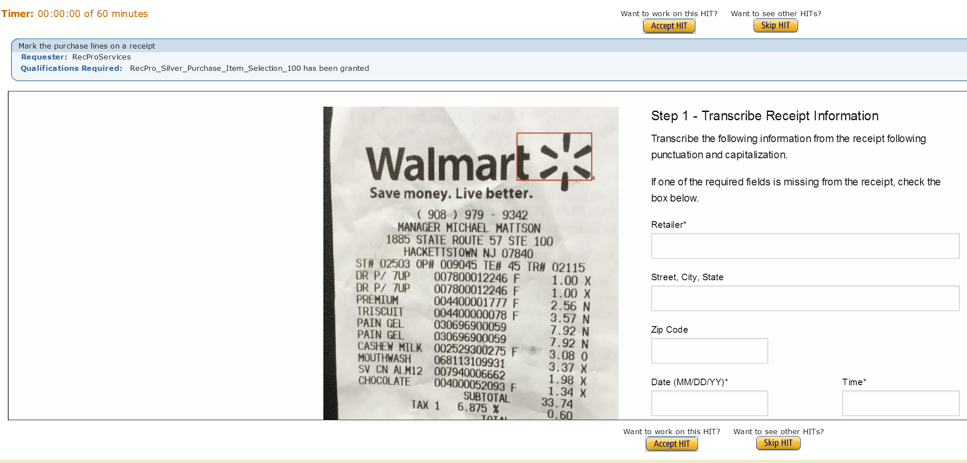
Examples of HITs (1)
Mark the purchase lines on a receipt

Slide 8
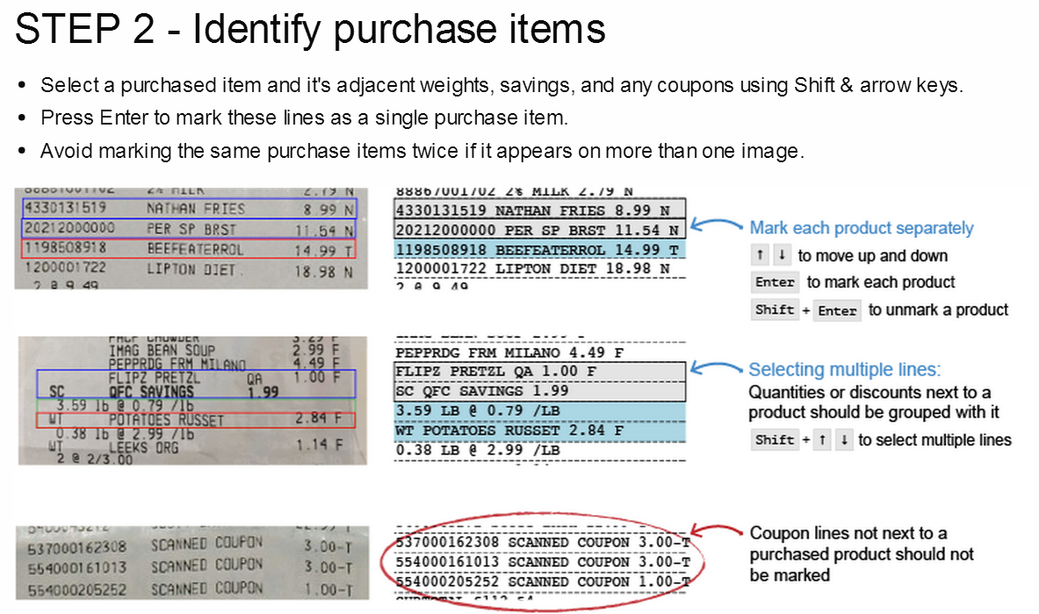
Examples of HITs (1) (cont'd)
Mark the purchase lines on a receipt

Slide 9
Examples of HITs (2)
Compare if two images contain the same person
Computer algorithms are not able to accomplish this task accurately

Slide 10
Outline
Crowdsourcing
Spatial Crowdsourcing

Slide 11
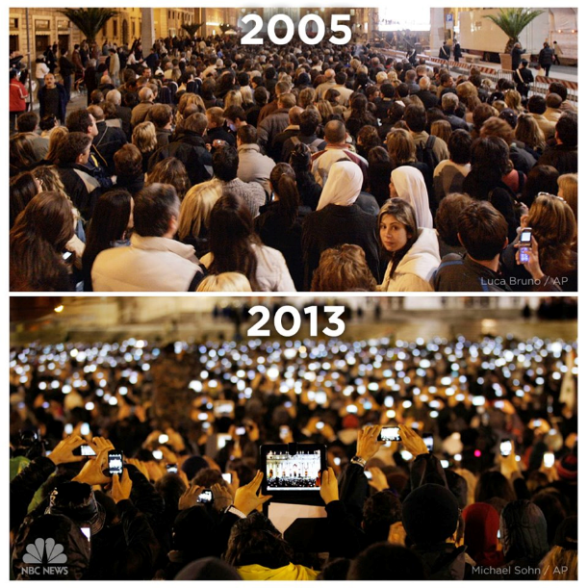
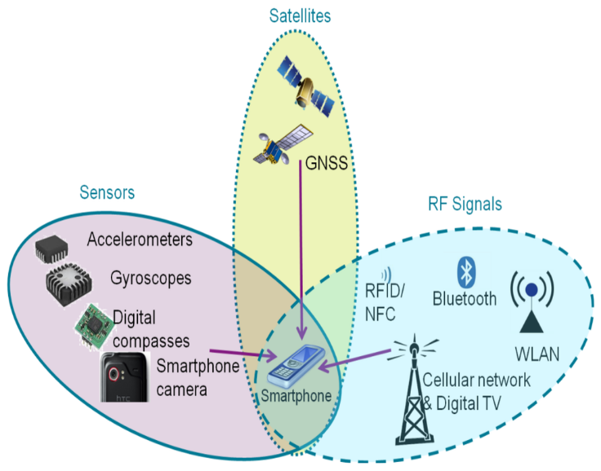
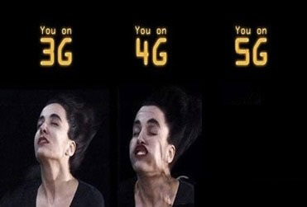
Motivation
Smart devices are so popular now
Smart devices have various sensors
The network quality becomes better
Notes:
Nowadays, the popularity of smartphones bring the convenience to our daily life. At the same time, every person, in fact, becomes a powerful and useful moving agent with smartphones. We can capture the information around us, like taking photos. Moreover, high speed network enable us to transfer information more easily.

Slide 12
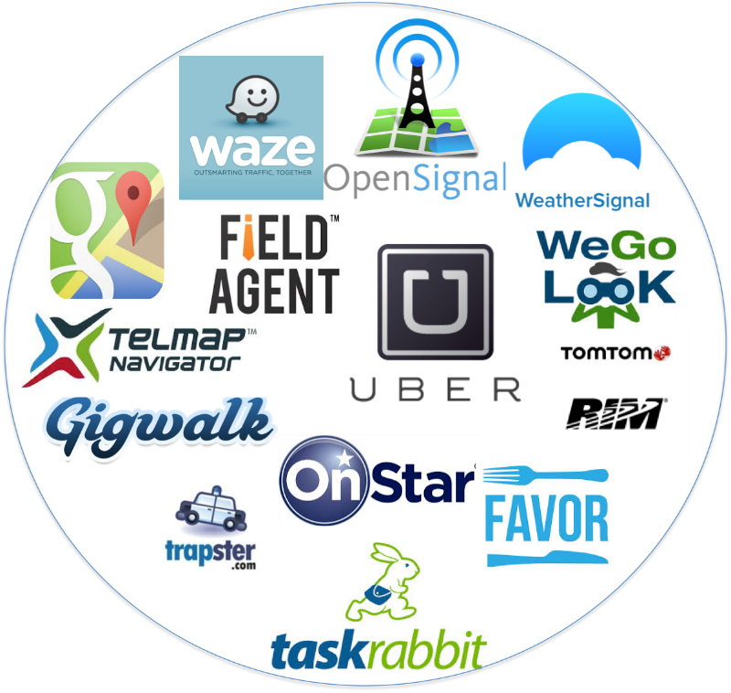
Spatial Crowdsourcing Applications
Waze: https://www.waze.com/
Gigwalk: https://play.google.com/store/apps/details?id=com.gigwalk&hl=en
TaskRabbit: https://www.taskrabbit.com/
gMission: http://www.gmissionhkust.com
…
(Picture provided by Hien To)
Notes:
These moving powerful agents can help us solve a lot of problems when using crowdsourcing. In fact, some company already see this opportunity and have developed some spatial crowdsourcing applications. Spatial crowdsourcing means workers need to physically move the specified locations to conduct tasks. This is a little bit different from the traditional crowdsourcing

Slide 13
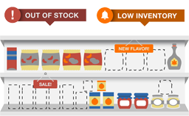
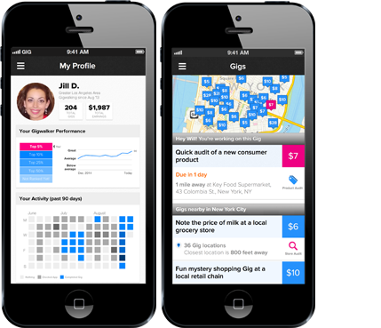
Gigwalk
Notes:
For example, on gigwalk, requesters can post tasks with specified locations. The tasks can be tracing store of products in shops, taking photos of a landmark or just reporting the waiting time of a hot restaurant. Then the dynamically moving workers around these tasks can move to the specified locations and conduct them on the fly.

Slide 14
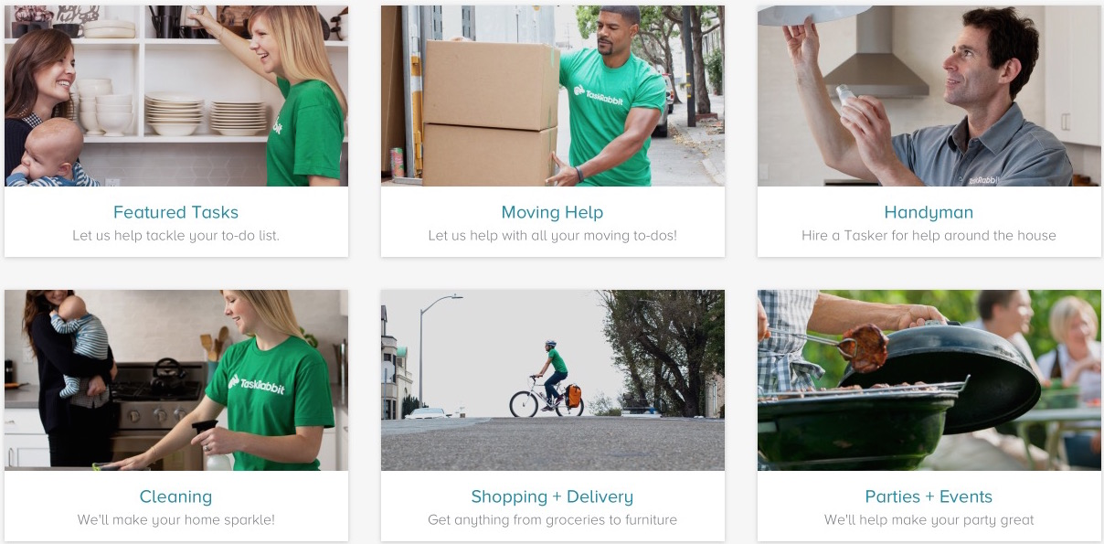
TaskRabbit
https://www.taskrabbit.com
14
Notes:
TaskRabbit is another example of spatial crowdsourcing application. On TaskRabbit, the tasks can be more complex, like help the requesters in moving heavy stuff, cleaning room and cooking food.

Slide 15
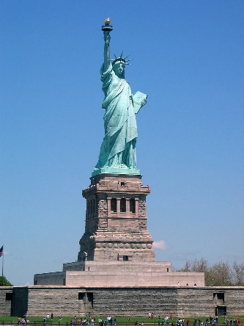
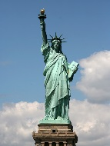
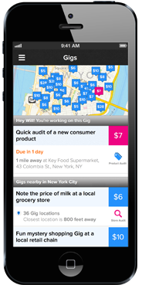
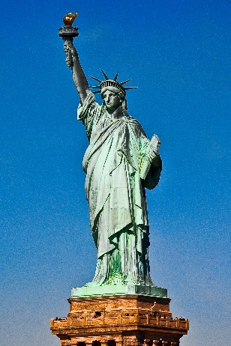
Spatial Task (Taking a Photo of Landmarks)
Taking Photos of a Landmark
Post Task

Slide 16
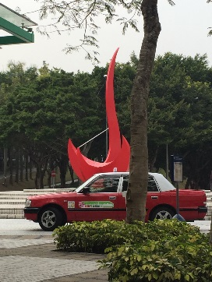
Spatial Task (Taking a Photo of Landmarks)
Take a photo of Firebird.
Workers:
Reject
Task
or
Miss
Deadline

Slide 17
Experiments
A 3D reconstruction showcase*
Sparse model of experimental data
Sparse model of ground truth data
*https://youtu.be/FfNoeqFc084 or http://www.gmissionhkust.com
Notes:
To show the effectiveness of our model, we built a 3D reconstruction showcase. In the figures each triangle indicates a photo. The left figure shows a result based on 23 photos taken by workers and the right figure shows a result based on 55 photos taken by ourselves.

Slide 18
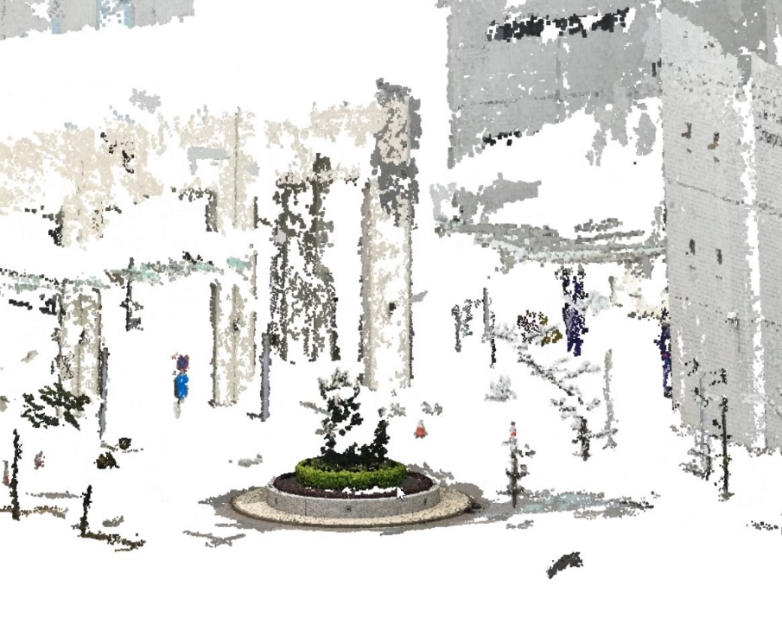
Experiments
A 3D reconstruction showcase*
Dense model of experimental data
Dense model of ground truth data
*https://youtu.be/FfNoeqFc084 or http://www.gmissionhkust.com
Notes:
The finial results are very similar with each other. This shows our model can guarantee the diversity of the answers. For more information, you can see a demo video on youtube or just simply go to the homepage of gmission. We put the video on it.

Slide 19
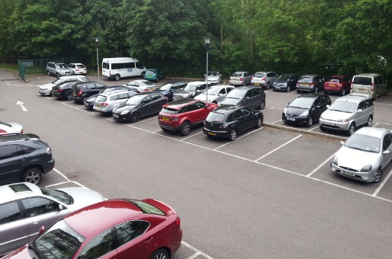
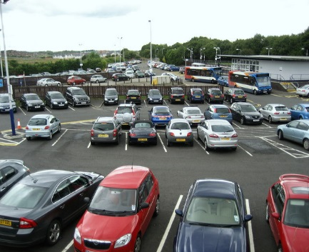
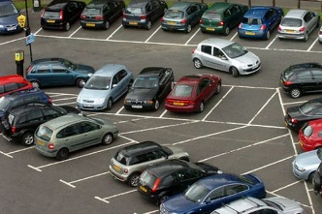
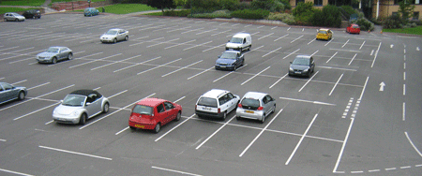
Spatial Task (Taking a Photo of Parking Lots)
Begin
End
2:00PM
6:00PM

Slide 20
List of Potential Projects
1. Location-based Web system and iOS implementation
2. iCampus
3. Street View Based GPS Assistance
4. Path Navigation over Road Networks
5. Spatial Question/Answer System
6. Keyword Search and Visualization of Knowledge Graphs
7. Crawling and Querying Social Networks
8. Guide of the Course Selection
9. Parsing and Visualizing the Bibliography
10. Visualizing and Querying New York Taxi Data
http://www.cs.kent.edu/~xlian/2018Spring_CS49901_CS44901/project_list.pdf

Slide 21
1. Location-based Web System and iOS Implementation
In this project, we aim to provide information about the hospitals, communities, student programs, non-government organizations to the user.
It will serve as the mediator between faculty and students.
Students can visit different intern locations and send their answers to faculty based on their GPS co-ordinates.
We use Google maps in the system to dynamically show location based points by using multilevel structure data from database. The database categorizes each application through the location name, question, answer, user, picture, and intern students tag.
Requirements: website programming, iOS mobile programming, database design, algorithm design

Slide 22
2. iCampus
In this project, we will implement a spatial crowdsourcing mobile App
Task 1: Collect data in KSU campus such as:
GPS locations (including floor numbers in buildings)
Received signal strengths (RSS) from different detected WiFi access points
Videos
Photos
Texts (points of interest [POI] or descriptions, entered by mobile users)
Timestamps, and
Dates
Task 2: Transmit the collected data back to a database server or Google drive under WiFi environment or by data networks
Task 3: Users should be able to register the account and start to collect campus data
Students are expected to walk through the KSU campus to collect
Task 4: Visualize the virtual tour of KSU campus
Task 5: POI search & campus navigation…? WiFi signal strength map?
Requirements: mobile programming, database design

Slide 23
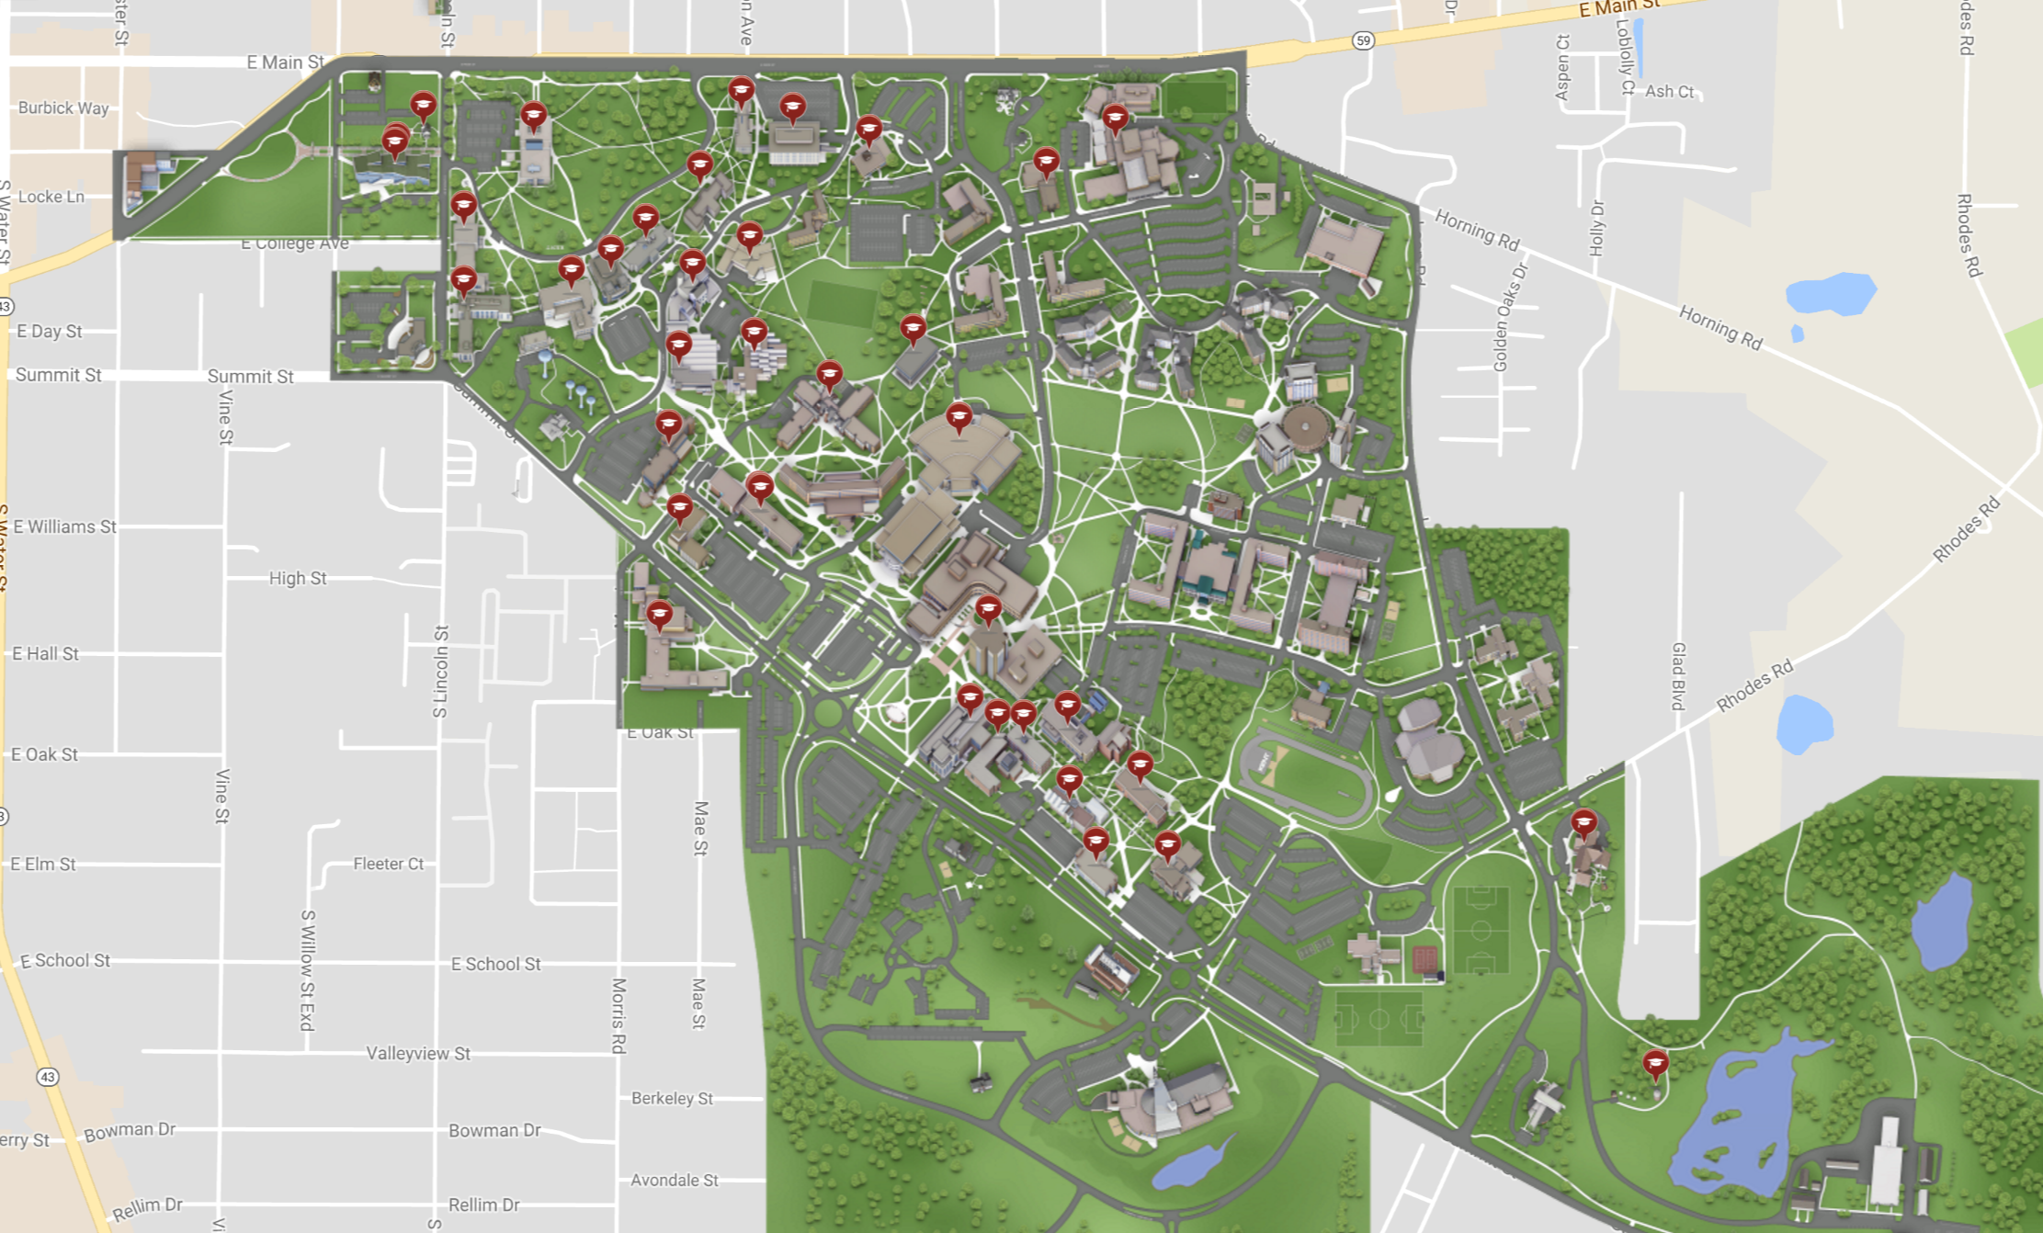
Tasks
Collect various information of KSU campus
https://www.youvisit.com/tour/kent?pl=v

Slide 24
Tasks (cont'd)
Transmit the collected data to a backend database server
Internet

Slide 25
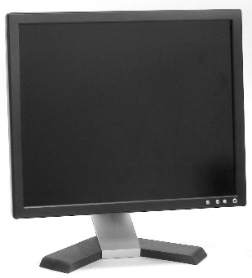
Tasks (cont'd)
Organize the database and provide mobile/Web interfaces to query the database
Internet
Graphical User Interface (GUI)

Slide 26
5. Spatial Question/Answer System
In this project, we will implement a mobile platform for task requesters to ask questions (spatial tasks) about spatial landmarks on a map and for mobile users nearby to answer questions (taking photos, or enter text descriptions)
We maintain a backend database server to track real-time locations of mobile users, and notify mobile users (workers near landmarks) to do spatial tasks
Other questions in this system include manually comparing whether two photos are taken in the same spatial locations
Requirements: mobile programming, database design

Slide 27
Two Types of Users
Task Requesters
Specify the task location on a mobile device or PC, and task description
Workers
Workers near the task location will be notified to accomplish spatial tasks (e.g., taking photos/videos)
Submit task results

Slide 28
Database Server
Database Server
Mobile devices of workers periodically send their current spatial locations to the server
Once a task requester specifies the task location, the server will send notifications to workers nearby
The server will receive the task result (including photos/videos/geolocations) from workers and store the data in a database

