Slide 1
Renouncing Hotel’s Data Through Queries Using Hadoop
By
Harshini Adusumalli
Suman Batta
Yamuna Chaparala
Snigdha Kunduru

Slide 2
Table of Contents
Introduction
Problem Statement
Required Technologies
Implementation & its Solution
Conclusion
Demonstration

Slide 3
Introduction
Make my trip is one of the travelling company that provides all the amenities in one place from transportation to stay to attractions around the place of customer choice.
Today we are going to retrieve the hotels data that are available and provided by make my trip, as per customer requirement and choice.
This data is retrieved by query processing using hive and hadoop. Dataset of format .txt file is used to retrieve data.
objective
Main objective is to ensure that the final data provided is proficient enough.

Slide 4
Problem Statement
Problem Statement
Major problem arrives to the user while selecting the hotel from the vast list, based on their requirements. To make it easier, user is provided an option of selecting hotels based on few attributes like room type, hotel overview or nearby attractions etc. Their search requests are processed by travel agencies.
Travel Agencies cannot always possess optimal booking management tools to help the customer with their needs. And also they cannot always return quality searches and book what the customer needs because customer may have multiple requirements and the booking management tools may not always provide with multiple searches.
The solution to this problem is providing with a interface where the customer representative takes the requirements by actively interacting with the customer by taking multiple requirements; by querying against dataset to find the insights from the visualization which aids in better customer support ,fast customer service, and optimal booking results.

Slide 5
Required Technologies
Hadoop - Distributed Data Processing Framework
Hive - Database Engine
Hive Query Language - It is a Primary data processing method for cloud data platform.
Zeppelin Visualization - Web based notebook which helps us for analyzing the data and it is integrated with distributed and general purpose data processing systems.

Slide 6
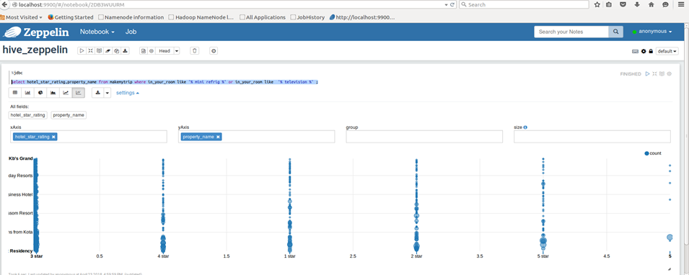
Implementation & its Solution
classifying data based on services provided.
Renouncing Hotel’s Data Through Queries Using Hadoop

Slide 7
Implementation & its Solution
2. Displaying the count based on city

Slide 8
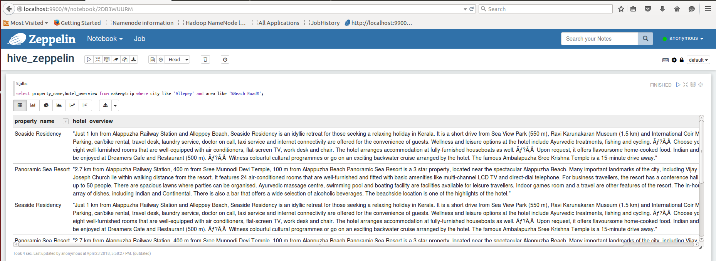
Implementation & its Solution
3. Displaying hotel name with overview based on city and area

Slide 9
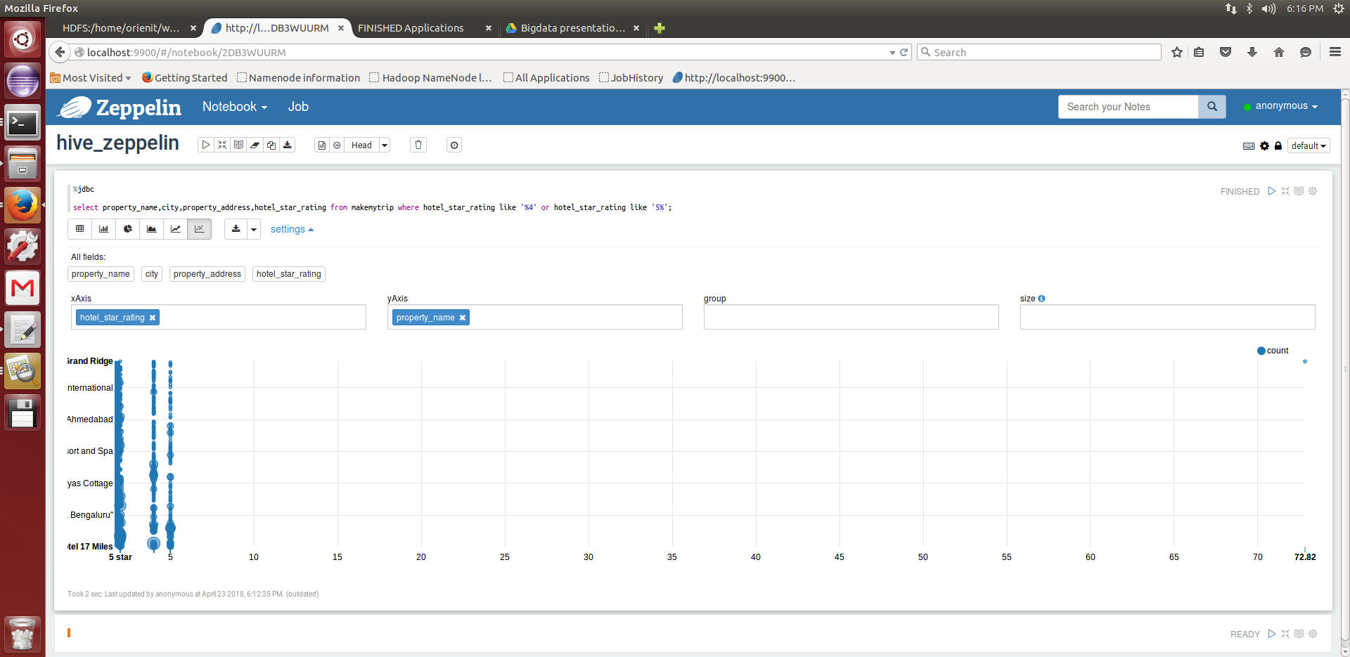
Implementation & its Solution
4. Displaying hotels with complete address which has either 4 or 5 rating.

Slide 10
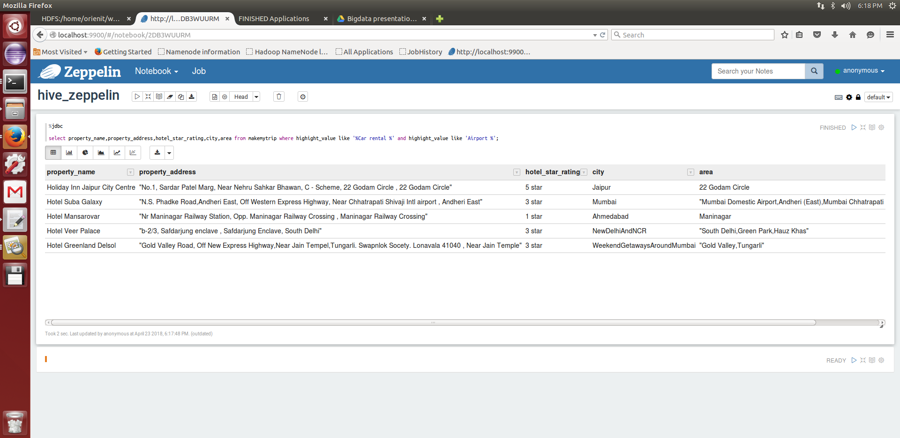
Implementation & its Solution
5. Classifying hotel data by highlight_value column which provides car rental and airport transportation facilities.

Slide 11
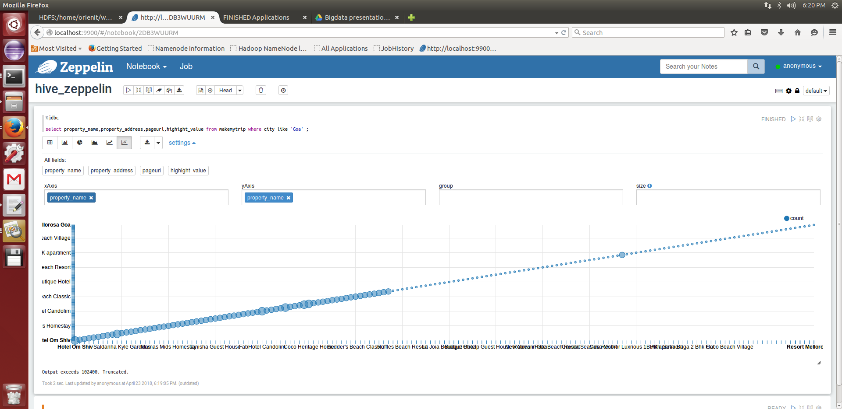
Implementation & its Solution
6. Classifying hotel data using city

Slide 12
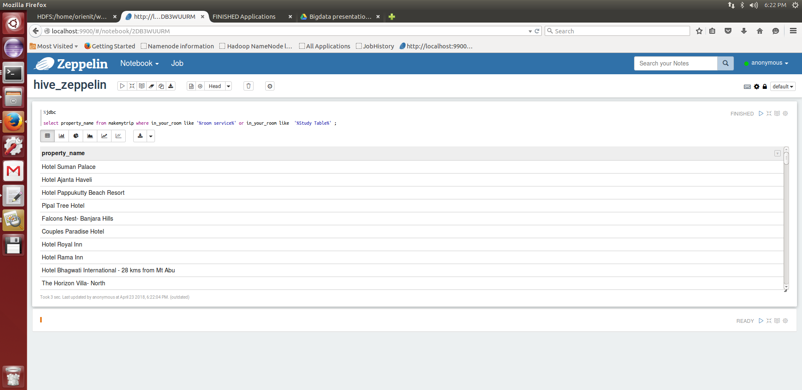
Implementation & its solution
7. Classifying hotel data based on the services provided in the in_your_room column

Slide 13
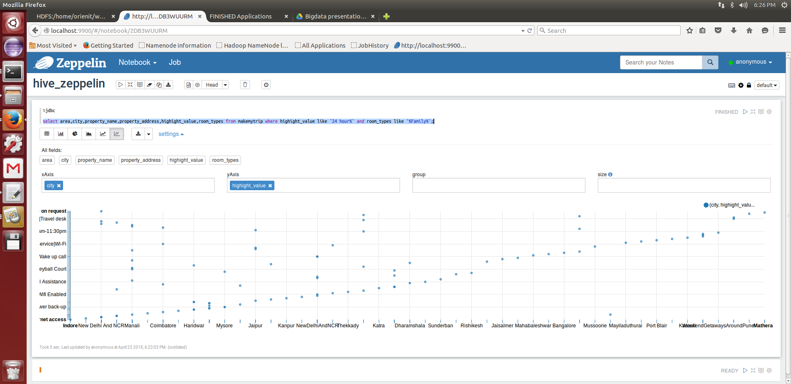
Implementation & its Solution
8. Displaying hotel data based on the 24 hour service provided from higllight_value and room types.

Slide 14
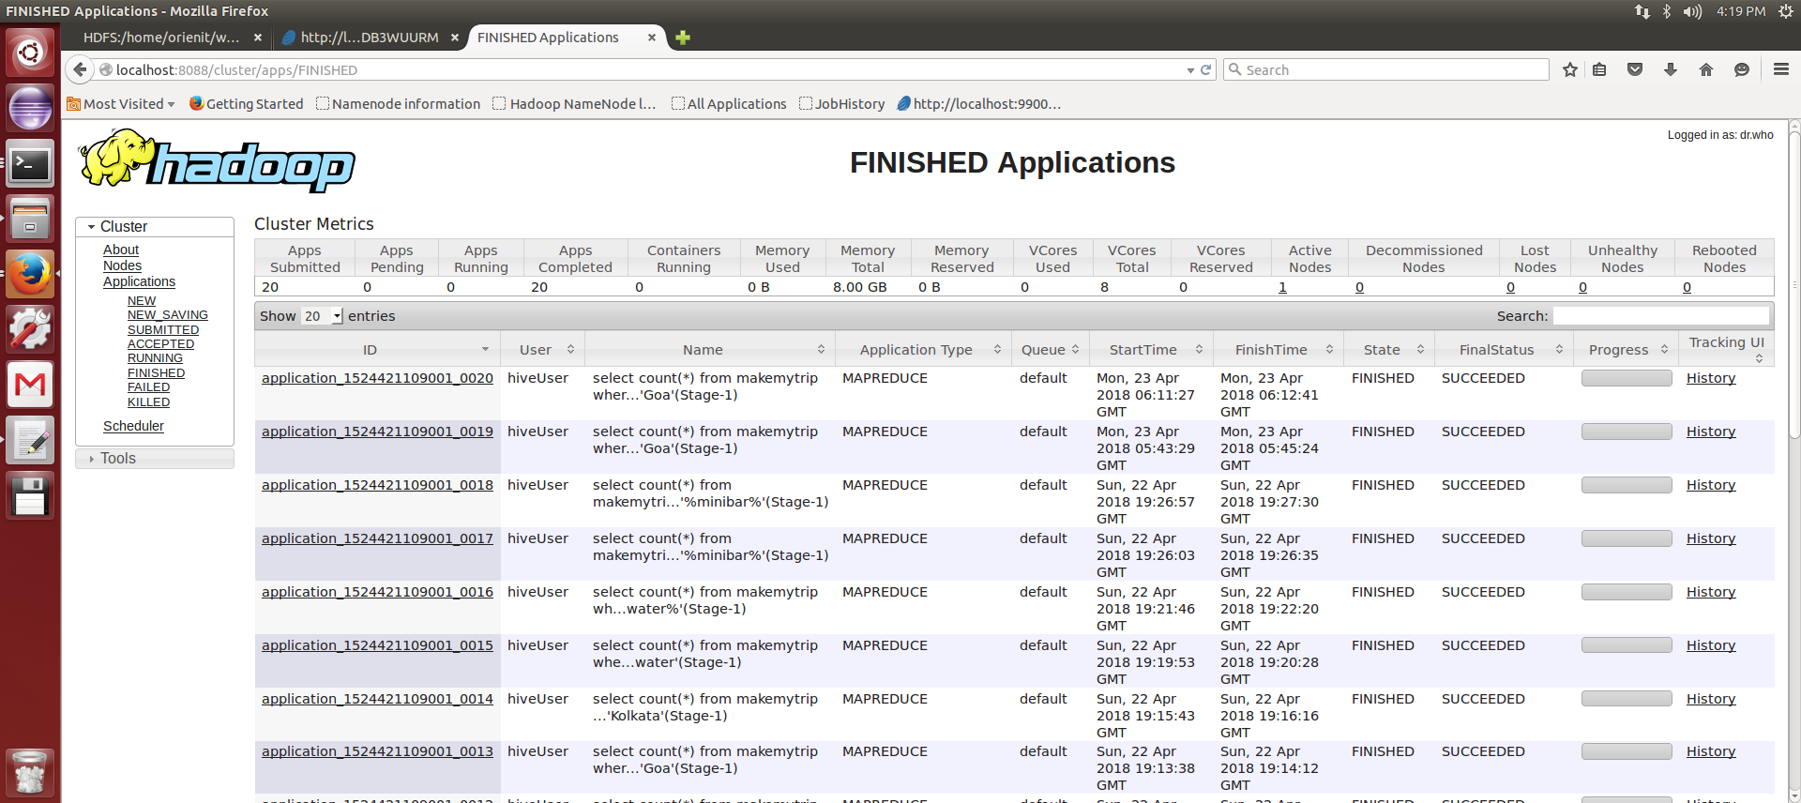
Implementation & its Solution

Slide 15
CONCLUSION
By using this system, travel agencies were able to provide better customer support by utilizing various components of the software.
By using visualizations ,customer representative is able to gain more insight which aids in providing better customer support.
Optimal results can be found even with increase of requirements.

Slide 16
Demonstration

Slide 18
Thank You

