Slide 1
Feature Extraction on Twitter Streaming data using Spark RDD

Slide 2
Agenda
Getting the streaming data from twitter
Handling the data stream using spark RDD
Linguistic feature extraction

Slide 3
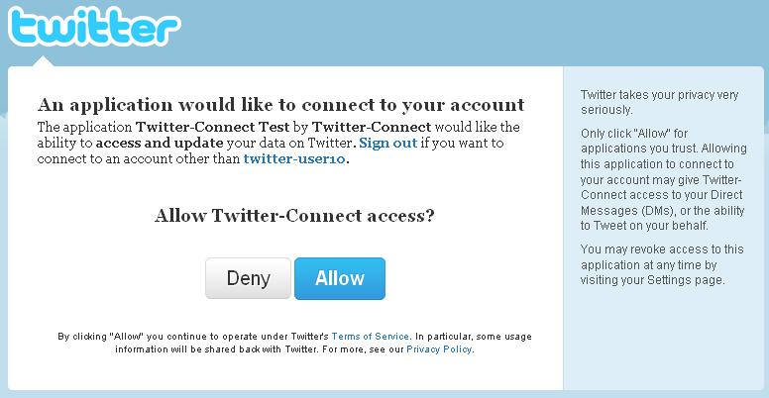
Authorization URL
Create a developer account in twitter
Set up Twitter OAuth keys Consumer Key Consumer_secret key Accesss_token Access_token_secret

Slide 4
Data from Twitter
Information about a user
User’s Followers or Friends
Tweets published by a user
Search results on Twitter
Places & Geo

Slide 5
STREAMING APIs Limits
No rate limit
Streaming API allows to be streamed up to 1% tweets of the total volume
https://dev.twitter.com/streaming/overview

Slide 6
In Python
HOW?
Used Tweepy library in python
Import StreamListener to listen when a tweet is generated
Used on_data to print results

Slide 7
Spark Streaming
Spark RDD
DStrems
Sliding windows

Slide 8
Streaming Computation
Map
Filter
Reduce By Key
Flat Map and more

Slide 9
Linguistic Feature extraction
Opinion Count
"think", "thought", "thinks", "thinking", "knowing", "knew", "knows","know","considering","considers", "considered", "consider"
Tentative Count
"maybe", "guess", "perhaps", "experimental" , "experiment"
Vulgarity Count
Offensive words
Positive, Negative, Neutral Count
TextBlob library
Returns sentimental polarity

Slide 10
Thank You!

