Slide 1
A Restaurant Recommendation System Based on Range and Skyline Queries
By:
Abhishek Singh
Asaad Althoubi
Pavan Poudel
Tala Talaei

Slide 2
Introduction
Over the last decade, an increasing interest in preference queries has witnessed
The reason behind that increasing concern comes from:
It is desirable to offer flexible queries that meet the user’s minds
These queries usually provide a basis for rank-ordering the objects retrieved
Thus, we have developed a restaurant recommendation system to satisfy the user’s requests.
In this system, a list of restaurants is shown to the user based on certain queries

Slide 3
Introduction (Cont.)
Five attributes are involved in this query system, namely cuisine, distance, price-level, score, and time.
The supported queries in this system are categorized into 2 types:
Range queries:
2. Skyline queries:

Slide 4
Introduction (Range Query)
Two attributes are considered in this query
Range query retrieves all records where some value is between an upper and lower bound
Geospatial query allows to efficiently execute queries on a collection that contains geospatial points

Slide 5
Introduction (Range Query)
Utilizing spatial range queries
In this system:
A user requests restaurants of certain type of cuisine within a certain range
A list of restaurants is provided to the user which is later sent to another query (Skyline)

Slide 6
Introduction (Skyline Query)
Three attributes are considered in this query
A set of restaurants that are not dominated by any other restaurants is returned
Four options of dominating restaurants are displayed:
3D (distance, price, score)
2D (distance, price), (distance, score), (price, score)

Slide 7
Related Works
A Restaurant Recommendation System Using Preference Queries over Incomplete Information
http://www.vldb.org/pvldb/vol9/p1509-miao.pdf
Restaurant Search with Predictive Multi-space Queries
https://foosoft.net/projects/restaurant-search/dl/article.pdf

Slide 8
Features
The system is capable of recommending restaurants based on selected attributes
It provides a real-time system for satisfying the existing preferences
It uses a real-time restaurants dataset from Google stream
It uses a preprocessing query step to reduce the complexity time of the Skyline query

Slide 9
Dataset
We utilize a real-time restaurants dataset crawled from Google to give the users the opportunity to interact and experience how the system can be used for retrieving the restaurants
No noisy data, such as incomplete or missing data
Live dataset obtained by using Google API
The dataset consists of various types attributes
The attributes were divided into two groups based on the query category
Range query ( Cuisine, Distance)
Skyline query ( Distance, Price, Rating )

Slide 10
Queries and Architecture (Cont.)
The user submits a query through the user interface, and the query is then sent to the system for processing
After the query is processed, the results are sent back to the user and displayed on Google Maps
What’s more?
The system suggests the most dominating restaurants in the selected region and based on chosen attributes

Slide 11
Queries and Architecture
Queries are based on the dominance relationship
For instance, given two objects p and q, p dominates q if these conditions hold:
For every dimension i, either p[i] is no worse than q[i]
There is at least one dimension j, in which both p[j] and q[j] are observed and p[j] is better than q[j]

Slide 12
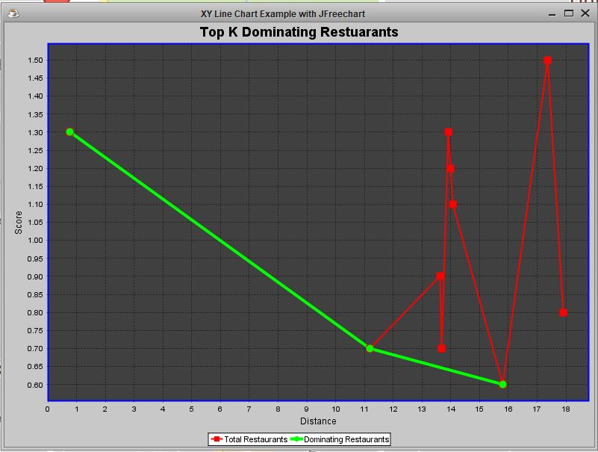
Queries and Architecture
Fig. : Skyline results based on distance and score

Slide 13
Queries and Architecture
Price: Lower price dominates the higher prices
Distance: Nearer distance dominates the far distances
Score (Rating): Higher score dominates the lower scores
(Recalculation of score is needed for skyline query)
score = 5.0 - original rating

Slide 14
Challenges
Integration
Google Map API
Graphical Analysis Tools
Feature Selection
Primary Features
Secondary Features
Quality Testing

Slide 15
.
Tools and Languages
Java8
Google Maps and Google Client API
JSON- Link
Java Libraries - Library Link
GitHub
.
.

Slide 16
Conclusion
In this project, we developed a restaurants recommendation system based on preference queries
The recommended restaurants can be visualized in graphs
The system is based on real-time Google dataset, range query, and Skyline queries

Slide 17
Future Work
Visualizing the query results properly is a critical part in enhancing search experience in 3D
Allow the users specifying an interested region by drawing a rectangle in map to obtain restaurants in that area
Allow the users to write reviews on the restaurants and score them such that the information of restaurants is updated
The system can be implemented on a mobile platform which provides user current locations using mobile GPS

Slide 18
Demo

