Slide 1
CS 63016 & CS 73016
Big Data Analytics
Chapter 1: Introduction
Xiang Lian
Department of Computer Science
Kent State University
Email: xlian@kent.edu
Homepage: http://www.cs.kent.edu/~xlian/
Notes:
The slides of this Big Data course used some public slides/materials on the Web. I would like to acknowledge these resources, and please let me know if I failed to cite them.

Slide 2
Objectives
In this chapter, you will:
  Get an overview of this course
  Know what are big data
  Explore characteristics and challenges of the big data
  Learn the solutions to deal with the big data
  Be aware of the applications of the big data

Slide 3
Outline
The Overview of the Course
The Definition of Big Data
Characteristics/Challenges of Big Data
Topics of Big Data
Applications of Big Data

Slide 4
CS 63016 & CS 73016 Big Data Analytics
Instructor: Xiang Lian
  Office: MSB 264
  Email: xlian@kent.edu
  Office hour: Tuesday and Thursday (1:00pm ~ 3:30pm); or by appointment
TA: TBD
  Email: TBD
Course:
  Homepage: http://www.cs.kent.edu/~xlian/2018Spring_CS63016_CS73016.html
  Location: Henderson (HDN), Room 109
  Time: 7:00pm ~ 8:15pm, TR

Slide 5
Background Required
Database techniques (e.g., indexing)
Algorithms & data structure
Programming languages
  Java
  C/C++
  Python
  ...

Slide 6
Skills Required
This course is a seminar course for Master & Ph.D. students
  Ability to read textbooks, reference books, and research papers
  Ability to identify problems
  Ability to solve problems

Slide 7
Study Group
Please form a team with 2-4 team members
  In each team, team members can be either Master or Ph.D. students
  The workload should be distributed evenly to each team member
Each team
  1 Survey + 1 Project + 1 Presentation

Slide 8
Scoring and Grading (cont'd)
Graduate team
  5% - Attendance
  50% - 5 Assignments
  10% - Survey
  25% - Research Project
  10% - Presentation & Q/A
  5% - Bonus Points, rated by other team members
Total: 105

Slide 9
Scoring and Grading (cont'd)
A = 90 -105
B = 80 - 89
C = 70 - 79
D = 60 - 69
F = <60
The maximum score you can get is: 105!

Slide 10
Reference Books
Books
  Kuan-Ching Li, Hai Jiang, Laurence T. Yang, and Alfredo Cuzzocrea. Big Data: Algorithms, Analytics, and Applications. Chapman & Hall/CRC Big Data Series, ISBN 9781482240559, 2015.
  Thomas Erl, Wajid Khattak, and Dr. Paul Buhler. Big Data Fundamentals: Concepts, Drivers & Techniques. The Prentice Hall Service Technology Series, ISBN-13: 978-0134291079, 2016.
Resources
  Please refer to a reading list of research papers on the course website
    Conferences: SIGMOD, PVLDB, ICDE
    Journals: TODS, VLDBJ, TKDE

Slide 11
Resources
ACM digital library
  http://dl.acm.org/
IEEE Xplore Digital Library
  http://ieeexplore.ieee.org/Xplore/home.jsp
DBLP
  http://dblp.uni-trier.de/
Database Conferences
  SIGMOD, PVLDB, ICDE, EDBT, CIKM
Database Journals
  TODS, VLDBJ, TKDE

Slide 12
Surveys/Projects
If the surveys and projects are of high quality and novel, I highly recommend you to submit them to database conferences or journals
After this class, I would like to invite some self-motivated, hardworking, and creative students to join my lab (Big Data Science Research Lab)!

Slide 13
Academic Dishonesty Policy
Warning: Do not copy from any sources (even for the survey)
  Any form of academic dishonesty will be strictly forbidden and will be punished to the maximum extent
  Allowing another student to copy one's work will be treated as an act of academic dishonesty, leading to the same penalty as copying

Slide 14
Outline
The Overview of the Course
The Definition of Big Data
Characteristics/Challenges of Big Data
Topics of Big Data
Applications of Big Data

Slide 15
What are Big Data?
Wikipedia (https://en.wikipedia.org/wiki/Big_data)
  "Big data is a term for data sets that are so large or complex that traditional data processing applications are inadequate to deal with them. Challenges include analysis, capture, data curation, search, sharing, storage, transfer, visualization, querying, updating and information privacy“
Gartner (2011)
  Big data is a popular term used to acknowledge the exponential growth, availability and use of information in the data-rich landscape of tomorrow.

Slide 16
Outline
The Overview of the Course
The Definition of Big Data
Characteristics/Challenges of Big Data
Topics of Big Data
Applications of Big Data

Slide 17
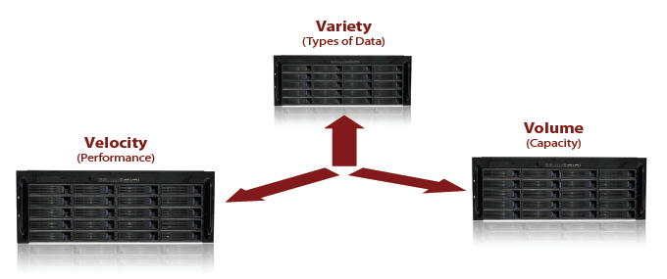
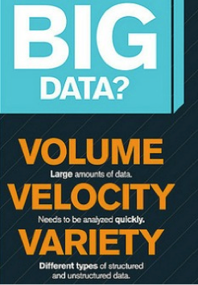
Characteristics of Big Data
Big data
Notes:
http://www.cs.kent.edu/~jin/BigData/
Gartner thinks the essential features of Big data can be summarized in 3V
Variety: ability to handle heterogeneous data source, representation and quality
Volume: the ability to scale out the storage as long as there is a data allocation require
Velocity: the ability to capture and analyze data with performance guarantees

Slide 18
Characteristics of Big Data (cont'd)
Variety: ability to handle heterogeneous data source, representation and quality
Velocity: the ability to capture and analyze data with performance guarantees
Volume: the ability to scale out the storage as long as there is a data allocation require
Other features (from Wiki and P. Valduriez):
  Variability: Inconsistency of the data set can hamper processes to handle and manage it
  Veracity: The quality of captured data can vary greatly, affecting accurate analysis
  Validity: Is the data correct and accurate?
  Volatility: How long do you need to store the data?
Notes:
https://en.wikipedia.org/wiki/Big_data
Patrick Valduriez, Indexing and Processing Big Data, slides

Slide 19
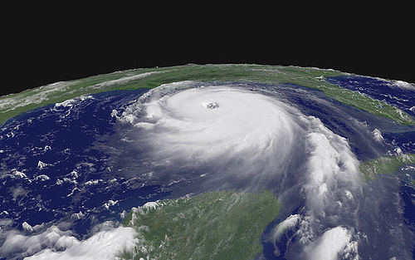
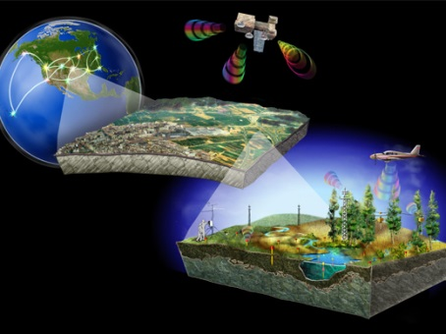
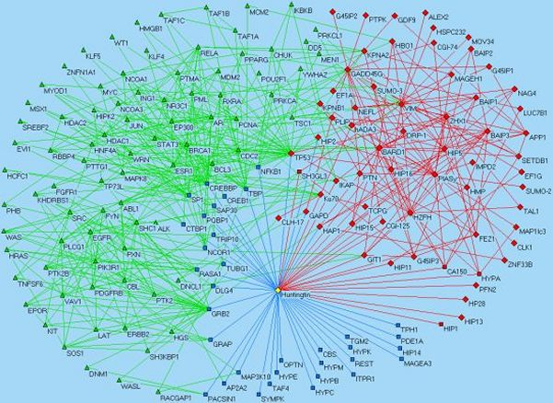

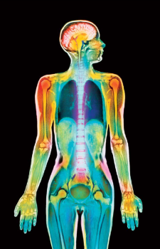
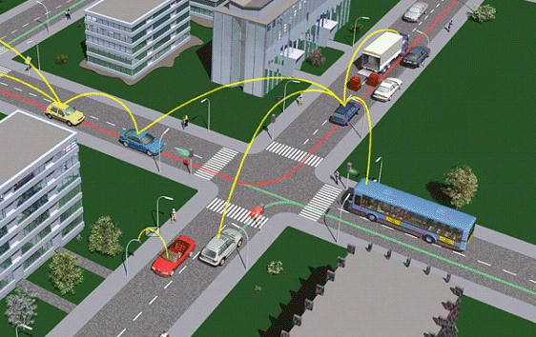
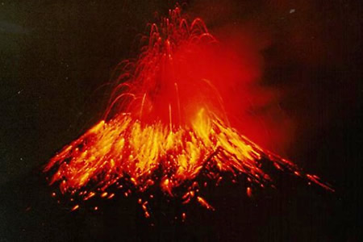
Variety
Hurricane moving path predication
Protein-to-protein interaction networks
Heterogeneous
Data
Satellite imagery, mobile station, distributed sensor networks, geographical plotting …
Web data
Heterogeneous Data of Various Formats and Data Qualities!!
Digital health care
Intelligent transportation
Volcano monitoring

Slide 20
Variety (cont'd)
Many types of big data
  Key-value pairs
  Relational tables
    Numeric data, text data
  Arrays
  Documents
    Unstructured text data (Web)
    Semi-structured data (XML, RDF triples, etc.)
  Graphs
    Social networks, Semantic Web (RDF graphs), road networks, …
  Data streams
    Sensor data, RFID data, network data, trajectory data, etc.
  Time series data
    Stock exchange data, video/audio data, trajectory, EEG data, etc.
  Multimedia data
    Audio, video, image, etc.
Notes:
Patrick Valduriez, Indexing and Processing Big Data, slides

Slide 21
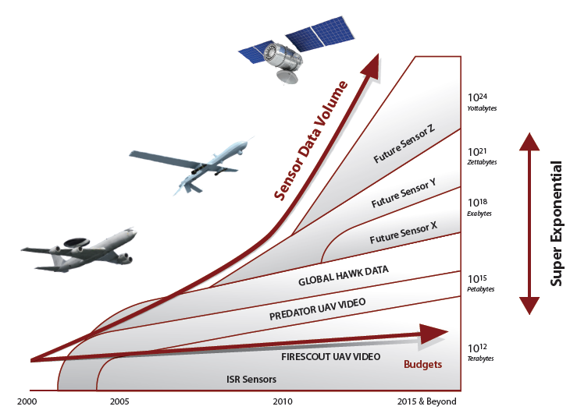

Volume
Super exponential growth in data volume
Large-Scale Data to Collect, Store, Organize, and Manipulate!
Copyright belongs to “Data Analysis Challenges”, JSR-08-142, Dec

Slide 22
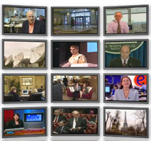

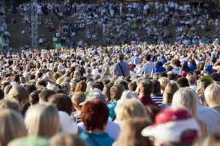

Volume (cont'd)
Old days: Only a few companies are generating data, all others are consuming data
Nowadays: All of us are generating data, and all of us are consuming data

Slide 23
Volume (cont'd)
Data volume is increasing exponentially
1.8 zetabytes (10²¹ bytes, or 1,024 exabytes)
  An estimation for the data stored by human kind in 2011
• 40 zetabytes in 2020
• But
  Less than 1% of big data is analyzed
  Less than 20% of big data is protected
Source: Digital Universe study of International Data Corporation (IDC), December, 2012
Notes:
Patrick Valduriez, Indexing and Processing Big Data, slides
Source: Digital Universe study of International Data Corporation (IDC), December, 2012

Slide 24








Velocity
Fast Data Retrieval, Analysis, and Mining
Efficient and Quality-Aware Query Processing Over Big Data!

Slide 25
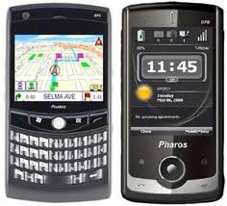
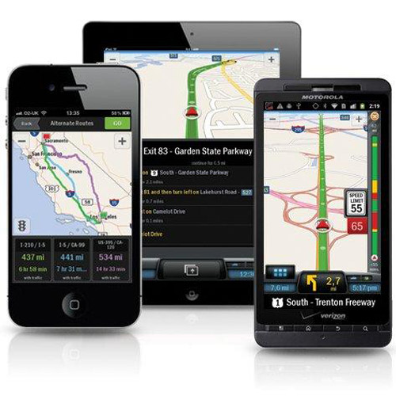
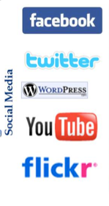
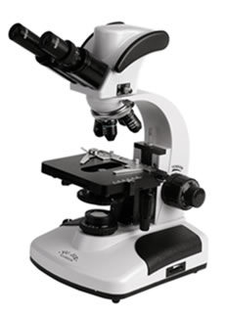
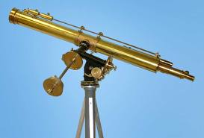
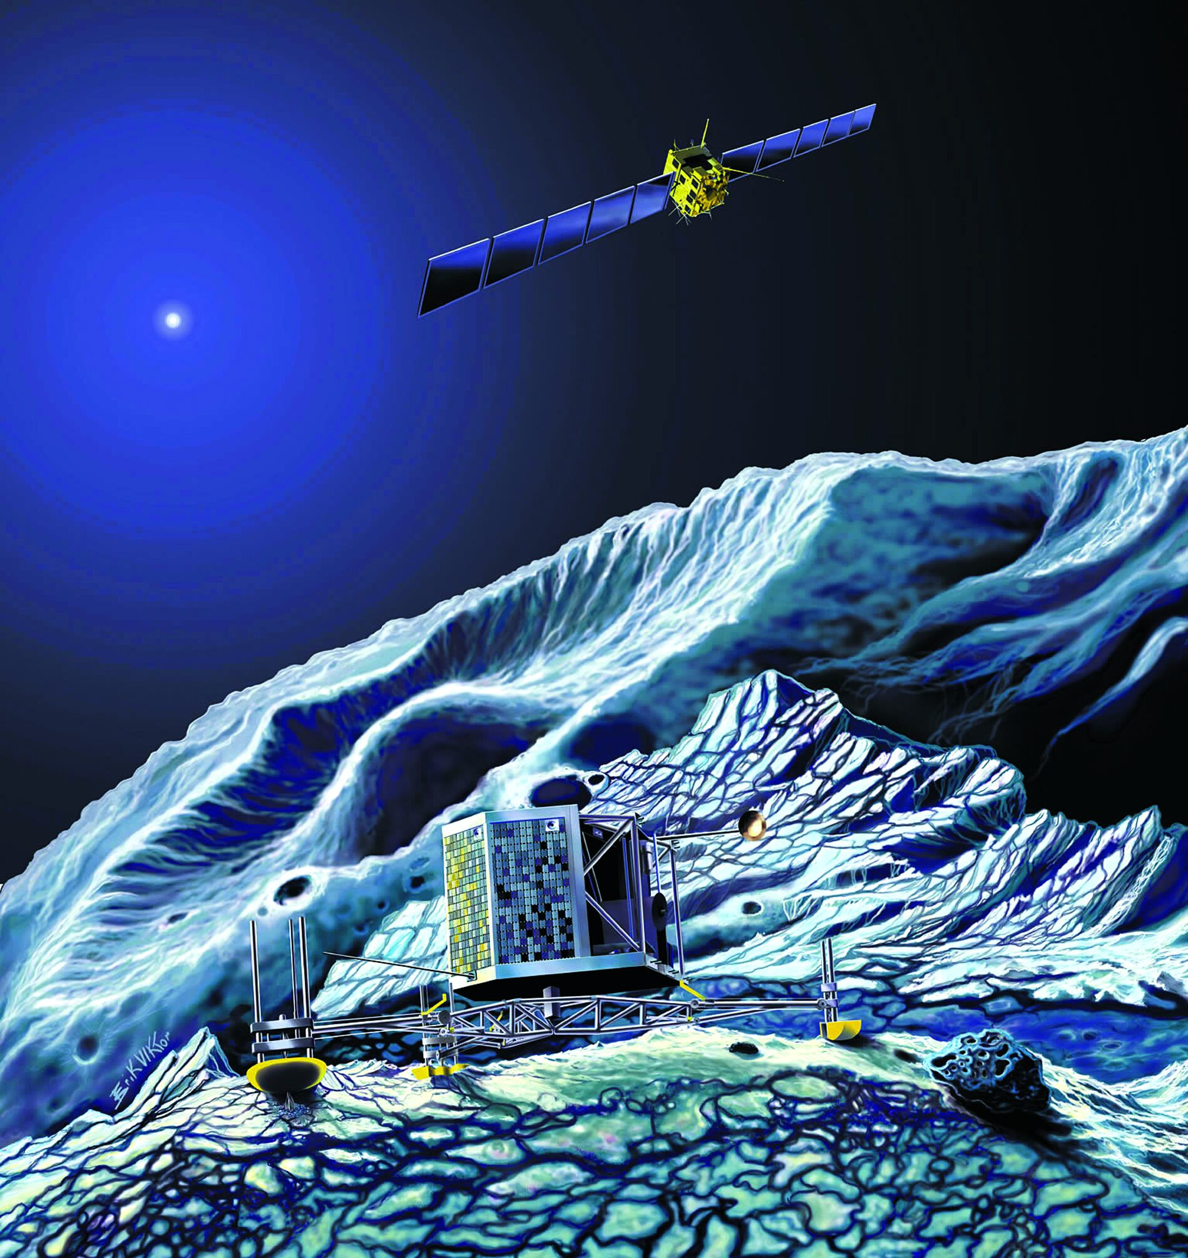
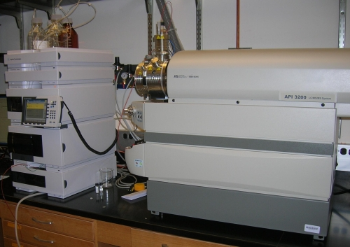
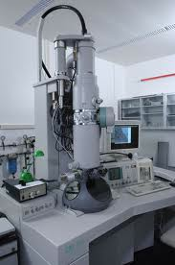
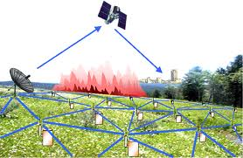
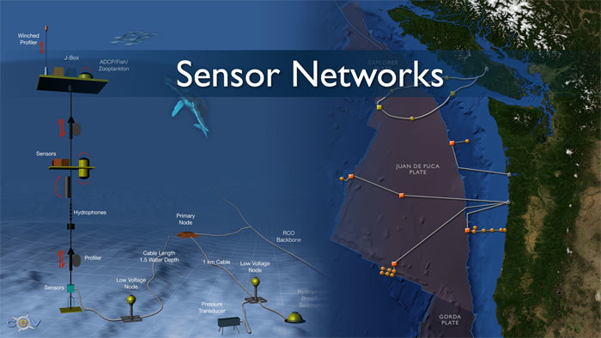
Real-Time/Fast Data
Mobile devices
(tracking all objects all the time)
Social media and networks
(all of us are generating data)
Scientific instruments
(collecting all sorts of data)
Sensor technology and networks
(measuring all kinds of data)
The progress and innovation is no longer hindered by the ability to collect data
But, by the ability to manage, analyze, summarize, visualize, and discover knowledge from the collected data in a timely manner and in a scalable fashion
Notes:
http://www.cs.kent.edu/~jin/BigData/

Slide 26
Ground Challenges for Current Data Service Infrastructure
Applications
Data Processing
(Processing lang., indexing, optimization)
<key,vals>
Object
E-R
Hierarchical
Data Model
(Interpretation, representation)
Network Topology
Storage
(Reliability, Scalability, Availability)
26
Notes:
Data being stored on storages connected with certain network topology. Data are interpreted into different data models and accordingly, particular data processing tools or APIs are provided for applications on the top.
However, for big data, current storage network is not ready for data in tremendous growth and updating pace. There are constraints on the network traffic volume, cost to add more storage node and handle failures.
As data are coming from heterogeneous sources, single or simply hierarchical data interpretation does not work.
And new tools are necessary to adapt the 3V features of big data

Slide 27
Data Model Challenges
Volume
Scale up, scale out, and scale in
Velocity
"Interactive" properties to facilitate processing
Variety
Simple but unified to adapt heterogeneity
Existing data models are not satisfactory
Functionality vs. Simplicity
<key,vals>
Object
E-R
Hierarchical
Notes:
For volume: Scale up/down refers to vertical dimension, meaning increasing processing power for certain machines, or the workload of certain machines.
while scale out/in refer to horizontal dimension, meaning adding machines to increase capability and limited the computation to maybe only a few nodes.
For velocity: since the underlying data may from different data source or even different fields, the data model must be adaptive enough such that data from various sources can be effectively processed. It requires the data model to be flexible and interactive, i.e., allowing the upper level processing be easily defined and performed.
For variety: since data could be from various sources, the challenge is how to make it simple but able to adapt all the heterogeneity.
None of existing data models can directly applied. A new tradeoff between functionality and simplicity must be found

Slide 28
Storage Challenges
Storage concerns:
  Reliability: data are safe and trustable
  Availability: data are accessible
  Scalability: data operation performance does not decay along with data size growth
However, the CAP theorem is the bottleneck. No one-for-all solution exists
  In theoretical computer science, the CAP theorem, also named Brewer's theorem after computer scientist Eric Brewer, states that it is impossible for a distributed computer system to simultaneously provide more than two out of three of the following guarantees: Consistency, Availability, and Partition tolerance
  https://en.wikipedia.org/wiki/CAP_theorem
Notes:
For storage, big data does not propose essential new challenges, because the same challenging problems have be identified when it come to large scale of distributed storage.
For storage system, it concerns about reliability, availability and scalability. Reliability mainly contains two part: fault tolerance and consistency.
However, there is a CAP theorm

Slide 29
Management Challenges
Solving 'Big Data' Challenge Involves More Than Just Managing Volumes of Data -- Gartner (2011)
Big Data Management
Indexing &
Partition
Functionality
Adaption to new requirement and new component
Flexibility
Notes:
The challenges of big data does not only lie in storing the huge volume of data, we want effective management of them.
In general, 3V features ask for the management provides both rich functionality and flexibility. With rich functionality, great Velocity(performance) can be achieved, and Variety feature cannot survive without adaptive updates of management system

Slide 30
Management Challenges (cont'd)
For example, indexing over big data
Volume
Large volume of data captured every time unit
Requires
Distributed adaptive index
Leads to
Significant cost on data updates
Variety
Data captured from different sources
Requires
Distributed adaptive index
Leads to
Ambiguity on indexing the same object
Notes:
We shall take indexing big data as an example. Considering two features, volume and variety. The box on the left side is what we want, the box in the middle is the state of art implementation technique, and the box on the right most is the inevitable cost or undesired problems.
For example, to index the large volume of data, we must use distributed adaptive index, however, there is significant cost to maintain the index considering the frequent updates and the update volume.

Slide 31
Challenges on Processing Big Data
For example, new query language (algebra) for big data
Desired | Sacrifices & Overhead
Flexibility | Complexity in data modeling
Relational Supporting | Poor scalability
Uncertain Supporting | Poor scalability and significant computing overhead
Scalability | Less functionality
Efficiency & Effectiveness | Poor scalability
Notes:
After all, well defined data processing operations are what we want. However, current processing tools (or languages) may not applicable. The above table summarizes the desired features of new query language for big data, however, there are always sacrifices and extra overhead. A optimal tradeoff must be found

Slide 32
Challenges on Processing Big Data (cont'd)
For example, new computing paradigm for processing big data
Distributed Computing Paradigm | Limitations
Message Passing | Poor scalability and fault tolerance
Unified Access | Invalidated efficiency over large computing nodes
MapReduce | Poor functionality
Notes:
Besides, for query language, current computing paradigms need to be re-explored too.
The well acknowledged three distributed computing paradigms are message passing, unified access and mapreduce. Although the first have the advantages in handling complex computing process and computing efficiency, they are not easy to maintain and not fault tolerant. Mapreduce is popular for its great scalability and fault tolerant, but suffers from naïve parallelism framework that limits the functionalities.

Slide 33
Challenges on Processing Big Data (cont'd)
For example, new optimization methodology for processing big data
Load Balance
Data Locality
High Parallelism
Merging Cost
Less Network I/O
Replicated Computing
Notes:
These conflicting optimization methodologies exists for distributed computing for a long time. We don’t believe there is a one-for-all solution, therefore, the optimization methodology must be considered case by case, depending on applications.

Slide 34



How to Tackle Challenges of Big Data?
Heterogeneity
Data Modeling with Quality Guarantees
Storage and Indexing
Efficient and Quality-Aware Query Answering
Big Data
Large Scale
Efficiency
Notes:
http://clinithink.com/wp-content/uploads//2012/02/find_in_file_5121.png

Slide 35
How to Tackle Challenges of Big Data? (cont'd)
Scalable computing paradigms/platforms
Big data programming models
Scalable storage indexing
Effective mechanisms and efficient algorithms
…

Slide 36
Outline
The Overview of the Course
The Definition of Big Data
Characteristics/Challenges of Big Data
Topics of Big Data
Applications of Big Data

Slide 37
Major Topics of Big Data
Scalable big data indexing
Big data stream techniques and algorithms
Big graph processing
Big data privacy
Big data visualizations
Problems in real applications
  ...

Slide 38
Major Topics of Big Data (cont'd)
Problems in real applications
  Big spatial-temporal data (e.g., geographical databases)
  Big financial data (e.g., time-series data)
  Big multimedia data (e.g., audios/videos)
  Big medical/health data
  Big social media data (e.g., social networks like Twitter)
  Big scientific data (e.g., bioinformatics data)

Slide 39
Cloud Computing
IT resources provided as a service
  Compute, storage, databases, queues
Clouds leverage economies of scale of commodity hardware
  Cheap storage, high bandwidth networks & multicore processors
  Geographically distributed data centers
Offerings from Microsoft, Amazon, Google, …
Notes:
R. Jin, Big Data Analytics, Kent State University, slides

Slide 40
Wikipedia: Cloud Computing
Notes:
R. Jin, Big Data Analytics, Kent State University, slides

Slide 41
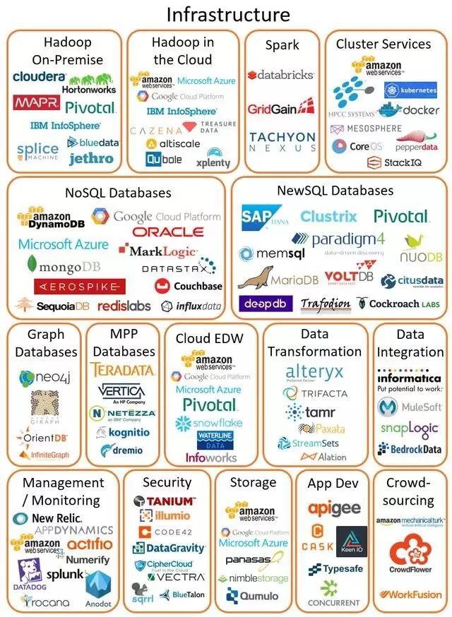
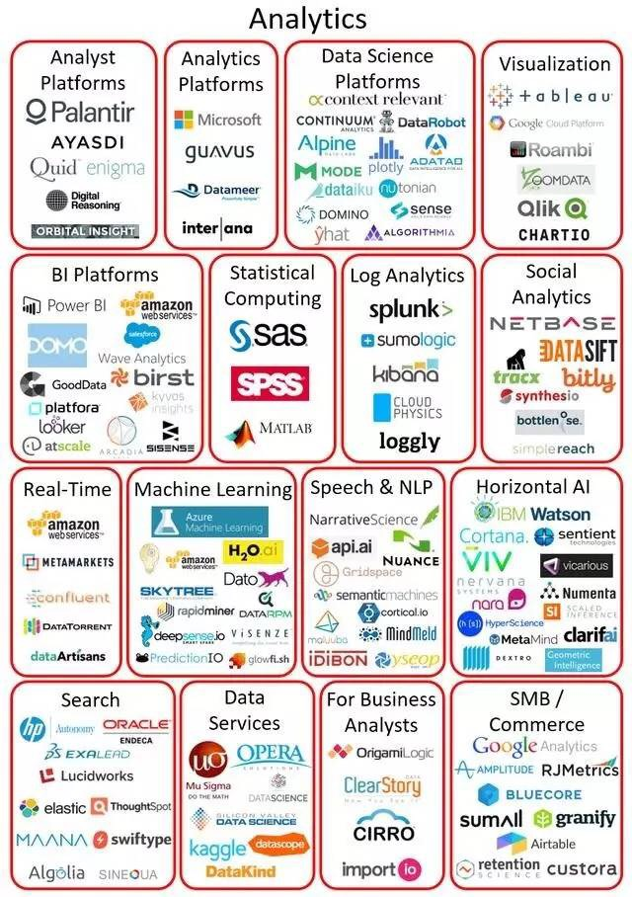
Big Data Technologies

Slide 42
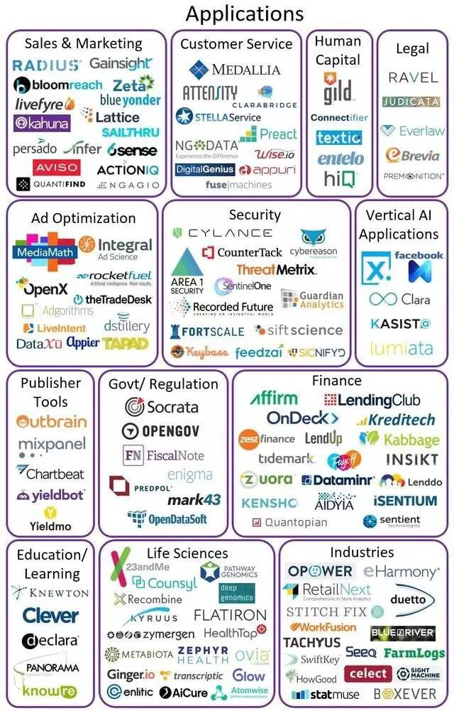
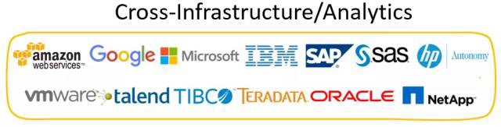
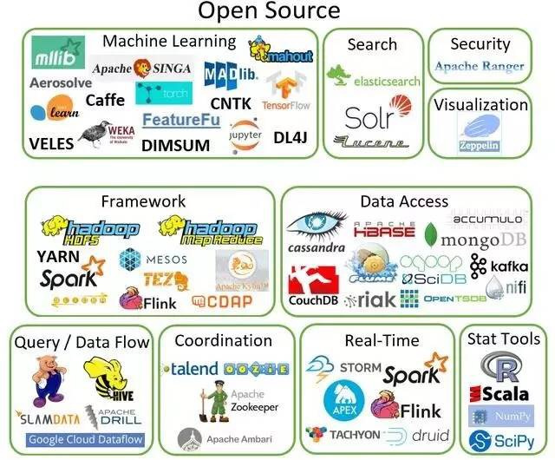
Big Data Technologies (cont'd)

Slide 43
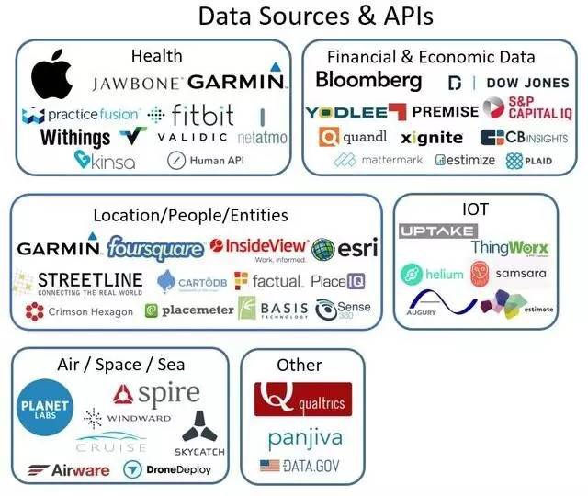
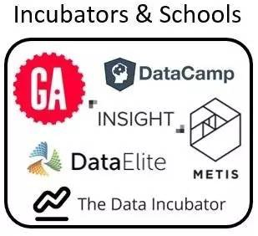
Big Data Technologies (cont'd)

Slide 44
Outline
The Overview of the Course
The Definition of Big Data
Characteristics/Challenges of Big Data
Topics of Big Data
Applications of Big Data

Slide 45
Applications of Big Data
Hurricane moving path predication
Protein-to-protein interaction networks
Satellite imagery, mobile station, distributed sensor networks, geographical plotting
Web data
Digital health care
Intelligent transportation
45
Volcano monitoring

Slide 46
Reading Materials
[1] Big Data https://en.wikipedia.org/wiki/Big_data
[2] Challenges and Opportunities with Big Data -- A community white paper developed by leading researchers across the United States, https://www.purdue.edu/discoverypark/cyber/assets/pdfs/BigDataWhitePaper.pdf
[3] Apache Hadoop,
https://en.wikipedia.org/wiki/Apache_Hadoop
[4] Amazon AWS, https://aws.amazon.com/

