Slide 1
CS 63016 & CS 73016
Big Data Analytics
Chapter 2: Indexing Big Data (1)
Xiang Lian
Department of Computer Science
Kent State University
Email: xlian@kent.edu
Homepage: http://www.cs.kent.edu/~xlian/
Notes:
The slides of this Big Data course used some public slides/materials on the Web. I would like to acknowledge these resources, and please let me know if I failed to cite them.

Slide 2
Objectives
In this chapter, you will:
  Get familiar with many indexing mechanisms:
    B⁺-tree, extensible hashing, bitmap
    Grid file
    Z-order, Hilbert curve
    Bitmap index
    Quadtree
    k-d tree
    R-tree, R⁺-tree, R*-tree
    SS-tree, SR-tree
    X-tree
    M-tree
    Embedding-based index
    Inverted index
    Local sensitive hashing
  Similarity search over indexes
  Distributed indexes

Slide 3
Outline
Introduction
Indexing Mechanisms
Similarity Search Over Indexes
Indexing for High-Dimensional Data
Permutation-Based Indexing

Slide 4
Introduction
In real applications, we usually collect data of large scale
  Relational tables with millions of records (tuples)
  Sensor networks with thousands of sensor nodes, each collecting data such as temperature, humidity, etc. over time
  In mobile computing or location-based services, millions of mobile users move around in the city
  …
Due to the large scale of data, it is very necessary to build indexes for accelerating the search over large data sets

Slide 5
The Reason for Indexes
Consider a relational table with two attributes, PID (person ID) and Age
Find those people with age between 20 and 30
  Two records: {(PID: 1, Age: 25), (PID: 2, Age: 31)}
  How about 10 records?
  100 records?
  1,000 records?
  1,000,000 records?
The search efficiency is not scalable for large data sets!

Slide 6
The Reason for Indexes (cont'd)
Consider a relational table with two attributes, PID (person ID) and Age
Find those people with age between 20 and 30
  1,000,000 records?
Usually, the size of the answer set is much smaller than the total data size (e.g., 1,000,000)!
Index is often used to reduce the search space, that is, access only a small number of records (<<1,000,000) before we obtain answers

Slide 7
Outline
Introduction
Indexing Mechanisms
Similarity Search Over Indexes
Indexing for High-Dimensional Data
Permutation-Based Indexing

Slide 8
Relational Tables
Set of rows, or tuples (no duplicates)
Each row describes a different entity
Each column states a particular fact about each entity
  Each column has an associated domain
    Domain of Status = {fresh, soph, junior, senior}
ID Name Address Status
1111 John 123 Main fresh
2222 Mary 321 Oak soph
1234 Bob 444 Pine soph
9999 Joan 777 Grand senior
Student Table

Slide 9
ER Model
Entity-Relationship (ER) Model
  Entity
    Student, Course
  Relationship
    enroll
ID Name Address Status
1111 John 123 Main fresh
2222 Mary 321 Oak soph
1234 Bob 444 Pine soph
9999 Joan 777 Grand senior
Student Table
Student
enroll
Course

Slide 10
Queries on Relational Tables
SQL – database language
  FROM clause specifies the data source
  WHERE clause gives the conditions of tuples in the query result
  SELECT clause retains listed columns
SELECT Name
FROM Student
WHERE Status = ‘soph’ and ID >1000 and ID<2000
equality query
range query

Slide 11
Example: Enroll Table
ID CrsCode Semester GPA
666666 MGT123 F1994 4.0
123456 CS305 S1996 4.0 page 0
987654 CS305 F1995 2.0
717171 CS315 S1997 4.0
666666 EE101 S1998 3.0 page 1
765432 MAT123 S1996 2.0
515151 EE101 F1995 3.0
234567 CS305 S1999 4.0
page 2
878787 MGT123 S1996 3.0
Heap File
(random order)

Slide 12
Example: Enroll Table (cont'd)
ID CrsCode Semester GPA
111111 MGT123 F1994 4.0
111111 CS305 S1996 4.0 page 0
123456 CS305 F1995 2.0
123456 CS315 S1997 4.0
123456 EE101 S1998 3.0 page 1
232323 MAT123 S1996 2.0
234567 EE101 F1995 3.0
234567 CS305 S1999 4.0
page 2
313131 MGT123 S1996 3.0
Sorted File
(sorted order)

Slide 13
Indexing for Relational Tables
In relational databases, we can build indexes over one or multiple attributes in relational tables
S
Search key
value
Location Mechanism
Location mechanism
facilitates finding
index entry for S
S
Index entries
Once index entry is found, the row can be directly accessed
S, …….

Slide 14
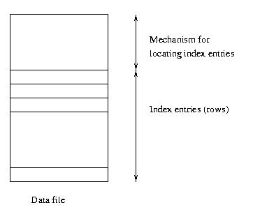
Indexing for Relational Tables (cont'd)
Integrated storage structure vs. separate storage structure
Contains table
and (main) index
Location mechanism
Storage
structure
for table
Index file
Index entries

Slide 15
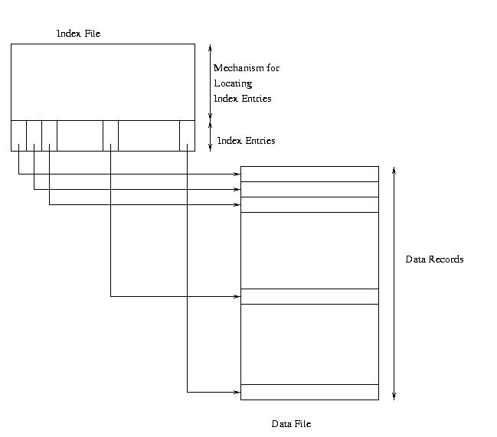
Clustered Secondary Index
1
2
3
8
10
1
2
3
8
10

Slide 16
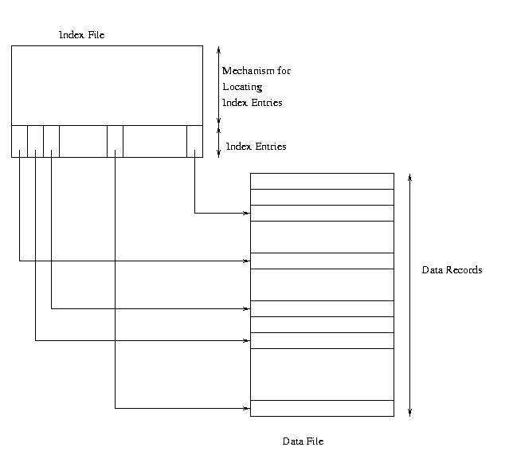
Unclustered Secondary Index
1
2
3
8
10
10
1
3
2
8

Slide 17
Sparse vs. Dense Index
Dense index: has index entry for each data record
  Unclustered index must be dense
  Clustered index need not be dense
Sparse index: has index entry for each page of data file
  Sparse index must be clustered

Slide 18
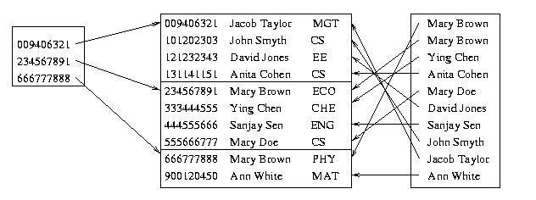
Sparse Vs. Dense Index
Id Name Dept
Sparse, clustered
index sorted on Id
Data file sorted on Id
Dense, unclustered index sorted on Name

Slide 19
Indexes for Relational Tables
Index Sequential Access Method (ISAM)
B⁺-tree
Hashing

Slide 20
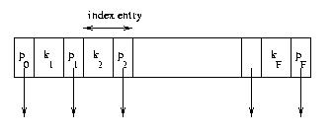
Index Sequential Access Method (ISAM)
Generally an integrated storage structure
  Clustered, index entries contain rows
Separator entry = (k_{i} , p_{i}); k_{i} is a search key value; p_{i} is a pointer to a lower level page
k_{i} separates set of search key values in the two subtrees pointed at by p_{i-1} and p_{i.}

Slide 21
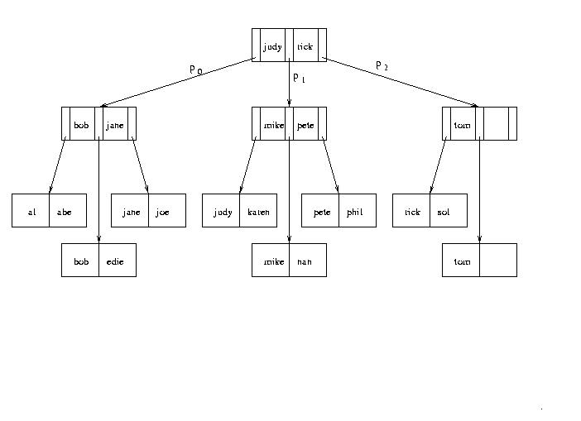
Example: Index Sequential Access Method
Location
mechanism

Slide 22
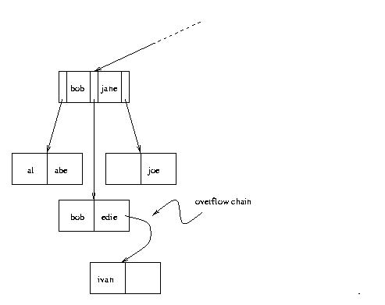
Overflow Chains
- Contents of leaf pages change
– Row deletion yields empty slot
in leaf page
– Row insertion can result in
overflow leaf page and
ultimately overflow chain
– Chains can be long, unsorted,
scattered on disk
– Thus ISAM can be inefficient
if table is dynamic

Slide 23
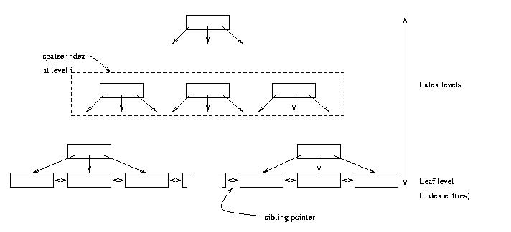
B⁺-Tree Structure
– Leaf level is a (sorted) linked list of index entries
– Sibling pointers support range searches in spite of
allocation and deallocation of leaf pages (but leaf
pages might not be physically contiguous on disk)

Slide 24
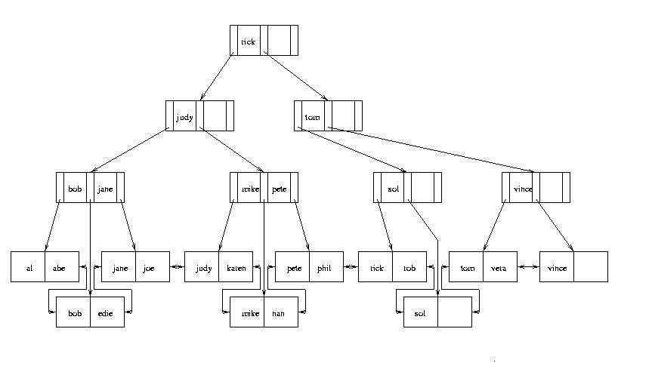
Example: B⁺-Tree
Search "pete"

Slide 25
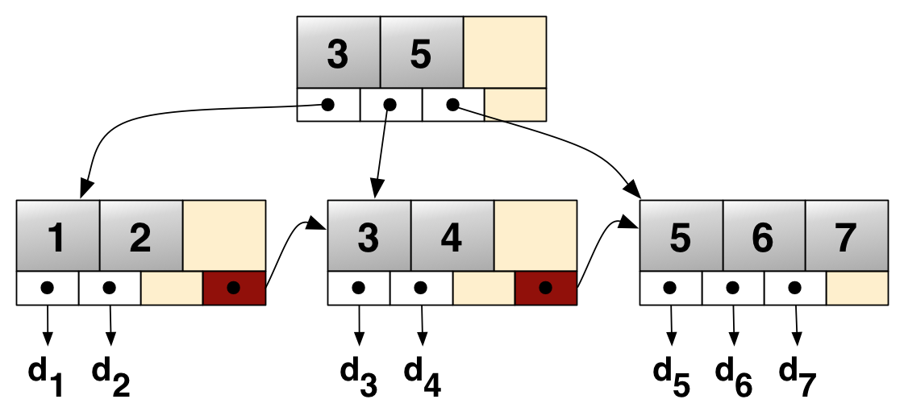
Example: B⁺-Tree (cont'd)
https://en.wikipedia.org/wiki/B%2B_tree

Slide 26
Insertion and Deletion in B⁺ Tree
Structure of tree changes to handle row insertion and deletion – no overflow chains
Tree remains balanced: all paths from root to index entries have same length
Algorithm guarantees that the number of separator entries in an index page is between Φ/2 and Φ
  Hence the maximum search cost is log_{Φ/2}Q + 1 (with ISAM search cost depends on length of overflow chain)

Slide 27
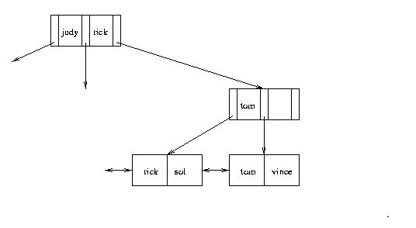
Handling Insertions - Example
- Insert “vince”
Φ = 2

Slide 28
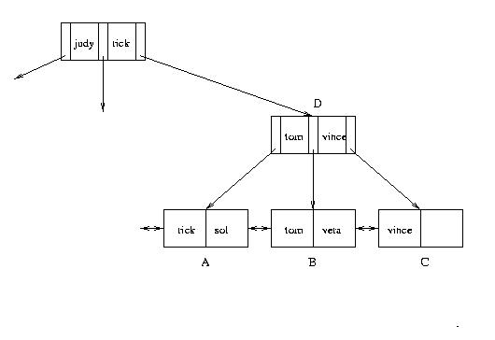
Handling Insertions (cont’d)
– Insert “vera”: Since there is no room in leaf page:
1. Create new leaf page, C
2. Split index entries between B and C (but maintain
sorted order)
3. Add separator entry at parent level
Φ = 2

Slide 29
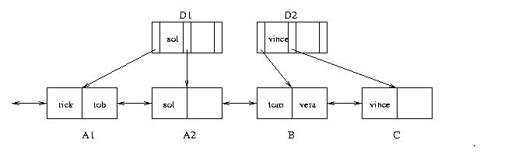
Handling Insertions (con’t)
– Insert “rob”. Since there is no room in leaf page A:
1. Split A into A1 and A2 and divide index entries
between the two (but maintain sorted order)
2. Split D into D1 and D2 to make room for additional
pointer
3. Three separators are needed: “sol”, “tom” and “vince”
Φ = 2

Slide 30
Handling Insertions (cont’d)
– When splitting a separator page, push a separator up
– Repeat process at next level
– Height of tree increases by one
Φ = 2

Slide 31
Handling Deletions
Deletion can cause page to have fewer than Φ/2 entries
  Entries can be redistributed over adjacent pages to maintain minimum occupancy requirement
  Ultimately, adjacent pages must be merged, and if merge propagates up the tree, height might be reduced
  See book
In practice, tables generally grow, and merge algorithm is often not implemented
  Reconstruct tree to compact it

Slide 32
Hash Index
Index entries partitioned into buckets in accordance with a hash function, h(v), where v ranges over search key values
Each bucket is identified by an address, a
Bucket at address a contains all index entries with search key v such that h(v) = a
Each bucket is stored in a page (with possible overflow chain)
If index entries contain rows, set of buckets forms an integrated storage structure; else set of buckets forms an (unclustered) secondary index

Slide 33
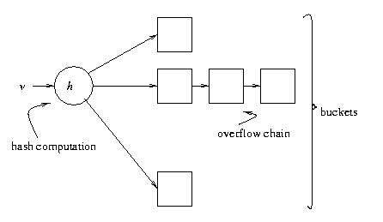
Equality Search with Hash Index
split bucket, instead of using an overflow chain
Location
mechanism
Given v:
1. Compute h(v)
2. Fetch bucket at h(v)
3. Search bucket
Cost = number of pages
in bucket (cheaper than
B⁺ tree, if no overflow
chains)

Slide 34
Extensible Hashing
Example:
  family of hash functions based on h:
    h_{k}(v) = h(v) mod 2^{k} (use the last k bits of h(v))
    At any given time a unique hash, h_{k} , is used depending on the number of times buckets have been split

Slide 35
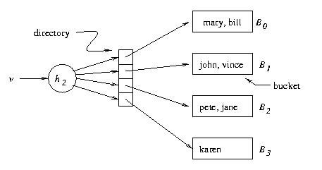
Example: Extendable Hashing
k = 2
Page capacity = 2
v h(v)
pete 11010
mary 00000
jane 11110
bill 00000
john 01001
vince 10101
karen 10111
00
01
10
11
Location
mechanism
Extendable hashing uses a directory (level of indirection) to accommodate family of hash functions
Suppose next action is to insert sol, where h(sol) = 10001.
Problem: This causes overflow in B₁

Slide 36
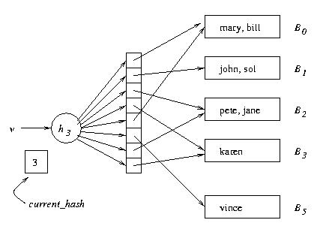
Example: Extendable Hashing (cont’d)
Solution:
1. Switch to h₃
2. Concatenate copy of old
directory to new directory
3. Split overflowed bucket, B,
into B and B′, dividing
entries in B between the
two using h₃
4. Pointer to B in directory
copy replaced by pointer
to B′
k = 3
Page capacity = 2
000
001
010
011
100
101
110
111
v h(v)
pete 11010
mary 00000
jane 11110
bill 00000
john 01001
vince 10101
karen 10111
sol 10001
current_hash identifies current hash function

Slide 37
Example: Extendable Hashing (cont’d)
k = 3
Page capacity = 2
000
001
010
Next action: Insert judy,
where h(judy) = 00110
B₂ overflows, but directory
need not be extended
011
100
101
110
111
Problem: When B_{i} overflows, we need a mechanism for deciding
whether the directory has to be doubled
Solution: bucket_level[i] records the number of times B_{i} has been
split. If current_hash > bucket_level[i], do not enlarge directory

Slide 38
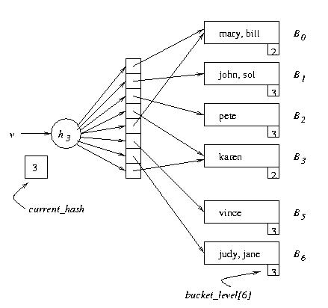
Example: Extendable Hashing (cont’d)
k = 3
Page capacity = 2
v h(v)
pete 11010
mary 00000
jane 11110
bill 00000
john 01001
vince 10101
karen 10111
sol 10001
judy 00110

Slide 39

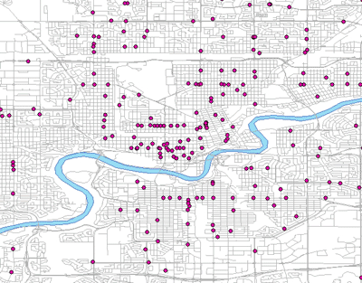
Spatial Data
Points of Interests (POIs)
https://www.mcgill.ca/library/find/maps/epoi
Notes:
https://www.mcgill.ca/library/find/maps/epoi

Slide 40
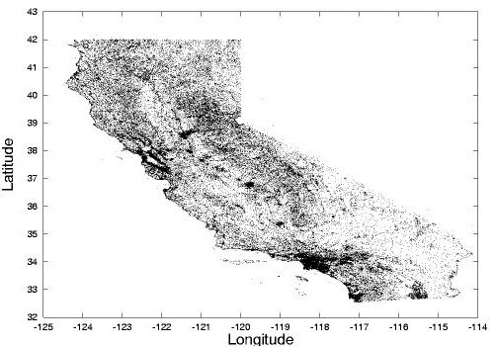
Grid File
Grid file – a spatial index
In the case of 2-dimensional spatial data
P. Rigaux, M. Scholl, and A. Voisard. Spatial Databases - with application to GIS. Morgan Kaufmann, San Francisco, 2002.
Notes:
https://www.cs.utah.edu/~lifeifei/SpatialDataset.htm
Rigaux, P., Scholl, M., and Voisard, A. 2002. Spatial Databases - with application to GIS. Morgan Kaufmann, San Francisco, 410pp.

Slide 41
Grid File (cont'd)
Fixed grid
  Partition a d-dimensional data space into cells of equal size
  Operations
    Insertion
    Point query
    Window query
point query
query range
Notes:
P. Rigaux, M. Scholl, and A. Voisard. Spatial Databases - with application to GIS. Morgan Kaufmann, San Francisco, 2002.

Slide 42
Grid Construction without Overflow Pages
(a)
(b)
Page Capacity = 4
(c)
(d)
Notes:
P. Rigaux, M. Scholl, and A. Voisard. Spatial Databases - with application to GIS. Morgan Kaufmann, San Francisco, 2002.

Slide 43
Fixed Grid for Rectangular Objects
contains
Rectangle
intersects
Cell
is contained
Notes:
P. Rigaux, M. Scholl, and A. Voisard. Spatial Databases - with application to GIS. Morgan Kaufmann, San Francisco, 2002.

Slide 44
Grid File Implementation
Y
grid array
X
2-dimensional grid directory
  Grid array: a 2-dimensional array (disk-based), each element with a pointer, p_{i}, pointing to a bucket
  Linear scales: two vectors (memory-based 1-dimensional array), X and Y, indicating the range of cells on the two dimensions
Example:
  Age vector X = [0, 20, 40, 60, 80] and last name vector Y = [A, H, O, U, Z]
  Search over grid with query (35, Lian)
  Exact match: at most 2 I/Os
  Range search: (1) use linear scales to obtain relevant cells; (2) access the grid array to obtain bucket addresses; and (3) retrieve data from buckets
Notes:
http://infolab.usc.edu/csci587/Fall2016/slides/session2-spatial-indexes-no-rtree.pdf

Slide 45
Grid Related Research Topics
Grid Indexes
  For fixed grid, how to set the size of cells?
  Fixed grid vs. variable grid?
  Space partitioning vs. data partitioning?
  …

Slide 46
Space-Filling Curves
A space-filling curve defines a total order on the cells (or pixels) of a 2D grid
  Converting 2-dimensional points/cells to a 1-dimensional value
  The order partially preserves the proximity
  Two close cells in the data space are more likely to be close in the total order
Z-order
Hilbert curves

Slide 47
Space-Filling Curves (cont'd)
Z-order or Z-ordering
Hilbert curve
Notes:
P. Rigaux, M. Scholl, and A. Voisard. Spatial Databases - with application to GIS. Morgan Kaufmann, San Francisco, 2002.

Slide 48
Z-Ordering
Any object in the cell/pixel has an encoding:
01 10
11
10
01
00
00
01
10
11

Slide 49
Bit-Shuffling
Any object in the cell/pixel has an encoding:
01 10
11
x y
01 10
10
z = (0 1 1 0)₂ = 6
01
00
00
01
10
11
Notes:
http://www.cs.cmu.edu/~christos/courses/721.S03/LECTURES-PDF/0230-z-ordering.PDF

Slide 50
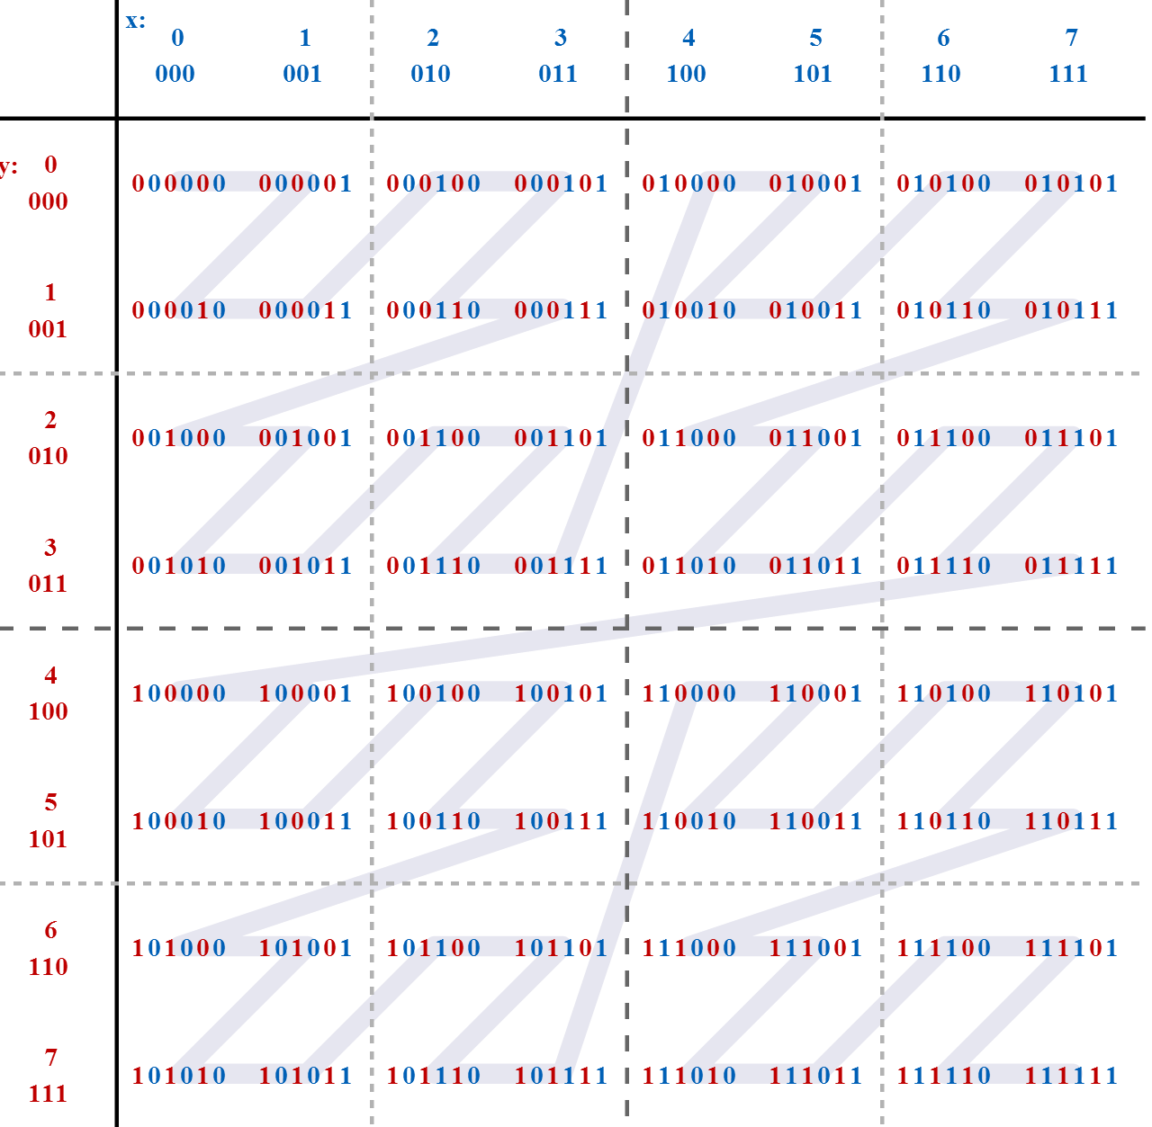
Bit-Shuffling (cont'd)
Interleaving the binary coordinate values yields binary z-values
Notes:
https://en.wikipedia.org/wiki/Z-order_curve#/media/File:Z-curve.svg

Slide 51
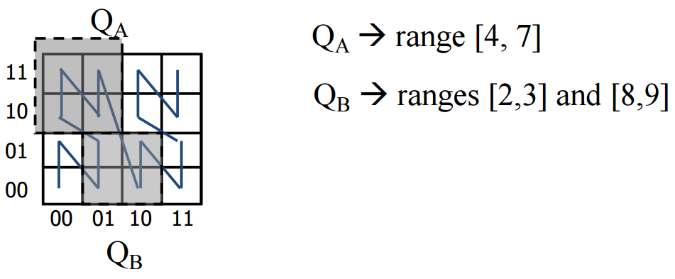
Indexing Over Z-Values
Given a number of objects o with 2D coordinates (o.x, o.y)
  Convert each object to a z-value, o.z
  Use a B⁺-tree index to organize z-values of all objects
A range query in a 2D data space can be mapped to a set of intervals for the converted z-values
Notes:
http://infolab.usc.edu/csci587/Fall2016/slides/session2-spatial-indexes-no-rtree.pdf

Slide 52
Hilbert Curve
Hilbert Curve
  Objects that are close in 1D space are also close in 2D space
  We want objects that are close in 2D space to be close in 1D space
Z-order has some "jumps", whereas Hilbert curve does not
Z-order
Hilbert curve

Slide 53


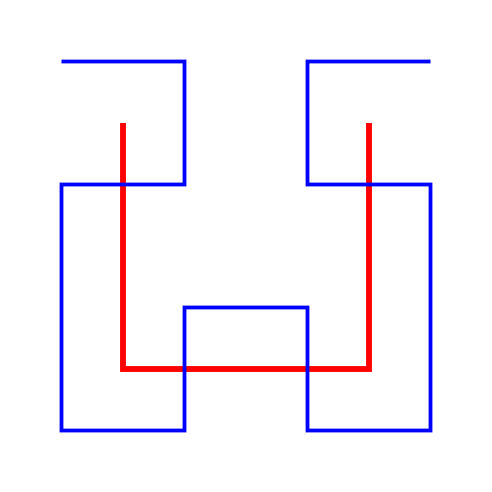
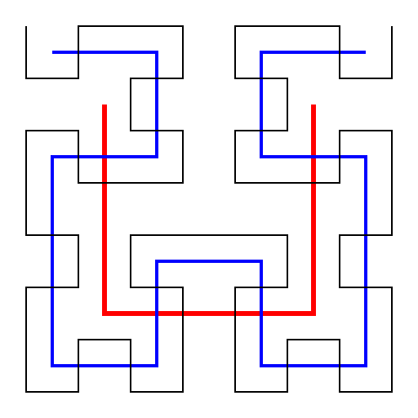
Hilbert Curve (cont'd)
Recursive Definition
  H_{i} (order-i) Hilbert curve for 2^{i}×2^{i} array
  Given the location (2D coordinates) of a cell, we can obtain a Hilbert value; vice versa
0
1
14
15
0
3
3
2
13
12
4
7
8
11
1
2
5
6
9
10
H₁
H₂
H₃
…
Notes:
H. V. Jagadish: Linear Clustering of Objects with Multiple Atributes. ACM SIGMOD Conference 1990: 332-342
https://en.wikipedia.org/wiki/Hilbert_curve

Slide 54
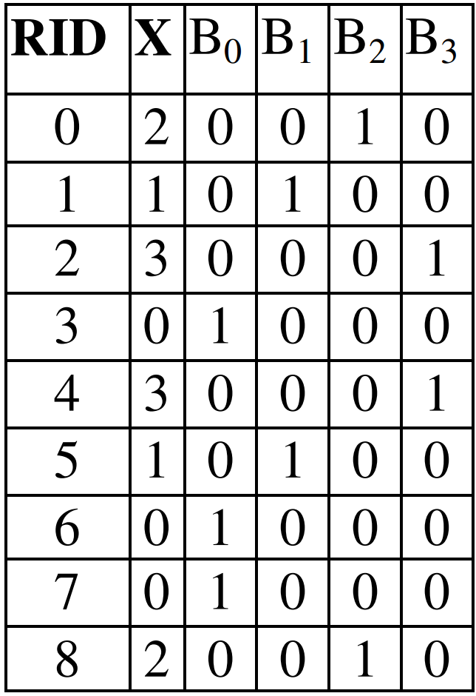
Bitmap Index
Bitmap index can be used in data warehouses
  Reduced response time for large classes of ad hoc queries
  Reduced storage requirements
    Bit representations
    For example, if the domain of an integer attribute is {0, 1, 2, 3}, then bitmap needs 4 bits to represent, instead of 4 bytes (i.e., 32 bits)
  Good performance with a relatively small number of CPUs or a small amount of memory
    Bitwise logical operations: AND, OR, NOT
    E.g., range query [1, 2]
      B₁ OR B₂
integers
bits
Bitmaps B₀~B₃ for attribute X
Notes:
https://en.wikipedia.org/wiki/Bitmap_index
https://docs.oracle.com/cd/B28359_01/server.111/b28313/indexes.htm#CIHGAFFF
http://www.vldb.org/pvldb/vol8/p1382-nagarkar.pdf
https://sdm.lbl.gov/~kewu/ps/LBNL-62756.pdf

Slide 55
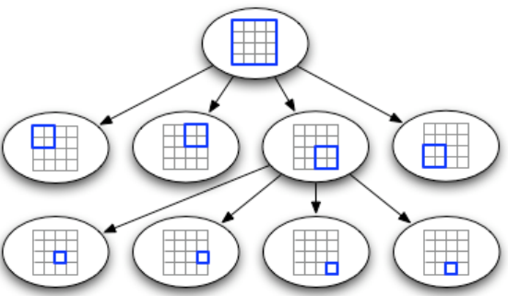
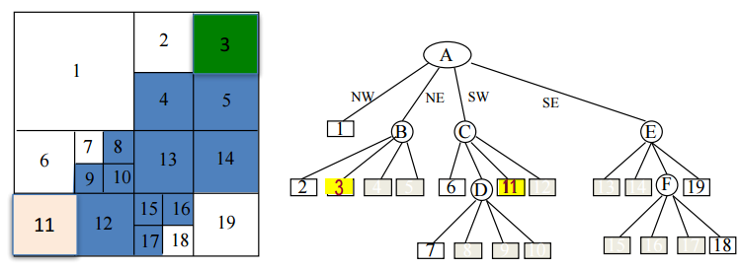
Quad Trees
A space-partitioning index
root A
1
2
3
B
4
5
6
D
13
14
C
E
11
12
12
F
19
Notes:
http://infolab.usc.edu/csci587/Fall2016/slides/session2-spatial-indexes-no-rtree.pdf
Raphael Finkel and J.L. Bentley (1974). "Quad Trees: A Data Structure for Retrieval on Composite Keys". Acta Informatica 4 (1): 1–9. doi:10.1007/BF00288933.

Slide 56
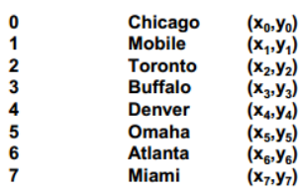
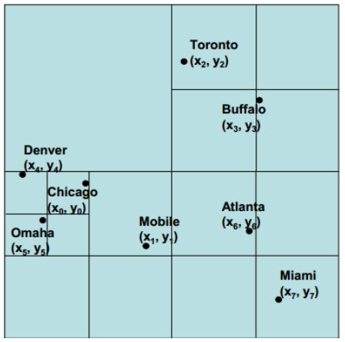
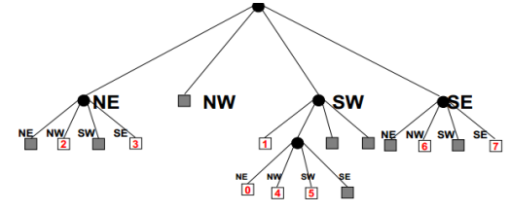
Another Example of Quad Trees
Notes:
Damn Cool Algorithms: Spatial indexing with Quadtrees and Hilbert Curves. http://blog.notdot. net/2009/11/Damn-Cool-Algorithms-Spatial-indexing-with-Quadtrees-and-Hilbert-Curves
http://web.eecs.utk.edu/~cphillip/cs594_spring2014/quadtree-Allan.pdf

Slide 57
Reading Materials
(Grid file) P. Rigaux, M. Scholl, and A. Voisard. Spatial Databases - with application to GIS. Morgan Kaufmann, San Francisco, 2002. http://bsolano.com/ecci/claroline/backends/download.php/TGlicm9zX2RlX3RleHRvL1NwYXRpYWxEQnNXaXRoQXBwbGljYXRpb25Ub0dJUy5wZGY%3D?cidReset=true&cidReq=CI1314
(Bitmap index) P. Nagarkar, K. S. Candan, and A. Bhat. Compressed Spatial Hierarchical Bitmap (cSHB) Indexes for Efficiently Processing Spatial Range Query Workloads. In PVLDB, 8(12), pages 1382-1393, 2015. http://dl.acm.org/citation.cfm?id=2824038
(Quadtree) H. Samet and R. E. Webber. Storing a collection of polygons using quadtrees. In ACM Trans. Graph, 1985. https://pdfs.semanticscholar.org/65ee/4429b5509173f12309539e809ac533e84690.pdf
H. Samet. Foundations of Multidimensional and Metric Data Structures. The Morgan Kaufmann Series in Computer Graphics and Geometric Modeling, ISBN: 0123694469, 2005. http://dl.acm.org/citation.cfm?id=1076819

Slide 58
Exercises
Install Apache Hadoop on your machine
  http://hadoop.apache.org/
  You can get virtual box from: https://kent.onthehub.com/
Read tutorials of Amazon AWS
  https://aws.amazon.com/

