Slide 1
CS 63016 & CS 73016
Big Data Analytics
Chapter 4: MapReduce
Xiang Lian
Department of Computer Science
Kent State University
Email: xlian@kent.edu
Homepage: http://www.cs.kent.edu/~xlian/
Notes:
The slides of this Big Data course used some public slides/materials on the Web. I would like to acknowledge these resources, and please let me know if I failed to cite them.

Slide 2
Objectives
In this chapter, you will:
  Learn the background of MapReduce
  Understand the MapReduce programming model
  Know the properties of MapReduce
  Get familiar with the idea of MapReduce with a "Hello world!" example
  Get to know big data platforms
    Google File Systems
    Hadoop
    Amazon Web Service (AWS)
Notes:
grid.hust.edu.cn/xhshi/course/files/talk-MapReduce.ppt
From Jimmy Lin’s slides (at UMD) http://www.cs.kent.edu/~jin/BigData/
https://research.google.com/archive/mapreduce-osdi04-slides/index.html

Slide 3


Outline
Introduction
Challenges
Background of MapReduce
MapReduce
Characteristics of MapReduce
Google File Systems
Hadoop
Amazon Web Services

Slide 4
Introduction
Lots of demands for large-scale data processing
  Big spatial data
  Big Web data
  Big stream data
  Big graph data
  …
Applications
  Location-based services
  Semantic Web
  Social media studies
  Transportation systems
  Sensor data analysis
  …

Slide 5
Typical Big Data Problems
Iterate over a large number of records
Extract something of interest from each
Shuffle and sort intermediate results
Aggregate intermediate results
Generate final output

Slide 6
Typical Big Data Problems (cont'd)
The problem
  Diverse input format (data diversity and heterogeneity)
  Large Scale: Terabytes, Petabytes
  Parallelization

Slide 7
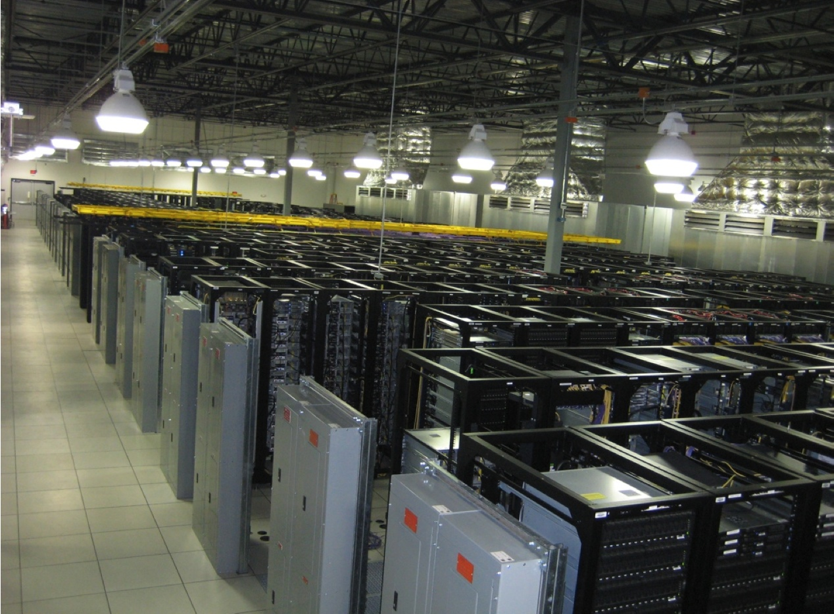
How to Leverage a Number of Cheap Off-the-Shelf Computers?
Image from http://wiki.apache.org/hadoop-data/attachments/HadoopPresentations/attachments/aw-apachecon-eu-2009.pdf

Slide 8
Divide and Conquer
“Work”
Partition
w₁
w₂
w₃
“worker”
“worker”
“worker”
r₁
r₂
r₃
Combine
“Result”

Slide 9
Distributed Grep
grep is a command-line utility for searching plain-text data sets for lines matching a regular expression.
Split data
grep
matches
very
big
data
Split data
grep
matches
Split data
grep
matches
All
matches
cat
Split data
grep
matches

Slide 10
Distributed Word Count
Word count is to count the number of words in documents
Split data
count
count
very
big
data
Split data
count
count
Split data
count
count
merge
merged
count
Split data
count
count

Slide 11
Parallelization Challenges
How do we assign work units to workers?
What if we have more work units than workers?
What if workers need to share partial results?
How do we aggregate partial results?
How do we know all the workers have finished?
What if workers die?
What is the common theme of all of these problems?

Slide 12
Common Theme?
Parallelization problems arise from:
  Communication between workers (e.g., to exchange state)
  Access to shared resources (e.g., data)
Thus, we need a synchronization mechanism

Slide 13
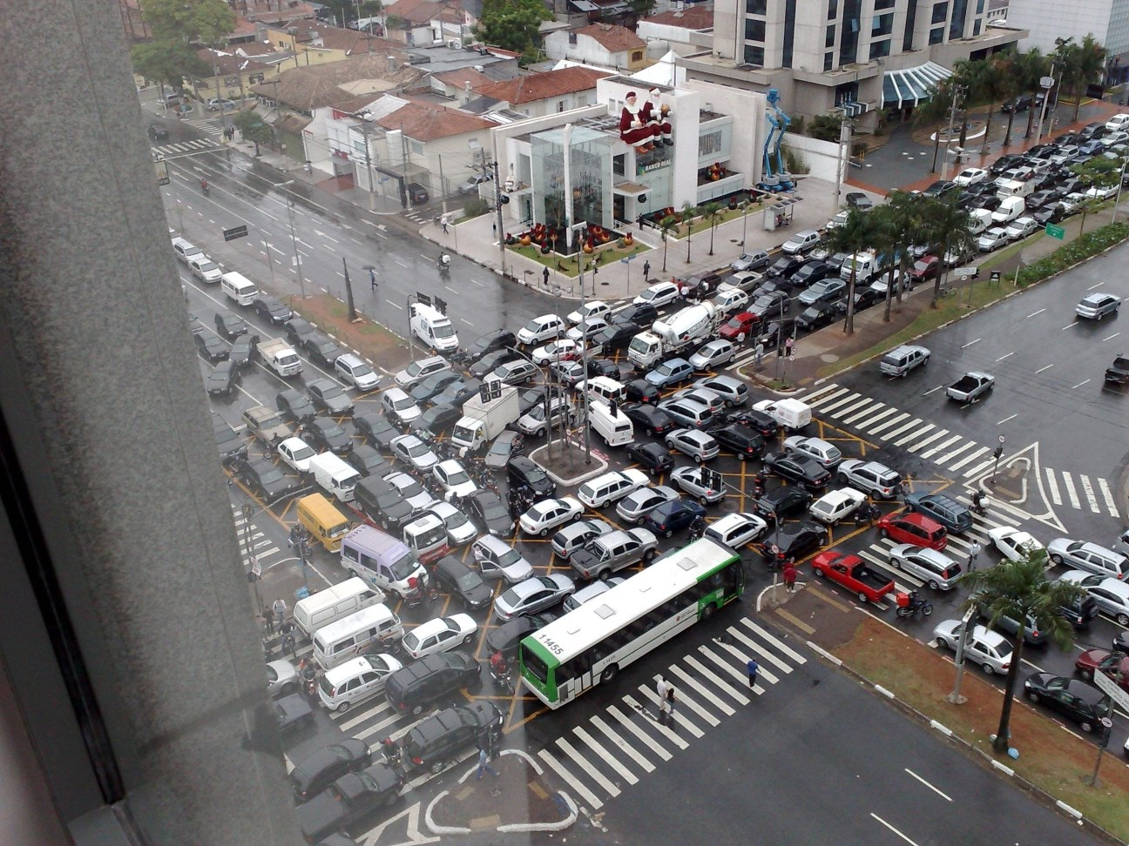
Source: Ricardo Guimarães Herrmann

Slide 14
Managing Multiple Workers
Difficult because
  We don’t know the order in which workers run
  We don’t know when workers interrupt each other
  We don’t know the order in which workers access shared data
Thus, we need:
  Semaphores (lock, unlock)
  Conditional variables (wait, notify, broadcast)
  Barriers
Still, lots of problems:
  Deadlock, livelock, race conditions...
  Dining philosophers, sleeping barbers, cigarette smokers...
Moral of the story: be careful!

Slide 15
Current Tools
Shared Memory
Message Passing
Programming models
  Shared memory (pthreads)
  Message passing (MPI)
Design Patterns
  Master-slaves
  Producer-consumer flows
  Shared work queues
Memory
P₁
P₂
P₃
P₄
P₅
P₁
P₂
P₃
P₄
P₅
producer
consumer
master
work queue
slaves
producer
consumer

Slide 16
Concurrency Challenge!
Concurrency is difficult to reason about
Concurrency is even more difficult to reason about
  At the scale of datacenters (even across datacenters)
  In the presence of failures
  In terms of multiple interacting services
Not to mention debugging…
The reality:
  Lots of one-off solutions, custom code
  Write you own dedicated library, then program with it
  Burden on the programmer to explicitly manage everything

Slide 17
What's the Point?
It's all about the right level of abstraction
  The von Neumann architecture has served us well, but is no longer appropriate for the multi-core/cluster environment
Hide system-level details from the developers
  No more race conditions, lock contention, etc.
Separating the what from how
  Developer specifies the computation that needs to be performed
  Execution framework (“runtime”) handles actual execution

Slide 18
Key Ideas
Scale "out", not "up"
  Limits of SMP and large shared-memory machines
Move processing to the data
  Cluster have limited bandwidth
Process data sequentially, avoid random access
  Seeks are expensive, disk throughput is reasonable
Seamless scalability
  From the mythical man-month to the tradable machine-hour

Slide 19
The Datacenter is the Computer!
Image from http://wiki.apache.org/hadoop-data/attachments/HadoopPresentations/attachments/aw-apachecon-eu-2009.pdf

Slide 20
What is MapReduce?
Origin from Google [OSDI’04]
  J. Dean and S. Ghemawat. MapReduce: Simplified Data Processing on Large Clusters. In OSDI, 2004.
  https://research.google.com/archive/mapreduce.html
A simple programming model
For large-scale data processing
  Exploits a large set of commodity computers
  Executes process in a distributed manner
  Offers high availability

Slide 21
Large Scale Data Processing
Many tasks: process lots of data to produce other data
  Want to use hundreds or thousands of CPUs
  ... but this needs to be easy
MapReduce provides:
  Automatic parallelization and distribution
  Fault-tolerance
  I/O scheduling
  Status and monitoring

Slide 22
Typical Large-Data Problem
Map
Iterate over a large number of records
Extract something of interest from each
Shuffle and sort intermediate results
Aggregate intermediate results
Generate final output
Reduce
Key idea: provide a functional abstraction for these two operations
(Dean and Ghemawat, OSDI 2004)

Slide 23
Map+Reduce
Map:
  Accepts input key/value pair
  Emits intermediate key/value pair
R
E
D
U
C
E
Reduce :
  Accepts intermediate key/value* pair
  Emits output key/value pair
very
big
data
M
A
P
Partitioning
Function
Result

Slide 24
MapReduce – A Programming Model
Input and Output of MapReduce
  each a set of key/value pairs
Programmers specify two functions:
  map (k, v) → [(k’, v’)]
  Processes input key/value pair
  Produces set of intermediate pairs
  reduce (k’, [v’]) → [(k’, v’)]
  Combines all intermediate values for a particular key (i.e., all values with the same key are sent to the same reducer)
  Produces a set of merged output values (usually just one)

Slide 25
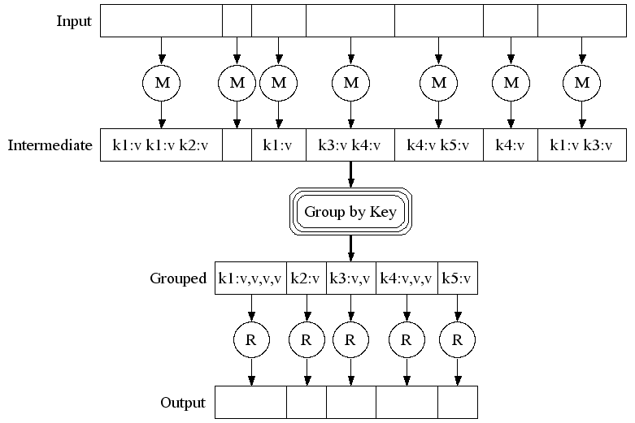
Execution

Slide 26
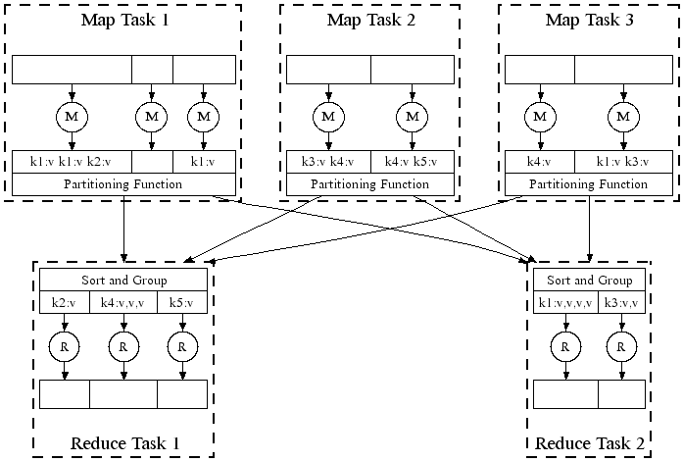
Parallel Execution

Slide 27
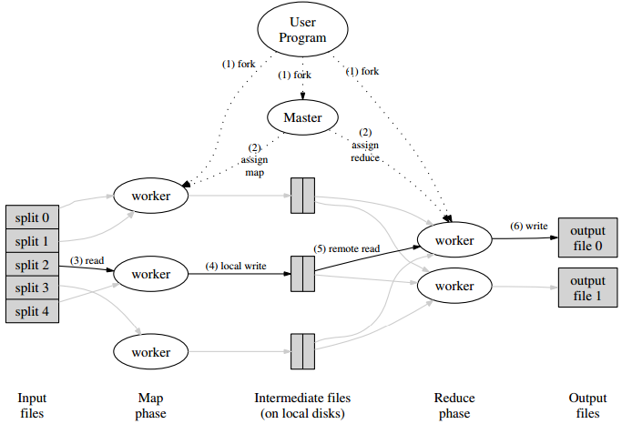

Slide 28
Example of MapReduce (Word Count)
k₁
v₁
k₂
v₂
k₃
v₃
k₄
v₄
k₅
v₅
k₆
v₆
map
map
map
map
a
1
b
2
c
3
c
6
a
5
c
2
b
7
c
8
Shuffle and Sort: aggregate values by keys
a
1
5
b
2
7
c
2
3
6
8
reduce
reduce
reduce
r₁
s₁
r₂
s₂
r₃
s₃

Slide 29
Word Count Execution
Input
Map
Shuffle & Sort
Reduce
Output
the, 1
brown, 1
fox, 1
the quick
brown fox
Map
brown, 2
fox, 2
how, 1
now, 1
the, 3
Reduce
the, 1
fox, 1
the, 1
the fox ate
the mouse
Map
quick, 1
how, 1
now, 1
brown, 1
ate, 1
mouse, 1
ate, 1
cow, 1
mouse, 1
quick, 1
Reduce
how now
brown cow
Map
cow, 1

Slide 30
"Hello World" Example: Count Word Occurrences
map (String input_key, String input_value):
// input_key: document name
// input_value: document contents
for each word w in input_value:
EmitIntermediate(w, "1");
reduce (String output_key, Iterator intermediate_values):
// output_key: a word
// output_values: a list of counts
int result = 0;
for each v in intermediate_values:
result += ParseInt(v);
Emit(AsString(result));

Slide 31
MapReduce – A Programming Model (cont'd)
Programmers specify two functions:
  map (k, v) → [(k', v')]
  reduce (k', [v']) → [(k', v')]
The execution framework handles everything else…
What’s "everything else"?

Slide 32
MapReduce "Runtime"
Handles scheduling
  Assigns workers to map and reduce tasks
Handles "data distribution"
  Moves processes to data
Handles synchronization
  Gathers, sorts, and shuffles intermediate data
Handles errors and faults
  Detects worker failures and restarts
Everything happens on top of a distributed FS (later)

Slide 33
MapReduce
Programmers specify two functions:
  map (k, v) → [(k', v')]
  reduce (k', [v']) → [(k', v')]
  All values with the same key are reduced together
The execution framework handles everything else…
Not quite…usually, programmers also specify:
  partition (k', number of partitions) → partition for k'
  Often a simple hash of the key, e.g., hash(k') mod n
  Divides up key space for parallel reduce operations
  combine (k', [v']) → [(k', v")]
  Mini-reducers that run in memory after the map phase
  Used as an optimization to reduce network traffic

Slide 34
k₁
v₁
k₂
v₂
k₃
v₃
k₄
v₄
k₅
v₅
k₆
v₆
map
map
map
map
a
1
b
2
c
3
c
6
a
5
c
2
b
7
c
8
combine
combine
combine
combine
a
1
b
2
c
9
a
5
c
2
b
7
c
8
partition
partition
partition
partition
Shuffle and Sort: aggregate values by keys
a
1
5
b
2
7
c
c
2
2
9
3
8
6
8
reduce
reduce
reduce
r₁
s₁
r₂
s₂
r₃
s₃

Slide 35
Google File System (GFS)

Slide 36
Architecture Overview
Master node
user
Job tracker
Slave node 1
Slave node 2
Slave node N
Task tracker
Task tracker
Task tracker
Workers
Workers
Workers

Slide 37
Distributed File System
Don't move data to workers … move workers to the data!
  Store data on the local disks of nodes in the cluster
  Start up the workers on the node that has the data local
Why?
  Not enough RAM to hold all the data in memory
  Disk access is slow, but disk throughput is reasonable
A distributed file system is the answer
  GFS (Google File System) for Google’s MapReduce
  HDFS (Hadoop Distributed File System) for Hadoop

Slide 38
GFS: Assumptions
Commodity hardware over "exotic" hardware
  Scale "out", not "up"
High component failure rates
  Inexpensive commodity components fail all the time
"Modest" number of huge files
  Multi-gigabyte files are common, if not encouraged
Files are write-once, mostly appended to
  Perhaps concurrently
Large streaming reads over random access
  High sustained throughput over low latency
GFS slides adapted from material by (Ghemawat et al., SOSP 2003)

Slide 39
GFS: Underlying Storage System
Goal
  Global view
  Make huge files available in the face of node failures
Master node (meta server)
  Centralized, index all chunks on data servers
Chunk server (data server)
  File is split into contiguous chunks, typically 16-64MB
  Each chunk replicated (usually 2x or 3x)
    Try to keep replicas in different racks

Slide 40
GFS: Design Decisions
Files stored as chunks
  Fixed size (64MB)
Reliability through replication
  Each chunk replicated across 3+ chunk servers
Single master to coordinate access, keep metadata
  Simple centralized management
No data caching
  Little benefit due to large datasets, streaming reads
Simplify the API
  Push some of the issues onto the client (e.g., data layout)
HDFS = GFS clone (same basic ideas)

Slide 41
GFS Architecture
GFS Master
Client
C₀
C₁
C₁
C₀
C₅
…
C₅
Chunkserver 1
Chunkserver 2
Chunkserver N
C₂
C₅
C₃
C₂

Slide 42
Functions in the Model
Map
  Process a key/value pair to generate intermediate key/value pairs
Reduce
  Merge all intermediate values associated with the same key
Partition
  By default : hash(key) mod R
  Well balanced

Slide 43
Fault Tolerance
Fault tolerance handled via re-execution
  Worker failure
    Heartbeat, Workers are periodically pinged by master
      NO response = failed worker
    If the processor of a worker fails, the tasks of that worker are reassigned to another worker
  Master failure
    Master writes periodic checkpoints
    Another master can be started from the last checkpointed state
    If eventually the master dies, the job will be aborted
Robust: lost 1600 of 1800 machines once, but finished fine

Slide 44
Fault Tolerance (cont'd)
Refinement: Redundant Execution
  The problem of “stragglers” (slow workers)
    Other jobs consuming resources on machine
    Bad disks with soft errors transfer data very slowly
    Weird things: processor caches disabled (!!)
  When the computation is almost done, reschedule in-progress tasks
  Whenever either the primary or the backup execution finishes, mark it as completed
Effect: Dramatically shortens job completion time

Slide 45
Usage: MapReduce Jobs Run in August 2004
Number of jobs 29,423
Average job completion time 634 secs
Machine days used 79,186 days
Input data read 3,288 TB
Intermediate data produced 758 TB
Output data written 193 TB
Average worker machines per job 157
Average worker deaths per job 1.2
Average map tasks per job 3,351
Average reduce tasks per job 55
Unique map implementations 395
Unique reduce implementations 269
Unique map/reduce combinations 426

Slide 46
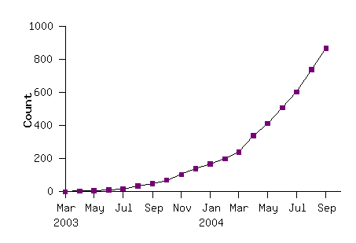
The MapReduce Model is Widely Applicable
MapReduce Programs in Google Source Tree
Examples as follows
distributed grep |  | distributed sort |  | web link-graph reversal
term-vector / host |  | web access log stats |  | inverted index construction
document clustering |  | machine learning |  | statistical machine translation
... |  | ... |  | ...

Slide 47
Applications
String Match, such as grep
Inverted index
Count URL access frequency
Lots of examples in data mining
  Mining frequent itemsets
  Clustering
  …

Slide 48
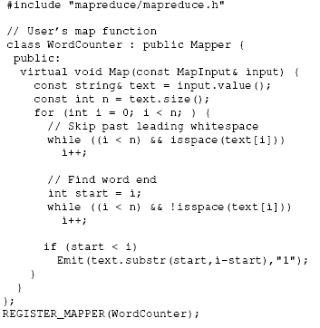
Detailed Example: Word Count (1)
Map

Slide 49
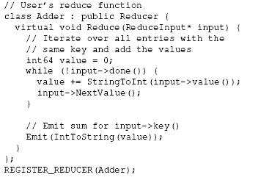
Detailed Example: Word Count (2)
Reduce

Slide 50
Detailed Example: Word Count (3)
main

Slide 51
What is Apache Hadoop?
Two components plus projects
  Open-source data storage
    HDFS (Hadoop Distributed File System)
  Processing API
    MapReduce
    Written in Java
  Projects/libraries
    HBase, Hive, Pig, etc.
Notes:
https://www.lynda.com/Hadoop-tutorials/Introducing-Hadoop/191942/369541-4.html

Slide 52
Google MapReduce vs. Apache Hadoop
Google | Yahoo
MapReduce | Hadoop
GFS | HDFS
Bigtable | HBase
Chubby lock | (nothing yet… but planned)

Slide 53
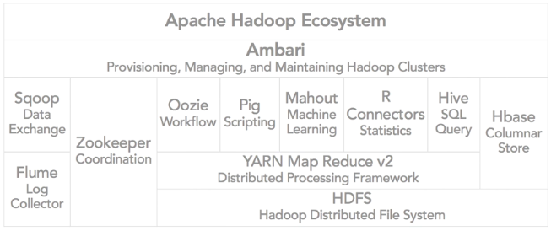
Hadoop Ecosystem
Oozie: workflow or coordination of jobs
Pig: a scripting language
Hive: HQL or the SQL-like query language that is used to query Hbase
YARN: Yet Another Resource Negotiator (Map Reduce Version Two)
Notes:
Oozie: workflow or coordination of jobs
Pig: a scripting language
Hive: HQL or the SQL-like query language that is used to query Hbase
YARN: Yet Another Resource Negotiator (Map Reduce Version Two)

Slide 54
From GFS to HDFS
Terminology differences:
  GFS master = Hadoop namenode
  GFS chunkservers = Hadoop datanodes
Functional differences:
  HDFS performance is (likely) slower
For the most part, we'll use the Hadoop terminology…

Slide 55
HDFS Working Flow
HDFS namenode
Application
(file name, block id)
/foo/bar
HDFS Client
File namespace
block 3df2
(block id, block location)
instructions to datanode
(block id, byte range)
datanode state
HDFS datanode
HDFS datanode
block data
Linux file system
Linux file system
…
…

Slide 56
HDFS Architecture
Cluster Membership
NameNode
1. filename
2. BlckId, DataNodes
Secondary
NameNode
Client
3.Read data
Cluster
Membership
DataNodes
NameNode : Maps a file to a file-id and list of MapNodes
DataNode : Maps a block-id to a physical location on disk
SecondaryNameNode: Periodic merge of transaction log

Slide 57
Distributed File System
Single namespace for entire cluster
Data coherency
  Write-once-read-many (WORM) access model
    Once written, cannot be modified
  Client can only append to existing files
Files are broken up into blocks
  Typically 128 MB block size
  Each block replicated on multiple DataNodes
Intelligent client
  Client can find location of blocks
  Client accesses data directly from DataNode

Slide 58
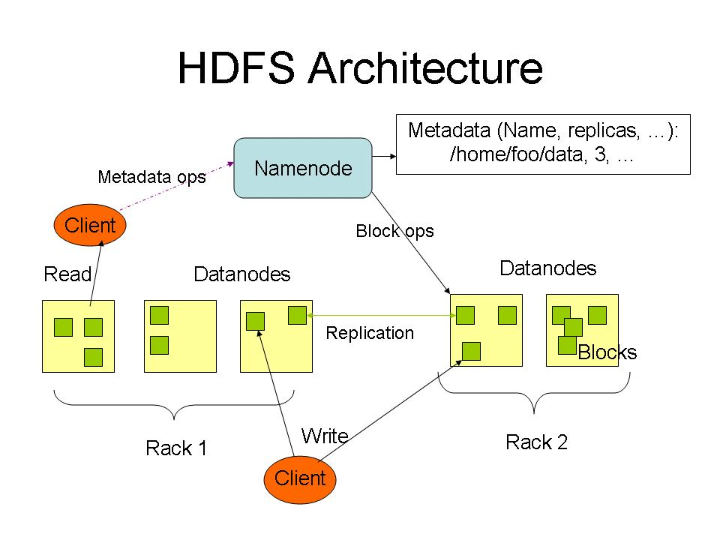
https://hortonworks.com/apache/hdfs/

Slide 59
NameNode Metadata
Meta-data in Memory
  The entire metadata is in main memory
  No demand paging of meta-data
Types of Metadata
  List of files
  List of Blocks for each file
  List of DataNodes for each block
  File attributes
    e.g., creation time, replication factor
A Transaction Log
  Records file creations, file deletions, etc.

Slide 60
NameNode Responsibilities
Managing the file system namespace:
  Holds file/directory structure, metadata, file-to-block mapping, access permissions, etc.
Coordinating file operations:
  Directs clients to datanodes for reads and writes
  No data is moved through the namenode
Maintaining overall health:
  Periodic communication with the datanodes
  Block re-replication and rebalancing
  Garbage collection

Slide 61
DataNode
A Block Server
  Stores data in the local file system
    Third extended filesystem (ext3)
  Stores meta-data of a block
    Cyclic redundancy check (CRC)
  Serves data and meta-data to Clients
Block Report
  Periodically sends a report of all existing blocks to the NameNode
Facilitates Pipelining of Data
  Forwards data to other specified DataNodes

Slide 62
Block Placement
Current Strategy
  One replica on local node
  Second replica on a remote rack
  Third replica on same remote rack
  Additional replicas are randomly placed
Clients read from nearest replica
Would like to make this policy pluggable

Slide 63
Data Correctness
Use Checksums to validate data
  Use CRC32
File Creation
  Client computes checksum per 512 byte
  DataNode stores the checksum
File access
  Client retrieves the data and checksum from DataNode
  If the validation fails, the client tries other replicas

Slide 64
NameNode Failure
A single point of failure
Transaction Log stored in multiple directories
  A directory on the local file system
  A directory on a remote file system (NFS/CIFS)
Need to develop a real high availability solution

Slide 65
Putting Everything Together…
namenode
job submission node
namenode daemon
jobtracker
tasktracker
tasktracker
tasktracker
datanode daemon
datanode daemon
datanode daemon
Linux file system
Linux file system
Linux file system
…
…
…
slave node
slave node
slave node

Slide 66
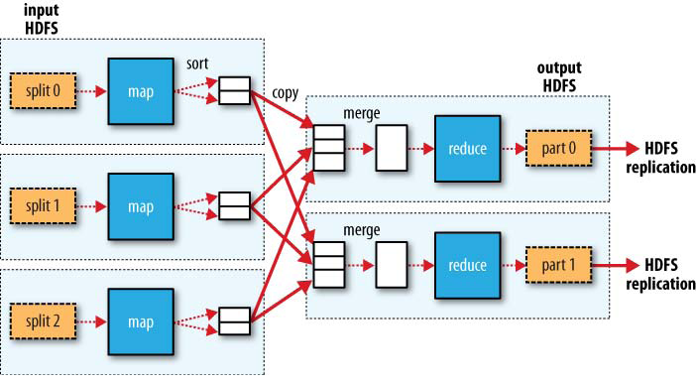
MapReduce Data Flow
Figure is from Hadoop, The Definitive Guide, 2nd Edition, Tom White, O’Reilly

Slide 67
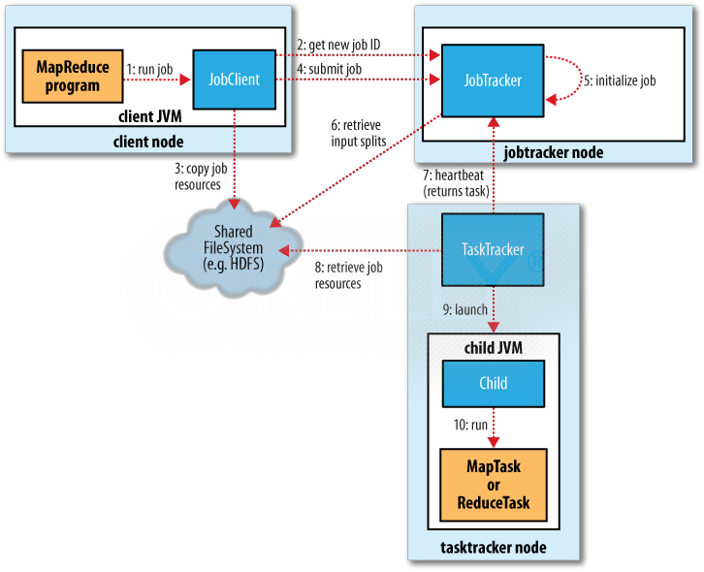
Figure is from Hadoop, The Definitive Guide, 2nd Edition

Slide 68
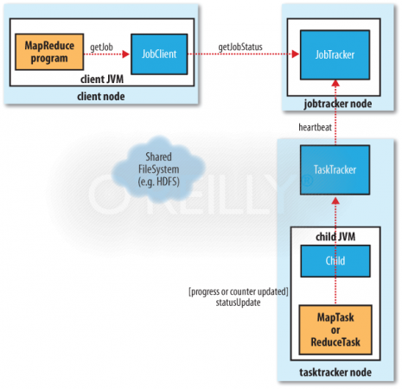
Figure is from Hadoop, The Definitive Guide, 2nd Edition

Slide 69
Amazon Web Services (AWS)
AWS is Amazon’s umbrella description of all of their web-based technology services.
Mainly infrastructure services:
  Amazon Elastic Compute Cloud (EC2)
  Amazon Simple Storage Service (S3)
  Amazon Simple Queue Service (SQS)
  Amazon CloudFront
  Amazon SimpleDB
Notes:
https://www.lynda.com/Amazon-Web-Services-tutorials/Welcome/383048/435232-4.html?srchtrk=index%3a1%0alinktypeid%3a2%0aq%3aamazon+web+services%0apage%3a1%0as%3arelevance%0asa%3atrue%0aproducttypeid%3a2
www.cse.buffalo.edu/~bina/cse487/fall2010/AWSOct18.ppt

Slide 70
Amazon Elastic Compute Cloud (EC2)
EC2 provides Web services API for provisioning, managing, and deprovioning virtual servers inside amazon cloud
Applications anywhere on the Internet can launch a virtual server in the amazon cloud with a single web services call

Slide 71
Storage
S3: for archival purposes: vault: store it now and retrieve it at a later date
Amazon SimpleDB: Relational database better than MySQL or Oracle for reliability

Slide 72
Amazon Cloud-Front
Cloud-based content distributing network enables you to place the content at the edges of the network for rapid delivery.
Place the contents in S3 and run the application from anywhere and the content is moved to where the application is (to the edges).

Slide 73
Amazon Simple Storage Service (S3)
Amazon Web Services API supports the ability to:
  Find buckets and objects
  Discover their meta data
  Create new buckets
  Upload new objects
  Delete existing buckets and objects
  When manipulating the buckets you can optionally specify where they should be stored.
  Use REST API preferably something that abstracts out even that: Jets3t; s3cmd (command line)
  BitTorrent access to S3 is also available

Slide 74
Tutorials
Lynda
  https://www.lynda.com/
  Sign in with the organization portal
  Enter www.kent.edu
  Use your Flashline username and password to log in
  Watch tutorials about Hadoop, AWS, Big Data, and many others

Slide 75
Reading Materials
(MapReduce) J. Dean and S. Ghemawat. MapReduce: Simplified Data Processing on Large Clusters. In OSDI, 2004. https://static.googleusercontent.com/media/research.google.com/en//archive/mapreduce-osdi04.pdf
A. Eldawy and M. F. Mokbel. SpatialHadoop: A MapReduce Framework for Spatial Data. In ICDE, 2015. http://www-users.cs.umn.edu/~eldawy/publications/ICDE15_industrial_522.pdf
A. Eldawy and M. F. Mokbel. The Era of Big Spatial Data: A Survey. In Foundations and Trends in Databases, 6(3-4): 163-273, 2016. www.nowpublishers.com/article/DownloadSummary/DBS-054
(Hadoop) Tom White. Hadoop: The Definitive Guide. ISBN: 9781491901687, 2015. http://javaarm.com/file/apache/Hadoop/books/Hadoop-The.Definitive.Guide_4.edition_a_Tom.White_April-2015.pdf
(AWS) http://cdn.cs50.net/2014/fall/seminars/aws/aws.pdf
(Tutorials) https://www.lynda.com/

