Slide 1
Probabilistic Data Management
Chapter 2: Data Uncertainty Model

Slide 2
Objectives
In this chapter, you will:
  Learn the formal definition of uncertain data
  Explore different granularities of data uncertainty
  Become familiar with different representations of uncertain data
  Become aware of possible worlds semantics
  Learn the representations of correlations over uncertain data

Slide 3
Outline
Introduction
Uncertain Data Model
Possible Worlds
Correlated Uncertain Data
Summary

Slide 4
Introduction
In real-world applications, uncertain data are of various types
  Numerical data
    Sensory data
    GPS data
    Medical data
  Categorical data
    Text data

Slide 5
Introduction (cont'd)
For example, noisy sensory data:
  Temperature
    Uncertainty interval
    [min_T, max_T]
    Within the interval,
    discrete samples can
    reflect the probabilistic
    distribution of the real
    temperature value
frequency
samples
temperature
min_T
max_T

Slide 6
Introduction (cont'd)
According to some model of sensor data, samples can follow continuous distributions
  E.g., Uniform or Gaussian distribution
probability
probability
1
1
pdf(x) ~ N (μ, σ²)
pdf(x) = 1 / (max_T - min_T)
cdf(x) = (x - min_T) / (max_T - min_T)
0
temperature
0
temperature
min_T
μ
max_T
min_T
max_T
Gaussian Distribution
Uniform Distribution

Slide 7
Outline
Introduction
Uncertain Data Model
Possible Worlds
Correlated Uncertain Data
Summary

Slide 8
In the Last Chapter: Classification of Data Uncertainty
Person ID | Zip code | Disease
PID₁ | (110000, 0.5), (110001, 0.5) | (pneumonia,0.3), (flu, 0.7)
PID₂ | (310000, 1) | (AIDS, 0.9)
Granularity
  Attribute Uncertainty
    Each attribute of a tuple has several possible values (associated with probabilities)
  Tuple Uncertainty
    Each tuple is associated with an existence probability
Witnessed Person | t.p
PID₁ | 0.9
PID₂ | 0.2
PID₃ | 0.1

Slide 9
Attribute-Level Uncertain Data
Uncertain object in uncertain databases
  Each uncertain object o is represented by an uncertainty region, UR(o)
  Within the uncertainty region, object o can appear anywhere following any distribution
  The object distribution can be represented by either discrete samples or continuous probabilistic distribution
uncertainty region

Slide 10
Attribute-Level Uncertain Data (cont'd)
The shape of the uncertainty region can be arbitrary
  Irregular shape
  Regular shape
    Hypersphere
    Hyperrectangle

Slide 11
Attribute Uncertainty
uncertain
object o
traditional certain database
uncertainty region UR(o)
uncertain database

Slide 12
Example of Attribute Uncertainty
probability
1
Uncertain databases
  Sensor data
pdf(x)
0
temperature
min_T
μ
max_T
uncertainty interval
= 1-dimensinal uncertainty region

Slide 13
Tuple Uncertainty
Block independent disjoint model
  A probabilistic database contains a set of x-tuples t_{i}
    Each x-tuple represents a data entity
    x-tuples are independent of each other
  Each x-tuple t_{i} has one or multiple alternatives t_{ij}
    Each alternative t_{ij} represents one possible instance of the data entity t_{i} that may appear in reality
    Each alternative t_{ij} is associated with an existence probability t_{ij}.p, such that ∑_{∀j} t_{ij}.p ≤ 1
    Alternatives in the same x-tuple are mutually exclusive

Slide 14
Example of Tuple Uncertainty
Person ID | Witness ID | Location | Prob.
a | a₁ | X | 0.5
a | a₂ | Y | 0.4
b | b₁ | Z | 0.8
Probabilistic databases
  x-tuples
    Person IDs a and b
    a and b are independent of each other
  Alternatives
    Person ID a: a₁, a₂
    Person ID b: b₁
    Each person (e.g., a) has at most one possible instance (witness person a₁ or a₂) appearing in reality (i.e., to be true)
probabilistic database

Slide 15
Outline
Introduction
Uncertain Data Model
Possible Worlds
Correlated Uncertain Data
Summary

Slide 16
Example of Possible Worlds
Previous example
  In reality, each person, a or b, can be located at one place at a timestamp
  Thus, for each person ID, at most one witness tuple is true
  E.g., a₁ and b₁
Person ID | Witness ID | Location | Prob.
a | a₁ | X | 0.5
a | a₂ | Y | 0.4
b | b₁ | Z | 0.8
probabilistic database

Slide 17
Possible Worlds in the Previous Example
Person ID | Witness ID | Location | Prob.
a | a₁ | X | 0.5
a | a₂ | Y | 0.4
b | b₁ | Z | 0.8
Possible Ground Truth
  PW₁ = {a₁, b₁}
    Pr{PW₁} = 0.5 × 0.8
  PW₃ = {a₁}
    Pr{PW₃}
    = 0.5 × (1-0.8)
probabilistic database
Possible Worlds, PW_{i} | Prob., Pr{PW_{i}}
PW₁ = {a₁, b₁} | 0.5 × 0.8 = 0.4
PW₂ = {a₂, b₁} | 0.4 × 0.8 = 0.32
PW₃ = {a₁} | 0.5 × (1-0.8) = 0.1
PW₄ = {a₂} | 0.4 × (1-0.8) = 0.08
PW₅ = {b₁} | (1-0.5-0.4) × 0.8 = 0.08
PW₆ = ∅ | (1-0.5-0.4) × (1-0.8) = 0.02
6 possible worlds of the probabilistic database

Slide 18
Possible Worlds Semantics
Person ID | Witness ID | Location | Prob.
a | a₁ | X | 0.5
a | a₂ | Y | 0.4
b | b₁ | Z | 0.8
In the probabilistic database D,
  A possible world is a materialized instance of the database that can appear in the real world
  Each x-tuple contributes at most one alternative to the possible world
  Each possible world, pw(D), is associated with an appearance probability, Pr{pw(D)}, indicating the chance that the possible world appears in the real world

Slide 19
Possible Worlds on Attribute Uncertainty
Uncertain database
  In a possible world, each uncertain object contributes one possible instance within the uncertainty region
  The probability of the possible world is given by the multiplication of instance existence probability
uncertain
object o
uncertainty region UR(o)

Slide 20
Comments on Possible Worlds
In uncertain/probabilistic databases, there can be exponential number of possible worlds w.r.t. database size
Possible world semantics is a natural interpretation of uncertain/probabilistic databases
Query processing under possible worlds semantics is rather costly, and efficient approaches have to be proposed

Slide 21
Exercises
x-tuple t_{i} | Alt. t_{ij} | Attr. | Prob.
t₁ | t₁₁ | 4 | 0.3
 | t₁₂ | 5 | 0.4
t₂ | t₂₁ | 2 | 0.7
t₃ | t₃₁ | 11 | 0.6
 | t₃₂ | 15 | 0.3
 | t₃₃ | 12 | 0.1
1. How many possible
worlds are there in the
probabilistic database?
2. Is {t₁₁, t₂₁, t₃₃} a possible world? Why? What is its appearance probability?
3. Is {t₁₁, t₃₃} a possible world? Why? What is its appearance probability?
4. Is {t₂₁} a possible world? Why? What is its appearance probability?
5. Is ∅ a possible world? Why? What is its appearance probability?
Notes:
3*2*3=18 possible worlds
Yes, 0.3*0.7*0.1
Yes, 0.3*(1-0.7)*0.1
No, 0
No, 0

Slide 22
Outline
Introduction
Uncertain Data Model
Possible Worlds
Correlated Uncertain Data
Summary

Slide 23
In the Last Chapter: Classification of Data Uncertainty
Correlations
  Independent Uncertainty
    Uncertain objects are independent of each other
    E.g., uncertain databases, probabilistic databases
  Correlated Uncertainty
    Attributes of uncertain objects are correlated with each other
    E.g., Bayesian network
  Uncertainty with Local Correlations
    Uncertain objects from different groups are independent
    Within each group, uncertain objects are locally correlated

Slide 24
Applications of Correlated Uncertain Data
Sensor networks
  Sensory data collected from spatially close sensors are correlated with each other
  E.g., temperature collected from sensors within 1 meter
Data integration
  Data sources may copy from each other
  Errors and impreciseness may be propagated
  Thus, uncertain data from different sources can be correlated

Slide 25
Model for Correlated Uncertain Data
Graphical Data Model
  Directed graph
    Markovian model
    Bayesian network
  Undirected graph
    Conditional random fields

Slide 26
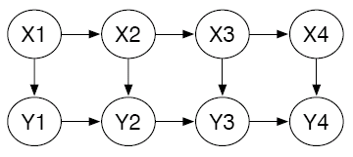
Markovian Model
Markov sequence
  A sequence of nodes that are temporally correlated with each other
p(X₁), prior distribution
p(X₃ | X₂), conditional probability
a markovian sequence
…
sequence 1
…
sequence 2
…

Slide 27
Example of Bayesian Networks
Bayesian network
P(A)
A
P(B | A)
B
C
P(C | A)
D
P(D | C, B)

Slide 28
Bayesian Networks
Bayesian network
  Vertices: random variables
  Directed edges: indicating the dependency between two random variables
  Conditional probability tables (CPTs): storing prior/conditional probabilities of labels in vertices
Possible worlds
  Each label assignment to graph vertices corresponds to one possible world

Slide 29
Variable Elimination
How do we compute P(X₂)?
Bayes' formula
X₁
X₂
Notes:
http://www.cs.bgu.ac.il/~pdm072/BN-VariableElim.ppt

Slide 30
Variable Elimination (cont'd)
X₁
X₂
X₃
How do we compute P(X₃)?
We already know how to compute P(X₂)...
Notes:
http://www.cs.bgu.ac.il/~pdm072/BN-VariableElim.ppt

Slide 31
Variable Elimination (cont'd)
V
S
T
L
A
B
P(V, S, T, L, A, B, X, D)
X
D
Eliminate: v
Compute:
Notes:
http://www.cs.bgu.ac.il/~pdm072/BN-VariableElim.ppt

Slide 32
Exercises
P(A)
A
How to compute the following joint probabilities?
  P(A, B, C, D)
  P(A, B)
  P(C)
  P(B, C, D)
  P(C, D)
P(B | A)
B
C
P(C | A)
D
P(D | C, B)
Notes:
P(A, B, C, D) = P(A) * P(B|A) * P(C|A) * P(D|B, C)
P(A, B) = \Sigma_A P(A)*P(B|A)
P(C) = \Sigma_A P(A, C) = \Sigma_A P(A) * P(C|A)
P(B, C, D) = \Sigma_A P(A, B, C, D) = \Sigma_A P(A) * P(B|A) * P(C|A) * P(D|B, C)
P(C, D) = \Sigma_B P(B, C, D)

Slide 33
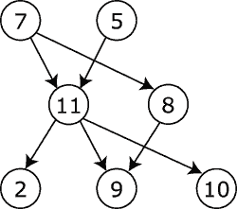
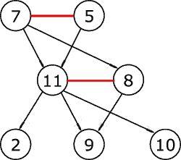
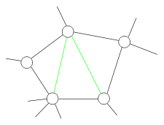
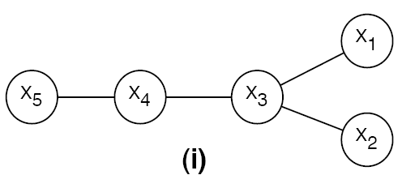
Junction Tree Algorithm
For directed or undirected graph
  If the graph is a directed acyclic graph, then moralize it by connecting nodes that have a common child, and then making all edges in the graph undirected
  Triangulate the graph to make it chordal
  Construct a junction tree from the
  triangulated graph
  Message passing
Steiner tree
Notes:
http://www.cs.bgu.ac.il/~pdm072/BN-VariableElim.ppt

Slide 34

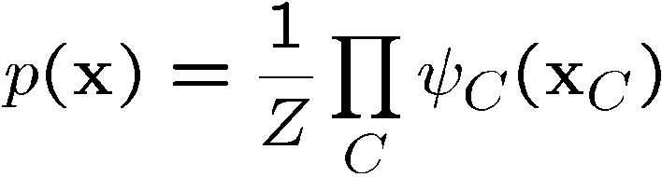

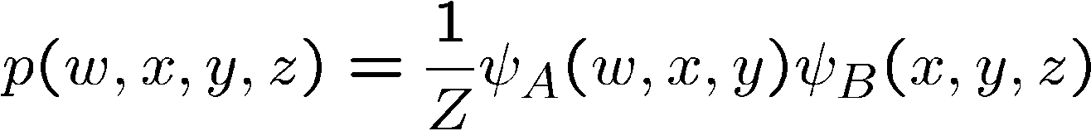
Undirected Graphical Model
Provided then joint distribution is product of non-negative functions over the cliques of the graph
where are the clique potentials, and Z is a normalization constant

Slide 35
Undirected Graphical Model (cont'd)
A graph G=(Y, E) where Y={y₁,y₂, …, y_{n}} are the nodes (vertices) and E={( y_{i} ,y_{j} ): i ≠ j} are the undirected edges.
The probability distribution is given as:
such that, potential function
,
where c are the cliques in the graph and Z is the partition function defined as:

Slide 36
Conditional Random Field (CRF)
Nodes in Y = {y₁,y₂, …, y_{n}} correspond to hidden (or unknown) states
Given some observation X={x₁, x₂, …, x_{n}}, we may want to infer states of x_{i} according to conditional probability Pr{Y | X}
  Parameters in Pr{Y | X} are learnt from training data

Slide 37
Uncertainty With Local Correlations
In many applications, data are locally correlated
  Sensor networks
    Spatially close sensors report correlated data
    Sensors far away from each other usually report independent data

Slide 38
Example of Uncertainty With Local Correlations
Sensory data: <temperature, light>
Forest monitoring application
forest
Notes:
Let me first give a motivation example.
In the application of forest monitoring, we deploy some sensors to the outdoor environment of the forest, and collect data such as temperature and light through this sensor network. Each sensor may report a sample at a timestamp.

Slide 39
Example of Uncertainty With Local Correlations (cont'd)
Sensory data are uncertain and imprecise
Uncertain object o_{i} collected from sensor node n_{i}
uncertainty regions
Notes:
In practice, however, data reported from each data can be imprecise and uncertain, for reasons such as environmental factors, packet losses, or low battery power.
Thus, in the literature, we can model such uncertain sensory data from each sensor by an uncertain object, which is represented by an uncertainty region. Within the uncertainty region, samples are located following arbitrary probabilistic distribution.

Slide 40
Example of Uncertainty With Local Correlations (cont'd)
3 monitoring areas
forest
Notes:
While some existing works in the literature of uncertain/probabilistic databases assume the independence among different uncertain objects, this may not hold for some applications.
For example, in the previous example, we sensors are deployed in 3 monitoring areas.

Slide 41
Example of Uncertainty With Local Correlations (cont'd)
3 monitoring areas
forest
sensors far away
spatially close sensors
Notes:
Within each monitoring area, sensors are close to each other, for example n4 and n5. In contrast, sensors from different monitoring areas are far awary from each other.

Slide 42
Locally Correlated Sensory Data
Area 2
Area 1
Area 3
Notes:
Therefore, we can see that sensory data collected from spatially close sensors are locally correlated with each other within each monitoring areas, whereas independent of other sensory data from sensors far away.
Thus, we can naturally model such sensory data by locally correlated uncertain objects. Our problem is to efficiently answer queries over such uncertain data with local correlations.

Slide 43
Data Model for Local Correlations
Data Model
  Each uncertain object contains several locally correlated partitions (LCPs)
    Uncertain objects within each LCP are correlated with each other
    Uncertain objects from distinct LCPs are independent of each other
Notes:
Here is our uncertainty model for locally correlated data.
We assume that uncertain object contains several locally correlated partitions (LCPs). Within each partition, uncertain objects are correlated with each other, and uncertain objects from distinct partitions are independent with each other.

Slide 44
Data Model for Local Correlations (cont'd)
Bayesian network
  Each vertex corresponds to a random variable
  Each vertex is associated with a conditional probability table (CPT)
Notes:
Within each LCP, we model the correlation among uncertain objects by a graphical model, Bayesian network.
In the network, each vertex represents a random variable, indicating the uncertain sensory data from an object in our example. Edges show the dependence relationships among uncertain objects. Each vertex is also associated with a conditional probability table to model the prior/conditional probabilities of object value assignments.

Slide 45
Data Model for Local Correlations (cont'd)
The joint probability of variables
  Join tuples in CPTs and multiply conditional probabilities
  Variable elimination
Notes:
Here is an example of CPT. In order to obtain the joint probability of random variables, we need to join these CPTs and evaluate the probabilities, which is costly especially when the graph is large.

Slide 46
Outline
Introduction
Uncertain Data Model
Possible Worlds
Correlated Uncertain Data
Summary

Slide 47
Summary
In different real applications, data uncertainty can have different representations
Attribute uncertainty vs. tuple uncertainty
  Uncertain databases (spatial representation)
  Probabilistic database (relational representation)
Possible worlds semantics
  A possible instance of the database that can appear in the real world

Slide 48
Summary (cont'd)
Correlated uncertainty
  Graphical model
    Markovian model
    Bayesian network
    Conditional random fields
  Calculation of the joint probability in graphical model
    Junction tree algorithm
  Uncertainty with local correlations

