Slide 1
Probabilistic Data Management
Chapter 1: An Overview of Probabilistic Data Management

Slide 2
Objectives
In this chapter, you will:
  Get to know what uncertain data look like
  Explore causes of uncertain data in different applications
  Learn the importance of studying uncertain data management
  Become aware of the classifications of uncertain data

Slide 3
Objectives (cont'd)
  Discover the pros and cons of uncertain data management, compared with traditional certain data management
  Become familiar with the history of uncertain data management, including some existing systems

Slide 4
Outline
Introduction
Applications of Probabilistic Data Management
Classifications of Uncertain Data
Comparisons: Uncertain vs. Certain Data
The Existing Systems

Slide 5
Introduction
Uncertain data are pervasive in real-world applications
  A.k.a. probabilistic data / imprecise data / inaccurate data / noisy data
Data uncertainty may occur, during:
  Data collection
  Data transmission
  Data processing
probability
reported data
actual data

Slide 6
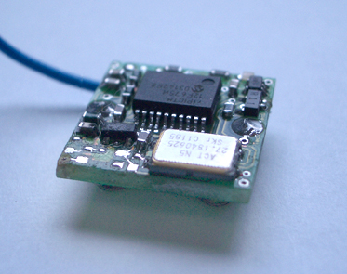
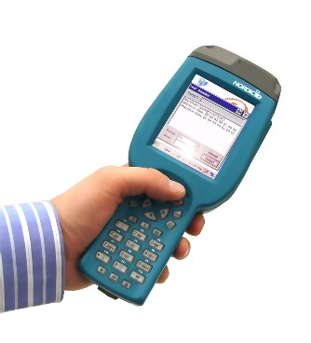
Data Collection
Data collection devices are sometimes imperfect
  Sensors
    Abnormal sensor readings
  RFID readers
    Miss-read
    Cross-read

Slide 7

Data Collection (cont'd)
Data extraction techniques are often inaccurate
  Information extraction from unstructured text
    Different techniques can produce different extraction results
Technique 1
Address: West Sugar Road
Technique 2
Address: Sugar Road
unstructured text
I live at 203W Sugar Road

Slide 8
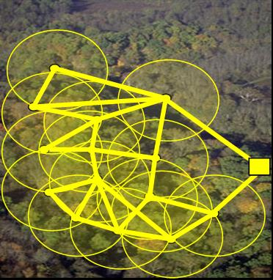

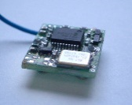
Data Transmission
During the data transmission, errors may occur
  Sensor networks
    Packet losses → fewer or biased samples
    Transmission errors → erroneous sensory data
sink
sensor network

Slide 9
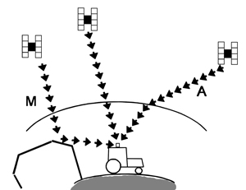
Data Transmission (cont'd)
During the data transmission, errors may occur
  Global Positioning System (GPS)
refraction
reflection

Slide 10
Data Processing
Data can be imprecise, when we manipulate the data
  Privacy preserving
    Add synthetic noises to protect users' privacy before publishing data
  Lossy data compression
    Trade the data accuracy for space
  Data integration
    Merge data from multiple data sources

Slide 11
Outline
Introduction
Applications of Probabilistic Data Management
Classifications of Uncertain Data
Comparisons: Uncertain vs. Certain Data
The Existing Systems

Slide 12
Real-World Applications
Applications of Probabilistic Data Management
  Sensor networks
  Location-based services
  Moving object search
  Data extraction and integration
  Privacy preserving

Slide 13
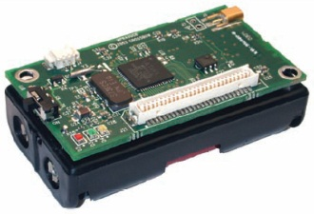

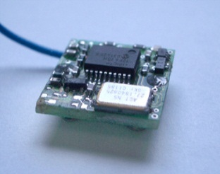
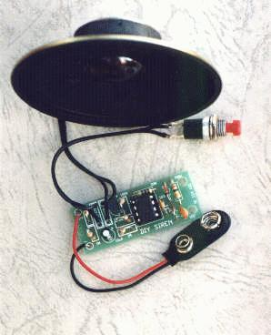


Applications (1) – Sensor Networks
Causes of data uncertainty
  Environmental factors
  Low battery power
  Packet losses
sensor networks
Notes:
Figure sources: : www.dei.unipd.it/~schenato/
http://particle.teco.edu/devices/devices.html
http://www.olsr.org/
www.robotstorehk.com/sensors/sensor.html

Slide 14

Applications (2) – Global Positioning System (GPS)
Causes of data uncertainty
  Reflection or refraction of the satellite signal
refraction
reflection
Notes:
Reflection or refraction of the signal

Slide 15








Applications (3) – Data Extraction and Integration
Causes of data uncertainty
  Unreliability of data sources
the confidence that a document is true
Doc 1
0.2
Doc 2
0.4
…
…
…
…
a document entity
Doc l
0.3
near duplicate documents
data sources

Slide 16
Applications (4) – Privacy Preserving
Medical data analysis
  Generalize attribute values to uncertain intervals
  Avoid identifying sensitive information of patients
Age | Sex | Zipcode | Disease
21 | M | 11000 | pneumonia
50 | M | 37000 | flu
51 | M | 31000 | AIDS
Age | Sex | Zipcode | Disease
[20, 30) | M | [10000, 20000] | pneumonia
[50, 60) | M | [30000, 40000] | flu
[50, 60) | M | [30000, 40000] | AIDS

Slide 17
Applications (5) – Privacy Preserving
Location-Based Services (LBS)
  Cloak the trajectories of GPS users
  Protect the places that users visited

Slide 18
Outline
Introduction
Applications of Probabilistic Data Management
Classifications of Uncertain Data
Comparisons: Uncertain vs. Certain Data
The Existing Systems

Slide 19

Classification of Data Uncertainty
Sources of data uncertainty
  Undesirable uncertainty
    Noisy sensor data
    Imprecise GPS data
    Unreliable extracted/integrated data
  Desirable uncertainty
    Medical data with generalized attributes
    Cloaked trajectory data

Slide 20
Classification of Data Uncertainty (cont'd)
Witnessed Person | t.p
PID₁ | 0.9
PID₂ | 0.2
PID₃ | 0.1
Granularity
  Tuple Uncertainty
    Each tuple is associated with an existence probability
  Attribute Uncertainty
    Each attribute of a tuple has several possible values (associated with probabilities)
Person ID | Zip code | Disease
PID₁ | (110000, 0.5), (110001, 0.5) | (pneumonia,0.3), (flu, 0.7)
PID₂ | (310000, 1) | (AIDS, 0.9)

Slide 21
Classification of Data Uncertainty (cont'd)
Correlations
  Independent Uncertainty
    Uncertain objects are independent of each other
  Correlated Uncertainty
    Attributes of uncertain objects are correlated with each other
  Uncertainty with Local Correlations
    Uncertain objects from different groups are independent
    Within each group, uncertain objects are locally correlated

Slide 22
Outline
Introduction
Applications of Probabilistic Data Management
Classifications of Uncertain Data
Comparisons: Uncertain vs. Certain Data
The Existing Systems

Slide 23
Certain Data Management
nearest neighbor query
Assume the underlying data are precise and certain
Many existing techniques target at certain data
Query answering is efficient
However, …
certain database
e
q
a
d
b
c
q
a
d
b
c
e
distance to q

Slide 24
Certain Data Management (cont'd)
However, not all application data are clean and precise
  Sensor data, GPS data, etc.
Even if using data cleaning techniques
  Cannot guarantee 100% data accuracy
  What is worse, introduce more errors!
  Cannot guarantee the confidence of query answers
So, …

Slide 25
Probabilistic Data Management
Advantages of probabilistic data management
  Directly model uncertain data without corrupting the original data
  Avoid introducing new errors
  Query answering with confidence guarantees

Slide 26
Probabilistic Data Management (cont'd)
Disadvantages of probabilistic data management
  Effectiveness issue
    How to obtain the probabilities of uncertain data
    How to guarantee confidence of query answers
  Efficiency issue
    Each object/attribute has several possible values
    There are totally an exponential number of possible combinations of object/attribute instances
    Efficient query answering over uncertain data is problematic!

Slide 27
Example of Nearest Neighbor Search in Uncertain Databases
probabilistic database
e
q
a
q
distance to q
d
d
a
b
c
b
e
c
instances of object a
nearest neighbor query

Slide 28
Exercises
Assume that:
  Uncertain object a has 6 possible instances, and
  Each of the rest uncertain objects, b ~ e has 2 possible instances
How many possible combinations of object instances in this database?
probabilistic database
e
q
d
a
b
c
nearest neighbor query
Notes:
6*(2^4) = 6*16=96

Slide 29
Exercises (cont'd)
Assume that:
  For each uncertain object, its instances have equal appearance probabilities
What is the NN probability of uncertain object d when a is located at the red point?
probabilistic database
e
q
d
a
b
c
nearest neighbor query
Notes:
When a is at the red point, object d is NN with probability 1/2

Slide 30
Outline
Introduction
Applications of Probabilistic Data Management
Classifications of Uncertain Data
Comparisons: Uncertain vs. Certain Data
The Existing Systems

Slide 31
Existing Systems to Manipulate the Data Uncertainty
Existing projects to deal with the data uncertainty
  MystiQ, University of Washington, 2005
  Orion, Purdue, 2003
  TRIO, Stanford Info Lab, 2005
  MayBMS, Cornell, 2007
  MCDB, IBM, 2008
  BayesStore, 2008

Slide 32
Summary
Data uncertainty occurs in the entire process of data collection, transmission, and processing
Uncertain data are ubiquitous in many real applications
  Sensor network
  GPS system
  Data extraction/integration
  Privacy preserving

Slide 33
Summary (cont'd)
Classifications of data uncertainty
  Data sources
  Granularity
  Correlations
Uncertain vs. certain data
  Many techniques are proposed for certain data, but not for uncertain data
  Query answering for certain data is much more efficient than that for uncertain data

Slide 34
Summary (cont'd)
  Real-world application data are not always certain data, and are often uncertain data
  Applying techniques proposed for certain data to uncertain data may lead to erroneous results without confidence guarantees, while uncertain data management can have such guarantees
Existing probabilistic data management systems

