Slide 1
Probabilistic Data Management
Chapter 10: Probabilistic Graph

Slide 2
Objectives
In this chapter, you will:
  Learn the uncertainty in structures
    Tree: XML data
    Graph: RDF data
  Become familiar with different queries over probabilistic XML or graphs
  Find solutions to different queries, either exact or approximate

Slide 3
Outline
Introduction
Probabilistic XML Model & Queries
Probabilistic Graph Model & Queries
Summary

Slide 4
Introduction
In many real applications, data uncertainty also exists in data structures
  The availability (existence) of a road segment in road networks
  The possible interactions among genes in biology databases
  The integration of XML/RDF data from different data sources

Slide 5

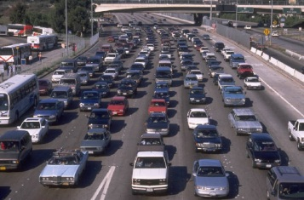


Introduction (cont'd)
Causes of uncertainty in data structures
  Road network
    Infrastructure construction
    Traffic jam
    Traffic accident
  Biology databases
    Inference from unclear images
  Data integration
    Inconsistency in unreliable data

Slide 6
Outline
Introduction
Probabilistic XML Model & Queries
Probabilistic Graph Model & Queries
Summary

Slide 7
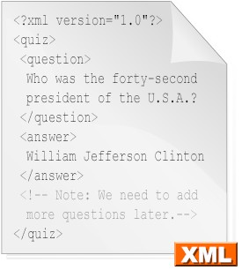
XML Documents
Wikipedia: Extensible Markup Language (XML) is a set of rules for encoding documents in machine-readable form
quiz
question
answer

Slide 8
Probabilistic XML Model
Probabilistic XML is a probability distribution over a space of documents
Types of nodes
  Ordinary nodes
    Regular XML nodes: a tag and a value
  Distributional nodes
    A distributional node specifies a distribution over the subsets of its children.
B. Kimelfeld and Y. Sagiv. Matching twigs in probabilistic XML. In VLDB, 2007.

Slide 9
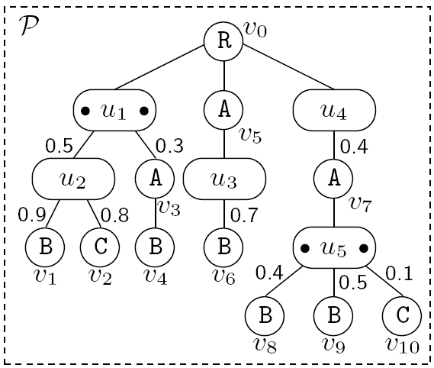
An Example of Probabilistic XML
ordinary node
distributional node

Slide 10
Distributional Nodes
Distributional nodes
  IDD nodes
    Children are probabilistically independent of each other
    Having zero or more children in reality
  MXD nodes
    Children are mutually exclusive
    Having at most one child in reality

Slide 11
Previous Example
IDD nodes
MXD nodes

Slide 12
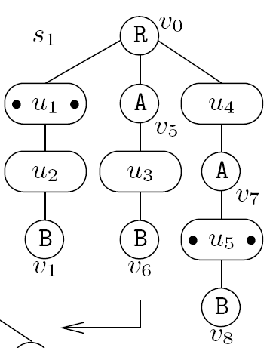
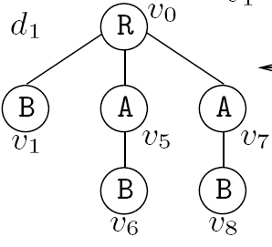
Samples of Probabilistic XML
Probabilistic XML
(p-document)
Sample
Random Document
Probability Calculation:
0.5*0.9*(1-0.8)*0.7*0.4*0.4

Slide 13
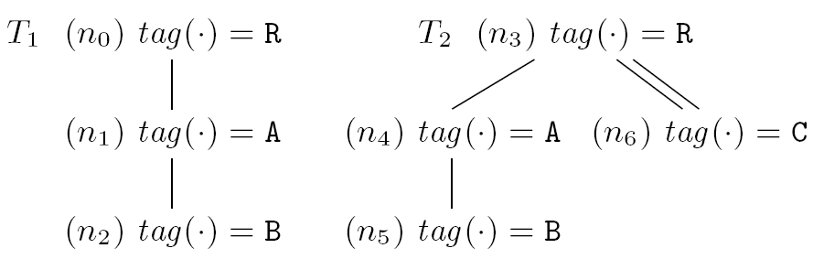
Twigs
A twig pattern (or twig for short) is a tree with child edges and descendant edges

Slide 14
Queries in Probabilistic XML
Complete semantics
  We want to obtain:
where C(P) is the set of matching random documents in probabilistic XML P, and p is the probabilistic threshold

Slide 15
Outline
Introduction
Probabilistic XML Model & Queries
Probabilistic Graph Model & Queries
Summary

Slide 16
Probabilistic Graph Model
Probabilistic graphs with the edge existence
  Each edge is associated with an existence probability
  Queries
    Shortest path [DASFAA, 2010]
    K-nearest neighbor [VLDB, 2010]
Notes:
Ye et al. Efficiently Answering Probability Threshold-Based SP Queries over Uncertain Graphs. DASFAA, 2010
Potamias et al. K-Nearest Neighbors in Uncertain Graphs. VLDB, 2010.

Slide 17
Probabilistic Graph Model (cont'd)
Probabilistic graphs with the label uncertainty
  Bayesian network
  Queries
    Subgraph matching
P(A)
A
P(B | A)
B
C
P(C | A)
D
P(D | C, B)

Slide 18
Applications
Probabilistic RDF graphs
  RDF is a W3C Standard for describing resources on the Web
  Representations
    Triple: < subject, predicate, object >
    Graph:
  Uncertain RDF graph data integrated from different data sources
subject
object
predicate

Slide 19
Efficient Query Answering in Probabilistic RDF Graphs
ACM Conference on the Management of Data (SIGMOD), 2011

Slide 20




Motivation Example
Semantic Web Applications
… …
Resource Description Framework (RDF)
representation
… …
… …
Triples
… …
… …
Graphs
<subject, predicate, object>
subject
object
predicate

Slide 21
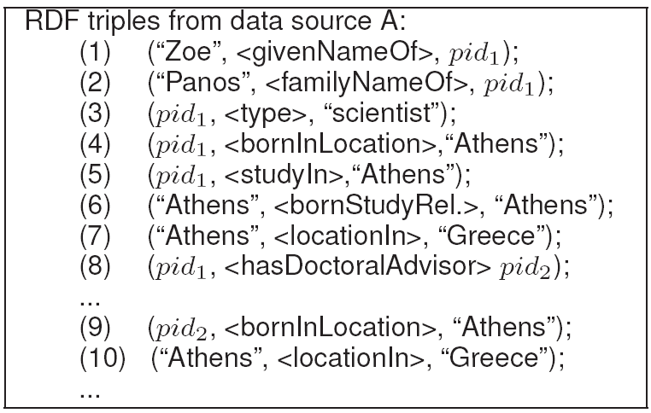
Motivation Example (cont'd)
Data Source A
triple representation
graph representation

Slide 22
Motivation Example (cont'd)
Data Source B
Data Source A

Slide 23
Motivation Example (cont'd)
Data Source B
Data Source A
Inconsistencies occur!

Slide 24

Motivation Example (cont'd)
Data Integration
  Merge RDF data from different data sources into probabilistic RDF data graphs
Data Source A
…
Data Source B

Slide 25
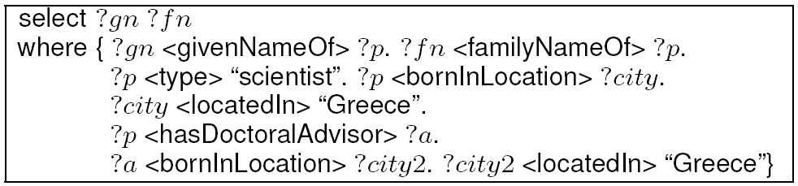
Motivation Example
(cont'd)
query graph q
A SPARQL query:
probabilistic RDF data graph G
probabilistic RDF subgraph matching

Slide 26
Model for Probabilistic Data Graphs
Model of a probabilistic RDF data graph
  Bayesian network
    Vertices
    Edges
    Conditional probability
    tables (CPTs)
Possible worlds
  Each label assignment to
  graph vertices corresponds
  to one possible world
Pr(v₁=a, v₂=c, v₄=g) = 0.4*0.6*0.8
= 0.192

Slide 27
Subgraph Matching Over Probabilistic Data Graphs
Subgraph matching queries in probabilistic RDF data graphs
  Input:
    a probabilistic RDF graph G
    a query graph q
    a user-specified probabilistic threshold α ∈ [0, 1)
  Output: subgraphs g ⊆ G and their label bindings l(g_{i}) for vertices g_{i} ∈ V(g), such that
    g is isomorphic to q
    Pr{g} > α holds

Slide 28
Challenges
Probabilistic RDF data graph
  Data correlations
  Exponential number of possible worlds
Large-scale RDF data graph
  Indexing
Efficiency!

Slide 29
Structural Pruning
Label pruning
Graph distance pruning
Degree/Counter pruning

Slide 30
Structural Pruning – Label Pruning
If i-th level label set of g ⊂ i-th level label set of q, g can be safely pruned
{d, e}
{a, b}
{f, g, h, i}
{c, d}
{a, b, c, d, e}
{a, b, c, d, e, f, g, h, i}
⊇
{a}
{a, g}
probabilistic RDF subgraph g
query graph q

Slide 31
Structural Pruning – Graph Distance Pruning
If the shortest path distance of g > shortest path distance of q, g can be safely pruned
shortest path distance from v₁ to v₄
≤
shortest path distance from q₁ to q₄
probabilistic RDF subgraph g
query graph q

Slide 32




Structural Pruning – Degree/Counter Pruning
Degree:
Number of vertices:
Number of edges:
probabilistic RDF subgraph g
query graph q

Slide 33


Synopses
Label Pruning:
Graph Distance Pruning:
To enable structural pruning, we design a synopsis to encode label information
  Hash all labels of vertices within i hops from v₁ to a bit vector
{d, e}
0
0
1
0
0
1
0
1
1
0
0
{a, b}
a
b, c
e
d
{f, g, h, i}
{c, d}
bit vector for the first level, BV_{≤1}(v₁)

Slide 34
Adaptive Hashing
Observation: frequently appearing labels will have lower pruning power w.r.t. synopses
Adaptive hashing
  Hash infrequent labels with weighted probabilities
    Infrequent labels have lower confliction rate with frequent ones
  A cost model for synopsis parameters
    The number of hashing functions, and
    The length of bit vectors and

Slide 35
Probabilistic Pruning
Basic idea
  Query predicates require that Pr{g} > α holds
  Derive an upper bound, UB_P(g), of Pr{g}
  If UB_P(g) ≤ α, then we can safely prune subgraph g

Slide 36
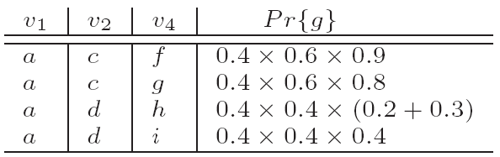
Probabilistic Pruning (cont'd)
Pre-computation of probability upper bound
probabilistic RDF data graph
query graph q

Slide 37



Derivation of Probability Upper Bound
Let a function P_{max}(n, i) be the probability upper bound for any subgraph of size n (i.e., |V(g)| = n), when we have accessed the i-th level of CPTs, denoted as S_{i}
{d, e}
{a, b}
{f, g, h, i}
We derived a cost model to balance between space and query costs!
{c, d}

Slide 38
Indexing & Query Answering
Construct a tree index over synopses of subgraphs in probabilistic RDF data graphs
  bit-OR in intermediate nodes of the tree index
Query answering framework over probabilistic RDF graphs
  Given a query graph, compute a query plan
  Traverse the tree index to perform the pruning
Notes:
Minimum spanning tree over a virtual query graph

Slide 39
Other Topics
Monte-Carlo sampling over uncertain data
  Sample possible worlds
  Estimate query results from samples
  Evaluate approximate query results

Slide 40
Outline
Introduction
Probabilistic XML Model & Queries
Probabilistic Graph Model & Queries
Summary

Slide 41
Summary
Uncertainty in data structures
  Tree structure: XML
  Graph structure: RDF data graph, road networks
Data model for probabilistic XML
  Existence uncertainty in edges
  Ordinary nodes
  Distributional nodes
    IDD
    MXD

Slide 42
Summary (cont'd)
Model for probabilistic RDF data graph
  Bayesian network
  Label uncertainty in nodes
Queries for probabilistic XML
  Twig pattern
  Semantics

Slide 43
Summary (cont'd)
Queries for probabilistic RDF data graph
  Subgraph matching on probabilistic RDF data graphs
  Pruning techniques for matching on probabilistic RDF graphs
  Query answering over probabilistic RDF graphs
Approximate solutions
  Monte Carlo sampling on possible worlds

