Slide 1
Probabilistic Data Management
Chapter 3: Probabilistic Query Answering (1)

Slide 2
Objectives
In this chapter, you will:
  Learn the challenge of probabilistic query answering on uncertain data
  Become familiar with the framework for probabilistic query answering
  Explore the definitions of some basic probabilistic query types
  Become aware of basic techniques to efficiently answer different probabilistic queries

Slide 3
Outline
Introduction
Probabilistic Query Types
Framework for Probabilistic Query Answering
Query Answering Techniques for Different Probabilistic Queries
Summary

Slide 4
Introduction
In real applications, we need to deal with uncertain data
  Answering queries issued by users
    Location-based services (LBS)
    Business planning and decision making
  Anomaly or outlier detection
    Time-series database
  Aggregation
    Sensor networks

Slide 5
Introduction (cont'd)
Challenges of the data manipulation over uncertain data
  The number of possible worlds over uncertain data is exponential w.r.t. the number of uncertain objects
Two requirements
  Efficiency: Efficient query answering over possible worlds
  Effectiveness: Query answers should guarantee the accuracy

Slide 6
Outline
Introduction
Probabilistic Query Types
Framework for Probabilistic Query Answering
Query Answering Techniques for Different Probabilistic Queries
Summary

Slide 7
Traditional Query Types
Relational database
  Selection
  Projection
  Join
  Set difference
  Union
  Intersection

Slide 8
Traditional Query Types (cont'd)
Spatial Query
Preference Query
8
Spatial database
  Range query
  k-nearest neighbor (kNN) query
  Group nearest neighbor (GNN) query
  Reverse k-nearest neighbor (RkNN) query
  Spatial join /similarity join
  Top-k query (or ranked query)
  Skyline query
  Reverse skyline query
Notes:
8

Slide 9
Probabilistic Query Types
Traditional query types usually assume the manipulation over certain and precise data
In practice, these query types may be issued over uncertain data
Due to the data uncertainty, traditional query types can no longer be applied to uncertain data

Slide 10
Probabilistic Query Types
Probabilistic Spatial Query
Probabilistic Preference Query
10
Uncertain/probabilistic database
  Probabilistic range query
  Probabilistic k-nearest neighbor query
  Probabilistic group nearest neighbor (PGNN) query
  Probabilistic reverse k-nearest neighbor query
  Probabilistic spatial join /similarity join
  Probabilistic top-k query (or ranked query)
  Probabilistic skyline query
  Probabilistic reverse skyline query
Notes:
10

Slide 11
Outline
Introduction
Probabilistic Query Types
Framework for Probabilistic Query Answering
Query Answering Techniques for Different Probabilistic Queries
Summary

Slide 12
General Framework for Answering Probabilistic Queries
Maintain a multidimensional index structure over uncertain database // indexing phase
For each probabilistic query
  Apply the pruning methods during the index traversal // pruning phase
  Refine candidates and return the answer set
  // refinement phase

Slide 13
Outline
Introduction
Probabilistic Query Types
Framework for Probabilistic Query Answering
Query Answering Techniques for Different Probabilistic Queries
  Probabilistic Range Query
  Probabilistic k-Nearest Neighbor Query
Summary

Slide 14
Probabilistic Range Queries in Uncertain Databases

Slide 15
Probabilistic Range Query
A probabilistic range query (PRQ) retrieves a set of data objects o_{i} which are in the query region, QR(q) , with probability p_{i} greater than or equal to a threshold p (≥ 0)
query region
q
Notes:
[1] Cheng, R., Kalashnikov, D. V., Prabhakar, S. Evaluating probabilistic queries over imprecise data. SIGMOD, 2003.
[2] Cheng, R., Kalashnikov, D. V., Prabhakar, S. Querying imprecise data in moving object environments. TKDE, Vol. 16, No. 9, pp. 1112-1127, Sep 2004.
[3] Cheng, R., Xia, Y., Prabhakar, S., Shah, R., Vitter, J. S. Efficient indexing methods for probabilistic threshold queries over uncertain data. VLDB, 2004.
[4] Tao, Y., Cheng, R., Xiao, X., Ngai, W. K., Kao, B., Prabhakar, S. Indexing multi-dimensional uncertain data with arbitrary probability density functions. VLDB, 2005.
[5] Chen, J., Cheng, R. Efficient evaluation of imprecise location-dependent queries. ICDE, 2007.

Slide 16
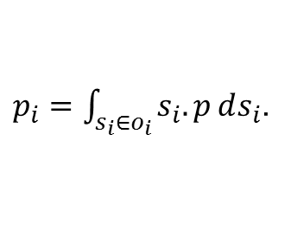
Probabilistic Range Query
(cont'd)
query region
q
The probability p_{i} of uncertain object o_{i} is defined as the appearance probability of object o_{i} falling into the query region QR(q)
  Discrete case
    p_{i} = ∑_{si∈oi ∧ si∈QR(q)} s_{i}.p, where s_{i} is the sample of object o_{i} and s_{i}.p is its existence probability
  Continuous case
    p_{i} is given by the integral over o_{i}
$p_{i}=\int_{s_{i}∈o_{i}}{s_{i}.p}ⅆs_{i}$.

Slide 17
Applications of PRQ
1-dimensional sensor data
  Obtain sensors that have values
    within distance r from query point q, or
    within a bound [l, u]
Cheng, R., Kalashnikov, D. V., Prabhakar, S. Evaluating probabilistic queries over imprecise data. In SIGMOD, 2003.
Notes:
[1] Cheng, R., Kalashnikov, D. V., Prabhakar, S. Evaluating probabilistic queries over imprecise data. SIGMOD, 2003.
[2] Cheng, R., Kalashnikov, D. V., Prabhakar, S. Querying imprecise data in moving object environments. TKDE, Vol. 16, No. 9, pp. 1112-1127, Sep 2004.

Slide 18
Exercises
query point q
Assume uncertain object o has a 2D rectangular uncertainty region of size 10 × 10, following Uniform distribution
A query point q is at one corner of the uncertainty region, and the query radius is 5
What is the probability that object o is within the query region?
5
10
10
uncertain object o
Notes:
P (o) = ((PI * 5 * 5) / 4)/ (10*10)

Slide 19
Straightforward Approach for PRQ Query Answering
To answer PRQ, it is not efficient to
  Check the intersection between every uncertain object and query region, and
  Compute the probability that the uncertain object falls into the intersection region
Therefore, efficient pruning techniques are proposed in the literature

Slide 20
PRQ Processing Techniques (1D)
1D sensor data, probabilistic range query
  x-bound: a bound such that the probability that sensory data are on its left/right side is equal to x
x-bound
p = 0.3,
Q is on RHS of B’s right-0.3-bound
➔ Object B can be safely pruned
Cheng, R., Xia, Y., Prabhakar, S., Shah, R., Vitter, J. S. Efficient indexing methods for probabilistic threshold queries over uncertain data. In VLDB, 2004.

Slide 21
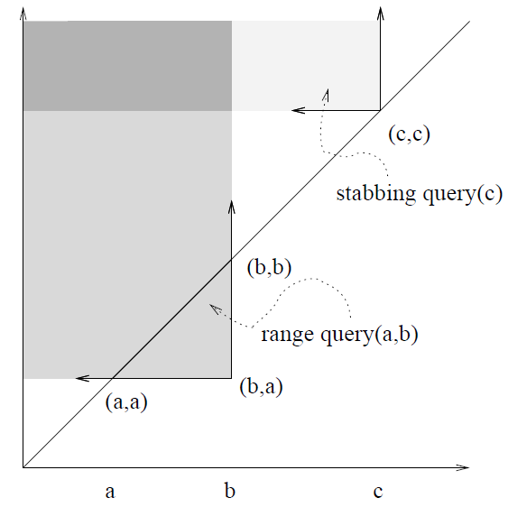
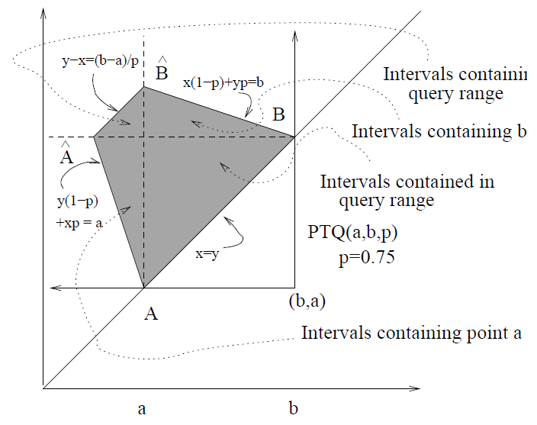
PRQ Processing Techniques (1D, cont'd)
1D sensor data, probabilistic range query
  Map 1D uncertain interval [x, y] (Uniform distribution) to a 2D point (x, y), which is indexed by R-tree
  Interval query [a, b] → 3-sided trapezoidal query
x ≤ a < b ≤ y
a ≤ x < b ≤ y
x ≤ a < y ≤ b
a < x < y < b
Interval Query
Probabilistic Threshold Query
Cheng, R., Xia, Y., Prabhakar, S., Shah, R., Vitter, J. S. Efficient indexing methods for probabilistic threshold queries over uncertain data. In VLDB, 2004.

Slide 22
PRQ Processing Techniques (Multidimensional Case)
PRQ on multidimensional uncertain data
  U-tree index
  Any dimensionality, range query, p-bound
0.2-bound
p_{q2} = 0.2
p_{q1} = 0.8
Tao, Y., Cheng, R., Xiao, X., Ngai, W. K., Kao, B., Prabhakar, S. Indexing multi-dimensional uncertain data with arbitrary probability density functions. In VLDB, 2005.

Slide 23
Probabilistic Nearest Neighbor Queries in Uncertain Databases

Slide 24
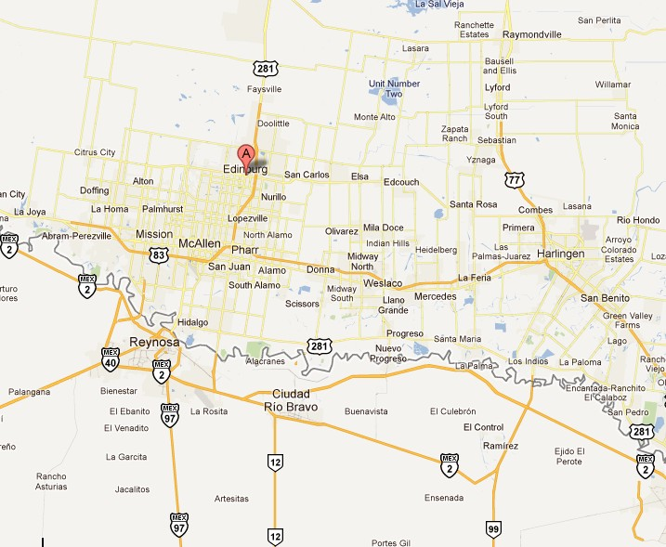


You are here!

Slide 25
Probabilistic Nearest Neighbor Query
uncertain database
e
the nearest neighbor of query point q is:
object d has probability of being NN > α
q
a
a, b or d
b, d
d
a
with maximum possible distance from q to a
b
c

Slide 26
Example (Nearest Neighbor Search)
traditional database
e
uncertain database
e
q
q
a
d
d
a
b
b
c
c
a
q
distance to q
d
q
a
d
b
c
e
distance to q
b
c
e

Slide 27
Probabilistic Nearest Neighbor Query
Given
  a query point q,
  an uncertain database D, and
  a probabilistic threshold α
A probabilistic nearest neighbor (PNN) query retrieves all the uncertain objects o in D that are nearest neighbors of q with probability P_{PNN}(q, o) greater than α, that is,
where r₁ and r₂ are the minimum and maximum distances from q to object o, respectively

Slide 28
Four Phases of PNNQ Processing
1. projection
phase
2. pruning
phase
3. bounding
phase
4. evaluation
phase
Cheng, R., Kalashnikov, D. V., Prabhakar, S. Querying imprecise data in moving object environments. In TKDE, Vol. 16, No. 9, pp. 1112-1127, Sep 2004.

Slide 29
Variant of PNNQ
PNNQ with uncertain query object
  Query object is an uncertain object
    E.g., in location based services, the position of a mobile user (query issue/object) is imprecise
    Double integral in the formula of probability:
  Discrete samples
    Indexing over samples
Kriegel, H.-P., Kunath, P., Renz, M. Probabilistic nearest-neighbor query on uncertain objects. In DASFAA, 2007.

Slide 30
Essential Pruning Ideas
Spatial Pruning
Probabilistic Pruning

Slide 31
Spatial Pruning
Basic idea
  Compute the lower/upper bounds of the distance, dist(q, o), from query point q to each uncertain object o at a low cost
  Use lower/upper bounds to filter out false alarms
uncertain database
e
q
d
a
b
c

Slide 32
Spatial Pruning (cont'd)
Obtain the smallest upper bound distance from q to objects we have seen so far as a threshold
If the lower bound distance from q to any object o is greater than threshold, then object o can be safely pruned
uncertain database
e
q
d
a
b
c

Slide 33
Example of Spatial Pruning
uncertain database
e
threshold
q
a
q
distance to q
d
d
a
candidates
b
b
c
false alarms
c
e

Slide 34
Probabilistic Pruning
(1-β)-Hypersphere
  For any uncertain object o, we can pre-compute a hypersphere within its uncertainty region UR(o), such that object o resides in the hypersphere with probability (1-β), where β ∈ [0, α]
Basic idea
  Use (1-β)-hypersphere to obtain the smallest upper bound distance from q to objects we have seen
  If the lower bound distance from q to any object o is greater than threshold, then object o can be safely pruned

Slide 35
Probabilistic Pruning
uncertain database
e
q
d
a
b
c

Slide 36
Probabilistic Pruning
uncertain database
e
threshold
q
a
q
distance to q
d
d
a
candidates
b
b
c
false alarms
c
e

Slide 37
PNN Query Processing
Maintain a multidimensional index structure over uncertain database // indexing phase
For each PNN query
  Apply the spatial/probabilistic pruning methods during the index traversal // pruning phase
  Refine candidates and return the answer set
  // refinement phase

Slide 38
Probabilistic k-Nearest Neighbor Queries
Generalization from 1NN to kNN
  A probabilistic k-nearest neighbor query (PkNNQ) retrieves a set of data objects o_{i} that are the k-nearest neighbors of a query object q with nonzero probability p_{i} (> 0)

Slide 39
Outline
Introduction
Probabilistic Query Types
Framework for Probabilistic Query Answering
Query Answering Techniques for Different Probabilistic Queries
Summary

Slide 40
Summary
In the scenario with uncertain data, queries need to be re-defined to probabilistic query types
Challenges of probabilistic query answering
  Efficiency
  effectiveness

Slide 41
Summary (cont'd)
Framework for answering probabilistic queries
  Indexing phase
  Pruning phase
  Refinement phase
Probabilistic queries
  Probabilistic range query
  Probabilistic k-nearest neighbor (kNN) query

