Slide 1
Probabilistic Data Management
Chapter 6: Probabilistic Query Answering (4)

Slide 2
Objectives
In this chapter, you will:
  Explore the definitions of more probabilistic query types
    Probabilistic spatial join /similarity join

Slide 3
Recall: Probabilistic Query Types
Probabilistic Spatial Query
Probabilistic Preference Query
3
Uncertain/probabilistic database
  Probabilistic range query
  Probabilistic k-nearest neighbor query
  Probabilistic group nearest neighbor (PGNN) query
  Probabilistic reverse k-nearest neighbor query
  Probabilistic spatial join /similarity join
  Probabilistic top-k query (or ranked query)
  Probabilistic skyline query
  Probabilistic reverse skyline query
Notes:
3

Slide 4
Probabilistic Spatial/Similarity Join
Given two uncertain databases D_{A} and D_{B}, a probabilistic spatial join (PSJ) retrieves objects o_{A}∈D_{A}, o_{B}∈D_{B} such that o_{A} and o_{B} satisfy join predicates with probability greater than a threshold p
Join result
D_{A}
D_{B}

Slide 5
Probabilistic Spatial/Similarity Join (cont'd)
Join predicates
  Equality, inequality, greater than, and less than
    Cheng, R., Singh, S., Prabhakar, S., Shah, R., Vitter J., Xia, Y. Efficient join processing over uncertain data. In CIKM, 2006.
  Range predicates
    Euclidean distance: dist(o_{A}, o_{B}) ≤ ε holds
      Kriegel, H.-P., Kunath, P., Pfeifle, M., Renz, M. Probabilistic similarity join on uncertain data. In DASFAA, 2006.
      Lian, X., Chen, L. Efficient Join Processing on Uncertain Data Streams. In CIKM, 2009.
    Expected edit distance (string)
      Jestes J., Li F., Yan, Z., Yi K. Probabilistic string similarity joins. In SIGMOD, 2010.
    Set similarity
      Lian, X., Chen, L. Set Similarity Join on Probabilistic Data. In VLDB, 2010

Slide 6
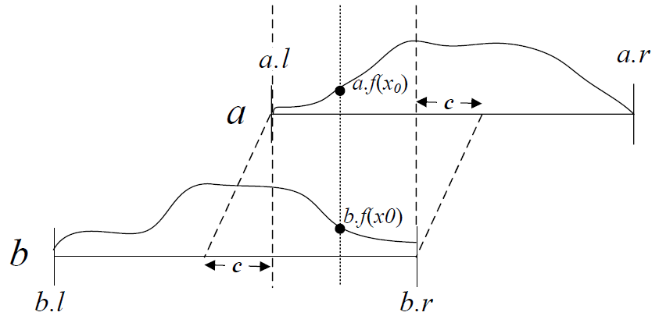
Join Over 1D Uncertain Data
  Data model
    Uncertainty interval: a.U = [a.l, a.r]
    Uncertainty pdf: a.f(x)
    Uncertainty cdf: a.F(x)
    Cheng, R., Singh, S., Prabhakar, S., Shah, R., Vitter J., Xia, Y. Efficient join processing over uncertain data. In CIKM, 2006.

Slide 7






Join Over 1D Uncertain Data (cont'd)
Given a resolution c, uncertain objects a and b satisfy the join predicate:
    Equality (=_{c}) with probability:
    Inequality (≠_{c}) with probability:
    Greater than (>) with probability:
    Less than (<) with probability:
    Cheng, R., Singh, S., Prabhakar, S., Shah, R., Vitter J., Xia, Y. Efficient join processing over uncertain data. In CIKM, 2006.

Slide 8
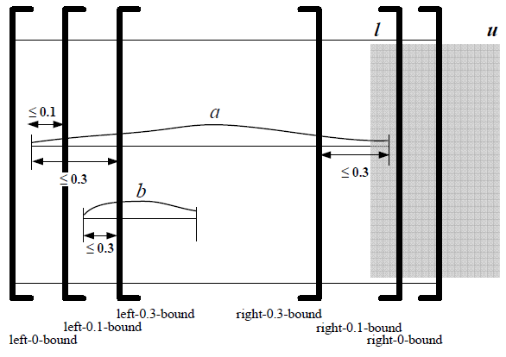
Join Over 1D Uncertain Data (cont'd)
Item-level pruning
  Derive lower/upper bounds for join probabilities
Pruning with x-bounds (also mentioned for PNN)
    Cheng, R., Singh, S., Prabhakar, S., Shah, R., Vitter J., Xia, Y. Efficient join processing over uncertain data. In CIKM, 2006.

Slide 9
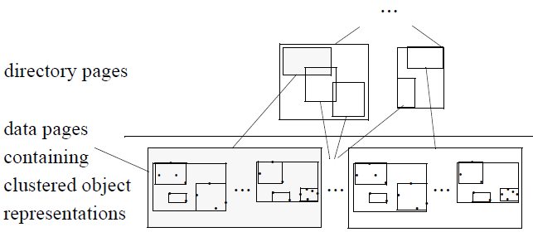
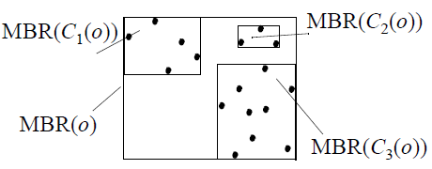
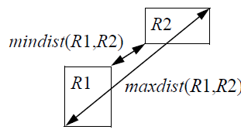
Spatial Join Over Uncertain Data
Data model
  Uncertain objects consist of several discrete samples
  Consider Euclidean distance among samples
Index for spatial join with range predicate
  Cluster objects
  Compute min/max distances between objects
  Index clustered objects
    Kriegel, H.-P., Kunath, P., Pfeifle, M., Renz, M. Probabilistic similarity join on uncertain data. In DASFAA, 2006.

Slide 10
Recall: Probabilistic Spatial/Similarity Join
Join predicates
  Equality, inequality, greater than, and less than
    Cheng, R., Singh, S., Prabhakar, S., Shah, R., Vitter J., Xia, Y. Efficient join processing over uncertain data. In CIKM, 2006.
  Range predicates
    Euclidean distance: dist(o_{A}, o_{B}) ≤ ε holds
      Kriegel, H.-P., Kunath, P., Pfeifle, M., Renz, M. Probabilistic similarity join on uncertain data. In DASFAA, 2006.
      Lian, X., Chen, L. Efficient Join Processing on Uncertain Data Streams. In CIKM, 2009.
    Expected edit distance (string)
      Jestes J., Li F., Yan, Z., Yi K. Probabilistic string similarity joins. In SIGMOD, 2010.
    Set similarity
      Lian, X., Chen, L. Set Similarity Join on Probabilistic Data. In VLDB, 2010

Slide 11
Efficient Join Processing on Uncertain Data Streams
ACM Conference on Information and Knowledge Management (CIKM), 2009

Slide 12
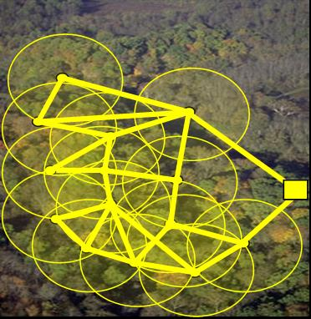

Coal Mine Application
In a coal mine, sensors are deployed in the tunnel to collect data such as the density of oxygen, dust, and gas, as well as the humidity and temperature
Detect abnormal events
  Fire
  Failures of sensors
coal mine
base
station
abnormal events
sensor data
Notes:
In the coal mine application, sensors are deployed to tunnels of the coal mine to collect data such as the temperature or humidity. The sensory data are transmitted from sensor nodes to the base station in the form of data streams. On the side of base station, the server should be able to identify some abnormal events such fire or failure of sensors.
Intuitively, sensors from spatially close locations are likely to report similar data. If a place is on fire, the temperature collected from a sensor in this place will deviate from that of its close sensor. In this case, if we continuously monitor the join pairs from these two streams, and there is a sudden decreasing number of similar data from two streams, then this place is likely to have abnormal events such as fire.

Slide 13

Trajectory Data Analysis
In the application of protecting the public safety, the trajectories of suspicious people can be monitored by police
suspicious people
Notes:
The Join on data streams also has the application in trajectory data analysis. To keep the public safety, the police can monitor the trajectories of suspicious people, either by GPS of mobile devices, or by some witnesses/police. In this case, we can also conduct a join on trajectories of these two suspicious people, and detect whether they recently go to the same place within a short period, possibly planning sth.

Slide 14
Other Applications
Elder-care applications
  Taking the wrong bus
  A sudden slow-down
Outlier detection
  Distance-based outliers
Notes:
Join on data streams has many other applications such as elder-care applications or outlier detection. If a person takes a wrong bus or has a sudden slow-down, his/her current trajectory may deviate from the normal one. Thus, the join can detect such changes and an alert can be sent.

Slide 15
Problem Statement
In many real-world applications, data uncertainty is ubiquitous
  Sensor networks
  Location-based services
  Moving object search
Problem: conduct the join processing over uncertain data streams efficiently and effectively
Notes:
In many real-world applications, data uncertainty is pervasive. As mentioned in previous examples, the sensor data or GPS data in data streams often contain noises, and are thus uncertain and imprecise.
Therefore, our problem is on how to conduct the join processing over uncertain data streams efficiently and effectively

Slide 16
Problem Definition
An uncertain data stream T consists of a sequence of uncertain objects T[1], T[2], …, T[t], …
Consider the sliding window containing the most recent w data
Notes:
Next, we give the formal definition for join on uncertain data streams.
An uncertain data stream consists of an ordered sequence of uncertain objects. For example, in data stream T1, X[1] is an uncertain object at timestamp 1.
In the literature of data stream, we usually consider the sliding window model containing the most recent w data. For example, W(T1) is the sliding window at timestamp t.. Then, at a new timestamp (t+1), the old data expire and the new data X[t+1] come in. We can obtain a new sliding window at timestamp (t+1).
Given two uncertain data streams, we want to conduct joins on the sliding windows of these two uncertain data streams, and output the joining pairs

Slide 17
Problem Definition (cont'd)
Join on uncertain data streams (USJ) retrieves pairs of uncertain objects X[i] and Y[j] from uncertain streams T₁ and T₂, respectively
  Pr{dist(X[i], Y[j]) ≤ ε}≥ α
Notes:
In particular, we say that two uncertain objects are joining with each other, if the probability that their distance is within \epsilon is greater than or equal to a threshold \alpha.
This join probability can be given by the formula below. Assuming each uncertain object consists of several samples, we need to compare the distance between pairwise samples and obtain the join probability.

Slide 18
Straightforward Method
For each pair of uncertain objects X[i] and Y[j]
  Compute probability Pr{dist(X[i], Y[j]) ≤ ε} using samples
  If Pr{dist(X[i], Y[j]) ≤ ε}≥ α
    Report pair (X[i], Y[j])
  Complexity: O(w²⋅l²⋅d)
    w is the size of sliding window
    l is the sample size per object
    d is the dimensionality of objects
Notes:
Therefore, one straightforward method is to check each pair of uncertain objects in sliding windows from two uncertain streams, and compute the join probability.
If the probability is greater than or equal to alpha, then we report the pair as join answer.
However, this method is inefficient, incurring O(w²⋅l²⋅d) cost, where w is the size of sliding window, l is the sample size per object, and d is the dimensionality of objects.
In order to filter out as many as false positives, we proposed effective pruning methods on both object-level and sample-level.

Slide 19
Object-Level Pruning
Basic idea
  Prune those object pairs that definitely do not match with each other
Bound all samples of an uncertain object X[i] (Y[j]) with a hypersphere
If mindist(X[i], Y[j])>ε, then pair (X[i], Y[j]) can be safely pruned
Notes:
The idea of the object-level pruning is to filter out those object pairs from two uncertain streams that definitely do not match with each other
In particular, we use a hypersphere to bound all the samples of each uncertain object.
Then, if the minimum distance between any two object hyperspheres is greater than epsilon, then any two samples within them have distance greater than epsilon. Thus, we can safely prune this object pair

Slide 20
Sample-Level Pruning
Basic idea
  Utilize the object distribution to prune those object pairs with matching probability smaller than α
(1-β)-hypersphere
  Object T[i] resides in (1-β)-hypersphere with probability (1-β)
Notes:
The second pruning method is the sample-level pruning, which uses the object distribution to prune object pairs with join probabilities smaller than alpha
To enable sample-level pruning, we use a notion called (1-β)-hypersphere, which is a smaller hypersphere within the bounding hypersphere of uncertainty region such that object resides in this smaller hypersphere with probability (1-b)

Slide 21
Sample-Level Pruning (cont'd)
Pruning condition
  If mindist(HS_{1-γ 1}(X[i]), HS_{1-γ 2}(X[y])) > ε, then uncertain object pair (X[i], Y[j]) can be safely pruned, where (1-γ₁) (1−γ₂) > 1-α
Notes:
By using the notion of (1-b)-hypersphere, we can have the sample-level pruning. That is, if the minimum distance between two (1-b)-hyperspheres is greater than epsilon, and the beta parameter satisfies the inequality (1-γ₁) (1−γ₂) > 1-α, τηεν οβϕεχτ Τ[ι] χαν βε σαφελψ πρυνεδ

Slide 22
Incremental Maintenance of USJ Results
Index uncertain objects from the stream in a grid index
  Each cell contains uncertain objects with centers in it
For each timestamp (t+1)
  Apply our pruning methods to reduce the search space to retrieve uncertain objects Y[j] in W(T₂) that are similar to X[t+1] with probability greater than α
  Refine the remaining candidates
Notes:
After introducing the pruning methods, we illustrate our USJ computation.
In particular, we index the uncertain objects in a grid index such that each cell contains uncertain objects with centers in it.
At each timestamp, we incrementally maintain the USJ results. That is, for each newly incoming data, say X[t+1], we join it with objects from the other stream, T2, and apply our pruning methods to filter out those false alarms via the grid index
After the filtering, we can obtain a candidate set, and refine candidates in it according the USJ definition

Slide 23
Experimental Evaluation
Real data sets
  Sensor data from Intel Berkeley Research lab: sensor
  GPS data (altitude, latitude, and longitude): GPS
  We simulate the uncertainty by generating samples within a hypersphere HS(o) centered at real data and with radius r ∈ [r_{min}, r_{min}] following Uniform or Gaussian distribution
Competitor
  Straightforward method: obtain pairs of uncertain objects from two uncertain data streams and check the join condition
Measure
  Pruning power
  Time cost per timestamp
Notes:
Finally, we illustrate the experimental results.
We conducted our experiments on real sensor and GPS data. We simulate the impreciseness in data by generating samples within a hypersphere centered at real data, and with radius r following uniform or Gaussian distribution
We compare our approach with the straightforward method, which obtains pairs of uncertain objects from two uncertain data streams and checks the join condition
We report our results in terms of the pruning power and time cost per timestamp

Slide 24
Pruning Power vs. Probabilistic Threshold α
sensor data
dimensionality d = 3, radius range [r_{min}, r_{max}] = [1, 50], and window size w = 1,000
Notes:
Here is the experimental result about the pruning power of our approach over sensor data. The upper part of columns correspond to the power of the object-level pruning, and the lower part is that of the sample-level pruning. We can see that the total pruning power is high, more than 90%

Slide 25
Performance vs. Window Size w
sensor_rUrG data
dimensionality d = 3, radius range [r_{min}, r_{max}] = [1, 50], and probabilistic threshold α = 0.5
Notes:
Here is another set of experiments about the performance on different window sizes. Grid is our method and the other one is the straightforward method. We can see that our approach performs much better than the straightforward method, which also indicates the effectiveness of our pruning methods.

Slide 26
Conclusions
We formalize the problem of join processing over uncertain data streams (USJ)
We propose effective pruning techniques for filtering out false alarms of candidate pairs
We give an efficient procedure to incrementally maintain USJ results via a grid index by utilizing the proposed pruning methods
We demonstrate the efficiency and effectiveness of our proposed USJ approach
Notes:
To conclude, we formalize the problem of join over uncertain data streams
We proposed effective pruning methods to prune false positives among candidate pairs
We provide an efficient procedure to incrementally main the USJ results by a grid index and apply our proposed pruning techniques
Finally, we conduct extensive experiments to test the efficiency and effectiveness of our proposed approach

Slide 27
Recall: Probabilistic Spatial/Similarity Join
Join predicates
  Equality, inequality, greater than, and less than
    Cheng, R., Singh, S., Prabhakar, S., Shah, R., Vitter J., Xia, Y. Efficient join processing over uncertain data. In CIKM, 2006.
  Range predicates
    Euclidean distance: dist(o_{A}, o_{B}) ≤ ε holds
      Kriegel, H.-P., Kunath, P., Pfeifle, M., Renz, M. Probabilistic similarity join on uncertain data. In DASFAA, 2006.
      Lian, X., Chen, L. Efficient Join Processing on Uncertain Data Streams. In CIKM, 2009.
    Expected edit distance (string)
      Jestes J., Li F., Yan, Z., Yi K. Probabilistic string similarity joins. In SIGMOD, 2010.
    Set similarity
      Lian, X., Chen, L. Set Similarity Join on Probabilistic Data. In VLDB, 2010

Slide 28
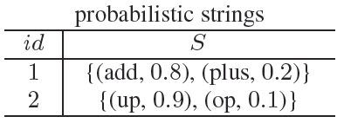
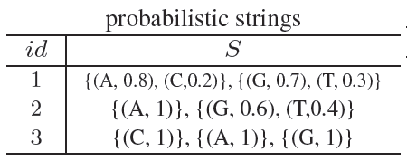
Probabilistic String Join
Probabilistic string model
  String-level model
  Character-level model
  Measure: Expected edit distance
  A probabilistic string join obtains pairs of strings from two probabilistic databases such that distance between string pairs are smaller than a given threshold τ
    Jestes J., Li F., Yan, Z., Yi K. Probabilistic string similarity joins. In SIGMOD, 2010.

Slide 29
Probabilistic Set Similarity Join
Probabilistic set model
  Set-level model
  Element-level model
  Measure: Jaccard distance
  A probabilistic set similarity join (PS²J) operator obtains all pairs (r_{i}, s_{j}) from R^{p} and S^{p} such that Pr{sim(r_{i}, s_{j}) ≥ γ} ≥ α, where sim(., .) is a set similarity measure, Jaccard similarity
    Lian, X., Chen, L. Set Similarity Join on Probabilistic Data. In VLDB, 2010

Slide 30
Set Similarity Join on Probabilistic Data
Very Large Data Bases (VLDB), 2010

Slide 31









Motivation Example – Data Integration
find and merge similar documents
data sources
integrated database
…
…
…
data integration
set similarity join on documents from different data sources

Slide 32
Motivation Example – Set-Level Probabilistic Sets
the confidence that a document is true
Doc 1
0.2
Doc 2
0.4
a set-level probabilistic set
…
…
…
a data source
a document entity
Doc l
0.3
each document contains a set of tokens
near duplicate documents

Slide 33
Motivation Example – Element-Level Probabilistic Sets
world 0.5
word 0.4
This is the ???.
… … … … …
an element-level probabilistic set
… … … … …
… ??? … … …
… … … … …
a data source
a document entity
different OCR documents

Slide 34

Motivation Example – Data Integration
data integration
identify and merge similar probabilistic sets with high confidence
data sources
…
…
…
Probabilistic Set Similarity Join
probabilistic sets

Slide 35
Outline
Introduction
Problem Definition
Probabilistic Set Similarity Join Processing
Experimental Results
Summary

Slide 36
Introduction
Set similarity join has many real applications
  Data cleaning
  Near duplicate detection
  Data integration
Due to the unreliability of data sources or data extraction techniques, uncertainty may exist in the collected set data
Doc 1
0.2
This is the ???.
Doc 2
0.4
… … … …
… … … …
…
…
…
… ??? … …
a document entity
Doc l
0.3
… … … …
near duplicate documents

Slide 37
Introduction (cont'd)
Our contributions
Formalize uncertainty models for probabilistic set data
Define the problem of probabilistic set similarity join (PS²J)
Reduce the PS²J problem and design effective pruning techniques to filter out false alarms

Slide 38
Uncertainty Models for Probabilistic Set Data
Uncertainty granularities
  Set-level probabilistic set data
  Element-level probabilistic set data

Slide 39
Uncertainty Models for Probabilistic Set Data (cont'd)
Uncertainty granularities
  Set-level probabilistic set data
Doc 1
0.2
Inst. r_{i1}
0.2
Doc 2
0.4
r_{i}
Inst. r_{i2}
0.4
…
…
…
…
…
…
Doc l
0.3
Inst. r_{i li}
0.3
a document entity
a probabilistic set, r_{i}
existence probability
r_{ik}.p
near duplicate documents
set instances,
r_{ik}
sets of token data for data integration
set-level probabilistic set, r_{i}

Slide 40
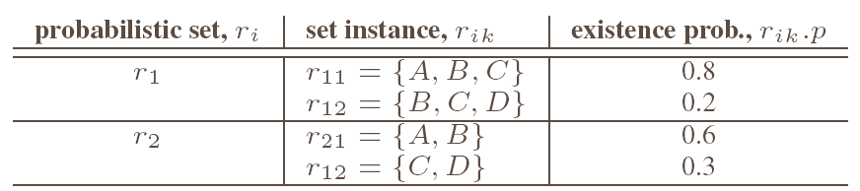
An Example of the Set-Level Probabilistic Set Database
set-level probabilistic set database, R^{P}
6 possible worlds of the set-level probabilistic set database, pw^{SL}(R^{P})

Slide 41
Uncertainty Models for Probabilistic Set Data (cont'd)
r_{i}¹[4].p
Uncertainty granularities
  Element-level probabilistic set data
world 0.5
word 0.4
r_{i}[4] = {(world, 0.5), (word, 0.4)}
This is the ???.
r_{i}[1] r_{i}[2] r_{i}[3] r_{i}[4]
… … … …
… … … … …
… … … …
… … … … …
… ??? … …
… r_{i} [k] … … …
… … … …
… … … … …
documents obtained from different OCRs
element-level probabilistic set r_{i}

Slide 42
An Example of the Element-Level Probabilistic Set Database
element-level probabilistic set database, R^{P}
8 possible worlds of the element-level probabilistic set database, pw^{EL}(R^{P})

Slide 43
Problem Definition
PS²J results
R^{p}
S^{p}
Probabilistic Set Similarity Join, PS²J
  Given
    two probabilistic set databases R^{p} and S^{p}
    a similarity threshold γ, and
    a probabilistic threshold α
  a PS²J operator obtains all pairs (r_{i}, s_{j}) from R^{p} and S^{p} such that Pr{sim(r_{i}, s_{j}) ≥ γ} ≥ α, where sim(., .) is a set similarity measure, Jaccard similarity
x ∩ y
x
y

Slide 44


Problem Definition (cont'd)
Computation of Pr{sim(r_{i}, s_{j}) ≥ γ} under the set-level uncertainty
an exponential number of possible worlds
…
pw(R^{p})
R^{p}
PS²J results
…
pw(S^{p})
S^{p}

Slide 45
Problem Reduction
To avoid checking an exponential number of possible worlds, we reduce the probability computation in possible worlds to the one on pairwise set instances
Pruning Techniques
  Jaccard distance pruning
  Probability upper bound pruning

Slide 46
Jaccard Distance Pruning
Basic idea
  Observation: Jaccard distance, J_dist (x, y) , is a metric distance function
    J_dist (x, y) = 1 – J(x, y), where J(x, y) is the Jaccard similarity measure
  Thus, J_dist (x, y) follows the triangle inequality
Pruning rule

Slide 47

Probability Upper Bound Pruning
We derived the probability upper bound, UB_P(r_{i}, s_{j}) of the PS²J probability Pr{J(r_{i}, s_{j}) ≥ γ}
If UB_P(r_{i}, s_{j}) < α, then the pair (r_{i}, s_{j}) can be safely pruned
≤ …

Slide 48
Derivation of Probability Upper Bound

Slide 49
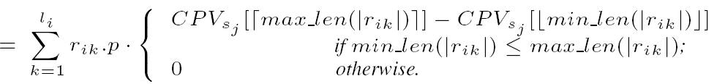
Derivation of Probability Upper Bound (cont'd)
We sort set instances s_{jk} of a probabilistic set s_{j} by their sizes
  Assume |r_{i1}| ≤ |r_{i2}| ≤ … ≤ |r_{ili}| and |s_{j1}| ≤ |s_{j2}| ≤ … ≤ |s_{jlj}|
  Construct a cumulative probability vector, CPV_{Sj}, where CPV_{Sj}[w] stores the cumulative probability of set instances s_{jk} satisfying |s_{jk}| ≤ w
where
and

Slide 50

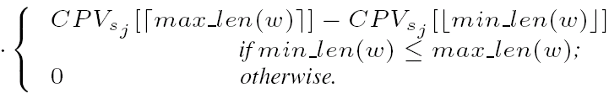

Highlight of Element-Level Probabilistic Sets
For the element-level uncertainty, we need to compute the probability that set instances in a probabilistic set r_{i} have size = w
recursive function
w

Slide 51
PS²J Processing
Use M-tree + synopses (e.g., CPV_{Sj}) to index each probabilistic set database
For any PS²J operator
  Traverse both indexes of probabilistic set databases
  For any pair of nodes/probabilistic sets we encounter
    Apply the Jaccard distance and probability upper bound pruning methods
  Refine candidate pairs and return answers
Notes:
If a pair of nodes cannot be pruned, we access their children; if a pair of probabilistic sets in leaf nodes cannot be pruned, we add it to a candidate set

Slide 52
Experimental Evaluation
Data sets:
  Synthetic data:
    For each probabilistic set r_{i}, generate set instances, r_{ik}, with elements following Uniform/Gaussian distribution (U-Syn / G-Syn)
    Randomly produce existence probabilities for set instances
  Real data: DBLP data
    Parse tokens in paper titles, and randomly generate set instances by altering elements
    Assign existence probabilities to set instances
  We also tested set data with the element-level uncertainty
Competitor
  Compare our PS²J approach with the nested loop join (NLJ)

Slide 53
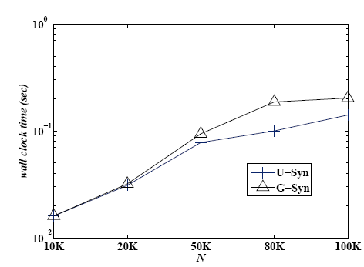
PS²J Performance vs. Data Size N
wall clock time
speed-up ratio
α = 0.5, γ = 0.5, the number of instances per probabilistic set ∈ [1, 5], the number of elements per set instance ∈ [5, 10]

Slide 54
Conclusions
Formalize uncertainty models for probabilistic set data
Define the problem of probabilistic set similarity join (PS²J)
Reduce the PS²J problem and design effective pruning methods to reduce the search space
Conduct extensive experiments to verify the PS²J performance of our approaches

Slide 55
Summary
Probabilistic spatial join /similarity join
  Join predicates

