Slide 1
CS 69099 Capstone Project - Data Science
Project Descriptions (2)
Xiang Lian
Department of Computer Science
Kent State University
Email: xlian@kent.edu
Homepage: http://www.cs.kent.edu/~xlian/
Notes:
The slides of this course used some public slides/materials on the Web. I would like to acknowledge these resources, and please let me know if I failed to cite them.

Slide 2
List of Potential Projects
1. Location-based Web system and iOS implementation
2. iCampus
3. Street View Based GPS Assistance
4. Path Navigation over Road Networks
5. Spatial Question/Answer System
6. Keyword Search and Visualization of Knowledge Graphs
7. Crawling and Querying Social Networks
8. Guide of the Course Selection
9. Parsing and Visualizing the Bibliography
10. Visualizing and Querying New York Taxi Data
http://www.cs.kent.edu/~xlian/2023Spring_CS69099.html

Slide 3
3. Street View Based GPS Assistance
People at the intersecting point of roads may often be confused about the name of crossing roads
In this project, we will use the sensors (compass) in mobile devices to show the street views and road names of the current direction, which can provide users with clear navigation direction
This project will use Google maps or other map API services, and provide GPS-based mobile assistance for mobile users
Requirements: mobile programming, database design, algorithm design

Slide 4
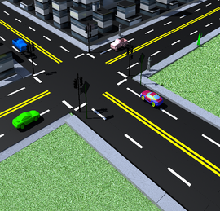
Navigation for Walking People
With GPS on smart phones, you can obtain the path on the map
At the intersection point, with unclear road signs, you may not know which direction you should go

Slide 5
Solution
Compass sensor in the smart phone
https://www.quora.com/How-does-a-compass-work-in-smart-phones-What-sensors-are-used-and-how-do-they-show-the-correct-directions
The direction can be obtained from the compass sensor
Integrate the direction information with the map
Assist people to identify the street names

Slide 6
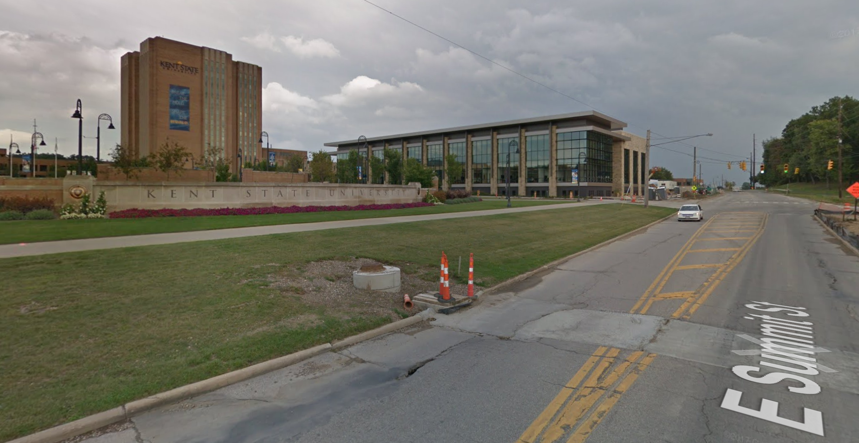
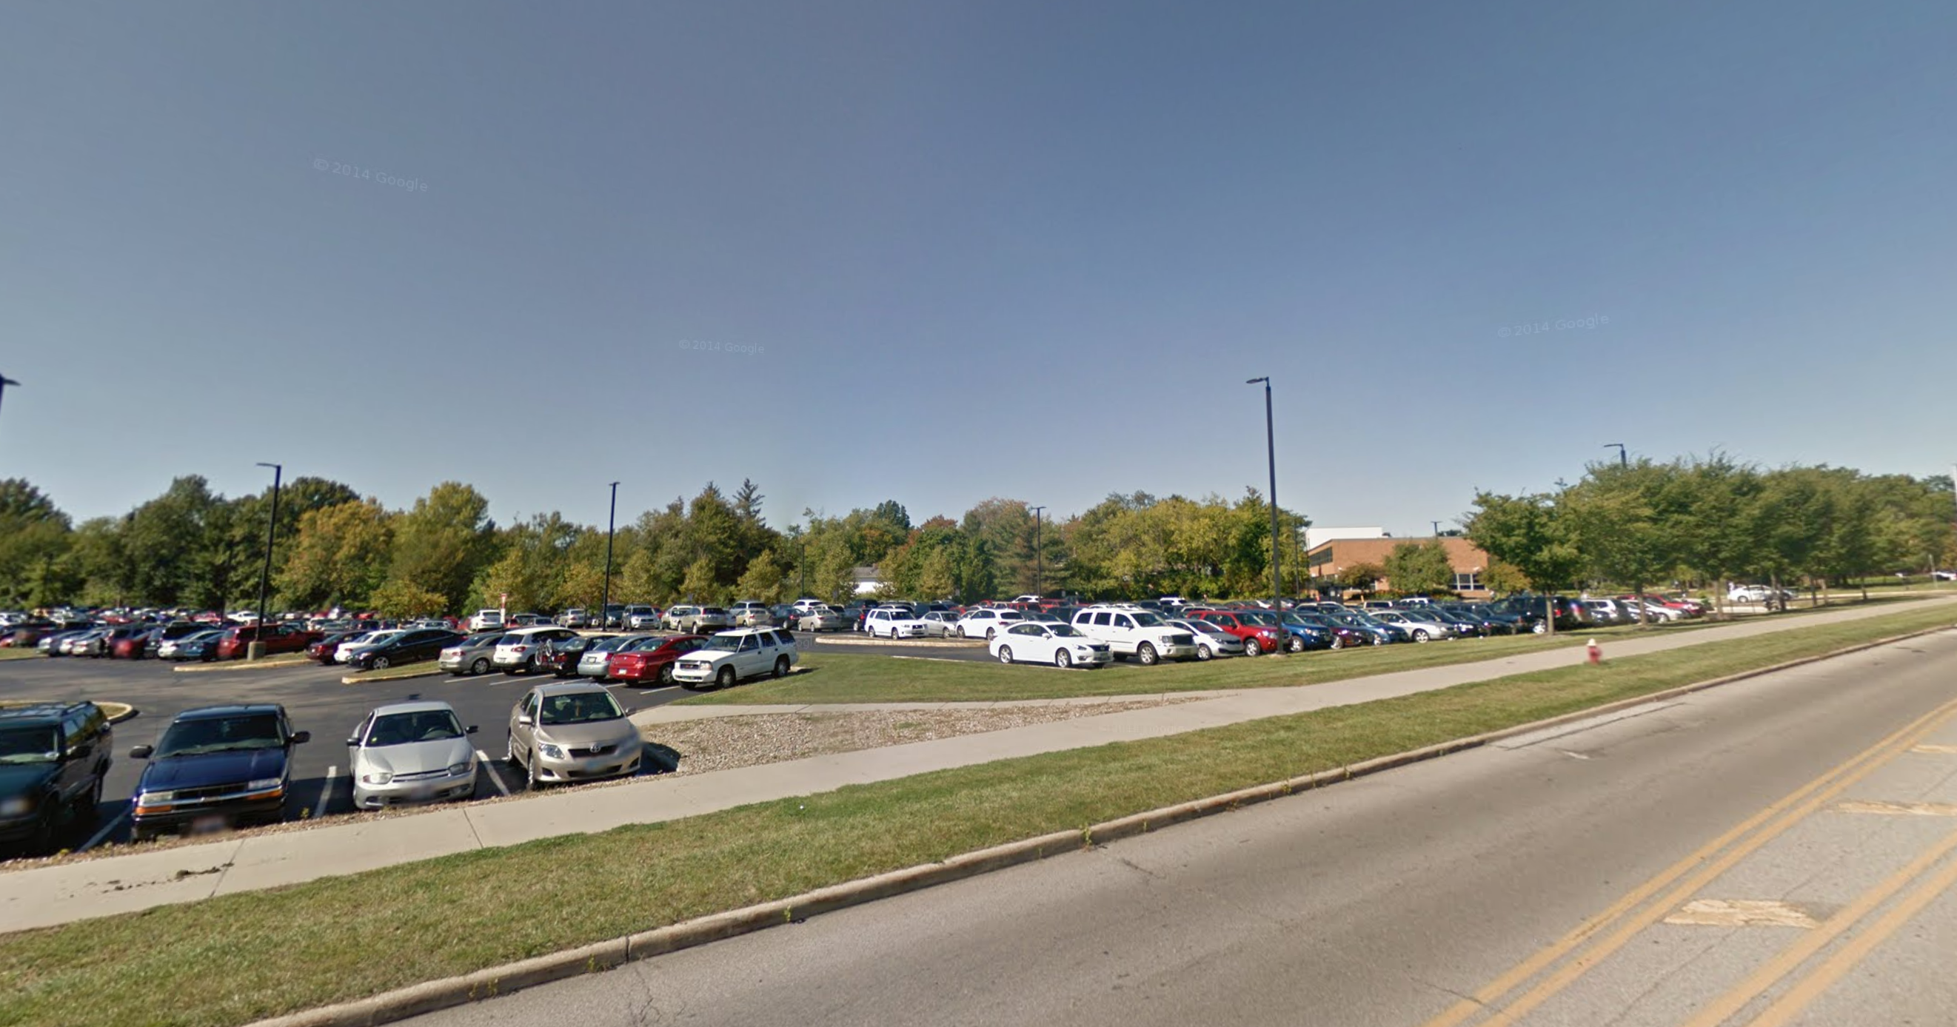
Basic Functions
Path navigation
Suggest the names of the intersection points of roads
Augmented recommendation of points of interests (POIs)
Like street view
Show POIs for different directions (obtained from compass)
KSU library
Schwartz Center

Slide 7
4. Path Navigation over Road Networks
In this project, we aim to collect real-time gas prices of gas stations on road networks, and find a best driving path from source to destination on road networks which needs to add gas at some gas station
The selected path passing by the gas station should have the lowest total gas consumption (distance) and price
The path navigation will be displayed by a mobile App
Requirements: mobile programming, database design, algorithm design

Slide 8
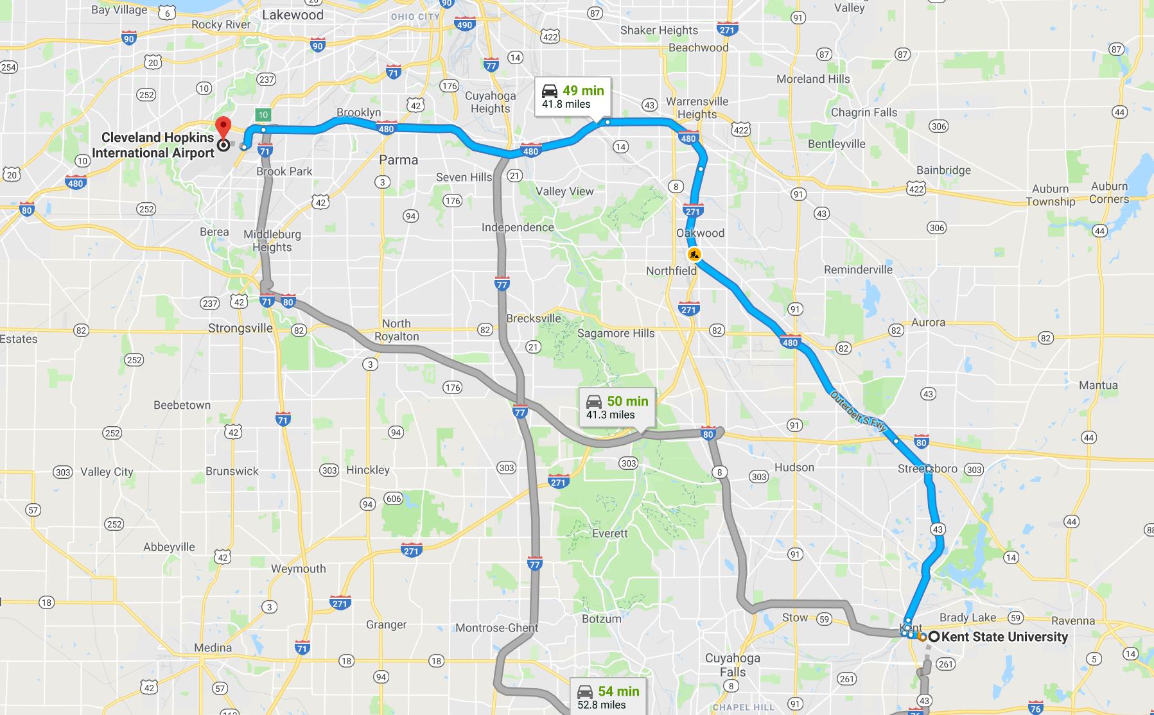
Which Path to Select?
$3.55/gallon
$3.19/gallon

Slide 9
Which Path to Select? (cont'd)
Each car has a miles per gallon (MPG) value (e.g., KBB)
Each gas station has a real-time gas price (e.g., from Gas Buddy)
You can know the extra distance you need to travel by detouring to the gas station
We can calculate the extra costs (= (extra distance / MPG) * gas price) for different gas stations
Select the one with the lowest extra cost
Kelley Blue Book: https://www.kbb.com/
Gas Buddy: http://then.gasbuddy.com/

Slide 10
List of Potential Projects
1. Location-based Web system and iOS implementation
2. iCampus
3. Street View Based GPS Assistance
4. Path Navigation over Road Networks
5. Spatial Question/Answer System
6. Keyword Search and Visualization of Knowledge Graphs
7. Crawling and Querying Social Networks
8. Guide of the Course Selection
9. Parsing and Visualizing the Bibliography
10. Visualizing and Querying New York Taxi Data
http://www.cs.kent.edu/~xlian/2023Spring_CS69099.html

Slide 11
6. Keyword Search and Visualization of Knowledge Graphs
In this project, we will conduct keyword search in knowledge graphs (e.g., Wikipedia, DBPedia, etc.) and visualize the relationships of Web pages that contain query keywords in a designed GUI interface
Requirements: visual programming (e.g., C++, C#, Java, Python, etc.), database design, algorithm design

Slide 12
DBPedia
DBPedia
http://wiki.dbpedia.org/develop/datasets
Resource Description Framework (RDF)
Describe resources and their relationships
Triple representation
Graph representation
<subject, predicate, object>
subject
object
predicate

Slide 13
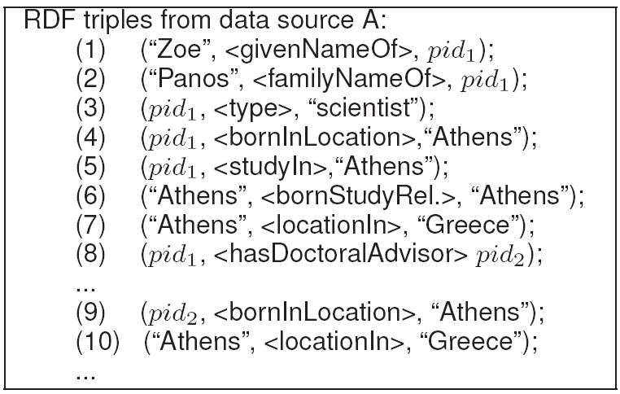
RDF Example
triple representation
graph representation

Slide 14
Queries
Query Examples:
Keyword search queries
Given 2 query keywords, find the relationships (paths) between nodes containing these two query keywords
Given n query keywords, find minimum subgraphs from the data graph (e.g., Dbpedia) that contain these query keywords
Database
Design a database to store these RDF data
Create indexes for keywords for fast access to data
Visualization
Design a GUI for visualizing and querying RDF graphs

Slide 15
7. Crawling and Querying Social Networks
In this project, we will crawl social network data (e.g., Twitter), store them in a graph database, conduct queries (e.g., spatial-temporal, keyword, sentimental queries) on social networks, and visualize social networks and query results
Requirements: Internet programming (e.g., C++, C#, Java, Python, etc.), database design, algorithm design

Slide 16
Twitter
Crawl Twitter data and store them in a database
Queries on Twitter data
Keyword search
Spatial-temporal queries (e.g., finding/visualizing hot topics at some spatial regions during some period)
Sentimental queries (positive, neutral, or negative about some topics like shopping on Black Friday)
Community search/detection
Visualization
Visualizing social networks
Visualizing Twitters on a map

Slide 17
8. Guide of the Course Selection
In this project, we will extract course information (including course prerequisites, credit hours, course descriptions, etc.) from KSU course catalog (http://catalog.kent.edu/coursesaz/asei/)
Construct a course prerequisite graph
Suggest students take new courses for the next semester, based on courses that students have already taken and course prerequisites
A query GUI interface will be designed in this project
Requirements: programming (e.g., C++, C#, Java, Python, etc.), database design, algorithm design

Slide 18
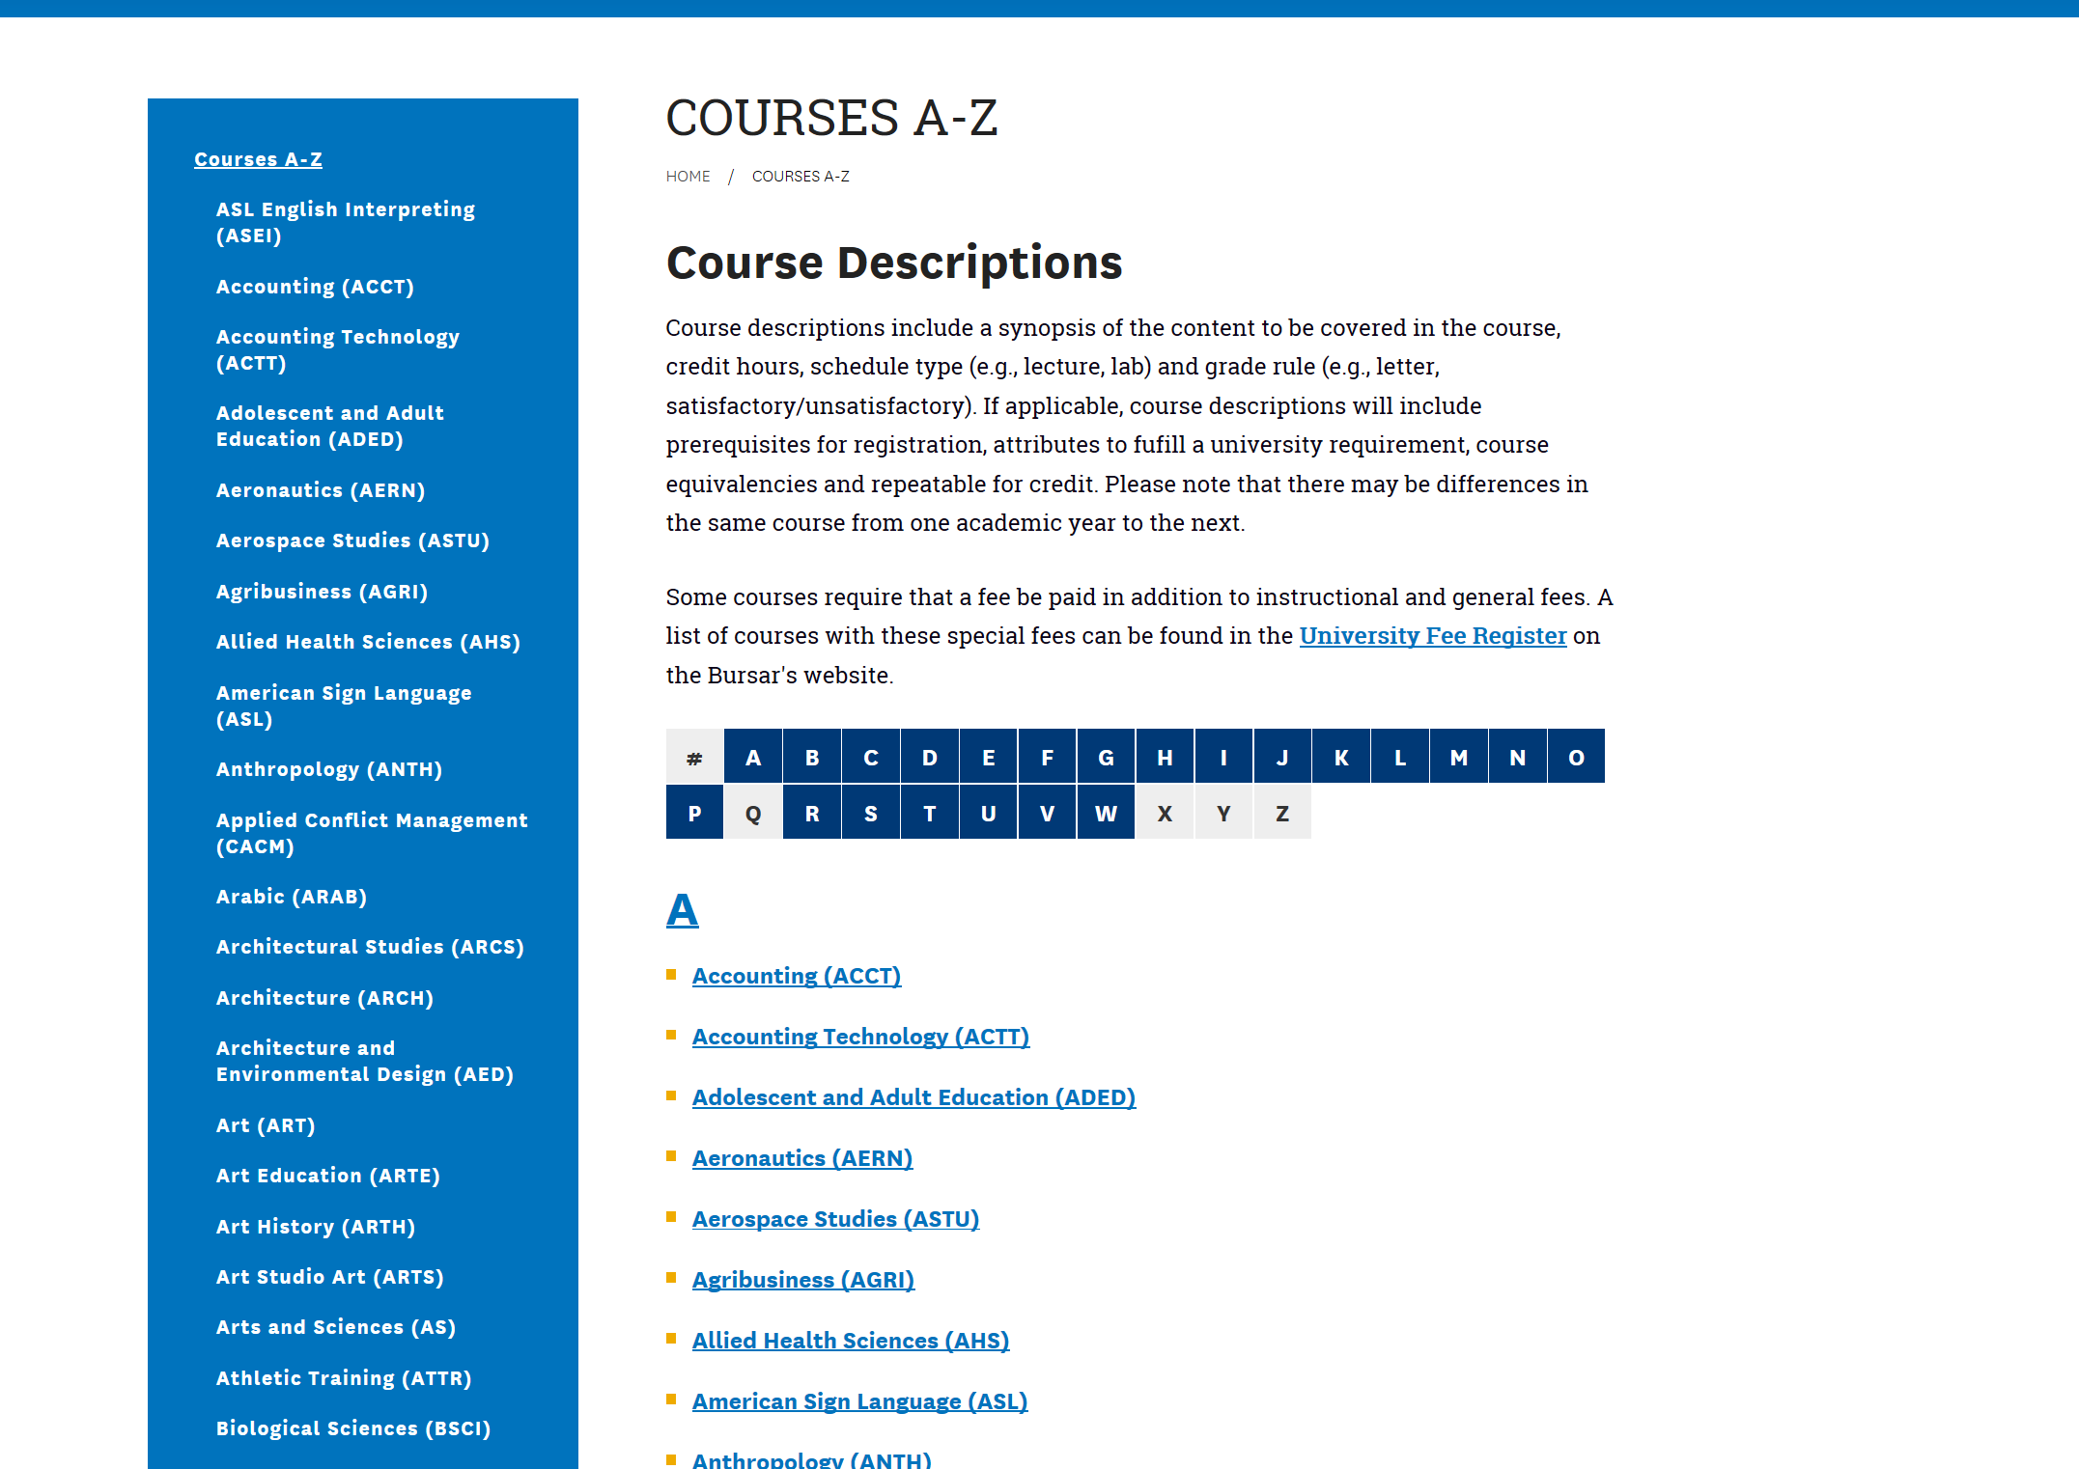
Automatic Crawling Data from KSU Course Catalog
Catalog may be updated every year
It is labor-costly to manually enter/update catalogs in the database
Automatic crawling of course information from KSU websites

Slide 19
Prerequisite Graph
CS 49901 Prerequisites: CS 35201 (Computer Communication Networks), CS 33901 (Software Engineering), CS 33007 (Introduction to Database System Design); Programming skills are required.
CS 35201
CS 33901
CS 33007
CS 49901

Slide 20
More Functions
Each student can create an account (database issue)
He/she can specify courses taken every semester (like a transcript)
The software can suggest courses that he/she can take (satisfying the prerequisite requirements)
Use GUI to visualize the prerequisite graph for this student, show course information, etc.

Slide 21
9. Parsing and Visualizing the Bibliography
In this project, we will automatically parse the bibliography data sets (e.g., DBLP: http://dblp.uni-trier.de/xml/), visualize the co-author relationships among authors, and conduct queries over bibliography data sets
Requirements: programming (e.g., C++, C#, Java, Python, etc.), database design, algorithm design

Slide 22
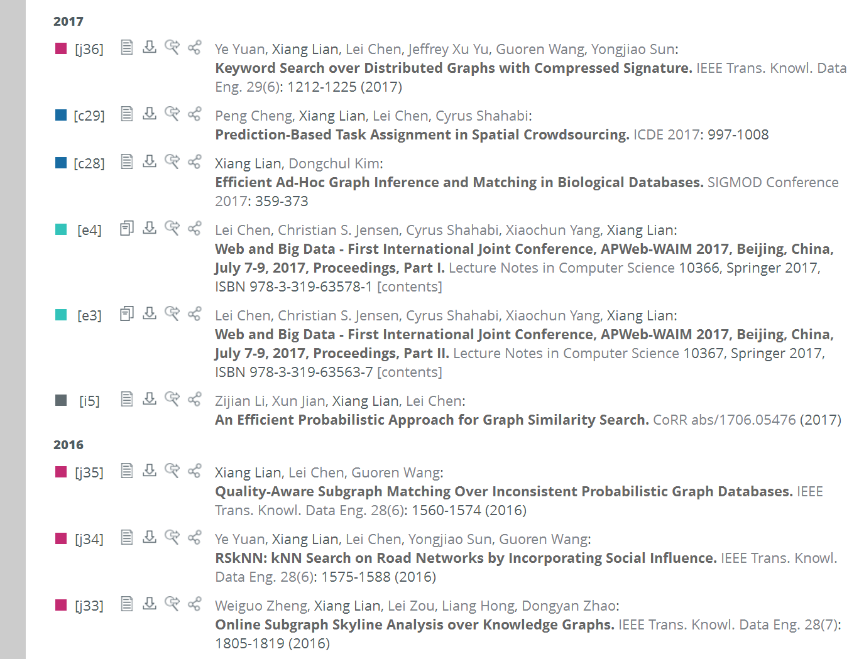
DBLP
DBLP in XML format
http://dblp.uni-trier.de/xml/
co-authors
paper title
journal/conference name
volume
issue
pages
year
…

Slide 23
Functions
Parse XML documents of DBLP data
Store them in a database
Create a graph of authors (each node is an author, and each edge between two persons/nodes if they have at least one co-author paper)
Queries
Keyword search
Find hot paper topics (keywords) within a user-specified period
Visualization
Node weight (a large node indicates a large number of publications)
Edge weight (a thick edge implies close collaboration between two authors)

Slide 24
10. Visualizing and Querying New York Taxi Data
See lecture slides in Chapter 1
Taxi data sets
https://opendata.cityofnewyork.us/data/
http://www.cs.kent.edu/~xlian/2023Spring_CS69099/NYC_taxi_description.pdf
Requirements: visual programming (e.g., C++, C#, Java, Python, etc.), database design

