Slide 1
CS 69099 Capstone Project - Data Science
Project Progress Report
Xiang Lian
Department of Computer Science
Kent State University
Email: xlian@kent.edu
Homepage: http://www.cs.kent.edu/~xlian/
Notes:
The slides of this course used some public slides/materials on the Web. I would like to acknowledge these resources, and please let me know if I failed to cite them.

Slide 2
Getting Started
Problem Definition
Definition of Functional/Non-functional Requirements
Software Development Life Cycle Overview
Use Cases

Slide 3
Problem Definition
Project Title
Reflect and cover topics of project
Be concise
Motivation examples of this project
Give the informal and formal definitions of your problem
Brief description about the intuition of your problem
Formal definition of your problem

Slide 4
Problem Definition (cont'd)
Challenges of the problem
Real applications
Who will use your software?
Student?
Faculty?
Company?
Government?
Local communities?
In what domain, will your software be used?
Map services?
Social network company?
Course catalog development?

Slide 5
Definition of Functional/Non-functional Requirements
Components of your project
Divide your project into subtasks
Backend database & server
Web or Mobile interfaces
Example:
Login function
Data collection function
Data transmission function
Data processing function
Data visualization function (GUI)
Each subtask is assigned with one or two group members
Example:
Database designers
Web or mobile programmers
GUI designers

Slide 6
Software & Tools
Software tools
DBMS, GUI, IDE, existing library, …
Required hardware
Related programming skills
Functions
Internet programming
Mobile programming (e.g., Android, iOS, etc.)
Object-oriented programming
Distributed environment

Slide 7
Definition of Functional/Non-functional Requirements (cont'd)
Functional requirements
Any project’s requirements need to be well thought out, balanced and clearly understood by all involved, but perhaps of most importance is that they are not dropped or compromised halfway through the project
Typically, functional requirements will specify a behavior or function
Display the name, total size, available space and format of a flash drive connected to the USB port
Add customer
Print invoice
Clarify the input and output of each component in your project
Define the protocol among multiple components in your project
Data schema
Data format during the data transmission
https://reqtest.com/requirements-blog/functional-vs-non-functional-requirements/
Notes:
https://reqtest.com/requirements-blog/functional-vs-non-functional-requirements/

Slide 8
Definition of Functional/Non-functional Requirements (cont'd)
Assign the workload among group members evenly
It is better to divide the workload such that all group members can work in parallel
Do not wait for each other
That is why you need to define the protocol for different components!
You can write the stub program
A method stub or simply stub in software development is a piece of code used to stand in for some other programming functionality
int sum (int x, int y) {
int rlt = x+y;
return rlt;
}
int sum (int x, int y) {
return 9;
}
stub
https://en.wikipedia.org/wiki/Method_stub

Slide 9
Definition of Functional/Non-functional Requirements (cont'd)
Non-functional requirements
Typical non-functional requirements describe how the system works
User Friendliness
Performance – Response Time, Throughput, Utilization, Static Volumetric
Scalability
Capacity
Availability
Reliability
Recoverability
Maintainability
Serviceability
Security
Regulatory
Manageability
Environmental
Data Integrity
Usability
Interoperability
quality characteristics or quality attributes
https://reqtest.com/requirements-blog/functional-vs-non-functional-requirements/

Slide 10
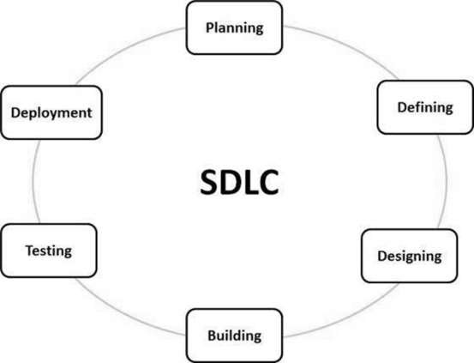
Software Development Life Cycle Overview
Software Development Life Cycle (SDLC) is a process used by the software industry to design, develop and test high quality software
https://www.tutorialspoint.com/sdlc/sdlc_overview.htm
Notes:
https://www.tutorialspoint.com/sdlc/images/sdlc_stages.jpg

Slide 11
Software Development Life Cycle Overview
Software Development Life Cycle (SDLC)
Stage 1: Planning and Requirement Analysis
Stage 2: Defining Requirements
Stage 3: Designing the Product Architecture
Stage 4: Building or Developing the Product
Stage 5: Testing the Product
Stage 6: Deployment in the Market and Maintenance
Stage 1: Planning and Requirement Analysis
Stage 2: …
https://www.tutorialspoint.com/sdlc/sdlc_overview.htm
Notes:
https://www.tutorialspoint.com/sdlc/images/sdlc_stages.jpg

Slide 12
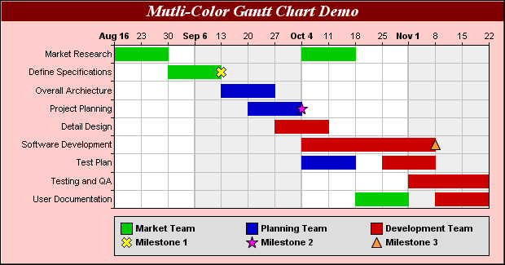
Software Development Life Cycle Overview
Week 4 ~ Week 12
Provide plans for milestones of each week (iteration)
Use Gantt charts to show the timeline of your project
https://www.tutorialspoint.com/sdlc/sdlc_overview.htm
Notes:
https://www.tutorialspoint.com/sdlc/images/sdlc_stages.jpg

Slide 13
Use Cases
In software and systems engineering, a use case is a list of actions or event steps typically defining the interactions between a role (known in the Unified Modeling Language as an actor) and a system to achieve a goal
https://en.wikipedia.org/wiki/Use_case

