Slide 1
CSCI 6315 Applied Database Systems Review for Midterm Exam I
Xiang Lian
The University of Texas Rio Grande Valley
Edinburg, TX 78539
xiang.lian@utrgv.edu

Slide 2
Review
Chapters 1, 2, 4, 5.1, 12, 13 in your textbook
Lecture slides
In-class exercises (examples)
Assignments
Projects

Slide 3
Review (cont'd)
Question Types
Q/A
Basic concepts of databases
ER or EER diagrams
Relational algebra
5 Questions (100 points) + 1 Bonus Question (20 extra points)

Slide 4
Chapters 1&2 Introduction to Databases
Database
Database Management System (DBMS)
Database Approach
Three-Level Architecture
Logical data independence
Physical data independence
Data Model

Slide 5
Database
Shared collection of logically related data (and a description of this data), designed to meet the information needs of an organization.
System catalog (metadata) provides description of data to enable program–data independence.
Logically related data comprises entities, attributes, and relationships of an organization’s information.
Pearson Education © 2014

Slide 6
Database Management System (DBMS)
A software system that enables users to define, create, maintain, and control access to the database.
(Database) application program: a computer program that interacts with database by issuing an appropriate request (SQL statement) to the DBMS.
Pearson Education © 2014

Slide 7
Database Approach
Controlled access to database may include:
a security system
an integrity system
a concurrency control system
a recovery control system
a user-accessible catalog.
Pearson Education © 2014

Slide 8
Database Management System (DBMS)
Pearson Education © 2014

Slide 9
ANSI-SPARC Three-Level Architecture
Pearson Education © 2014
9

Slide 10
ANSI-SPARC Three-Level Architecture
External Level
Users’ view of the database.
Describes that part of database that is relevant to a particular user.
Conceptual Level
Community view of the database.
Describes what data is stored in database and relationships among the data.
Pearson Education © 2014
10

Slide 11
ANSI-SPARC Three-Level Architecture
Internal Level
Physical representation of the database on the computer.
Describes how the data is stored in the database.
Pearson Education © 2014
11

Slide 12
Data Independence and the ANSI-SPARC Three-Level Architecture
Pearson Education © 2014
12

Slide 13
Data Models
Object-Based Data Models
Entity-Relationship
Semantic
Functional
Object-Oriented.
Record-Based Data Models
Relational Data Model
Network Data Model
Hierarchical Data Model.
Physical Data Models
Pearson Education © 2014
13

Slide 14
Relational Data Model
Pearson Education © 2014
14

Slide 15
Chapter 12&13 (Enhanced) Entity-Relationship Modeling
ER Modeling
Entity type
Relationship type
Attributes
Enhanced ER Modeling
Superclass
Subclass
Draw EER diagrams for real applications (see examples on the course website)

Slide 16
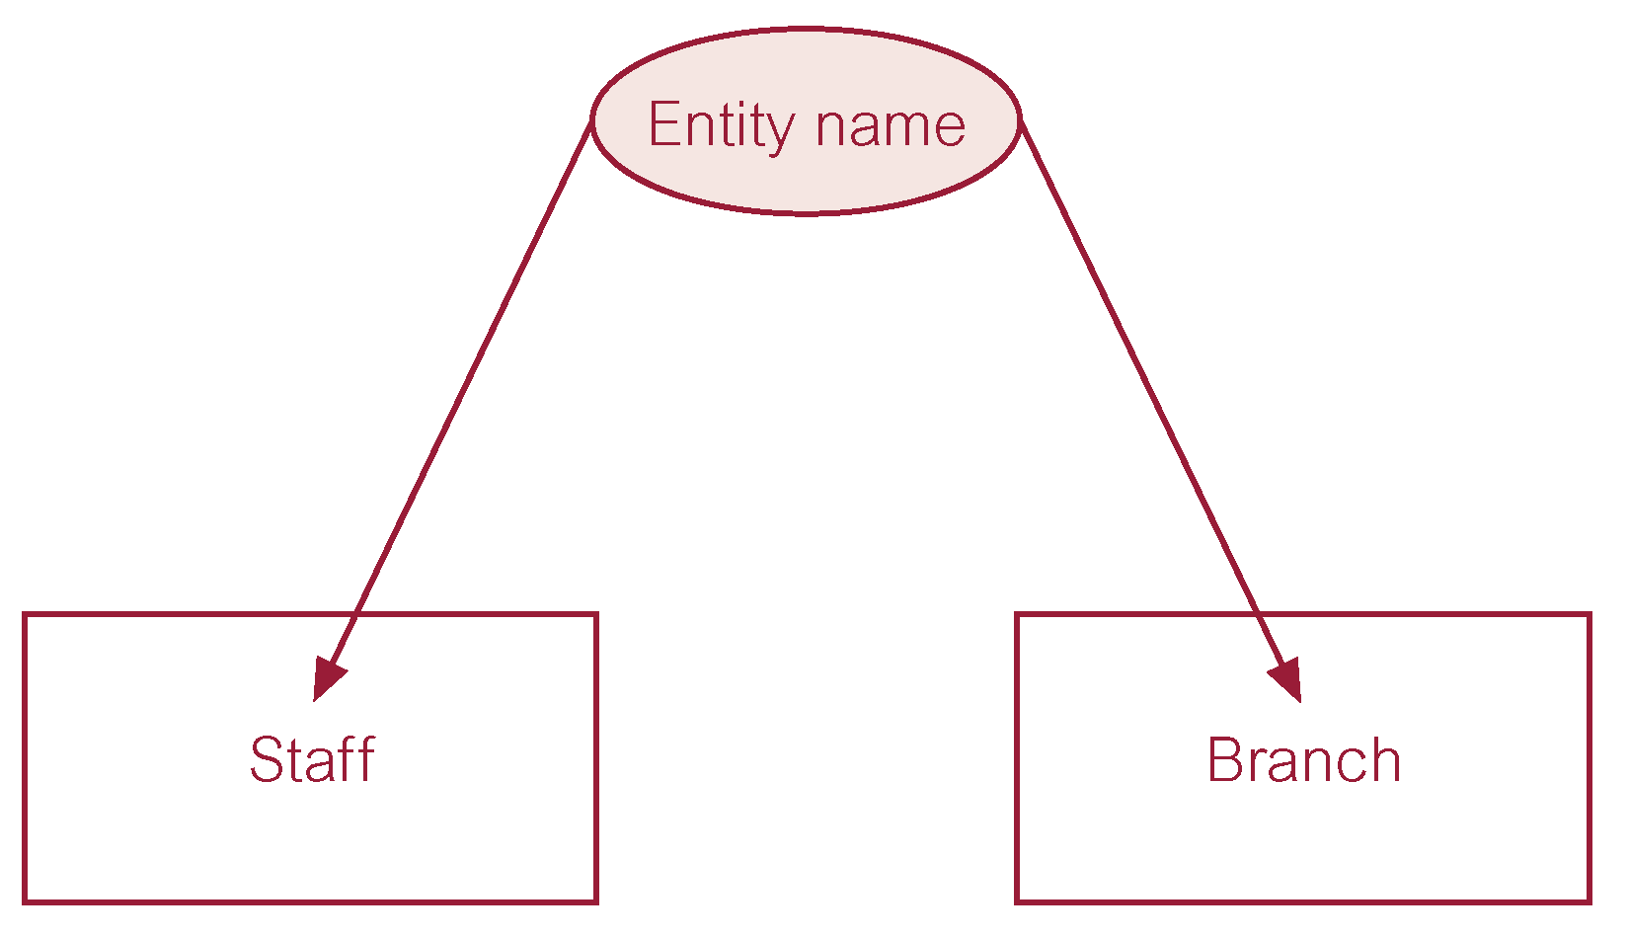
ER diagram of Staff and Branch entity types

Slide 17
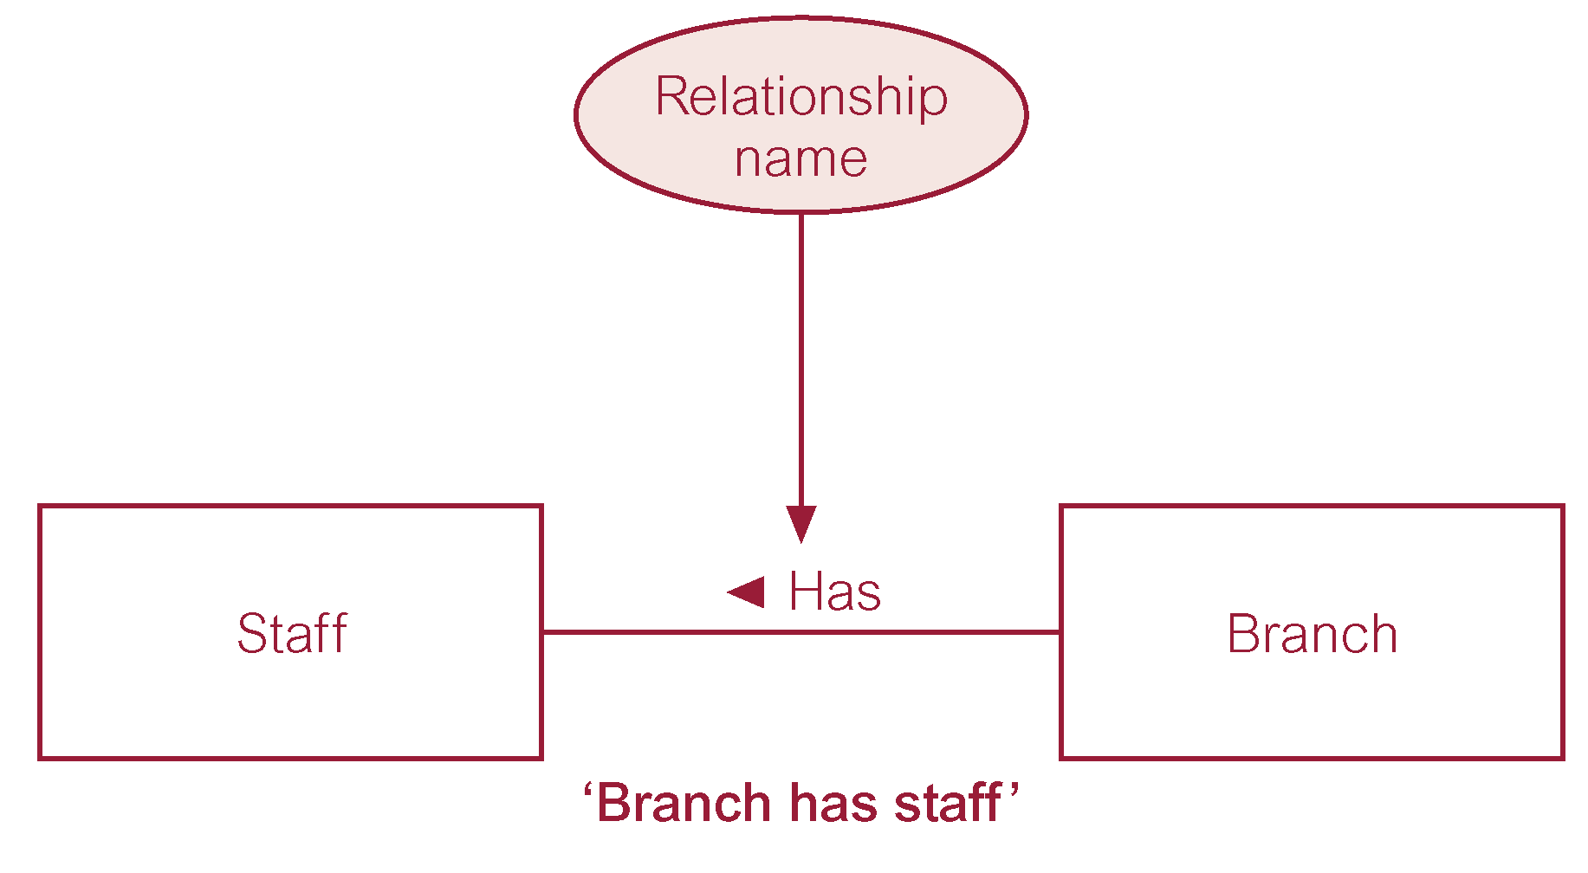
ER diagram of Branch Has Staff relationship

Slide 18
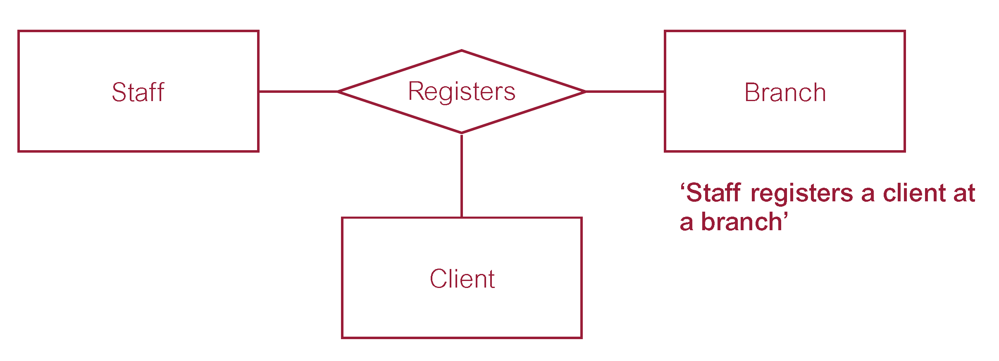
Ternary relationship called Registers

Slide 19
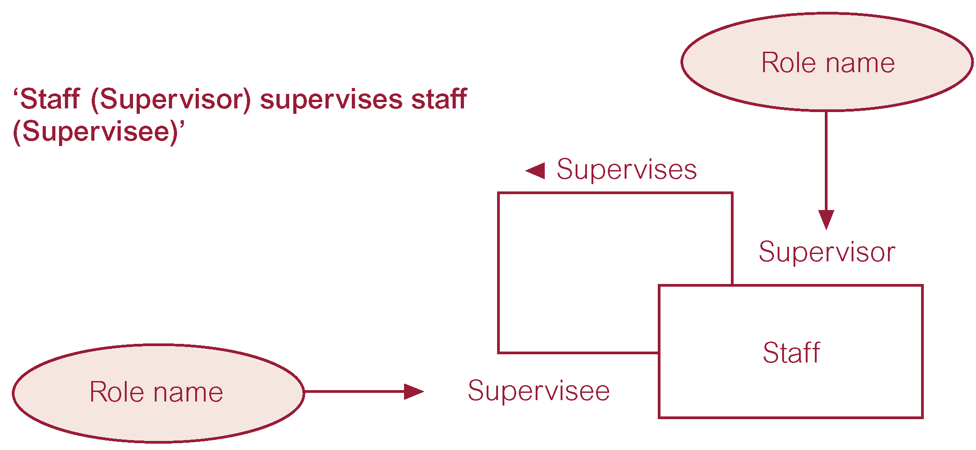
Recursive relationship called Supervises with role names

Slide 20
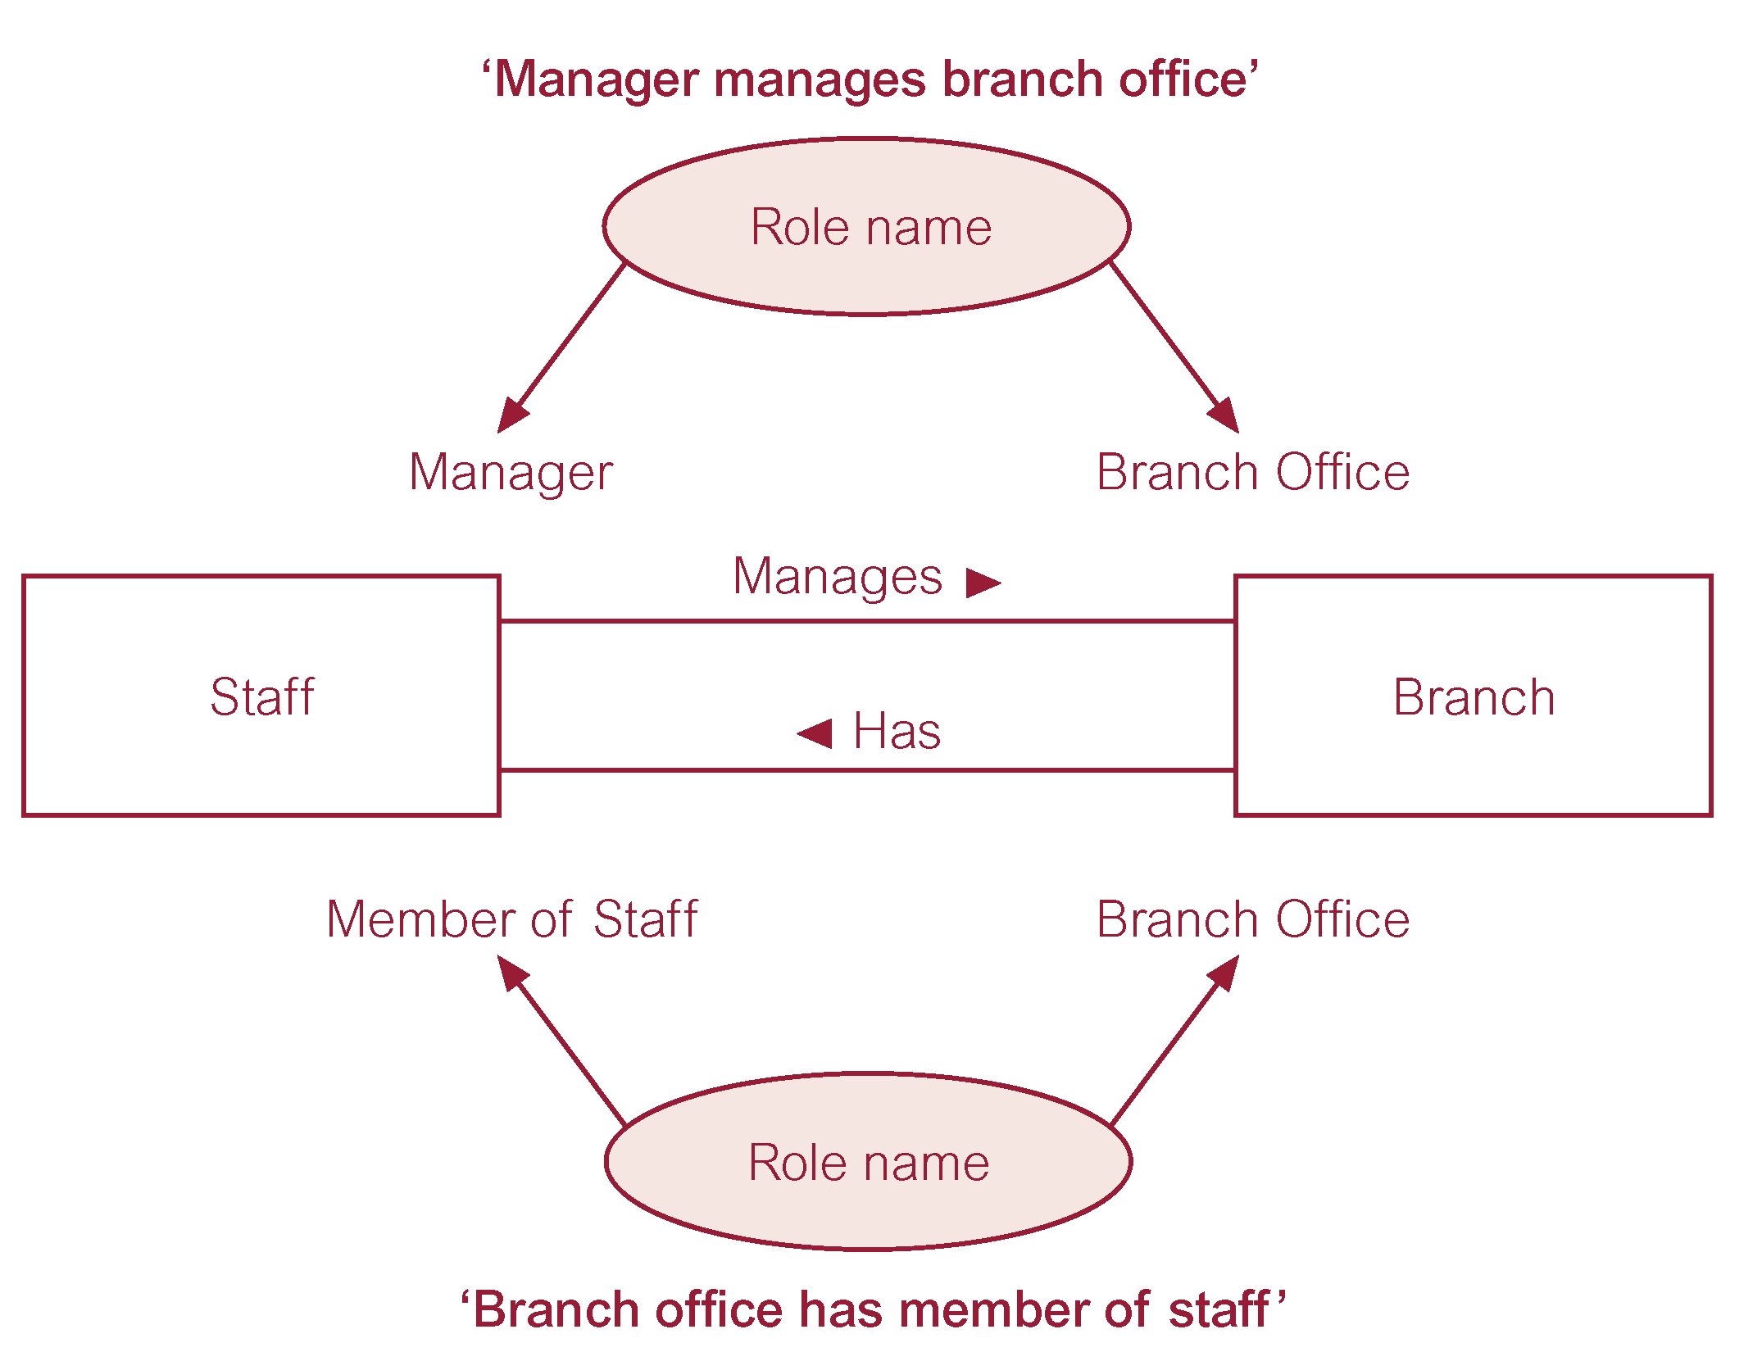
Entities associated through two distinct relationships with role names

Slide 21
Attributes
Simple Attribute
Attribute composed of a single component with an independent existence.
Composite Attribute
Attribute composed of multiple components, each with an independent existence.

Slide 22
Attributes
Single-valued Attribute
Attribute that holds a single value for each occurrence of an entity type.
Multi-valued Attribute
Attribute that holds multiple values for each occurrence of an entity type.

Slide 23
Attributes
Derived Attribute
Attribute that represents a value that is derivable from value of a related attribute, or set of attributes, not necessarily in the same entity type.

Slide 24
Keys
Candidate Key
Minimal set of attributes that uniquely identifies each occurrence of an entity type.
Primary Key
Candidate key selected to uniquely identify each occurrence of an entity type.
Composite Key
A candidate key that consists of two or more attributes.

Slide 25
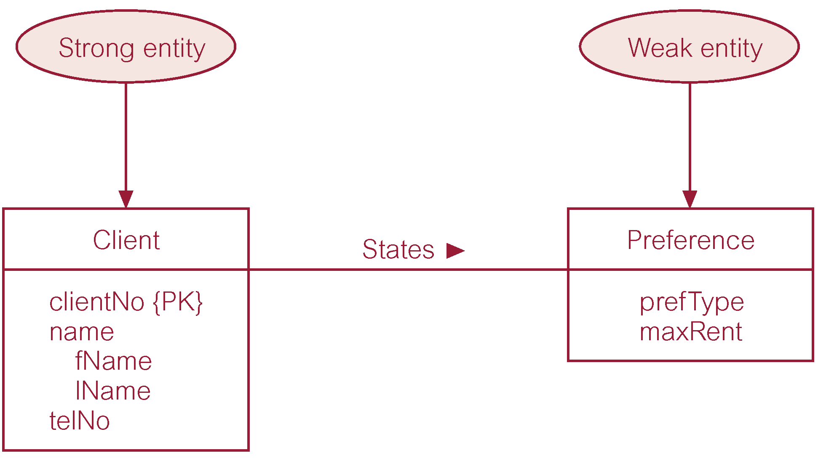
Strong entity type called Client and weak entity type called Preference

Slide 26
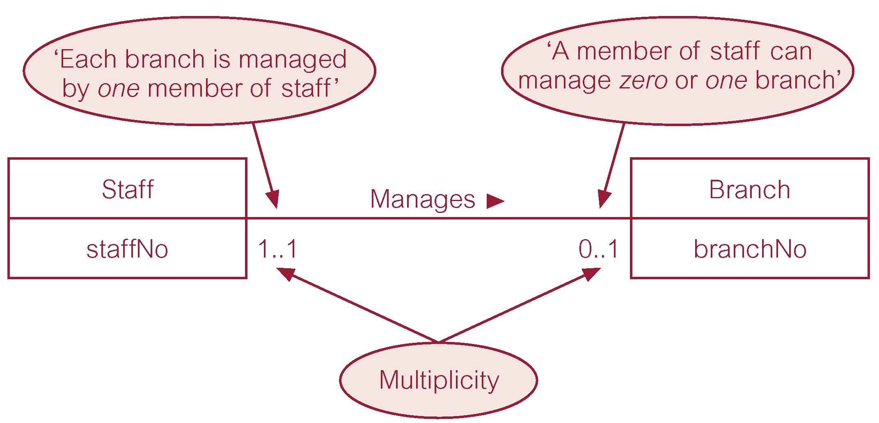
Multiplicity of Staff Manages Branch (1:1) relationship

Slide 27
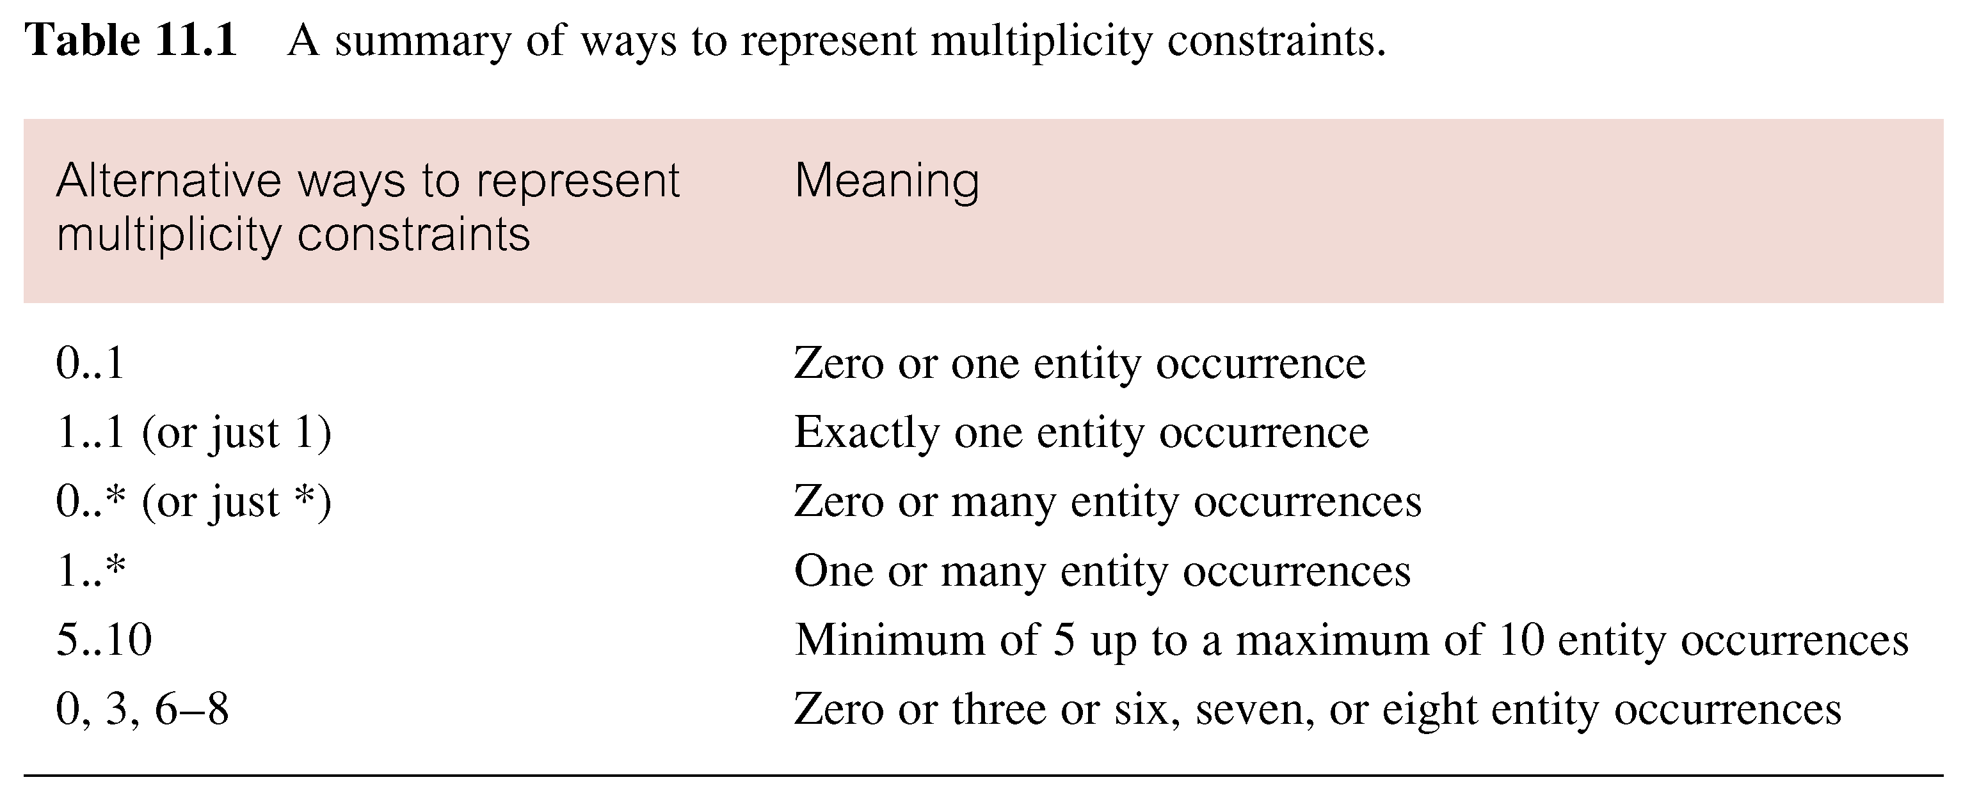
Summary of multiplicity constraints

Slide 28
Specialization / Generalization
Superclass
An entity type that includes one or more distinct subgroupings of its occurrences.
Subclass
A distinct subgrouping of occurrences of an entity type.

Slide 29
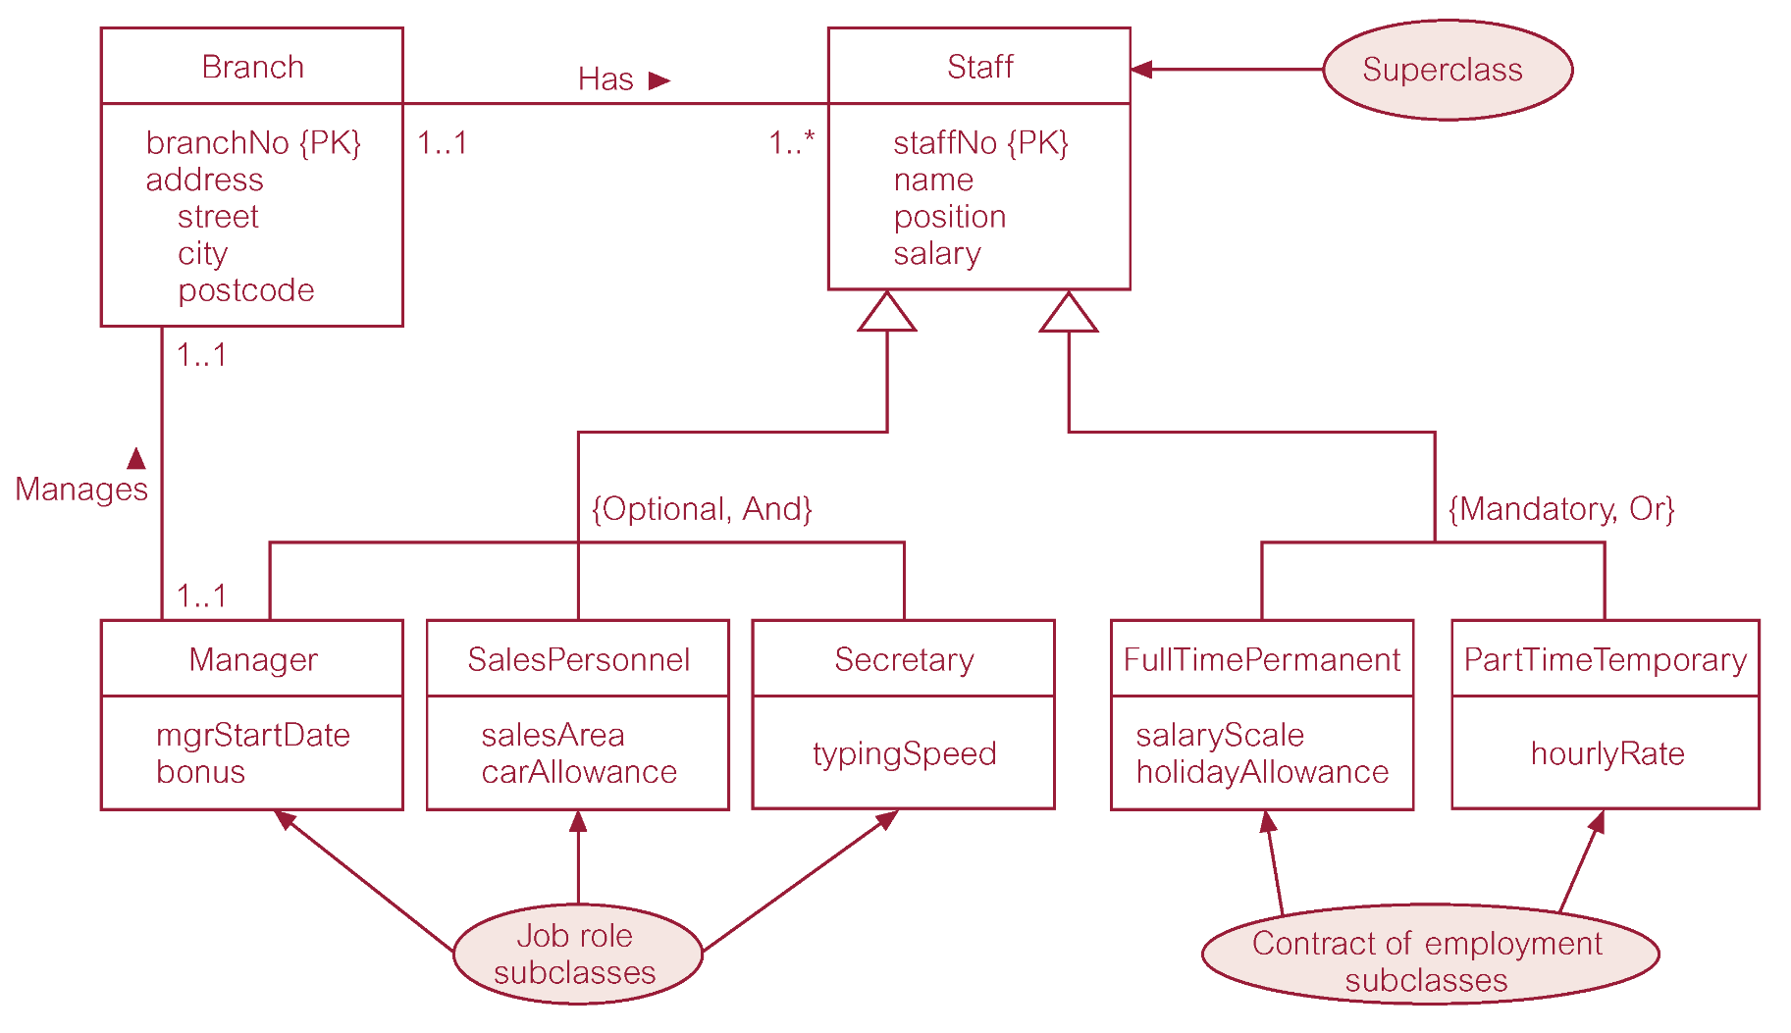
Specialization/generalization of Staff entity into job roles and contracts of employment

Slide 30
DreamHome worked example - Person superclass with Staff, PrivateOwner, and Client subclasses

Slide 31
Chapter 4 Relational Model
Database schema
Table schema
Attributes (name, domain, NULL or no NULL, default values, …)
Primary key, candidate key, foreign key
Constraints (entity integrity, referential integrity, general constraints)
View

Slide 32
Instances of Branch and Staff Relations
Pearson Education © 2014
32

Slide 33
Alternative Terminology for Relational Model
Pearson Education © 2014
33

Slide 34
Database Relations
Relation schema
Named relation defined by a set of attribute and domain name pairs.
Relational database schema
Set of relation schemas, each with a distinct name.
Pearson Education © 2014
34

Slide 35
Properties of Relations
Relation name is distinct from all other relation names in relational schema.
Each cell of relation contains exactly one atomic (single) value.
Each attribute has a distinct name.
Values of an attribute are all from the same domain.
Pearson Education © 2014
35

Slide 36
Properties of Relations
Each tuple is distinct; there are no duplicate tuples.
Order of attributes has no significance.
Order of tuples has no significance, theoretically.
Pearson Education © 2014
36

Slide 37
Relational Keys
Superkey
An attribute, or set of attributes, that uniquely identifies a tuple within a relation.
Candidate Key
Superkey (K) such that no proper subset is a superkey within the relation.
In each tuple of R, values of K uniquely identify that tuple (uniqueness).
No proper subset of K has the uniqueness property (irreducibility).
Pearson Education © 2014
37

Slide 38
Relational Keys
Primary Key
Candidate key selected to identify tuples uniquely within relation.
Alternate Keys
Candidate keys that are not selected to be primary key.
Foreign Key
Attribute, or set of attributes, within one relation that matches candidate key of some (possibly same) relation.
Pearson Education © 2014
38

Slide 39
Integrity Constraints
Null
Represents value for an attribute that is currently unknown or not applicable for tuple.
Deals with incomplete or exceptional data.
Represents the absence of a value and is not the same as zero or spaces, which are values.
Pearson Education © 2014
39

Slide 40
Integrity Constraints
Entity Integrity
In a base relation, no attribute of a primary key can be null.
Referential Integrity
If foreign key exists in a relation, either foreign key value must match a candidate key value of some tuple in its home relation or foreign key value must be wholly null.
Pearson Education © 2014
40

Slide 41
Integrity Constraints
General Constraints
Additional rules specified by users or database administrators that define or constrain some aspect of the enterprise.
Pearson Education © 2014
41

Slide 42
Views
Base Relation
Named relation corresponding to an entity in conceptual schema, whose tuples are physically stored in database.
View
Dynamic result of one or more relational operations operating on base relations to produce another relation.
Pearson Education © 2014
42

Slide 43
Chapter 5.1 Relational Algebra
Relational algebra
Selection
Projection
Cartesian product
Union
Set Difference
Join
Intersection
Division

Slide 44
Relational Algebra
Five basic operations in relational algebra: Selection, Projection, Cartesian product, Union, and Set Difference.
These perform most of the data retrieval operations needed.
Also have Join, Intersection, and Division operations, which can be expressed in terms of 5 basic operations.
Pearson Education © 2014
44

Slide 45
Relational Algebra Operations
Pearson Education © 2014
45

Slide 46
Selection (or Restriction)
σ_{predicate} (R)
Works on a single relation R and defines a relation that contains only those tuples (rows) of R that satisfy the specified condition (predicate).
Pearson Education © 2014
46

Slide 47
Example - Selection (or Restriction)
List all staff with a salary greater than £10,000.
σ_{salary > 10000} (Staff)
Pearson Education © 2014
47

Slide 48
Projection
Π_{col1, . . . , coln}(R)
Works on a single relation R and defines a relation that contains a vertical subset of R, extracting the values of specified attributes and eliminating duplicates.
Pearson Education © 2014
48

Slide 49
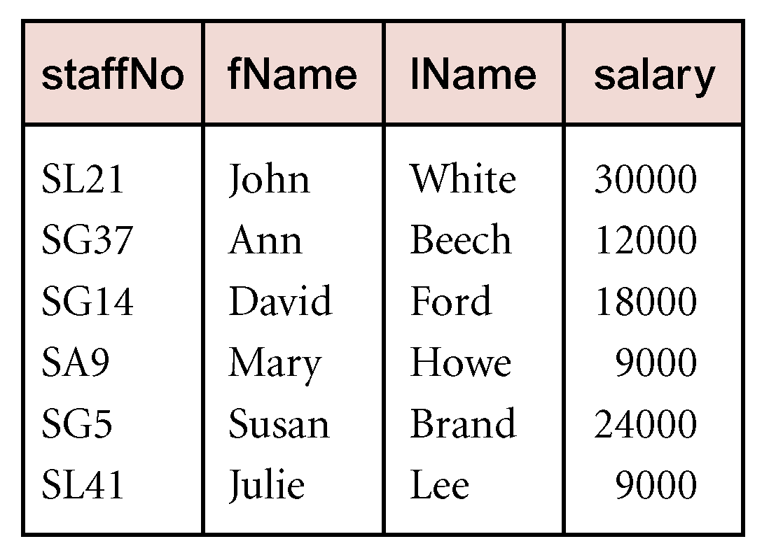
Example - Projection
Produce a list of salaries for all staff, showing only staffNo, fName, lName, and salary details.
Π_{staffNo, fName, lName, salary}(Staff)
49
Pearson Education © 2014

Slide 50
Union
R ∪ S
Union of two relations R and S defines a relation that contains all the tuples of R, or S, or both R and S, duplicate tuples being eliminated.
R and S must be union-compatible.
If R and S have I and J tuples, respectively, union is obtained by concatenating them into one relation with a maximum of (I + J) tuples.
Pearson Education © 2014
50

Slide 51
Intersection
R ∩ S
Defines a relation consisting of the set of all tuples that are in both R and S.
R and S must be union-compatible.
Expressed using basic operations:
R ∩ S = R – (R – S)
Pearson Education © 2014
51

Slide 52
Cartesian product
R X S
Defines a relation that is the concatenation of every tuple of relation R with every tuple of relation S.
Pearson Education © 2014
52

Slide 53
Set Difference
R – S
Defines a relation consisting of the tuples that are in relation R, but not in S.
R and S must be union-compatible.
Pearson Education © 2014
53

Slide 54
Theta join (θ-join)
R _{F}S
Defines a relation that contains tuples satisfying the predicate F from the Cartesian product of R and S.
The predicate F is of the form R.a_{i} θ S.b_{i} where θ may be one of the comparison operators (<, ≤, >, ≥, =, ≠).
Pearson Education © 2014
54

Slide 55
Division
R ÷ S (or R/S
Defines a relation over the attributes C that consists of set of tuples from R that match combination of every tuple in S.
Expressed using basic operations:
T₁ ← Π_{C}(R)
T₂ ← Π_{C}((S X T₁) – R)
T ← T₁ – T₂
Pearson Education © 2014
55

Slide 56
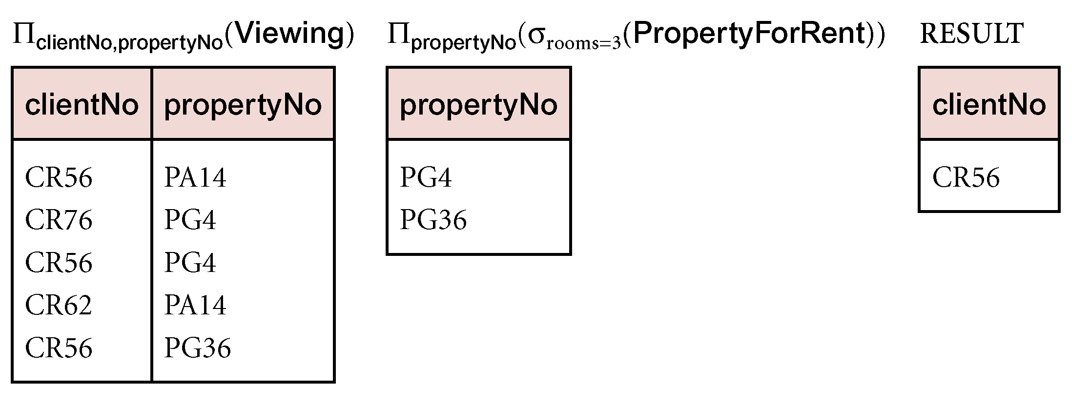
Example - Division
Identify all clients who have viewed all properties with three rooms.
(Π_{clientNo, propertyNo}(Viewing)) ÷
(Π_{propertyNo}(σ_{rooms = 3} (PropertyForRent)))
Pearson Education © 2014
56

Slide 57
Good Luck!

