Slide 1
CSCI 6315 Applied Database Systems Review for Midterm Exam II
Xiang Lian
The University of Texas Rio Grande Valley
Edinburg, TX 78539
xiang.lian@utrgv.edu

Slide 2
Review
Chapters 6, 7, 8, 14, 15 in your textbook
Lecture slides, reading materials
In-class exercises (examples)
Assignments
Projects

Slide 3
Review (cont'd)
Question Types
Q/A
Relational algebra
SQL
Normalization theory
5 Questions (100 points) + 1 Bonus Question (20 extra points)

Slide 4
Chapter 5.1 Relational Algebra
Relational algebra
Selection
Projection
Cartesian product
Union
Set Difference
Join
Intersection
Division

Slide 5
Relational Algebra
Five basic operations in relational algebra: Selection, Projection, Cartesian product, Union, and Set Difference.
These perform most of the data retrieval operations needed.
Also have Join, Intersection, and Division operations, which can be expressed in terms of 5 basic operations.
Pearson Education © 2014
5

Slide 6
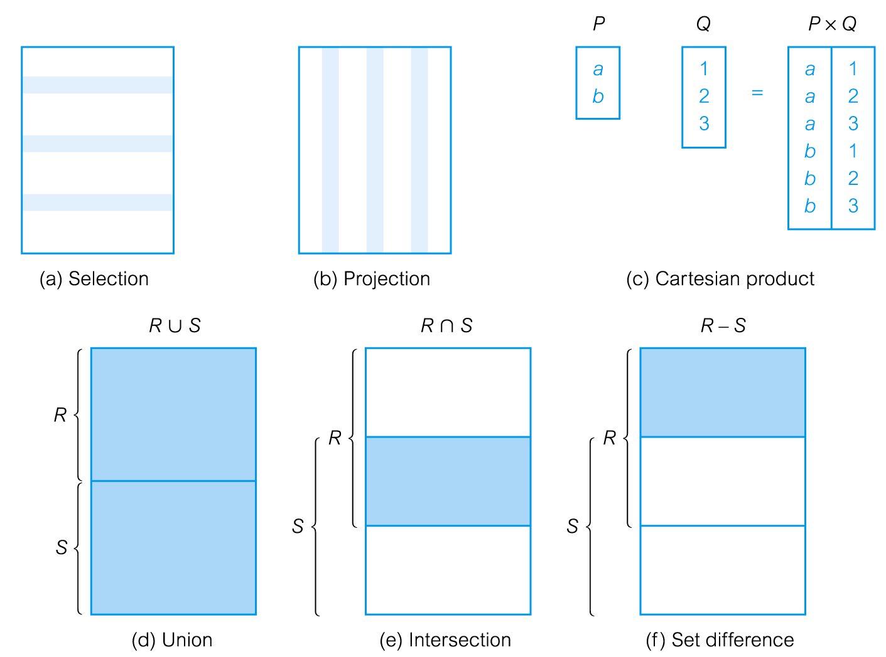
Relational Algebra Operations
Pearson Education © 2014
6

Slide 7
Selection (or Restriction)
σ_{predicate} (R)
Works on a single relation R and defines a relation that contains only those tuples (rows) of R that satisfy the specified condition (predicate).
Pearson Education © 2014
7

Slide 8
Example - Selection (or Restriction)
List all staff with a salary greater than £10,000.
σ_{salary > 10000} (Staff)
Pearson Education © 2014
8

Slide 9
Projection
Π_{col1, . . . , coln}(R)
Works on a single relation R and defines a relation that contains a vertical subset of R, extracting the values of specified attributes and eliminating duplicates.
Pearson Education © 2014
9

Slide 10
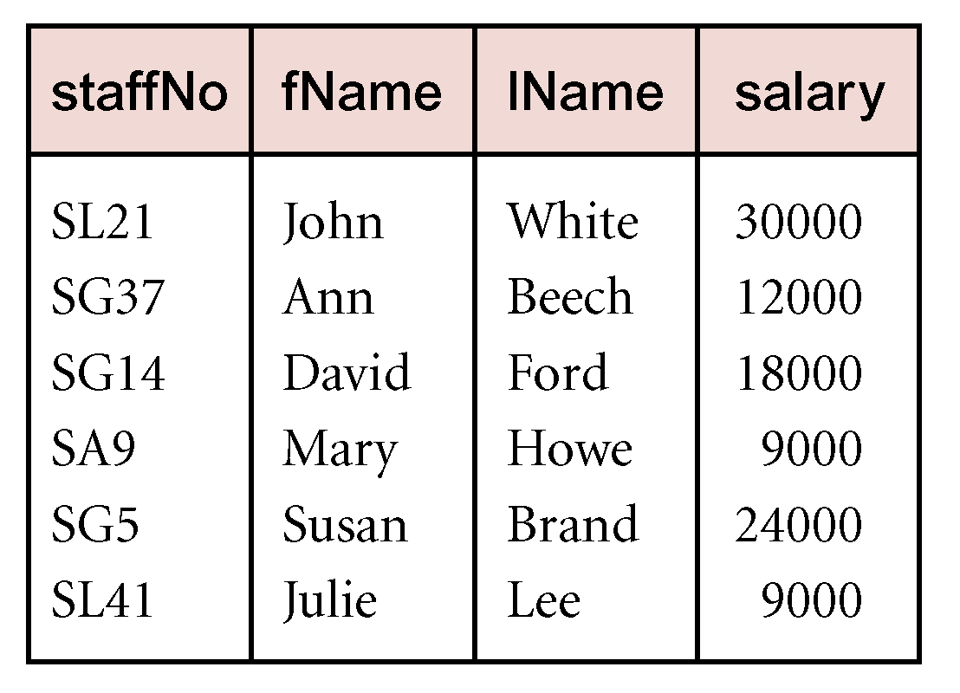
Example - Projection
Produce a list of salaries for all staff, showing only staffNo, fName, lName, and salary details.
Π_{staffNo, fName, lName, salary}(Staff)
10
Pearson Education © 2014

Slide 11
Union
R ∪ S
Union of two relations R and S defines a relation that contains all the tuples of R, or S, or both R and S, duplicate tuples being eliminated.
R and S must be union-compatible.
If R and S have I and J tuples, respectively, union is obtained by concatenating them into one relation with a maximum of (I + J) tuples.
Pearson Education © 2014
11

Slide 12
Intersection
R ∩ S
Defines a relation consisting of the set of all tuples that are in both R and S.
R and S must be union-compatible.
Expressed using basic operations:
R ∩ S = R – (R – S)
Pearson Education © 2014
12

Slide 13
Cartesian product
R X S
Defines a relation that is the concatenation of every tuple of relation R with every tuple of relation S.
Pearson Education © 2014
13

Slide 14
Set Difference
R – S
Defines a relation consisting of the tuples that are in relation R, but not in S.
R and S must be union-compatible.
Pearson Education © 2014
14

Slide 15
Theta join (θ-join)
R _{F}S
Defines a relation that contains tuples satisfying the predicate F from the Cartesian product of R and S.
The predicate F is of the form R.a_{i} θ S.b_{i} where θ may be one of the comparison operators (<, ≤, >, ≥, =, ≠).
Pearson Education © 2014
15

Slide 16
Division
R ÷ S (or R/S
Defines a relation over the attributes C that consists of set of tuples from R that match combination of every tuple in S.
Expressed using basic operations:
T₁ ← Π_{C}(R)
T₂ ← Π_{C}((S X T₁) – R)
T ← T₁ – T₂
Pearson Education © 2014
16

Slide 17
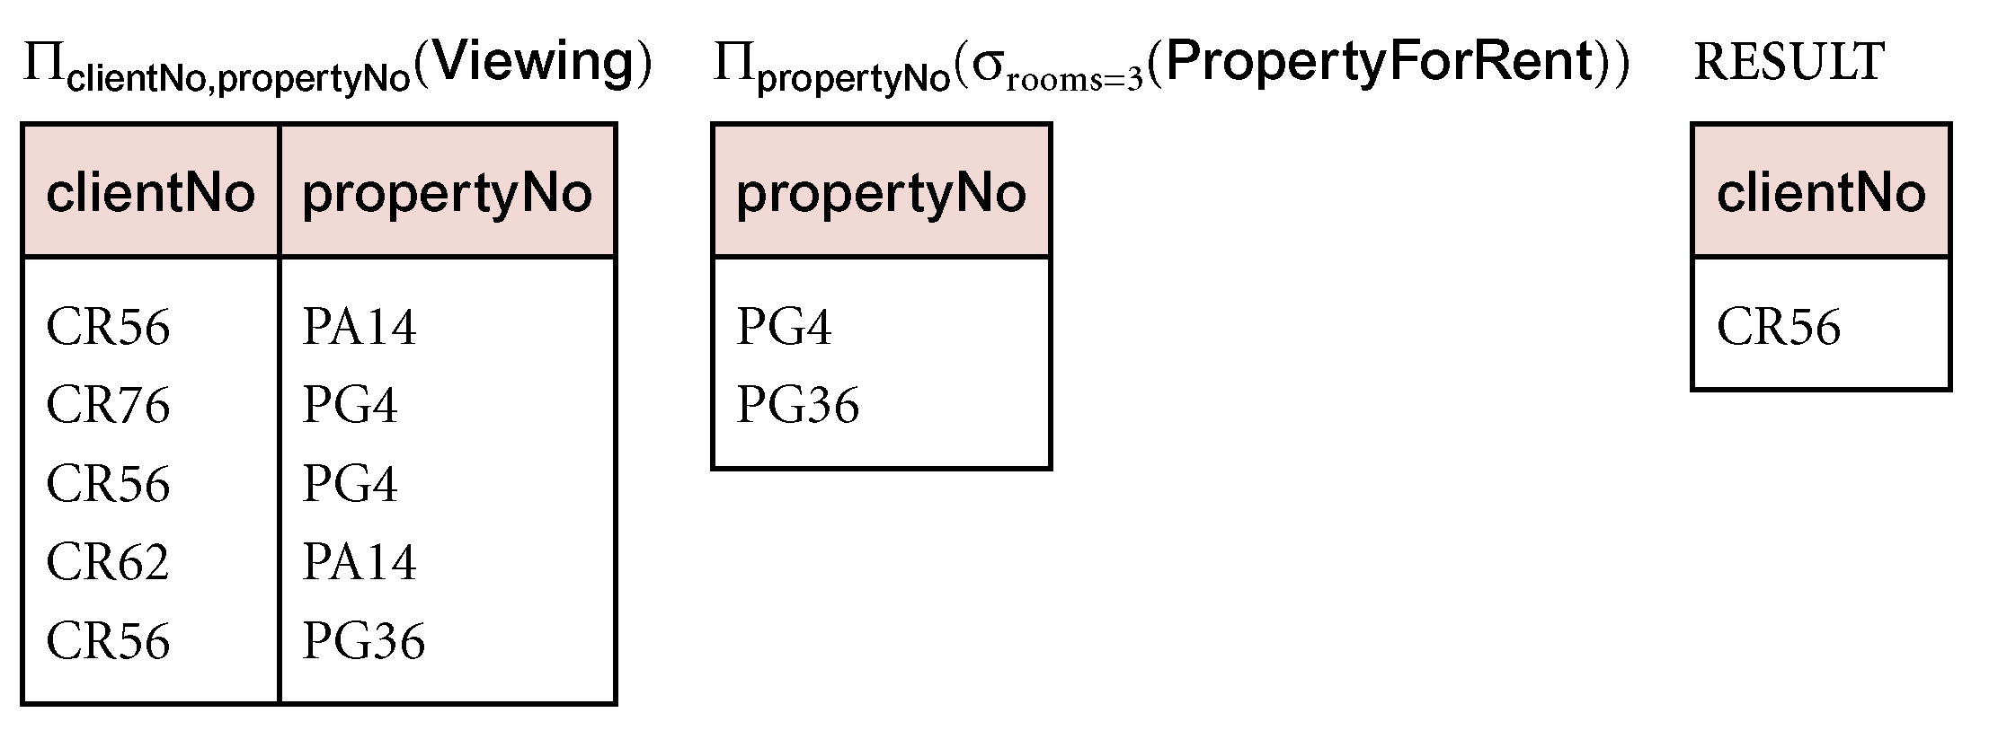
Example - Division
Identify all clients who have viewed all properties with three rooms.
(Π_{clientNo, propertyNo}(Viewing)) ÷
(Π_{propertyNo}(σ_{rooms = 3} (PropertyForRent)))
Pearson Education © 2014
17

Slide 18
Chapters 6-8 SQL
Basic clauses in SQL
SELECT
FROM
WHERE
ORDER BY
GROUP BY … HAVING
Aggregates
Examples in lecture slides and reading materials

Slide 19
SELECT Statement
FROM Specifies table(s) to be used.
WHERE Filters rows.
GROUP BY Forms groups of rows with same
column value.
HAVING Filters groups subject to some
condition.
SELECT Specifies which columns are to
appear in output.
ORDER BY Specifies the order of the output.
Pearson Education © 2014
19

Slide 20
Query Sublanguage of SQL
SELECT C.CrsName
FROM Course C
WHERE C.DeptId = ‘CS’
Tuple variable C ranges over rows of Course.
Evaluation strategy:
FROM clause produces Cartesian product of listed tables
WHERE clause assigns rows to C in sequence and produces table containing only rows satisfying condition
SELECT clause retains listed columns
Equivalent to: π_{CrsName}σ_{DeptId=‘CS’}(Course)

Slide 21
Join Queries
SELECT C.CrsName
FROM Course C, Teaching T
WHERE C.CrsCode=T.CrsCode AND T.Semester=‘S2000’
List CS courses taught in S2000
Tuple variables clarify meaning.
Join condition “C.CrsCode=T.CrsCode”
relates facts to each other
Selection condition “ T.Semester=‘S2000’ ”
eliminates irrelevant rows
Equivalent (using natural join) to:
π_{CrsName}(Course
σ_{Semester=‘S2000’} (Teaching) )
π_{CrsName} (σ_{Sem=‘S2000’} (Course Teaching) )

Slide 22
Correspondence Between SQL and Relational Algebra
SELECT C.CrsName
FROM Course C, Teaching T
WHERE C.CrsCode = T.CrsCode AND T.Semester = ‘S2000’
Also equivalent to:
π_{CrsName} σC_CrsCode=T_CrsCode AND Semester=‘S2000’
(Course [C_CrsCode, DeptId, CrsName, Desc]
× Teaching [ProfId, T_CrsCode, Semester])
This is the simplest evaluation algorithm for SELECT.
Relational algebra expressions are procedural.
Which of the two equivalent expressions is more easily evaluated?

Slide 23
Self-join Queries
Find Ids of all professors who taught at least two courses in the same semester:
SELECT T1.ProfId
FROM Teaching T1, Teaching T2
WHERE T1.ProfId = T2.ProfId
AND T1.Semester = T2.Semester
AND T1.CrsCode <> T2.CrsCode
Tuple variables are essential in this query!
Equivalent to:
π_{ProfId} (σ_{T1.CrsCode≠T2.CrsCode}(Teaching[ProfId, T1.CrsCode, Semester]
Teaching[ProfId, T2.CrsCode, Semester]))

Slide 24
Duplicates
Duplicate rows not allowed in a relation
However, duplicate elimination from query result is costly and not done by default; must be explicitly requested:
SELECT DISTINCT …..
FROM …..

Slide 25
Use of Expressions
Equality and comparison operators apply to strings (based on lexical ordering)
WHERE S.Name < ‘P’
Concatenate operator applies to strings
WHERE S.Name || ‘--’ || S.Address = ….
Expressions can also be used in SELECT clause:
SELECT S.Name || ‘--’ || S.Address AS NmAdd
FROM Student S

Slide 26
Set Operators
SQL provides UNION, EXCEPT (set difference), and INTERSECT for union compatible tables
Example: Find all professors in the CS Department and all professors that have taught CS courses
(SELECT P.Name
FROM Professor P, Teaching T
WHERE P.Id=T.ProfId AND T.CrsCode LIKE ‘CS%’)
UNION
(SELECT P.Name
FROM Professor P
WHERE P.DeptId = ‘CS’)
Notes:
% -- 0 or more characters
_ -- 1 single character

Slide 27
Aggregates
Functions that operate on sets:
COUNT, SUM, AVG, MAX, MIN
Produce numbers (not tables)
Not part of relational algebra (but not hard to add)
SELECT COUNT(*)
FROM Professor P
SELECT MAX (Salary)
FROM Employee E

Slide 28
Grouping
But how do we compute the number of courses taught in S2000 per professor?
Strategy 1: Fire off a separate query for each professor:
SELECT COUNT(T.CrsCode)
FROM Teaching T
WHERE T.Semester = ‘S2000’ AND T.ProfId = 123456789
Cumbersome
What if the number of professors changes? Add another query?
Strategy 2: define a special grouping operator:
SELECT T.ProfId, COUNT(T.CrsCode)
FROM Teaching T
WHERE T.Semester = ‘S2000’
GROUP BY T.ProfId

Slide 29
HAVING Clause
Eliminates unwanted groups (analogous to WHERE clause, but works on groups instead of individual tuples)
HAVING condition is constructed from attributes of GROUP BY list and aggregates on attributes not in that list
SELECT T.StudId,
AVG(T.Grade) AS CumGpa,
COUNT (*) AS NumCrs
FROM Transcript T
WHERE T.CrsCode LIKE ‘CS%’
GROUP BY T.StudId
HAVING AVG (T.Grade) > 3.5

Slide 30
ORDER BY Clause
Causes rows to be output in a specified order
SELECT T.StudId, COUNT (*) AS NumCrs,
AVG(T.Grade) AS CumGpa
FROM Transcript T
WHERE T.CrsCode LIKE ‘CS%’
GROUP BY T.StudId
HAVING AVG (T.Grade) > 3.5
ORDER BY DESC CumGpa, ASC StudId
Descending
Ascending

Slide 31
Chapters 14-15 Normalization Theory
Redundancy in the schema
Update, deletion, insertion anomalies
Solution: decomposition
Normalization theory
Functional dependencies
FD closure
Attribute closure

Slide 32
Chapters 14-15 Normalization Theory (cont'd)
BCNF
What are two conditions of BCNF?
BCNF decomposition algorithm
3NF
What are 3 conditions of 3NF?
How to calculate the minimal cover?
3NF decomposition algorithm
Lossless decomposition
Conditions? R = R₁ R₂ … R_{n}
Dependency preserving
Conditions? F⁺ = (F1 ∪ F2 ∪ ... ∪ F_{n})⁺

Slide 33
Redundancy
Dependencies between attributes cause redundancy
Ex. All addresses in the same town have the same zip code
SSN Name Town Zip
1234 Joe Stony Brook 11790
4321 Mary Stony Brook 11790
5454 Tom Stony Brook 11790
………………….
Redundancy

Slide 34
Anomalies
Redundancy leads to anomalies:
Update anomaly: A change in Address must be made in several places
Deletion anomaly: Suppose a person gives up all hobbies. Do we:
Set Hobby attribute to null? No, since Hobby is part of key
Delete the entire row? No, since we lose other information in the row
Insertion anomaly: Hobby value must be supplied for any inserted row since Hobby is part of key

Slide 35
Decomposition
Solution: use two relations to store Person information
Person1 (SSN, Name, Address)
Hobbies (SSN, Hobby)
The decomposition is more general: people without hobbies can now be described
No update anomalies:
Name and address stored once
A hobby can be separately supplied or deleted

Slide 36
Functional Dependencies
Definition: A functional dependency (FD) on a relation schema R is a constraint of the form
X → Y, where X and Y are subsets of attributes of R.
Definition: An FD X → Y is satisfied in an instance r of R if for every pair of tuples, t and s: if t and s agree on all attributes in X then they must agree on all attributes in Y
Key constraint is a special kind of functional dependency: all attributes of relation occur on the right-hand side of the FD:
SSN → SSN, Name, Address

Slide 37
Armstrong’s Axioms for FDs
This is the syntactic way of computing/testing the various properties of FDs
Reflexivity: If Y ⊆ X then X → Y (trivial FD)
Name, Address → Name
Augmentation: If X → Y then X Z→ YZ
If Town → Zip then Town, Name → Zip, Name
Transitivity: If X → Y and Y → Z then X → Z

Slide 38
Generating F⁺
F
AB→ C
AB→ BCD
A→ D AB→ BD AB→ BCDE AB→ CDE
D→ E BCD → BCDE
union
decomp
aug
trans
aug
Thus, AB→ BD, AB → BCD, AB → BCDE, and AB → CDE
are all elements of F⁺

Slide 39
Computation of Attribute Closure X⁺_{F}
closure := X; // since X ⊆ X⁺_{F}
repeat
old := closure;
if there is an FD Z → V in F such that
Z ⊆ closure and V ⊆ closure
then closure := closure ∪ V
until old = closure
– If T ⊆ closure then X → T is entailed by F

Slide 40
Example: Computation of Attribute Closure
Problem: Compute the attribute closure of AB with
respect to the set of FDs :
AB → C (a)
A → D (b)
D → E (c)
AC → B (d)
Solution:
Initially closure = {AB}
Using (a) closure = {ABC}
Using (b) closure = {ABCD}
Using (c) closure = {ABCDE}

Slide 41
BCNF
Definition: A relation schema R is in BCNF if for every FD X→ Y associated with R either
Y ⊆ X (i.e., the FD is trivial) or
X is a superkey of R
Example: Person1(SSN, Name, Address)
The only FD is SSN → Name, Address
Since SSN is a key, Person1 is in BCNF

Slide 42
Third Normal Form
A relational schema R is in 3NF if for every FD X→ Y associated with R either:
Y ⊆ X (i.e., the FD is trivial); or
X is a superkey of R; or
Every A∈ Y is part of some key of R
3NF is weaker than BCNF (every schema that is in BCNF is also in 3NF)
BCNF conditions

Slide 43
Lossless Schema Decomposition
A decomposition should not lose information
A decomposition (R₁,…,R_{n}) of a schema, R, is lossless if every valid instance, r, of R can be reconstructed from its components:
where each r_{i} = π_{Ri}(r)
r = r₁
r₂
……
r_{n}

Slide 44
Testing for Losslessness
A (binary) decomposition of R = (R, F) into R₁ = (R₁, F₁) and R₂ = (R₂, F₂) is lossless if and only if :
either the FD
(R₁ ∩ R₂ ) → R₁ is in F⁺
or the FD
(R₁ ∩ R₂ ) → R₂ is in F⁺

Slide 45
Dependency Preservation
Consider a decomposition of R = (R, F) into R₁ = (R₁, F₁) and R₂ = (R₂, F₂)
An FD X → Y of F⁺ is in F_{i} iff X ∪ Y ⊆ R_{i}
An FD, f ∈F⁺ may be in neither F₁, nor F₂, nor even (F₁ ∪ F₂)⁺
Checking that f is true in r₁ or r₂ is (relatively) easy
Checking f in r₁ r₂ is harder – requires a join
Ideally: want to check FDs locally, in r₁ and r₂, and have a guarantee that every f ∈F holds in r₁ r₂
The decomposition is dependency preserving iff the sets F and F₁ ∪ F₂ are equivalent: F⁺ = (F₁ ∪ F₂)⁺
Then checking all FDs in F, as r₁ and r₂ are updated, can be done by checking F₁ in r₁ and F₂ in r₂

Slide 46
BCNF Decomposition Algorithm
Input: R = (R; F)
Decomp := R
while there is S = (S; F’) ∈ Decomp and S not in BCNF do
Find X → Y ∈ F’ that violates BCNF // X isn’t a superkey in S
Replace S in Decomp with S₁ = (XY; F₁), S₂ = (S - (Y - X); F₂)
// F₁ = all FDs of F’ involving only attributes of XY
// F₂ = all FDs of F’ involving only attributes of S - (Y - X)
end
return Decomp

Slide 47
Third Normal Form
Compromise – Not all redundancy removed, but dependency preserving decompositions are always possible (and, of course, lossless)
3NF decomposition is based on a minimal cover

Slide 48
Minimal Cover
A minimal cover of a set of dependencies, F, is a set of dependencies, U, such that:
U is equivalent to F (F⁺ = U⁺)
All FDs in U have the form X → A where A is a single attribute
It is not possible to make U smaller (while preserving equivalence) by
Deleting an FD
Deleting an attribute from an FD (either from LHS or RHS)
FDs and attributes that can be deleted in this way are called redundant

Slide 49
Computing Minimal Cover
Example: F = {ABH → CK, A → D, C → E,
BGH → L, L → AD, E → L, BH → E}
step 1: Make RHS of each FD into a single attribute
Algorithm: Use the decomposition inference rule for FDs
Example: L → AD replaced by L → A, L → D ; ABH → CK by ABH →C, ABH →K
step 2: Eliminate redundant attributes from LHS.
Algorithm: If FD XB → A ∈ F (where B is a single attribute) and X → A is entailed by F, then B was unnecessary
Example: Can an attribute be deleted from ABH → C ?
Compute AB⁺_{F}, AH⁺_{F}, BH⁺_{F}.
Since C ∈ (BH)⁺_{F} , BH → C is entailed by F and A is redundant in ABH → C.

Slide 50
Computing Minimal Cover (con’t)
step 3: Delete redundant FDs from F
Algorithm: If F – {f} entails f, then f is redundant
If f is X → A then check if A ∈ X⁺_{F-{f}}
Example: BGH → L is entailed by E → L, BH → E, so it is redundant
Note: The order of steps 2 and 3 cannot be interchanged!! See the textbook for a counterexample

Slide 51
Synthesizing a 3NF Schema
Starting with a schema R = (R, F)
step 1: Compute a minimal cover, U, of F. The decomposition is based on U, but since U⁺ = F⁺ the same functional dependencies will hold
A minimal cover for F={ABH→CK, A→D, C→E, BGH→L, L→AD,
E→ L, BH → E}
is
U={BH→C, BH→K, A→D, C→E, L→A, E→L}

Slide 52
Synthesizing a 3NF schema (con’t)
step 2: Partition U into sets U₁, U₂, … U_{n} such that the LHS of all elements of U_{i} are the same
U₁ = {BH → C, BH → K}, U₂ = {A → D},
U₃ = {C → E}, U₄ = {L → A}, U₅ = {E → L}

Slide 53
Synthesizing a 3NF schema (con’t)
step 3: For each U_{i} form schema R_{i} = (R_{i}, U_{i}), where R_{i} is the set of all attributes mentioned in U_{i}
Each FD of U will be in some R_{i}. Hence the decomposition is dependency preserving
R₁ = (BHCK; BH→C, BH→ K), R₂ = (AD; A→D), R₃ = (CE; C → E), R₄ = (AL; L→A), R₅ = (EL; E → L)

Slide 54
Synthesizing a 3NF schema (con’t)
step 4: If no R_{i} is a superkey of R, add schema R₀ = (R₀,{}) where R₀ is a key of R.
R₀ = (BGH, {})
R₀ might be needed when not all attributes are necessarily contained in R₁∪R₂ …∪R_{n}
A missing attribute, A, must be part of all keys
(since it’s not in any FD of U, deriving a key constraint from U involves the augmentation axiom)
R₀ might be needed even if all attributes are accounted for in R₁∪R₂ …∪R_{n}
Example: (ABCD; {A→B, C→D}).
Step 3 decomposition: R₁ = (AB; {A→B}), R₂ = (CD; {C→D}).
Lossy! Need to add (AC; { }), for losslessness
Step 4 guarantees lossless decomposition.

Slide 55
Good Luck!

