Slide 1
Knowing Where You Are
Given a map and a query point q specified by its coordinates, find the region of the map containing q.
A map can be treated as a subdivision of the plane into regions, or planar subdivision.
A map can be stored electronically for query preprocessing to answer point location query fast and display the map interactively.

Slide 2

Planar Point Location
• Let S be a planar subdivision with n edges. The planar point location problem is to store S in such a way that we can answer: given a query point q, report the face f of S that contains q. If q lies on an edge or a vertex, report so.
  Partition the plane into horizontal slabs.
  Store the y-coordinates of the vertices in the
  sorted order in an array. This makes it
  possible to determine in O(log n) time the
  slab containing a query point q.

Slide 3
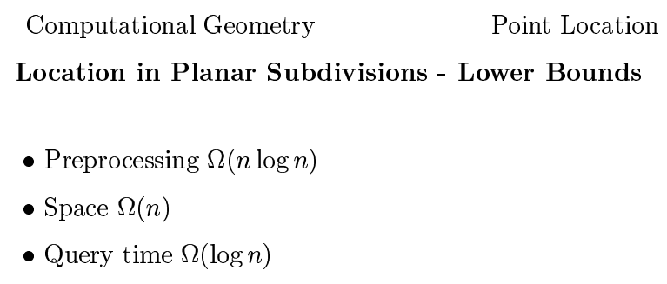

Slide 4
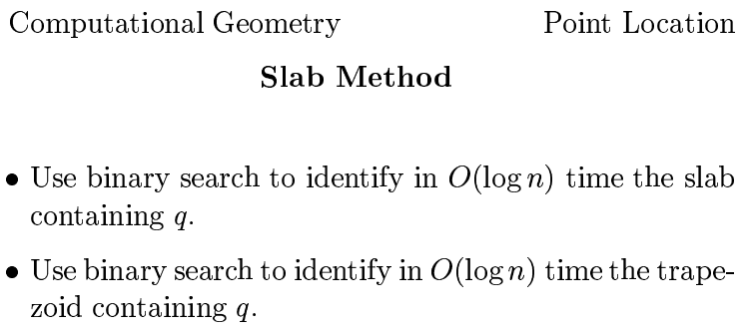

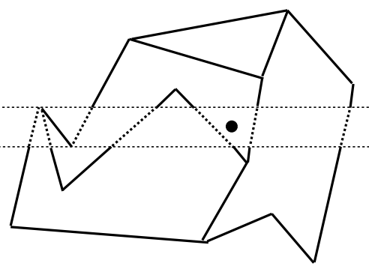

Slide 5



Slide 6
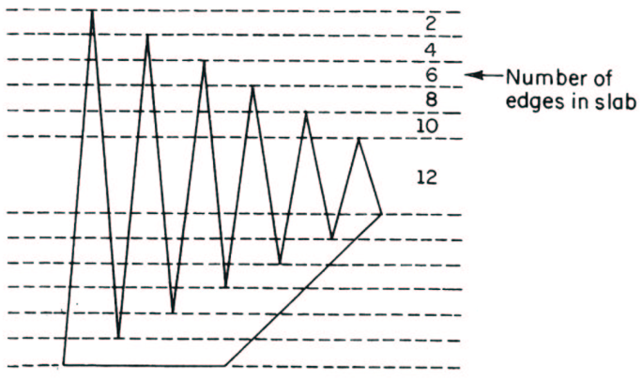

Slide 7
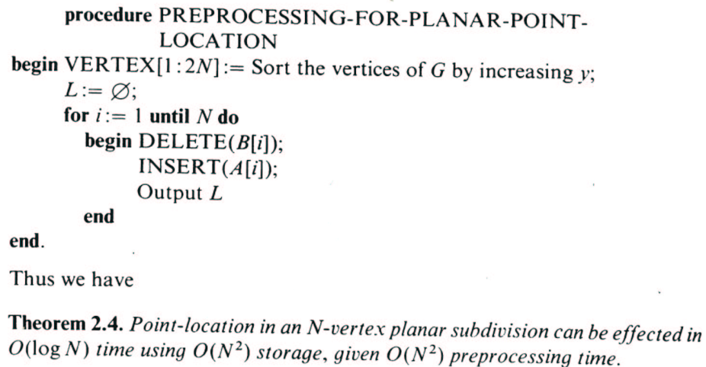

Slide 8

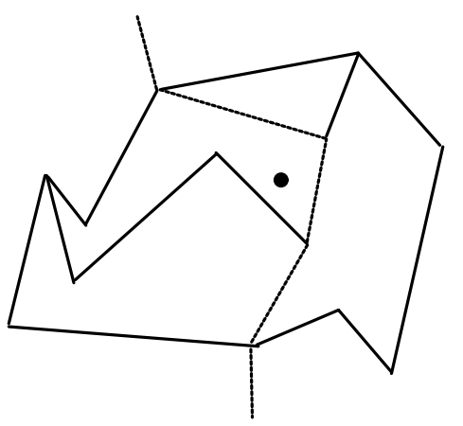
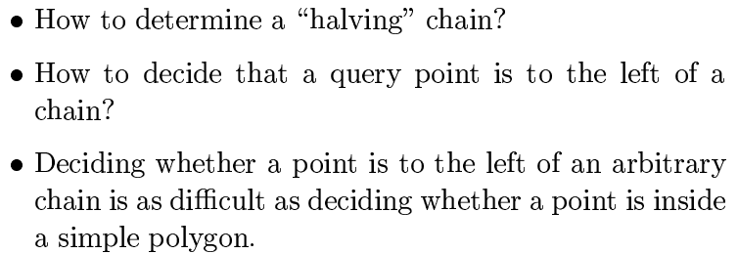

Slide 9
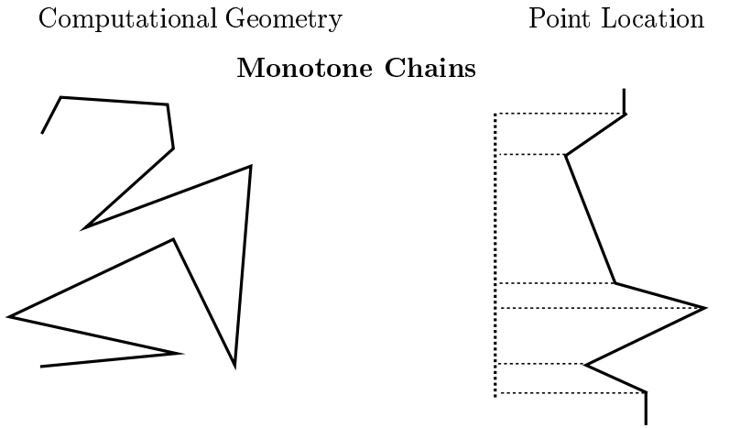


Slide 10

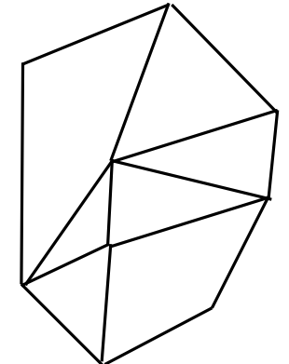
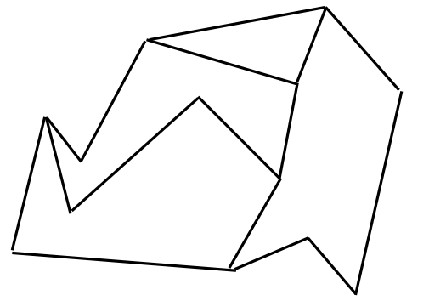


Slide 11
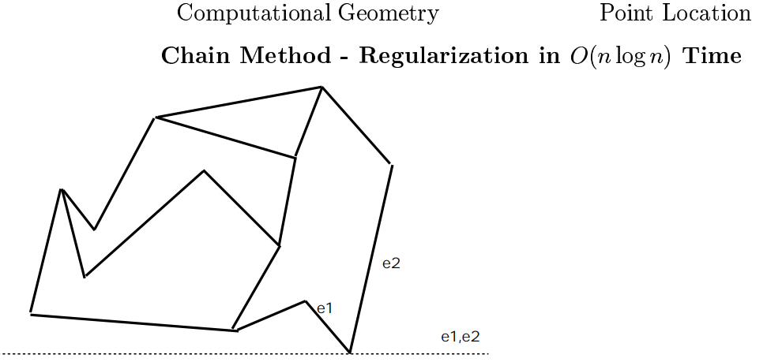
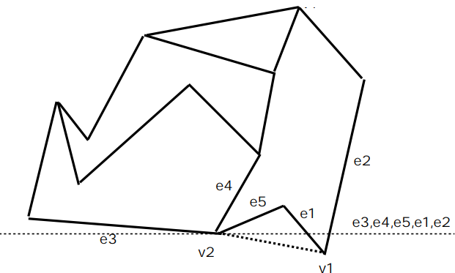

Slide 12
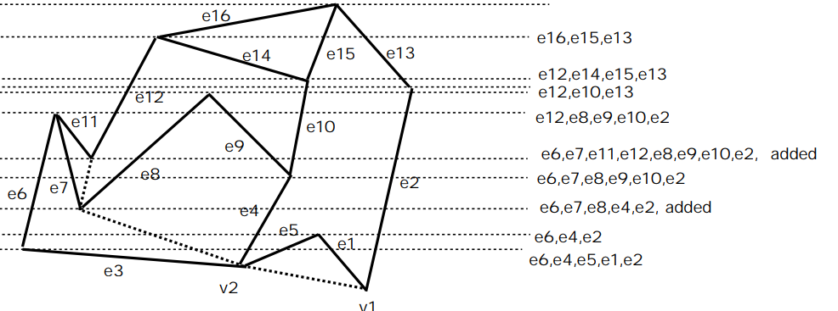

Slide 13
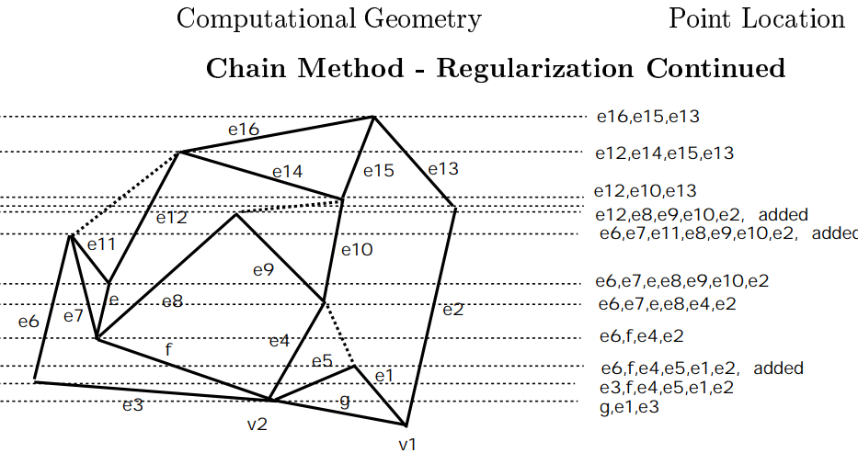

Slide 14

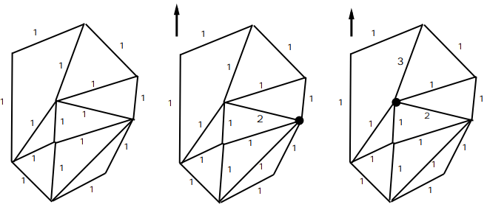

Slide 15
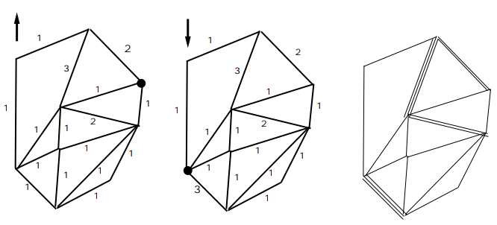
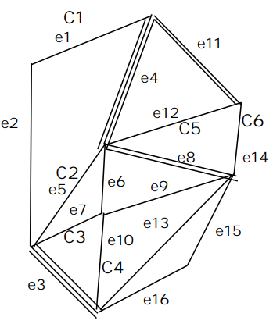

Slide 16
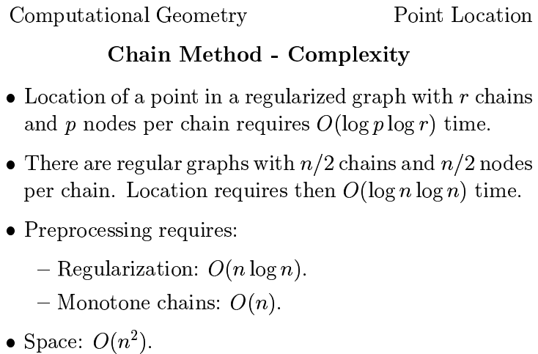
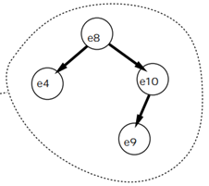
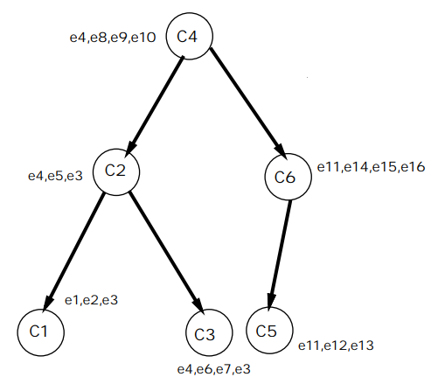

Slide 17
