Slide 1
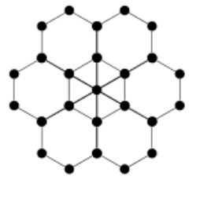
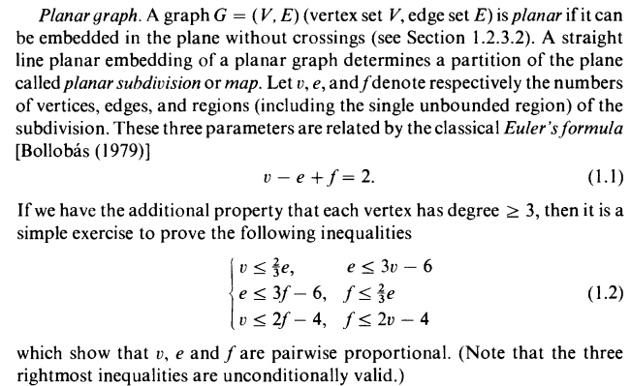
Planar Graphs and Doubly Connected Edge List (DCEL)

Slide 2
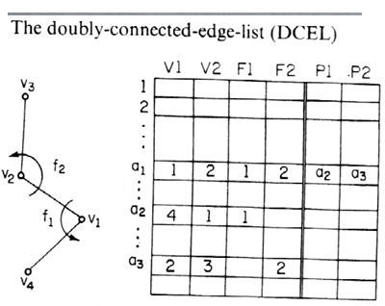
 | V1 | V2 | F1 | F2 | P1 | P2
1 | 1 | 2 | 4 | 1 | 2 | 3
2 | 3 | 1 | 4 | 1 | 10 | 1
3 | 4 | 2 | 1 | 2 | 4 | 6
4 | 3 | 4 | 1 | 3 | 2 | 5
5 | 4 | 5 | 2 | 3 | 3 | 7
6 | 5 | 2 | 2 | 4 | 5 | 1
7 | 6 | 5 | 3 | 4 | 8 | 6
8 | 6 | 7 | 4 | 3 | 7 | 9
9 | 8 | 7 | 3 | 4 | 10 | 8
10 | 8 | 3 | 4 | 3 | 9 | 4
F4
2
1
6
1
5
3
F2
F1
5
F4
2
4
4
3
F3
7
F4
7
8
10
9
F4
6
8

Slide 3
V1: lower end of the edge
V2: upper end of the edge
F1: left face of the edge
F2: right face of the edge
P1: next edge going counterclockwise from lower end
P2: next edge going counterclockwise from upper end
 | V1 | V2 | F1 | F2 | P1 | P2
1 | 1 | 2 | 4 | 1 | 2 | 3
2 | 3 | 1 | 4 | 1 | 10 | 1
3 | 4 | 2 | 1 | 2 | 4 | 6
4 | 3 | 4 | 1 | 3 | 2 | 5
5 | 4 | 5 | 2 | 3 | 3 | 7
6 | 5 | 2 | 2 | 4 | 5 | 1
7 | 6 | 5 | 3 | 4 | 8 | 6
8 | 6 | 7 | 4 | 3 | 7 | 9
9 | 8 | 7 | 3 | 4 | 10 | 8
10 | 8 | 3 | 4 | 3 | 9 | 4
F4
2
6
1
5
1
3
F2
F1
F4
5
2
4
4
3
F3
7
F4
7
8
10
9
F4
6
8

Slide 4
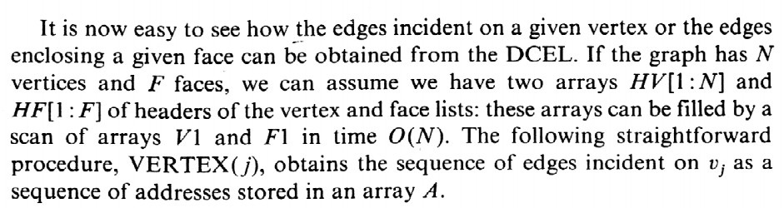
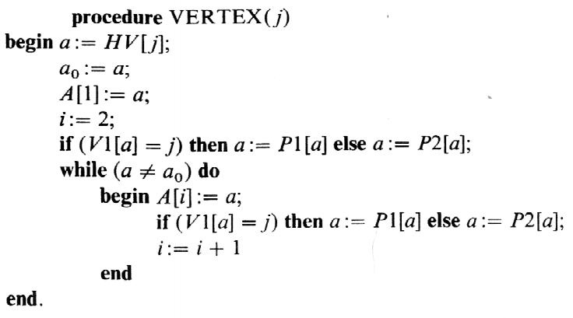
 | V1 | V2 | F1 | F2 | P1 | P2
1 | 1 | 2 | 4 | 1 | 2 | 3
2 | 3 | 1 | 4 | 1 | 10 | 1
3 | 4 | 2 | 1 | 2 | 4 | 6
4 | 3 | 4 | 1 | 3 | 2 | 5
5 | 4 | 5 | 2 | 3 | 3 | 7
6 | 5 | 2 | 2 | 4 | 5 | 1
7 | 6 | 5 | 3 | 4 | 8 | 6
8 | 6 | 7 | 4 | 3 | 7 | 9
9 | 8 | 7 | 3 | 4 | 10 | 8
10 | 8 | 3 | 4 | 3 | 9 | 4

Slide 5
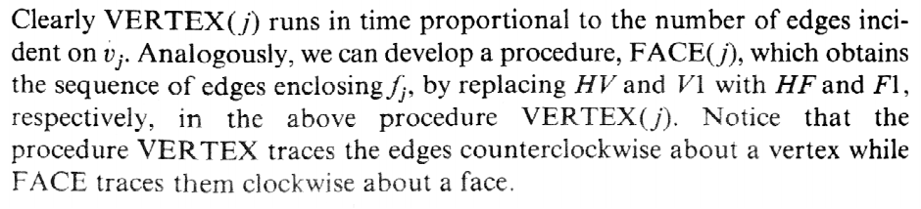
 | V1 | V2 | F1 | F2 | P1 | P2
1 | 1 | 2 | 4 | 1 | 2 | 3
2 | 3 | 1 | 4 | 1 | 10 | 1
3 | 4 | 2 | 1 | 2 | 4 | 6
4 | 3 | 4 | 1 | 3 | 2 | 5
5 | 4 | 5 | 2 | 3 | 3 | 7
6 | 5 | 2 | 2 | 4 | 5 | 1
7 | 6 | 5 | 3 | 4 | 8 | 6
8 | 6 | 7 | 4 | 3 | 7 | 9
9 | 8 | 7 | 3 | 4 | 10 | 8
10 | 8 | 3 | 4 | 3 | 9 | 4

Slide 6
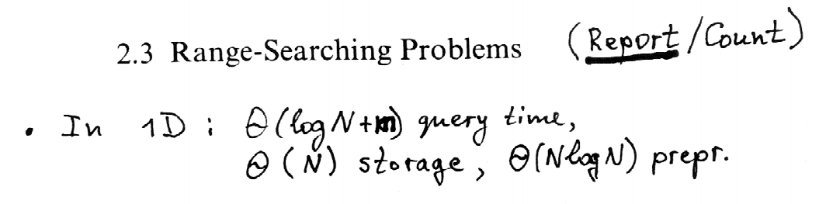

Slide 7
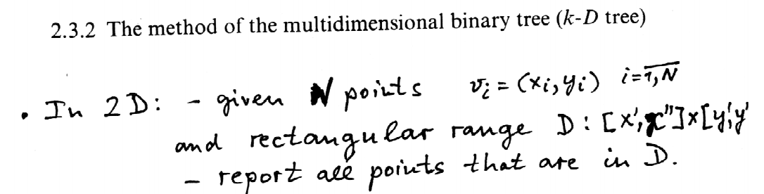

Slide 8

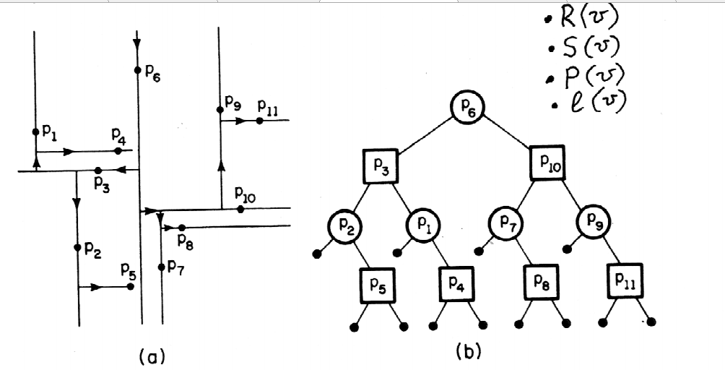
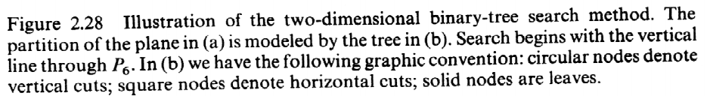

Slide 9
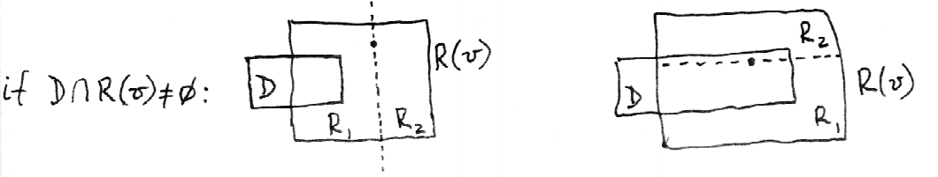

Slide 10
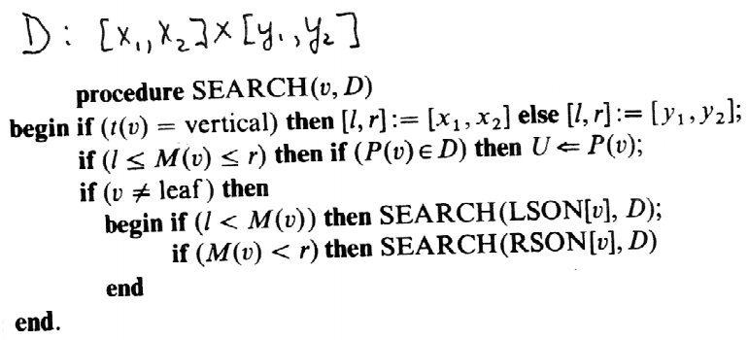
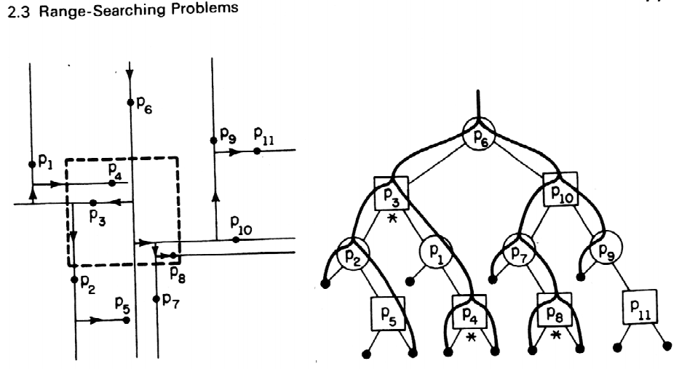
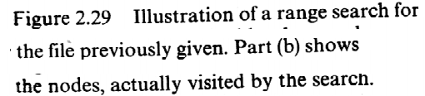



Slide 11
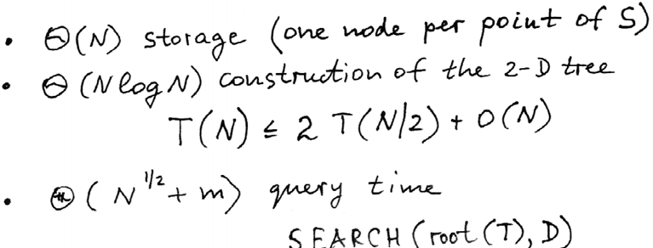
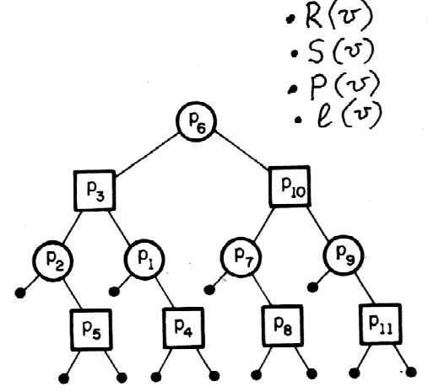

Slide 12
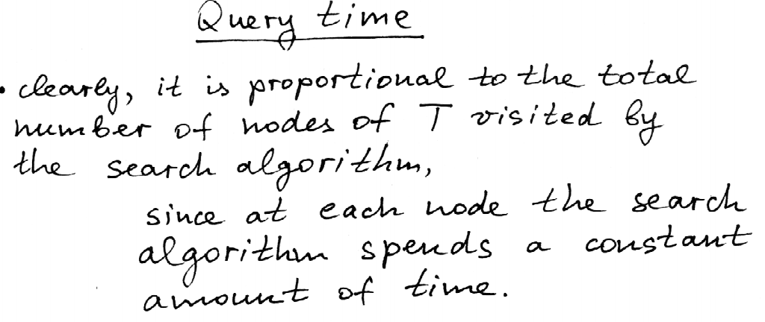
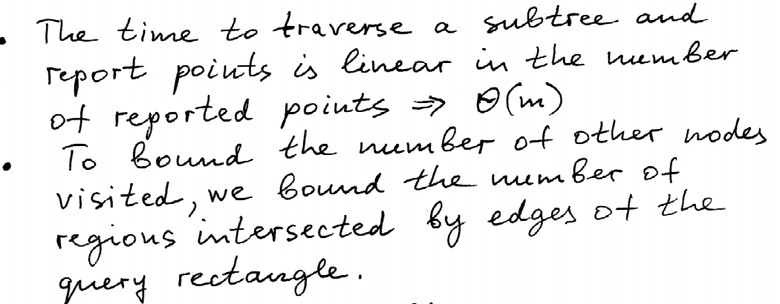
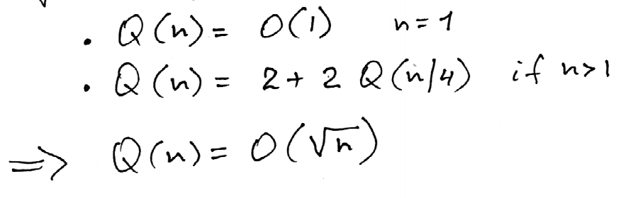

Slide 13
