Slide 1
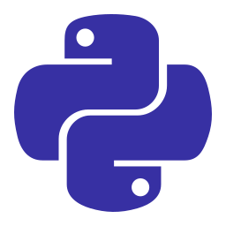
MODULE 1 OF 4
PYTHON PROGRAMMING · MODULE 1
Hello, Python
What code is, why Python is a great first language, and how to run your very first program.
Python Programming · A Beginner-Friendly Course

Slide 2
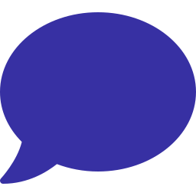


START HERE
What even is programming?
Giving a computer instructions
A program is just a list of steps written in a language the computer understands. The computer follows them exactly, in order.
Computers are fast, not smart
They do simple things billions of times a second — but only what you tell them. Clear instructions matter.
You turn ideas into action
Games, apps, websites, robots — all of it is code. Learning to code is learning to build.

Slide 3




WHY THIS LANGUAGE
Why learn Python first?
Reads like English
Used everywhere
Python code is clean and close to plain language, so you spend time thinking, not fighting syntax.
Web apps, data science, AI, games, automation — Python runs all of it in the real world.
Huge community
Beginner-proof
Millions of learners and free resources. Whatever you get stuck on, someone has answered it.
No semicolons, no curly braces to forget. You can build something real in your first week.

Slide 4

PART ONE
Running Your Code
Where Python lives and how to make it do something.

Slide 5

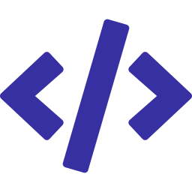

THE SETUP
Three ways to run Python
The interactive shell (REPL)
Type a line, press Enter, see the result instantly. Great for quick experiments and testing ideas.
A script file (.py)
Write many lines in a file, then run the whole thing at once. This is how real programs are built.
Online editors
Sites like replit.com or Google Colab run Python in your browser — nothing to install to get started.

Slide 6
YOUR FIRST PROGRAM
The classic "Hello, World!"
PYTHON
OUTPUT
print("Hello, World!")
print("I am learning Python.")
Hello, World!
I am learning Python.
Try it: print() shows text on the screen. Change the words in the quotes and run it again.

Slide 7
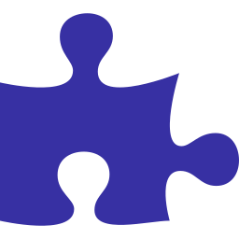
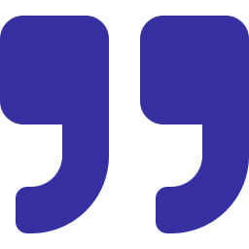
BREAKING IT DOWN
The parts of a print statement
print
The name of the built-in function — the command that says 'show this on screen'.
( ) the parentheses
Functions are followed by parentheses. Whatever you want to print goes inside them.
" " the quotes
Text (called a string) is wrapped in quotes. The quotes tell Python 'this is words, not code'.

Slide 8
USEFUL TRICKS
print can do more than one thing
PYTHON
OUTPUT
print("Score:", 42)
print("a", "b", "c")
# sep changes the separator
print("2024", "12", "25", sep="-")
Score: 42
a b c
2024-12-25
Try it: Separate items with commas. Python adds a space between them automatically.

Slide 9
NOTES TO HUMANS
Comments: code Python ignores
PYTHON
OUTPUT
# This line is a comment.
# Python skips anything after a #
print("This runs") # end-of-line note
# print('This does NOT run')
This runs
Try it: Use comments to explain WHY your code does something. Your future self will thank you.

Slide 10

PART TWO
When Things Go Wrong
Errors are normal. Every programmer reads them all day.

Slide 11



DON'T PANIC
Errors are feedback, not failure
Everyone gets errors
Professionals see errors constantly. It just means Python found something it can't do yet.
Read the last line first
Python tells you the error type and the line number. The bottom of the message is the most useful part.
It's a clue, not a scolding
An error points you straight to the problem. Fix one, run again, repeat. That's the whole game.

Slide 12
SPOT THE BUG
Two beginner mistakes
✕ ERROR
✓ FIXED
print("Hi)
# SyntaxError:
# missing closing quote
prnt("Hello")
# NameError: 'prnt'
# is not defined (typo)
print("Hi")
# quote closed
print("Hello")
# spelled correctly
Why it matters: Most early errors are typos: a missing quote, a missing bracket, or a misspelled word.

Slide 13
FIELD GUIDE
Errors you'll meet early
Error | What it means | Usual fix
SyntaxError | Python can't parse your line | Check quotes, brackets, colons
NameError | Used a name that doesn't exist | Fix the typo or define it first
TypeError | Mixed incompatible types | Convert one of the values
IndentationError | Spacing is off | Line up your indents evenly

Slide 14

PART THREE
Thinking in Steps
Code is just a clear plan, broken into small pieces.

Slide 15
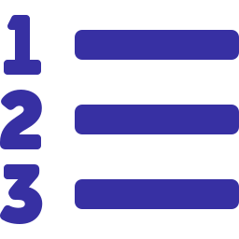


THE BIG SKILL
Break problems into small steps
An algorithm is a recipe
A step-by-step plan to solve a problem. 'Make toast' = get bread, toast it, add butter. Code is the same.
Small steps, one at a time
Don't try to write the whole program at once. Solve one tiny piece, test it, then add the next.
Test as you go
Run your code often. Catching a mistake after one new line is far easier than after fifty.

Slide 16
PLAN BEFORE YOU TYPE
Pseudocode: plain-English steps
PYTHON
# Goal: greet the user
#
# 1. ask for their name
# 2. store the name
# 3. print a greeting
# using the name
Try it: Write the steps as comments first, then fill in real code under each one.

Slide 17
YOU TRY
Make a tiny name card
PYTHON
OUTPUT
print("+-----------------+")
print("| Ada Lovelace |")
print("| Programmer #1 |")
print("+-----------------+")
+-----------------+
| Ada Lovelace |
| Programmer #1 |
+-----------------+
Try it: Swap in your own name. Notice how print draws the box line by line.

Slide 18



GOOD HABITS
Start strong from day one
Run code constantly
Comment your thinking
After almost every line. Instant feedback is how you learn fastest.
Explain tricky bits in plain words so you understand it again later.
Type, don't copy
Read the error
Typing examples yourself builds muscle memory copying never will.
Slow down and actually read the message. The answer is usually right there.

Slide 19
YOU'RE IN GOOD COMPANY
Most people start right here
Python is one of the most popular languages on Earth — and almost everyone writing it today began exactly where you are now.
#1
1991
15 min
most-taught first language in schools
the year Python was first released
to write your first real program

Slide 20
CHEAT SHEET
Words from this module
Term | Means
Program / script | A file full of instructions for the computer
Function | A named command you can run, like print()
String | Text wrapped in quotes
Comment | A # note that Python ignores
Syntax | The grammar rules of the language

Slide 21
PART FOUR
Putting It Together
One last example, then you're off.

Slide 22
A COMPLETE MINI-PROGRAM
Everything from this module
PYTHON
OUTPUT
# My first real program
print("Welcome!")
print("Today we learn Python.")
print("Lesson 1 of many.")
Welcome!
Today we learn Python.
Lesson 1 of many.
Try it: Comment, three print calls, clean output. You already understand every part of this.

Slide 23

POP QUIZ
What does the # symbol do in Python?
A
Multiplies two numbers
B
Starts a comment that Python ignores
C
Prints text to the screen
D
Marks the end of a program
Answer: Anything after a # on a line is a comment. Python skips it — comments are notes for humans.

Slide 24

KEY TAKEAWAYS
Module 1 in a Nutshell
A program is a list of instructions a computer follows in order.
Python is readable, popular, and a great first language.
print() shows text; strings go in quotes inside the ( ).
Comments start with # and are ignored by Python.
Errors are normal feedback — read the last line first.
Next up — Module 2: storing and using information with variables.

Slide 25

UP NEXT · MODULE 2
Variables & Data
How programs remember and work with information.

